Slide 1
Lecture 16: Trie Cont
Lecture Participation Poll #16
Log onto pollev.com/cse374
Or
Text CSE374 to 22333
CSE 374: Intermediate Programming Concepts and Tools

Slide 2
Administrivia
Assignments
HW4 turn in coming later today

Slide 3
Binary Trees
struct BinaryTreeNode
{
int data;
struct BinaryTreeNode* left;
struct BinaryTreeNode* right;
}
struct BinaryTree
{
struct BinaryTreeNode* root;
}

Slide 4
N-Ary Tree
struct TrinaryTreeNode
{
char* data;
struct TrinaryTreeNode* left;
struct TrinaryTreeNode* middle;
struct TrinaryTreeNode* right;
}
struct QuadTreeNode
{
char* data;
struct QuadTreeNode* children[4];
}
Binary trees just one formal can have any “branching number”
Trinary tres have branching number of three
For arbitrarily large branching numbers, arrays can make more sense than lists of named pointers.

Slide 5
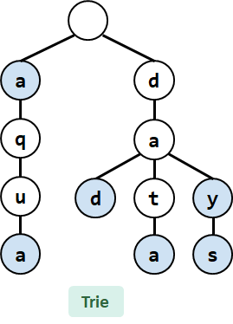
Prefix Tree (Trie)
Tries are a character-by-character set-of-Strings implementation
Nodes store parts of keys instead of keys
Compact data storage
Key of each node defined entirely by position
efficient worst case searching
strings often use 26-ary tree
predictive text
spell check
Trying to Understand Tries.

Slide 6
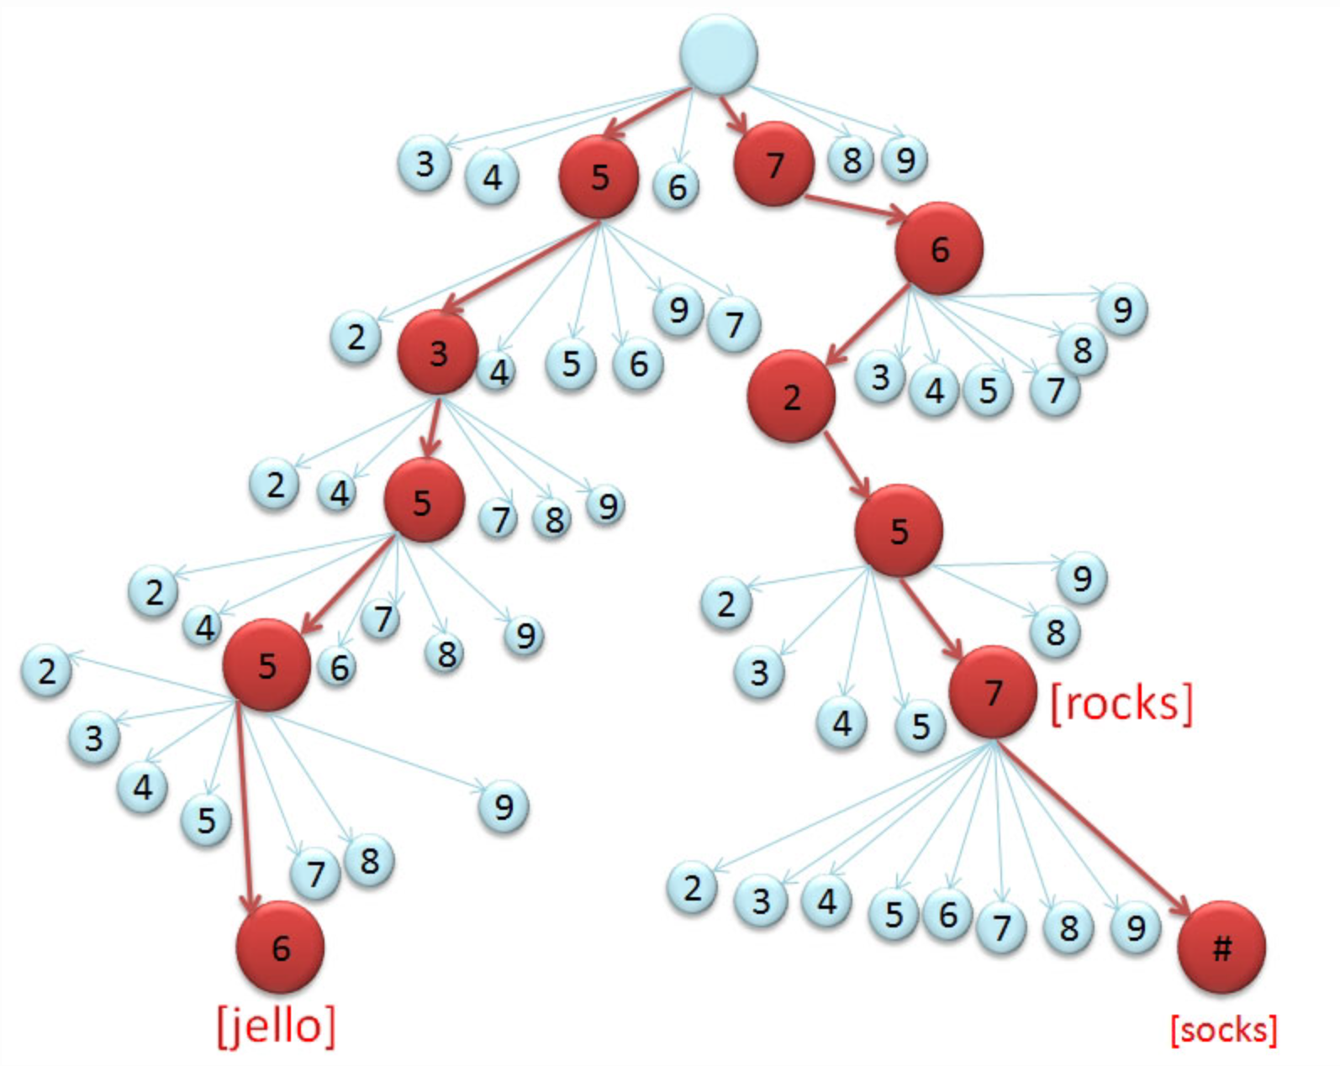
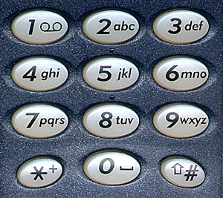
HW5 - T9 Trie
Synopsis
In this assignment, you will build programs to implement T9 predictive text, a text input mode developed originally for cell phones and still used for numeric keypads. Each number from 2-9 on the keypad represents three or four letters, the number 0 represents a space, and 1 represents a set of symbols such as { , . ! ? } etc. The numbers from 2-9 represent letters as follows:
2 => ABC
3 => DEF
4 => GHI
5 => JKL
6 => MNO
7 => PQRS
8 => TUV
9 => WXYZ
Classic trie data structures have edges labeled with letters to store prefixes of strings. But for this application, we use a compressed trie that has only 10 possible branches at each node instead of 26, since the digits 0-9 represent the 26 letters, space and symbols. Because of this, an extra layer of complexity is needed to figure out the string represented by a path.
If a word with the same numeric sequence already exists in the trie, add the new word to the trie as a link to a new node with an edge labeled '#' instead of one of the digits 2-9. (The words linked from a node by the '#' edges essentially form a "linked list" of words that have the same numeric code, but we use additional tree nodes to link the words together instead of defining a separate kind of linked-list node just for this situation.)

Slide 7
Trie Struct
typedef struct TrieNode {
char *word;
struct TrieNode *children[NUM_CHILDREN];
} TrieNode;
typedef struct Trie {
TrieNode *root;
} Trie;
TrieNode* makeNode() {
TrieNode *t = (TrieNode*) malloc(sizeof(TrieNode));
if (t == NULL) {
return NULL;
}
for (int i = 0; i < NUM_NODES; i++) {
t->next[i] = NULL;
}
t->word = NULL;
return t;
}

Slide 8
Inserting word into T9 Trie
/*
Recursively follows or inserts nodes starting from previous_node until the location for word is found, at which point it is inserted. Current_letter is the index of word where the recursive algorithm is currently at.
*/
int node_insert(TrieNode *previous_node, char word[], int current_letter) {
if (word[current_letter] == '\0') { // word is empty
// word is empty
}
int digit = letter_to_digit(word[current_letter]);
if (previous_node->children[digit] == NULL) {
// node doesn't exist, create it
} else { // node already exists
current_node = //next unexamined child of previous node
}
if (word[current_letter + 1] == '\0') { // at the end of the word
if (current_node->word == NULL) { // current node doesn’t have a word yet
// save word here
} else {
// current node already has a word, add it as an additional completion
}
} else { // not at the end of the string, so continue to the next letter
return node_insert(current_node, word, current_letter + 1);
}
}

Slide 9
Memory Architecture

Slide 10
Thought experiment
public int sum1(int n, int m, int[][] table) {
int output = 0;
for (int i = 0; i < n; i++) {
for (int j = 0; j < m; j++) {
output += table[i][j];
}
}
return output;
}
public int sum2(int n, int m, int[][] table) {
int output = 0;
for (int i = 0; i < n; i++) {
for (int j = 0; j < m; j++) {
output += table[j][i];
}
}
return output;
}
What do these two methods do?
What is the big-Θ
Θ(n*m)

Slide 11
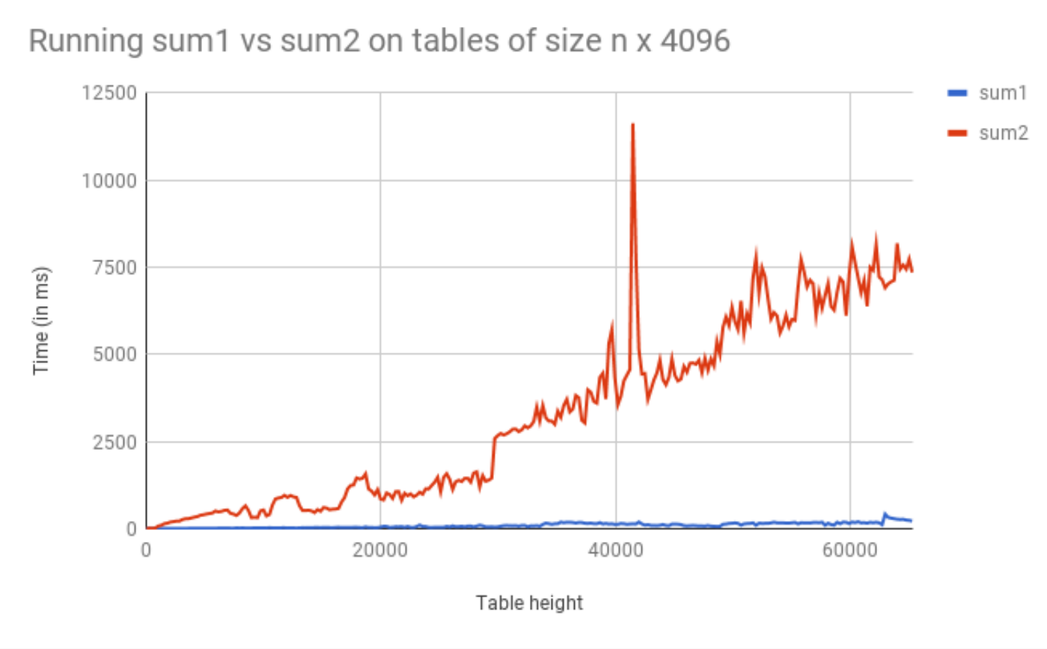
Thought Experiment Graphed

Slide 12
Incorrect Assumptions
Lies!
Accessing memory is a quick and constant-time operation
Sometimes accessing memory is cheaper and easier than at other times
Sometimes accessing memory is very slow

Slide 13
Memory Architecture
What is it? | Typical Size | Time
The brain of the computer! | 32 bits | ≈free
Extra memory to make accessing it faster | 128KB | 0.5 ns
Extra memory to make accessing it faster | 2MB | 7 ns
Working memory, what your programs need | 8GB | 100 ns
Large, longtime storage | 1 TB | 8,000,000 ns
CPU Register
L1 Cache
L2 Cache
RAM
Disk
Notes:
1 ns vs 8,000,000 is like 1 sec vs 3 months
It’s faster to do:
5 million arithmetic ops than 1 disk access
2500 L2 cache accesses than 1 disk access
400 RAM accesses than 1 disk access

Slide 14
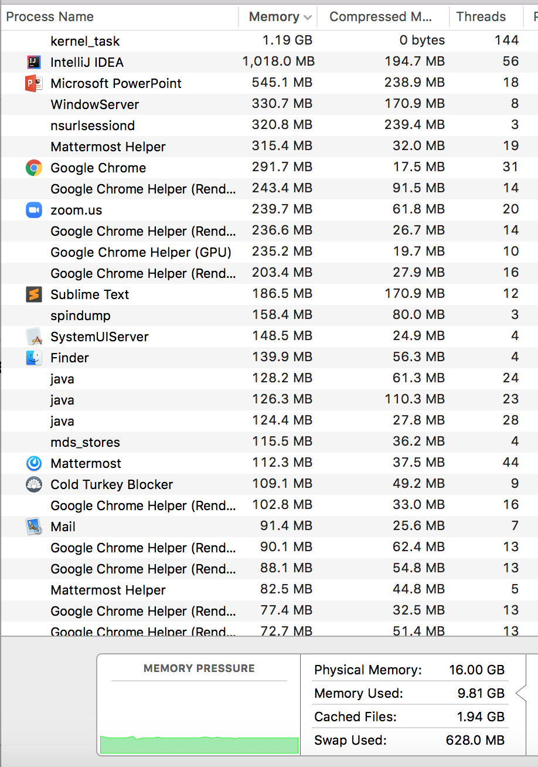
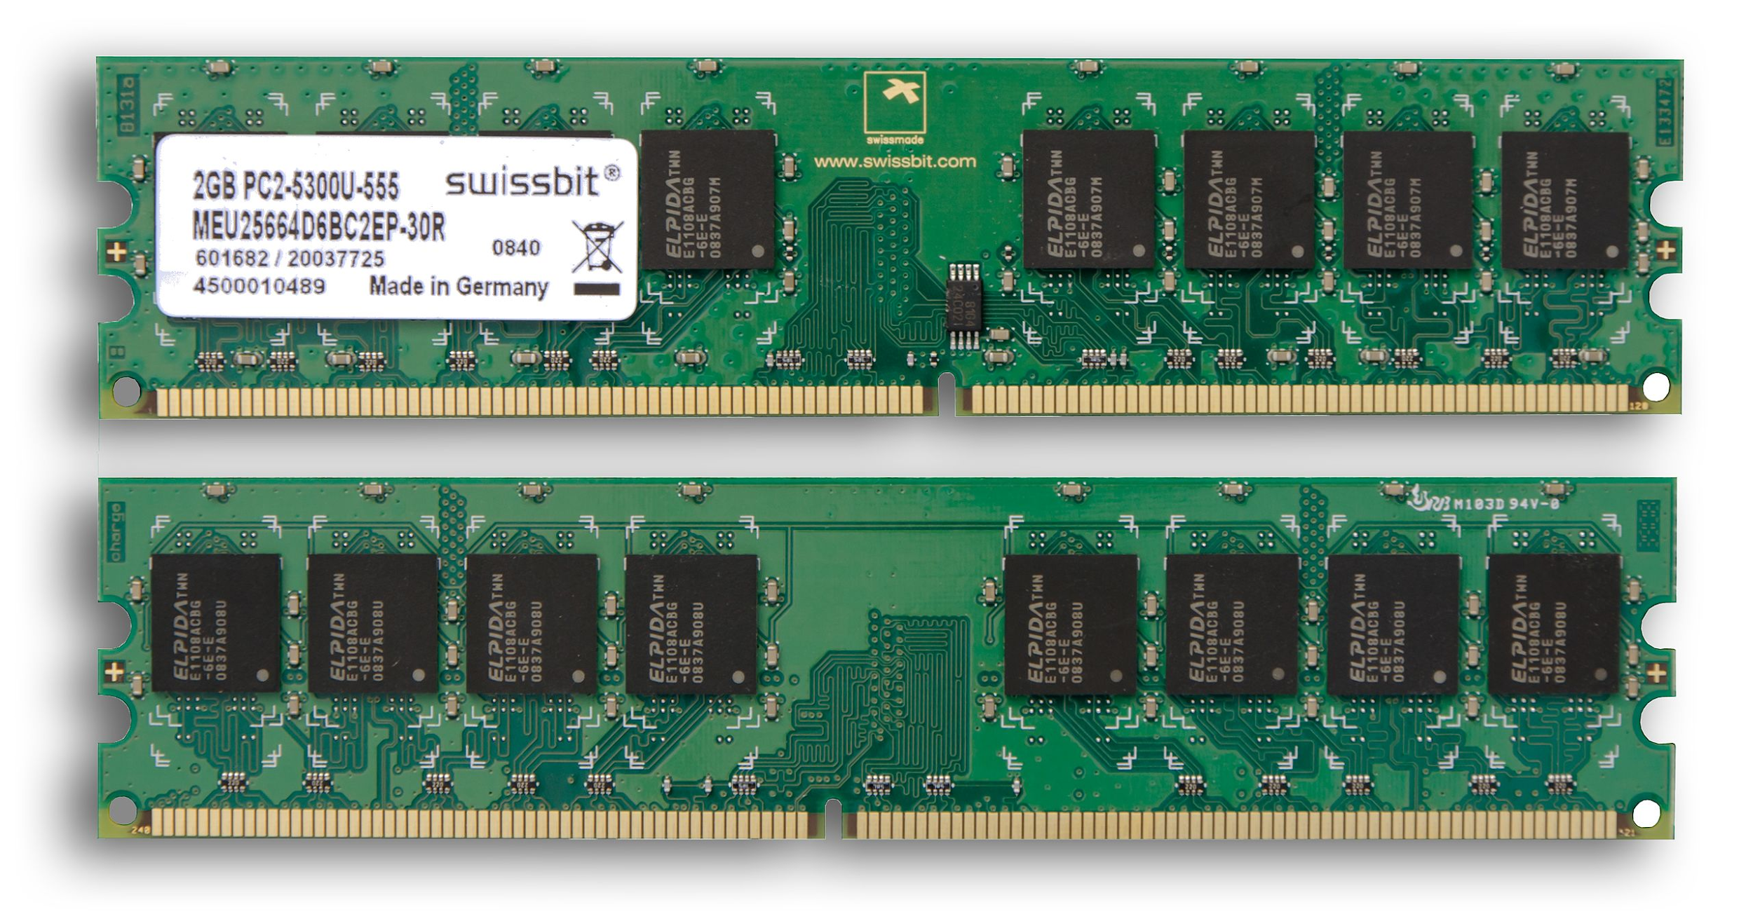
RAM (Random-Access Memory)
- RAM is where data gets stored for the programs you run. Think of it as the main memory storage location for your programs.
- RAM goes by a ton of different names: memory, main memory, RAM are all names for this same thing.
Notes:
RAM is a term frequently mentioned when purchasing computers and looking at the hardware details. For us programmers, RAM is the physical location where data gets stored for the programs we run. It’s the main location for data structures, variables, method calls, etc. that we create in our programs. When you look at this screenshot saying how much memory is being used, it’s talking about how much RAM. Somewhat frequently when things say ‘memory’ it really means RAM.

Slide 15
RAM can be represented as a huge array
This is a main takeaway
RAM:
addresses, storing stuff at specific locations
random access
Arrays
indices, storing stuff at specific locations
random access
=
If you’re interested in deeper than this : https://www.youtube.com/watch?v=fpnE6UAfbtU or take some EE classes?
CSE 373 SP 20- ZACH CHUN
Notes:
It turns out that for computer scientists / programming, we don’t have to know about the circuits and electricity that makes this green blob computer chip works. Luckily for us RAM can be thought of as a very big array -- this is how we should thing about RAM in our programs for us to be able to take advantage of it / understand how our programs interact with it.
RAM can be thought of as an array for 2 reasons in particular
you think of RAM having spaces for you to store stuff, just like you would in an array … and it also has indices (but for memory its called addresses) that describe where in RAM / the array a particular piece of data is located
Also just because of this Random access thing – you might have heard this before but people sometimes describe arrays as random access because you can access any random index in an array equally to other indices / easily. It’s the same for RAM (the computer chip one) – all addresses are easily accessed as all the others

Slide 16
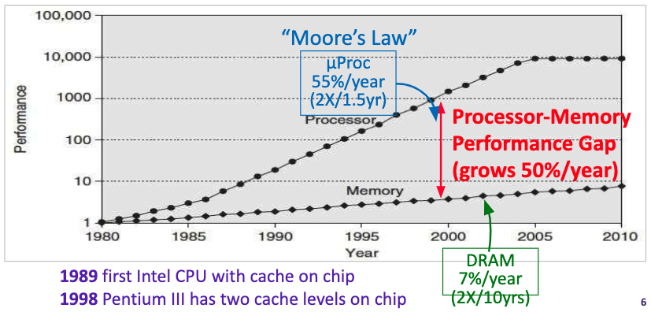
Processor – Memory Gap

Slide 17
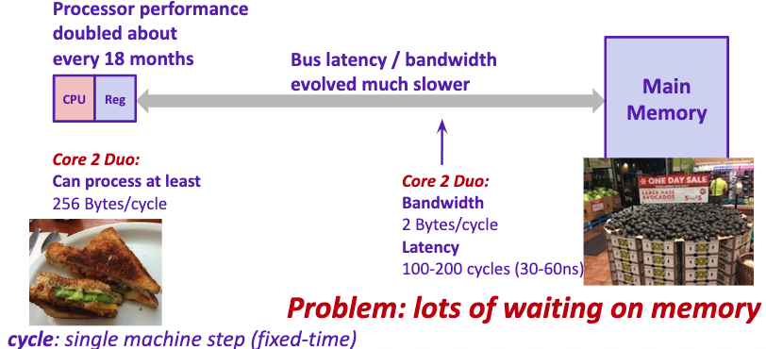
Problem: Processor-Memory Bottleneck

Slide 18
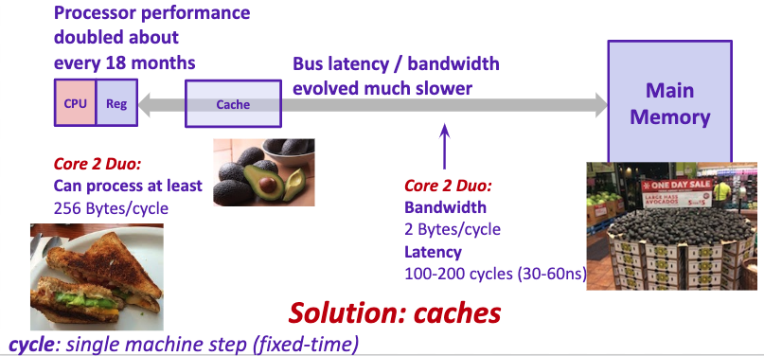
Problem: Processor-Memory Bottleneck

Slide 19
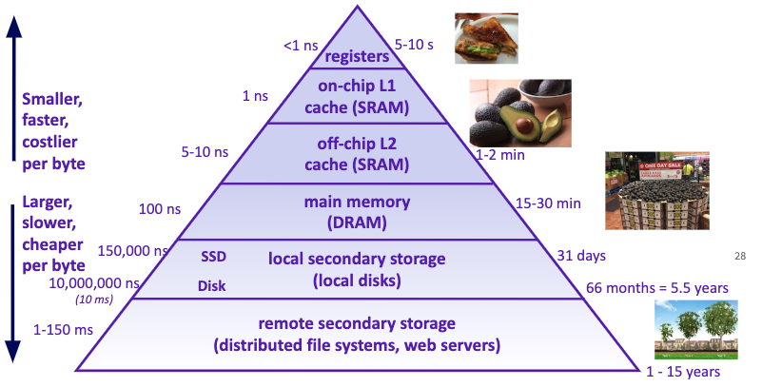
Example Memory Hierarchy

Slide 20
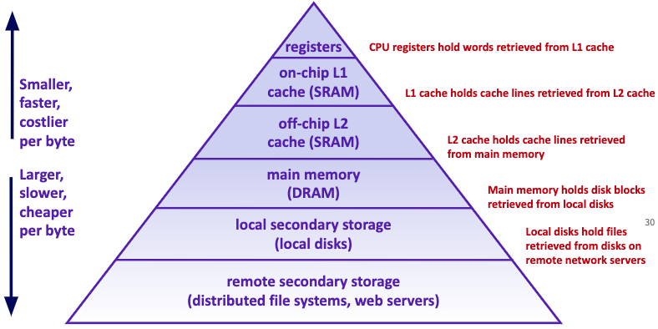
Example Memory Hierarchy

Slide 21
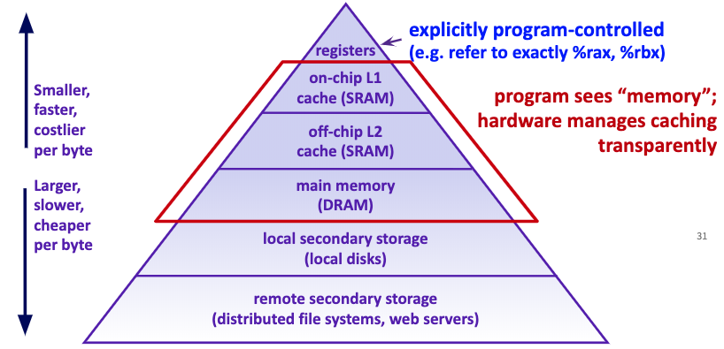
Example Memory Hierarchy

Slide 22
Review: Binary, Bits and Bytes
byte
The most commonly referred to unit of memory, a grouping of 8 bits
Can represent 265 different numbers (28)
1 Kilobyte = 1 thousand bytes (kb)
1 Megabyte = 1 million bytes (mb)
1 Gigabyte = 1 billion bytes (gb)
binary
A base-2 system of representing numbers using only 1s and 0s
- vs decimal, base 10, which has 9 symbols
bit
The smallest unit of computer memory represented as a single binary value either 0 or 1
Decimal | Decimal Break Down | Binary | Binary Break Down
0 |  | 0
1 |  | 1
10 |  | 1010
12 |  | 1100
127 |  | 01111111

Slide 23
Memory Architecture
Takeaways:
- the more memory a layer can store, the slower it is (generally)
- accessing the disk is very slow
Computer Design Decisions
Physics
Speed of light
Physical closeness to CPU
Cost
“good enough” to achieve speed
Balance between speed and space

Slide 24
Appendix

