Slide 1
Lecture 15: Intro to Trie
Lecture Participation Poll #15
Log onto pollev.com/cse374
Or
Text CSE374 to 22333
CSE 374: Intermediate Programming Concepts and Tools

Slide 2
Administrivia
Assignments
HW4 Due Thursday Nov 11

Slide 3
Make Files
Make is a program which automates building dependency trees
List of rules written in a Makefile declares the commands which build each intermediate part
Helps you avoid manually typing gcc commands, easier and less prone to typos
Automates build process
Makefiles are a list of with Make rules which include:
Target - An output file to be generated, dependent on one or more sources
Source – Input source code to be built
Recipe - command to generate target
Makefile logic
Make builds based on structural organization of how code depends on other code as defined by includes
Recursive – if a source is also a target for other sources, must also evaluate its dependencies and remake as required
Make can check when you've last edited each file, and only build what is needed!
Files have "last modification date". make can check whether the sources are more recent than the target
Make isn’t language specific: recipe can be any valid shell command
run make command from within same folder
$make [ -f makefile] [ options ] … [ targets ] ../
Starts with first rule in file then follows dependency tree
-f specifies makefile name, if non provided will default to “Makefile”
if no target is specified will default to first listed in file
target: source
recipe
tab not spaces!
ll.o: ll.c ll.h
gcc -c ll.c
https://www.gnu.org/software/make/manual/make.html#Introduction

Slide 4
Makefile Example: Linked List
try_lists
#include "ll.h"
int main() {
Node *n1 = make_node(4, NULL);
// rest of main…
main.o
ll.o
main.c
#ifndef LL_H
#define LL_H
typedef struct Node {
// rest of Node def…
main.c
ll.h
ll.c
try_lists: ll.o main.o
gcc –o try_lists ll.o main.o
ll.o: ll.c ll.h
gcc –c ll.c –o ll.o
main.o: main.c ll.h
gcc –c main.c –o main.o
ll.h
#include <stdlib.h>
#include <stdio.h>
#include "ll.h"
Node *make_node(int value, Node *next) {
// rest of linked list code…
Makefile
ll.c

Slide 5
More Make Tools
CC = gcc
CGLAGS = -Wall
foo.o: foo.c foo.h bar.h
$(CC) $(CFLAGS) –c foo.c –o foo.o
make CFLAGS=-g
EXE=
ifdef WINDIR #defined on Windows
EXE=.exe
endif
widget$(EXE): foo.o bar.o
$(CC) $(CFLAGS) –o widget$(EXE)\
foo.o bar.o
OBJFILES = foo.o bar.o baz.o
widget: $(OBJFILES)
gcc –o widget $(OBJFILES)
%.o: %.c
$(CC) –c $(CFLAGS) $< -o $@
clean:
rm *.o widget
make variables help reduce repetitive typing and make alterations easier
can change variables from command line
enables us to reuse Makefiles on new projects
can use conditionals to choose variable settings
ifdef checks if a given variable is defined for conditional execution
ifndef checks if a given variable is NOT defined
Special characters:
$@ for target
$^ for all sources
$< for left-most source
\ enables multiline recipies
* functions as wildcard (use carefully)
% enables implicit rule definition by using % as a make specific wildcard
Makefile
http://cslibrary.stanford.edu/107/UnixProgrammingTools.pdf

Slide 6
Phony Targets
A target that doesn’t create the listed output
A way to force run commands regardless of dependency tree
Common uses:
all – used to list all top notes across multiple dependency trees
clean – cleans up files after usage
test – specifies test functionality
printing messages or info
CC = gcc
CGLAGS = -Wall
all: my_program your_program
my_program: foo.o bar.o
$(CC) $(CFLAGS) -o my_program foo.o bar.o
your_program: bar.o baz.o
$(CC) $(CFLAGS) –o your_program foo.o baz.o
#not shown: foo.o, bar.o, baz.o targets
clean:
rm *.o my_program your_program
all: try_lists test_suite
clean:
rm objectfiles
test: test_suite
./test_suite
Makefile

Slide 7
Example Makefile
variable definitions
CC = gcc
CGLAGS = -g –Wall –std=c11
try_lists: main.o ll.o
$(CC) $(CFLAGS) -o try_lists main.o ll.o
main.o: main.c ll.h
$(CC) $(CFLAGS) –c main.c
ll.o: ll.c ll.h
$(CC) $(CFILES) –c ll.c
clean:
rm *.o
try_lists
must include rules for each file
main.o
ll.o
rules define dependency hierarchy
main.c
ll.h
ll.c
Makefile

Slide 8
Example
#include <stdlib.h>
#include <string.h>
#include <ctype.h>
#include "speak.h"
#include "shout.h"
/* Write message m in uppercase to stdout */
void shout(char m[])
{
int len; /* message length */
char *mcopy; /* copy of original message */
int i;
len = strlen(m);
mcopy = (char *)malloc(len*sizeof(char)+1);
strcpy(mcopy,m);
for (i = 0; i < len; i++)
mcopy[i] = toupper(mcopy[i]);
speak(mcopy); free(mcopy);
}
talk
shout.o
main.o
speak.o
shout.c
shout.h
main.c
speak.h
speak.c
#include <stdio.h>
#include "speak.h"
/* Write message m to stdout */
void speak(char m[])
{
printf("%s\n", m);
}
#include "speak.h"
#include "shout.h"
/* Say HELLO and goodbye */
int main(int argc, char* argv[])
{
shout("hello");
speak("goodbye");
return 0;
}
speak.c
main.c
shout.c
#ifndef SHOUT_H
#define SHOUT_H
/* Write message m in uppercase to stdout */
void shout(char m[]);
#endif /* ifndef SHOUT_H */
#ifndef SPEAK_H
#define SPEAK_H
/* Write message m to stdout */
void speak(char m[]);
#endif /* ifndef SPEAK_H */
shout.h
speak.h

Slide 9
Example
talk
shout.o
main.o
speak.o
shout.c
shout.h
main.c
speak.h
speak.c
all: talk
# The executable
talk: main.o speak.o shout.o
gcc -Wall -std=c11 -g -o talk main.o speak.o shout.o
# Individual source files
speak.o: speak.c speak.h
gcc -Wall -std=c11 -g -c speak.c
shout.o: shout.c shout.h speak.h
gcc -Wall -std=c11 -g -c shout.c
main.o: main.c speak.h shout.h
gcc -Wall -std=c11 -g -c main.c
# A "phony" target to remove built files and backups clean: rm -f *.o talk *~
Makefile

Slide 10
Example
Makefile
talk
CC = gcc
# Compiler flags: -Wall for debugger warnings
# -std=c11 for updated standards
CFLAGS = -Wall -std=c11
ifdef DEBUG
CFLAGS += -g
endif
# The name of the program that we are producing.
TARGET = talk
# This is a "phony" target that tells
# make what other targets to build.
all: $(TARGET)
# All the .o files we need for our executable.
OBJS = main.o speak.o shout.o
# The executable
$(TARGET): $(OBJS)
$(CC) $(CFLAGS) -o talk $(OBJS)
shout.o
main.o
speak.o
shout.c
shout.h
main.c
speak.h
speak.c
# Individual source files
speak.o: speak.c speak.h
$(CC) $(CFLAGS) -c speak.c
shout.o: shout.c shout.h speak.h
$(CC) $(CFLAGS) -c shout.c
main.o: main.c speak.h shout.h
$(CC) $(CFLAGS) -c main.c
# A "phony" target to remove built files and backups
clean: rm -f *.o talk *~

Slide 11
Binary Trees
struct BinaryTreeNode
{
int data;
struct BinaryTreeNode* left;
struct BinaryTreeNode* right;
}
struct BinaryTree
{
struct BinaryTreeNode* root;
}

Slide 12
N-Ary Tree
struct TrinaryTreeNode
{
char* data;
struct TrinaryTreeNode* left;
struct TrinaryTreeNode* middle;
struct TrinaryTreeNode* right;
}
struct QuadTreeNode
{
char* data;
struct QuadTreeNode* children[4];
}
Binary trees just one formal can have any “branching number”
Trinary tres have branching number of three
For arbitrarily large branching numbers, arrays can make more sense than lists of named pointers.

Slide 13
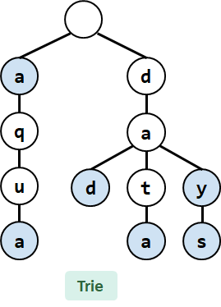
Prefix Tree (Trie)
Tries are a character-by-character set-of-Strings implementation
Nodes store parts of keys instead of keys
Compact data storage
Key of each node defined entirely by position
efficient worst case searching
strings often use 26-ary tree
predictive text
spell check
Trying to Understand Tries.

Slide 14
T9 Trie

Slide 15
Autocomplete
Search Engines support autocomplete.
How do you efficiently implement autocomplete with the ADTs we know so far?
Formal Problem: Given a “prefix” of a string, find all strings in a set of possible strings that have the given prefix.

Slide 16
Abstract Trie
Each level represents an index
Children represent next possible characters at that index
This Trie stores the following set of Strings:
a, aqua, dad,
data, day, days
How do we deal with a and aqua?
Mark complete Strings with a boolean (shown in blue)
Complete string: a String that belongs in our set
Index 0
a
d
0
0
1
2
3
0
1
2
0
1
2
3
0
1
2
0
1
2
3
Index 1
q
a
Index 2
u
d
t
y
Index 3
a
a
s
Abstract Trie
20AU - SCHAFER

Slide 17
Searching in Tries
a, aqua, dad,
data, day, days
a
d
q
a
u
d
t
y
a
a
s
Abstract Trie
20AU - SCHAFER

Slide 18
Prefix Operations with Tries
a, aqua, dad,
data, day, days
The main appeal of Tries is its efficient prefix matching!
Prefix: find set of keys associated with given prefix
keysWithPrefix("day") returns ["day", "days"]
Longest Prefix From Trie: given a String, retrieve
longest prefix of that String that exists in the Trie
longestPrefixOf("aquarium") returns "aqua"
longestPrefixOf("aqueous") returns "aqu"
longestPrefixOf("dawgs") returns "da"
a
d
q
a
u
d
t
y
a
a
s
Abstract Trie
20AU - SCHAFER

Slide 19
Collecting Trie Keys
Collect: return set of all keys in the Trie (like keySet())
collect(trie) = ["a", "aqua", "dad", "data", "day", "days"]
List collect() { List keys; for (Node c : root.children) { collectHelper(n.char, keys, c); } return keys; } void collectHelper(String str, List keys, Node n) { if (n.isKey()) { keys.add(s); } for (Node c : n.children) { collectHelper(str + c.char, keys, c); } }
collectHelper("a", keys, )
d
a
collectHelper("aq", keys, )
a
q
collectHelper("aqu", keys, )
d
t
y
u
collectHelper("aqua", keys, )
a
a
s
20AU - SCHAFER

Slide 20
keysWithPrefix Implementation
keysWithPrefix(String prefix)
Find all the keys that corresponds to the given prefix
List keysWithPrefix(String prefix) {
Node root; // Node corresponding to given prefix
List keys; // Empty list to store keys
for (Node n : root.children) {
collectHelper(prefix + n.char, keys, c);
}
}
void collectHelper(String str, List keys, Node n) { if (n.isKey()) { keys.add(s); } for (Node c : n.children) { collectHelper(str + c.char, keys, c); } }
root
a
d
q
a
u
d
t
y
a
a
s
20AU - SCHAFER

Slide 21
Autocomplete with Tries
Autocomplete should return the most relevant results
One method: a Trie-based Map<String, Relevance>
When a user types in a string "hello", call keysWithPrefix("hello")
Return the 10 Strings with the highest relevance
20AU - SCHAFER

Slide 22
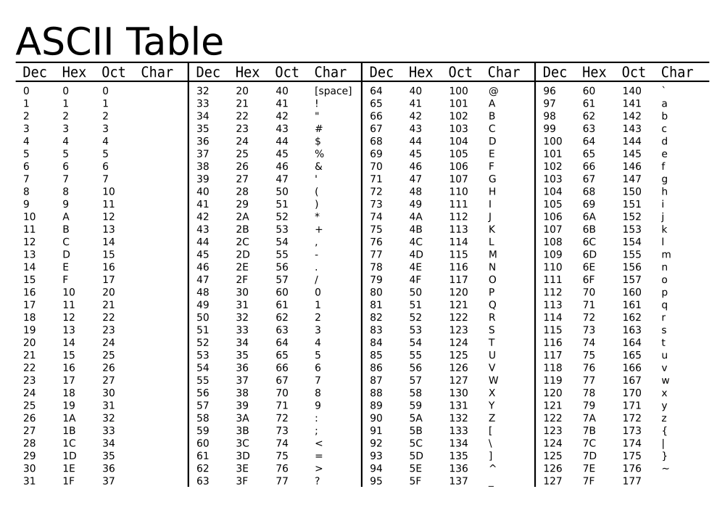
Trie Implementation Idea: Encoding
20AU - SCHAFER

Slide 23
DataIndexedCharMap Pseudocode
class TrieSet {
final int R = 128; // # of ASCII encodings
Node overallRoot;
// Private internal class
class Node {
// Field declarations
char ch;
boolean isKey;
DataIndexedCharMap<Node> next; // array encoding
// Constructor
Node(char c, boolean b, int R) {
ch = c;
isKey = b;
next = new DataIndexedCharMap<Node>(R);
}
}
}
a
d
q
a
u
d
t
y
a
a
s
20AU - SCHAFER

Slide 24
Data Structure for Trie Implementation
20AU - SCHAFER

Slide 25
Data-Indexed Array Visualization
// Private internal class
class Node {
// Field declarations
char ch;
boolean isKey;
DataIndexedCharMap<Node> next;
}
Node
ch | u
isKey | false
next
DataIndexedCharMap
items
u
u
0 | 1 | … | 111 | 112 | 113 | … | 126 | 127
Node
p
p
ch | p
isKey | true
next
DataIndexedCharMap
items
0 | 1 | … | … | … | … | … | 126 | 127
20AU - SCHAFER

Slide 26
Removing Redundancy
a
b
c
d
e
class TrieSet {
final int R = 128;
Node overallRoot;
// Private internal class
class Node {
// Field declarations
char ch;
boolean isKey;
DataIndexedCharMap<Node> next;
// Constructor
Node(char c, boolean b, int R) {
ch = c;
isKey = b;
next = new DataIndexedCharMap<Node>(R);
}
}
}
a
b
c
d
e
q
a
q
a
u
d
t
y
u
d
t
y
a
a
s
a
a
s
20AU - SCHAFER

Slide 27
Does the structure of a Trie depend on the order of insertion?
a) Yes
b) No
c) I’m not sure…
a
b
c
d
e
q
a
u
d
t
y
a
a
s
20AU - SCHAFER

Slide 28
Runtime Comparison
u
u
p
p
Data Structure | Key Type | contains | add | keysWithPrefix
Balanced BST | Comparable
Hash Map | Hashable
Trie (Data-Indexed Array) | String (Character)
* In-practice runtime
** Where p is the number of strings with the given prefix. Usually p << n.
20AU - SCHAFER
Notes:
Trie is constant, which is great!
But other structures can also give us that, we’ll talk about why tries later
Bigger problem:
Pros
Capitalize on random access of arrays: Θ(1) runtime
Supports ordered traversal
Straightforward deletion: change boolean of key
No need to determine a complicated hash function
Cons
Takes up a ton of space that can often be unused

Slide 29
Trie Takeaways
Tries can be used for storing Strings (or any sequential data)
Real-world performance often better than Hash Table or Search Tree
Many different implementations: DataIndexedCharMap, Hash Tables, BSTs (and more possible data structures within nodes), and TSTs
Tries enable efficient prefix operations like keysWithPrefix
20AU - SCHAFER

Slide 30
Appendix

Slide 31
File IO - working with strings
FILE *fopen(const char *path, const char *mode);
opens the file whose name is the string pointed to by path and associates a stream with it.
char *fgets(char *s, int size, FILE *stream);
reads in at most one less than size characters from stream and stores them into the buffer pointed to by s. Reading stops after an EOF or a newline. If a newline is read, it is stored into the buffer. A terminating null byte ('\0') is stored after the last character in the buffer.
int fprintf(FILE *stream, const char *format, ...);
It’s printf, but to a file.
int fputc(int c, FILE *stream); // print a single character
int fputs(const char *s, FILE *stream); // print a string

