Slide 1
Lecture 15: Debugging in C
Lecture Participation Poll #15
Log onto pollev.com/cse374
Or
Text CSE374 to 22333
CSE 374: Intermediate Programming Concepts and Tools

Slide 2
Administrivia
Klaatu is down again? -_-
HW2 & HW3 due tomorrow, lock on Sunday
HW4 will be posted later today
Midterm on Friday

Slide 3
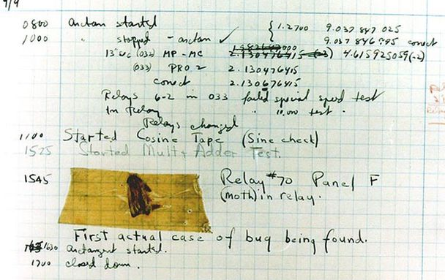
What is a Bug?
A bug is a difference between the design of a program and its implementation
Definition based on Ko & Meyers (2004)
We expected something different from what is happening
“it’s not a bug it’s a feature” - Microsoft
Examples of bugs
Expected factorial(5) to be 120, but it returned 0
Expected program to finish successfully, but crashed and printed "segmentation fault"
Expected normal output to be printed, but instead printed strange symbols

Slide 4
Debugging techniques
Comment out (or delete) code
tests to determine whether removed code was source of problem
Test one function at a time
Add print statements
Check if certain code is reachable
check current state of variables
Use a debugger
lets you control program execution line by line
lets you see current state of variables
In C: gdb
Write tests
unit tests = test of input and output of singular code modules
often many tests to one function
Type errors/warnings into Google
gcc -Wall -Werror will show you more compiler output

Slide 5
Debugging Basics
Debugging strategies look like:
Describe a difference between expected and actual behavior
Hypothesize possible causes
Investigate possible causes (if not found, go to step 2)
Fix the code which was causing the bug
Vast majority of the time spent in steps 2 & 3

Slide 6
Hypothesize
Now, let's look at the code for factorial()
Select all the places where the error could be coming from
The if statement's "then" branch
The if statement's "else" branch
Somewhere else
int factorial(int x) {
if (x == 0) {
return x;
} else {
return x * factorial(x-1);
}
}

Slide 7
Investigate
Let's investigate the base case and recursive case
Base case is the "if then" branch
Recursive case is the "else" branch
int factorial(int x) {
if (x == 0) {
return x;
} else {
return x * factorial(x-1);
}
}
Case | Input | Math Equivalent | Expected | Actual
Base | factorial(0) | 0! = 1 | 1 | ???
Recursive | factorial(1) | 1! = 1 | 1 | ???
Recursive | factorial(2) | 2! = 1 * 2 | 2 | ???
Recursive | factorial(3) | 3! = 1 * 2 * 3 | 6 | ???

Slide 8
Investigate
One way to investigate is to write code to test different inputs
If we do this, we find that the base case has a problem
int factorial(int x) {
if (x == 0) {
return x;
} else {
return x * factorial(x-1);
}
}
Case | Input | Math Equivalent | Expected | Actual
Base | factorial(0) | 0! = 1 | 1 | 0
Recursive | factorial(1) | 1! = 1 | 1 | 0
Recursive | factorial(2) | 2! = 1 * 2 | 2 | 0
Recursive | factorial(3) | 3! = 1 * 2 * 3 | 6 | 0

Slide 9
Fix
int factorial(int x) {
if (x == 0) {
return x;
} else {
return x * factorial(x-1);
}
}
int factorial(int x) {
if (x == 0) {
return 1;
} else {
return x * factorial(x-1);
}
}
Case | Input | Math Equivalent | Expected | Actual
Base | factorial(0) | 0! = 1 | 1 | 1
Recursive | factorial(1) | 1! = 1 | 1 | 1
Recursive | factorial(2) | 2! = 1 * 2 | 2 | 2
Recursive | factorial(3) | 3! = 1 * 2 * 3 | 6 | 6

Slide 10
Common C Bugs
forget to free -> program uses more memory than needed
memory leak -> lose pointer to start of dynamically allocated memory, can’t free
keep using after free -> later calls to malloc may reuse freed memory
double free -> can corrupt internal data structures of malloc
dangling pointer -> lose memory that pointer referenced, dereferencing dangling pointer, undefined behavior
Segmentation Fault
attempt to access memory that “does not belong to you”
indicates memory corruption
Can be caused by:
array index out of bounds
accessing freed memory
dereferencing null pointer
changing String(char*) literal
https://en.wikipedia.org/wiki/Segmentation_fault

Slide 11
C Debugger
A debugger is a tool that lets you stop running programs, inspect values etc…
instead of relying on changing code (commenting out, printf) interactively examine variable values, pause and progress set-by-step
don’t expect the debugger to do the work, use it as a tool to test theories
Most modern IDEs have built in debugging functionality
‘gdb’ -> gnu debugger, standard part of linux development, supports many languages
techniques are the same as in most debugging tools
can examine a running file
can also examine core files of previous crashed programs
Want to know which line we crashed at (backtrace)
Inspect variables during run time
Want to know which functions were called to get to this point (backtrace)

Slide 12
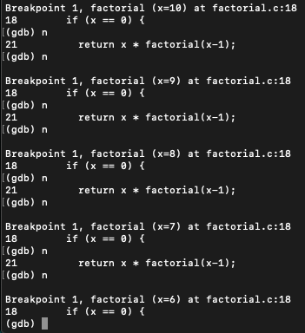
Meet gdb
Compile code with ‘-g’ flag
gcc -g program.c
saves human readable info
Open program with gdb <executable file>
gdb a.out
start or restart the program: run <program args>
quit the program: kill
quit gdb: quit
Reference information: help
Most commands have short abbreviations
bt = backtrace
n = next
s = step
q = quit
<return> often repeats the last command
[Video] gdb debugger demo
Notes:
gdb ./myexecutable
r - run [args] ...
q - quit
bt - backtrace
tui enable/disable
b - break (line number/function name)
n - next
s - step
c - continue

Slide 13
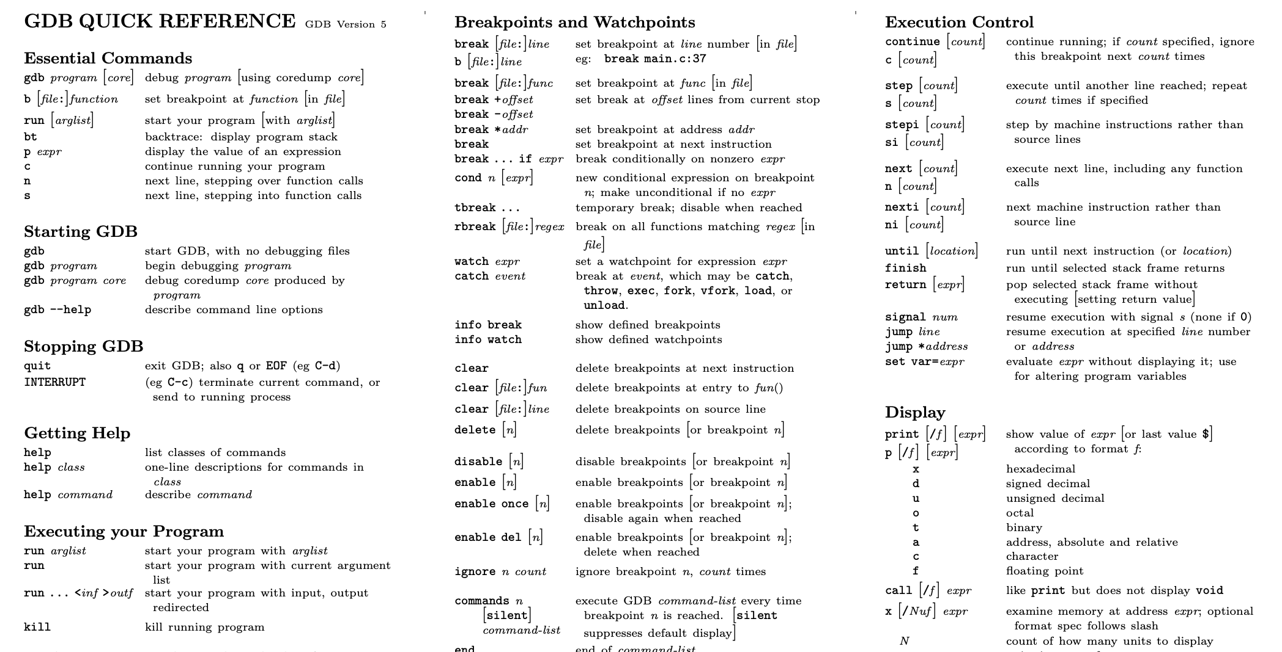
https://courses.cs.washington.edu/courses/cse374/19sp/refcard.pdf

Slide 14
Useful GDB Commands
bt – stack backtrace
up, down – change current stack frame
list – display source code (list n, list <function name>)
print <expression> – evaluate and print expression
display <expression>
re-evaluate and print expression every time execution pauses
undisplay – remove an expression from the recurring list
info locals – print all locals (but not parameters)
x (examine) – look at blocks of memory in various formats
If we get a segmentation fault:
gdb ./myprogram
Type "run" into GDB
When you get a segfault, type "backtrace" or "bt"
Look at the line numbers from the backtrace, starting from the top

Slide 15
Breakpoints
break – sets breakpoint
break <function name> | <line number> | <file>:<line number>
info break – print table of currently set breakpoints
clear – remove breakpoints
disable/enable temporarily turn breakpoints off/on
continue – resume execution to next breakpoint or end of program
step - execute next source line
next – execute next source line, but treat function calls as a single statement and don’t “step in”
finish – execute to the conclusion of the current function
how to recover if you meant “next” instead of “step”
temporarily stop program running at given points
look at values in variables
test conditions
break function (or line-number)
conditional breakpoints
to skip a bunch of iterations
to do assertion checking

Slide 16
Valgrind
Valgrind is a tool that simulates your program to find memory errors
catches pointer errors during execution
prints summary of heap usage, including details of memory leaks
gcc -g -o myprogram myprogram.c
valgrind --leak-check=full myprogram arg1 ag
Can show:
Use of uninitialized memory
Reading/writing memory after it has been free'd
Reading/writing off the end of malloc'd blocks
Reading/writing inappropriate areas on the stack
Memory leaks -- where pointers to malloc'd blocks are lost forever
Mismatched use of malloc/new/new [] vs free/delete/delete []
Overlapping src and dst pointers in memcpy() and related functions
[Video] Valgrind Demo

Slide 17
Valgrind Example
example1.c
Attempt to write 4 bytes to an invalid location in memory (sizeof(int))
a[10] -> index out of bounds
terminal

Slide 18
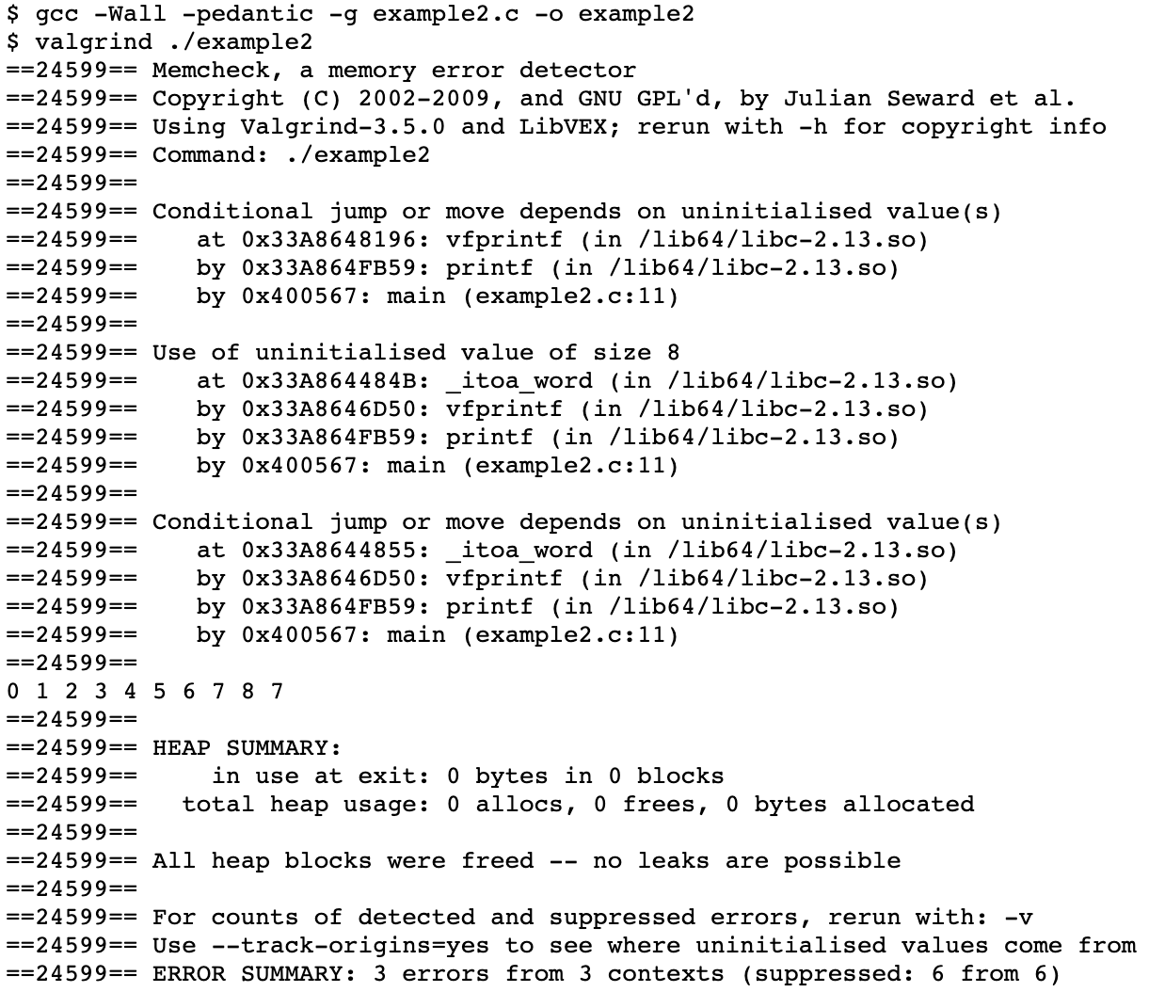
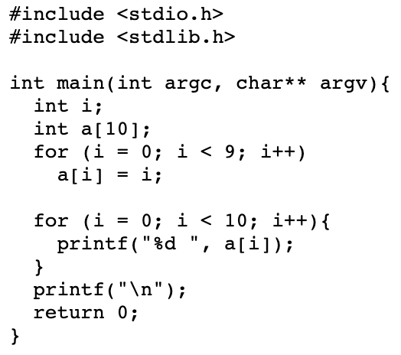
Valgrind EX2
example2.c
attempting to print a[10] which is not an initialized value (array index out of bounds)
terminal

Slide 19
Testing
Computers don’t make mistakes- people do!
“I’m almost done, I just need to make sure it works”
– Naive 14Xers
Software Test: a separate piece of code that exercises the code you are assessing by providing input to your code and finishes with an assertion of what the result should be.
Isolate
Break your code into small modules
Build in increments
Make a plan from simplest to most complex cases
Test as you go
As your code grows, so should your tests

Slide 20
Types of Tests
Black Box
Behavior only – ADT requirements
From an outside point of view
Does your code uphold its contracts with its users?
Performance/efficiency
White Box
Includes an understanding of the implementation
Written by the author as they develop their code
Break apart requirements into smaller steps
“unit tests” break implementation into single assertions

Slide 21
What to test?
Expected behavior
The main use case scenario
Does your code do what it should given friendly conditions?
Forbidden Input
What are all the ways the user can mess up?
Empty/Null
Protect yourself!
How do things get started?
Boundary/Edge Cases
First
last
Scale
Is there a difference between 10, 100, 1000, 10000 items?

Slide 22
Tips for testing
You cannot test every possible input, parameter value, etc.
Think of a limited set of tests likely to expose bugs.
Think about boundary cases
Positive; zero; negative numbers
Right at the edge of an array or collection's size
Think about empty cases and error cases
0, -1, null; an empty list or array
test behavior in combination
Maybe add usually works, but fails after you call remove
Make multiple calls; maybe size fails the second time only

Slide 23
Midterm Review

Slide 24
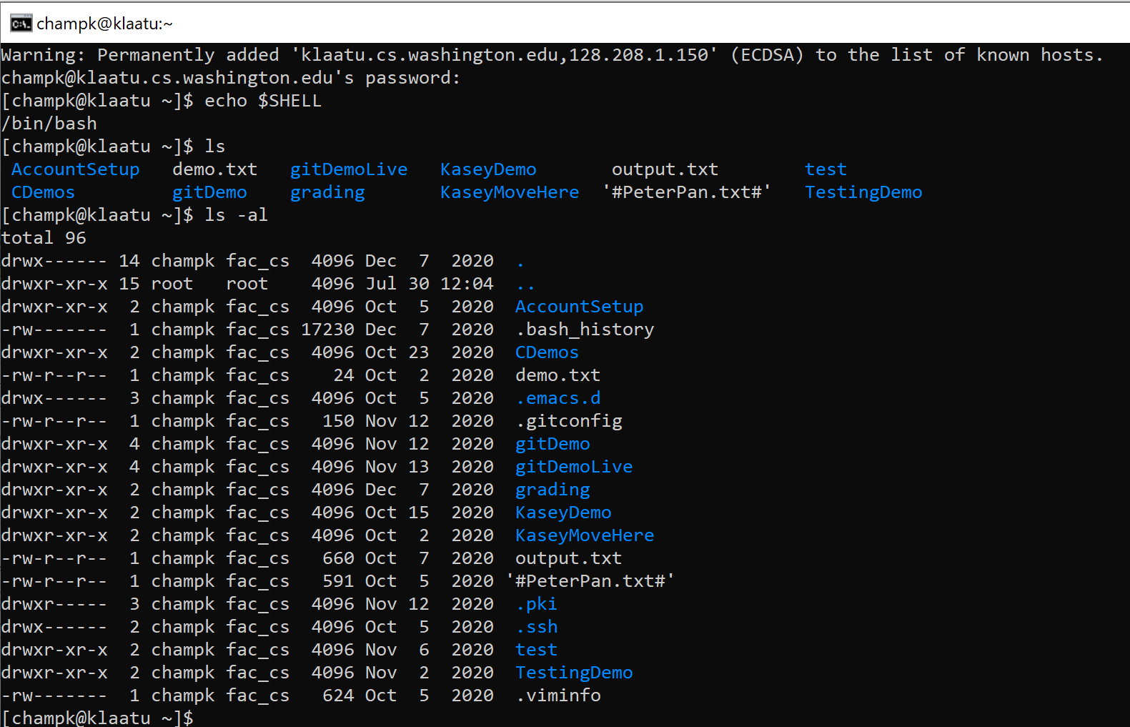
Linux File Permissions
Permission Groups
u – Owner
g – Group
o – Others
a – All users
Permission Types
r- read – a user’s ability to read the contents of the file.
w - write – a user’s capability to write or modify a file or directory.
x - execute – a user’s capability to execute a file or view the contents of a directory.
reading ls -l
_rw_rw_rw = owner, group and all users have read & write permissions
first character is either a - or a d : d means “directory”, “-” means file
chmod <group>+||-<permission> <file>
chmod a-rw file1 : remove read and write permissions on file1 for all users
chmod a+rw file1 : add read and write permissions on file1 for all users
https://www.linux.com/training-tutorials/understanding-linux-file-permissions/

Slide 25
Shell Variables
Shell variables = string substitution
Declare variables in the shell to easily refer to a given string
All variables are strings
Declare variables in the terminal with a name and a string value
<var name>=“<var string>”
EX: myvar=“myvalue”
Note: no white space allowed on either side of the “=“
Refer to your variable using the “$” symbol before the var name
$<var name>
EX: echo $myvar
myvalue
Alias
Rename a bash command, create your own shortcut
alias <string>=“substitution string”
EX: alias cheer=“echo hip hip horray!”
Only exists within the currents state of your shell
Can store alias in bashrc file to preserve alias across all shells

Slide 26
Bash Script Variables
When writing scripts you can use the following default variables
$# - stores number of parameters entered
Ex: if [$# -lt 1] tests if script was passed less than 1 argument
$N - returns Nth argument passed to script
Ex: sort $1 passes first string passed into script into sort command
$0 – command name
Ex: echo “$0 needs 1 argument” prints “<name of script> needs 1 argument”
$* returns all arguments
$@ returns a space separated string containing all arguments
”$@” prevents args originally quoted from being read as multiple args

Slide 27
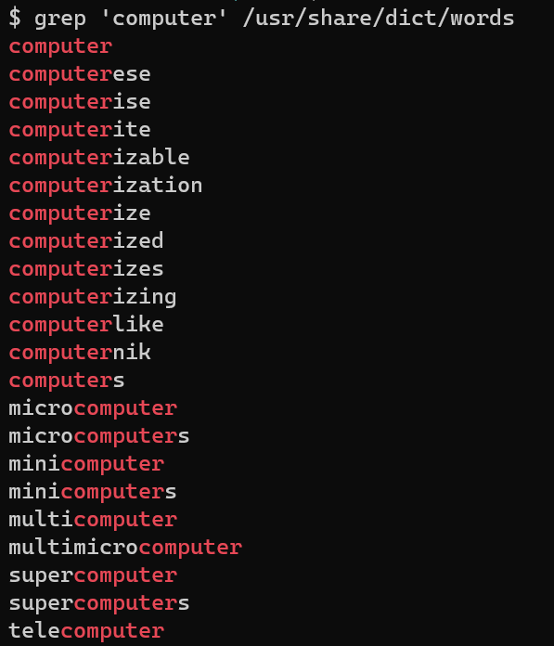
grep
Search for a given string within a given file
grep [options] pattern [files]
EX: grep “computer” /usr/share/dict/words
Helpful Options
-c : prints count of lines with given pattern
-h : display matched lines (without filenames)
-i : ignore case when matching
-l : display list of filenames with matches
https://www.geeksforgeeks.org/grep-command-in-unixlinux/

Slide 28
Redirecting Streams
Redirection Syntax:
< yourInput
> yourOutput
>> appendYourOutput
2> yourError
&> yourOutputAndError
Stdout & stderr default to terminal
Examples
cmd > file sends stdout to file
cmd 2> file sends stderr to file
cmd 1> output.txt 2> error.txt redirects both stdout and stderr to files
cmd < file accepts input from file
Instead of directly putting arg in command, pass args in from given file
cat file1.txt file2.txt file3.txt or cat < fileList.txt
https://www.gnu.org/software/bash/manual/html_node/Redirections.html
Notes:
If you leave an argument off some utilities they will process input from stdin
Ex: grep ‘mystring’
Will search through stdin
EX: foo<bar
Runs the program foo, with stdin from file bar

Slide 29
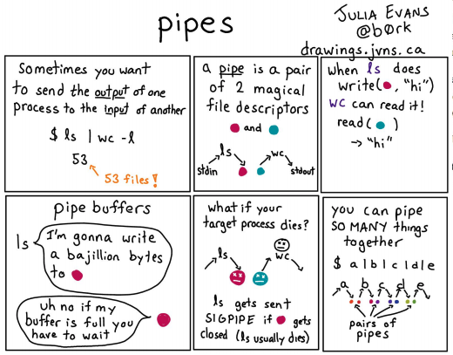
I/O Piping
We can feed the stdout of one process to the stdin of another using a pipe (“|”)
Data flows from process to the other through multiple transformations seamlessly
Similar to redirection, but specifically passes streams into other programs instead of their defaults
Example:
Instead of:
du –h –d 1 . > sizes.txt
grep ‘M’ sizes.txt
We can use piping
du – h –d 1 . | grep ‘M’
Piping is effective when you have one set of data that needs to be transformed multiple times
Cmd1 | cmd2 – pipe output of cmd1 into input of cmd2
Video: The Magic of Piping

Slide 30
If Statements
if [ $# -ne 2 ]
then
echo "$0: takes 2 arguments" 1>&2
exit 1
fi
if [ test ]; then
commands
fi
if [ -f .bash_profile ]; then
echo “You have a .bash_profile.”
else
echo “You do not have a .bash_profile”
fi
https://ryanstutorials.net/bash-scripting-tutorial/bash-if-statements.php

Slide 31
Loops
while [ test ]
do
commands
done
counter=1
while [ $counter -le 10 ]
do
echo $counter
((counter++))
done
while [ $# -gt 0 ]
do
echo $*
shift
done
for variable in words; do
commands
done
for value in {1..5}
do
echo $value
done
https://ryanstutorials.net/bash-scripting-tutorial/bash-loops.php

Slide 32
Regex special characters
\ - escape following character
. – matches any single character at least once
c.t matches {cat, cut, cota}
| - or, enables multiple patterns to match against
a|b matches {a} or {b}
* - matches 0 or more of the previous pattern (greedy match)
a* matches {, a, aa, aaa, …}
? – matches 0 or 1 of the previous pattern
a? matches {, a}
+ - matches one or more of previous pattern
a+ matches {a, aa, aaa, …}
{n} – matches exactly n repetitions of the preceding
a{3} matches {aaa}
() – groups patterns for order of operations
[] – contains literals to be matched, single or range
[a-b] matches all lowercase letters
^ - anchors to beginning of line
^// matches lines that start with //
$ - anchors to end of line
;$ matches lines that end with ;

Slide 33
Main function
void main(int argc, char** argv) {
printf(“hello, %s\n”, argv[1]);
}
argv is the array of inputs from the command line
Tokenized representation of the command line that invoked your program
argv[0] is the name of the program being run
argc stores the number of arguments ($#)+1
Like bash!
Main is the first function your program executes once it starts
Expect a return of 0 for successful execution or -1 for failure

Slide 34
Printf – print format function
Produces string literals to stdout based on given string with format tags
Format tags are stand ins for where something should be inserted into the string literal
%s – string with null termination, %d – int, %f – float
Number of format tags should match number of arguments
Format tags will be replaced with arguments in given order
Defined in stdio.h
printf(“format string %s”, stringVariable);
Replaces %s with variable given
printf(“hello, %s\n”, myName);
https://en.wikipedia.org/wiki/Printf_format_string

Slide 35
Strings in C
char s1[] = {’c’, ‘s’, ‘e’, ‘\0’};
char s2[] = “cse”;
char* s3 = “cse”;
All are equivalent ways to define a string in C
There are no “strings” in C, only arrays of characters
- “null terminated array of characters”
char* is another way to refer to strings in C
- Technically is a pointer to the first char in the series of chars for the string
Strings cannot be concatenated in C
printf(“hello, “ + myName + “\n”); // will not work
0x00 | 0x01 | 0x02 | 0x03 | 0x04 | 0x05 | 0x06 | 0x07 | 0x08 | 0x09
a | q | s | h | e | l | l | o | \0 | r

Slide 36
Appendix

