Slide 1
Lecture 7: Intro to C Programming
Lecture Participation Poll #7
Log onto pollev.com/cse374
Or
Text CSE374 to 22333
CSE 374: Intermediate Programming Concepts and Tools

Slide 2
Administrivia
Bash sample code + demo videos added to course calendar on website
Schedule 1:1 time with Kasey via Calendly
https://calendly.com/kasey-champion/1on1
Link posted on OH page of course website
HW1 turn in fixed
grading scripts misbehaving
due date will be “flexible”
HW1 Individual Assignment open on gradescope
HW2 posting later today, more Bash

Slide 3
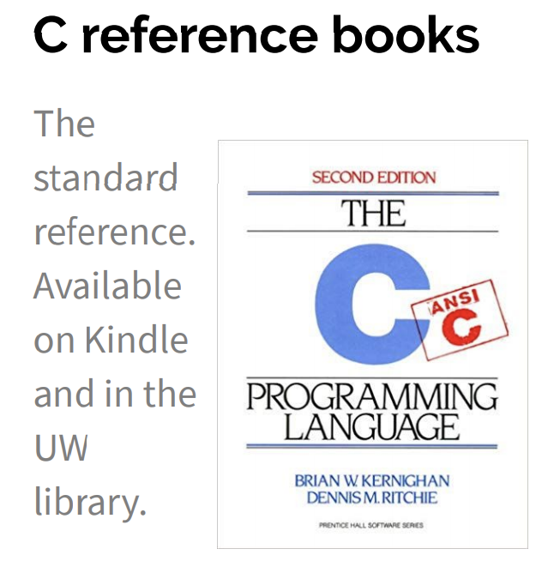
Meet C
Invented to rewrite the Unix OS, successor to B
A “low level” language gives the developer the ability to work directly with memory and processes
Low level means it sits closer to assembly, the language the CPU uses
Java is a “high level” language, compiles to bytecode, has a garbage collector that manages memory for you
Useful for software that requires low-level fOS interaction
Robotics, mobile, high performance software, drivers
Compact language, human readable but few features compared to Java
Still used for:
Embedded programming
Systems programming
High-performance code
GPU programming
Ancestor of most modern languages
Java, C++, C#
Much syntax is shared
http://cslibrary.stanford.edu/101/EssentialC.pdf
http://www.cplusplus.com/

Slide 4
C vs Java
C
low level
user responsible for memory
“functions”
No classes - NOT object oriented
compiled
conditional controls
modern syntax (human readable)
small standard library
Java
high level
memory managed (garbage collection)
“methods”
classes define objects
compiled
conditional controls
modern syntax (human readable)
large standard library, HUGE extended libraries

Slide 5
GCC
GCC is the C compiler we will use
Translates C into assembly code
Java compiler takes java code and turns it into Java bytecode (when you install JDK you teach your computer to understand javanite code)
Assembly is the language of your CPU
Can provide warnings for program crashes or failures, but don’t trust it much
Before compiling your code, gcc runs the C preprocessor on it
Removes comments
Handles preprocessor directives starting with #
gcc <options> -o <output exe> <c file to compile> <c file to compile>
gcc –o hello.exe hello.c
Options
-g enables debugging
-Wall checks for all warnings
-std=c11 uses the 2011 C standard, what we will use for this class

Slide 6
C Hello World
# indicates preprocessor directive
Header file to enable printf
#include <stdio.h>
/**
* comment
*/
int main(int argc, char** argv)
{
printf(“Hello world\n”);
return 0;
}
return type
arguments
“hello, world!\n” is a string of length 15 where \n is one character but contains the null terminator \0
successful return
Save in file “hello.c”
Compile with command gcc hello.c
creates executable a.out
Compile with command gcc –o hello.exe hello.c
creates executable hello.exe
Run ./hello.exe

Slide 7
Hello World in C

Slide 8
#include
Provides access to code in another file, similar to Java import statements
#include<somefile.h> will insert code in somefile.h into your C file
.h files are called “header files”
#include <foo.h> // standard libraries
searches for foo.h in “system include” directories
#include “foo.h” // developer files
searches current directory, lets coder break project into smaller files (java does this automatically)
Executed by preprocessor
Pulls in code before it is compiled
Includes work recursively, pulls in includes from headers that were directly included
stdio.h provides foundational set of input and output functions
printf, stdout
other useful standard libraries
stdlib
math
assert
http://www.cplusplus.com/reference/cstdio/

Slide 9
Functions
C programs are broken into functions
Named portion of code that can be referenced by code elsewhere
Similar to methods and classes in java
returnType functionName (type param1, …, type paramN) {
// statements
}
Declaration – specifies the function name, return type and parameters
//declaration
int square (int n);
The function header ending in ;
Similar to interfaces in Java
exist so you can call a function before you fully define it
Definition – declaration plus the code to run
//definition
int square (int n) {
return n * n;
}
You will get a Linker-error if an item is used but not defined (java equivalent of “symbol not found”)

Slide 10
Main function
void main(int argc, char** argv) {
printf(“hello, %s\n”, argv[1]);
}
argv is the array of inputs from the command line
Tokenized representation of the command line that invoked your program
argv[0] is the name of the program being run
argc stores the number of arguments ($#)+1
Like bash!
Main is the first function your program executes once it starts
Expect a return of 0 for successful execution or -1 for failure

Slide 11
Arguments to Main
char = datatype
char* = pointer to a place in memory that stores a char
char** = pointer to a place in memory that stores pointers to chars
int argc = number of pointers stored in argv
char** argv = “array” of pointers to program input arguments from command line
Access values with argv[index] Ex: argv[1]
argv[0] = program name, just like bash
Array of chars = String
Arrays do not store their length as a field (not an object), must be passed in argc

Slide 12
Printf – print format function
Produces string literals to stdout based on given string with format tags
Format tags are stand ins for where something should be inserted into the string literal
%s – string with null termination, %d – int, %f – float
Number of format tags should match number of arguments
Format tags will be replaced with arguments in given order
Defined in stdio.h
printf(“format string %s”, stringVariable);
Replaces %s with variable given
printf(“hello, %s\n”, myName);
https://en.wikipedia.org/wiki/Printf_format_string

Slide 13
Variables
C variable types: int, char, double, arrays (details)
No Booleans, use int values of nonZero=true and 0=false instead,
WARNING: opposite of bash
<type> <name> = <value> - Left side evaluates to locations = right side evaluates to values
int x = 1; // stores value 1 at location labeled x
char c = ’a’; // stores value a at location labeled c
double d = 2.5; // stores value 2.5 at location labeled d
int* xPtr = &x; // stores value of location x at location xPtr
x = 2; // stores value 2 at location x
*xPtr = 3; //stores value 3 at location xPtr
Much more on * and & tomorrow!

Slide 14
Global vs Local Variables
Variables defined inside a function are local to that function
Can only be used by function within which they are defined
May have multiple instances (recursion)
Only ”lives” until end of function
Space on stack allocated when reached, deallocated after block
Variables defined outside functions are global and can be used anywhere in the file and by any function
Will only ever be a single instance of a global variable
Lives until end of program
Space on stack allocated before main, deallocated after main
Should be avoided if possible for encapsulation
example.c
global
int result = 0;
int sumTo(int max) {
if (max == 1) return 1;
result = max + sumTo(max – 1);
return result;
}
local

Slide 15
The Stack
An area of local memory set aside to hold local variables
Functions like the stack data structure – first in first out
When we call a function it allocates memory on the stack for all local variables
Size of memory depends on datatype
When the function returns the memory for the local variables is deallocated
Java has been doing something similar in the background for you all along- garbage collector

Slide 16
Strings in C
char s1[] = {’c’, ‘s’, ‘e’, ‘\0’};
char s2[] = “cse”;
char* s3 = “cse”;
All are equivalent ways to define a string in C
There are no “strings” in C, only arrays of characters
- “null terminated array of characters”
char* is another way to refer to strings in C
- Technically is a pointer to the first char in the series of chars for the string
Strings cannot be concatenated in C
printf(“hello, “ + myName + “\n”); // will not work
0x00 | 0x01 | 0x02 | 0x03 | 0x04 | 0x05 | 0x06 | 0x07 | 0x08 | 0x09
a | q | s | h | e | l | l | o | \0 | r

Slide 17
Printf – print format function
Produces string literals to stdout based on given string with format tags
Format tags are stand ins for where something should be inserted into the string literal
%s – string with null termination, %d – int, %f – float
Number of format tags should match number of arguments
Format tags will be replaced with arguments in given order
Defined in stdio.h
printf(“format string %s”, stringVariable);
Replaces %s with variable given
printf(“hello, %s\n”, myName);
https://en.wikipedia.org/wiki/Printf_format_string

Slide 18
Demo: echo.c

Slide 19
Example: echo.c
#include <studio.h>
#include <stdlib.h>
#define EXIT_SUCCESS = 0;
int main (int argc, char** argv) {
for (int i = 1; i < argc; i++) {
printf(“%s “, argv[i]);
}
printf(“\n”);
return EXIT_SUCCESS;
}

Slide 20
Arrays in C
datatype name[length]
Contiguous block of memory
C doesn’t pass arrays around like ints, but rather passes the references to the array
Just like Java
Each item in array has an address based off of initial start item which is at 0
Arrays must be declared with a known length (so compiler can allocate space)
This size is not stored like in Java, you have to save length as a separate variable you pass around
No default values, arrays will hold whatever was in that spot before you declared it so accessing those addresses will cause errors
char arr[] = “cse”;
char* ptr = arr;
char letter_e = ptr[2]; // synonymous to *(ptr + 2)
int myArr[10];

Slide 21
C style
C curly brace style
Each curly brace is on its own line, not at the end of an instruction
C naming conventions
Constants are ALL_CAPS with underscores for spaces
C white space conventions
One declaration per line

Slide 22
Anatomy of a C program
// includes for functions & types
#include <stuff.h>
// symbolic constants
#define TRUE 1
#define FALSE 0
//global variables (if any)
Int x = 1;
// Function declarations
Void do_this(char, int)
Function definitions
Void do_this(char s, int m)
{
//statements
}
<main method at end of file?>

