Slide 1
Lecture 4: Bash Scripts
Lecture Participation Poll #4
Log onto pollev.com/cse374
Or
Text CSE374 to 22333
CSE 374: Intermediate Programming Concepts and Tools

Slide 2
Administrivia
Course webpage live!
HW1 actually posted
after this lecture you now have everything you need
klaatu accounts created
set up SSH
ssh yourUWNetId@klaatu.cs.washington.edu
password: tempPassword
passwd #will let you change your password
issues fill out this form: https://forms.gle/sFojyRU4eC8kJT4T9
Grading scripts are still being adjusted

Slide 3
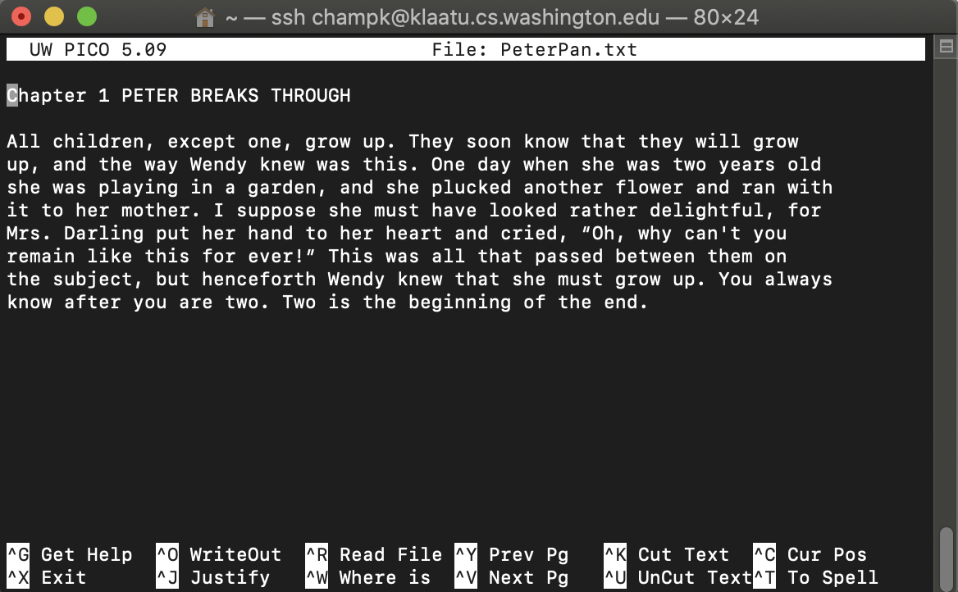
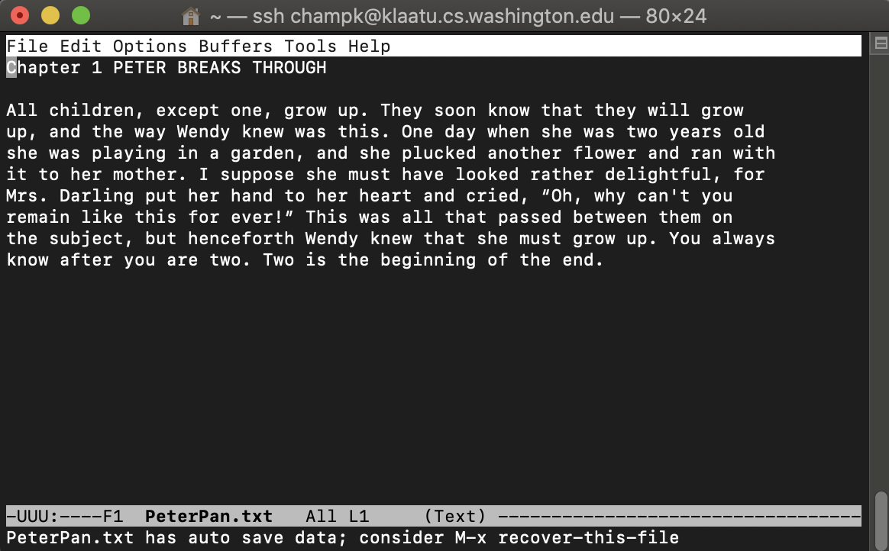
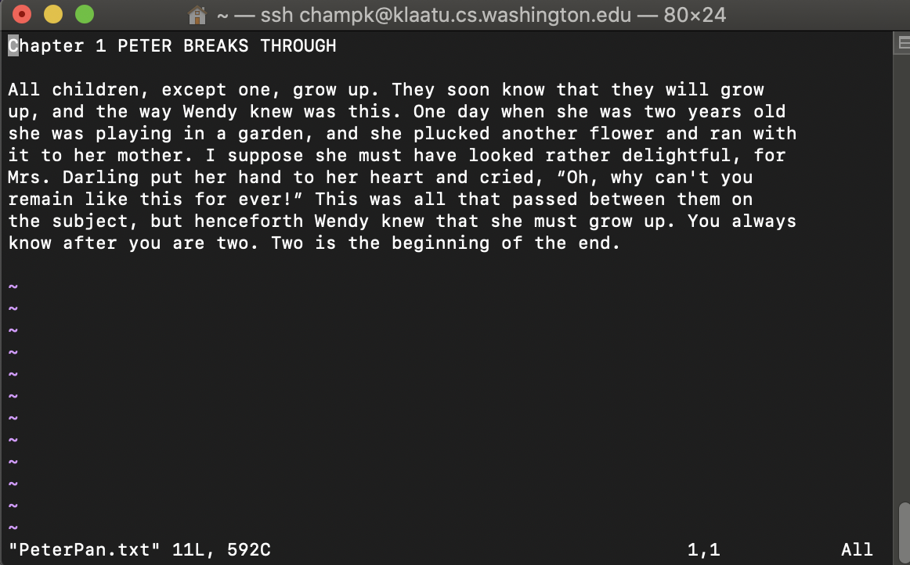
Terminal Text Editing
While working with the text interface for the OS often it is helpful to use the text interface editors
You do not have to use any of these in this course
Editors are a matter of preference
PICO
EMACS
VIM

Slide 4
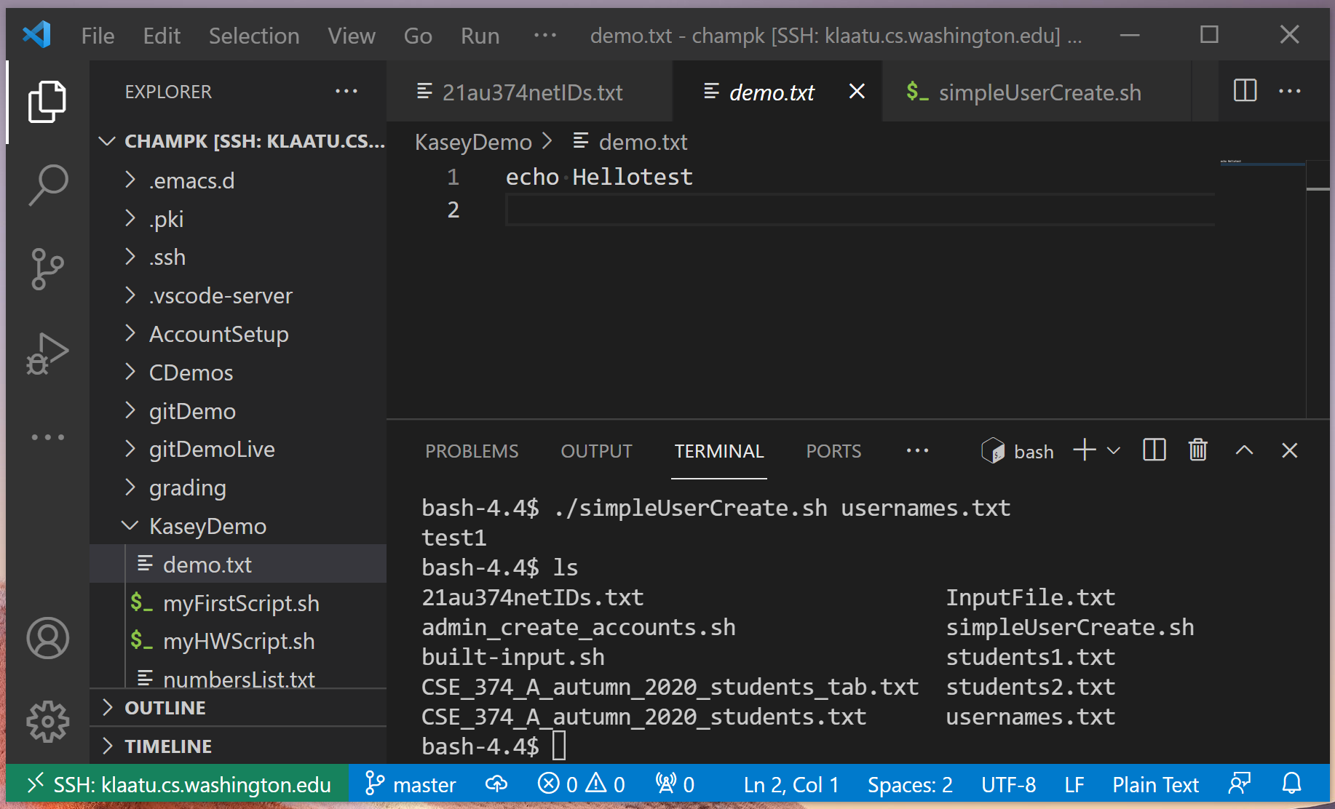
Working in VS Code
Install VS Code
it’s free!
ctrl + shift + P or F1 to open SSH dialog
enter in klaatu account info
open folder to see your files
use terminal on bottom

Slide 5
Transferring files between local and remote
tar – tape archive – compresses directory of files for easy transfer (like zip or archive)
tar -c <directory to compress>
tar –c –v –f myTarFile.tar /home/champk/
-c – creates new .tar archive file
-v - Verbosely show the tar process
-f - to decide name of tar file
tar –x <file to extract>
tar –x –v myTarFile.tar
wget – non-interactive download of files from the web supporting http, https and FTP
Non interactive means it can work in the background (helpful if the files take a while)
wget http://website.come/files/file.zip
scp – secure copy – uses ssh protocol to transfer files between different hosts
scp user@remote.host:file.txt /local/directory copies file.txt from remote host to local directory
scp file.txt user@remote.host:/remote/directory/ copies file.txt from local host to remote directory
You can always use a file transfer GUI like FileZilla uses FTP or SFTP, available for all platforms
Notes:
Let's say we wanted to archive several files into one file to make it easier to send to our friends.
We know that there is a tool in bash called `tar` that can do something like this, but we aren't sure how to use it.
Run `man tar` to open the manual page for `tar`. Look at the three example commands listed. Which is most similar to what we want to do? Type out the example they give.
Let’s say we want to download a file with a given URL and name the downloaded file `newFileName`. We know that there is a tool in bash called `wget` that can do something like this, but we are not sure exactly how to do it.
Use `man wget` to open the manual page for `wget`. Look for the options listed; which option will achieve our goal? Type out the command which would do this, including all options and parameters.
Use `URL` to replace the true URL. Use `newFileName` to replace the name you would like to use for the downloaded file.
[____](wget -O newFileName URL)

Slide 6
Writing Scripts
Instead of writing commands directly into terminal save them in a file
Use file extension “.sh”
Bash can run these files as executables
Add line at top of file to tell computer this should be run using bash
#! /bin/sh
# by itself makes a comment
Always include header comment with usage instructions
Give the file execution permissions
chmod u+x myscript.sh
Stop bash script on first failure by adding set –e at top of script

Slide 7
Bash Script Variables
When writing scripts you can use the following default variables
$# - stores number of parameters entered
Ex: if [$# -lt 1] tests if script was passed less than 1 argument
$N - returns Nth argument passed to script
Ex: sort $1 passes first string passed into script into sort command
$0 – command name
Ex: echo “$0 needs 1 argument” prints “<name of script> needs 1 argument”
$* returns all arguments
$@ returns a space separated string containing all arguments
”$@” prevents args originally quoted from being read as multiple args

Slide 8
Script Error Checking
If incorrect number of arguments passed
if [ $# -ne 2 ]; then
echo “$0 requires 2 arguments” >&2
exit 1
fi
Check if file exists
if [ ! -f $1 ]; then
echo "File does not exist" <& 1
exit 1
fi

Slide 9
Exit Codes
The command “exit” exits a shell and ends a shell-script program
ctrl+c aborts a process
When a process exits you can use a number to indicate either a success or failure
0 = success
1 or any non-zero positive number = error

Slide 10
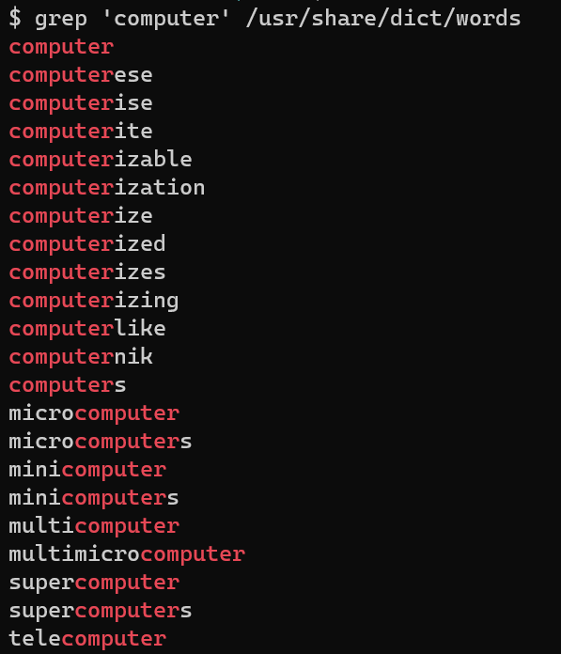
grep
Search for a given string within a given file
grep [options] pattern [files]
EX: grep “computer” /usr/share/dict/words
Helpful Options
-c : prints count of lines with given pattern
-h : display matched lines (without filenames)
-i : ignore case when matching
-l : display list of filenames with matches
https://www.geeksforgeeks.org/grep-command-in-unixlinux/

Slide 11
Demo: Grep

Slide 12
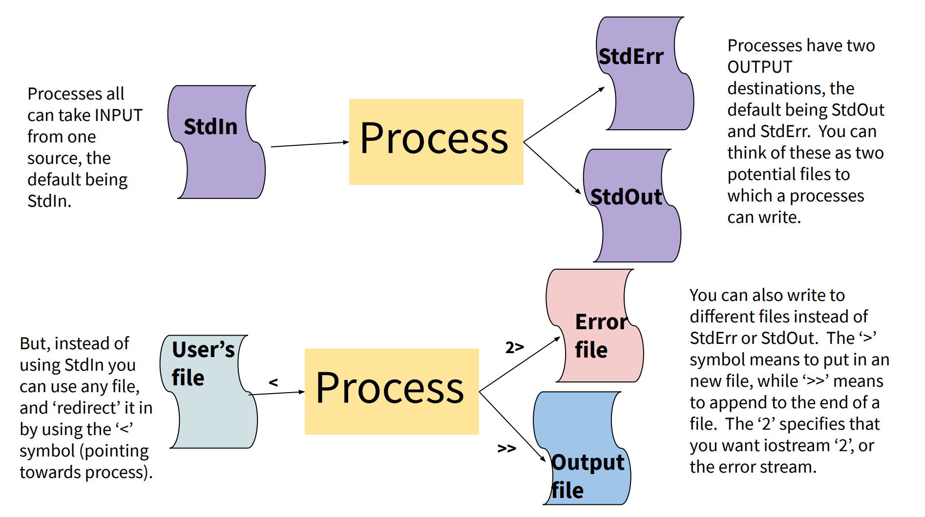

Slide 13
Input / Output Streams
stdin – Standard in (File Descriptor = 0)
Keyboard input typed into the terminal
stdout – Standard out (File Descriptor = 1)
Results of a process after it has completed printed to the screen of the terminal
stderr – Standard error (File Descriptor = 2)
Results of a process if it exits in error printed to the screen of the terminal

Slide 14
Redirecting Streams
Redirection Syntax:
< yourInput
> yourOutput
>> appendYourOutput
2> yourError
&> yourOutputAndError
Stdout & stderr default to terminal
Examples
cmd > file sends stdout to file
cmd 2> file sends stderr to file
cmd 1> output.txt 2> error.txt redirects both stdout and stderr to files
cmd < file accepts input from file
Instead of directly putting arg in command, pass args in from given file
cat file1.txt file2.txt file3.txt or cat < fileList.txt
https://www.gnu.org/software/bash/manual/html_node/Redirections.html
Notes:
If you leave an argument off some utilities they will process input from stdin
Ex: grep ‘mystring’
Will search through stdin
EX: foo<bar
Runs the program foo, with stdin from file bar

Slide 15
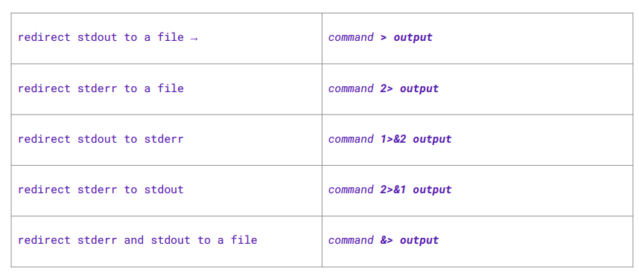
Redirection Syntax

Slide 16
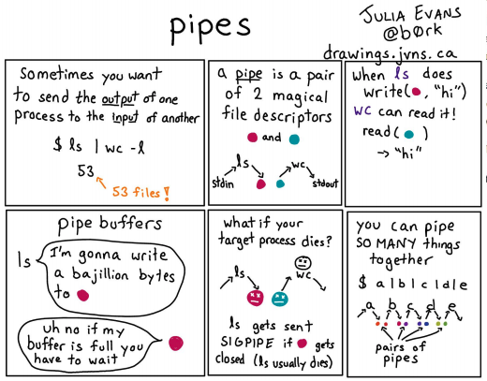
I/O Piping
We can feed the stdout of one process to the stdin of another using a pipe (“|”)
Data flows from process to the other through multiple transformations seamlessly
Similar to redirection, but specifically passes streams into other programs instead of their defaults
Example:
Instead of:
du –h –d 1 . > sizes.txt
grep ‘M’ sizes.txt
We can use piping
du – h –d 1 . | grep ‘M’
Piping is effective when you have one set of data that needs to be transformed multiple times
Cmd1 | cmd2 – pipe output of cmd1 into input of cmd2
Video: The Magic of Piping

Slide 17
What is the difference between | and >?
What is the difference between | and >?
Pipe is used to pass output to another program or utility
Redirect is used to pass output to either a file or stream
thing1 > thing2 runs thing1 and then sends the stdout stream to thing2, if these are files thing2 will be overwritten
thing1 > tempFile && thing2 <tempFile sends stdout of thing1 to stdin of thing2 without overwriting files
Equivalent to thing1 | thing2 much more elegant!
https://askubuntu.com/questions/172982/what-is-the-difference-between-redirection-and-pipe

Slide 18
Demo: Stream Redirection

Slide 19
Some more commands
Du – disk utilization – prints the disk size of each folder/file passed as args
EX: du myDir test.txt
Common options
-h for human readable (Kilobytes, Megabytes, Gigabytes)
-d 1 limits the depth of the recursion to 1st level of directories
EX: du – h –d 1 .
Prints the size of all the files/folders in the current directory
Cal – prints current month and year with a text image of the current month

