Slide 1
Lecture 11: Dynamic Memory Allocation Continued…
Lecture Participation Poll #11
Log onto pollev.com/cse374
Or
Text CSE374 to 22333
CSE 374: Intermediate Programming Concepts and Tools

Slide 2
Administrivia
Assignments
HW2 Live - Soft Deadline Thursday October 29th at 9pm PST
Don’t need to zip files
More hints added!
HW1 Hidden Case 2 – make “*” work as input
Check discord if you are spending too much time!
If it works locally but not in gradescope ping @staff
Reminder: Midpoint Deadline Friday November 6th at 9pm PST
Review Assignment Live – Due Wednesday
24 hrs late 20% penalty
48 hrs late 50% penalty
Not accepted more than 48hrs late

Slide 3
Memory Allocation
Type | Storage Size | Value Range
char | 1 byte | -128 to 127 or 0 to 255
unsigned char | 1 byte | 0 to 255
signed char | 1 byte | -128 to 127
int | 2 or 4 bytes | -32,786 to 32,767 or -2,147,483,648 to 2,147,483,647
unsigned int | 2 or 4 bytes | 0 to 65,535 or 0 to 4,294,967,295
short | 2 bytes | -32,768 to 32,767
unsigned short | 2 bytes | 0 to 65,535
long | 8 bytes | -9223372036854775808 to 9223372036854775807
unsigned long | 8 bytes | 0 to 18446744073709551615
float | 4 bytes | 1.2E-38 to 3.4E+38
double | 8 bytes | 2.3E-308 to 1.7E+308
long double | 10 bytes | 3.4E-4932 to 1.1E+4932
Allocation refers to any way of asking for the operating system to set aside space in memory
How much space? Based on variable type & your system
to get specific sizes for your system use “sizeof(<datatype>)” function in stdlib.h
Global Variables – static memory allocation
space for global variables is set aside at compile time, stored in RAM next to program data, not stack
space set aside for global variables is determined by C based on data type
space is preserved for entire lifetime of program, never freed
Local variables – automatic memory allocation
space for local variables is set aside at start of function, stored in stack
space set aside for local variables is determined by C based on data type
space is deallocated on return
* pointers require space needed for an address – dependent on your system - 4 bytes for 32-bit, 8 bytes for 64-bit
https://www.gnu.org/software/libc/manual/html_node/Memory-Allocation-and-C.html

Slide 4
Does this always work?
Static and automatic memory allocation – memory set aside is known at runtime
Fast and easy to use
partitions the maximum size per data type – not efficient
life of data is automatically determined – not efficient
What if we don’t know how much memory we need until program starts running?
char* ReadFile(char* filename)
{
int size = GetFileSize(filename);
char* buffer = AllocateMem(size);
ReadFileIntoBuffer(filename, buffer);
return buffer;
}
You don’t know how big the filesize is

Slide 5
Dynamic Allocation
Situations where static and automatic allocation aren’t sufficient
Need memory that persists across multiple function calls
Lifetime is known only at runtime (long-lived data structures)
Memory size is not known in advance to the caller
Size is known only at runtime (ie based on user input)
Dynamically allocated memory persists until:
A garbage collector releases it (automatic memory management)
Implicit memory allocator, programmer only allocates space, doesn’t free it
“new” in Java, memory is cleaned up after program finishes
Your code explicitly deallocates it (manual memory management)
C requires you manually manage memory
Explicit memory allocation requires the programmer to both allocate space and free it up when finished
”malloc” and “free” in C
Memory is allocated from the heap, not the stack
Dynamic memory allocators acquire memory at runtime

Slide 6
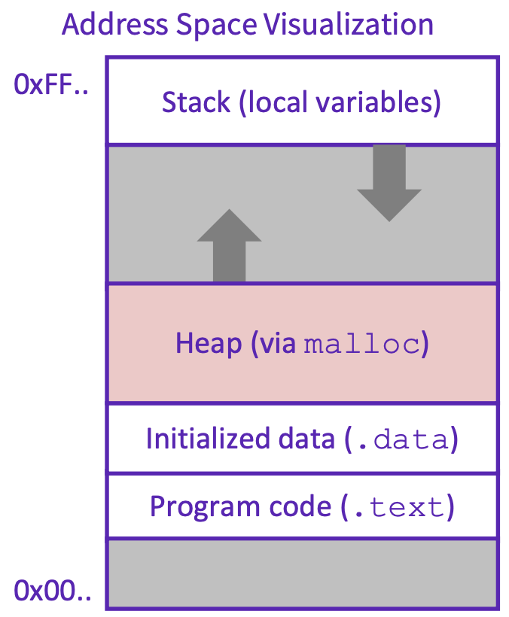
Storing Program Data in the RAM
When you trigger a new program the operating system starts to allocate space in the RAM
Operating System will default to keeping all memory for a program as close together within the ram addresses as possible
Operating system manages where exactly in the RAM your data is stored
Space is first set aside for program code (lowest available addresses)
Then space is set side for initialized data (global variables, constants, string literals)
As program runs…
When the programmer manually allocates memory for data it is stored in the next available addresses on top of the initialized data, building upwards as space is needed
When the program requires local variables they are stored in the empty space at top of RAM, leaving space between stack and heap
When the space between the stack and heap is full - crash (out of memory)
The heap is a large pool of available memory set aside specifically for dynamically allocated data

Slide 7
Allocating Memory in C with malloc()
void* malloc(size_t size)
allocates a continuous block of “size” bytes of uninitialized memory
Returns null if allocation fails or if size == 0
Allocation fails if out of memory, very rare but always check allocation was successful before using pointer
void* means a pointer to any type (int, char, float)
malloc returns a pointer to the beginning of the allocated block
var = (type*) malloc(sizeInBytes)
Cast void* pointer to known type
Use sizeof(type) to make code portable to different machines
free deallocates data allocated by malloc
Must add #include <stdlib.h>
Variables in C are uninitialized by default
No default “0” values like Java
Invalid read – reading from memory before you have written to it
//allocate an array to store 10 floats
float* arr = (float*) malloc(10*sizeof(float));
if (arr == NULL)
{
return ERROR;
}
printf(“%f\n”, *arr) // Invalid read!
<add something to array>
<print f again, now it’s ok>

Slide 8
calloc()
var = (type*) calloc(numOfElements, bytesPerElement);
Like malloc, but also initializes the memory by filling it with 0 values
Slightly slower, but useful for non-performance critical code
Also in stdlib.h
//allocate an array to store 10 doubles
double* arr = (double*) calloc(10, sizeof(double));
if (arr == NULL)
{
return ERROR;
}
printf(“%f\n”, arr[0]) // Prints 0.00000

Slide 9
realloc()
void* realloc(void* p, size_t size)
creates a new allocation with given size, copies the contents of p into it and then frees p
saves a few lines of code
can sometimes be faster due to allocator optimizations
part of stdlib.h

Slide 10
Freeing Memory in C with free()
Void free(void* ptr)
Released whole block of memory stored at location ptr to pool of available memory
ptr must be the address originally returned by malloc (the beginning of the block) otherwise system exception raised
ptr is unaffected by free
Set pointer to NULL after freeing it to deallocate that space too
Calling free on an already released block (double free) is undefined behavior – best case program crashes
Rule of thumb: for every runtime call to malloc there should be one runtime call to free
if you lose all pointers to an object you can no longer free it – memory leak!
be careful when reassigning pointers
this is usually the cause of running out of memory- unreachable data that cannot be freed
if you attempt to use an object that has been freed you hit a dangling pointer
all memory is freed once a process exits, and it is ok to rely on this in many cases
//allocate an array to store 10 floats
float* arr = (float*) malloc(10*sizeof(float));
if (arr == NULL)
{
return ERROR;
}
for (int i = 0; i < size*num; i++)
{
arr[i] = 0;
}
free(arr);
arr = NULL; // Optional

Slide 11
Example
void foo(int n, int m)
{
int i, *p; // declare local variables
p = (int*) malloc(n*sizeof(int)); //allocate block of n ints
if (p == NULL) // check for allocation error
{
perror(“malloc”); //prints error message to stderr
exit(0);
}
for (i=0; i<n; i++) // initialize int array
p[i] = i;
p = (int*) realloc(p, (n+m)*sizeof(int)); // add space for m at end of p block
if (p == NULL) // check for allocation error
{
perror(“realloc”);
exit(0);
}
for (i=n; i<n+m; i++) // initialize new space at back of array
p[i] = i;
for (i=0; i<n+m; i++) // print out array
printf(“%d\n”, p[i]);
free(p); // free p, pointer will be freed at end of function
}

Slide 12
Demo: malloc() and realloc()

Slide 13
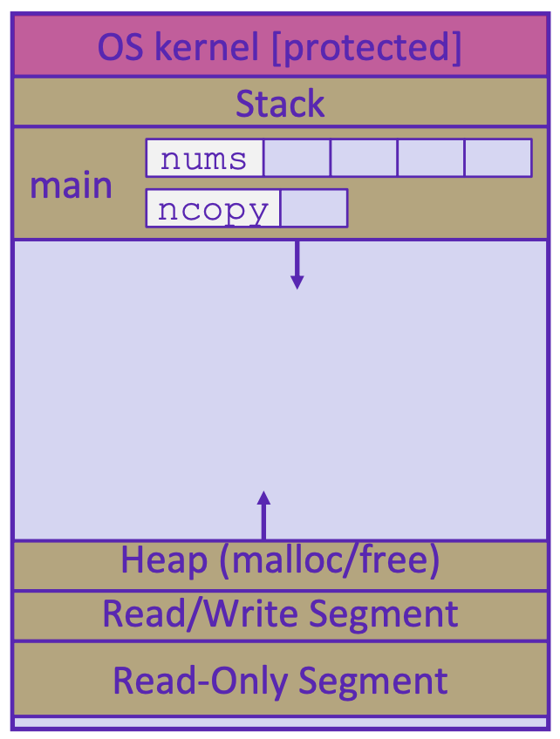
Example: 1 – initialized data
#include <stdlib.h>
int* copy(int a[], int size)
{
int i, *a2;
a2 = malloc(size*sizeof(int));
if (a2 == NULL)
return NULL;
for (i = 0; i < size; i++)
a2[i] = a[i];
return a2;
}
int main(int argc, char** argv)
{
int nums[4] = {1, 2, 3, 4};
int* ncopy = copy(nums, 4);
// do stuff with your copy!
free(ncopy);
return EXIT_SUCCESS;
}

Slide 14
Example: 2 – main local variable in stack
#include <stdlib.h>
int* copy(int a[], int size)
{
int i, *a2;
a2 = malloc(size*sizeof(int));
if (a2 == NULL)
return NULL;
for (i = 0; i < size; i++)
a2[i] = a[i];
return a2;
}
int main(int argc, char** argv)
{
int nums[4] = {1, 2, 3, 4};
int* ncopy = copy(nums, 4);
// do stuff with your copy!
free(ncopy);
return EXIT_SUCCESS;
}
1 2 3 4

Slide 15
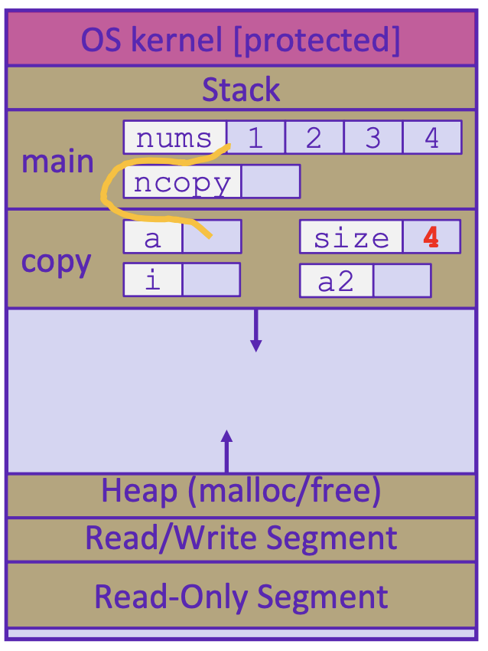
Example: 3 – copy local variables in stack
#include <stdlib.h>
int* copy(int a[], int size)
{
int i, *a2;
a2 = malloc(size*sizeof(int));
if (a2 == NULL)
return NULL;
for (i = 0; i < size; i++)
a2[i] = a[i];
return a2;
}
int main(int argc, char** argv)
{
int nums[4] = {1, 2, 3, 4};
int* ncopy = copy(nums, 4);
// do stuff with your copy!
free(ncopy);
return EXIT_SUCCESS;
}
1 2 3 4

Slide 16
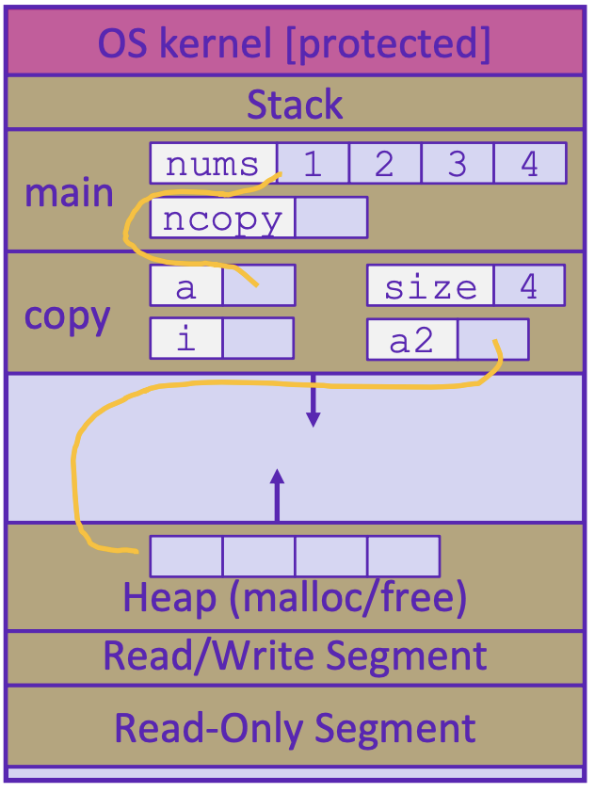
Example: 4 – malloc space for int array
#include <stdlib.h>
int* copy(int a[], int size)
{
int i, *a2;
a2 = malloc(size*sizeof(int));
if (a2 == NULL)
return NULL;
for (i = 0; i < size; i++)
a2[i] = a[i];
return a2;
}
int main(int argc, char** argv)
{
int nums[4] = {1, 2, 3, 4};
int* ncopy = copy(nums, 4);
// do stuff with your copy!
free(ncopy);
return EXIT_SUCCESS;
}
1 2 3 4

Slide 17
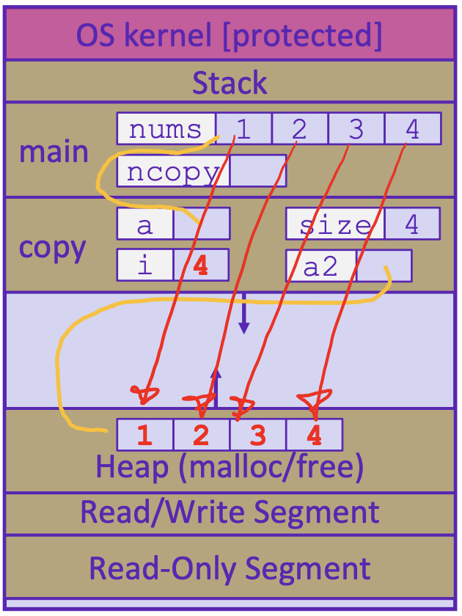
Example: 5 – fill available space from local var
#include <stdlib.h>
int* copy(int a[], int size)
{
int i, *a2;
a2 = malloc(size*sizeof(int));
if (a2 == NULL)
return NULL;
for (i = 0; i < size; i++)
a2[i] = a[i];
return a2;
}
int main(int argc, char** argv)
{
int nums[4] = {1, 2, 3, 4};
int* ncopy = copy(nums, 4);
// do stuff with your copy!
free(ncopy);
return EXIT_SUCCESS;
}
1 2 3 4
0

Slide 18
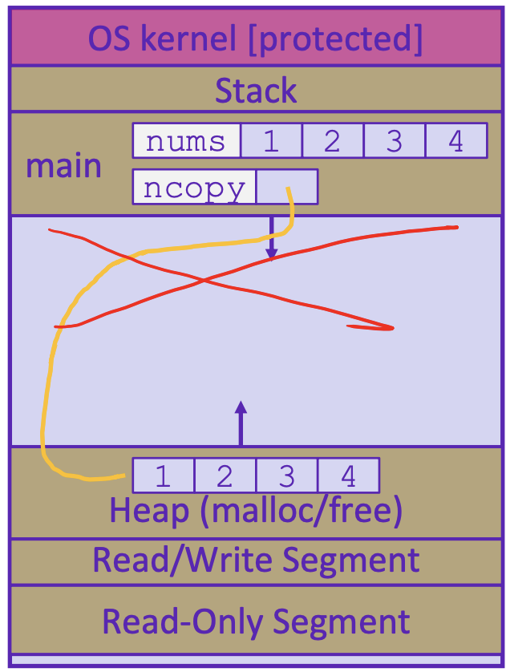
Example: 6 – finish copy and free stack space
#include <stdlib.h>
int* copy(int a[], int size)
{
int i, *a2;
a2 = malloc(size*sizeof(int));
if (a2 == NULL)
return NULL;
for (i = 0; i < size; i++)
a2[i] = a[i];
return a2;
}
int main(int argc, char** argv)
{
int nums[4] = {1, 2, 3, 4};
int* ncopy = copy(nums, 4);
// do stuff with your copy!
free(ncopy);
return EXIT_SUCCESS;
}
1 2 3 4

Slide 19
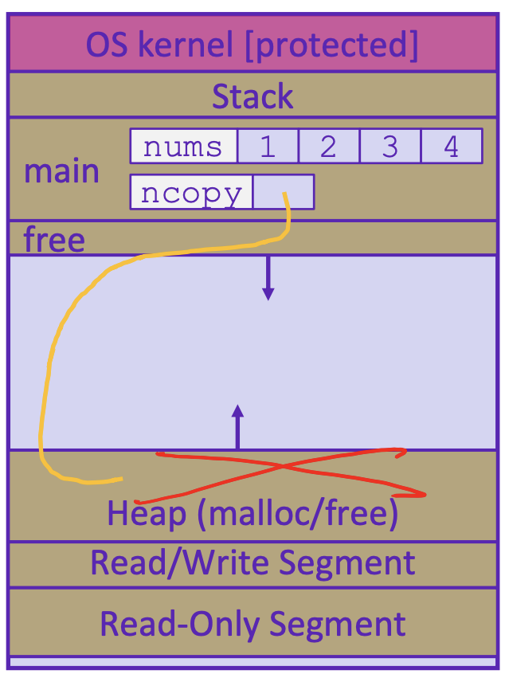
Example: 7 – free ncopy from heap
#include <stdlib.h>
int* copy(int a[], int size)
{
int i, *a2;
a2 = malloc(size*sizeof(int));
if (a2 == NULL)
return NULL;
for (i = 0; i < size; i++)
a2[i] = a[i];
return a2;
}
int main(int argc, char** argv)
{
int nums[4] = {1, 2, 3, 4};
int* ncopy = copy(nums, 4);
// do stuff with your copy!
free(ncopy);
return EXIT_SUCCESS;
}
1 2 3 4

Slide 20
Memory Leak
A memory leak occurs when code fails to deallocate dynamically-allocated memory that is no longer used
Caused by forgetting to call free() on a malloc’d block of memory or losing a pointer to a malloc-d block
Program’s memory will keep growing
What’s the problem?
Short-lived program might not be an issue, all memory is deallocated when program ends
Long-lived programs might slow down over time, exhaust all available memory and crash or starve other programs of memory

Slide 21
Common Memory Errors
int x[] = {1, 2, 3};
free(x);
x = (int*)malloc(M*sizeof(int));
free(x);
y = (int*)malloc(M*sizeof(int));
free(x);
x is a local variable stored in stack, cannot be freed
Double free and Forgetting to free memory “memory leak”
char** strings = (char**)malloc(sizeof(char)*5);
free(strings);
Mismatch of type - wrong allocation size
x = (int*)malloc(M*sizeof(int));
free(x);
y = (int*)malloc(M*sizeof(int));
for (i=0; i<M; i++)
y[i] = x[i];
Accessing freed memory

Slide 22
Common Memory Errors
int* foo()
{
int val = 0;
return &val;
}
#define LEN 8
int arr[LEN];
for (int i = 0; i <= LEN; i++)
arr[i] = 0;
dangling pointer
Out of bounds access
int foo()
{
int* arr = (int*)malloc(sizeof(int)*N);
read_n_ints(N, arr);
int sum = 0;
for (int i = 0; i < N; i++)
sum += arr[i];
return sum;
}
long val;
printf(“%d”, &val);
Dereferencing a non-pointer
int sum_int(int* arr, int len)
{
int sum;
for (int i = 0; i < len; i++)
sum += arr[i];
return sum;
}
memory leak – failing to free memory
Reading memory before allocation

Slide 23
Finding and Fixing Memory Errors
Valgrind is a tool that simulates your program to find memory errors
it can detect all of the errors we’ve discussed so far!
catches pointer errors during execution
prints summary of heap usage, including details of memory leaks
valgrind [options] ./myprogram arg1 arg2
Useful option: --leak-check=full

Slide 24
Appendix

Slide 27
errno
How do you know if an error has occurred in C?
no exceptions like Java
usually return a special error value (NULL, -1)
stdlib functions set a global variable called errno
check errno for specific error types
if (errno == ENOMEM) // allocation failure
perror(“error message”) prints to stderr

Slide 28
C Garbage Collector
garbage collection is the automatic reclamation of heap-allocated memory that is never explicitly freed by application
used in many modern languages: Java, C#, Ruby, Python, Javascript etc…
“conservative” garbage collectors do exist for C and C++ but cannot collect all garbage
Data is considered “garbage” if it is no longer reachable
lost pointers to data (Like a dropped link list node in Java)
memory allocator can sometimes get help from the compiler to know what data is a pointer and what is not

