Slide 1
CSE 374 Programming Concepts & Tools
Hal Perkins
Fall 2015
Lecture 18 – Linking and Libraries

Slide 2
Intro to linking
Linking is just one example of “using stuff in other files”...
In compiling and running code, one constantly needs other files and programs that find them
Examples:
C preprocessor #include
C libraries (where is the code for printf, malloc?)
Usually you’re happy with programs “automatically finding what you need” so the complicated rules can be hidden
Today we will demystify and make generalizations

Slide 3
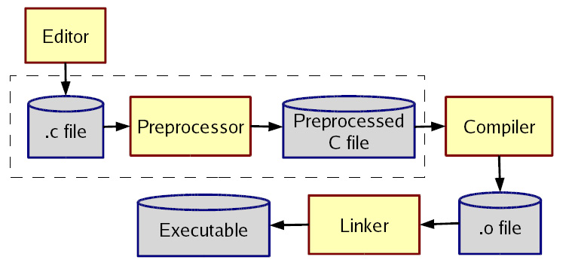
The compilation picture (revisited)
Old story, but new details…

Slide 4
Common questions
What you are looking for?
When are you looking for it?
Where are you looking?
What problems do cycles cause?
How do you change the answers?
Old friends: files, function names, paths, environment variables, command-line flags, scripts, configuration files, ...

Slide 5
#include files – what really happens?
cpp (invoked implicitly by gcc or g++ on files ending in .c, .cc, .cpp, etc.).
What: files named “foo” when encountering #include <foo> or #include "foo" (note: .h is just a convention)
When: When the preprocessor is run (making x.i from x.c, although usually you don’t see this)
Where: “include path”: current-directory, directories chosen when cpp is installed (e.g., /usr/include), directories listed in INCLUDE shell variable, directories listed via -I flags, ...

Slide 6
more #include…
The rules on “what overrides what” exist, but tough to remember
Can look at result to see “what really happened”
Example: for nested #include, the original current-directory or the header file’s current-directory?
Example: Why shouldn’t you run cpp on one machine and compile the results on another?
What about cycles?
File a.c calls functions in file b.c which calls functions in file a.c which …
Not a problem – put declarations in header files and include each header file as needed. Actual function definitions aren’t circular

Slide 7
Compiled code – .o files
So far we have talked about finding source code to create compiled code (.o files for C)
These files are not whole applications, so we have the same questions for “finding the other code”
printf, malloc, getmem (called from main), …
A .o file is not “runnable” – you have to actually link it with the other code to make an executable
Linking (ld, or called via gcc or g++) is a “when” between compiling and executing
Again, gcc usually hides this from you, but it helps to know what is going on

Slide 8
Linking
If a C file uses but does not define a function (or global variable) foo, then the .o has “unresolved references”. Declarations don’t count; only definitions.
The linker takes multiple .o files and “patches them” to include the references. (It literally moves code and changes instructions like function calls.)
An executable must have no unresolved references (you have seen this error message)
What: Definitions of functions/variables
When: The linker creates an executable
Where: Other .o files on the command-line (and much more...)

Slide 9
More about where
The linker and O/S don’t know anything about main or the C library
That’s why gcc “secretly” links in other things
We can do it ourselves, but we would need to know a lot about how the C library is organized. Get gcc to tell us:
gcc -v -static hello.c
Should be largely understandable
-static (a simple “get all the code you need into a.out” story for now)
the secret *.o files: (they do the stuff before main gets called, which is why gcc gives errors about main not being defined)

Slide 10
Archives
An archive is roughly a tar file, but with extra header information about the .o files in it
Create with ar program (lots of features, but fundamentally take .o files and put them in, but order matters)
The semantics of passing ld an argument like -lfoo is complicated and often not what you want:
Look for what: file libfoo.a (ignoring shared libraries for now), when: at link-time, where: defaults, environment variables, and the -L flags (analogous to -I)
Go through the .o files in libfoo.a in order
If a .o defines a needed reference, include the .o
Including a .o may add more needed references
Continue

Slide 11
The rules for linking
A call to ld (or gcc for linking) has .o files and -lfoo options in left-to-right order
State: “Set of needed functions not defined” initially empty
Action for .o file:
Include code in result
Remove from set any functions defined
Add to set any functions used and not yet defined
Action for .a file: For each .o in the archive, in order
If it defines one or more functions in set, do all 3 things we do for a .o file
Else do nothing
At end, if set is empty create executable, else error

Slide 12
Library gotchas
Position of -lfoo on command-line matters
Only resolves references for “things to the left”
So -lfoo typically put “on the right”
Cycles
If two .o files in a .a need each other, you’ll have to link the library in (at least) twice!
If two .a files need each other, you might do -lfoo –lbar -lfoo -lbar -lfoo ...
(There are command-line options to do this for you, but not the default.)
If you include math.h, then you’ll need -lm

Slide 13
Another gotcha
No repeated function names
Two .o files in an executable can’t have (public) functions of the same name
Can have static functions with the same name! (“static” on a function means not externally visible)
Can get burned by library functions you do not know exist, but only if you need another function from the same .o file
(Solution: 1 public function per file?!)

Slide 14
Dynamic Linking
The basic static linking model has disadvantages:
Uses lots of disk space (copy library functions for every application)
More memory when programs are running (what if the O/S could have different processes magically share code?)
So we can link later:
Shared libraries (link when program starts executing). Saves disk space. O/S can share actual memory behind your back (if/because code is immutable).
Dynamically linked/loaded libraries. Even later (while program is running). Devil is in the details.
“DLL hell” – if the version of a library on a machine is not the one the program was tested with…

Slide 15
Summary
Things like “standard libraries” “header files” “linkers” etc. are not magic
But since you rarely need fine-grained control, you easily forget how to control typically-implicit things. (You don’t need to know any of this until you need to know it ☺)
There’s a huge difference between source code and compiled code (a header file and an archive are quite different)
The linker includes files from archives using strange rules

