Slide 1
CSE 374 Programming Concepts & Tools
Hal Perkins
Fall 2015
Lecture 15 – Testing

Slide 2
Where we are
Some very basic “software engineering” topics in the midst of tools
Today: testing (how, why, some terms)
Later: (partial) specification
“Test your software or your users will”
Hunt & Thomas
The Pragmatic Programmer

Slide 3
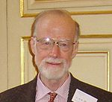
Software design
“There are two ways of constructing a software design:
One way is to make it so simple that there are obviously no deficiencies, and
the other way is to make it so complicated that there are no obvious deficiencies.
The first method is far more difficult.”
Sir C. A. R. Hoare

Slide 4
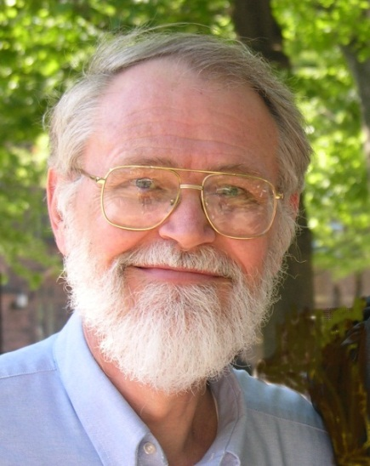
Debugging
“Debugging is twice as hard as writing the code in the first place. Therefore, if you write the code as cleverly as possible, you are, by definition, not smart enough to debug it.”
Brian Kernighan

Slide 5
Testing
“Program testing can be a very effective way to show the presence of bugs, but is hopelessly inadequate for showing their absence.”
Edsger Dijkstra
1972 Turing Award Lecture
http://userweb.cs.utexas.edu/~EWD/transcriptions/EWD03xx/EWD340.html

Slide 6
Fixing bugs…
Use languages and tools that make errors impossible when you can
Java eliminates a large class of memory bugs
Don’t introduce defects
Think, design, analyze – don’t write the bugs in the first place!
Make defects visible
Assertions, exceptions (if you have them)
Rigorous testing
Debugging – last resort

Slide 7
Testing 1, 2, 3
Role of testing and its plusses/minuses
Unit testing or “testing in the small”
Stubs, or “cutting off the rest of the world” (which might not exist yet)

Slide 8
A little theory
Testing is very limited and difficult:
Small number of inputs
Small number of calling contexts, environments, compilers, …
Small amount of observable output
Requires more things to get right, e.g., test code
Standard coverage metrics (statement, branch, path) are useful but only emphasize how limited it is.

Slide 9
How much is enough?
This code is supposed to compute something resembling C’s “a or b” function. How do we test it? How many tests do we need? What kinds of tests should they be?
int f(int a, int b) {
int ans = 0;
if(a)
ans += a;
if(b)
ans += b;
return ans;
}

Slide 10
Three coverage metrics
int f(int a, int b) {
int ans = 0;
if(a)
ans += a;
if(b)
ans += b;
return ans;
}
Statement coverage: f(1,1) sufficient
Branch coverage: f(1,1) and f(0,0) sufficient
Path coverage: f(0,0), f(1,0), f(0,1), f(1,1) sufficient
But even the example path-coverage test suite suggests f is a correct “or” function for C; it is not.

Slide 11
Colored boxes
“black box” vs “white box”
black-box: test a unit without looking at its implementation
Pros: don’t make same mistakes, think in terms of interface, independent validation
Basic example: remember to try negative numbers
white-box: test a unit while looking at its implementation (sometimes called “clear box”)
Pros: can be more efficient, can find the implementation’s corner cases
Basic example: try loop boundaries, “special constants”, max values, empty/full data structure…

Slide 12
Stubs
Unit testing (a small group of functions) vs. integration testing (combining units) vs. system testing (the “whole thing” whatever that means)
How to test units (“code under test”) when the other code:
may not exist
may be buggy
may be large and slow
Answer: You provide a “fake implementation” of the other code that “works well enough for the tests”
Fake implementation is as small as possible, so the functions are often called “stubs”
Tools like JUnit et seq. exist to support unit testing — take advantage of them when they make sense

Slide 13
Stubbing techniques
It’s an art, not a science. Some useful techniques:
Instead of computing a function, use a small table of pre-encoded answers
Return wrong answers that won’t mess up what you’re testing
Don’t do things (e.g., print) that won’t be missed
Use a slower algorithm
Use an implementation of fixed size (an array instead of a list?)
... other ideas?

Slide 14
Eat your vegetables
Make tests:
early
easy to run (e.g., a make target with an automatic diff against sample output)
that test interesting and well-understood properties
that are as well-written and documented as other code
Write the tests first! (seems odd until you do it)
Write much more code than the “assignment requires you turn-in”
Manually or automatically compute test-inputs and right-answers?
Write regression tests and run on each version to ensure bugs do not creep in for stuff that “used to work”.

Slide 15
Debugging
When a test uncovers a problem, need to find the cause and fix it
Often more art then science, but don’t thrash randomly
Treat debugging as a scientific experiment:
Hypothesis: the problem is because …
Experiment: design tests to verify hypothesis
Not verified? Start over with a new hypothesis
Verified? Bug found! Fix it, test it, and add the test that demonstrated the bug to your collection

Slide 16
Testing – of what
Summary: Testing has some concepts worth knowing and using
Coverage (statement, branch, path)
White-box vs. black-box
Stubbing
But we made a big assumption, that we know what the code is supposed to do!
Specification is a topic we need to talk more about…
… and we will.

