Slide 1
CSE 374 Programming Concepts & Tools
Hal Perkins
Fall 2015
Lecture 13 – C: The Rest of the Preprocessor

Slide 2
Administrivia
Midterms are mostly graded – sample solution + scores posted sometime tomorrow, exams returned at end of class Friday
HW5 due next Thursday night
Demo/discussion today
Must read assignment carefully by Friday so we can take questions in class & so you can make serious progress over the weekend
HW6 – multiple parts with a partner
Pick a partner by end of next week. Partner info must be submitted online by 11pm next Friday (details next week, cannot send that info late)

Slide 3
The story so far…
We’ve looked at the basics of the preprocessor
#include to access declarations in header files
#define for symbolic constants
Now:
More details; where it fits
Multiple source and header files
A bit about macros (somewhat useful, somewhat a warning)

Slide 4
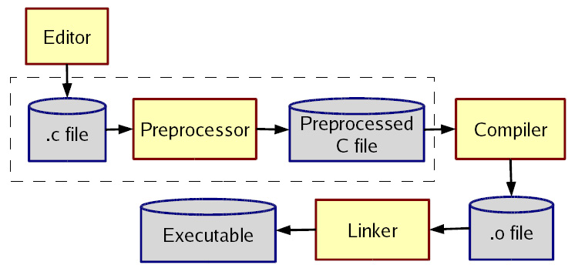
The compilation picture
gcc does all this for you (reminder)
-E to only preprocess; result on stdout (rare)
-c to stop with .o (common for individual files in larger program)

Slide 5
More about multiple files
Typical usage:
Preprocessor #include to read file containing declarations describing code
Linker handles your .o files and other code
By default, the “standard C library”
Other .o and .a files
Whole lecture on linking and libraries later…

Slide 6
The preprocessor
Rewrites your .c file before the compiler gets at the code.
Lines starting with # tell it what to do
Can do crazy things (please don’t); uncrazy things are:
Including contents of header files
Defining constants and parameterized macros
Token-based, but basically textual replacement
Easy to misdefine and misuse
Conditional compilation
Include/exclude part of a file
Example uses: code for debugging, code for particular computers (handling portability issues), “the trick” for including header files only once

Slide 7
File inclusion (review)
#include <hdr.h>
Search for file hdr.h in “standard include directories” and include its contents in this place
Typically lots of nested includes, result not fit for human consumption
Idea is simple: declaration of standard library routines are in headers; allows correct use after declaration
#include “hdr.h”
Same, but first look in current directory
How to break your program into smaller files that can call routines in other files
gcc -I option: look first in specified directories for headers (keep paths out of your code files) (not needed for 374)

Slide 8
Header file conventions
Conventions: always follow these when writing a header file
Give included files names ending in .h; only include these header files. Never #include a .c source file
Do not put functions definitions in a header file; only struct definitions, prototypes (declarations), and other includes
Do all your #includes at the beginning of a file
For header file foo.h start it with:
#ifndef FOO_H
#define FOO_H
and end it with:
#endif
(We will learn why very soon)

Slide 9
Simple macros (review)
Symbolic constants and other text
#define NOT_PI 22/7
#define VERSION 3.14
#define FEET_PER_MILE 5280
#define MAX_LINE_SIZE 5000
Replaces all matching tokens in rest of file
Knows where “words” start and end (unlike sed)
Has no notion of scope (unlike C compiler)
(Rare: can shadow with another #define or use #undef to remove)

Slide 10
Macros with parameters
#define TWICE_AWFUL(x) x*2
#define TWICE_BAD(x) ((x)+(x))
#define TWICE_OK(x) ((x)*2)
double twice(double x) { return x+x; } // best (editorial opinion)
Replace all matching “calls” with “body” but with text of arguments where the parameters are (just string substitution)
Gotchas (understand why!):
y=3; z=4; w=TWICE_AWFUL(y+z);
y=7; z=TWICE_BAD(++y); z=TWICE_BAD(y++);
Common misperception: Macros avoid performance overhead of a function call (maybe true in 1975, not now)
Macros can be more flexible though (TWICE_OK works on ints and doubles without conversions (which could round))

Slide 11
Justifiable uses
Parameterized macros are generally to be avoided (use functions), but there are things functions cannot do:
#define NEW_T(t,howmany) ((t*)malloc((howmany)*sizeof(t))
#define PRINT(x) printf("%s:%d %s\n", __FILE__, __LINE__,x)

Slide 12
Conditional compilation
#ifdef FOO (matching #endif later in file)
#ifndef FOO (matching #endif later in file)
#if FOO > 2 (matching #endif later in file)
(You can also have a #else inbetween somewhere.)
Simple use: #ifdef DEBUG // do following only when debugging
printf(...);
#endif
Fancier: #ifdef DEBUG // use DBG_PRINT for debug-printing
#define DBG_PRINT(x) printf("%s",x)
#else
#define DBG_PRINT(x) // replace with nothing
#endif
Note: gcc -D FOO makes FOO “defined”

Slide 13
Back to header files
Now we know what this means:
#ifndef SOME_HEADER_H
#define SOME_HEADER_H
... rest of some_header.h ...
#endif
Assuming nobody else defines SOME_HEADER_H (convention), the first #include "some_header.h" will do the define and include the rest of the file, but the second and later will skip everything
More efficient than copying the prototypes over and over again
In presence of circular includes, necessary to avoid “creating” an infinitely large result of preprocessing
So we always do this

Slide 14
C preprocessor summary
A few easy to abuse features and a bunch of conventions (for overcoming C’s limitations).
#include (the way you say what other definitions you need; cycles are fine with “the trick”)
#define (avoids magic constants; parameterized macros have a few justifiable uses; token-based text replacement)
#if... (for showing the compiler less code)

