Slide 1
Lecture 4: Asymptotic Analysis
Please log onto https://edstem.org/us/courses/21257/discussion/1354458 to submit live lecture questions
Please log onto PollEv.com/champk to answer the daily lecture participation question
CSE 373: Data Structures and Algorithms

Slide 2
Design Decisions
Situation #1: Write a data structure that implements the List ADT that will be used to store a list of songs in a playlist.
ArrayList – optimize for the ability to shuffle play on the playlist
LinkedList - optimize for adding/removing/changing order of songs
Situation #2: Write a data structure that implements the List ADT that will be used to store the history of a bank customer’s transactions.
ArrayList – optimize for accessing of elements and adding to back
LinkedList - if structured backwards, could optimize for addition to front
Situation #3: Write a data structure that implements the List ADT that will be used to store the order of students waiting to speak to a TA at a tutoring center
LinkedList - optimize for removal from front
ArrayList – optimize for addition to back

Slide 3
Announcements
Course website live with slides
HW 0 – 143 Review Project
Live on website
Due Wednesday April 6th

Slide 4
Questions?

Slide 5
Two more ADTs: Stacks and Queues

Slide 6
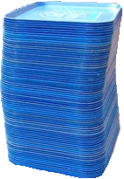
Review: What is a Stack?
stack: A collection based on the principle of adding elements and retrieving them in the opposite order.
Last-In, First-Out ("LIFO")
Elements are stored in order of insertion.
We do not think of them as having indexes.
Client can only add/remove/examine the last element added (the "top").
push
pop, peek
top | 3
 | 2
bottom | 1
Stack ADT
state
supported operations:
push(item): Add an element to the top of stack
pop(): Remove the top element and returns it
peek(): Examine the top element without removing it
size(): how many items are in the stack?
isEmpty(): true if there are 1 or more items in stack, false otherwise
Set of ordered items
Number of items
behavior
push(item) add item to top
pop() return and remove item at top
peek() look at item at top
size() count of items
isEmpty() count of items is 0?

Slide 7
Implementing a Stack with an Array
Stack ADT
ArrayStack<E>
Big O Analysis
pop()
peek()
size()
isEmpty()
push()
state
state
O(1) Constant
Set of ordered items
Number of items
data[]
size
O(1) Constant
behavior
behavior
push(item) add item to top
pop() return and remove item at top
peek() look at item at top
size() count of items
isEmpty() count of items is 0?
push data[size] = value, if out of room grow data
pop return data[size - 1], size-1
peek return data[size - 1]
size return size
isEmpty return size == 0
O(1) Constant
O(1) Constant
O(N) linear if you have to resize O(1) otherwise
push(3)
0 | 1 | 2 | 3
push(4)
3
4
5
pop()
2
0
push(5)
numberOfItems =
1

Slide 8
Implementing a Stack with Nodes
Stack ADT
LinkedStack<E>
Big O Analysis
pop()
peek()
size()
isEmpty()
push()
state
state
O(1) Constant
Set of ordered items
Number of items
Node top
size
O(1) Constant
behavior
behavior
push(item) add item to top
pop() return and remove item at top
peek() look at item at top
size() count of items
isEmpty() count of items is 0?
push add new node at top
pop return and remove node at top
peek return node at top
size return size
isEmpty return size == 0
O(1) Constant
O(1) Constant
O(1) Constant
4
push(3)
front
3
push(4)
pop()
numberOfItems =
1
0
2

Slide 9
Real-World Scenarios - Stacks
Undo/Redo Feature in editing software
DNA Parsing Implementation
https://www.nature.com/articles/s41467-021-25023-6
stack is able to record combinations of two different DNA signals, release the signals into solution in reverse order, and then re-record
social implications + ethical concerns?
accuracy limits
performance of stack dependent on efficiency of “washing steps” between stack operations
what if certain DNA needs more stack operations to parse than other? what kind of inequalities can this create between more common and more rare DNA? what are some social consequences of using a stack for DNA sequencing?

Slide 10
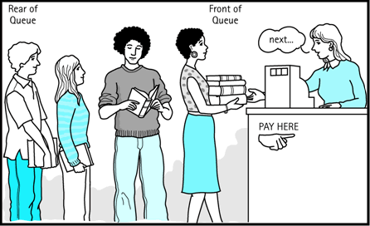
Review: What is a Queue?
queue: Retrieves elements in the order they were added.
First-In, First-Out ("FIFO")
Elements are stored in order of insertion but don't have indexes.
Client can only add to the end of the queue, and can only examine/remove the front of the queue.
Queue ADT
front |  | back
1 | 2 | 3
remove, peek
add
state
Set of ordered items
Number of items
behavior
supported operations:
add(item): aka “enqueue” add an element to the back.
remove(): aka “dequeue” Remove the front element and return.
peek(): Examine the front element without removing it.
size(): how many items are stored in the queue?
isEmpty(): if 1 or more items in the queue returns true, false otherwise
add(item) add item to back
remove() remove and return item at front
peek() return item at front
size() count of items
isEmpty() count of items is 0?

Slide 11
Implementing a Queue with an Array
Queue ADT
ArrayQueue<E>
Big O Analysis
remove()
peek()
size()
isEmpty()
add()
state
state
O(1) Constant
Set of ordered items
Number of items
data[]
Size
front index
back index
O(1) Constant
behavior
add(item) add item to back
remove() remove and return item at front
peek() return item at front
size() count of items
isEmpty() count of items is 0?
O(1) Constant
behavior
add – data[size] = value, if out of room grow data
remove – return data[size - 1], size-1
peek – return data[size - 1]
size – return size
isEmpty – return size == 0
O(1) Constant
O(N) linear if you have to resize O(1) otherwise
0 | 1 | 2 | 3 | 4
add(5)
5
8
9
add(8)
1
2
numberOfItems =
3
add(9)
0
1
remove()
front = 0
back = 0
2
1
Notes:
Spend rest of class implementing queue – do we need to address circular queues?

Slide 12
Implementing a Queue with an Array
> Wrapping Around
add(7)
front
back
add(4)
0 | 1 | 2 | 3 | 4
add(1)
4
5
9
2
7
front
5
3
back
numberOfItems =
4
0 | 1 | 2 | 3 | 4 | 5 | 6 | 7 | 8 | 9
5 | 9 | 2 | 7 | 4
1

Slide 13
Implementing a Queue with Nodes
Queue ADT
LinkedQueue<E>
Big O Analysis
remove()
peek()
size()
isEmpty()
add()
state
state
O(1) Constant
Set of ordered items
Number of items
Node front
Node back
size
O(1) Constant
behavior
add(item) add item to back
remove() remove and return item at front
peek() return item at front
size() count of items
isEmpty() count of items is 0?
O(1) Constant
behavior
add – add node to back
remove – return and remove node at front
peek – return node at front
size – return size
isEmpty – return size == 0
O(1) Constant
O(1) Constant
numberOfItems =
0
2
1
add(5)
add(8)
remove()
front
5
8
back
Notes:
Spend rest of class implementing queue – do we need to address circular queues?

Slide 14
Real-World Examples
Serving requests on a single shared resource
e.g. a printer, CPU task scheduling, etc.
Call Center phone systems use Queues to hold people calling them in order, until a service representative is free.
Handling of interrupts in real-time systems. The interrupts are handled in the same order as they arrive i.e First come first served.

Slide 15
Design Decisions
Activity: Talk to those around you!
Discuss with your neighbors: For the following scenario select the appropriate ADT and implementation and explain why they are optimal for this situation.
Situation: You are writing a program to schedule jobs sent to a laser printer. The laser printer should process these jobs in the order in which the requests were received. There are busy and slow times for requests that can have large differences in the volume of jobs sent to the printer. Which ADT and what implementation would you use to store the jobs sent to the printer?
Kasey’s Answer
LinkedQueue
This will maintain the original order of the print jobs, but allow you to easily cancel jobs stuck in the middle of the queue. This will also keep the space used by the queue at the minimum required levels despite the fact the queue will have very different lengths at different times.
ADT options:
List
Stack
Queue
Implementation options:
array
linked nodes

Slide 16
Dictionaries

Slide 17
Dictionaries (aka Maps)
Every Programmer’s Best Friend
You’ll probably use one in almost every programming project.
Because it’s hard to make a big project without needing one sooner or later.
// two types of Map implementations supposedly covered in CSE 143
Map<String, Integer> map1 = new HashMap<>();
Map<String, String> map2 = new TreeMap<>();

Slide 18
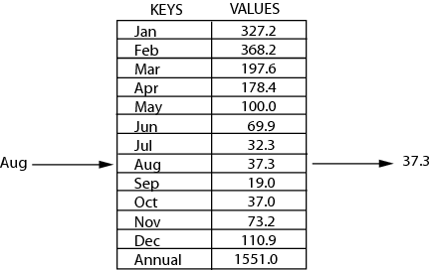
Review: Maps
key | value
“at" | 43
key | value
“in" | 37
key | value
“you" | 22
map: Holds a set of distinct keys and a collection of values, where each key is associated with one value.
a.k.a. "dictionary"
key | value
“the" | 56
map.get("the")
56
Dictionary ADT
supported operations:
put(key, value): Adds a given item into collection with associated key,
if the map previously had a mapping for the given key, old value is replaced.
get(key): Retrieves the value mapped to the key
containsKey(key): returns true if key is already associated with value in map, false otherwise
remove(key): Removes the given key and its mapped value
state
Set of items & keys
Count of items
behavior
put(key, item) add item to collection indexed with key
get(key) return item associated with key
containsKey(key) return if key already in use
remove(key) remove item and associated key
size() return count of items

Slide 19
Implementing a Dictionary with an Array
Big O Analysis –
(if key is the last one looked at / not in the dictionary)
put()
get()
containsKey()
remove()
size()
Dictionary ADT
ArrayDictionary<K, V>
O(N) linear
state
state
O(N) linear
Set of items & keys
Count of items
Pair<K, V>[] data
O(N) linear
behavior
behavior
put find key, overwrite value if there. Otherwise create new pair, add to next available spot, grow array if necessary
get scan all pairs looking for given key, return associated item if found
containsKey scan all pairs, return if key is found
remove scan all pairs, replace pair to be removed with last pair in collection
size return count of items in dictionary
O(N) linear
put(key, item) add item to collection indexed with key
get(key) return item associated with key
containsKey(key) return if key already in use
remove(key) remove item and associated key
size() return count of items
O(1) constant
Big O Analysis –
(if the key is the first one looked at)
put()
get()
containsKey()
remove()
size()
O(1) constant
O(1) constant
O(1) constant
containsKey(‘c’)
get(‘d’)
put(‘b’, 97)
put(‘e’, 20)
O(1) constant
0 | 1 | 2 | 3
4
O(1) constant
(‘a’, 1)
(‘b’, 2)
(‘c’, 3)
(‘d’, 4)
(‘e’, 20)
97)

Slide 20
Implementing a Dictionary with Nodes
Big O Analysis –
(if key is the last one looked at / not in the dictionary)
put()
get()
containsKey()
remove()
size()
Dictionary ADT
LinkedDictionary<K, V>
O(N) linear
state
state
O(N) linear
Set of items & keys
Count of items
front
size
behavior
O(N) linear
behavior
put(key, item) add item to collection indexed with key
get(key) return item associated with key
containsKey(key) return if key already in use
remove(key) remove item and associated key
size() return count of items
put if key is unused, create new with pair, add to front of list, else replace with new value
get scan all pairs looking for given key, return associated item if found
containsKey scan all pairs, return if key is found
remove scan all pairs, skip pair to be removed
size return count of items in dictionary
O(N) linear
O(1) constant
Big O Analysis –
(if the key is the first one looked at)
put()
get()
containsKey()
remove()
size()
O(1) constant
O(1) constant
containsKey(‘c’)
get(‘d’)
put(‘b’, 20)
front
O(1) constant
O(1) constant
O(1) constant
‘b’
20
‘a’
1
7
‘c’
9
‘d’
4

Slide 21
Big O

Slide 22
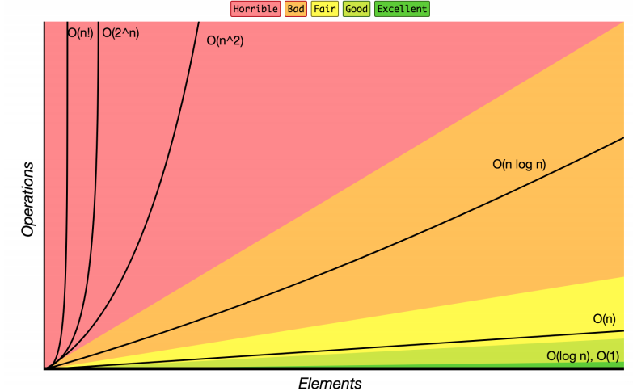
Review: Complexity Class
Note: You don’t have to understand all of this right now – we’ll dive into it soon.
complexity class: A category of algorithm efficiency based on the algorithm's relationship to the input size N.
Complexity Class | Big-O | Runtime if you double N | Example Algorithm
constant | O(1) | unchanged | Accessing an index of an array
logarithmic | O(log₂ N) | increases slightly | Binary search
linear | O(N) | doubles | Looping over an array
log-linear | O(N log₂ N) | slightly more than doubles | Merge sort algorithm
quadratic | O(N²) | quadruples | Nested loops!
... | ... | ... | ...
exponential | O(2^{N}) | multiplies drastically | Fibonacci with recursion

Slide 23
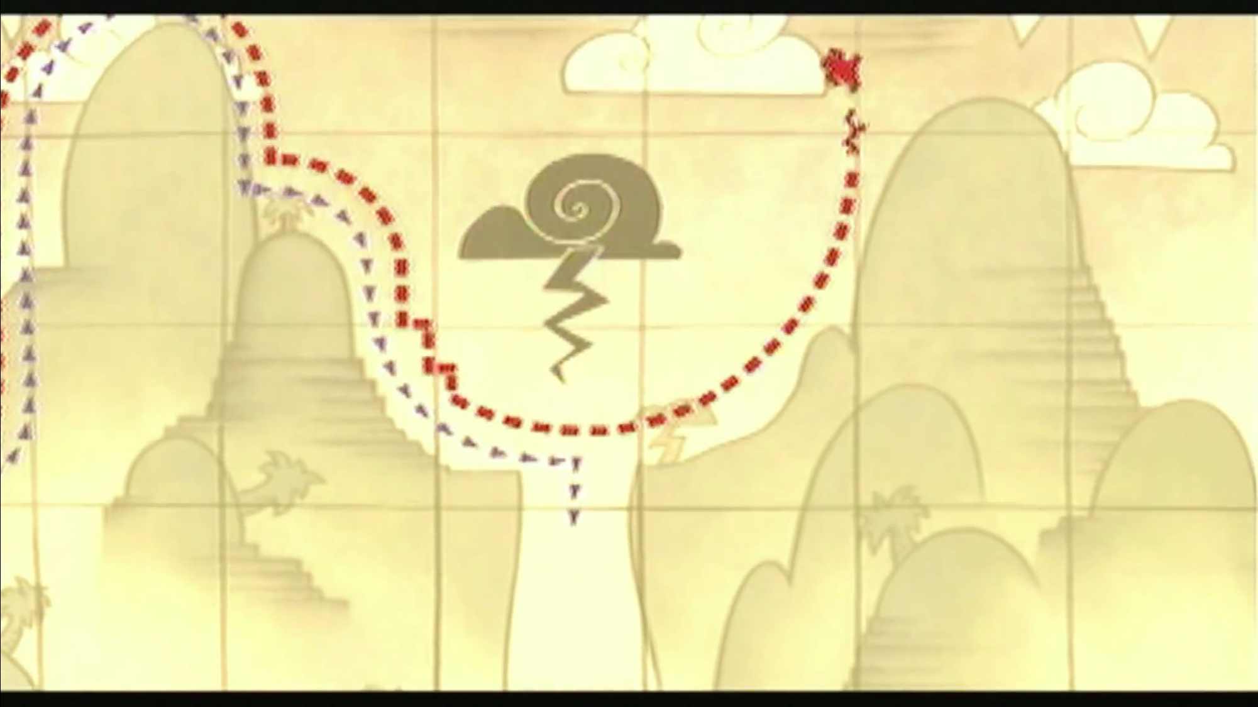
Code to Big-Oh
CODE
BIG-OH
?
for (i = 0; i < n; i++) {
a[i] = 1;
b[i] = 2;
}
O(n)
143 general patterns: “O(1) constant is no loops, O(n) is one loop, O(n²) is nested loops”
This is still useful!
But in 373 we’ll go much more in depth: we can explain more about why, and how to handle more complex cases when they arise (which they will!)

Slide 24
Meet Algorithmic Analysis
1
2
CODE
RUNTIME
FUNCTION
COMPLEXITY
CLASS
Code Modeling
Asymptotic Analysis
for (i = 0; i < n; i++) {
a[i] = 1;
b[i] = 2;
}
f(n) = 2n
O(n)
Algorithmic Analysis: The overall process of characterizing code with a complexity class, consisting of:
Code Modeling: Code 🡪 Function describing code’s runtime
Asymptotic Analysis: Function 🡪 Complexity class describing asymptotic behavior

Slide 25
Code Modeling
1
CODE
RUNTIME
FUNCTION
Code Modeling
Code Modeling – the process of mathematically representing how many operations a piece of code will run in relation to the input size n.
Convert from code to a function representing its runtime

Slide 26
What Counts?
We don’t know exact runtime of every operation, but for now let’s try simplifying assumption: all basic operations take the same time
Basics:
+, -, /, *, %, ==
Assignment
Returning
Variable/array access
Function Calls
Total runtime in body
Remember: new calls a function (constructor)
Conditionals
Test + time for the followed branch
Learn how to reason about branch later
Loops
Number of iterations * total runtime in condition and body

Slide 27
Code Modeling Example 1
public void method1(int n) {
int sum = 0;
int i = 0;
while (i < n) {
sum = sum + (i * 3);
i = i + 1;
}
return sum;
}
+1
+1
+1
Loop runs n times
+3
+6
*n
+2
+1
f(n) = 6n + 3

Slide 28
Code Modeling Example 2
You try!
f(n) = (9n+4)n + 3
public void method2(int n) {
int sum = 0;
int i = 0;
while (i < n) {
int j = 0;
while (j < n) {
if (j % 2 == 0) {
// do nothing
}
sum = sum + (i * 3) + j;
j = j + 1;
}
i = i + 1;
} return sum;
}
+1
+1
+1
+1
+1
This outer loop
runs n times
This inner loop
runs n times
+2
9n + 4
*n
+9
*n
+4
+2
+2
+1

Slide 29
Where are we?
1
2
CODE
RUNTIME
FUNCTION
COMPLEXITY
CLASS
Code Modeling
Asymptotic Analysis
for (i = 0; i < n; i++) {
a[i] = 1;
b[i] = 2;
}
f(n) = 2n
O(n)
We just turned a piece of code into a function!
We’ll look at better alternatives for code modeling later
Now to focus on step 2, asymptotic analysis

Slide 30
Finding a Big Oh
2
RUNTIME
FUNCTION
COMPLEXITY
CLASS
Asymptotic Analysis
f(n) = (9n+3)n + 3
= 9n² + 3n + 3
≈ 9n²
≈ n²
f(n) is O(n²)

Slide 31
Can we really throw away all that info?
Big-Oh is like the “significant digits” of computer science
Asymptotic Analysis: Analysis of function behavior as its input approaches infinity
We only care about what happens when n approaches infinity
For small inputs, doesn’t really matter: all code is “fast enough”
Since we’re dealing with infinity, constants and lower-order terms don’t meaningfully add to the final result. The highest-order term is what drives growth!
Remember our goals:
Simple
We don’t care about tiny differences in implementation, want the big picture result
Decisive
Produce a clear comparison indicating which code takes “longer”
1.
2.

Slide 32
Function growth
Imagine you have three possible algorithms to choose between.
Each has already been reduced to its mathematical model
The growth rate for f(n) and g(n) looks very different for small numbers of input
…but since both are linear eventually look similar at large input sizes
But for very small input values h(n) actually has a slower growth rate than either f(n) or g(n)
whereas h(n) has a distinctly different growth rate

Slide 33
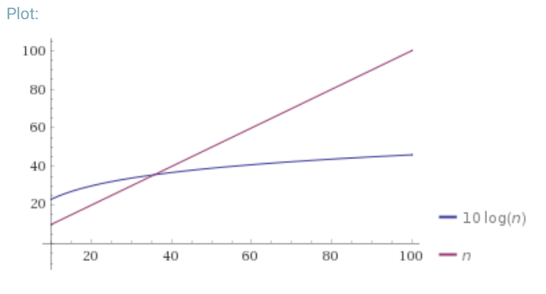
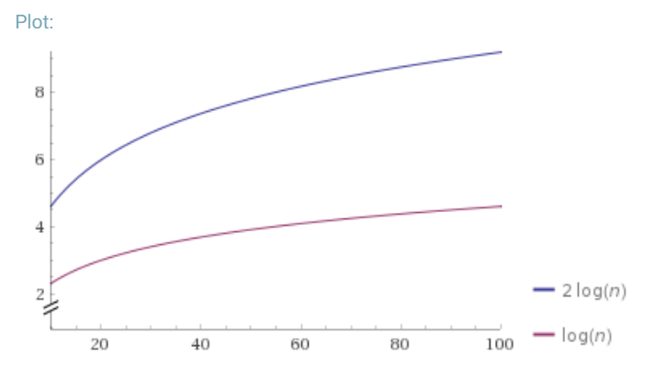
Definition: Big-O
Big-O

Slide 34
Questions?

