Slide 1
Lecture 3: Design Tradeoffs
Please log onto https://edstem.org/us/courses/21257/discussion/1336583 to submit live lecture questions
Please log onto PollEv.com/champk to answer the daily lecture participation question
CSE 373: Data Structures and Algorithms

Slide 2
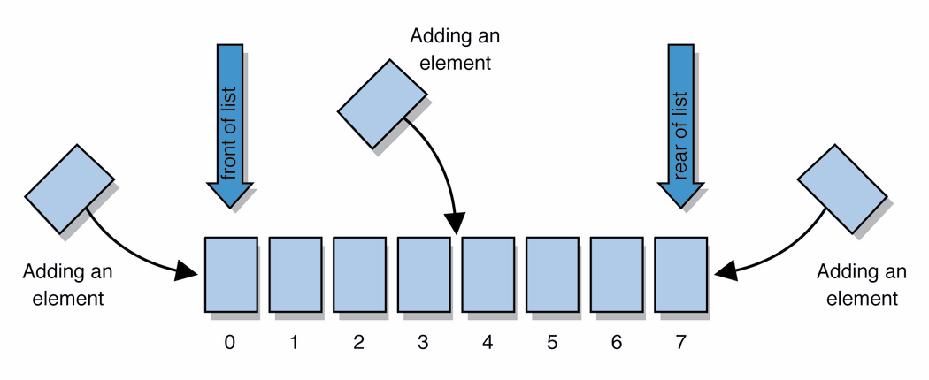
Warm Up
Please fill out the Poll at- pollev.com/champk
Q: Would you use a LinkedList or ArrayList implementation for each of these scenarios?
ArrayList
uses an Array as underlying storage
LinkedList
uses nodes as underlying storage
Situation #1: Choose a data structure that implements the List ADT that will be used to store a list of songs in a playlist.
Situation #2: Choose a data structure that implements the List ADT that will be used to store the history of a bank customer’s transactions.
Situation #3: Choose a data structure that implements the List ADT that will be used to store the order of students waiting to speak to a TA at a tutoring center
ArrayList
LinkedList
state
state
data[]
size
Node front
size
behavior
behavior
get return data[index]
set data[index] = value
add data[size] = value, if out of space grow data
insert shift values to make hole at index, data[index] = value, if out of space grow data
delete shift following values forward
size return size
get loop until index, return node’s value
set loop until index, update node’s value
add create new node, update next of last node
insert create new node, loop until index, update next fields
delete loop until index, skip node
size return size
List ADT
state
Set of ordered items
Count of items
behavior
get(index) return item at index
set(item, index) replace item at index
append(item) add item to end of list
insert(item, index) add item at index
delete(index) delete item at index
size() count of items
0 | 1 | 2 | 3 | 4
88.6 | 26.1 | 94.4 | 0 | 0
88.6
26.1
94.4
list
free space

Slide 3
Announcements
Course website live with slides
HW 0 – 143 Review Project
Live on website
Due Wednesday

Slide 4
Design Decisions
For every ADT there are lots of different ways to implement them
Based on your situation you should consider:
Memory vs Speed
Generic/Reusability vs Specific/Specialized
One Function vs Another
Robustness vs Performance
This class is all about implementing ADTs based on making the right design tradeoffs!
> A common topic in interview questions

Slide 5
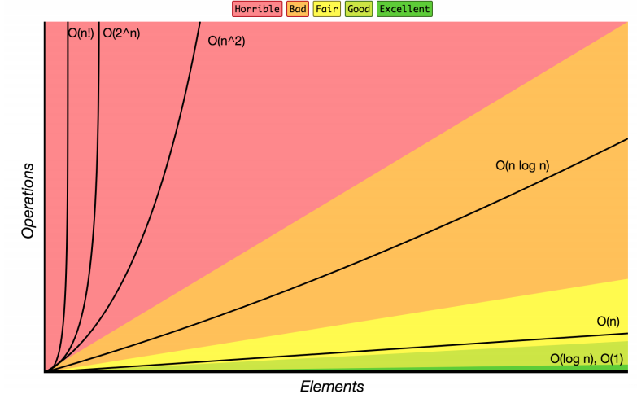
Review: Complexity Class
Note: You don’t have to understand all of this right now – we’ll dive into it soon.
complexity class: A category of algorithm efficiency based on the algorithm's relationship to the input size N.
Complexity Class | Big-O | Runtime if you double N | Example Algorithm
constant | O(1) | unchanged | Accessing an index of an array
logarithmic | O(log₂ N) | increases slightly | Binary search
linear | O(N) | doubles | Looping over an array
log-linear | O(N log₂ N) | slightly more than doubles | Merge sort algorithm
quadratic | O(N²) | quadruples | Nested loops!
... | ... | ... | ...
exponential | O(2^{N}) | multiplies drastically | Fibonacci with recursion

Slide 6
List ADT Design Tradeoffs
Recall these basic Big-O ideas from 14X: Suppose our list has N elements
-If a method takes a constant number of steps (like 23 or 5) its running time is O(1)
-If a method takes a linear number of steps (like 4N+3) its running time is O(N)
For ArrayLists and LinkedLists, what is the O() for each of these operations?
-Time needed to access N^th element:
-Time needed to insert at end (the array is full!)
What are the memory tradeoffs for our two implementations?
-Amount of space used overall
-Amount of space used per element
Time needed to access N^th element:
-ArrayList: O(1) constant time
-LinkedList: O(N) linear time
Time needed to insert at N^th element (the array is full!)
-ArrayList: O(N) linear time
-LinkedList: O(N) linear time
Amount of space used overall
-ArrayList: sometimes wasted space
-LinkedList: compact
Amount of space used per element
-ArrayList: minimal
-LinkedList: tiny extra

Slide 7
Real-World Scenarios - Lists
LinkedList
Image viewer - Previous and next images are linked, hence can be accessed by next and previous button
Dynamic memory allocation - We use linked list of free blocks
Implementations of other ADTs such as Stacks, Queues, Graphs, etc.
ArrayList
Maintaining Database Records - List of records you want to add / delete from and maintain your order after
Music Player – Songs in music player are linked to previous and next song. you can play songs either from starting or ending of the list

Slide 8
Design Decisions
Situation #1: Write a data structure that implements the List ADT that will be used to store a list of songs in a playlist.
ArrayList – optimize for the ability to shuffle play on the playlist
LinkedList - optimize for adding/removing/changing order of songs
Situation #2: Write a data structure that implements the List ADT that will be used to store the history of a bank customer’s transactions.
ArrayList – optimize for accessing of elements and adding to back
LinkedList - if structured backwards, could optimize for addition to front
Situation #3: Write a data structure that implements the List ADT that will be used to store the order of students waiting to speak to a TA at a tutoring center
LinkedList - optimize for removal from front
ArrayList – optimize for addition to back

Slide 9
Questions?

Slide 10
Two more ADTs: Stacks and Queues

Slide 11
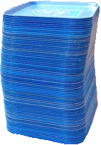
Review: What is a Stack?
stack: A collection based on the principle of adding elements and retrieving them in the opposite order.
Last-In, First-Out ("LIFO")
Elements are stored in order of insertion.
We do not think of them as having indexes.
Client can only add/remove/examine the last element added (the "top").
push
pop, peek
top | 3
 | 2
bottom | 1
Stack ADT
state
supported operations:
push(item): Add an element to the top of stack
pop(): Remove the top element and returns it
peek(): Examine the top element without removing it
size(): how many items are in the stack?
isEmpty(): true if there are 1 or more items in stack, false otherwise
Set of ordered items
Number of items
behavior
push(item) add item to top
pop() return and remove item at top
peek() look at item at top
size() count of items
isEmpty() count of items is 0?

Slide 12
Implementing a Stack with an Array
Stack ADT
ArrayStack<E>
Big O Analysis
pop()
peek()
size()
isEmpty()
push()
state
state
O(1) Constant
Set of ordered items
Number of items
data[]
size
O(1) Constant
behavior
behavior
push(item) add item to top
pop() return and remove item at top
peek() look at item at top
size() count of items
isEmpty() count of items is 0?
push data[size] = value, if out of room grow data
pop return data[size - 1], size-1
peek return data[size - 1]
size return size
isEmpty return size == 0
O(1) Constant
O(1) Constant
O(N) linear if you have to resize O(1) otherwise
push(3)
0 | 1 | 2 | 3
Take 1 min to respond to activity
push(4)
3
4
5
pop()
www.pollev.com/cse373activity
What do you think the worst possible runtime of the “push()” operation will be?
2
0
push(5)
numberOfItems =
1

Slide 13
Implementing a Stack with Nodes
Stack ADT
LinkedStack<E>
Big O Analysis
pop()
peek()
size()
isEmpty()
push()
state
state
O(1) Constant
Set of ordered items
Number of items
Node top
size
O(1) Constant
behavior
behavior
push(item) add item to top
pop() return and remove item at top
peek() look at item at top
size() count of items
isEmpty() count of items is 0?
push add new node at top
pop return and remove node at top
peek return node at top
size return size
isEmpty return size == 0
O(1) Constant
O(1) Constant
O(1) Constant
4
Take 1 min to respond to activity
push(3)
front
3
www.pollev.com/cse373activity
What do you think the worst possible runtime of the “push()” operation will be?
push(4)
pop()
numberOfItems =
1
0
2

Slide 14
Real-World Scenarios - Stacks
Undo/Redo Feature in editing software
DNA Parsing Implementation
https://www.nature.com/articles/s41467-021-25023-6
stack is able to record combinations of two different DNA signals, release the signals into solution in reverse order, and then re-record
social implications + ethical concerns?
accuracy limits
performance of stack dependent on efficiency of “washing steps” between stack operations
what if certain DNA needs more stack operations to parse than other? what kind of inequalities can this create between more common and more rare DNA? what are some social consequences of using a stack for DNA sequencing?

Slide 15
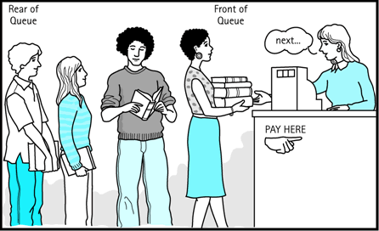
Review: What is a Queue?
queue: Retrieves elements in the order they were added.
First-In, First-Out ("FIFO")
Elements are stored in order of insertion but don't have indexes.
Client can only add to the end of the queue, and can only examine/remove the front of the queue.
Queue ADT
front |  | back
1 | 2 | 3
remove, peek
add
state
Set of ordered items
Number of items
behavior
supported operations:
add(item): aka “enqueue” add an element to the back.
remove(): aka “dequeue” Remove the front element and return.
peek(): Examine the front element without removing it.
size(): how many items are stored in the queue?
isEmpty(): if 1 or more items in the queue returns true, false otherwise
add(item) add item to back
remove() remove and return item at front
peek() return item at front
size() count of items
isEmpty() count of items is 0?

Slide 16
Implementing a Queue with an Array
Queue ADT
ArrayQueue<E>
Big O Analysis
remove()
peek()
size()
isEmpty()
add()
state
state
O(1) Constant
Set of ordered items
Number of items
data[]
Size
front index
back index
O(1) Constant
behavior
add(item) add item to back
remove() remove and return item at front
peek() return item at front
size() count of items
isEmpty() count of items is 0?
O(1) Constant
behavior
add – data[size] = value, if out of room grow data
remove – return data[size - 1], size-1
peek – return data[size - 1]
size – return size
isEmpty – return size == 0
O(1) Constant
O(N) linear if you have to resize O(1) otherwise
0 | 1 | 2 | 3 | 4
add(5)
5
8
9
add(8)
1
2
numberOfItems =
3
add(9)
0
1
remove()
front = 0
back = 0
2
1
Notes:
Spend rest of class implementing queue – do we need to address circular queues?

Slide 17
Implementing a Queue with an Array
> Wrapping Around
add(7)
front
back
add(4)
0 | 1 | 2 | 3 | 4
add(1)
4
5
9
2
7
front
5
3
back
numberOfItems =
4
0 | 1 | 2 | 3 | 4 | 5 | 6 | 7 | 8 | 9
5 | 9 | 2 | 7 | 4
1

Slide 18
Implementing a Queue with Nodes
Queue ADT
LinkedQueue<E>
Big O Analysis
remove()
peek()
size()
isEmpty()
add()
state
state
O(1) Constant
Set of ordered items
Number of items
Node front
Node back
size
O(1) Constant
behavior
add(item) add item to back
remove() remove and return item at front
peek() return item at front
size() count of items
isEmpty() count of items is 0?
O(1) Constant
behavior
add – add node to back
remove – return and remove node at front
peek – return node at front
size – return size
isEmpty – return size == 0
O(1) Constant
O(1) Constant
numberOfItems =
Take 1 min to respond to activity
0
2
1
add(5)
add(8)
remove()
www.pollev.com/cse373activity
What do you think the worst case runtime of the “add()” operation will be?
front
5
8
back
Notes:
Spend rest of class implementing queue – do we need to address circular queues?

Slide 19
Real-World Examples
Serving requests on a single shared resource
e.g. a printer, CPU task scheduling, etc.
Call Center phone systems use Queues to hold people calling them in order, until a service representative is free.
Handling of interrupts in real-time systems. The interrupts are handled in the same order as they arrive i.e First come first served.

Slide 20
Design Decisions
Activity: Talk to those around you!
Discuss with your neighbors: For the following scenario select the appropriate ADT and implementation and explain why they are optimal for this situation.
Situation: You are writing a program to schedule jobs sent to a laser printer. The laser printer should process these jobs in the order in which the requests were received. There are busy and slow times for requests that can have large differences in the volume of jobs sent to the printer. Which ADT and what implementation would you use to store the jobs sent to the printer?
Kasey’s Answer
LinkedQueue
This will maintain the original order of the print jobs, but allow you to easily cancel jobs stuck in the middle of the queue. This will also keep the space used by the queue at the minimum required levels despite the fact the queue will have very different lengths at different times.
ADT options:
List
Stack
Queue
Implementation options:
array
linked nodes

Slide 21
Questions?

Slide 22
Dictionaries

Slide 23
Dictionaries (aka Maps)
Every Programmer’s Best Friend
You’ll probably use one in almost every programming project.
Because it’s hard to make a big project without needing one sooner or later.
// two types of Map implementations supposedly covered in CSE 143
Map<String, Integer> map1 = new HashMap<>();
Map<String, String> map2 = new TreeMap<>();

Slide 24
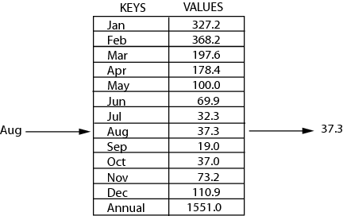
Review: Maps
key | value
“at" | 43
key | value
“in" | 37
key | value
“you" | 22
map: Holds a set of distinct keys and a collection of values, where each key is associated with one value.
a.k.a. "dictionary"
key | value
“the" | 56
map.get("the")
56
Dictionary ADT
supported operations:
put(key, value): Adds a given item into collection with associated key,
if the map previously had a mapping for the given key, old value is replaced.
get(key): Retrieves the value mapped to the key
containsKey(key): returns true if key is already associated with value in map, false otherwise
remove(key): Removes the given key and its mapped value
state
Set of items & keys
Count of items
behavior
put(key, item) add item to collection indexed with key
get(key) return item associated with key
containsKey(key) return if key already in use
remove(key) remove item and associated key
size() return count of items

Slide 25
Implementing a Dictionary with an Array
2 Minutes
Big O Analysis – (if key is the last one looked at / not in the dictionary)
put()
get()
containsKey()
remove()
size()
Dictionary ADT
ArrayDictionary<K, V>
state
state
O(N) linear
Set of items & keys
Count of items
Pair<K, V>[] data
O(N) linear
behavior
behavior
put find key, overwrite value if there. Otherwise create new pair, add to next available spot, grow array if necessary
get scan all pairs looking for given key, return associated item if found
containsKey scan all pairs, return if key is found
remove scan all pairs, replace pair to be removed with last pair in collection
size return count of items in dictionary
O(N) linear
put(key, item) add item to collection indexed with key
get(key) return item associated with key
containsKey(key) return if key already in use
remove(key) remove item and associated key
size() return count of items
O(N) linear
O(1) constant
Big O Analysis – (if the key is the first one looked at)
put()
get()
containsKey()
remove()
size()
O(1) constant
O(1) constant
containsKey(‘c’)
get(‘d’)
put(‘b’, 97)
0 | 1 | 2 | 3
O(1) constant
4
O(1) constant
(‘a’, 1)
(‘b’, 2)
(‘c’, 3)
(‘d’, 4)
(‘e’, 20)
put(‘e’, 20)
97)
O(1) constant

Slide 26
Implementing a Dictionary with Nodes
2 Minutes
Big O Analysis – (if key is the last one looked at / not in the dictionary)
put()
get()
containsKey()
remove()
size()
Dictionary ADT
LinkedDictionary<K, V>
state
state
O(N) linear
Set of items & keys
Count of items
front
size
O(N) linear
behavior
behavior
O(N) linear
put(key, item) add item to collection indexed with key
get(key) return item associated with key
containsKey(key) return if key already in use
remove(key) remove item and associated key
size() return count of items
put if key is unused, create new with pair, add to front of list, else replace with new value
get scan all pairs looking for given key, return associated item if found
containsKey scan all pairs, return if key is found
remove scan all pairs, skip pair to be removed
size return count of items in dictionary
O(N) linear
O(1) constant
Big O Analysis – (if the key is the first one looked at)
put()
get()
containsKey()
remove()
size()
O(1) constant
containsKey(‘c’)
get(‘d’)
put(‘b’, 20)
O(1) constant
front
O(1) constant
O(1) constant
‘b’
20
O(1) constant
‘a’
1
7
‘c’
9
‘d’
4

Slide 27
Real-World Examples
Used for fast data lookups & hashing
Symbol table for compilers
Database indexing
Data stored in databases is generally of the key-value format which is done through hash tables.
Caches
Unique data representation
Every time we type something to be searched in google chrome or other browsers, it generates the desired output based on the principle of hashing
Message Digest
a function of cryptography also uses hashing for creating output in such a manner that reaching to the original input from that generated output is almost next to impossible
Computer File Managing
each file has two very crucial information that is, filename and file path, in order to make a connection between the filename to its corresponding file path hash tables are used

Slide 28
Questions?

