Slide 1
Lecture 2: List and Stacks
Please log onto https://edstem.org/us/courses/21257/discussion/1336583 to submit live lecture questions
Please log onto PollEv.com/champk to answer the daily lecture participation question
CSE 373: Data Structures and Algorithms

Slide 2
Agenda
Dust off data structure cobwebs
List Case Study
Stack Case Study
Notes:
Intros (10)
- Why learn D&A (5) (ZC)
- Meet the course staff (5)
- Lecturers (Each have our own slide)
- TAs (slide with pics and names)
Course Administration (15) (figure out together) X
- syllabus
- remote logistics (trying the breakouts here if not too many students to introduce self to others?)
A note about imposter syndrome (course culture) (5) (KC)
Intro to Data Structures (20)
- Definitions (KC)
- define data structure
- define ADT
- List ADT (ZC)
- ArrayList implementation
- LinkedList implementation

Slide 3
Announcements
Things are live!
course website – one stop for all things 373
Canvas - Calendar + office hours
Ed board – get your course content questions answered + connect with students
Gradescope
HW 0 Assigned – Due Wednesday
143 review

Slide 4
Questions?
Clarification on syllabus, General complaining/moaning

Slide 5
Data Structures and Algorithms
What are they anyway?

Slide 6
Basic Definitions
Data Structure
A way of organizing and storing data
Examples from CSE 14X: arrays, linked lists, stacks, queues, trees
Algorithm
A series of precise instructions to produce to a specific outcome
Examples from CSE 14X: binary search, merge sort, recursive backtracking

Slide 7
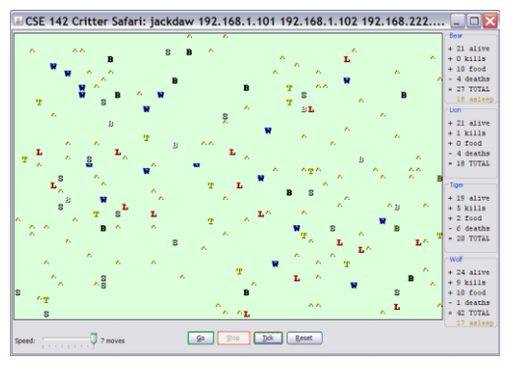
Review: Clients vs Objects
CLIENT CLASSES
OBJECT CLASSES
A class that is executable, in Java this means it contains a Main method
public static void main(String[] args)
A coded structure that contains data and behavior
Start with the data you want to hold, organize the things you want to enable users to do with that data

Slide 8
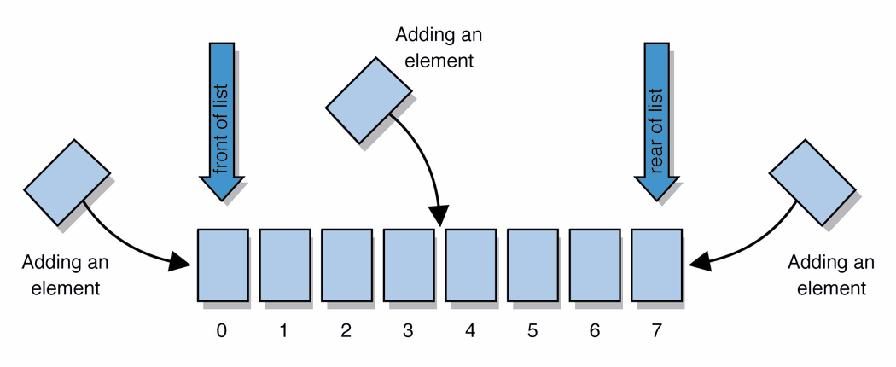
Abstract Data Types (ADT)
Abstract Data Types
An abstract definition for expected operations and behavior
Defines the input and outputs, not the implementations
Review: List - a collection storing an ordered sequence of elements
each element is accessible by a 0-based index
a list has a size (number of elements that have been added)
elements can be added to the front, back, or elsewhere
in Java, a list can be represented as an ArrayList object
Notes:
A way to communicate with other programmers, a standard that we all can agree on so we can discuss conceptual ways of organizing data

Slide 9
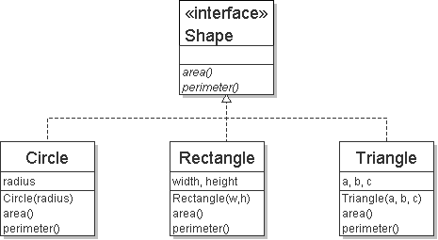
Review: Interfaces
Example
// Describes features common to all // shapes.
public interface Shape {
public double area();
public double perimeter();
}
interface: A construct in Java that defines a set of methods that a class promises to implement
Interfaces give you an is-a relationship without code sharing.
A Rectangle object can be treated as a Shape but inherits no code.
Analogous to non-programming idea of roles or certifications:
"I'm certified as a CPA accountant. This assures you I know how to do taxes, audits, and consulting."
"I'm 'certified' as a Shape, because I implement the Shape interface. This assures you I know how to compute my area and perimeter."
public interface name {
public type name(type name, ..., type name);
public type name(type name, ..., type name);
...
public type name(type name, ..., type name);
}

Slide 10
Review: Java Collections
Java provides some implementations of ADTs for you!
Lists List<Integer> a = new ArrayList<Integer>();
Stacks Stack<Character> c = new Stack<Character>();
Queues Queue<String> b = new LinkedList<String>();
Maps Map<String, String> d = new TreeMap<String, String>();
But some data structures you made from scratch… why?
Linked Lists - LinkedIntList was a collection of ListNode
Binary Search Trees – SearchTree was a collection of SearchTreeNodes
ADTs
Data Structures

Slide 11
Full Definitions
Abstract Data Type (ADT)
A definition for expected operations and behavior
A mathematical description of a collection with a set of supported operations and how they should behave when called upon
Describes what a collection does, not how it does it
Can be expressed as an interface
Examples: List, Map, Set
Data Structure
A way of organizing and storing related data points
An object that implements the functionality of a specified ADT
Describes exactly how the collection will perform the required operations
Examples: LinkedIntList, ArrayIntList

Slide 12
ADTs we’ll discuss this quarter
List
Set
Map
Stack
Queue
Priority Queue
Graph
Disjoint Set

Slide 13
Questions?

Slide 14
Case Study: The List ADT
list: a collection storing an ordered sequence of elements.
Each item is accessible by an index.
A list has a size defined as the number of elements in the list
Expected Behavior:
get(index): returns the item at the given index
set(value, index): sets the item at the given index to the given value
append(value): adds the given item to the end of the list
insert(value, index): insert the given item at the given index maintaining order
delete(index): removes the item at the given index maintaining order
size(): returns the number of elements in the list
List<String> names = new ArrayList<>();
names.add("Anish");
names.add("Amanda");
names.add(0, "Brian");

Slide 15
Case Study: List Implementations
ArrayList
uses an Array as underlying storage
LinkedList
uses nodes as underlying storage
List ADT
ArrayList<E>
LinkedList<E>
state
Set of ordered items
Count of items
state
state
data[]
size
Node front
size
behavior
get(index) return item at index
set(item, index) replace item at index
append(item) add item to end of list
insert(item, index) add item at index
delete(index) delete item at index
size() count of items
behavior
behavior
get return data[index]
set data[index] = value
append data[size] = value, if out of space grow data
insert shift values to make hole at index, data[index] = value, if out of space grow data
delete shift following values forward
size return size
get loop until index, return node’s value
set loop until index, update node’s value
append create new node, update next of last node
insert create new node, loop until index, update next fields
delete loop until index, skip node
size return size
0 | 1 | 2 | 3 | 4
88.6 | 26.1 | 94.4 | 0 | 0
88.6
26.1
94.4
list
free space
Notes:
Code up an implementation of List

Slide 16
Implementing Insert
ArrayList<E>
insert(element, index) with shifting
0 | 1 | 2 | 3
insert(10, 0)
3
4
5
5
10
3
4
3
numberOfItems =
4
LinkedList<E>
insert(element, index) with shifting
insert(10, 0)
10
3
4
5
numberOfItems =
4
3

Slide 17
Implementing Delete
ArrayList<E>
delete(index) with shifting
0 | 1 | 2 | 3
3
4
delete(0)
10
4
5
5
3
numberOfItems =
4
3
LinkedList<E>
delete(index) with shifting
delete(0)
10
3
4
5
numberOfItems =
4
3

Slide 18
Implementing Append
ArrayList<E>
append(element) with growth
0 | 1 | 2 | 3
append(2)
10
3
4
5
numberOfItems =
4
5
0 | 1 | 2 | 3 | 4 | 5 | 6 | 7
10
3
4
5
2
LinkedList<E>
append(element) with growth
append(2)
10
3
4
5
2
numberOfItems =
4
5

Slide 19
Design Decisions
For every ADT there are lots of different ways to implement them
Based on your situation you should consider:
Memory vs Speed
Generic/Reusability vs Specific/Specialized
One Function vs Another
Robustness vs Performance
This class is all about implementing ADTs based on making the right design tradeoffs!
> A common topic in interview questions

Slide 20
Design Decisions
Situation #1: Write a data structure that implements the List ADT that will be used to store a list of songs in a playlist.
ArrayList – optimize for the ability to shuffle play on the playlist
LinkedList - optimize for adding/removing/changing order of songs
Situation #2: Write a data structure that implements the List ADT that will be used to store the history of a bank customer’s transactions.
ArrayList – optimize for accessing of elements and adding to back
LinkedList - if structured backwards, could optimize for addition to front
Situation #3: Write a data structure that implements the List ADT that will be used to store the order of students waiting to speak to a TA at a tutoring center
LinkedList - optimize for removal from front
ArrayList – optimize for addition to back

Slide 21
What is this class about?
CSE 143 – OBJECT ORIENTED PROGRAMMING
CSE 373 – DATA STRUCTURES AND ALGORITHMS
Classes and Interfaces
Methods, variables and conditionals
Loops and recursion
Linked lists and binary trees
Sorting and Searching
O(n) analysis
Generics
Design decisions
Design analysis
Implementations of data structures
Debugging and testing
Abstract Data Types
Code Modeling
Complexity Analysis
Software Engineering Practices

Slide 22
Data Structures and Algorithms
What are they anyway?

Slide 23
Basic Definitions
Data Structure
A way of organizing and storing data
Examples from CSE 14X: arrays, linked lists, stacks, queues, trees
Algorithm
A series of precise instructions to produce to a specific outcome
Examples from CSE 14X: binary search, merge sort, recursive backtracking

Slide 24
Review: Clients vs Objects
CLIENT CLASSES
OBJECT CLASSES
A class that is executable, in Java this means it contains a Main method
public static void main(String[] args)
A coded structure that contains data and behavior
Start with the data you want to hold, organize the things you want to enable users to do with that data

Slide 25
Abstract Data Types (ADT)
Abstract Data Types
An abstract definition for expected operations and behavior
Defines the input and outputs, not the implementations
Review: List - a collection storing an ordered sequence of elements
each element is accessible by a 0-based index
a list has a size (number of elements that have been added)
elements can be added to the front, back, or elsewhere
in Java, a list can be represented as an ArrayList object
Notes:
A way to communicate with other programmers, a standard that we all can agree on so we can discuss conceptual ways of organizing data

Slide 26
Review: Interfaces
Example
// Describes features common to all // shapes.
public interface Shape {
public double area();
public double perimeter();
}
interface: A construct in Java that defines a set of methods that a class promises to implement
Interfaces give you an is-a relationship without code sharing.
A Rectangle object can be treated as a Shape but inherits no code.
Analogous to non-programming idea of roles or certifications:
"I'm certified as a CPA accountant. This assures you I know how to do taxes, audits, and consulting."
"I'm 'certified' as a Shape, because I implement the Shape interface. This assures you I know how to compute my area and perimeter."
public interface name {
public type name(type name, ..., type name);
public type name(type name, ..., type name);
...
public type name(type name, ..., type name);
}

Slide 27
Review: Java Collections
Java provides some implementations of ADTs for you!
Lists List<Integer> a = new ArrayList<Integer>();
Stacks Stack<Character> c = new Stack<Character>();
Queues Queue<String> b = new LinkedList<String>();
Maps Map<String, String> d = new TreeMap<String, String>();
But some data structures you made from scratch… why?
Linked Lists - LinkedIntList was a collection of ListNode
Binary Search Trees – SearchTree was a collection of SearchTreeNodes
ADTs
Data Structures

Slide 28
Full Definitions
Abstract Data Type (ADT)
A definition for expected operations and behavior
A mathematical description of a collection with a set of supported operations and how they should behave when called upon
Describes what a collection does, not how it does it
Can be expressed as an interface
Examples: List, Map, Set
Data Structure
A way of organizing and storing related data points
An object that implements the functionality of a specified ADT
Describes exactly how the collection will perform the required operations
Examples: LinkedIntList, ArrayIntList

Slide 29
ADTs we’ll discuss this quarter
List
Set
Map
Stack
Queue
Priority Queue
Graph
Disjoint Set

Slide 30
Case Study: The List ADT
list: a collection storing an ordered sequence of elements.
Each item is accessible by an index.
A list has a size defined as the number of elements in the list
List<String> names = new ArrayList<>();
names.add("Anish");
names.add("Amanda");
names.add(0, "Brian");
Anish
Amanda
Amanda
Brian
Anish

Slide 31
Case Study: The List ADT
list: a collection storing an ordered sequence of elements.
Each item is accessible by an index.
A list has a size defined as the number of elements in the list
Expected Behavior:
get(index): returns the item at the given index
set(value, index): sets the item at the given index to the given value
append(value): adds the given item to the end of the list
insert(value, index): insert the given item at the given index maintaining order
delete(index): removes the item at the given index maintaining order
size(): returns the number of elements in the list

Slide 32
Case Study: List Implementations
ArrayList
uses an Array as underlying storage
LinkedList
uses nodes as underlying storage
List ADT
ArrayList<E>
LinkedList<E>
state
Set of ordered items
Count of items
state
state
data[]
size
Node front
size
behavior
get(index) return item at index
set(item, index) replace item at index
append(item) add item to end of list
insert(item, index) add item at index
delete(index) delete item at index
size() count of items
behavior
behavior
get return data[index]
set data[index] = value
append data[size] = value, if out of space grow data
insert shift values to make hole at index, data[index] = value, if out of space grow data
delete shift following values forward
size return size
get loop until index, return node’s value
set loop until index, update node’s value
append create new node, update next of last node
insert create new node, loop until index, update next fields
delete loop until index, skip node
size return size
0 | 1 | 2 | 3 | 4
88.6 | 26.1 | 94.4 | 0 | 0
88.6
26.1
94.4
list
free space
Notes:
Code up an implementation of List

Slide 33
Implementing ArrayList
insert(element, index) with shifting
ArrayList<E>
0 | 1 | 2 | 3
state
insert(10, 0)
5
5
3
3
4
5
10
4
3
4
data[]
size
4
behavior
numberOfItems =
3
get return data[index]
set data[index] = value
append data[size] = value, if out of space grow data
insert shift values to make hole at index, data[index] = value, if out of space grow data
delete shift following values forward
size return size
delete(index) with shifting
0 | 1 | 2 | 3
3
3
4
10
4
5
5
delete(0)
3
4
numberOfItems =
4
4
3

Slide 34
Implementing ArrayList
append(element) with growth
ArrayList<E>
0 | 1 | 2 | 3
state
append(2)
10
3
4
5
data[]
size
behavior
get return data[index]
set data[index] = value
append data[size] = value, if out of space grow data
insert shift values to make hole at index, data[index] = value, if out of space grow data
delete shift following values forward
size return size
numberOfItems =
4
5
0 | 1 | 2 | 3 | 4 | 5 | 6 | 7
10
3
4
5
2

Slide 35
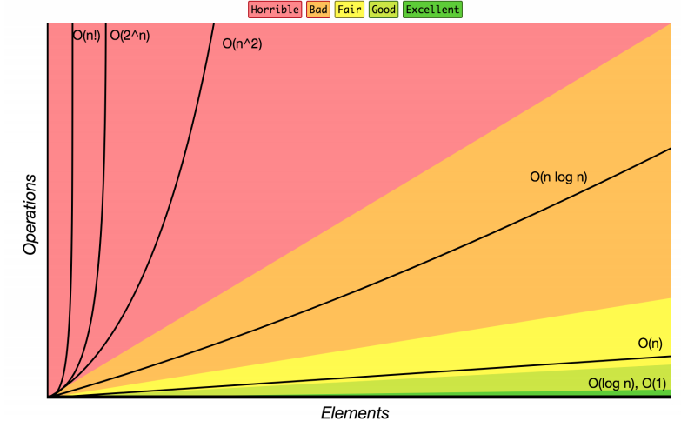
Review: Complexity Class
Note: You don’t have to understand all of this right now – we’ll dive into it soon.
complexity class: A category of algorithm efficiency based on the algorithm's relationship to the input size N.
Complexity Class | Big-O | Runtime if you double N | Example Algorithm
constant | O(1) | unchanged | Accessing an index of an array
logarithmic | O(log₂ N) | increases slightly | Binary search
linear | O(N) | doubles | Looping over an array
log-linear | O(N log₂ N) | slightly more than doubles | Merge sort algorithm
quadratic | O(N²) | quadruples | Nested loops!
... | ... | ... | ...
exponential | O(2^{N}) | multiplies drastically | Fibonacci with recursion

Slide 36
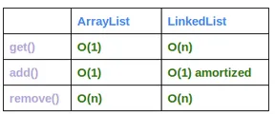
Case Study: List Implementations - Time and Space Complexities
Time
Space
ArrayList - O(n)
LinkedList - O(n)
ArrayList uses “more” memory when there are many resizes
LinkedList uses more memory per element (holding node value, previous link, next link, etc.)
Which would you use if there were many insertions and deletions? What if there wasn’t?
list
free space
Notes:
Code up an implementation of List

Slide 37
Design Decisions
For every ADT there are lots of different ways to implement them
Based on your situation you should consider:
Memory vs Speed
Generic/Reusability vs Specific/Specialized
One Function vs Another
Robustness vs Performance
This class is all about implementing ADTs based on making the right design tradeoffs!
> A common topic in interview questions

Slide 38
Design Decisions
Situation #1: Write a data structure that implements the List ADT that will be used to store a list of songs in a playlist.
ArrayList – I want to be able to shuffle play on the playlist
Situation #2: Write a data structure that implements the List ADT that will be used to store the history of a bank customer’s transactions.
ArrayList – optimize for addition to back and accessing of elements
Situation #3: Write a data structure that implements the List ADT that will be used to store the order of students waiting to speak to a TA at a tutoring center
LinkedList - optimize for removal from front
ArrayList – optimize for addition to back

Slide 39
List ADT tradeoffs
ArrayList<Character> myArr
LinkedList<Character> myLl
0 | 1 | 2 | 3 | 4
‘h’ | ‘e’ | ‘l’ | ‘l’ | ‘o’
‘h’
‘o’ | /
‘e’
‘l’
front
‘l’

Slide 40
List ADT tradeoffs
ArrayList<Character> myArr
0 | 1 | 2 | 3 | 4
‘h’ | ‘e’ | ‘l’ | ‘l’ | ‘o’
LinkedList<Character> myLl
‘h’
‘o’ | /
‘e’
‘l’
front
‘l’

Slide 41
Real-World Scenarios - Lists
LinkedList
Image viewer - Previous and next images are linked, hence can be accessed by next and previous button
Dynamic memory allocation - We use linked list of free blocks
Implementations of other ADTs such as Stacks, Queues, Graphs, etc.
ArrayList
Maintaining Database Records - List of records you want to add / delete from and maintain your order after
Music Player – Songs in music player are linked to previous and next song. you can play songs either from starting or ending of the list

Slide 42
Question Break

Slide 43
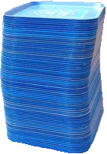
Review: What is a Stack?
stack: A collection based on the principle of adding elements and retrieving them in the opposite order.
Last-In, First-Out ("LIFO")
Elements are stored in order of insertion.
We do not think of them as having indexes.
Client can only add/remove/examine the last element added (the "top").
push
pop, peek
top | 3
 | 2
bottom | 1
Stack ADT
state
supported operations:
push(item): Add an element to the top of stack
pop(): Remove the top element and returns it
peek(): Examine the top element without removing it
size(): how many items are in the stack?
isEmpty(): true if there are 1 or more items in stack, false otherwise
Set of ordered items
Number of items
behavior
push(item) add item to top
pop() return and remove item at top
peek() look at item at top
size() count of items
isEmpty() count of items is 0?

Slide 44
Implementing a Stack with an Array
Stack ADT
ArrayStack<E>
Big O Analysis
pop()
peek()
size()
isEmpty()
push()
state
state
O(1) Constant
Set of ordered items
Number of items
data[]
size
O(1) Constant
behavior
behavior
push(item) add item to top
pop() return and remove item at top
peek() look at item at top
size() count of items
isEmpty() count of items is 0?
push data[size] = value, if out of room grow data
pop return data[size - 1], size-1
peek return data[size - 1]
size return size
isEmpty return size == 0
O(1) Constant
O(1) Constant
O(N) linear if you have to resize O(1) otherwise
push(3)
0 | 1 | 2 | 3
Take 1 min to respond to activity
push(4)
3
4
5
pop()
www.pollev.com/cse373activity
What do you think the worst possible runtime of the “push()” operation will be?
2
0
push(5)
numberOfItems =
1

Slide 45
Implementing a Stack with Nodes
Stack ADT
LinkedStack<E>
Big O Analysis
pop()
peek()
size()
isEmpty()
push()
state
state
O(1) Constant
Set of ordered items
Number of items
Node top
size
O(1) Constant
behavior
behavior
push(item) add item to top
pop() return and remove item at top
peek() look at item at top
size() count of items
isEmpty() count of items is 0?
push add new node at top
pop return and remove node at top
peek return node at top
size return size
isEmpty return size == 0
O(1) Constant
O(1) Constant
O(1) Constant
4
Take 1 min to respond to activity
push(3)
front
3
www.pollev.com/cse373activity
What do you think the worst possible runtime of the “push()” operation will be?
push(4)
pop()
numberOfItems =
1
0
2

Slide 46
Real-World Scenarios - Stacks
Undo/Redo Feature in editing software
DNA Parsing Implementation
https://www.nature.com/articles/s41467-021-25023-6
stack is able to record combinations of two different DNA signals, release the signals into solution in reverse order, and then re-record
social implications + ethical concerns?
accuracy limits
performance of stack dependent on efficiency of “washing steps” between stack operations
what if certain DNA needs more stack operations to parse than other? what kind of inequalities can this create between more common and more rare DNA? what are some social consequences of using a stack for DNA sequencing?

