Slide 1
Lecture 1: Welcome!
Please log onto https://edstem.org/us/courses/21257/discussion/1327540 to submit live lecture questions
Please log onto PollEv.com/champk to answer the daily lecture participation question
CSE 373: Data Structures and Algorithms

Slide 2
Agenda
Introductions
Syllabus
Dust off data structure cobwebs
Meet the ADT
Questions
Notes:
Intros (10)
- Why learn D&A (5) (ZC)
- Meet the course staff (5)
- Lecturers (Each have our own slide)
- TAs (slide with pics and names)
Course Administration (15) (figure out together) X
- syllabus
- remote logistics (trying the breakouts here if not too many students to introduce self to others?)
A note about imposter syndrome (course culture) (5) (KC)
Intro to Data Structures (20)
- Definitions (KC)
- define data structure
- define ADT
- List ADT (ZC)
- ArrayList implementation
- LinkedList implementation

Slide 3
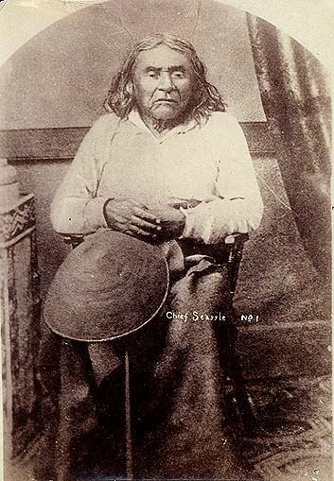
Welcome!
We are SO excited to be fully back in person, but we know things are changing rapidly and the world is still a mess so please be kind to yourselves and one another
We are in this together
Humans first, students second
Patience, vulnerability, compassion
“We acknowledge that we are on the traditional land of the first people of Seattle, the Duwamish People past and present and honor with gratitude the land itself and the Duwamish Tribe.”
https://www.realrentduwamish.org/

Slide 4
Waitlist/ Overloads
I have told CSE the more the merrier, but technically I have no control over these things :/
Email cse373@cs.washington.edu for all registration questions
Many students move around, likely a spot will open
Keep coming to lecture!

Slide 5
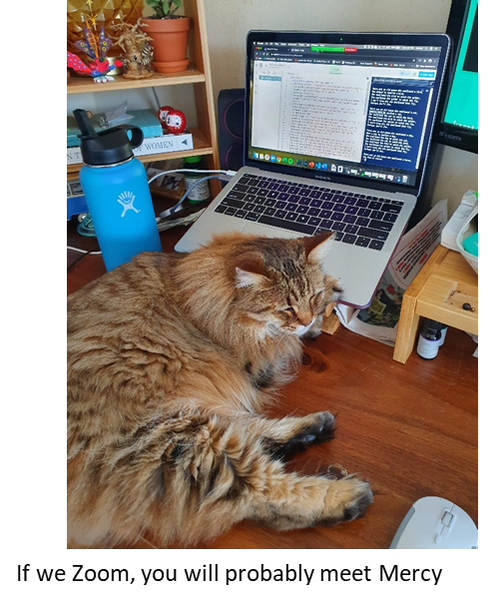
Hello! I am Kasey Champion (she/her)
Technical Program Manager @ Google
> Kasey has to go to her “real job” during the day L
Previously: Technical Interview Content Team Lead @ Karat
Previously: Software Engineer @ Microsoft
Electrical Engineering and Computing @ UW
champk@cs.washington.edu
https://calendly.com/kasey-champion

Slide 6
Course Overview
Course Goals
Design data structures and algorithms by implementing and maintaining invariants.
Analyze the runtime and design values of data structures and algorithms.
Critique the application of data structures and algorithms towards complex problems.
Prepare for technical interviews
Course Topics
Data Structures and ADTs: lists, stacks, queues, sets, dictionaries, arrays, linked lists, trees, hash tables, priority queues, binary heaps and disjoint sets
Algorithm analysis: Big O Notation, asymptotic analysis, P and NP complexity, Dynamic Programming optimization
Sorting algorithms: selection, insertion, merge, quick, more…
Graphs and graph algorithms: graph search, shortest path, minimum spanning trees

Slide 7
Course Components
Learning Components
Lectures
Recorded on Panopto
In-Person~ Please come hang out with us
Lecture Participation Polls
Graded on participation NOT correctness
Exercises
Sets of conceptual problems distributed via Gradescope
Projects
Programming assignments distributed via GitLab
”Simulated Assessments”
2 this quarter, midterm and final
“Test like questions” without time limit
Groups, notes, internet searches allowed, but no staff help
After you complete the questions, we will release the solutions and you will submit your reflections on your answers to be graded
Office Hours
Please come hang out with us!
Course Tools
Class webpage
Central location for all information
Course canvas
Gradebook
Zoom
Some Office Hours
Poll Everywhere
Lecture participation extra credit
Gradescope
Exercise distribution and submission
Ed Discussion board
Get help
Lecture questions
Find partners
GitLab
Project file distribution and submission
Anonymous Feedback Tool
Tell us how it’s going

Slide 8
A note about transitioning back to in-person
We are all figuring this out as we go!
Lecture
Please be prepared to interact throughout the hour
Poll Everywhere
Section
Similar to lecture
Please be prepared to work with other students
Discuss in small groups when working on problems
Ed Discussion Board
Please feel free to use this to meet and engage with one another
Office Hours
Both online and in-person meetings, logistics coming later this week
Feel free to use this to meet and engage with one another (but make sure you are not sharing code, only ideas!)
Please be prepared to share your screen
Turn on mic
Let us know what works!
Share what you’ve seen elsewhere
Use the anonymous feedback form
Always happy to take suggestions / feedback ☺

Slide 9
Course Policies
Turn In Policies
7 late days per student
use for projects or exercises
use up to 3 per assignment unless you speak to Kasey
Assignments
Solo or groups of 3
Projects out/in on Wednesdays
Exercises out/in on Fridays
after all late days used up -5% for each 24-hour period turned in late
Simulated Exams
Students fill out take home assignment about Design Decisions
Open note/open book, no staff help
Students fill out code review worksheet
No late exams accepted
Participation Extra Credit
Poll everywhere open at start of lecture
Due before start of next lecture
No late polls will be accepted
Grade Breakdown
Programming Projects (40%)
Written Exercises (30%)
Exam I (15%)
Exam II (15%)
Participation (EC round up to 0.05)
Academic Misconduct
Don’t share your code
Don’t look at others code
Don’t ”step by step”
DO talk to one another about concepts and approaches
DO look things up on the internet
No posting code on discussion board or ANYWHERE online
We do run MOSS
Accommodations and Extenuating Circumstances
Make sure you get the support you are entitled to via DRS
If you’re having issues with DRS system reach out to Kasey
When in doubt, reach out!

Slide 10
Questions?
Clarification on syllabus, General complaining/moaning

Slide 11
What is this class about?
CSE 142 – INTRO TO PROGRAMMING
CSE 143 – OBJECT ORIENTED PROGRAMMING
CSE 373 – DATA STRUCTURES AND ALGORITHMS
Java syntax
Methods
Variables
Parameters & Returns
File IO
Scanner
Arrays
Classes and Interfaces
Methods, variables and conditionals
Loops and recursion
Linked lists and binary trees
Sorting and Searching
O(n) analysis
Generics
Design decisions
Design analysis
Implementations of data structures
Debugging and testing
Abstract Data Types
Code Modeling
Complexity Analysis
Software Engineering Practices
Vocab
Grammar
Creative Writing

Slide 12
Data Structures and Algorithms
What are they anyway?

Slide 13
Basic Definitions
Data Structure
A way of organizing and storing data
Examples from CSE 14X: arrays, linked lists, stacks, queues, trees
Algorithm
A series of precise instructions to produce to a specific outcome
Examples from CSE 14X: binary search, merge sort, recursive backtracking

Slide 14
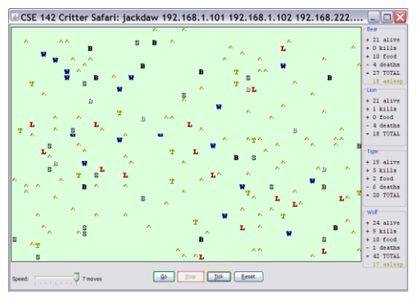
Review: Clients vs Objects
CLIENT CLASSES
OBJECT CLASSES
A class that is executable, in Java this means it contains a Main method
public static void main(String[] args)
A coded structure that contains data and behavior
Start with the data you want to hold, organize the things you want to enable users to do with that data

Slide 15
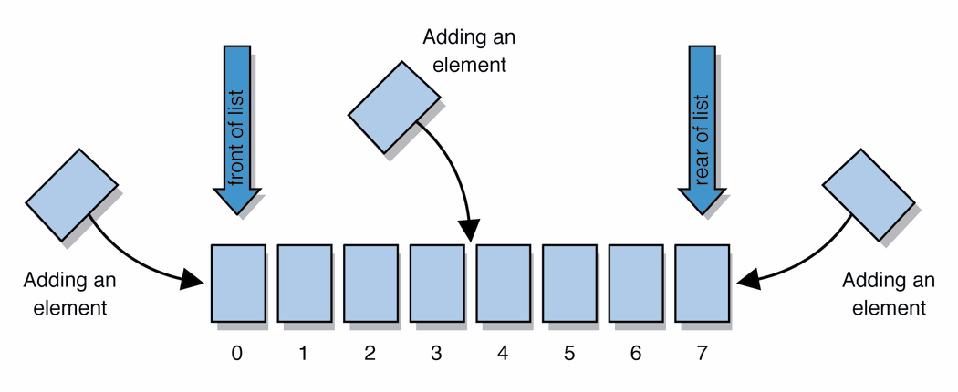
Abstract Data Types (ADT)
Abstract Data Types
An abstract definition for expected operations and behavior
Defines the input and outputs, not the implementations
Review: List - a collection storing an ordered sequence of elements
each element is accessible by a 0-based index
a list has a size (number of elements that have been added)
elements can be added to the front, back, or elsewhere
in Java, a list can be represented as an ArrayList object
Notes:
A way to communicate with other programmers, a standard that we all can agree on so we can discuss conceptual ways of organizing data

Slide 16
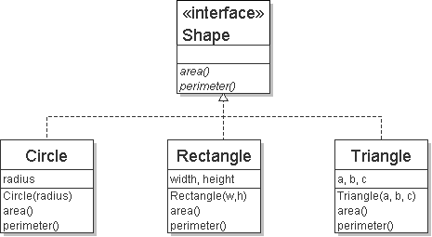
Review: Interfaces
Example
// Describes features common to all // shapes.
public interface Shape {
public double area();
public double perimeter();
}
interface: A construct in Java that defines a set of methods that a class promises to implement
Interfaces give you an is-a relationship without code sharing.
A Rectangle object can be treated as a Shape but inherits no code.
Analogous to non-programming idea of roles or certifications:
"I'm certified as a CPA accountant. This assures you I know how to do taxes, audits, and consulting."
"I'm 'certified' as a Shape, because I implement the Shape interface. This assures you I know how to compute my area and perimeter."
public interface name {
public type name(type name, ..., type name);
public type name(type name, ..., type name);
...
public type name(type name, ..., type name);
}

Slide 17
Review: Java Collections
Java provides some implementations of ADTs for you!
Lists List<Integer> a = new ArrayList<Integer>();
Stacks Stack<Character> c = new Stack<Character>();
Queues Queue<String> b = new LinkedList<String>();
Maps Map<String, String> d = new TreeMap<String, String>();
But some data structures you made from scratch… why?
Linked Lists - LinkedIntList was a collection of ListNode
Binary Search Trees – SearchTree was a collection of SearchTreeNodes
ADTs
Data Structures

Slide 18
Full Definitions
Abstract Data Type (ADT)
A definition for expected operations and behavior
A mathematical description of a collection with a set of supported operations and how they should behave when called upon
Describes what a collection does, not how it does it
Can be expressed as an interface
Examples: List, Map, Set
Data Structure
A way of organizing and storing related data points
An object that implements the functionality of a specified ADT
Describes exactly how the collection will perform the required operations
Examples: LinkedIntList, ArrayIntList

Slide 19
ADTs we’ll discuss this quarter
List
Set
Map
Stack
Queue
Priority Queue
Graph
Disjoint Set

Slide 20
Questions?

Slide 21
Case Study: The List ADT
list: a collection storing an ordered sequence of elements.
Each item is accessible by an index.
A list has a size defined as the number of elements in the list
Expected Behavior:
get(index): returns the item at the given index
set(value, index): sets the item at the given index to the given value
append(value): adds the given item to the end of the list
insert(value, index): insert the given item at the given index maintaining order
delete(index): removes the item at the given index maintaining order
size(): returns the number of elements in the list
List<String> names = new ArrayList<>();
names.add("Anish");
names.add("Amanda");
names.add(0, "Brian");

Slide 22
Case Study: List Implementations
ArrayList
uses an Array as underlying storage
LinkedList
uses nodes as underlying storage
List ADT
ArrayList<E>
LinkedList<E>
state
Set of ordered items
Count of items
state
state
data[]
size
Node front
size
behavior
get(index) return item at index
set(item, index) replace item at index
append(item) add item to end of list
insert(item, index) add item at index
delete(index) delete item at index
size() count of items
behavior
behavior
get return data[index]
set data[index] = value
append data[size] = value, if out of space grow data
insert shift values to make hole at index, data[index] = value, if out of space grow data
delete shift following values forward
size return size
get loop until index, return node’s value
set loop until index, update node’s value
append create new node, update next of last node
insert create new node, loop until index, update next fields
delete loop until index, skip node
size return size
0 | 1 | 2 | 3 | 4
88.6 | 26.1 | 94.4 | 0 | 0
88.6
26.1
94.4
list
free space
Notes:
Code up an implementation of List

Slide 23
Implementing Insert
ArrayList<E>
insert(element, index) with shifting
0 | 1 | 2 | 3
insert(10, 0)
3
4
5
5
10
3
4
3
numberOfItems =
4
LinkedList<E>
insert(element, index) with shifting
insert(10, 0)
10
3
4
5
numberOfItems =
4
3

Slide 24
Implementing Delete
ArrayList<E>
delete(index) with shifting
0 | 1 | 2 | 3
3
4
delete(0)
10
4
5
5
3
numberOfItems =
4
3
LinkedList<E>
delete(index) with shifting
delete(0)
10
3
4
5
numberOfItems =
4
3

Slide 25
Implementing Append
ArrayList<E>
append(element) with growth
0 | 1 | 2 | 3
append(2)
10
3
4
5
numberOfItems =
4
5
0 | 1 | 2 | 3 | 4 | 5 | 6 | 7
10
3
4
5
2
LinkedList<E>
append(element) with growth
append(2)
10
3
4
5
2
numberOfItems =
4
5

Slide 26
Design Decisions
For every ADT there are lots of different ways to implement them
Based on your situation you should consider:
Memory vs Speed
Generic/Reusability vs Specific/Specialized
One Function vs Another
Robustness vs Performance
This class is all about implementing ADTs based on making the right design tradeoffs!
> A common topic in interview questions

Slide 27
Design Decisions
Situation #1: Write a data structure that implements the List ADT that will be used to store a list of songs in a playlist.
ArrayList – optimize for the ability to shuffle play on the playlist
LinkedList - optimize for adding/removing/changing order of songs
Situation #2: Write a data structure that implements the List ADT that will be used to store the history of a bank customer’s transactions.
ArrayList – optimize for accessing of elements and adding to back
LinkedList - if structured backwards, could optimize for addition to front
Situation #3: Write a data structure that implements the List ADT that will be used to store the order of students waiting to speak to a TA at a tutoring center
LinkedList - optimize for removal from front
ArrayList – optimize for addition to back

