Slide 1
Lecture 26: Tries
CSE 373: Data Structures and Algorithms

Slide 2
Memory & B Trees Takeaways
Memory in your computer is organized into layers spanning out from the CPU > L1 Cache > L2 Cache > RAM > Disk
  cache: a place to store some memory that’s smaller and closer to the CPU compared to RAM
    Analogy: refrigerator keeps food closer to kitchen than store
  Getting data from cache to CPU is a lot quicker than from RAM to CPU.
  the more memory a layer can store, the slower it is (generally)
  accessing the disk is very slow
  Operating system is “the memory boss”
  pulls data from outer layers closer to CPU based on usage
  When do we “evict” memory to make room? How does the OS minimize disk accesses?
  Temporal locality: Once we load something into RAM or cache, keep it around or a while
    Analogy: top layer of clothing stays on floor, don’t wash that knife you just used to cut a sandwich just yet (I am a good adult I swear)
    EX: if you accessed one index of an array in the cache, keep that array around for a while
  Spatial Locality: Computers try to partition memory you are likely to use close by
    Analogy: if you’re going to your storage unit, might as well fill up your car
    EX: if you ask for one index of an array from RAM, pull the whole array down

Slide 3
Announcements
P4 due a week from today
  please get started soon
Interview practice tomorrow in section
TA Career Panel
Memorial day next week
  no class, no office hours
  Office hours end on Friday June 4th
Grades posted to canvas
  late penalties have yet to be applied
  please let us know if there are any issues
  regrade requests live on gradescope
Course Evals are out
  please fill out the official one
  supplemental one – if we get over 90.5% everyone gets 1-point ec!
TA Lead Final Review

Slide 4
Final Exam Topics
Sorting
  Sorting algorithm properties (stable, in-place)
  Quadratic sorts: insertion sort, selection sort
  Faster sorts: heap sort, merge sort, quick sort
  Runtimes of all of the above (in the best and worst case)
Graphs
  definitions (e.g., directed, undirected, weighted, unweighted, walks, paths, cycles, self-loops, parallel edges, trees, DAGs, etc.)
  implementations (Adjacency list, Adjacency matrix, and their pros and cons)
  traversals (BFS and DFS)
  Single-source shortest-path algorithms: Dijkstra's algorithm
  Topological sort
  MST algorithms: Prim and Kruskal
  Disjoint sets
  Framing/modeling problems with graphs
Coding Projects
  Implementation of each data structure
  Best / average / worst case runtime for each method of each data structure
Design Decisions
  Given a scenario, what ADT, data structure implementation and/or algorithm is best optimized for your goals?
    What is unique or specialized about your chosen tool?
    How do the specialized features of your chosen tool contribute to solving the given problem scenario?
    How expensive is this tool and its features in terms of runtime and memory?
  Given a scenario, what changes might you make to a design to better serve your goals?
Memory and Locality
  How to leverage caching
Pre-midterm topics
  all ADTs and data structures
  Asymptotic analysis
    Code Modeling (including recurrences)
    Complexity Classes
    Big O, Omega, Theta
  BSTs, AVL Trees
  Hashing
  Heaps

Slide 5


Autocomplete
Search Engines support autocomplete.
How do you efficiently implement autocomplete with the ADTs we know so far?
Formal Problem: Given a “prefix” of a string, find all strings in a set of possible strings that have the given prefix.

Slide 6
Tries: A Specialized Data Structure
Tries are a character-by-character set-of-Strings implementation
Nodes store parts of keys instead of keys
pair
a
d
0
aqua
parts
1
a
par
q
a
2
aqua
part
paw
pair
3
part
u
d
t
y
a
paw
par
parts
a
a
s
Binary Search Tree
Trie
Hash Table
Trying to Understand Tries.
20AU - SCHAFER

Slide 7
Abstract Trie
Each level represents an index
  Children represent next possible characters at that index
This Trie stores the following set of Strings:
a, aqua, dad,
data, day, days
How do we deal with a and aqua?
  Mark complete Strings with a boolean (shown in blue)
  Complete string: a String that belongs in our set
Index 0
a
d
Index 1
q
a
0
0
1
2
3
0
1
2
Index 2
u
d
t
y
0
1
2
3
0
1
2
0
1
2
3
Index 3
a
a
s
Abstract Trie
20AU - SCHAFER

Slide 8
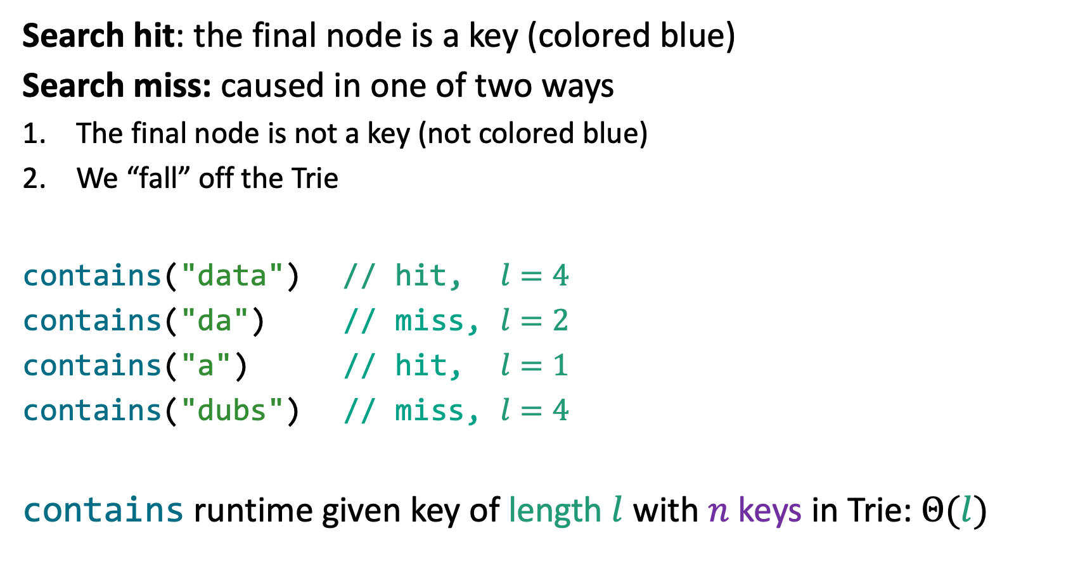

Searching in Tries
a, aqua, dad,
data, day, days
Search hit: the final node is a key (colored blue)
Search miss: caused in one of two ways
The final node is not a key (not colored blue)
We “fall” off the Trie
contains("data") // hit, $l=4$
contains("da") // miss, $l=2$
contains("a") // hit, $l=1$
contains("dubs") // miss, $l=4$
contains runtime given key of length $l$ with $n$ keys in Trie: $Θ(l)$
$$n=6$$
a
d
q
a
u
d
t
y
a
a
s
Abstract Trie
20AU - SCHAFER

Slide 9
Prefix Operations with Tries
a, aqua, dad,
data, day, days
The main appeal of Tries is its efficient prefix matching!
Prefix: find set of keys associated with given prefix
keysWithPrefix("day") returns ["day", "days"]
Longest Prefix From Trie: given a String, retrieve
longest prefix of that String that exists in the Trie
longestPrefixOf("aquarium") returns "aqua"
longestPrefixOf("aqueous") returns "aqu"
longestPrefixOf("dawgs") returns "da"
a
d
q
a
u
d
t
y
a
a
s
Abstract Trie
20AU - SCHAFER

Slide 10
Collecting Trie Keys
Collect: return set of all keys in the Trie (like keySet())
  collect(trie) = ["a", "aqua", "dad", "data", "day", "days"]
List collect() {
List keys;
for (Node c : root.children) {
collectHelper(n.char, keys, c);
}
return keys;
}
void collectHelper(String str, List keys, Node n) {
if (n.isKey()) {
keys.add(s);
}
for (Node c : n.children) {
collectHelper(str + c.char, keys, c);
}
}
collectHelper("a", keys, )
d
a
collectHelper("aq", keys, )
a
q
collectHelper("aqu", keys, )
d
t
y
u
collectHelper("aqua", keys, )
a
a
s
20AU - SCHAFER

Slide 11
keysWithPrefix Implementation
keysWithPrefix(String prefix)
  Find all the keys that corresponds to the given prefix
List keysWithPrefix(String prefix) {
Node root; // Node corresponding to given prefix
List keys; // Empty list to store keys
for (Node n : root.children) {
collectHelper(prefix + n.char, keys, c);
}
}
void collectHelper(String str, List keys, Node n) {
if (n.isKey()) {
keys.add(s);
}
for (Node c : n.children) {
collectHelper(str + c.char, keys, c);
}
}
root
a
d
q
a
u
d
t
y
a
a
s
20AU - SCHAFER

Slide 12
Autocomplete with Tries
Autocomplete should return the most relevant results
One method: a Trie-based Map<String, Relevance>
  When a user types in a string "hello", call keysWithPrefix("hello")
  Return the 10 Strings with the highest relevance
20AU - SCHAFER

Slide 13
Lecture Outline
Tries Introduction
Implementing a Trie using arrays
Advanced Implementations: dealing with sparsity
  Hash Tables, BSTs, and Ternary Search Trees
20AU - SCHAFER

Slide 14
Trie Implementation Idea: Encoding
20AU - SCHAFER

Slide 15
DataIndexedCharMap Pseudocode
class TrieSet {
final int R = 128; // # of ASCII encodings
Node overallRoot;
// Private internal class
class Node {
// Field declarations
char ch;
boolean isKey;
DataIndexedCharMap<Node> next; // array encoding
// Constructor
Node(char c, boolean b, int R) {
ch = c;
isKey = b;
next = new DataIndexedCharMap<Node>(R);
}
}
}
a
d
q
a
u
d
t
y
a
a
s
20AU - SCHAFER

Slide 16




Data Structure for Trie Implementation
Think of a Binary Tree
  Instead of two children, we have $128$ possible children
  Each child represents a possible next character of our Trie
How could we store these $128$ children?
$$…$$
$$…$$
$2$ children
$128$ children
20AU - SCHAFER

Slide 17

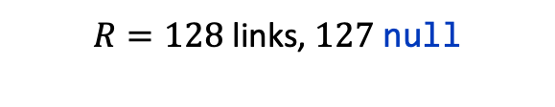


Data-Indexed Array Visualization
$$…$$
// Private internal class
class Node {
// Field declarations
char ch;
boolean isKey;
DataIndexedCharMap<Node> next;
}
Node
ch | u
isKey | false
next
DataIndexedCharMap
items
u
u
0 | 1 | … | 111 | 112 | 113 | … | 126 | 127
$$…$$
Node
p
p
ch | p
isKey | true
next
$R=128$ links, $127$ null
DataIndexedCharMap
items
0 | 1 | … | … | … | … | … | 126 | 127
$$…$$
20AU - SCHAFER

Slide 18







Removing Redundancy
a
b
c
d
e
class TrieSet {
final int R = 128;
Node overallRoot;
// Private internal class
class Node {
// Field declarations
char ch;
boolean isKey;
DataIndexedCharMap<Node> next;
// Constructor
Node(char c, boolean b, int R) {
ch = c;
isKey = b;
next = new DataIndexedCharMap<Node>(R);
}
}
}
$$…$$
a
b
c
d
e
$$…$$
q
a
$$…$$
$$…$$
q
a
$$…$$
u
$$…$$
d
t
y
$$…$$
$$…$$
$$…$$
u
d
t
y
a
$$…$$
$$…$$
a
$$…$$
s
$$…$$
a
a
s
$$…$$
$$…$$
$$…$$
20AU - SCHAFER

Slide 19











Does the structure of a Trie depend on the order of insertion?
a) Yes
b) No
c) I’m not sure…
a
b
c
d
e
$$…$$
$$…$$
q
a
$$…$$
$$…$$
$$…$$
u
$$…$$
d
t
y
$$…$$
$$…$$
$$…$$
a
$$…$$
$$…$$
a
$$…$$
s
$$…$$
$$…$$
$$…$$
$$…$$
20AU - SCHAFER

Slide 20
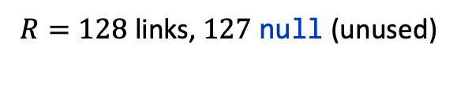


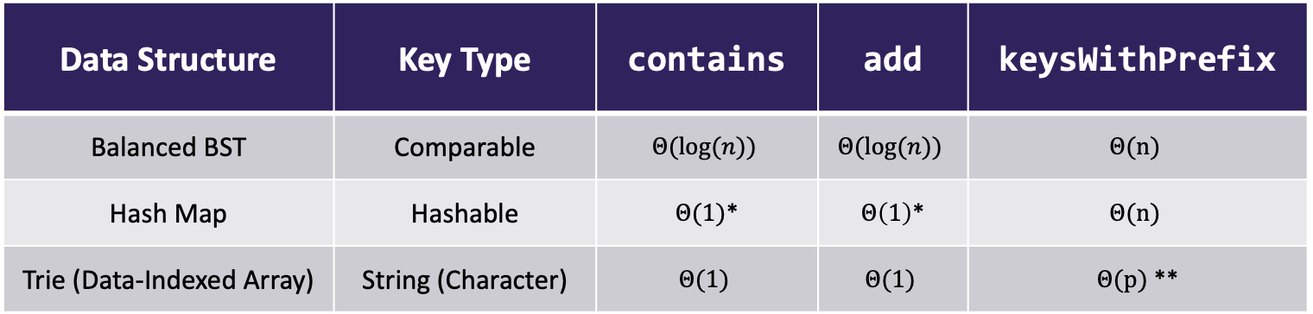
Runtime Comparison
u
u
$$…$$
p
p
Typical runtime when treating length $l$ of
keys as a constant:
Takeaways:
  $+$ When keys are Strings, Tries give us a better add and contains runtime
  $−$ DataIndexedCharMap takes up a lot of space by storing $R$ links per node
$R=128$ links, $127$ null (unused)
Data Structure | Key Type | contains | add | keysWithPrefix
Balanced BST | Comparable | $$Θ(\log{(n))}$$ | $$Θ(\log{(n))}$$ | $$Θ(n)$$
Hash Map | Hashable | $Θ(1)$* | $Θ\left(1\right)$* | $$Θ(n)$$
Trie (Data-Indexed Array) | String (Character) | $$Θ(1)$$ | $$Θ(1)$$ | $Θ(p)$ **
* In-practice runtime
** Where p is the number of strings with the given prefix. Usually p << n.
20AU - SCHAFER

Slide 21
Lecture Outline
Tries Introduction
Implementing a Trie using arrays
Advanced Implementations: dealing with sparsity
  Hash Tables, BSTs, and Ternary Search Trees
20AU - SCHAFER

Slide 22
DataIndexedCharMap Implementation
isKey = false
… | 97 | … | 117 | 118 | …
key = "a"
isKey = false
isKey = true
a
u
… | 109 | 110 | 111 | 112 | …
p
key = "up"
isKey = true
22
Abstract Trie
Data-Indexed Array Trie
20AU - SCHAFER

Slide 23
Hash Table-based Implementation
Use Hash Table to find character at a given index
0
isKey = false
u
1
a
2
key = "a"
0
isKey = false
0
isKey = true
a
u
1
1
p
2
2
p
key = "up"
0
isKey = true
23
1
2
Abstract Trie
Hash Table-based Trie
20AU - SCHAFER

Slide 24
BST-based Implementation
Use Binary Search Tree to find character at a given index
Two types of children:
  “Trie” child: advance a character (index)
  “Internal” child: another character
  option at current character (index)
Both are essentially child references
  Could we simplify this design?
isKey = false
a
2) “Internal” children
(another character option)
Each Trie node stores its own BST
u
key = "a"
isKey = false
isKey = true
a
u
p
p
1) “Trie” children
(advance a character)
key = "up"
isKey = true
24
Abstract Trie
BST-based Trie
20AU - SCHAFER

Slide 25
Ternary Search Tree (TST) Implementation
Combines character mapping with Trie itself
Index 0
u
Index 0
a
u
Index 1
a
p
Index 1
p
Abstract Trie
Ternary Search Tree (TST)
“Internal” left child
(smaller character at same index)
“Trie” child: advance to next String index
“Internal” right child
(greater character at same index)
20AU - SCHAFER

Slide 26
Which node is associated with the key "CAC"?
A
C
1
C
A
G
G
G
5
C
2
C
3
C
C
6
G
C
4
20AU - SCHAFER
Tries in COS 226 (Sedgewick, Wayne/Princeton)

Slide 27
Searching in a TST
Searching in a TST
  If smaller, take left link
  If greater, take right link
  If equal, take the middle link and move to next character
Search hit: final node yields a key that belongs in our set
Search miss: reach null link or final node is yields a key not in our set
Index 0
u
Keys:
Index 0
a
u
[ | a | , |  | u | p | ]
 | 0 |  |  | 0 | 1
Index 1
Index:
a
p
Index 1
p
Abstract Trie
Ternary Search Tree (TST)
20AU - SCHAFER

Slide 28
Trie Takeaways
Tries can be used for storing Strings (or any sequential data)
Real-world performance often better than Hash Table or Search Tree
Many different implementations: DataIndexedCharMap, Hash Tables, BSTs (and more possible data structures within nodes), and TSTs
Tries enable efficient prefix operations like keysWithPrefix
20AU - SCHAFER

