Slide 1
Lecture 21: Toposort and Reductions
CSE 373: Data Structures and Algorithms

Slide 2
Warm Up
Fill in the array with the correct values representing this Disjoint Set forest
Use the indices that correspond with the values
weight = 1
weight = 10
weight = 8
0
1
11
2
6
12
15
3
4
5
7
10
13
14
16
17
8
9
18
0 | 1 | 2 | 3 | 4 | 5 | 6 | 7 | 8 | 9 | 10 | 11 | 12 | 13 | 14 | 15 | 16 | 17 | 18
0 | 1 | 2 | 3 | 4 | 5 | 6 | 7 | 8 | 9 | 10 | 11 | 12 | 13 | 14 | 15 | 16 | 17 | 18
-1 | -1 | 1 | 2 | 2 | 2 | 1 | 6 | 7 | 7 | 6 | -1 | 11 | 12 | 12 | 11 | 15 | 15 | 17
0 | 1 | 2 | 3 | 4 | 5 | 6 | 7 | 8 | 9 | 10 | 11 | 12 | 13 | 14 | 15 | 16 | 17 | 18
-1 | -10 | 1 | 2 | 2 | 2 | 1 | 6 | 7 | 7 | 6 | -8 | 11 | 12 | 12 | 11 | 15 | 15 | 17
Store (weight * -1)
Each “node” now only takes 4 bytes of memory instead of 32

Slide 3
Using Arrays for Up-Trees
Since every node can have at most one parent, what if we use an array to store the parent relationships?
Proposal: each node corresponds to an index, where we store the index of the parent (or –1 for roots). Use the root index as the representative ID!
Just like with heaps, tree picture still conceptually correct, but exists in our minds!
Aileen (2)
Joyce (0)
Santino
Sam
Ken
Alex
Paul (4)
0 | 1 | 2 | 3 | 4 | 5 | 6
-1 | 0 | -1 | 6 | -1 | 2 | 0
Joyce | Sam | Aileen | Alex | Paul | Santino | Ken

Slide 4
Using Arrays: Find
find(A):
index = jump to A node’s index
while array[index] > 0:
index = array[index]
path compression
return index
1
Initial jump to element still done with extra Map
But traversing up the tree can be done purely within the array!
2
3
Can still do path compression by setting all indices along the way to the root index!
Aileen (2)
Joyce (0)
Alex
Santino
Sam
Ken
Aileen
1
find(Alex)
= 0
Sam
Alex
Paul (4)
…
0 | 1 | 2 | 3 | 4 | 5 | 6
-1 | 0 | -1 | 6 | -1 | 2 | 0
Joyce | Sam | Aileen | Alex | Paul | Santino | Ken
3
0
2

Slide 5
Using Arrays: Union
union(A, B):
rootA = find(A)
rootB = find(B)
use -1 * array[rootA] and -1 *
array[rootB] to determine weights
put lighter root under heavier root
For WeightedQuickUnion, we need to store the number of nodes in each tree (the weight)
Instead of just storing -1 to indicate a root, we can store -1 * weight!
weight 2
weight 4
Aileen (2)
Joyce (0)
Santino
Sam
Ken
union(Ken, Santino)
Alex
0 | 1 | 2 | 3 | 4 | 5 | 6
-4 | 0 | -2 | 6 | -1 | 2 | 0
Joyce | Sam | Aileen | Alex | Paul | Santino | Ken
weight 1
Paul (4)

Slide 6
Using Arrays: Union
union(A, B):
rootA = find(A)
rootB = find(B)
use -1 * array[rootA] and -1 *
array[rootB] to determine weights
put lighter root under heavier root
For WeightedQuickUnion, we need to store the number of nodes in each tree (the weight)
Instead of just storing -1 to indicate a root, we can store -1 * weight!
weight 6
Joyce (0)
Sam
Ken
Aileen (2)
Aileen
union(Ken, Santino)
Alex
Santino
0 | 1 | 2 | 3 | 4 | 5 | 6
-4 | 0 | -2 | 6 | -1 | 2 | 0
Joyce | Sam | Aileen | Alex | Paul | Santino | Ken
weight 1
-6
0
Paul (4)

Slide 7
Practice
weight = 6
weight = 1
weight = 2
weight = 8
3
5
6
13
4
0
7
9
10
12
1
11
2
15
14
8
16
0 | 1 | 2 | 3 | 4 | 5 | 6 | 7 | 8 | 9 | 10 | 11 | 12 | 13 | 14 | 15 | 16
0 | 1 | 2 | 3 | 4 | 5 | 6 | 7 | 8 | 9 | 10 | 11 | 12 | 13 | 14 | 15 | 16
3 | 0 | 0 | -6 | 3 | -1 | -2 | 6 | 12 | 13 | 13 | 0 | 13 | -8 | 12 | 12 | 12
union(2, 16)

Slide 8
Practice
union(2, 16)
findSet(2) with path compression
findSet(16) with path compression
union(3,13) by weight
weight = 6
weight = 1
weight = 2
weight = 8
3
5
6
13
4
0
7
9
10
12
1
11
2
15
14
8
16
0 | 1 | 2 | 3 | 4 | 5 | 6 | 7 | 8 | 9 | 10 | 11 | 12 | 13 | 14 | 15 | 16
0 | 1 | 2 | 3 | 4 | 5 | 6 | 7 | 8 | 9 | 10 | 11 | 12 | 13 | 14 | 15 | 16
3 | 0 | 3 | 13 | 3 | -1 | -2 | 6 | 12 | 13 | 13 | 0 | 13 | -8 | 12 | 12 | 13

Slide 9
Using Arrays for WQU+PC
Same asymptotic runtime as using tree nodes, but check out all these other benefits:
More compact in memory
Better spatial locality, leading to better constant factors from cache usage
Simplify the implementation!
 | (Baseline) | QuickFind | QuickUnion | WeightedQuickUnion | WQU + Path Compression | ArrayWQU+PC
makeSet(value) | $$Θ(1)$$ | $$Θ(1)$$ | $$Θ(1)$$ | $$Θ(1)$$ | $$Θ(1)$$ | $$Θ(1)$$
find(value) | $$Θ(n)$$ | $$Θ(1)$$ | $$Θ(n)$$ | $$Θ(\log{n})$$ | $$O(\log^{∗}{n})$$ | $$O(\log^{∗}{n})$$
union(x, y) assuming root args | $$Θ(n)$$ | $$Θ(n)$$ | $$Θ(1)$$ | $$Θ(1)$$ | $$Θ(1)$$ | $$Θ(1)$$
union(x, y) | $$Θ(n)$$ | $$Θ(n)$$ | $$Θ(n)$$ | $$Θ(\log{n})$$ | $$O(\log^{∗}{n})$$ | $$O(\log^{∗}{n})$$

Slide 10
Implementing Dijkstra’s

Slide 11
Review Dijkstra’s Algorithm: Key Properties
Once a vertex is marked known, its shortest path is known
Can reconstruct path by following back-pointers (in edgeTo map)
While a vertex is not known, another shorter path might be found
We call this update relaxing the distance because it only ever shortens the current best path
Going through closest vertices first lets us confidently say no shorter path will be found once known
Because not possible to find a shorter path that uses a farther vertex we’ll consider later
dijkstraShortestPath(G graph, V start)
Set known; Map edgeTo, distTo;
initialize distTo with all nodes mapped to ∞, except start to 0
while (there are unknown vertices):
let u be the closest unknown vertex
known.add(u)
for each edge (u,v) to unknown v with weight w:
oldDist = distTo.get(v) // previous best path to v
newDist = distTo.get(u) + w // what if we went through u?
if (newDist < oldDist):
distTo.put(v, newDist)
edgeTo.put(v, u)

Slide 12
Review Why Does Dijkstra’s Work?
Dijkstra’s Algorithm Invariant
All vertices in the “known” set have the correct shortest path
INVARIANT
KNOWN
5
1
6??
Similar “First Try Phenomenon” to BFS
How can we be sure we won’t find a shorter path to X later?
Key Intuition: Dijkstra’s works because:
IF we always add the closest vertices to “known” first,
THEN by the time a vertex is added, any possible relaxing has happened and the path we know is always the shortest!
3
A
8??
1
X
Example:
We’re about to add X to the known set
But how can we be sure we won’t later find a path through some node A that is shorter to X?
Because if we could, Dijkstra’s would explore A first

Slide 13
Review Why Does Dijkstra’s Work?
Dijkstra’s Algorithm Invariant
All vertices in the “known” set have the correct shortest path
INVARIANT
KNOWN
5
1
6
Similar “First Try Phenomenon” to BFS
How can we be sure we won’t find a shorter path to X later?
Key Intuition: Dijkstra’s works because:
IF we always add the closest vertices to “known” first,
THEN by the time a vertex is added, any possible relaxing has happened and the path we know is always the shortest!
3
A
7??
1
X
Example:
We’re about to add X to the known set
But how can we be sure we won’t later find a path through some node A that is shorter to X?
Because if we could, Dijkstra’s would explore A first

Slide 14
Implementing Dijkstra’s
How do we implement “let u be the closest unknown vertex”?
Would sure be convenient to store vertices in a structure that…
Gives them each a distance “priority” value
Makes it fast to grab the one with the smallest distance
Lets us update that distance as we discover new, better paths
dijkstraShortestPath(G graph, V start)
Set known; Map edgeTo, distTo;
initialize distTo with all nodes mapped to ∞, except start to 0
while (there are unknown vertices):
let u be the closest unknown vertex
known.add(u)
for each edge (u,v) to unknown v with weight w:
oldDist = distTo.get(v) // previous best path to v
newDist = distTo.get(u) + w // what if we went through u?
if (newDist < oldDist):
distTo.put(u, newDist)
edgeTo.put(u, v)
MIN PRIORITY QUEUE ADT

Slide 15
Implementing Dijkstra’s: Pseudocode
dijkstraShortestPath(G graph, V start)
Map edgeTo, distTo;
initialize distTo with all nodes mapped to ∞, except start to 0
PriorityQueue<V> perimeter; perimeter.add(start);
while (!perimeter.isEmpty()):
u = perimeter.removeMin()
for each edge (u,v) to v with weight w:
oldDist = distTo.get(v) // previous best path to v
newDist = distTo.get(u) + w // what if we went through u?
if (newDist < oldDist):
distTo.put(v, newDist)
edgeTo.put(v, u)
if (perimeter.contains(v)):
perimeter.changePriority(v, newDist)
else:
perimeter.add(v, newDist)
Use a MinPriorityQueue to keep track of the perimeter
Don’t need to track entire graph
Don’t need separate “known” set – implicit in PQ (we’ll never try to update a “known” vertex)
This pseudocode is much closer to what you’ll implement in P4
However, still some details for you to figure out!
e.g. how to initialize distTo with all nodes mapped to ∞
Spec will describe some optimizations for you to make ☺

Slide 16
Dijkstra’s Runtime
dijkstraShortestPath(G graph, V start)
Map edgeTo, distTo;
initialize distTo with all nodes mapped to ∞, except start to 0
PriorityQueue<V> perimeter; perimeter.add(start);
while (!perimeter.isEmpty()):
u = perimeter.removeMin()
for each edge (u,v) to v with weight w:
oldDist = distTo.get(v) // previous best path to v
newDist = distTo.get(u) + w // what if we went through u?
if (newDist < oldDist):
distTo.put(v, newDist)
edgeTo.put(v, u)
if (perimeter.contains(v)):
perimeter.changePriority(v, newDist)
else:
perimeter.add(v, newDist)
$$Θ(|V|)$$
$$Θ\left(|V|log⁡|V|\right)$$
$Θ(|V|)$ iterations
$$Θ(log⁡|V|)$$
total $Θ\left(\left|E\right|\right)$ iterations
$$Θ\left(1\right)$$
$$Θ\left(|E|log⁡|V|\right)$$
$$Θ\left(log⁡|V|\right)$$
$$Θ\left(log⁡|V|\right)$$

Slide 17
Dijkstra’s Runtime
dijkstraShortestPath(G graph, V start)
Map edgeTo, distTo;
initialize distTo with all nodes mapped to ∞, except start to 0
PriorityQueue<V> perimeter; perimeter.add(start);
while (!perimeter.isEmpty()):
u = perimeter.removeMin()
for each edge (u,v) to v with weight w:
oldDist = distTo.get(v) // previous best path to v
newDist = distTo.get(u) + w // what if we went through u?
if (newDist < oldDist):
distTo.put(v, newDist)
edgeTo.put(v, u)
if (perimeter.contains(v)):
perimeter.changePriority(v, newDist)
else:
perimeter.add(v, newDist)
$$Θ(|V|)$$
Final result:
$$Θ\left(|V|log⁡|V|\right)$$
$Θ(|V|)$ iterations
$$Θ(log⁡|V|)$$
$$Θ\left(\left|V\right|\log\left|V\right|+ |E|log⁡|V|\right)$$
total $Θ\left(\left|E\right|\right)$ iterations
Why can’t we simplify further?
We don’t know if |V| or |E| is going to be larger, so we don’t know which term will dominate.
Sometimes we assume |E| is larger than |V|, so |E|log|V| dominates. But not always true!
$$Θ\left(1\right)$$
$$Θ\left(|E|log⁡|V|\right)$$
$$Θ\left(log⁡|V|\right)$$
$$Θ\left(log⁡|V|\right)$$

Slide 18
Topological Sort

Slide 19
Topological Sort
Input:
A topological sort of a directed graph G is an ordering of the nodes, where for every edge in the graph, the origin appears before the destination in the ordering
Intuition: a “dependency graph”
An edge (u, v) means u must happen before v
A topological sort of a dependency graph gives an ordering that respects dependencies
Applications:
Graduating
Compiling multiple Java files
Multi-job Workflows
A before C
A
A before B
C
B
B before C
Topological Sort:
A
B
C
With original edges for reference:
A
B
C

Slide 20
Can We Always Topo Sort a Graph?
Can you topologically sort this graph?
What’s the difference between this graph and our first graph?
A graph has a topological ordering if it is a DAG
But a DAG can have multiple orderings
CSE 373
🤔 Where do I start?
Where do I end? 🤔
No 😭
CSE 143
CSE 417
MATH 126
CSE 374
A directed graph without any cycles
Edges may or may not be weighted
DIRECTED ACYCLIC GRAPH
CSE 143
CSE 142
CSE 373
CSE 417
Notes:
3:00

Slide 21
Problem 1: Ordering Dependencies
Today’s (first) problem: Given a bunch of courses with prerequisites, find an order to take the courses in.
Math 126
CSE 374
CSE 143
CSE 142
CSE 373
CSE 417

Slide 22
Problem 1: Ordering Dependencies
Given a directed graph G, where we have an edge from u to v if u must happen before v.
We can only do things one at a time, can we find an order that respects dependencies?
Given: a directed graph G
Find: an ordering of the vertices so all edges go from left to right (all the dependency arrows are satisfied and the vertices can be processed left to right with no problems) .
Topological Sort (aka Topological Ordering)

Slide 23
Ordering a DAG
Does this graph have a topological ordering? If so find one.
0
0
0
1
1
A
C
D
B
E
2
1
1
0
0
A
C
B
D
E
If a vertex doesn’t have any edges going into it, we can add it to the ordering.
More generally, if the only incoming edges are from vertices already in the ordering, it’s safe to add.

Slide 24
Topological Ordering
A course prerequisite chart and a possible topological ordering.
Math 126
CSE 374
CSE 143
CSE 142
CSE 373
CSE 417
Math 126
CSE 142
CSE 143
CSE 373
CSE 374
CSE 417

Slide 25
Reductions

Slide 26
Reductions
P INPUT
A reduction is a problem-solving strategy that involves using an algorithm for problem Q to solve a different problem P
Rather than modifying the algorithm for Q, we modify the inputs/outputs to make them compatible with Q!
“P reduces to Q”
1. Convert input for P into input for Q
2. Solve using algorithm for Q
3. Convert output from Q into output from P
Q INPUT
PROBLEM P
PROBLEM Q
Q OUTPUT
P OUTPUT

Slide 27
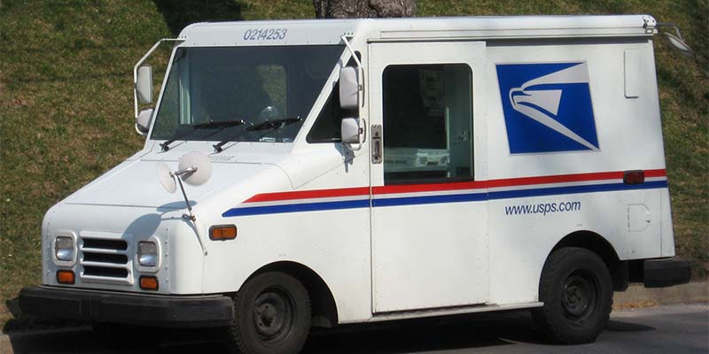
Reductions
Seattle
Example: I want to get a note to my friend in Chicago, but walking all the way there is a difficult problem to solve ☹
Instead, reduce the “get a note to Chicago” problem to the “mail a letter” problem!
1. Place note inside of envelope
2. Mail using US Postal Service
3. Take note out of envelope
Seattle
Q INPUT
Get a note to Chicago
Mail a letter
Q OUTPUT
Chicago
Chicago

Slide 28
How To Perform Topo Sort?
👻
If we add a phantom “start” vertex pointing to other starts, we could use BFS!
2
2
0
3
5
0
3
5
1
4
6
1
4
6
Performing Topo Sort
7
7
Reduce topo sort to BFS by modifying graph, running BFS, then modifying output back
BFS
Sweet sweet victory 😎
👻
👻
4
6
4
6
4
6
7
7
1
3
5
7
1
3
5
0
2
1
3
5
0
2
0
2

Slide 29
Checking for Duplicates
Problem: We want to determine whether an array contains duplicate elements.
Initial idea: Compare every element to every other element!
Runtime: $θ(n^{2})$
Could we do better?
containsDuplicates(array) {
for (int i = 0; i < array.length; i++):
for (int j = i; j < array.length; j++):
if (array[i] == array[j]):
return true
return false
}
0 | 1 | 2 | 3 | 4
2 | 4 | 8 | 3 | 8

Slide 30
Goal of a Reduction
P INPUT
Goal: Reduce the problem of “Contains Duplicates?” to another problem we have an algorithm for.
Try to identify each of the following:
Q INPUT
How will you convert the “Contains Duplicates?” input?
What algorithm will you apply?
How will you convert the algorithm’s output?
PROBLEM P
PROBLEM Q
Q OUTPUT
0 | 1 | 2 | 3 | 4
2 | 4 | 8 | 3 | 8
P OUTPUT

Slide 31
One Solution: Sorting!
Array
One Solution: Reduce “Contains Duplicates?” to the problem of sorting an array
We know several algorithms that solve this problem quickly!
Array
Simply pass array input to “Sorting”
Use Heap Sort, Merge Sort, or Quick Sort to sort
Scan through sorted array: check for duplicates now next to each other, a $θ\left(n\right)$ operation!
Contains Duplicates?
Sorting
Sorted Array
Totally okay to do work in input/output conversion! Even with this pass, runtime is $θ\left(n\log{n}+n\right)$, so just $θ\left(n\log{n}\right)$. Reduction helped us avoid quadratic runtime!
Boolean

Slide 32
Graph Modeling Review

Slide 33
Recap: Graph Modeling
Often need to refine original model as you work through details of algorithm
MODEL AS A GRAPH
RUN ALGORITHM
Just visit every node?
BFS or DFS
s-t Connectivity?
BFS or DFS
Unweighted shortest path?
BFS
Weighted shortest path?
Dijkstra’s
Minimum Spanning Tree?
Prim’s or Kruskal’s
Choose vertices
Choose edges
Directed/Undirected
Weighted/Unweighted
Cyclic/Acyclic
…
SCENARIO
&
QUESTION TO ANSWER
ANSWER!
Many ways to model any scenario with a graph, but question motivates which data is important

Slide 34
Graph Modeling Activity
Note Passing - Part I
Imagine you are an American High School student. You have a very important note to pass to your crush, but the two of you do not share a class so you need to rely on a chain of friends to pass the note along for you. A note can only be passed from one student to another when they share a class, meaning when two students have the same teacher during the same class period.
Unfortunately, the school administration is not as romantic as you, and passing notes is against the rules. If a teacher sees a note, they will take it and destroy it. Figure out if there is a sequence of handoffs to enable you to get your note to your crush.
How could you model this situation as a graph?
 | Period 1 | Period 2 | Period 3 | Period 4
You | Smith | Patel | Lee | Brown
Anika | Smith | Lee | Martinez | Brown
Bao | Brown | Patel | Martinez | Smith
Carla | Martinez | Jones | Brown | Smith
Dan | Lee | Lee | Brown | Patel
Crush | Martinez | Brown | Smith | Patel

Slide 35
Possible Design
Algorithm
BFS or DFS to see if you and your Crush are connected
Vertices
Students
Fields: Name, have note
Edges
Classes shared by students
Not directed
Could be left without weights
Fields: vertex 1, vertex 2, teacher, period
Adjacency List
You
A
B
C
D
Crush
A
B
You
B
D
Smith, 1
Anika
You
A
C
You
Lee, 2
Carla
B
D
Crush
Martinez, 3
Patel, 2
Martinez, 1
Smith, 4
Brown, 3
A
C
Crush
Bao
Patel, 4
Crush
C
D
Dan

Slide 36
More Design
Note Passing - Part II
Now that you know there exists a way to get your note to your crush, we can work on picking the best hand off path possible.
Thought Experiments:
What if you want to optimize for time to get your crush the note as early in the day as possible?
How can we use our knowledge of which period students share to calculate for time knowing that period 1 is earliest in the day and period 4 is later in the day?
How can we account for the possibility that it might take more than a single school day to deliver the note?
2. What if you want to optimize for rick avoidance to make sure your note only gets passed in classes least likely for it to get intercepted?
- Some teachers are better at intercepting notes than others. The more notes a teacher has intercepted, the more likely it is they will take yours and it will never get to your crush. If we knew how many notes each teacher has intercepted how might we incorporate that into our graph to find the least risky route?

Slide 37
Optimize for Time
“Distance” will represent the sum of which periods the note is passed in, because smaller period values are earlier in the day the smaller the sum the earlier the note gets there except in the case of a “wrap around”
Add the period number to each edge as its weight
Run Dijkstra’s from You to Crush
1
Anika
Vertex | Distance | Predecessor | Process Order
You | 0 | -- | 0
Anika | 1 | You | 1
Bao | 2 | You | 5
Carla | 6 | Dan | 3
Dan | 3 | Anika | 2
Crush | 7 | Carla | 4*
You
2
Carla
3
2
1
4
3
Bao
4
Crush
Dan
*The path found wraps around to a new school day because the path moves from a later period to an earlier one
- We can change our algorithm to check for wrap arounds and try other routes

Slide 38
Optimize for Risk
Add the number of letters intercepted by the teacher to each edge as its weight
Run Dijkstra’s from You to Crush
Teacher | Notes Intercepted
Smith | 1
Martinez | 3
Lee | 4
Brown | 5
Patel | 2
“Distance” will represent the sum of notes intercepted across the teachers in your passing route. The smaller the sum of notes the “safer” the path.
1
Anika
You
4
Carla
3
2
Vertex | Distance | Predecessor | Process Order
You | 0 | -- | 0
Anika | 1 | You | 1
Bao | 4 | Anika | 2
Carla | 5 | Bao | 3
Dan | 10 | Carla | 5
Crush | 8 | Carla | 4
1
3
5
Bao
4
Crush
Dan

Slide 39
Seam Carving

Slide 40
Content-Aware Image Resizing
Seam carving: A distortion-free technique for resizing an image by removing “unimportant seams”
Original Photo
Horizontally-Scaled (castle and person are distorted)
Seam-Carved (castle and person are undistorted; “unimportant” sky removed instead)
Seam carving for content-aware image resizing (Avidan, Shamir/ACM); Broadway Tower (Newton2, Yummifruitbat/Wikimedia)

Slide 41
Demo: https://www.youtube.com/watch?v=vIFCV2spKtg
Notes:
https://www.youtube.com/watch?v=vIFCV2spKtg: stop the video after they show the first vertical seam identified during the alphabet blocks – about 2.5m

Slide 42
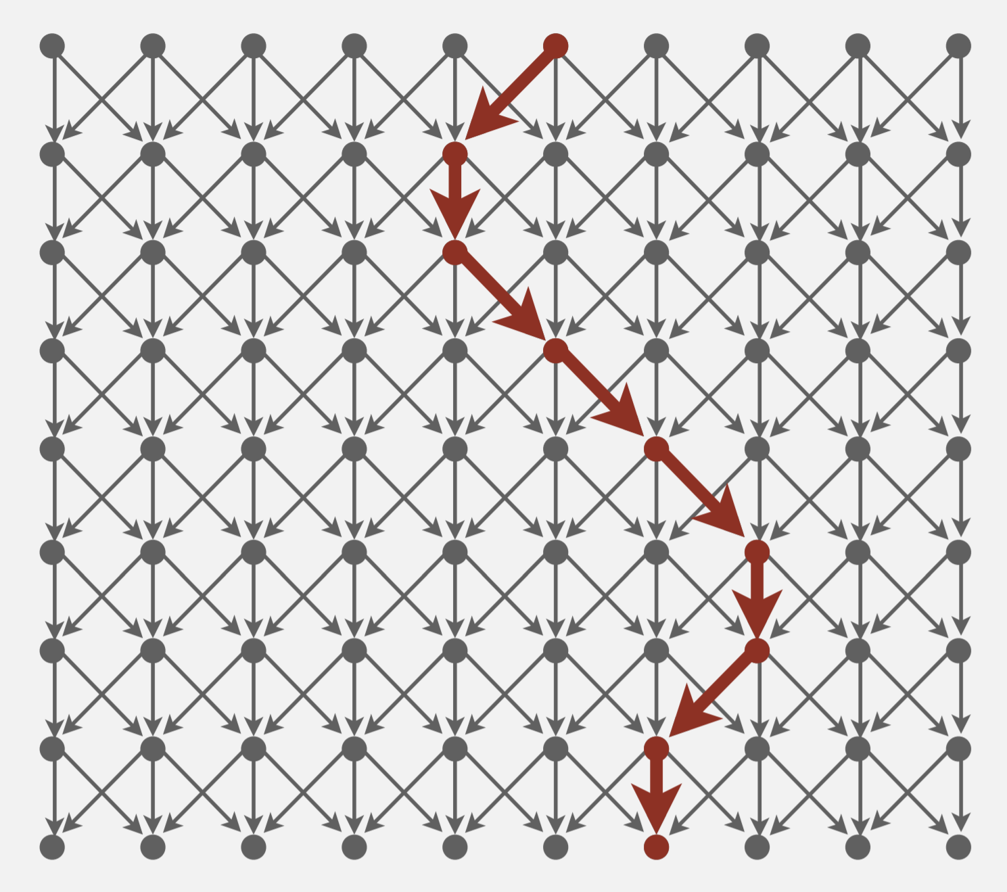
Seam Carving Reduces to Dijkstra’s!
Transform the input so that it can be solved by the standard algorithm
Formulate the image as a graph
Vertices: pixel in the image
Edges: connects a pixel to its 3 downward neighbors
Edge Weights: the “energy” (visual difference) between adjacent pixels
Run the standard algorithm as-is on the transformed input
Run Dijkstra’s to find the shortest path (sum of weights) from top row to bottom row
Transform the output of the algorithm to solve the original problem
Interpret the path as a removable “seam” of unimportant pixels
greater pixel difference = higher weight!
1.5
58.2
1.0
1.6
120.9
Shortest Paths (Robert Sedgewick, Kevin Wayne/Princeton)

Slide 43
An Incomplete Reduction
Complication:
Dijkstra’s starts with a single vertex S and ends with a single vertex T
This problem specifies sets of vertices for the start and end
Question to think about: how would you transform this graph into something Dijkstra’s knows how to operate on?
S
T
Shortest Paths (Robert Sedgewick, Kevin Wayne/Princeton)

Slide 44
In Conclusion
P INPUT
Topo Sort is a widely applicable “sorting” algorithm
Reductions are an essential tool in your CS toolbox -- you’re probably already doing them without putting a name to it
Many more reductions than we can cover!
Shortest Path in DAG with Negative Edges reduces to Topological Sort! (Link)
2-Color Graph Coloring reduces to 2-SAT (Link)
…
Staying on top of the end of the quarter in this course reduces to starting early on P4 and EX4/5
Q INPUT
PROBLEM P
PROBLEM Q
Q OUTPUT
P OUTPUT

Slide 45
Appendix

