Slide 1
Lecture 9: Hash Maps
CSE 373: Data Structures and Algorithms

Slide 2
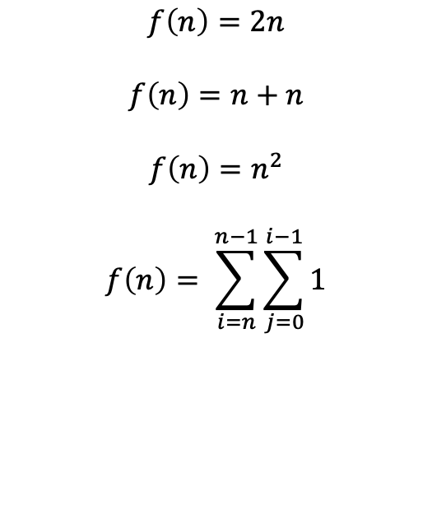
Warm Up!
Keep an eye on loop bounds!
Write a mathematical model of the following code
for (int i = 0; i < n; i++) {
for (int j = 0; j < i; j++) {
System.out.println(“Hello!”);
}
}
+1
n
n
f(n) = n²
Which of the following is a mathematical model for the runtime of the code given?
a.)
b.)
c.)
d.)
$$f\left(n\right)=2n$$
$$f\left(n\right)=n+n$$
$$f\left(n\right)=n^{2}$$
$$f\left(n\right)= \sum_{i=n}^{n−1}{\sum_{j=0}^{i−1}{1}}$$

Slide 3
Modeling Complex Loops
for (int i = 0; i < n; i++) {
for (int j = 0; j < i; j++) {
System.out.print(“Hello! ”);
}
  Sysem.out.println();
}
+1
0 + 1 + 2 + 3 +…+ i-1
n
T(n) = (0 + 1 + 2 + 3 +…+ i-1)
Definition: Summation
How do we model this part?
Summations!
1 + 2 + 3 + 4 +… + n =
$$\sum_{i=1}^{n}{i}$$
$$\sum_{i=a}^{b}{f(i)}$$
= f(a) + f(a + 1) + f(a + 2) + … + f(b-2) + f(b-1) + f(b)
$$\sum_{i=0}^{n−1}{\sum_{j=0}^{i−1}{1}}$$
T(n) =
What is the Big O?

Slide 4
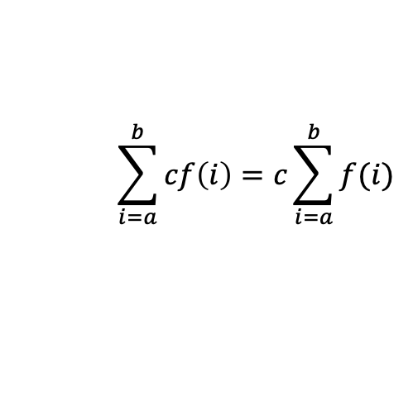
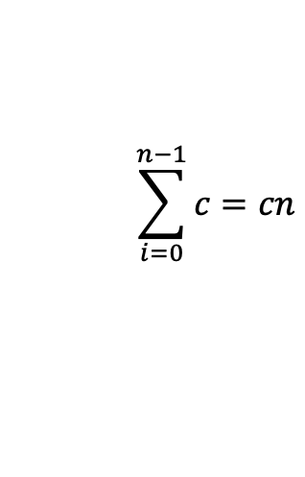
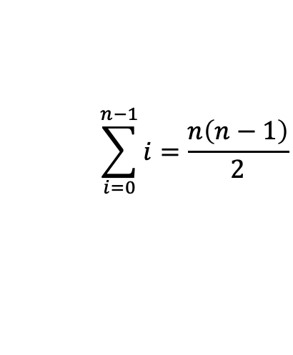
Simplifying Summations
Find closed form using summation identities
(given on exams)
for (int i = 0; i < n; i++) {
for (int j = 0; j < i; j++) {
System.out.println(“Hello!”);
}
}
$$T\left(n\right)=\sum_{i=0}^{n−1}{\sum_{j=0}^{i−1}{1}}$$
simplified tight big O
closed form
$$T\left(n\right)=\sum_{i=0}^{n−1}{\sum_{j=0}^{i−1}{1}}$$
$$=\sum_{i=0}^{n−1}{1・i}$$
$$=1\sum_{i=0}^{n−1}{i}$$
$$=\frac{n\left(n−1\right)}{2}$$
$$= \frac{1}{2}n^{2}−\frac{1}{2}n$$
$$=O(n^{2})$$
Summation of a constant
Factoring out a constant
Gauss’s Identity
$$\sum_{i=a}^{b}{cf\left(i\right)=c\sum_{i=a}^{b}{f(i)}}$$
$$\sum_{i=0}^{n−1}{i=\frac{n\left(n−1\right)}{2}}$$
$$\sum_{i=0}^{n−1}{c=cn}$$

Slide 5
Traversing Data
Array
for (int i = 0; i < arr.length; i++) {
System.out.println(arr[i]);
}
List
for (int i = 0; i < myList.size(); i++) {
System.out.println(myList.get(i));
}
for (T item : list) {
System.out.println(item);
}
Iterator!

Slide 6
Review: Iterators
iterator: a Java interface that dictates how a collection of data should be traversed. Can only move in the forward direction and in a single pass.
Iterator Interface
supported operations:
hasNext() – returns true if the iteration has more elements yet to be examined
next() – returns the next element in the iteration and moves the iterator forward to next item
behavior
hasNext() – true if elements remain
next() – returns next element
ArrayList<Integer> list = new ArrayList<Integer>();
//fill up list
Iterator itr = list.iterator();
while (itr.hasNext()) {
int item = itr.next();
}
ArrayList<Integer> list = new ArrayList<Integer>();
//fill up list
for (int i : list) {
int item = i;
}

Slide 7
Implementing an Iterator
hasNext()
itr
Result
front
4
3
2
1
true
itr
front
4
3
2
1
false
next()
itr
front
4
3
2
1
4
itr
front
4
3
2
1
2
Notes:
Implement over the map we just made

Slide 8
Administrivia
Project 2 out today
  Due Wednesday April 28th
  Exercise 2 out today
  Due Friday April 23rd

Slide 9
Questions

Slide 10
Roadmap for lecture content today
Maps/Dictionary review
DirectAccessMap
  a map implemented with an array with only integer keys
SimpleHashMap
  a more flexible version of DirectAccessMap that uses a hash function on the key of interest to figure out where it is in the array
SeparateChainingHashMap
  fixes some limitations of the above Maps while still being very fast (in-practice).
  It’s what you’ll implement in project 2 / what Java’s official HashMap does -- it’s the back-bone data structure that powers so many Java programs and that you will definitely use if you keep programming. Get hyped!

Slide 11
Dictionaries (aka Maps)
Every Programmer’s Best Friend
You’ll probably use one in almost every programming project.
  Because it’s hard to make a big project without needing one sooner or later.
// two types of Map implementations supposedly covered in CSE 143
Map<String, Integer> map1 = new HashMap<>();
Map<String, String> map2 = new TreeMap<>();

Slide 12
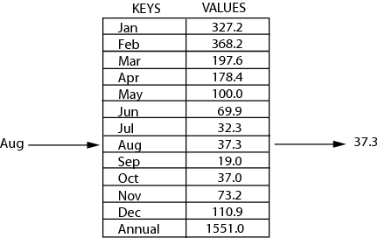
Review: Maps
key | value
“at" | 43
key | value
“in" | 37
key | value
“you" | 22
map: Holds a set of distinct keys and a collection of values, where each key is associated with one value.
  a.k.a. "dictionary"
key | value
“the" | 56
map.get("the")
56
Dictionary ADT
supported operations:
  put(key, value): Adds a given item into collection with associated key,
    if the map previously had a mapping for the given key, old value is replaced.
  get(key): Retrieves the value mapped to the key
  containsKey(key): returns true if key is already associated with value in map, false otherwise
  remove(key): Removes the given key and its mapped value
state
Set of items & keys
Count of items
behavior
put(key, item) add item to collection indexed with key
get(key) return item associated with key
containsKey(key) return if key already in use
remove(key) remove item and associated key
size() return count of items

Slide 13
Implementing a Map with an Array
Big O Analysis – (if key is the last one looked at / not in the dictionary)
put()
get()
containsKey()
remove()
size()
Map ADT
ArrayMap<K, V>
state
state
O(N) linear
Set of items & keys
Count of items
Pair<K, V>[] data
O(N) linear
behavior
behavior
put find key, overwrite value if there. Otherwise create new pair, add to next available spot, grow array if necessary
get scan all pairs looking for given key, return associated item if found
containsKey scan all pairs, return if key is found
remove scan all pairs, replace pair to be removed with last pair in collection
size return count of items in dictionary
O(N) linear
put(key, item) add item to collection indexed with key
get(key) return item associated with key
containsKey(key) return if key already in use
remove(key) remove item and associated key
size() return count of items
O(N) linear
O(1) constant
Big O Analysis – (if the key is the first one looked at)
put()
get()
containsKey()
remove()
size()
O(1) constant
O(1) constant
containsKey(‘c’)
get(‘d’)
put(‘b’, 97)
put(‘e’, 20)
O(1) constant
0 | 1 | 2 | 3
4
O(1) constant
(‘a’, 1)
(‘b’, 2)
(‘c’, 3)
(‘d’, 4)
(‘e’, 20)
97)
O(1) constant

Slide 14
Implementing a Map with Nodes
Big O Analysis – (if key is the last one looked at / not in the dictionary)
put()
get()
containsKey()
remove()
size()
Map ADT
LinkedMap<K, V>
state
state
O(N) linear
Set of items & keys
Count of items
front
size
O(N) linear
behavior
behavior
O(N) linear
put(key, item) add item to collection indexed with key
get(key) return item associated with key
containsKey(key) return if key already in use
remove(key) remove item and associated key
size() return count of items
put if key is unused, create new with pair, add to front of list, else replace with new value
get scan all pairs looking for given key, return associated item if found
containsKey scan all pairs, return if key is found
remove scan all pairs, skip pair to be removed
size return count of items in dictionary
O(N) linear
O(1) constant
Big O Analysis – (if the key is the first one looked at)
put()
get()
containsKey()
remove()
size()
O(1) constant
containsKey(‘c’)
get(‘d’)
put(‘b’, 20)
O(1) constant
front
O(1) constant
O(1) constant
‘b’
20
O(1) constant
‘a’
1
7
‘c’
9
‘d’
4

Slide 15
Can we do better?
DirectAccessMap<Integer, V>
state
Data[]
size
Let’s simplify the problem we’re working with + combine it with some facts about arrays.
problem simplification: only worry about supporting integer keys
array facts: accessing (data[i]) or updating an element (data[i] = …) at a given index takes Theta(1) runtime.
If we store the Key-Value pairs at the data[key] then we don’t have to do any looping to find it. For example consider `containsKey` or `get` -- we can just jump directly to data[key] to figure out the return answer.
behavior
put put item at given index
get get item at given index
containsKey if data[] null at index, return false, return true otherwise
remove nullify element at index
size return count of items in dictionary

Slide 16
Can we do better?
DirectAccessMap<Integer, V>
state
Data[]
size
Let’s simplify the problem we’re working with + combine it with some facts about arrays.
problem simplification: only worry about supporting integer keys
array facts: accessing (data[i]) or updating an element (data[i] = …) at a given index takes Theta(1) runtime.
If we store the Key-Value pairs at the data[key] then we don’t have to do any looping to find it. For example consider `containsKey` or `get` -- we can just jump directly to data[key] to figure out the return answer.
behavior
put put item at given index
get get item at given index
containsKey if data[] null at index, return false, return true otherwise
remove nullify element at index
size return count of items in dictionary
indices | 0 | 1 | 2 | 3 | 4 | 5 | 6 | 7 | 8 | 9
data
put(3, “Sherdil”);
get(3);

Slide 17
Can we do better?
DirectAccessMap<Integer, V>
state
Data[]
size
Let’s simplify the problem we’re working with + combine it with some facts about arrays.
problem simplification: only worry about supporting integer keys
array facts: accessing (data[i]) or updating an element (data[i] = …) at a given index takes Theta(1) runtime.
If we store the Key-Value pairs at the data[key] then we don’t have to do any looping to find it. For example consider `containsKey` or `get` -- we can just jump directly to data[key] to figure out the return answer.
behavior
put put item at given index
get get item at given index
containsKey if data[] null at index, return false, return true otherwise
remove nullify element at index
size return count of items in dictionary
indices | 0 | 1 | 2 | 3 | 4 | 5 | 6 | 7 | 8 | 9
data |  |  |  | (3, Sherdil)
put(3, “Sherdil”);
get(3);

Slide 18
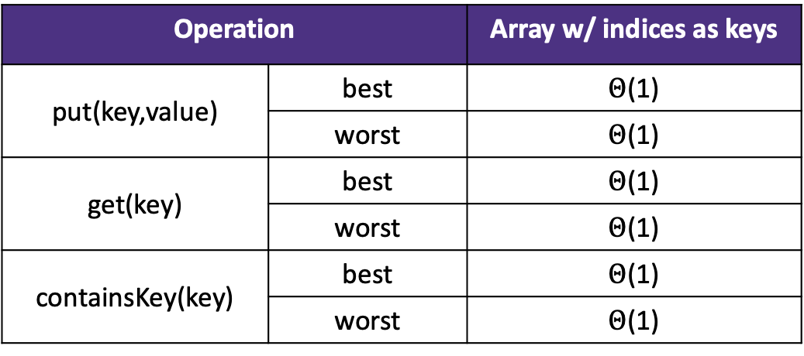
Can we do better? -- Direct Access Map impl.
DirectAccessMap<Integer, V>
public void put(int key, V value) {
this.array[key] = value;
}
public boolean containsKey(int key) {
return this.array[key] != null;
}
public V get(int key) {
  return this.array[key];
}
public void remove(int key) {
this.array[key] = null;
}
state
Data[]
size
behavior
put put item at given index
get get item at given index
containsKey if data[] null at index, return false, return true otherwise
remove nullify element at index
size return count of items in dictionary
Operation |  | Array w/ indices as keys
put(key,value) | best | $Θ$(1)
 | worst | $Θ$(1)
get(key) | best | $Θ$(1)
 | worst | $Θ$(1)
containsKey(key) | best | $Θ$(1)
 | worst | $Θ$(1)

Slide 19
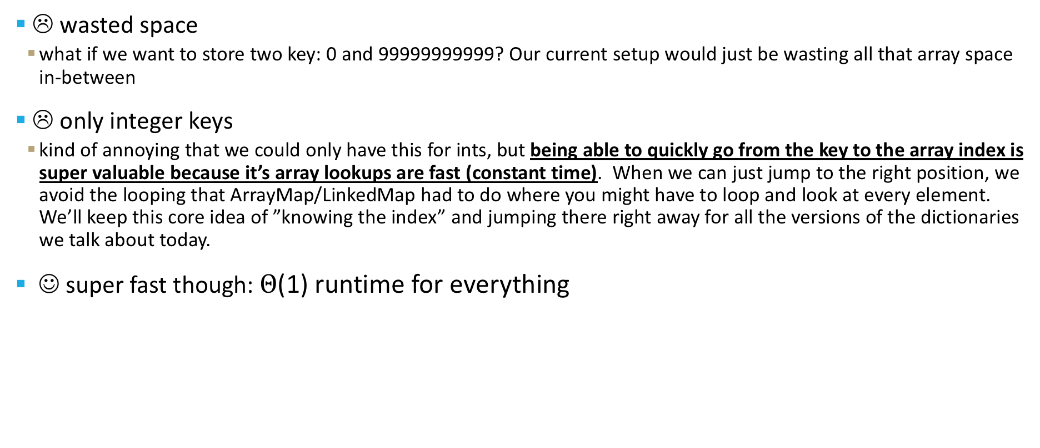
Direct Access Map tradeoffs:
take 1 seconds to review what DirectAccessMap is in your notes and send some ideas in the activity polleverywhere:
- what’s a benefit of using DirectAccessMap?
- what’s a bad thing when using DirectAccessMap?
☹ wasted space
  what if we want to store two key: 0 and 99999999999? Our current setup would just be wasting all that array space in-between
☹ only integer keys
  kind of annoying that we could only have this for ints, but being able to quickly go from the key to the array index is super valuable because it’s array lookups are fast (constant time). When we can just jump to the right position, we avoid the looping that ArrayMap/LinkedMap had to do where you might have to loop and look at every element. We’ll keep this core idea of ”knowing the index” and jumping there right away for all the versions of the dictionaries we talk about today.
☺ super fast though: $Θ$(1) runtime for everything

Slide 20
Can we do this for any integer?
Idea 1:
Create a GIANT array with every possible integer as an index
Problems:
  Can we allocate an array big enough?
  Super wasteful
Idea 2:
Create a smaller array, but create a way to translate given integer keys into available indices. Way less wasteful space-wise.
Problem:
  How can we pick a good translation?

Slide 21
Hash functions: translating a piece of data to an int
Hash function definition
A hash function is any function that can be used to map data of arbitrary size to fixed-size values.
In our case: we want to translate int keys to a valid index in our array. If our array is length 10 but our input key is 500, we need to make sure we have a way of mapping that to a number between 0 and 9 (the valid indices for a length 10 array). This mapping that we decide on is a hash function.
One simple thing we can do (and that you will do when you implement this in your project):
Hash function: take your key and % it by the length of the array.
ex: key is 500, and array is length 10 – if you take 500 % 10, you will get the number 0, so we’d just plop 500 and it’s value at index 0.

Slide 22
“review”: Integer remainder with % “mod”
The % operator computes the remainder from integer division.
  14 % 4 is 2
  3 43
  4 ) 14 5 ) 218
  12 20
  2 18
  15
  3
Applications of % operator:
  Obtain last digit of a number: 230857 % 10 is 7
  See whether a number is odd: 7 % 2 is 1, 42 % 2 is 0
  Limit integers to specific range: 8 % 12 is 8, 18 % 12 is 6
218 % 5 is 3
Equivalently, to find a % b (for a,b > 0):
while(a > b-1)
a -= b;
return a;
Limit keys to indices within array
For more review/practice, check out https://www.khanacademy.org/computing/computer-science/cryptography/modarithmetic/a/what-is-modular-arithmetic

Slide 23
First Hash Function: % table size
indices | 0 | 1 | 2 | 3 | 4 | 5 | 6 | 7 | 8 | 9
elements
“foo”
“biz”
“bar”
“bop”
put(0, “foo”);
put(5, “bar”);
put(11, “biz”)
put(18, “bop”);
0 % 10 = 0
5 % 10 = 5
11 % 10 = 1
18 % 10 = 8

Slide 24
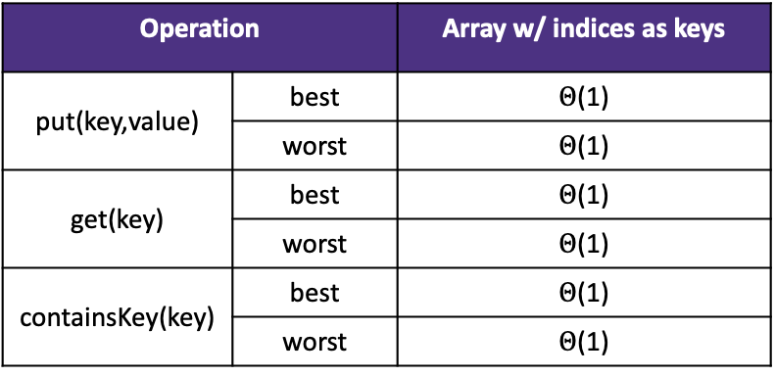
Implement First Hash Function
SimpleHashMap<Integer>
public void put(int key, int value) {
data[hashToValidIndex(key)] = value;
}
public V get(int key) {
return data[hashToValidIndex(key)];
}
public int hashToValidIndex(int k) {
return k % this.data.length;
}
state
Data[]
size
behavior
put mod key by table size, put item at result
get mod key by table size, get item at result
containsKey mod key by table size, return data[result] == null remove mod key by table size, nullify element at result
size return count of items in dictionary
Operation |  | Array w/ indices as keys
put(key,value) | best | $Θ$(1)
 | worst | $Θ$(1)
get(key) | best | $Θ$(1)
 | worst | $Θ$(1)
containsKey(key) | best | $Θ$(1)
 | worst | $Θ$(1)
Note: % is just a math operator like +, -, /, *, so it’s constant runtime

Slide 25
Questions?
things we talked about:
review of ArrayMap + LinkedMap
DirectAccessMap
% as a hash function andSimpleHashMap

Slide 26
First Hash Function: % table size
indices | 0 | 1 | 2 | 3 | 4 | 5 | 6 | 7 | 8 | 9
elements
“foo”
“biz”
“bar”
“bop”
“:(”
put(0, “foo”);
put(5, “bar”);
put(11, “biz”)
put(18, “bop”);
put(20, “:(”);
0 % 10 = 0
5 % 10 = 5
11 % 10 = 1
18 % 10 = 8
20 % 10 = 0
Collision!

Slide 27
Hash Obsession: Collisions
Collision: multiple keys translate to the same location of the array
Future big idea: the fewer the collisions, the better the runtime! (we’ll see this when we figure out that resolving these leads to worse runtime)
Two questions:
1. When we have a collision, how do we resolve it?
2. How do we minimize the number of collisions?

Slide 28
Roadmap for lecture content today
Maps/Dictionary review
DirectAccessMap
  a map implemented with an array with only integer keys
SimpleHashMap
  a more flexible version of DirectAccessMap that uses a hash function on the key of interest to figure out where it is in the array
SeparateChainingHashMap
  fixes some limitations of the above Maps while still being very fast (in-practice).
  It’s what you’ll implement in project 2 / what Java’s official HashMap does -- it’s the back-bone data structure that powers so many Java programs and that you will definitely use if you keep programming. Get hyped!

Slide 29
Strategies to handle hash collision
There are multiple strategies. In this class, we’ll cover the following ones:
1. Separate chaining
2. Open addressing
  Linear probing
  Quadratic probing
  Double hashing

Slide 30
Separate chaining
Solution 1: Separate Chaining
Each index in our array represents a “bucket”. When an item x hashes to index h:
  If the bucket at index h is empty: create a new list containing x
  If the bucket at index h is already a list: add x if it is not already present
in other words:
If multiple things hash to the same index, then we’ll just put all of those in that same index bucket. Often, you’ll see the data structure chosen is a linked-list like structure.

Slide 31
Separate chaining
Reminder: the implementations of put/get/containsKey are all very similar, and almost always will have the same complexity class runtime
// some pseudocode
public boolean containsKey(int key) {
int bucketIndex = key % data.length;
loop through data[bucketIndex]
return true if we find the key in
data[bucketIndex]
return false if we get to here (didn’t
find it)
}
runtime analysis
Are there different possible states for our Hash Map that make this code run slower/faster, assuming there are already n key-value pairs being stored?
Yes! If we had to do a lot of loop iterations to find the key in the bucket, our code will run slower.

Slide 32
A best case situation for separate chaining
0 | 1 | 2 | 3 | 4 | 5 | 6 | 7 | 8 | 9
(0, b)
(2, b)
(3, b)
(4, b)
(5, b)
(6, b)
(7, b)
(8, b)
It’s possible (and likely if you follow some best-practices) that everything is spread out across the buckets pretty evenly. This is the opposite of the last slide: when we have minimal collisions, our runtime should be less. For example, if we have a bucket with only 0 or 1 element in it, checking containsKey for something in that bucket will only take a constant amount of time.
We’re going to try a lot of stuff we can to make it more likely we achieve this beautiful state ☺.

Slide 33
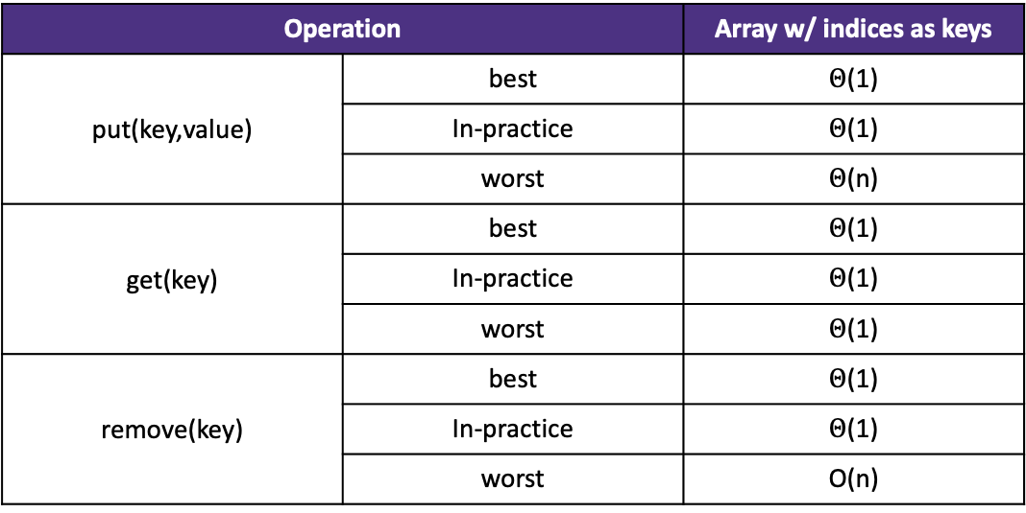
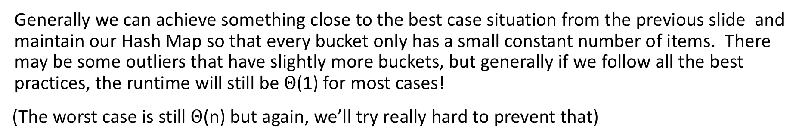
In-practice situations for separate chaining
Generally we can achieve something close to the best case situation from the previous slide and maintain our Hash Map so that every bucket only has a small constant number of items. There may be some outliers that have slightly more buckets, but generally if we follow all the best practices, the runtime will still be $Θ$(1) for most cases!
(The worst case is still $Θ$(n) but again, we’ll try really hard to prevent that)
Operation |  | Array w/ indices as keys
put(key,value) | best | $Θ$(1)
 | In-practice | $Θ$(1)
 | worst | $Θ$(n)
get(key) | best | $Θ$(1)
 | In-practice | $Θ$(1)
 | worst | $Θ$(1)
remove(key) | best | $Θ$(1)
 | In-practice | $Θ$(1)
 | worst | O(n)
Reminder: the in-practice runtimes are assuming an even distribution of the keys inside the array and following of best-practices to ensure the average chain length is low.

Slide 34
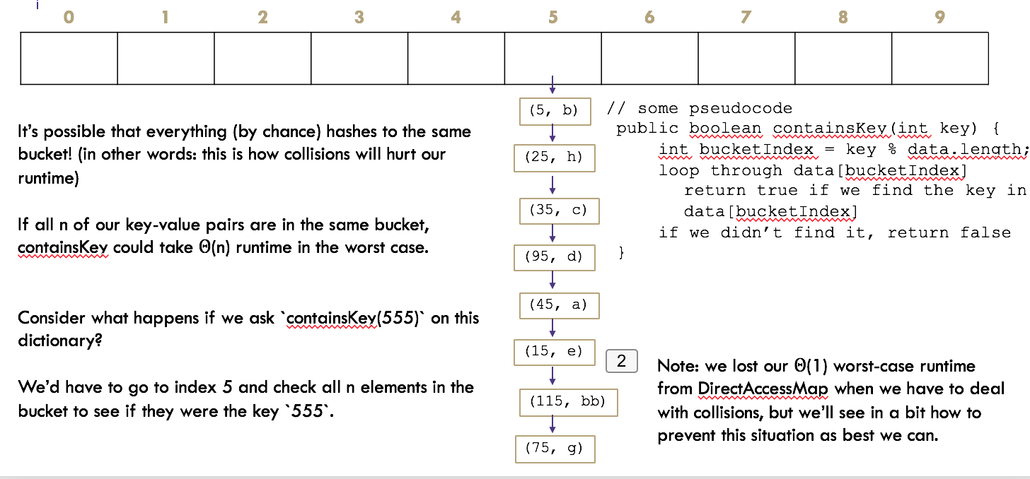
Best practices (pay attention to this for the hw)
what about resizing?
  for data structures like ArrayMap or ArrayList or ArrayStack we had to resize when we’re full just because we couldn’t store any more things! But our Separate Chaining Hash Map is a little bit different: we aren’t ever forced to resize our main array, since the buckets are flexible size.
It turns out we still want to resize “every so often” to make sure the average/expected length of each bucket is a small number.
Consider what happens if we had the array length 10 like on the left, but had 100 key-value pairs?
Assuming our in-practice niceness (not-worst case) you would expect on average each of the 10 buckets has about 10 key-value pairs in it.
What happens if we stick with the same size array but add 100 more key-value pairs? Each bucket gets about 10 more –key-value pairs and the runtime is getting worse and worse.

Slide 35
Best practices (pay attention to this for the hw)
It turns out we still want to resize “every so often” to make sure the average/expected length of each bucket is a small number.
Consider what happens if we had the array length 10 like on the left, but had 100 key-value pairs?
Assuming our in-practice niceness (not-worst case) you would expect on average each of the 10 buckets has about 10 key-value pairs in it.
What happens if we stick with the same size array but add 100 more key-value pairs? Each bucket gets about 10 more –key-value pairs and the runtime is getting worse and worse.
The pattern we’re getting to is that the expected runtime is approximately: # of pairs / array.length (AKA n / c where n is the number of elements and c is the number of possible chains). If array.length is fixed for your whole program, then this is an order-n runtime, but if the array.length also increases (because you re-size) and you redistribute out the values evenly across the buckets, you can keep your runtime low. In particular, if you resize when when your n / c ratio increases to about 1, you’re expected to have 1 element or fewer in each bucket at all times. (do this on your homework).
Tip: make sure you re-hash (re-distribute) your keys by the new array length after re-sizing so they don’t get clustered in the old array length range.

Slide 36

Lambda + resizing rephrased
To be more precise, the in-practice runtime depends on λ, the current average chain length.
However, if you resize once you hit that 1:1 threshold, the current λ is expected to be less than 1 (which is a constant / constant runtime, so we can simplify to O(1)).
Operation |  | Array w/ indices as keys
put(key,value) | best | O(1)
 | In-practice | O(λ)
 | worst | O(n)
get(key) | best | O(1)
 | In-practice | O(λ)
 | worst | O(n)
remove(key) | best | O(1)
 | In-practice | O(λ)
 | worst | O(n)
“In-Practice” Case:
Depends on average number of elements per chain
Load Factor λ
If n is the total number of key-value pairs
Let c be the capacity of array
Load Factor λ = $\frac{n}{c}$

Slide 37
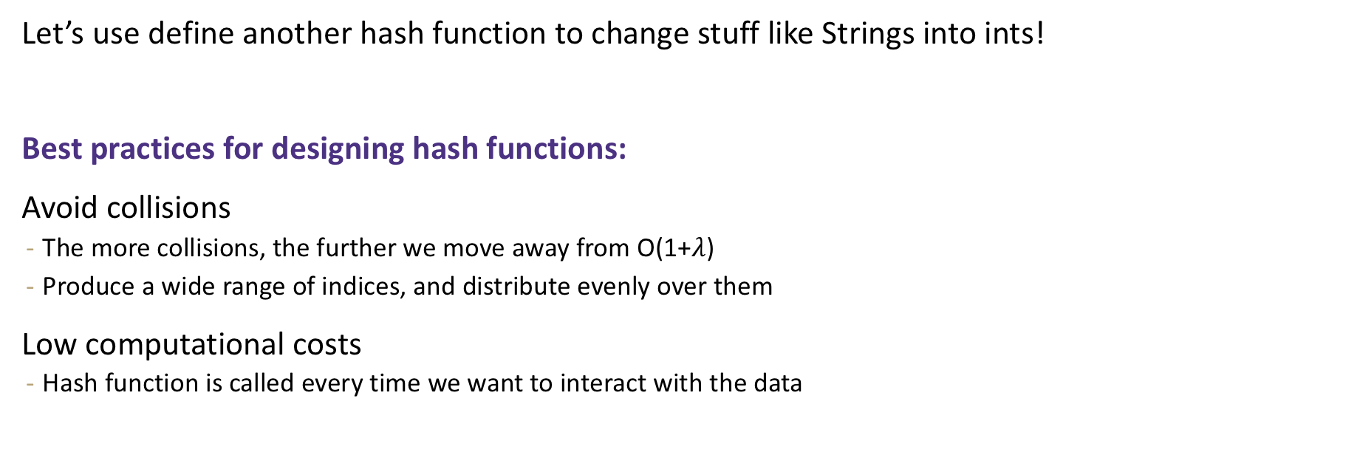
What about non integer keys?
Hash function definition
A hash function is any function that can be used to map data of arbitrary size to fixed-size values.
Let’s use define another hash function to change stuff like Strings into ints!
Best practices for designing hash functions:
Avoid collisions
  The more collisions, the further we move away from O(1+$λ$)
  Produce a wide range of indices, and distribute evenly over them
Low computational costs
  Hash function is called every time we want to interact with the data

Slide 38
(Before we % by length, we have to convert the data into an int)
Implementation 1: Simple aspect of values
public int hashCode(String input) {
return input.length();
}
Implementation 2: More aspects of value
public int hashCode(String input) {
int output = 0;
for(char c : input) {
out += (int)c;
}
return output;
}
Implementation 3: Multiple aspects of value + math!
public int hashCode(String input) {
int output = 1;
for (char c : input) {
int nextPrime = getNextPrime();
out *= Math.pow(nextPrime, (int)c);
}
return Math.pow(nextPrime, input.length());
}
Pro: super fast
Con: lots of collisions!
Pro: still really fast
Con: some collisions
Pro: few collisions
Con: slow, gigantic integers

Slide 39
Java’s hashCode (relevant for project)
Luckily, most of these design decisions have been made for us by smart people. All objects in java come with a `hashCode()` method that does some magic (see previous slide for the not-magic version) to turn any object type (like String, ArrayList, Point, Scanner) into an integer. These hashCodes are designed to distribute pretty evenly / not have lots of collisions, so we use them as the starting point for determining the bucket index.
high level steps to figure out which bucket a key goes into
  call the key.hashCode() to get an int representation of the object
  % by the array table length to convert it to a valid index for your hash map

Slide 40
Best practices for an nice distribution of keys recap
resize when lambda (number of elements / number of buckets) increases up to 1
when you resize, you can choose a the table length that will help reduce collisions if you multiply the array length by 2 and then choose the nearest prime number
design the hashCode of your keys to be somewhat complex and lead to a distribution of different output numbers

Slide 41
Practice
Consider an IntegerDictionary using separate chaining with an internal capacity of 10. Assume our buckets are implemented using a LinkedList where we append new key-value pairs to the end.
Now, suppose we insert the following key-value pairs. What does the dictionary internally look like?
(1, a) (5,b) (11,a) (7,d) (12,e) (17,f) (1,g) (25,h)
0 | 1 | 2 | 3 | 4 | 5 | 6 | 7 | 8 | 9
(1, a)
(12, e)
(5, b)
(7, d)
(1, g)
(11, a)
(25, h)
(17, f)

Slide 42
Practice
Consider a StringDictionary using separate chaining with an internal capacity of 10. Assume our buckets are implemented using a LinkedList. Use the following hash function:
public int hashCode(String input) {
return input.length() % arr.length;
}
Now, insert the following key-value pairs. What does the dictionary internally look like?
(“a”, 1) (“ab”, 2) (“c”, 3) (“abc”, 4) (“abcd”, 5) (“abcdabcd”, 6) (“five”, 7) (“hello world”, 8)
0 | 1 | 2 | 3 | 4 | 5 | 6 | 7 | 8 | 9
(“a”, 1)
(“ab”, 2)
(“abc”, 4)
(“abcd”, 5)
(“c”, 3)
(“abcdabcd”, 6)
(“hello world”, 8)
(“five”, 7)

Slide 43
Java and Hash Functions
Object class includes default functionality:
  equals
  hashCode
If you want to implement your own hashCode you should:
  Override BOTH hashCode() and equals()
  If a.equals(b) is true then a.hashCode() == b.hashCode() MUST also be true
That requirement is part of the Object interface.
Other people’s code will assume you’ve followed this rule.
Java’s HashMap (and HashSet) will assume you follow these rules and conventions for your custom objects if you want to use your custom objects as keys.

