Slide 1
Lecture 2: Abstract Data Types
Please fill out the Poll at- pollev.com/21sp373
CSE 373: Data Structures and Algorithms

Slide 2
Agenda
Dust off data structure cobwebs
Meet the ADT
List Case Study
Notes:
Intros (10)
- Why learn D&A (5) (ZC)
- Meet the course staff (5)
- Lecturers (Each have our own slide)
- TAs (slide with pics and names)
Course Administration (15) (figure out together) X
- syllabus
- remote logistics (trying the breakouts here if not too many students to introduce self to others?)
A note about imposter syndrome (course culture) (5) (KC)
Intro to Data Structures (20)
- Definitions (KC)
- define data structure
- define ADT
- List ADT (ZC)
- ArrayList implementation
- LinkedList implementation

Slide 3
Announcements
Things are live!
course website – one stop for all things 373
Discord – connect with students + office hours
Ed board – get your course content questions answered
Gradescope
HW 0 Assigned – Due Wednesday
143 review
solo assignment

Slide 4
Questions?
Clarification on syllabus, General complaining/moaning

Slide 5
What is this class about?
CSE 143 – Object Oriented Programming
CSE 373 – Data Structures and Algorithms
Classes and Interfaces
Methods, variables and conditionals
Loops and recursion
Linked lists and binary trees
Sorting and Searching
O(n) analysis
Generics
Design decisions
Design analysis
Implementations of data structures
Debugging and testing
Abstract Data Types
Code Modeling
Complexity Analysis
Software Engineering Practices

Slide 6
Data Structures and Algorithms
What are they anyway?

Slide 7
Basic Definitions
Data Structure
A way of organizing and storing data
Examples from CSE 14X: arrays, linked lists, stacks, queues, trees
Algorithm
A series of precise instructions to produce to a specific outcome
Examples from CSE 14X: binary search, merge sort, recursive backtracking

Slide 8
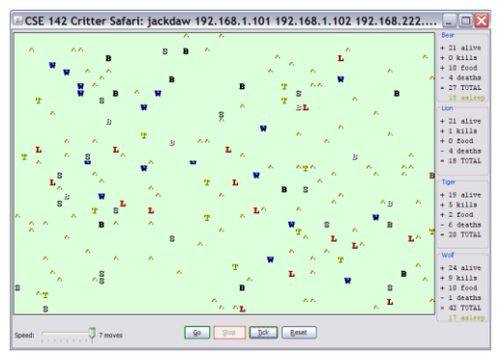
Review: Clients vs Objects
Client classes
Object Classes
A class that is executable, in Java this means it contains a Main method
public static void main(String[] args)
A coded structure that contains data and behavior
Start with the data you want to hold, organize the things you want to enable users to do with that data

Slide 9
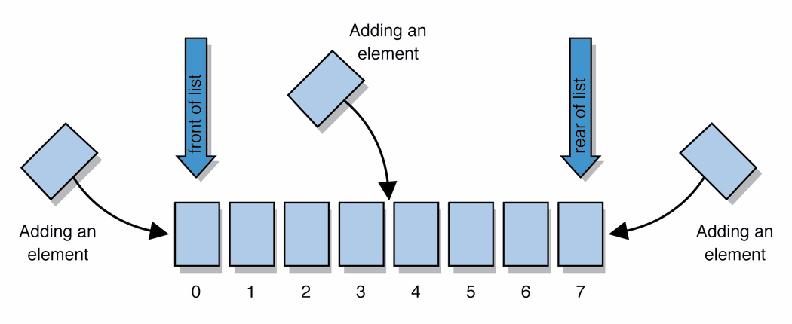
Abstract Data Types (ADT)
Abstract Data Types
An abstract definition for expected operations and behavior
Defines the input and outputs, not the implementations
Review: List - a collection storing an ordered sequence of elements
each element is accessible by a 0-based index
a list has a size (number of elements that have been added)
elements can be added to the front, back, or elsewhere
in Java, a list can be represented as an ArrayList object
Notes:
A way to communicate with other programmers, a standard that we all can agree on so we can discuss conceptual ways of organizing data

Slide 10
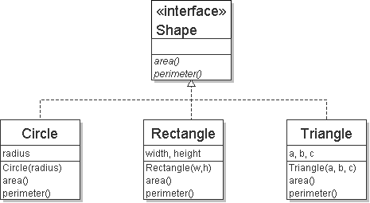
Review: Interfaces
Example
// Describes features common to all // shapes.
public interface Shape {
public double area();
public double perimeter();
}
interface: A construct in Java that defines a set of methods that a class promises to implement
Interfaces give you an is-a relationship without code sharing.
A Rectangle object can be treated as a Shape but inherits no code.
Analogous to non-programming idea of roles or certifications:
"I'm certified as a CPA accountant. This assures you I know how to do taxes, audits, and consulting."
"I'm 'certified' as a Shape, because I implement the Shape interface. This assures you I know how to compute my area and perimeter."
public interface name {
public type name(type name, ..., type name);
public type name(type name, ..., type name);
...
public type name(type name, ..., type name);
}

Slide 11
Review: Java Collections
Java provides some implementations of ADTs for you!
Lists List<Integer> a = new ArrayList<Integer>();
Stacks Stack<Character> c = new Stack<Character>();
Queues Queue<String> b = new LinkedList<String>();
Maps Map<String, String> d = new TreeMap<String, String>();
But some data structures you made from scratch… why?
Linked Lists - LinkedIntList was a collection of ListNode
Binary Search Trees – SearchTree was a collection of SearchTreeNodes
ADTs
Data Structures

Slide 12
Full Definitions
Abstract Data Type (ADT)
A definition for expected operations and behavior
A mathematical description of a collection with a set of supported operations and how they should behave when called upon
Describes what a collection does, not how it does it
Can be expressed as an interface
Examples: List, Map, Set
Data Structure
A way of organizing and storing related data points
An object that implements the functionality of a specified ADT
Describes exactly how the collection will perform the required operations
Examples: LinkedIntList, ArrayIntList

Slide 13
ADTs we’ll discuss this quarter
List
Set
Map
Stack
Queue
Priority Queue
Graph
Disjoint Set

Slide 14
Case Study: The List ADT
list: a collection storing an ordered sequence of elements.
Each item is accessible by an index.
A list has a size defined as the number of elements in the list
List<String> names = new ArrayList<>();
names.add("Anish");
names.add("Amanda");
names.add(0, "Brian");

Slide 15
Case Study: The List ADT
list: a collection storing an ordered sequence of elements.
Each item is accessible by an index.
A list has a size defined as the number of elements in the list
Expected Behavior:
get(index): returns the item at the given index
set(value, index): sets the item at the given index to the given value
append(value): adds the given item to the end of the list
insert(value, index): insert the given item at the given index maintaining order
delete(index): removes the item at the given index maintaining order
size(): returns the number of elements in the list

Slide 16
Case Study: List Implementations
ArrayList
uses an Array as underlying storage
LinkedList
uses nodes as underlying storage
List ADT
ArrayList<E>
LinkedList<E>
state
Set of ordered items
Count of items
state
state
data[]
size
Node front
size
behavior
get(index) return item at index
set(item, index) replace item at index
append(item) add item to end of list
insert(item, index) add item at index
delete(index) delete item at index
size() count of items
behavior
behavior
get return data[index]
set data[index] = value
append data[size] = value, if out of space grow data
insert shift values to make hole at index, data[index] = value, if out of space grow data
delete shift following values forward
size return size
get loop until index, return node’s value
set loop until index, update node’s value
append create new node, update next of last node
insert create new node, loop until index, update next fields
delete loop until index, skip node
size return size
0 | 1 | 2 | 3 | 4
88.6 | 26.1 | 94.4 | 0 | 0
88.6
26.1
94.4
list
free space
Notes:
Code up an implementation of List

Slide 17
Implementing ArrayList
insert(element, index) with shifting
ArrayList<E>
0 | 1 | 2 | 3
state
insert(10, 0)
5
3
4
5
10
3
4
data[]
size
4
behavior
numberOfItems =
3
get return data[index]
set data[index] = value
append data[size] = value, if out of space grow data
insert shift values to make hole at index, data[index] = value, if out of space grow data
delete shift following values forward
size return size
delete(index) with shifting
0 | 1 | 2 | 3
10
3
4
5
delete(0)
3
4
5
numberOfItems =
4
3

Slide 18
Implementing ArrayList
append(element) with growth
ArrayList<E>
0 | 1 | 2 | 3
state
append(2)
10
3
4
5
data[]
size
behavior
get return data[index]
set data[index] = value
append data[size] = value, if out of space grow data
insert shift values to make hole at index, data[index] = value, if out of space grow data
delete shift following values forward
size return size
numberOfItems =
4
5
0 | 1 | 2 | 3 | 4 | 5 | 6 | 7
2

Slide 19
Design Decisions
For every ADT there are lots of different ways to implement them
Based on your situation you should consider:
Memory vs Speed
Generic/Reusability vs Specific/Specialized
One Function vs Another
Robustness vs Performance
This class is all about implementing ADTs based on making the right design tradeoffs!
> A common topic in interview questions

