Slide 1
CSE 373 Section 7
Dijkstra + MSTs + Disjoint Sets

Slide 2
Logistics
P3 due last night
Ex3 due Friday night
Email problems -> DM Farrell on discord if you want the section slides

Slide 3
MicroTeach: Dijkstra’s

Slide 4
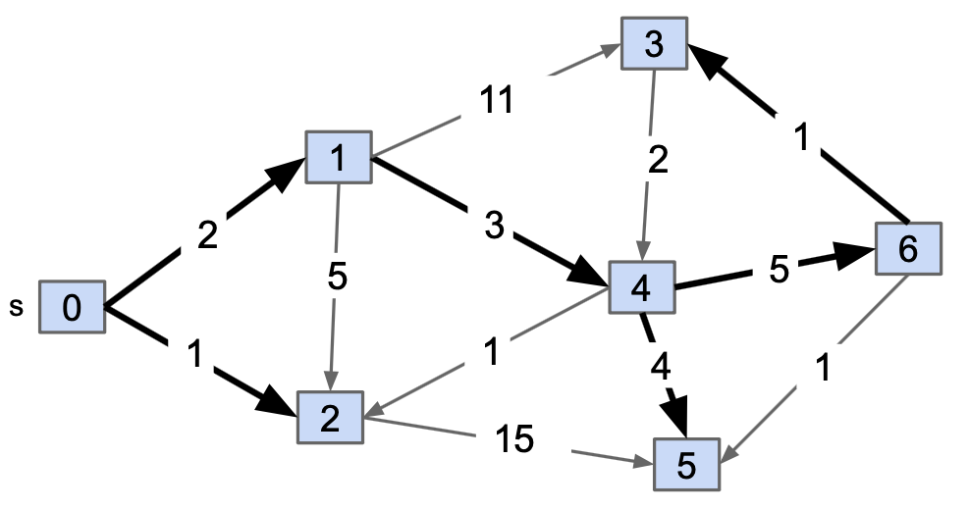
Dijkstra’s Algorithm
Pathfinding on a weighted graph!
Main idea: find shortest path/shortest distance from start node in graph to every other node.
Uses a Priority Queue, where priorities of nodes are their distance from the start node
We pull the closest node off the queue each iteration, and update the distances for its adjacent nodes. Then repeat.

Slide 5
Dijkstra’s Pseudocode
Dijkstra(Graph G, Vertex source)
initialize distances to ∞
mark all vertices unprocessed
mark source as distance 0
while(there are unprocessed vertices){
let u be the closest unprocessed vertex
for each(edge (u,v) leaving u){
if(u.dist+weight(u,v) < v.dist){
v.dist = u.dist+weight(u,v)
v.predecessor = u
}
}
mark u as processed
}

Slide 6
Q: How to get the shortest path?
A: After running Dijkstra, start from the target node and follow the backpointers!
GetPath(Graph G, Vertex source, Vertex target)
// We never reached the target :(
if (target.dist == INFINITY)
return null
path = []
curNode = target
path.add_back(target)
while(curNode != source)
curNode = curNode.predecessor
path.add_back(curNode)
// If we want the path to go from source -> goal.
return path.reversed()

Slide 7
BFS vs. Dijkstra SPT Side to Side Comparison
BFS implements “fake” distances to be able to backtrace and find the SPT
Dijkstra(Graph G, Vertex source)
initialize distances to ∞
mark all vertices unprocessed
mark source as distance 0
while(there are unprocessed vertices){
let u be the closest unprocessed vertex
for each(edge (u,v) leaving u){
if(u.dist+weight(u,v) < v.dist){
v.dist = u.dist+weight(u,v)
v.predecessor = u
}
}
mark u as processed
}
GetPath(Graph G, Vertex source, Vertex target)
// We never reached the target :(
if (target.dist == INFINITY)
return null
path = []
curNode = target
path.add_back(target)
while(curNode != source)
curNode = curNode.predecessor
path.add_back(curNode)
// If we want the path to go from source -> goal.
return path.reversed()

Slide 8
Problem 1A (Dijkstra)

Slide 9
Problem 1A: Dijkstra
S
T
Vertex | Distance | Pred | Processed (?)
S | 0 | --
T | inf | --
X | inf | --
Y | inf | --
Z | inf | --
6
5
8
7
4
2
Y
9
Z
7
X
3

Slide 10
Problem 1A: Dijkstra
S
T
Vertex | Distance | Pred | Processed (?)
S | 0 | -- | ✓
T | inf | --
X | inf | --
Y | inf | --
Z | inf | --
6
5
8
7
4
2
Y
9
Z
7
X
3

Slide 11
Problem 1A: Dijkstra
S
T
Vertex | Distance | Pred | Processed (?)
S | 0 | -- | ✓
T | inf 6 | S
X | inf | --
Y | inf 7 | S
Z | inf | --
6
5
8
7
4
2
Y
9
Z
7
X
3

Slide 12
Problem 1A: Dijkstra
S
T
Vertex | Distance | Pred | Processed (?)
S | 0 | -- | ✓
T | inf 6 | S | ✓
X | inf | --
Y | inf 7 | S
Z | inf | --
6
5
8
7
4
2
Y
9
Z
7
X
3

Slide 13
Problem 1A: Dijkstra
S
T
Vertex | Distance | Pred | Processed (?)
S | 0 | -- | ✓
T | inf 6 | S | ✓
X | inf 11 | T
Y | inf 7 | S
Z | inf 10 | T
6
5
8
7
4
2
Y
9
Z
7
X
3

Slide 14
Problem 1A: Dijkstra
S
T
Vertex | Distance | Pred | Processed (?)
S | 0 | -- | ✓
T | inf 6 | S | ✓
X | inf 11 | T
Y | inf 7 | S | ✓
Z | inf 10 | T
6
5
8
7
4
2
Y
9
Z
7
X
3

Slide 15
Problem 1A: Dijkstra
S
T
Vertex | Distance | Pred | Processed (?)
S | 0 | -- | ✓
T | inf 6 | S | ✓
X | inf 11 10 | T Y
Y | inf 7 | S | ✓
Z | inf 10 | T
6
5
8
7
4
2
Y
9
Z
7
X
3

Slide 16
Problem 1A: Dijkstra
S
T
Vertex | Distance | Pred | Processed (?)
S | 0 | -- | ✓
T | inf 6 | S | ✓
X | inf 11 10 | T Y | ✓
Y | inf 7 | S | ✓
Z | inf 10 | T
6
5
8
7
4
2
Y
9
Z
7
X
3

Slide 17
Problem 1A: Dijkstra
S
T
Vertex | Distance | Pred | Processed (?)
S | 0 | -- | ✓
T | inf 6 | S | ✓
X | inf 11 10 | T Y | ✓
Y | inf 7 | S | ✓
Z | inf 10 | T
6
5
8
7
4
2
Y
9
Z
7
X
3
(Nothing happens!)

Slide 18
Problem 1A: Dijkstra
S
T
Vertex | Distance | Pred | Processed (?)
S | 0 | -- | ✓
T | inf 6 | S | ✓
X | inf 11 10 | T Y | ✓
Y | inf 7 | S | ✓
Z | inf 10 | T | ✓
6
5
8
7
4
2
Y
9
Z
7
X
3

Slide 19
Problem 1A: Dijkstra
S
T
Vertex | Distance | Pred | Processed (?)
S | 0 | -- | ✓
T | inf 6 | S | ✓
X | inf 11 10 | T Y | ✓
Y | inf 7 | S | ✓
Z | inf 10 | T | ✓
6
5
8
7
4
2
Y
9
Z
7
X
3
(Nothing happens!)

Slide 20
Problem 1A: Dijkstra
S
T
Vertex | Distance | Pred | Processed (?)
S | 0 | -- | ✓
T | inf 6 | S | ✓
X | inf 11 10 | T Y | ✓
Y | inf 7 | S | ✓
Z | inf 10 | T | ✓
6
5
8
7
4
2
Y
9
Z
7
X
3

Slide 21
Problem 1A: Dijkstra
S
T
Vertex | Distance | Pred | Processed (?)
S | 0 | -- | ✓
T | inf 6 | S | ✓
X | inf 11 10 | T Y | ✓
Y | inf 7 | S | ✓
Z | inf 10 | T | ✓
6
5
8
7
4
2
Y
9
Z
7
X
3
Resulting SPT

Slide 22
MicroTeach: MSTs

Slide 23
MSTs
Tree: (when talking about graphs) An undirected, connected acyclic graph.
Spanning Tree: A set of edges connecting all nodes of the graph in a Tree.
Minimum Spanning Tree: The Spanning Tree of lowest possible total weight.
Multiple algorithms that are used to find MSTs!
A
1
B
A
1
B
A
1
B
3
3
3
4
2
4
2
4
2
C
D
C
D
C
D
5
5
5

Slide 24
MSTs vs. SPTs: A Key Difference
A shortest paths tree depends on the source vertex. There is no source vertex for a minimum spanning tree. The SPT for every other vertex is different from the MST!
B
C
SPT from A
2
3
Minimizes each node’s distance from source
1
A
4
D
B
MST
C
2
3
Minimizes tree’s total edge weight
1
A
4
D

Slide 25
MST Finding Algorithms
Prim’s
Start a tree from a single node. Each iteration, connect a node in the tree to a node not in the tree with the cheapest edge possible. (Slowly builds up one, connected tree).
Kruskal’s
Repeatedly add the smallest edge that doesn’t cause a cycle in the tree you are building. (Can build a few disconnected trees before they all merge).
[Thinks about nodes!]
[Thinks about edges!]

Slide 26
Prim’s Pseudocode
PrimMST(Graph G)
initialize distances to
mark source as distance 0
mark all vertices unprocessed
foreach (edge (source, v) ) {
v.dist = weight(source,v)
v.bestEdge = (source,v)
}
while (there are unprocessed vertices) {
let u be the closest unprocessed vertex
add u.bestEdge to spanning tree
foreach (edge (u,v) leaving u) {
if (weight(u,v) < v.dist && v unprocessed ) {
V.dist = weight(u,v)
v.bestEdge = (u,v)
}
}
mark u as processed
}
∞

Slide 27
Kruskal’s Pseudocode
KruskalMST(Graph G)
initialize each vertex to be its own component
sort the edges by weight
foreach (edge (u, v) in sorted order) {
if (u and v are in different components) {
add (u,v) to the MST
Update u and v to be in the same component
}
}
Use Disjoint Set to distinguish components!

Slide 28
Kruskal’s Pseudocode (with Disjoint Set impl. details)
KruskalMST(Graph G)
foreach (v : G.vertices) {
makeSet(v)
}
sort the edges by weight
foreach(edge (u, v) in sorted order) {
if (findSet(v) is not the same as findSet(u)) {
union(u, v)
}
}

Slide 29
Problem 2A: Prim’s

Slide 30
Problem 2A: Prim’s
B
 | dist | edge | processed
A | 0 | none | yes
B | 2 | (AB)
C | 7 | (AC)
D | infinity
E | 8 | (AE)
F | infinity
G | infinity
2
4
3
A
7
C
1
D
6
5
10
8
E
9
G
0
F

Slide 31
Problem 2A: Prim’s
B
 | dist | edge | processed
A | 0 | none | yes
B | 2 | (AB) | yes
C | 3 | (BC)
D | 4 | (BD)
E | 8 | (AE)
F | infinity
G | infinity
2
4
3
A
7
C
1
D
6
5
10
8
E
9
G
0
F

Slide 32
Problem 2A: Prim’s
B
 | dist | edge | processed
A | 0 | none | yes
B | 2 | (AB) | yes
C | 3 | (BC) | yes
D | 1 | (CD)
E | 5 | (CE)
F | infinity
G | infinity
2
4
3
A
7
C
1
D
6
5
10
8
E
9
G
0
F

Slide 33
Problem 2A: Prim’s
B
 | dist | edge | processed
A | 0 | none | yes
B | 2 | (AB) | yes
C | 3 | (BC) | yes
D | 1 | (CD) | yes
E | 5 | (CE)
F | 6 | (DF)
G | 10 | (DG)
2
4
3
A
7
C
1
D
6
5
10
8
E
9
G
0
F

Slide 34
Problem 2A: Prim’s
B
 | dist | edge | processed
A | 0 | none | yes
B | 2 | (AB) | yes
C | 3 | (BC) | yes
D | 1 | (CD) | yes
E | 5 | (CE) | yes
F | 6 | (DF)
G | 9 | (EG)
2
4
3
A
7
C
1
D
6
5
10
8
E
9
G
0
F

Slide 35
Problem 2A: Prim’s
B
 | dist | edge | processed
A | 0 | none | yes
B | 2 | (AB) | yes
C | 3 | (BC) | yes
D | 1 | (CD) | yes
E | 5 | (CE) | yes
F | 6 | (DF) | yes
G | 0 | (FG)
2
4
3
A
7
C
1
D
6
5
10
8
E
9
G
0
F

Slide 36
Problem 2A: Prim’s
B
 | dist | edge | processed
A | 0 | none | yes
B | 2 | (AB) | yes
C | 3 | (BC) | yes
D | 1 | (CD) | yes
E | 5 | (CE) | yes
F | 6 | (DF) | yes
G | 0 | (FG) | yes
2
4
3
A
7
C
1
D
6
5
10
8
E
9
G
0
F

Slide 37
Problem 2A: Prim’s
B
2
3
A
C
1
D
6
5
E
G
0
F

Slide 38
Problem 2B: More Prim’s

Slide 39
Problem 2B: Prim’s
B
 | dist | edge | processed
A | 8 | (EA)
B | infinity
C | 5 | (EC)
D | infinity
E | 0 | none | yes
F | infinity
G | 9 | (EG)
2
4
3
A
7
C
1
D
6
5
10
8
E
9
G
0
F

Slide 40
Problem 2B: Prim’s
B
 | dist | edge | processed
A | 7 | (CA)
B | 3 | (CB)
C | 5 | (EC) | yes
D | 1 | (CD)
E | 0 | none | yes
F | infinity
G | 9 | (EG)
2
4
3
A
7
C
1
D
6
5
10
8
E
9
G
0
F

Slide 41
Problem 2B: Prim’s
B
 | dist | edge | processed
A | 7 | (CA)
B | 3 | (CB)
C | 5 | (EC) | yes
D | 1 | (CD) | yes
E | 0 | none | yes
F | 6 | (DF)
G | 9 | (EG)
2
4
3
A
7
C
1
D
6
5
10
8
E
9
G
0
F

Slide 42
Problem 2B: Prim’s
B
 | dist | edge | processed
A | 2 | (BA)
B | 3 | (CB) | yes
C | 5 | (EC) | yes
D | 1 | (CD) | yes
E | 0 | none | yes
F | 6 | (DF)
G | 9 | (EG)
2
4
3
A
7
C
1
D
6
5
10
8
E
9
G
0
F

Slide 43
Problem 2B: Prim’s
B
 | dist | edge | processed
A | 2 | (BA) | yes
B | 3 | (CB) | yes
C | 5 | (EC) | yes
D | 1 | (CD) | yes
E | 0 | none | yes
F | 6 | (DF)
G | 9 | (EG)
2
4
3
A
7
C
1
D
6
5
10
8
E
9
G
0
F

Slide 44
Problem 2B: Prim’s
B
 | dist | edge | processed
A | 2 | (BA) | yes
B | 3 | (CD) | yes
C | 5 | (EC) | yes
D | 1 | (CD) | yes
E | 0 | none | yes
F | 6 | (DF) | yes
G | 0 | (FG)
2
4
3
A
7
C
1
D
6
5
10
8
E
9
G
0
F

Slide 45
Problem 2B: Prim’s
B
 | dist | edge | processed
A | 2 | (BA) | yes
B | 3 | (CD) | yes
C | 5 | (EC) | yes
D | 1 | (CD) | yes
E | 0 | none | yes
F | 6 | (DF) | yes
G | 0 | (FG) | yes
2
4
3
A
7
C
1
D
6
5
10
8
E
9
G
0
F

Slide 46
Problem 2B: Prim’s
B
2
3
A
C
1
D
6
5
E
G
0
F

Slide 47
Problem 2C: Prim’s Again!

Slide 48
Problem 2C: Prim’s
B
2
3
A
C
1
D
6
5
E
G
0
F

Slide 49
Only 1 MST!
Problem 2C: Prim’s
B
2
3
A
C
1
D
6
5
E
G
0
F

Slide 50
Only 1 MST!
(All edge weights are unique.)
Problem 2C: Prim’s
B
2
3
A
C
1
D
6
5
E
G
0
F

Slide 51
Only 1 MST!
(All edge weights are unique.)
Intuition: Doing a swap like this would make MST more expensive!
Problem 2C: Prim’s
B
2
3
A
C
1
D
6
5
8
E
G
0
F

Slide 52
Problem 2D: Kruskal’s

Slide 53
Problem 2D: Kruskal’s
B
2
4
3
A
7
C
1
D
6
5
10
8
E
9
G
0
F

Slide 54
Problem 2D: Kruskal’s
B
2
4
3
A
7
C
1
D
6
5
10
8
E
9
G
0
F

Slide 55
Problem 2D: Kruskal’s
B
2
4
3
A
7
C
1
D
6
5
10
8
E
9
G
0
F

Slide 56
Problem 2D: Kruskal’s
B
2
4
3
A
7
C
1
D
6
5
10
8
E
9
G
0
F

Slide 57
Problem 2D: Kruskal’s
B
2
4
3
A
7
C
1
D
6
5
10
8
E
9
G
0
F

Slide 58
Problem 2D: Kruskal’s
B
2
4
X
3
A
7
C
1
D
6
5
10
8
E
9
G
0
F

Slide 59
Problem 2D: Kruskal’s
B
2
4
X
3
A
7
C
1
D
6
5
10
8
E
9
G
0
F

Slide 60
Problem 2D: Kruskal’s
B
2
4
X
3
A
7
C
1
D
6
5
10
8
E
9
G
0
F

Slide 61
Problem 2D: Kruskal’s
B
2
4
X
3
A
7
C
1
D
X
6
5
10
8
E
9
G
0
F

Slide 62
Problem 2D: Kruskal’s
B
2
4
X
3
A
7
C
1
D
X
X
6
5
10
8
E
9
G
0
F

Slide 63
Problem 2D: Kruskal’s
B
2
4
X
3
A
7
C
1
D
X
X
6
5
10
8
X
E
9
G
0
F

Slide 64
Problem 2D: Kruskal’s
B
2
4
X
3
A
7
C
1
D
X
X
X
6
5
10
8
X
E
9
G
0
F

Slide 65
Problem 2D: Kruskal’s
B
2
3
A
C
1
D
6
5
E
G
0
F

Slide 66
MicroTeach: Disjoint Sets

Slide 67
Disjoint Set ADT
makeSet(x): creates a new set within the disjoint set where the only member is x (also representative for set).
findSet(x): looks up the set containing element x, returns representative of that set.
union(x, y): looks up set containing x and set containing y, combines two sets into one. Picks new representative for resulting set.
Representative
8
2
Representative
1
7
12
11
13

Slide 68
Disjoint Set Uses
Big Idea: find out if two elements are in the same set!
Example below: findSet(1) = findSet(7) = 8. So 1 and 7 are in the same set!
Representative
8
2
Representative
1
7
12
11
13

Slide 69
Example: union(1, 2)
Step 1: Use findSet twice to find the two representatives.
findSet(1)
8
2
findSet(2)
1
7
12
11
13
Step 2: Stick one representative under the other.
8
1
7
12
11
13
2

Slide 70
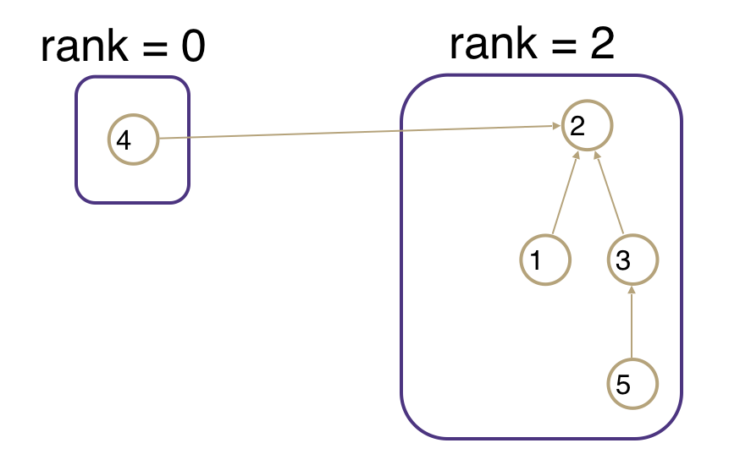
Optimization 1: Union By Size
Problem: Trees can be unbalanced!
size(x) upper bounds the height of x (so size(x) >= height(x)).
Keep track of size of all trees.
When unioning make the tree with larger size the root.
If it’s a tie, pick one to be the root arbitrarily.
size = 1
size = 4

Slide 71
Union by Size: Worst-Case Height Tree
Worst-case analysis still works when we track subtree size, rather than subtree height!
Since size ≥ height and there’s a clear relationship between their worst cases, we can use size to model the worst-case height.
Size = 4, Height = 2
Size = 8, Height = 3
0
0
4
0
2
1
2
1
2
5
6
1
3
3
3
7
Size = 16, Height = 4

Slide 72
Optimization 2: Path Compression
Clever idea: When we do findSet(15), tie all nodes seen to the root!
Additional cost is insignificant (same complexity class).
0
1
2
3
4
5
6
7
8
9
10
11
12
13
14
15

Slide 73
Optimization 2: Path Compression
Clever idea: When we do findSet(15), tie all nodes seen to the root!
Additional cost is insignificant (same complexity class).
0
1
2
3
4
5
6
7
8
9
10
11
12
13
14
15

Slide 74
Problem 5B: Disjoint Sets

Slide 75
Problem 5B: Disjoint Sets
Size 6
Size 1
Size 5
Size 2
6
2
8
7
0
4
3
9
10
11
13
1
5
12
union(2, 13)

Slide 76
Problem 5B: Disjoint Sets
Size 6
Size 1
Size 5
Size 2
6
2
8
7
0
4
3
9
10
11
13
1
5
12
union(2, 13)

Slide 77
Problem 5B: Disjoint Sets
Size 6
Size 1
Size 5
Size 2
6
2
8
7
0
4
3
9
10
11
13
1
5
12
union(2, 13)

Slide 78
Problem 5B: Disjoint Sets
Size 6
Size 5
Size 3
6
8
7
0
4
3
9
10
11
2
13
1
5
12
union(2, 13) ✅

Slide 79
Problem 5B: Disjoint Sets
Size 6
Size 5
Size 3
6
8
7
0
4
3
9
10
11
2
13
1
5
12
union(4, 12)

Slide 80
Problem 5B: Disjoint Sets
Size 6
Size 5
Size 3
6
8
7
0
4
3
9
10
11
2
13
1
5
12
Call findSet(12)
union(4, 12)

Slide 81
Problem 5B: Disjoint Sets
Size 6
Size 5
Size 3
6
8
7
0
4
3
9
10
11
2
13
1
5
12
Path compression! 😎
union(4, 12)

Slide 82
Problem 5B: Disjoint Sets
Size 6
Size 5
Size 3
6
8
7
0
4
3
9
10
11
2
13
1
5
12
union(4, 12)

Slide 83
Problem 5B: Disjoint Sets
Size 11
Size 3
6
7
0
4
3
8
2
13
1
5
9
10
11
12
union(4, 12) ✅

Slide 84
Problem 5B: Disjoint Sets
Size 11
Size 3
6
7
0
4
3
8
2
13
1
5
9
10
11
12
union(2, 8)

Slide 85
Problem 5B: Disjoint Sets
Size 11
Size 3
6
7
0
4
3
8
2
13
1
5
9
10
11
12
union(2, 8)

Slide 86
Problem 5B: Disjoint Sets
Size 11
Size 3
6
7
0
4
3
8
2
13
1
5
9
10
11
12
union(2, 8)

Slide 87
Problem 5B: Disjoint Sets
Size 14
6
0
4
3
8
7
1
5
9
10
11
12
2
13
union(2, 8) ✅

Slide 88
Problem 5B: Disjoint Sets
Size 14
6
0
4
3
8
7
1
5
9
10
11
12
2
13

Slide 89
Kruskal’s Pseudocode (with Disjoint Set impl. details)
KruskalMST(Graph G)
foreach (v : G.vertices) {
makeSet(v)
}
sort the edges by weight
foreach(edge (u, v) in sorted order) {
if (findSet(v) is not the same as findSet(u)) {
union(u, v)
}
}

