Slide 1
CSE 373 SP20 Section 3
Worksheet: cs.washington.edu/373/sections/section03.pdf
OR
Go to our website -> Click on blank worksheet
Recurrence Party 🎉

Slide 2
Logistics
P1 due last night
P2 Maps to be released tomorrow (due in ~2 weeks)x

Slide 3
MicroTeach: Tree Method Big Idea

Slide 4
Big Idea
Three steps in solving for the runtime of a recursive function.
Model Code with Recurrence
1
Use Tree Method to Turn Recurrence into Summation.
2
Solve Summation for Closed Form
3

Slide 5
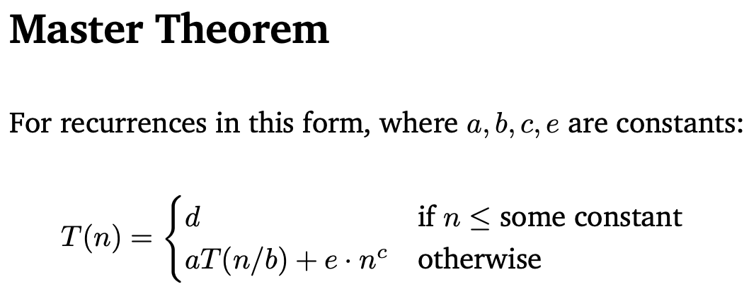
Big Idea
NOTE: If your recurrence matches the Master Theorem form, then you may use this formula to also get the final bound.

Slide 6
Modeling Code with Recurrences?

Slide 7
What is a Recurrence?
An expression that lets us express the runtime of a function recursively.

Slide 8
What is a Recurrence?
An expression that lets us express the runtime a function recursively.
Base Case
Recursive Case

Slide 9
What is a Recurrence?
An expression that lets us express the runtime a function recursively.
Base Case
Recursive Case
Recursive Call

Slide 10
Problem 3Ai: Code to Recurrence

Slide 11
Problem 3(i)
Hint: This identity may be helpful.

Slide 12
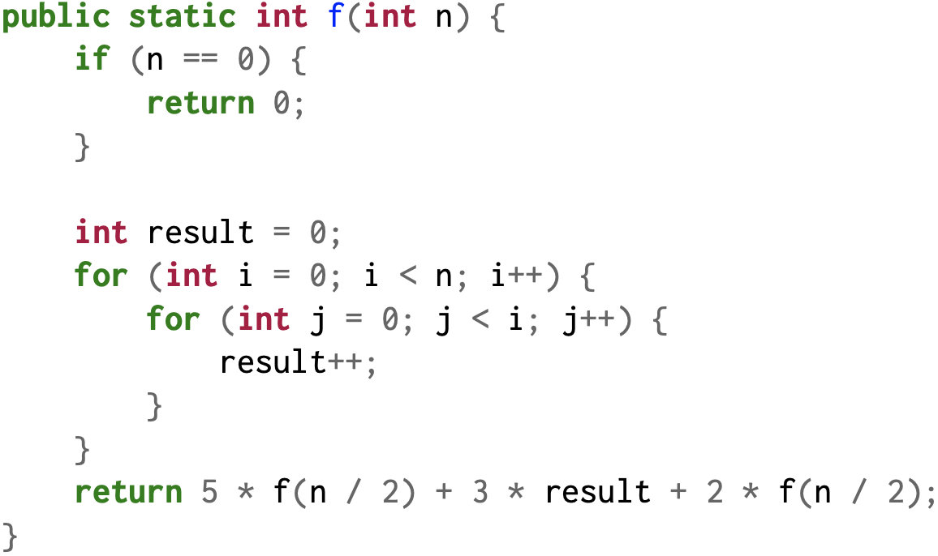
Problem 3(i)

Slide 13
Problem 3(i)
Base case when the input N is 0

Slide 14
Problem 3(i)
Outer loop runs N times

Slide 15
Problem 3(i)
The inner loop depends on the outer loop

Slide 16
Problem 3(i)
Inside the inner loop, we have a constant time operation

Slide 17
Problem 3(i)
Call f(n/2)
Constant addition
Call f(n/2)

Slide 18
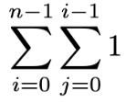
Problem 3(i)
Outer loop runs 0 ~ n - 1 times which defines i
Inner loop runs 0 ~ i - 1 times
As inner loop depends on the outer loop, we can express as the summation below.

Slide 20
Express As Recurrence
Work happening in both outer and inner loops
Calling 2 functions and the input is divided by half each level

Slide 21
MicroTeach: Core Tree Method

Slide 22
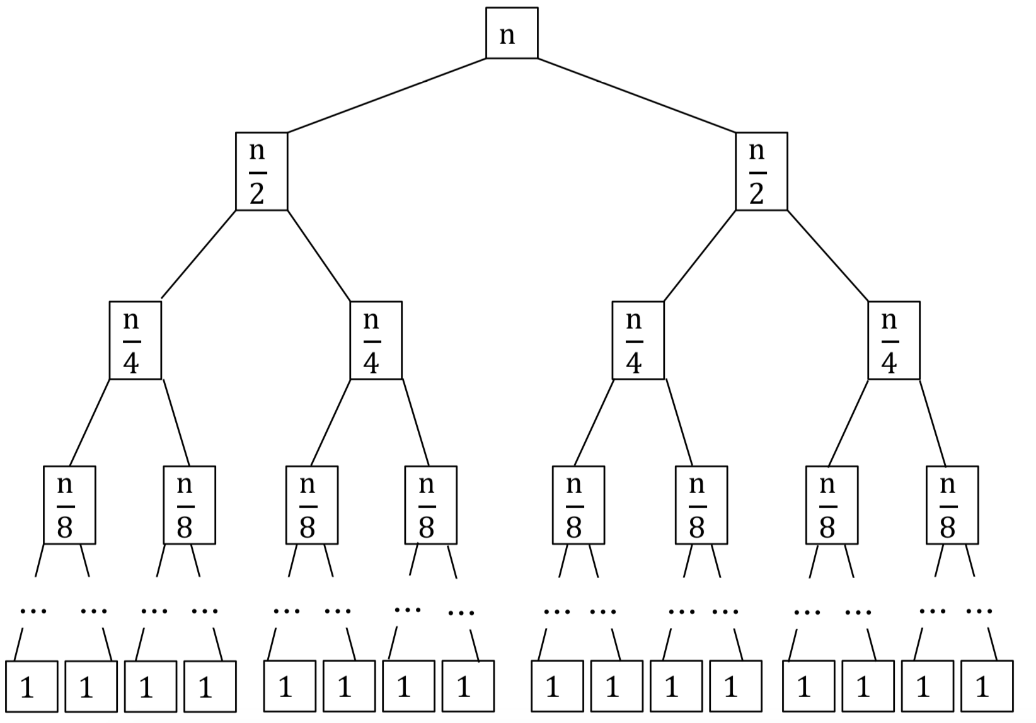
Tree Method: Big Idea
This is a drawing approach that turns recurrences into summations.

Slide 23
Tree Method: Big Idea
This is a drawing approach that turns recurrences into summations.
i =0
i =1
i =2
i = 3
i = ???

Slide 24
Tree Method: Big Idea
This is a drawing approach that turns recurrences into summations.
Total Work:
i =0
i =1
i =2
i = 3
i = ???

Slide 25
Tree Method: Big Idea
This is a drawing approach that turns recurrences into summations.
Total Work:
i =0
i =1
i =2
But to actually compute this, there are multiple sub-questions we have to ask! (See Problem 5)
i = 3
i = ???

Slide 26
Problem 5A-I: Recurrence to Summation

Slide 27
The Tree

Slide 28
The Tree

Slide 29
The Tree

Slide 30
The Tree

Slide 31
5A: Input to a node at level i
We divide by 6 at each level, so the input at level i is n/6^{i}.

Slide 32
5B: Work per node at (recursive) level i?
Same as the input to a node (in this case), so also n/6^{i}.

Slide 33
5C: Number of nodes at level i
Each (non-base-case) node produces 3 more nodes, so at level i we have 3^{i} nodes.

Slide 34
5D: Total work at the ith recursive level
(number of nodes in level) x (work per node at level)

Slide 35
5D: Total work at the ith recursive level
(number of nodes in level) x (work per node at level)
3^{i} x n/6^{i}

Slide 36
5E: Last Level of the Tree
We hit our base case when n/6^{i} = 1.

Slide 37
5E: Last Level of the Tree
n/6^{i} = 1

Slide 38
5E: Last Level of the Tree
n = 6^{i}

Slide 39
5E: Last Level of the Tree
log₆(n) = i

Slide 40
5F: Total Work Done in the Base Case
(number of nodes in base case level) x (work per node in base case level)

Slide 41
5F: Total Work Done in the Base Case
(number of nodes in base case level) x (work per node in base case level)

Slide 42
5F: Total Work Done in the Base Case
(number of nodes in base case level) x (work per node in base case level)

Slide 43
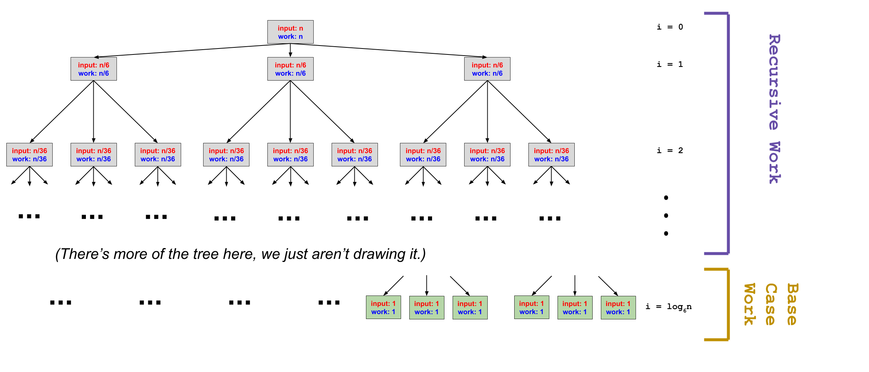
5G: Total Work Summation

Slide 44
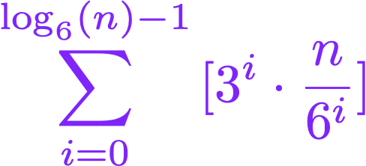
5G: Total Work Summation

Slide 45
Problem 5H: Getting the Closed Form

Slide 46
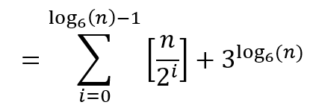
5H: Simplify to a closed form
Simplify the summation if possible (look for terms that can be pushed out of the summation)
Does this match any of our identities?

Slide 47
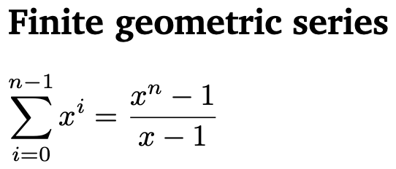
5H: Simplify to a closed form

Slide 48
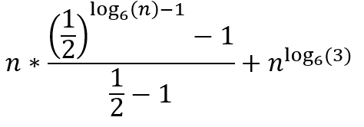
5H: Simplify to a closed form
NOTE: You don’t have to simplify further, but if you were, you would get the following: (See section solutions for steps)

Slide 49
Problem 5I: Master Theorem

Slide 50
5I: Use Master Theorem to find closed form

Slide 51
5I: Use Master Theorem to find closed form
Original recurrence:
Step 1: Does A(n) match Master Theorem form?
a = 3
e = 1
b = 6
c = 1

Slide 52
5I: Use Master Theorem to find closed form
Original recurrence:
Step 2: Calculate log_{b}(a) and compare it to c
log_{b}(a) = log₆(3)
a = 3
e = 1
log₆(3) = x
b = 6
c = 1
6^{x} = 3 so x < 1
c = 1 so x < c
Ta-da!
log_{b}(a) < c so T(n) ∈ Θ(n^{c})

