Slide 1
Section 1 CSE143 Review
Worksheet: cs.washington.edu/373/sections/section01.pdf
OR
Go to our website -> Click on blank worksheet

Slide 2
About me
From: Jakarta, Indonesia
Major: Computer Science
Classes I’m taking:
MATH394
Hobbies:
Guitar/Piano
Card magic
Rubik’s cube
League of Legends

Slide 3
What about you??
Name?
Other classes you are taking?
Hobbies?

Slide 4
MicroTeach:
Passing by Value and Reference

Slide 5
Note: The underlined code has just been executed. Code for main is underlined in red. Code in functions called by main is underlined in blue.

Slide 6
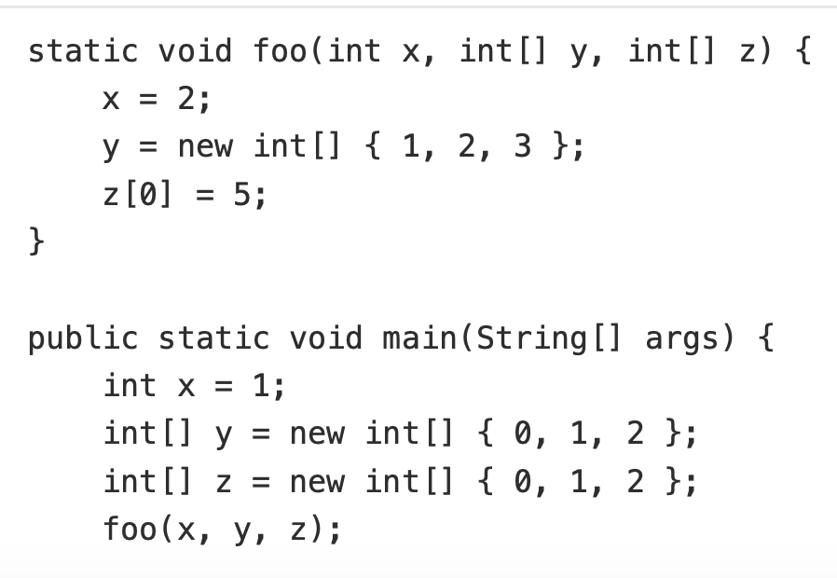
main
x
1
y
0
1
2
z
0
1
2
Note 1: Each method in Java gets its own set of variables to operate on. This is called a stack frame (you don’t need to know the name).
Note 2: x is an int (primitive type). y and z are arrays (object type). Hence the arrows.

Slide 7
main
x
1
y
0
1
2
z
0
1
2
foo
x
1
y
z
Note: The int is passed by value, the arrays by reference. This is because an int is a primitive type, while an array is not!

Slide 8
main
x
1
y
0
1
2
z
0
1
2
foo
x
1
y
z
What happens to foo’s x value when the first line of foo (x = 2) is called? What happens to main’s x value?

Slide 9
main
x
1
y
0
1
2
z
0
1
2
foo
x
2
y
z
Because it was passed by value, each method gets its own copy of the int!

Slide 10
main
x
1
y
0
1
2
z
0
1
2
foo
x
2
y
1
2
3
z

Slide 11
main
x
1
y
0
1
2
z
5
1
2
foo
x
2
y
1
2
3
z

Slide 12
main
x
1
y
0
1
2
z
5
1
2

Slide 13
Problem 1.1a Reference Semantics
Worksheet: cs.washington.edu/373/sections/section01.pdf

Slide 14
Note: The underlined code has just been executed. Code for main is underlined in red. Code in functions called by main is underlined in blue.

Slide 15
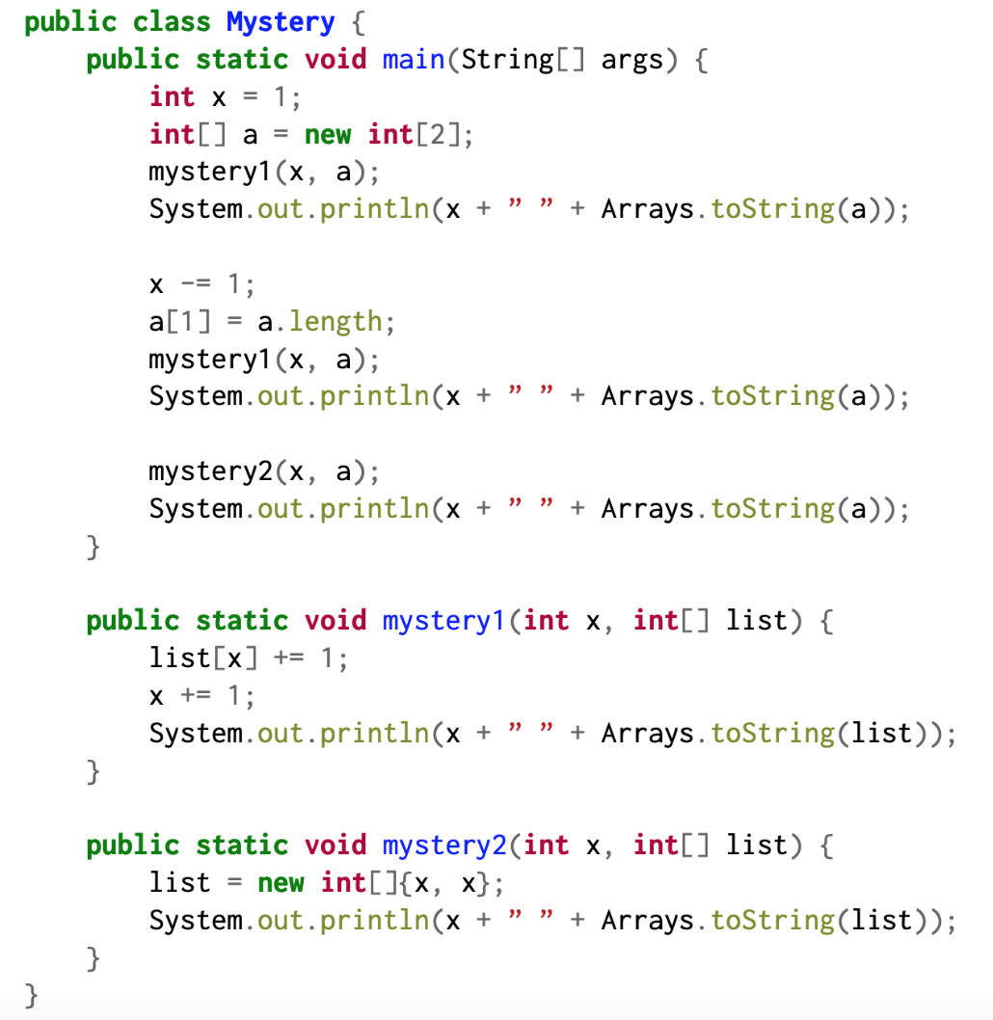
main
x
1
a
0
0
Note: When an array is born, it holds the default value for its data type unless otherwise specified. (The default for int is 0!)
Output:

Slide 16
main
x
1
a
0
0
mystery1
x
1
list
Note: The int is passed by value, the array by reference.This is because an int is a primitive type, while an array is not!
Output:

Slide 17
main
x
1
a
0
1
mystery1
x
1
list
Output:

Slide 18
main
x
1
a
0
1
mystery1
x
2
list
Note: Each method has its own set of variables that it acts on! (So the x in the mystery1 method changes).
Output:

Slide 19
main
x
1
a
0
1
mystery1
x
2
list
Output:
2 [0, 1]

Slide 20
main
x
1
a
0
1
Output:
1 [0, 1]

Slide 21
main
x
0
a
0
2
Output:

Slide 22
main
x
0
a
0
2
mystery1
x
0
list
Output:

Slide 23
main
x
0
a
1
2
mystery1
x
0
list
Output:

Slide 24
main
x
0
a
1
2
mystery1
x
1
list
Output:

Slide 25
main
x
0
a
1
2
mystery1
x
1
list
Output:
1 [1, 2]

Slide 26
main
x
0
a
1
2
Output:
0 [1, 2]

Slide 27
main
x
0
a
1
2
mystery2
x
0
list
Output:

Slide 28
main
x
0
a
1
2
mystery2
x
0
list
0
0
Note: list is a reference (or pointer) to an array, so here we change the reference to point to a new array.
Output:

Slide 29
main
x
0
a
1
2
mystery2
x
0
list
0
0
Output:
0 [0, 0]

Slide 30
main
x
0
a
1
2
Output:
0 [1, 2]

Slide 31
Problem 1.1b Reference Semantics

Slide 32
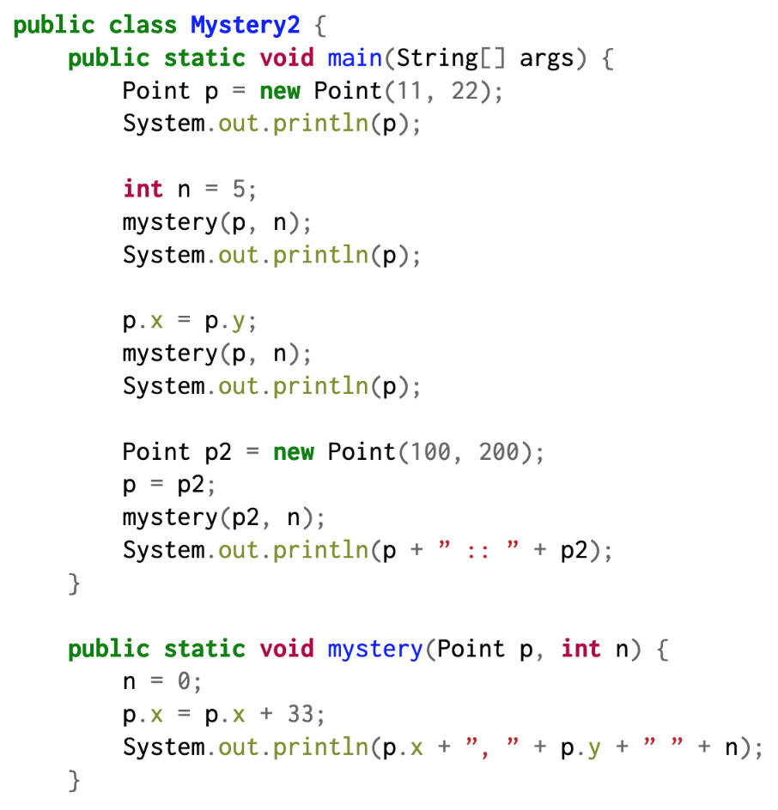
main
p
x: 11
y: 22
Output:

Slide 33
main
p
x: 11
y: 22
Output:
(11, 22)

Slide 34
main
n
5
p
x: 11
y: 22
Output:

Slide 35
main
n
5
p
x: 11
y: 22
mystery
n
5
p
Note: The int is passed by value, the point by reference.This is because an int is a primitive type, while the point is not!
Output:

Slide 36
main
n
5
p
x: 11
y: 22
mystery
n
0
p
Output:

Slide 37
main
n
5
p
x: 44
y: 22
mystery
n
0
p
Output:

Slide 38
main
n
5
p
x: 44
y: 22
mystery
n
0
p
Output:
44, 22 0

Slide 39
main
n
5
p
x: 44
y: 22
Output:
(44, 22)

Slide 40
main
n
5
p
x: 22
y: 22
Output:

Slide 41
main
n
5
p
x: 22
y: 22
mystery
n
5
p
Output:

Slide 42
main
n
5
p
x: 22
y: 22
mystery
n
0
p
Output:

Slide 43
main
n
5
p
x: 55
y: 22
mystery
n
0
p
Output:

Slide 44
main
n
5
p
x: 55
y: 22
mystery
n
0
p
Output:
55, 22 0

Slide 45
main
n
5
p
x: 55
y: 22
Output:
(55, 22)

Slide 46
main
n
5
p
x: 55
y: 22
p2
x: 100
y: 200
Output:

Slide 47
main
n
5
p
x: 100
y: 200
p2
Output:

Slide 48
main
n
5
p
x: 100
y: 200
p2
mystery
n
5
p
Output:

Slide 49
main
n
5
p
x: 100
y: 200
p2
mystery
n
0
p
Output:

Slide 50
main
n
5
p
x: 133
y: 200
p2
mystery
n
0
p
Output:

Slide 51
main
n
5
p
x: 133
y: 200
p2
mystery
n
0
p
Output:
133, 200 0

Slide 52
main
n
5
p
x: 133
y: 200
p2
Output:
(133, 200) :: (133, 200)

Slide 53
Problem 1.2a MyArrayList removeFront()

Slide 54
What is the problem asking? (Problem 1.2a)
Input - What parameters does this method accept? (Data type, restrictions, representation)
An integer k, which is between 0 and the size of our list inclusive. Represents number of elements to be removed
Functionality - What does the method do?
Remove the first k values in the MyArrayList.
Output - What does this method return?
Nothing.

Slide 55
Example: MyArrayList removeFront(4)
data = [8, 17, 9, 24, 42, 3, 8]
size = 7
list.removeFront(4)
data = [42, 3, 8]
size = 3
Note: Remember that we’re implementing the MyArrayList data structure, so when we write the code for removeFront(k), we need to make sure to modify our data and size fields accordingly!

Slide 56
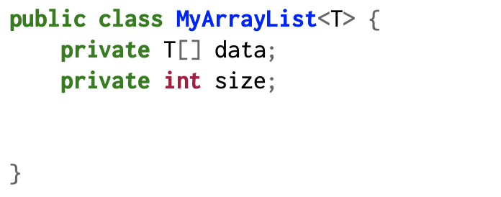
Walkthrough: MyArrayList removeFront(4)
Expected behavior:
[8, 17, 9, 24, 42, 3, 8] → [42, 3, 8]
public void removeFront(int k) {...}
0
1
2
3
4
5
6
k = 4
size = 7
8
17
9
24
42
3
8

Slide 57
Walkthrough: MyArrayList removeFront(4)
Expected behavior:
[8, 17, 9, 24, 42, 3, 8] → [42, 3, 8]
public void removeFront(int k) {...}
0
1
2
3
4
5
6
k = 4
size = 7
8
17
9
24
42
3
8
Intuition: We want our array to contain only the values between indices k and size - 1, so let’s place them at the front.

Slide 58
Walkthrough: MyArrayList removeFront(4)
Expected behavior:
[8, 17, 9, 24, 42, 3, 8] → [42, 3, 8]
public void removeFront(int k) {...}
0
1
2
3
4
5
6
k = 4
size = 7
8
17
9
24
42
3
8

Slide 59
Walkthrough: MyArrayList removeFront(4)
Expected behavior:
[8, 17, 9, 24, 42, 3, 8] → [42, 3, 8]
public void removeFront(int k) {...}
0
1
2
3
4
5
6
k = 4
size = 7
8 42
17
9
24
42
3
8

Slide 60
Walkthrough: MyArrayList removeFront(4)
Expected behavior:
[8, 17, 9, 24, 42, 3, 8] → [42, 3, 8]
public void removeFront(int k) {...}
0
1
2
3
4
5
6
k = 4
size = 7
8 42
17
9
24
42
3
8

Slide 61
Walkthrough: MyArrayList removeFront(4)
Expected behavior:
[8, 17, 9, 24, 42, 3, 8] → [42, 3, 8]
public void removeFront(int k) {...}
0
1
2
3
4
5
6
k = 4
size = 7
8 42
17 3
9
24
42
3
8

Slide 62
Walkthrough: MyArrayList removeFront(4)
Expected behavior:
[8, 17, 9, 24, 42, 3, 8] → [42, 3, 8]
public void removeFront(int k) {...}
0
1
2
3
4
5
6
k = 4
size = 7
8 42
17 3
9
24
42
3
8

Slide 63
Walkthrough: MyArrayList removeFront(4)
Expected behavior:
[8, 17, 9, 24, 42, 3, 8] → [42, 3, 8]
public void removeFront(int k) {...}
0
1
2
3
4
5
6
k = 4
size = 7
8 42
17 3
9 8
24
42
3
8

Slide 64
Walkthrough: MyArrayList removeFront(4)
Expected behavior:
[8, 17, 9, 24, 42, 3, 8] → [42, 3, 8]
public void removeFront(int k) {...}
0
1
2
3
4
5
6
k = 4
size = 7
8 42
17 3
9 8
24
42
3
8
The first 3 indices of data now have what we want!

Slide 65
Walkthrough: MyArrayList removeFront(4)
Expected behavior:
[8, 17, 9, 24, 42, 3, 8] → [42, 3, 8]
public void removeFront(int k) {...}
0
1
2
3
4
5
6
k = 4
size = 7
42
3
8
24
42
3
8
What about the remaining elements in data?

Slide 66
Walkthrough: MyArrayList removeFront(4)
Expected behavior:
[8, 17, 9, 24, 42, 3, 8] → [42, 3, 8]
public void removeFront(int k) {...}
0
1
2
3
4
5
6
k = 4
size = 7 - 4
42
3
8
24
42
3
8
We can just get rid of them by reducing size!

Slide 67
Walkthrough: MyArrayList removeFront(4)
Expected behavior:
[8, 17, 9, 24, 42, 3, 8] → [42, 3, 8]
public void removeFront(int k) {...}
0
1
2
3
4
5
6
k = 4
size = 3
42
3
8
24
42
3
8
Note: The last 4 indices still exist in data. Remember that data.length != size. Since it’s an expectation that all our MyArrayList methods will only access indices of data between 0 and size - 1, we don’t have to worry about what values live beyond that! As such, the client of our class can only interact with indices 0 to size - 1.

Slide 68
Solution: MyArrayList removeFront(k)
public class MyArrayList<T> {
private T[] data;
private int size;
public void removeFront(int k) {
for (int i = 0; i < this.size - k; i++) {
this.data[i] = this.data[i + k];
}
this.size -= k;
}
// other methods commented out
}

Slide 69
Problem 1.3a MyLinkedList removeFront()

Slide 70
What is the problem asking?
Input - What parameters does this method accept?
An integer k, which is between 0 and the size of our list inclusive.
Functionality - What does the method do?
Remove the first k values in the MyLinkedList assuming the list doesn’t have any null elements.
Output - What does this method return?
Nothing.

Slide 71
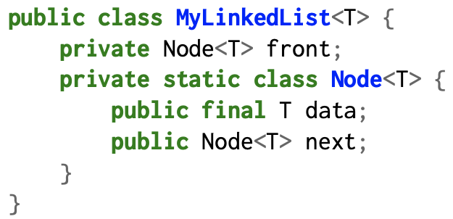
Example: MyLinkedList removeFront(2)
data
data
data
data
front
8
next
11
next
91
next
2
next
null
list.removeFront(2)
Note: Remember that we’re implementing the MyLinkedList data structure, so when we write the code for removeFront(k), we need to make sure to modify our front field accordingly!
data
data
front
91
next
2
next
null

Slide 72
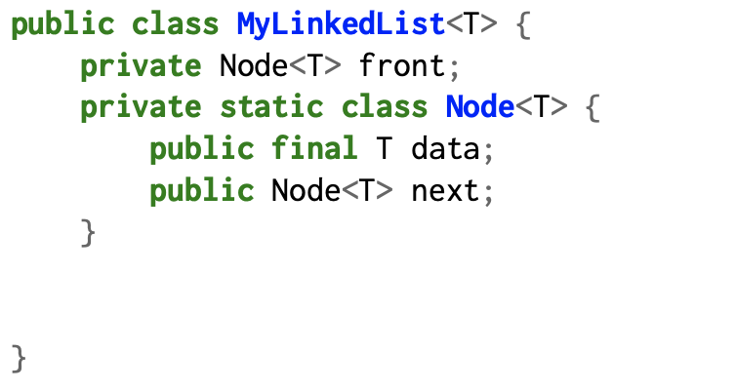
Walkthrough: MyLinkedList removeFront(2)
Expected behavior:
Before:
f
8
11
91
2
null
f
91
2
null
After:
public void removeFront(int k) {...}
f
8
11
91
2
null

Slide 73
Walkthrough: MyLinkedList removeFront(2)
Expected behavior:
Before:
f
8
11
91
2
null
f
91
2
null
After:
public void removeFront(int k) {...}
f
8
11
91
2
null
Intuition: Advance the front pointer k times.

Slide 74
Walkthrough: MyLinkedList removeFront(2)
Expected behavior:
Before:
f
8
11
91
2
null
f
91
2
null
After:
public void removeFront(int k) {...}
f
8
11
91
2
null
curr

Slide 75
Walkthrough: MyLinkedList removeFront(2)
Expected behavior:
Before:
f
8
11
91
2
null
f
91
2
null
After:
public void removeFront(int k) {...}
f
8
11
91
2
null
curr

Slide 76
Walkthrough: MyLinkedList removeFront(2)
Expected behavior:
Before:
f
8
11
91
2
null
f
91
2
null
After:
public void removeFront(int k) {...}
f
8
11
91
2
null
curr

Slide 77
Walkthrough: MyLinkedList removeFront(2)
Expected behavior:
Before:
f
8
11
91
2
null
f
91
2
null
After:
public void removeFront(int k) {...}
f
8
11
91
2
null
curr
curr now points to what we want!

Slide 78
Walkthrough: MyLinkedList removeFront(2)
Expected behavior:
Before:
f
8
11
91
2
null
f
91
2
null
After:
public void removeFront(int k) {...}
8
11
91
2
null
f
curr

Slide 79
Walkthrough: MyLinkedList removeFront(2)
Expected behavior:
Before:
f
8
11
91
2
null
f
91
2
null
After:
public void removeFront(int k) {...}
Note: This part gets automatically deleted when Java runs its garbage collector because there’s nothing pointing to it!
8
11
91
2
null
f

Slide 80
Walkthrough: MyLinkedList removeFront(2)
Expected behavior:
Before:
f
8
11
91
2
null
f
91
2
null
After:
public void removeFront(int k) {...}
f
91
2
null

Slide 81
Solution: MyLinkedList removeFront(k)
public class MyLinkedList<T> {
private Node<T> front;
private static class Node<T> {
public final T data;
public Node<T> next;
}
public void removeFront(int k) {
Node<T> curr = this.front;
for (int i = 0; i < k; i++) {
curr = curr.next;
}
this.front = curr;
}
// other methods commented out
}

Slide 82
Problem 1.3d transferFrom()

Slide 83
What is the problem asking?
Input - Which parameters does this method accept?
Two MyLinkedLists. Each MyLinkedList is guaranteed not to be null. Either list may be empty.
Functionality - What does the method do?
Move values from the second list to the first list and empty the second list.
Output - What does this method return?
None.

Slide 84
Visualize it with an example
What is the result of calling transferFrom([8, 17, 2, 4], [1, 2, 3])?
We start with the input:
8 | 17 | 2 | 4
1 | 2 | 3
And want to end up with:
8 | 17 | 2 | 4 | 1 | 2 | 3
Reminder that you can only add/replace items where there is a pointer!

Slide 85
Intermediate Steps
8 | 17 | 2 | 4 | 1 | 2 | 3
8 | 17 | 2 | 4
1 | 2 | 3
list1
current
list1
current
list1
current
list1
current
list1
front
list2
front
list2
front
list1
current
TA - DA!
list2
front
What if either of the lists
are empty?
What should go
at the ends of these
two arrows?
Don’t forget to empty list 2
at the end!

Slide 86
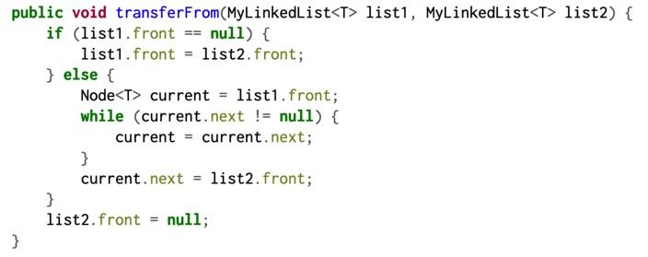
Solution

