Slide 1
Hash Maps
BEFORE WE START
Now that you’ve been here a few weeks, let us know what’s working for you and what could be improved! (~6 min.)
tinyurl.com/20SuWeek3

Slide 2
Announcements
EX1 (Algo Analysis I) due TONIGHT 11:59pm PDT
  You can use late days on exercises, just like projects!
P2 (Maps) and EX2 (Algo Analysis II) released today
Don’t forget to fill out the P2 Partner Form!
  Even if you want the default, please confirm for us by filling it out!
  https://courses.cs.washington.edu/courses/cse373/tools/20su/partner/p2/
Summations Reference published (on course calendar under Wednesday’s lecture)

Slide 3
STUDENT FEEDBACK
What’s what sound? Could it be
THANK YOU for letting us know how optional review questions could be more helpful for you! Don’t stop here: your feedback & ideas are how we make this the best course it can be!
Post-Lecture Optional Review Questions:
  New We’ll publish solutions at the same time as problems. Use however you prefer!
  New Reflection: what’s one conception you cleared up, or one question you still have?
  Extra credit: No points, but doing lots can round up your GPA 0.1 (completion only, not graded on correctness)
  No deadline: Complete anytime during the quarter. Recommendation: before next lecture

Slide 4
P2: Maps
Implement everyone’s favorite data structure!

Slide 5
Announcements
Regarding the fall F-1 online classes visa situation:
  No updates to share yet from UW, but they are working on a response
  Widespread legal action is being taken by universities across the country
We’ll
We know this is a stressful time, and you may need flexibility to work on things that aren’t this class
We’ll

Slide 6
Welcome to the Data Structures Part™
We’re now armed with a toolbox stuffed full of analysis tools
  Wednesday was the last algorithmic analysis lecture
  It’s time to apply this theory to more practical topics!
Today, we’ll take our first deep dive using those tools on a data structure: Hash Maps!
Graphs
Hash Maps
Disjoint Sets
B-Trees
BFS
Sorting
Heaps
Binary Search Trees
Algorithmic Analysis
AVL Trees
Dijkstra’s
DFS

Slide 7
Learning Objectives
After this lecture, you should be able to...
Compare the relative pros/cons of various Map implementations, especially given a design like the ones we cover today
Trace operations in a Separate Chaining Hash Map on paper (such as insertion, getting an element, resizing)
Implement a Separate Chaining Hash Map in code (P2)
Differentiate between the “worst” and “in practice” runtimes of a Separate Chaining Hash Map, and describe what assumptions allow us to consider the “in practice” case

Slide 8
Lecture Outline
MAP ADT
4
3
Review
SeparateChaining
HashMap
2
SimpleHashMap
1
YOUR BEST FRIEND: Addresses limitations with hash collisions, but still fast!
DirectAccessMap
MORE FLEXIBLE: Hash function supports any type of key
ArrayMap
FASTER: Jump directly to element, only int keys
As seen on
As seen on
Project 2
Project 2

Slide 9
Lecture Outline
MAP ADT
4
3
Review
SeparateChaining
HashMap
2
SimpleHashMap
1
YOUR BEST FRIEND: Addresses limitations with hash collisions, but still fast!
DirectAccessMap
MORE FLEXIBLE: Hash function supports any type of key
ArrayMap
FASTER: Jump directly to element, only int keys

Slide 10
Review The Map ADT
MAP ADT
Map: an ADT representing a set of distinct keys and a collection of values, where each key is associated with one value.
  Also known as a dictionary
  If a key is already associated with something, calling put(key, value) replaces the old value
Used all over the place
  It’s hard to work on a big project without needing one sooner or later
  CSE 143 introduced:
    Map<String, Integer> map1 = new HashMap<>();
    Map<String, String> map2 = new TreeMap<>();
State
Set of keys, Collection of values
Count of keys
Behavior
put(key, value) add value to collection, associated with key
get(key) return value associated with key
containsKey(key) return if key is associated
remove(key) remove key and associated value
size() return count
clear() remove all
iterator() get an iterator

Slide 11
Review Implementing a Map with an Array
MAP ADT
ArrayMap<K, V>
Big-Oh Analysis – (if key is the last one looked at / not in the dictionary)
put()
get()
containsKey()
remove()
size()
State
State
O(n) linear
Set of keys, Collection of values
Count of keys
Pair<K, V>[] data
O(n) linear
Behavior
Behavior
put find key, overwrite value if there. Otherwise create new pair, add to next available spot, grow array if necessary
get scan all pairs looking for given key, return associated item if found
containsKey scan all pairs, return if key is found
remove scan all pairs, replace pair to be removed with last pair in collection
size return count of items in dictionary
O(n) linear
put(key, value) add value to collection, associated with key
get(key) return value associated with key
containsKey(key) return if key is associated
remove(key) remove key and associated value
size() return count
O(n) linear
O(1) constant
Big-Oh Analysis – (if the key is the first one looked at)
put()
get()
containsKey()
remove()
size()
O(1) constant
O(1) constant
0 | 1 | 2 | 3
4
O(1) constant
put(‘b’, 97)
put(‘e’, 20)
O(1) constant
(‘a’, 1)
(‘b’,97)
(‘b’, 2)
(‘c’, 3)
(‘d’, 4)
(‘e’,20)
O(1) constant

Slide 12
Review Implementing a Map with Linked Nodes
MAP ADT
LinkedMap<K, V>
Big O Analysis – (if key is the last one looked at / not in the dictionary)
put()
get()
containsKey()
remove()
size()
State
State
O(n) linear
Set of keys, Collection of values
Count of keys
front
size
O(n) linear
Behavior
Behavior
O(n) linear
put if key is unused, create new with pair, add to front of list, else replace with new value
get scan all pairs looking for given key, return associated item if found
containsKey scan all pairs, return if key is found
remove scan all pairs, skip pair to be removed
size return count of items in dictionary
put(key, value) add value to collection, associated with key
get(key) return value associated with key
containsKey(key) return if key is associated
remove(key) remove key and associated value
size() return count
O(n) linear
O(1) constant
Big O Analysis – (if the key is the first one looked at)
put()
get()
containsKey()
remove()
size()
O(1) constant
O(1) constant
containsKey(‘c’)
get(‘d’)
put(‘b’, 20)
front
O(1) constant
O(1) constant
‘b’
20
‘a’
1
7
‘c’
9
‘d’
4
O(1) constant

Slide 13
Could we do better?
put, get, and remove have Θ(n) runtimes. Could we use a Θ(1) operation to improve?
What about array indexing?
  data[i] (array access) and data[i] = 2 (array update) are constant runtime!
  What if we could jump directly to the requested key?
  We could simplify the problem: only allow integer keys

Slide 14
Lecture Outline
MAP ADT
4
3
Review
SeparateChaining
HashMap
2
SimpleHashMap
1
YOUR BEST FRIEND: Addresses limitations with hash collisions, but still fast!
DirectAccessMap
MORE FLEXIBLE: Hash function supports any type of key
ArrayMap
FASTER: Jump directly to element, only int keys

Slide 15
DirectAccessMap
DirectAccessMap<K, V>
put, get, and remove have Θ(n) runtimes. Could we use a Θ(1) operation to improve?
What about array indexing?
  data[i] (array access) and data[i] = 2 (array update) are constant runtime!
  What if we could jump directly to the requested key?
  We could simplify the problem: only allow integer keys
State
data[]
size
Behavior
put put item at given index
get get item at given index
containsKey if data[] null at index, return false, return true otherwise
remove nullify element at index
size return count of items in dictionary
put(3, “Melissa”)
get(3)
index | 0 | 1 | 2 | 3 | 4 | 5 | 6 | 7 | 8 | 9
data
Melissa

Slide 16
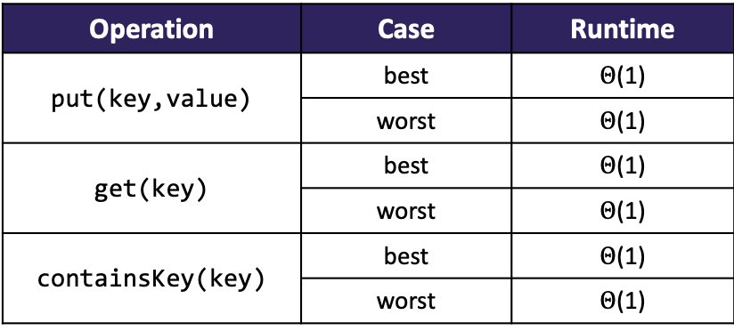
DirectAccessMap Implementation
DirectAccessMap<K, V>
public void put(int key, V value) {
this.array[key] = value;
}
public boolean containsKey(int key) {
return this.array[key] != null;
}
public V get(int key) {
  return this.array[key];
}
public void remove(int key) {
this.array[key] = null;
}
State
data[]
size
Behavior
put put item at given index
get get item at given index
containsKey if data[] null at index, return false, return true otherwise
remove nullify element at index
size return count of items in dictionary
Operation | Case | Runtime
put(key,value) | best | $Θ$(1)
 | worst | $Θ$(1)
get(key) | best | $Θ$(1)
 | worst | $Θ$(1)
containsKey(key) | best | $Θ$(1)
 | worst | $Θ$(1)

Slide 17
Pros and Cons of DirectAccessMap
What’s a benefit of using it? What’s a drawback?

Slide 18
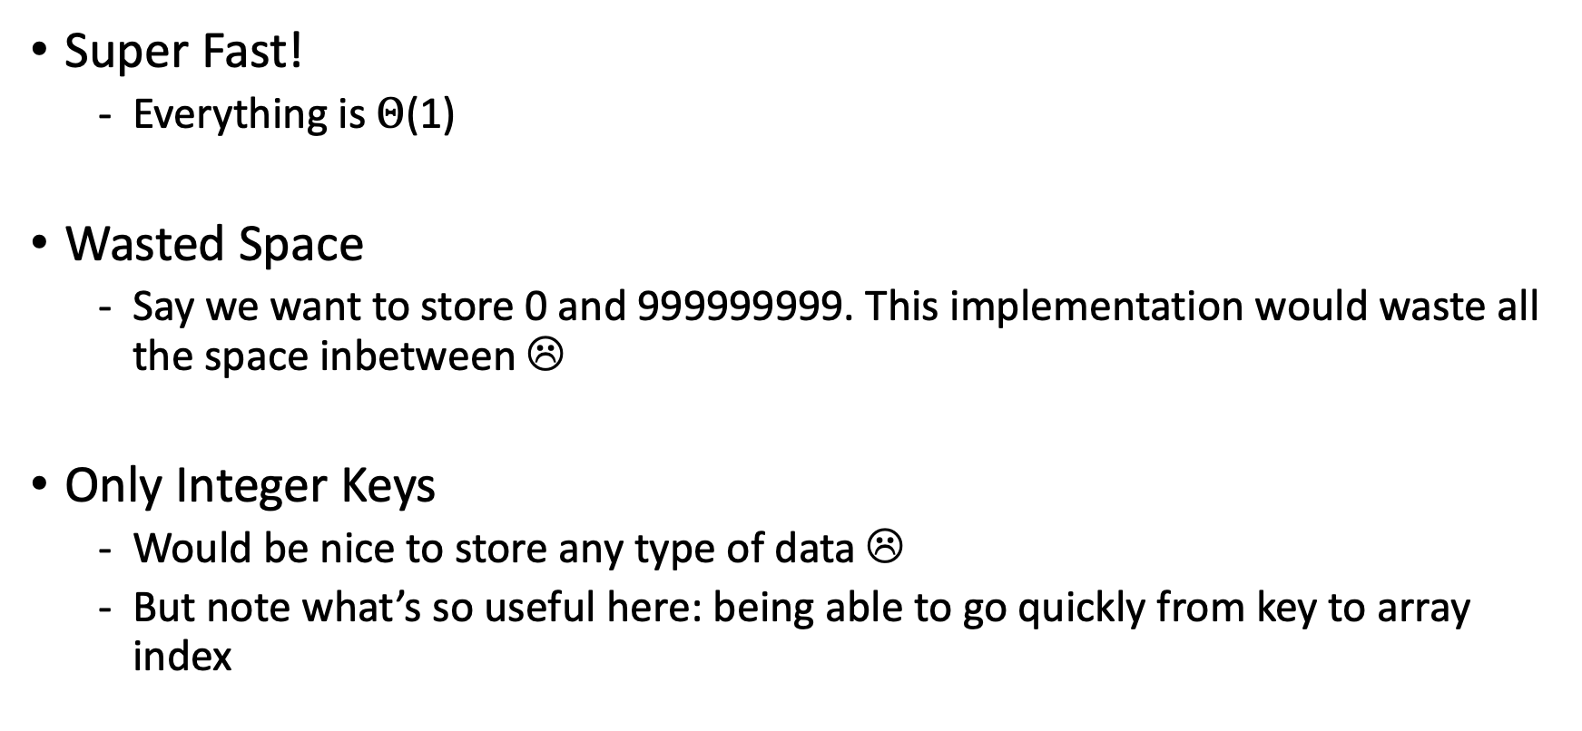
Pros and Cons of DirectAccessMap
Super Fast!
  Everything is $Θ$(1)
Wasted Space
  Say we want to store 0 and 999999999. This implementation would waste all the space inbetween ☹
Only Integer Keys
  Would be nice to store any type of data ☹
  But note what’s so useful here: being able to go quickly from key to array index

Slide 19
Can We Store Any Integer?
IDEA 1
IDEA 2
Create a GIANT array with every possible integer as an index
Problems:
  Can we allocate an array big enough?
  Super wasteful
Create a smaller array, with a translation from integer keys into available indices
Problems:
  How can we construct a translation?
0
0
504
1
9002
504
1
9002
1
1
1
1
0
1
2
3
4
...
9002
2
504
504
3
...
504
4
9002
9002
5

Slide 20
Hash Functions
Hash Function: any function that can be used to map data of an arbitrary size to fixed-size values.
  We want to translate from the set of all integers to the set of valid indexes in our array
504
1
9002
HASH FUNCTION
0
1
2
...
9
% by size
9002 % 10 = 2 (so store it in index 2 of the array)
- One simple approach: take the key and % (mod) it by size of the array

Slide 21
Lecture Outline
MAP ADT
4
3
Review
SeparateChaining
HashMap
2
SimpleHashMap
1
YOUR BEST FRIEND: Addresses limitations with hash collisions, but still fast!
DirectAccessMap
MORE FLEXIBLE: Hash function supports any type of key
ArrayMap
FASTER: Jump directly to element, only int keys

Slide 22
Mod: Remainder
The % operator computes the remainder from integer division.
  3 43
  4 ) 14 5 ) 218
  12 20
  2 18
  15
  3
Applications of % operator:
  Obtain last digit of a number: 230857 % 10 is 7
  See whether a number is odd: 7 % 2 is 1, 42 % 2 is 0
  Limit integers to specific range: 8 % 12 is 8, 18 % 12 is 6
14 % 4 is 2
218 % 5 is 3
Equivalently, to find a % b (for a,b > 0):
while(a > b-1)
a -= b;
return a;
Limit keys to indices within array
For more review/practice, check out https://www.khanacademy.org/computing/computer-science/cryptography/modarithmetic/a/what-is-modular-arithmetic

Slide 23
SimpleHashMap: “% by size” as Hash Function
IMPLEMENTATION
public void put(int key, int value) {
data[hashToValidIndex(key)] = value;
}
public V get(int key) {
return data[hashToValidIndex(key)];
}
public int hashToValidIndex(int k) {
return k % this.data.length;
}
put(0, “I”) 0 % 10 = 0
put(8, “Maps”) 8 % 10 = 8
put(11, “<3”) 11 % 10 = 1
put(23, “Hash”) 23 % 10 = 3
index | 0 | 1 | 2 | 3 | 4 | 5 | 6 | 7 | 8 | 9
data | I | <3 |  | Hash |  |  |  |  | Maps

Slide 24
SimpleHashMap: Collisions?!
IMPLEMENTATION
public void put(int key, int value) {
data[hashToValidIndex(key)] = value;
}
public V get(int key) {
return data[hashToValidIndex(key)];
}
public int hashToValidIndex(int k) {
return k % this.data.length;
}
put(0, “I”) 0 % 10 = 0
put(8, “Maps”) 8 % 10 = 8
put(11, “<3”) 11 % 10 = 1
put(23, “Hash”) 23 % 10 = 3
put(20, “We”) 20 % 10 = 0
index | 0 | 1 | 2 | 3 | 4 | 5 | 6 | 7 | 8 | 9
data | I | <3 |  | Hash |  |  |  |  | Maps
We

Slide 25
Lecture Outline
MAP ADT
4
3
Review
SeparateChaining
HashMap
2
SimpleHashMap
1
YOUR BEST FRIEND: Addresses limitations with hash collisions, but still fast!
DirectAccessMap
MORE FLEXIBLE: Hash function supports any type of key
ArrayMap
FASTER: Jump directly to element, only int keys

Slide 26
Handling Collisions
Two common strategies to handle collisions:
Separate Chaining
”Chain” together multiple values stored in a single bucket
2. Open Addressing
If a bucket is taken, find a new bucket using some strategy:
Linear Probing
Quadratic Probing
Double Hashing
Bonus topic beyond the scope of the class
We’ll focus on separate chaining this quarter, much more common in practice

Slide 27
Separate Chaining
0
1
2
3
4
5
6
7
8
9
If two values want to live in the same index, let’s just let them be roommates!
Each index is a “bucket”
  Linked Nodes are a common implementation for these bucket “chains”
When item x hashes to index h:
  If bucket at h is empty, create new list with x
  Else, add x to the list
red
pink
tan
orange
blue
aqua

Slide 28
Separate Chaining
0
1
2
3
4
5
6
7
8
9
If two values want to live in the same index, let’s just let them be roommates!
Each index is a “bucket”
  Linked Nodes are a common implementation for these bucket “chains”
When item x hashes to index h:
  If bucket at h is empty, create new list with x
  Else, add x to the list
But if multiple keys can hash to the same index, need to store the key too!
(1,red)
(21,pink)
(22,tan)
(4,orange)
(7,blue)
(77,aqua)

Slide 29
Separate Chaining
0
1
2
3
4
5
6
7
8
9
Implementation of get/put/containsKey very similar
(1,red)
(21,pink)
PSEUDOCODE
(22,tan)
public boolean get(int key) {
int bucketIndex = key % data.length;
loop through each pair in data[bucketIndex]
if pair.key == key
return pair.value
return null if we get here
}
(4,orange)
(7,blue)
(77,aqua)
Let’s analyze the runtime. First, are there different possible states for this HashMap to make the code faster or slower, assuming n key/value pairs are already stored?

Slide 30
Separate Chaining Worst Case
0
1
2
3
4
5
6
7
8
9
(1,red)
(21,pink)
(11,tan)
(91,orange)
(41,aqua)
(51,blue)
It’s possible that everything hashes to the same bucket by chance!
  get would take Θ(n) time ☹
Consider get(51)
  Use hash function (% 10) to get index (5)
  Check every element in bucket for key 51
We’ve lost that Θ(1) runtime
PSEUDOCODE
public boolean get(int key) {
int bucketIndex = key % data.length;
loop through each pair in data[bucketIndex]
if pair.key == key
return pair.value
return null if we get here
}

Slide 31
Separate Chaining Best Case
0
1
2
3
4
5
6
7
8
9
(60,pink)
However, if everything is spread evenly across the buckets, get takes Θ(1)
Consider get(22)
  Use hash function (% 10) to get index (2)
  Check the single element in bucket for key 22 – a constant time operation!
Key to a successful Hash Map implementation: how can we keep the buckets as close to this distribution as possible?
(1,red)
(22,tan)
(4,orange)
(85,aqua)
(7,blue)

Slide 32
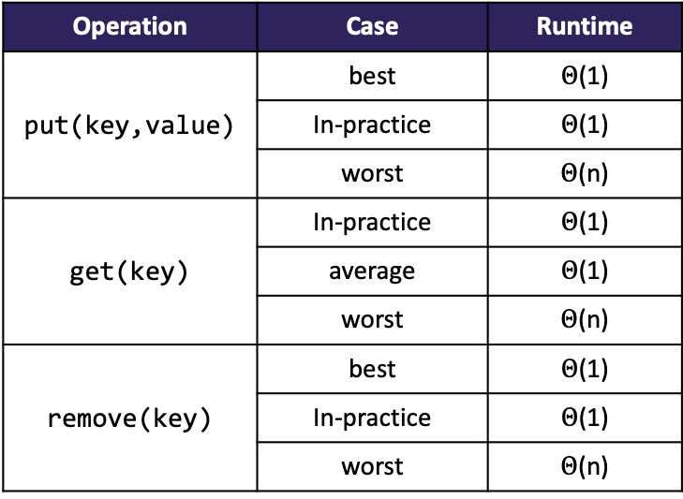
Separate Chaining... In Practice
A well-implemented separate chaining hash map will stay very close to the best case
  Most of the time, operations are fast. Rarely, do an expensive operation that restores the map close to best case.
How to stay close to best case?
  Good distribution & Resizing!
We can describe the “in-practice” case as what almost always happens:
  (1) items are fairly evenly distributed
  (2) assume resizing doesn’t occur
    This is similar to the concept of “amortized”
Operation | Case | Runtime
put(key,value) | best | $Θ$(1)
 | In-practice | $Θ$(1)
 | worst | $Θ$(n)
get(key) | In-practice | $Θ$(1)
 | average | $Θ$(1)
 | worst | $Θ$(n)
remove(key) | best | $Θ$(1)
 | In-practice | $Θ$(1)
 | worst | $Θ$(n)

Slide 33
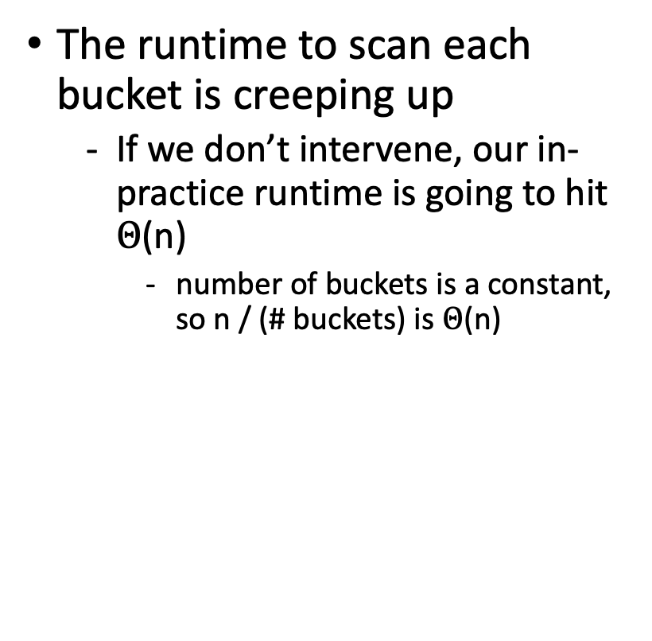
Resizing
0
1
2
3
4
The runtime to scan each bucket is creeping up
  If we don’t intervene, our in-practice runtime is going to hit $Θ$(n)
    number of buckets is a constant, so n / (# buckets) is $Θ$(n)
(1,red)
(6,pink)
(22,tan)
(7,blue)
(77,aqua)
(8,lilac)
(53,puce)
(4,orange)

Slide 34
Resizing
Don’t forget to re-distribute your keys!
As seen on
Project 2
0
1
2
3
4
5
6
7
8
9
0
1
2
3
4
5
6
7
8
9
(1,red)
(6,pink)
(1,red)
(22,tan)
(7,blue)
(77,aqua)
(22,tan)
(8,lilac)
(53,puce)
(53,puce)
(4,orange)
(4,orange)
How to Resize:
Expand the buckets array
For every element in the old hash table, re-distribute! Recompute its position by taking the mod with the new length
If we just expand the buckets array, several values are hashed in the wrong place
(6,pink)
(7,blue)
(77,aqua)
(8,lilac)

Slide 35
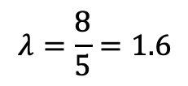
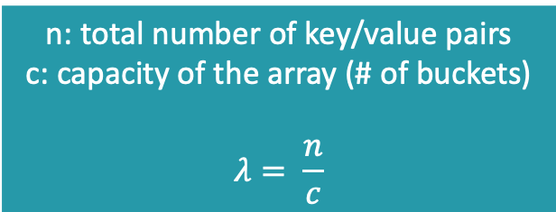
When to Resize?
In ArrayList, we were forced to resize when we ran out of room
  In SeparateChainingHashMap, never forced to resize, but we want to make sure the buckets don’t get too long for good runtime
How do we quantify “too full”?
  Look at the average bucket size: number of elements / number of buckets
0
1
2
3
4
LOAD FACTOR λ
(1,red)
(6,pink)
n: total number of key/value pairs
c: capacity of the array (# of buckets)
$$λ= \frac{n}{c}$$
(22,tan)
(7,blue)
(77,aqua)
(8,lilac)
(53,puce)
(4,orange)
$$λ=\frac{8}{5}=1.6$$

Slide 36
When to Resize?
In ArrayList, we were forced to resize when we ran out of room
  In SeparateChainingHashMap, never forced to resize, but we want to make sure the buckets don’t get too long for good runtime
How do we quantify “too full”?
  Look at the average bucket size: number of elements / number of buckets
If we resize when λ hits some constant value like 1:
  We expect to see 1 element per bucket: constant runtime!
  If we double the capacity each time, the expensive resize operation becomes less and less frequent
LOAD FACTOR λ
n: total number of key/value pairs
c: capacity of the array (# of buckets)
$$λ= \frac{n}{c}$$

Slide 37
Hashing
What about non-integer data?
  Remember the definition -- Hash Function: any function that can be used to map data of an arbitrary size to fixed-size values.
504
1
9002
“Melissa”
“Joyce”
“Howard”
HASH FUNCTION
Considerations for Hash Functions:
  Deterministic – same input should generate the same output
  Efficient – reasonable runtime
  Uniform – inputs spread “evenly” across output range

Slide 38
Hashing
Implementation 1: Simple aspect of values
public int hashCode(String input) {
return input.length();
}
Implementation 2: More aspects of value
public int hashCode(String input) {
int output = 0;
for(char c : input) {
out += (int)c;
}
return output;
}
Implementation 3: Multiple aspects of value + math!
public int hashCode(String input) {
int output = 1;
for (char c : input) {
int nextPrime = getNextPrime();
out *= Math.pow(nextPrime, (int)c);
}
return Math.pow(nextPrime, input.length());
}
Pro: super fast
Con: lots of collisions!
Pro: still really fast
Con: some collisions
Pro: few collisions
Con: slower, gigantic integers

Slide 39
Hashing
Fortunately, experts have made most of these design decisions for us!
  All objects in Java have a .hashCode() method that does some magic to make a “good” hash for any object type (e.g. String, ArrayList, Scanner)
  The built-in hashCode() has a good distribution/not a lot of collisions
More precisely, hashCode() just gets us an int representation: then we % by size
1. call key.hashCode() to get int representation of object
2. Mod (%) by the number of buckets to get our index
504
1
9002
“Melissa”
“Joyce”
“Howard”
HASH FUNCTION
0
1
2
3
4

Slide 40
Review Iterators
Iterator: a Java interface that dictates how a collection of data should be traversed. Can only move forward and in a single pass.
Iterator Interface
hasNext() – returns true if the iteration has more elements yet to be examined
next() – returns the next element in the iteration and moves the iterator forward to next item
Behavior
hasNext() – true if elements remain
next() – returns next element
Two ways to use an iterator in Java:
ArrayList<Integer> list;
Iterator itr = list.iterator();
while (itr.hasNext()) {
int item = itr.next();
}
ArrayList<Integer> list;
for (int i : list) {
int item = i;
}

Slide 41
P2 Reminders
0
1
2
3
4
5
6
7
8
9
Implementing an iterator for a Hash Map is complex!
  You need to iterate through the elements of a bucket, but when you reach the end of the chain, have to move to the next bucket
  “you’re not iterating over some linear data structure, you’re playing 2D chess”
  – Howard Xiao
Start early! P2 is out for over 1.5 weeks, but for good reason!
  Especially the ChainedHashMap iterator
Remember to read the entire Tips section of the instructions!
(1,red)
(21,pink)
(22,tan)
(4,orange)
(7,blue)
(77,aqua)

