Slide 1
Topo Sort & Reductions
BEFORE WE START
How many total pivots would Quick Sort need for the divide step on this array if we choose the pivot as:
First element
Median of the first, middle, and last elements
11 | 2 | 9 | 3 | 8 | 5 | 4
pollev.com/uwcse373

Slide 2
The Final Stretch
You are here
You’re almost there! Here’s what’s coming up in the last week of the quarter:
 |  |  |  |  | FRI Topo Sort, Reductions (Last day of content for Exam II) TA-Led Industry Panel 4:30! | SAT
SUN | MON Tries (Guest Lecture: Eric Fan!!) EX4 Due | TUE | WED Course Wrap-Up P4 Due | THU EX4 Late Cutoff | FRI Exam II Released Exam II OH | SAT Exam II Due P4 Late Cutoff Extra Credit Due
Eternal Mastery
of Data Structures

Slide 3
Learning Objectives
After this lecture, you should be able to...
Implement Quick Sort, derive its runtimes, and implement the in-place variant
Define a topological sort and determine whether a given problem could be solved with a topological sort
Write code to produce a topological sort and identify valid and invalid topological sorts for a given graph
Explain the makeup of a reduction, identify whether algorithms are considered reductions, and solve a problem using a reduction to a known problem

Slide 4
Lecture Outline
Comparison Sorts
Review Sorting Overview
In-Place Quick Sort
Topological Sort
Reductions
Definitions
Examples

Slide 5
STRATEGY 1:
ITERATIVE IMPROVEMENT
STRATEGY 2:
IMPOSE STRUCTURE
STRATEGY 3:
DIVIDE AND CONQUER
Insertion Sort
Merge Sort
WORST
$$θ(n^{2})$$
WORST
$$θ(n\log{n})$$
BEST
$$θ(n)$$
BEST
$$θ(n\log{n})$$
Heap Sort
Simple, stable, low-overhead, great if already sorted.
Stable, very reliable! In-place variant is slower.
IN-PLACE
STABLE
SPACE
$$θ(1)$$
WORST
$$θ(n\log{n})$$
STABLE
SPACE
$$θ(n)$$
BEST
$$θ(n)$$
Selection Sort
Always good runtimes, great if already sorted.
Quick Sort
$$θ(n^{2})$$
IN-PLACE
SPACE
$$θ(1)$$
$$θ(n^{2})$$
WORST
WORST
BEST
$$θ(n^{2})$$
BEST
$$θ(n\log{n})$$
Minimizes array writes, otherwise never preferred.
Fastest in practice (constant factors), bad worst case.
IN-PLACE
SPACE
$$θ(1)$$
IN-PLACE
SPACE
$$θ(1)$$

Slide 6
STRATEGY 1:
ITERATIVE IMPROVEMENT
STRATEGY 2:
IMPOSE STRUCTURE
STRATEGY 3:
DIVIDE AND CONQUER
Insertion Sort
Merge Sort
WORST
$$θ(n^{2})$$
WORST
$$θ(n\log{n})$$
BEST
$$θ(n)$$
BEST
$$θ(n\log{n})$$
Heap Sort
Simple, stable, low-overhead, great if already sorted.
Stable, very reliable! In-place variant is slower.
IN-PLACE
STABLE
SPACE
$$θ(1)$$
WORST
$$θ(n\log{n})$$
STABLE
SPACE
$$θ(n)$$
BEST
$$θ(n)$$
Selection Sort
Always good runtimes, great if already sorted.
Quick Sort
$$θ(n^{2})$$
IN-PLACE
SPACE
$$θ(1)$$
$$θ(n^{2})$$
WORST
WORST
BEST
$$θ(n^{2})$$
BEST
$$θ(n\log{n})$$
Minimizes array writes, otherwise never preferred.
Fastest in practice (constant factors), bad worst case.
IN-PLACE
SPACE
$$θ(1)$$
IN-PLACE
SPACE
$$θ(1)$$
Can we do better than n log n?
For comparison sorts, NO. A proven upper bound!
Intuition: n elements to sort, no faster way to find “right place” than log n
However, niche sorts can do better in specific situations!
Many cool niche sorts beyond the scope of 373!
Radix Sort (Wikipedia, VisuAlgo) - Go digit-by-digit in integer data. Only 10 digits, so no need to compare!
Counting Sort (Wikipedia)
Bucket Sort (Wikipedia)
External Sorting Algorithms (Wikipedia) - For big data™

Slide 7
Review Merge Sort
n
0 | 1 | 2 | 3
55 | 1 | 7 | 6
mergeSort(list) {
if (list.length == 1):
return list
else:
smallerHalf = mergeSort(new [0, ..., mid])
largerHalf = mergeSort(new [mid + 1, ...])
return merge(smallerHalf, largerHalf)
}
0 | 1
55 | 1
0 | 1
7 | 6
2 log n
0
55
0
1
0
7
0
6
$$T\left(n\right)= \left\{\begin{aligned}1 if n≤1 \\ 2T\left(\frac{n}{2}\right)+n otherwise\end{aligned}\right.$$
0 | 1
1 | 55
0 | 1
6 | 7
Worst case runtime?
Best case runtime?
In Practice runtime?
Stable?
In-place?
Same
=$Θ(n\log{n})$
0 | 1 | 2 | 3
1 | 6 | 7 | 55
Same
Yes
No
2
Don’t forget your old friends, the 3 recursive patterns!
Constant size Input

Slide 8
Review Quick Sort (v1)
Worst case: Pivot only chops off one value
Best case: Pivot divides each array in half
0 | 1 | 2 | 3
2 | 1 | 7 | 6
PIVOT
quickSort(list) {
if (list.length == 1):
return list
else:
pivot = choosePivot(list)
smallerHalf = quickSort(getSmaller(pivot, list))
largerHalf = quickSort(getBigger(pivot, list))
return smallerHalf + pivot + largerHalf
}
0
1
0
2
0 | 1
7 | 6
PIVOT
0
6
0
7
$$T\left(n\right)= \left\{\begin{aligned}1 if n≤1 \\ T\left(n−1\right)+n otherwise\end{aligned}\right.$$
Worst case runtime?
Best case runtime?
In-practice runtime?
Stable?
In-place?
$$=Θ(n^{2})$$
0 | 1
6 | 7
$$T\left(n\right)= \left\{\begin{aligned}1 if n≤1 \\ 2T\left(\frac{n}{2}\right)+n otherwise\end{aligned}\right.$$
$$=Θ(n\log{n})$$
0 | 1 | 2 | 3
1 | 2 | 6 | 7
Just trust me: $Θ(n\log{n)}$
(absurd amount of math to get here)
No
Can be done!

Slide 9
Review Strategies for Choosing a Pivot
Just take the first element
Very fast!
But has worst case: for example, sorted lists have$Ω\left(n^{2}\right)$ behavior
Take the median of the first, last, and middle element
Makes pivot slightly more content-aware, at least won’t select very smallest/largest
Worst case is still $Ω(n^{2})$, but on real-world data tends to perform well!
Take the median of the full array
Can actually find the median in $O(n)$ time (google QuickSelect). It’s complicated.
$O(n log n)$ even in the worst case… but the constant factors are awful. No one does quicksort this way.
Pick a random element
Get $O(n\log{n)}$runtime with probability at least $1−1/n^{2}$
No simple worst-case input (e.g. sorted, reverse sorted)
Most commonly used

Slide 10
Lecture Outline
Comparison Sorts
Review Sorting Overview
In-Place Quick Sort
Topological Sort
Reductions
Definitions
Examples

Slide 11
Quick Sort (v2: In-Place)
Divide
0 | 1 | 2 | 3 | 4 | 5 | 6 | 7 | 8 | 9
8 | 1 | 4 | 9 | 0 | 3 | 5 | 2 | 7 | 6
PIVOT?
PIVOT!
PIVOT?
PIVOT?
Select a pivot
0 | 1 | 2 | 3 | 4 | 5 | 6 | 7 | 8 | 9
6 | 1 | 4 | 9 | 0 | 3 | 5 | 2 | 7 | 8
Move pivot out of the way
Bring low and high pointers together, swapping elements if needed
Low
X < 6
High
X >= 6
0 | 1 | 2 | 3 | 4 | 5 | 6 | 7 | 8 | 9
6 | 1 | 4 | 2 | 0 | 3 | 5 | 9 | 7 | 8
Meeting point is where pivot belongs; swap in. Now recurse on smaller portions of same array!
Low
X < 6
High
X >= 6
0 | 1 | 2 | 3 | 4 | 5 | 6 | 7 | 8 | 9
5 | 1 | 4 | 2 | 0 | 3 | 6 | 9 | 7 | 8

Slide 12
Quick Sort (v2: In-Place)
quickSort(list) {
if (list.length == 1):
return list
else:
pivot = choosePivot(list)
smallerPart, largerPart = partition(pivot, list)
smallerPart = quickSort(smallerPart)
largerPart = quickSort(largerPart)
return smallerPart + pivot + largerPart
}
choosePivot:
- Use one of the pivot selection strategies
partition:
For in-place Quick Sort, series of swaps to build both partitions at once
Tricky part: moving pivot out of the way and moving it back!
Similar to Merge Sort divide step: two pointers, only move smaller one
$$T\left(n\right)= \left\{\begin{aligned}1 if n≤1 \\ T\left(n−1\right)+n otherwise\end{aligned}\right.$$
Worst case runtime?
Best case runtime?
In-practice runtime?
Stable?
In-place?
$$=Θ(n^{2})$$
$$T\left(n\right)= \left\{\begin{aligned}1 if n≤1 \\ 2T\left(\frac{n}{2}\right)+n otherwise\end{aligned}\right.$$
$$=Θ(n\log{n})$$
Just trust me: $Θ(n\log{n)}$
(absurd amount of math to get here)
0 | 1 | 2 | 3 | 4 | 5
0 | 3 | 6 | 9 | 7 | 8
No
Yes

Slide 13
Lecture Outline
Comparison Sorts
Review Sorting Overview
In-Place Quick Sort
Topological Sort
Reductions
Definitions
Examples

Slide 14
Sorting Dependencies
Given a set of courses and their prerequisites, find an order to take the courses in (assuming you can only take one course per quarter)
Possible ordering:
MATH 126
CSE 374
CSE 143
CSE 142
CSE 373
CSE 417
MATH 126
CSE 142
CSE 143
CSE 373
CSE 417
CSE 374

Slide 15
Topological Sort
Input:
A topological sort of a directed graph G is one where for every edge, the origin appears before the destination
Intuition: a “dependency graph”
An edge (u, v) means u must happen before v
A topological sort of a dependency graph gives an ordering that respects dependencies
Applications:
Graduating
Compiling multiple Java files
Multi-job Workflows
A before C
A
A before B
C
B
B before C
Topological Sort:
A
B
C
With original edges for reference:
A
B
C

Slide 16
Can We Always Topo Sort a Graph?
Can you topologically sort this graph?
What’s the difference between this graph and our first graph?
A graph has a topological ordering iff it is a DAG
But a DAG can have multiple orderings
CSE 373
🤔 Where do I start?
Where do I end? 🤔
No 😭
CSE 143
CSE 417
A directed graph without any cycles
Edges may or may not be weighted
CSE 374
DIRECTED ACYCLIC GRAPH
MATH 126
CSE 143
CSE 142
CSE 373
CSE 417
Notes:
3:00

Slide 17
How To Perform Topo Sort?
Input:
Topo sort is an ordering problem. Could we use… BFS?
2
0
3
5
IDEA 1
1
4
6
Performing Topo Sort
7
Use BFS, starting from a vertex with no incoming edges
BFS starting at 0:
0
1
3
4
7
Doesn’t reach all vertices ☹

Slide 18
How To Perform Topo Sort?
Input:
Okay, there may be multiple “roots”. What if we use BFS multiple times?
2
0
3
5
IDEA 2
1
4
6
Performing Topo Sort
7
Use BFS, starting from ALL vertices with no incoming edges
BFS starting at 0:
+ BFS starting at 2:
Doesn’t respect all edges ☹
0
1
3
4
7
2
5
6

Slide 19
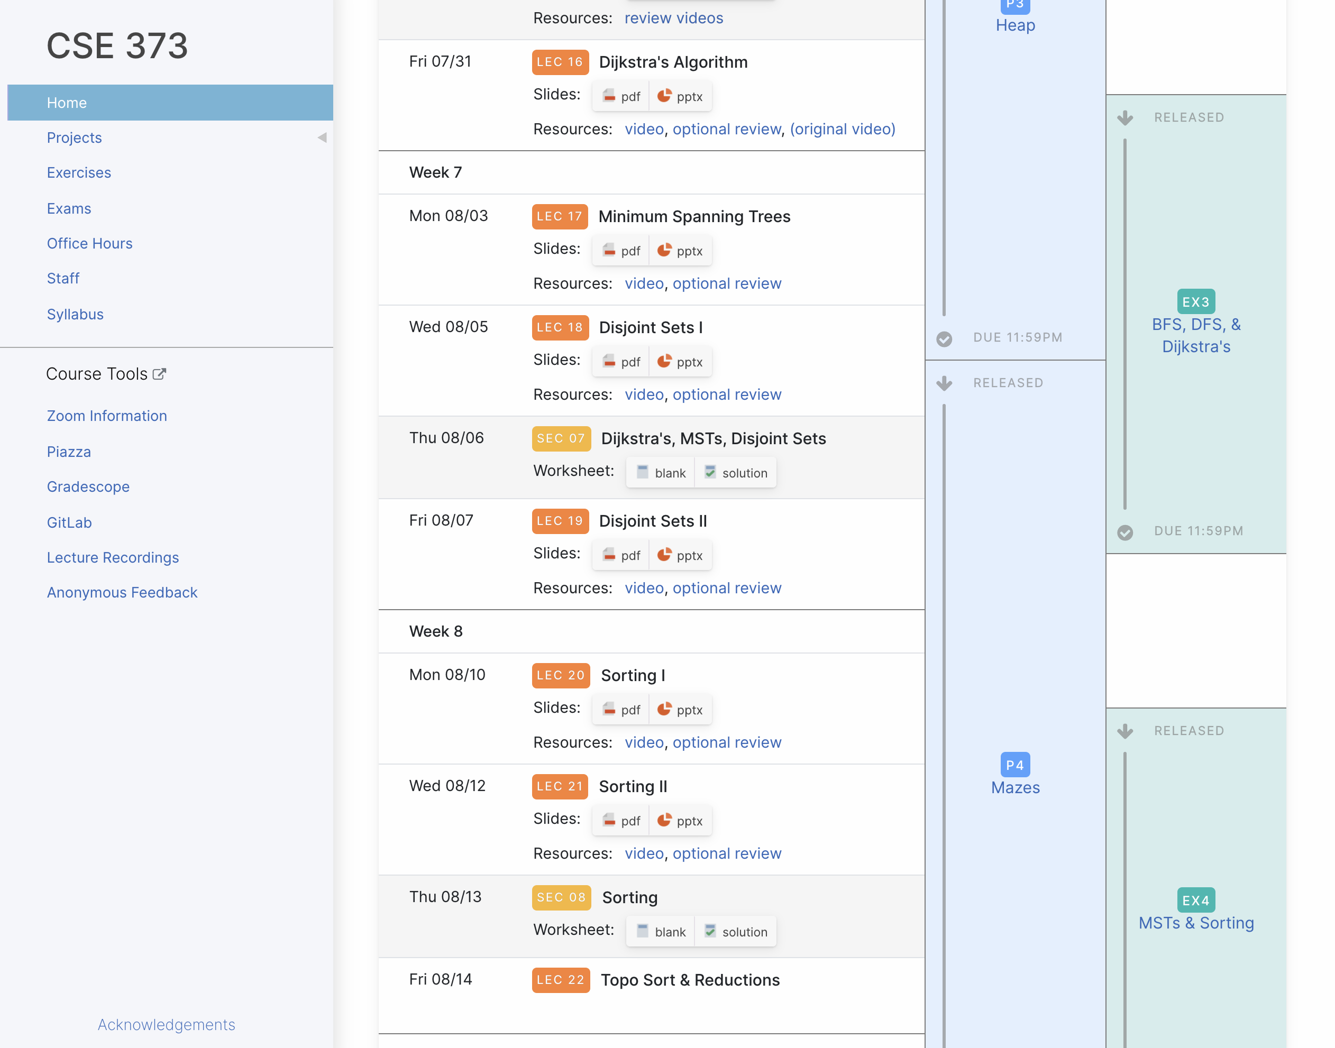
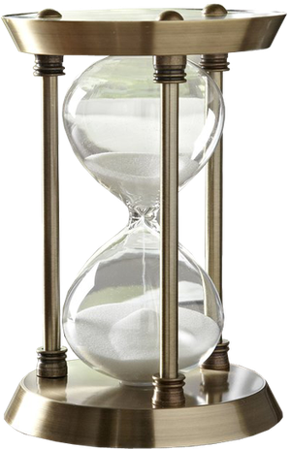
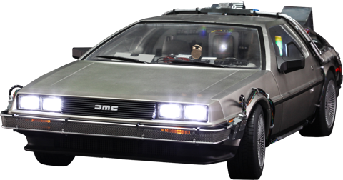

Slide 20
Lecture Outline
Comparison Sorts
Review Sorting Overview
In-Place Quick Sort
Topological Sort
Reductions
Definitions
Examples

Slide 21
Reductions
P INPUT
A reduction is a problem-solving strategy that involves using an algorithm for problem Q to solve a different problem P
Rather than modifying the algorithm for Q, we modify the inputs/outputs to make them compatible with Q!
“P reduces to Q”
1. Convert input for P into input for Q
2. Solve using algorithm for Q
3. Convert output from Q into output from P
Q INPUT
PROBLEM P
PROBLEM Q
Q OUTPUT
P OUTPUT

Slide 22
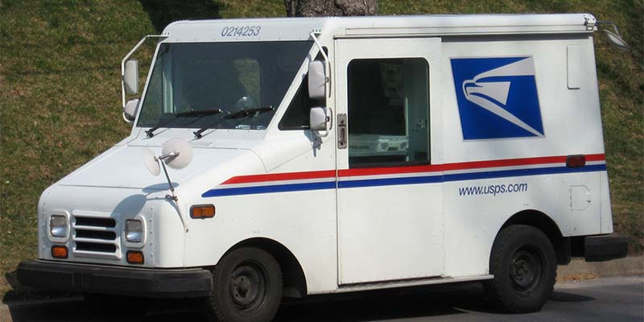
Reductions
Seattle
Example: I want to get a note to my friend in Chicago, but walking all the way there is a difficult problem to solve ☹
Instead, reduce the “get a note to Chicago” problem to the “mail a letter” problem!
1. Place note inside of envelope
2. Mail using US Postal Service
3. Take note out of envelope
Seattle
Q INPUT
Get a note to Chicago
Mail a letter
Q OUTPUT
Chicago
Chicago

Slide 23
How To Perform Topo Sort?
👻
If we add a phantom “start” vertex pointing to other starts, we could use BFS!
2
2
0
3
5
0
3
5
IDEA 3
1
4
6
1
4
6
Performing Topo Sort
7
7
Reduce topo sort to BFS by modifying graph, running BFS, then modifying output back
BFS
Sweet sweet victory 😎
👻
👻
4
6
4
6
4
6
7
7
1
3
5
7
1
3
5
0
2
1
3
5
0
2
0
2

Slide 24
Reductions
Are Prim’s and Dijkstra’s related via a reduction?
Yes. Prim’s reduces to Dijkstra’s.
Yes. Dijkstra’s reduces to Prim’s.
No. This is not a reduction.
A reduction is a problem-solving strategy that involves using an algorithm for problem Q to solve a different problem P
Rather than modifying the algorithm for Q, we modify the inputs/outputs to make them compatible with Q!
“P reduces to Q”
1. Convert input for P into input for Q
2. Solve using algorithm for Q
3. Convert output from Q into output from P
In a reduction, we modify inputs/outputs, not the algorithm itself!

Slide 25
Lecture Outline
Comparison Sorts
Review Sorting Overview
In-Place Quick Sort
Topological Sort
Reductions
Definitions
Examples

Slide 26
Checking for Duplicates
Problem: We want to determine whether an array contains duplicate elements.
Initial idea: Compare every element to every other element!
Runtime: $θ(n^{2})$
Could we do better?
containsDuplicates(array) {
for (int i = 0; i < array.length; i++):
for (int j = i; j < array.length; j++):
if (array[i] == array[j]):
return true
return false
}
0 | 1 | 2 | 3 | 4
2 | 4 | 8 | 3 | 8

Slide 27
Your Turn!
P INPUT
Goal: Reduce the problem of “Contains Duplicates?” to another problem we have an algorithm for.
Try to identify each of the following:
Q INPUT
How will you convert the “Contains Duplicates?” input?
What algorithm will you apply?
How will you convert the algorithm’s output?
PROBLEM P
PROBLEM Q
Q OUTPUT
0 | 1 | 2 | 3 | 4
2 | 4 | 8 | 3 | 8
P OUTPUT

Slide 28
Your Turn!
Array
Q INPUT
Contains Duplicates?
PROBLEM Q
Q OUTPUT
Boolean
Notes:
How would you reduce "Contains Duplicates?" to another problem?
https://www.polleverywhere.com/discourses/UjzNl2233GyR9rOfazjm0

Slide 29
Your Turn!
Array
One Solution: Reduce “Contains Duplicates?” to the problem of sorting an array
We know several algorithms that solve this problem quickly!
Array
Simply pass array input to “Sorting”
Use Heap Sort, Merge Sort, or Quick Sort to sort
Scan through sorted array: check for duplicates now next to each other, a $θ\left(n\right)$ operation!
Contains Duplicates?
Sorting
Sorted Array
Totally okay to do work in input/output conversion! Even with this pass, runtime is $θ\left(n\log{n}+n\right)$, so just $θ\left(n\log{n}\right)$. Reduction helped us avoid quadratic runtime!
Boolean

Slide 30
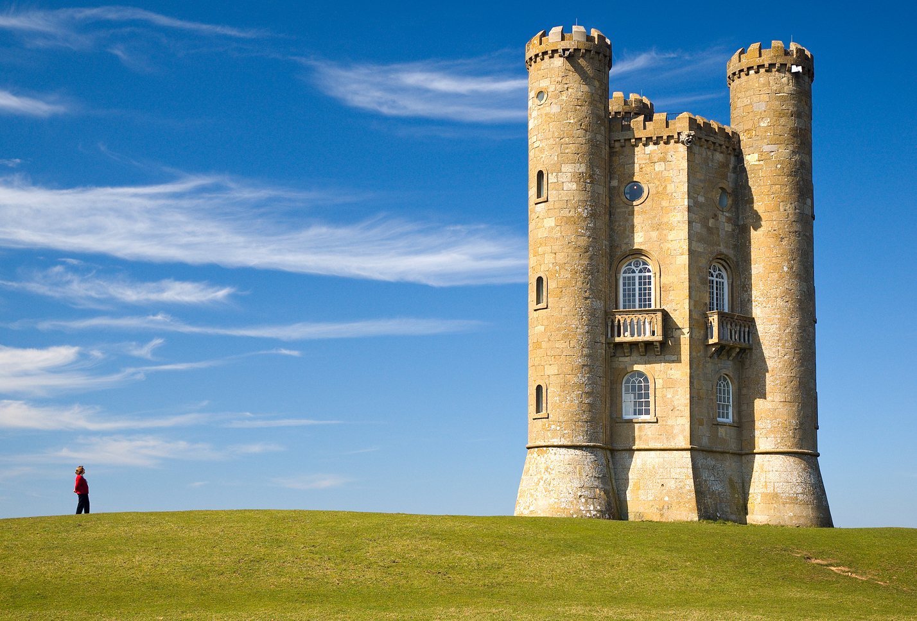
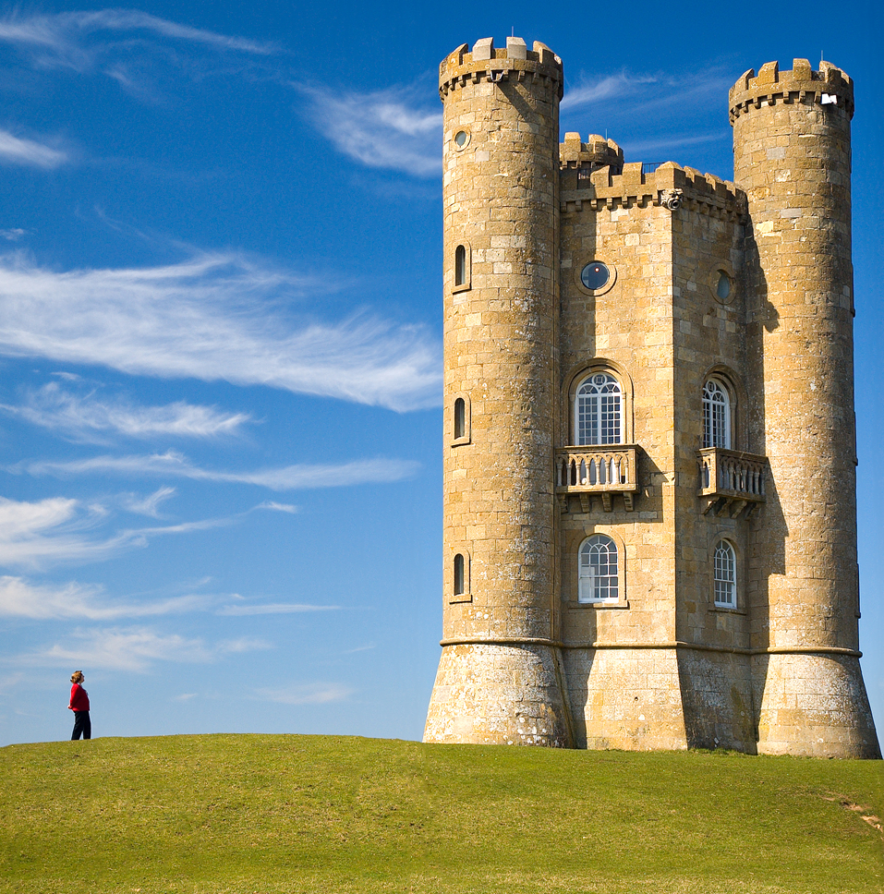
Content-Aware Image Resizing
Seam carving: A distortion-free technique for resizing an image by removing “unimportant seams”
Original Photo
Horizontally-Scaled (castle and person are distorted)
Seam-Carved (castle and person are undistorted; “unimportant” sky removed instead)
Seam carving for content-aware image resizing (Avidan, Shamir/ACM); Broadway Tower (Newton2, Yummifruitbat/Wikimedia)

Slide 31
Demo: https://www.youtube.com/watch?v=vIFCV2spKtg
Notes:
https://www.youtube.com/watch?v=vIFCV2spKtg: stop the video after they show the first vertical seam identified during the alphabet blocks – about 2.5m

Slide 32
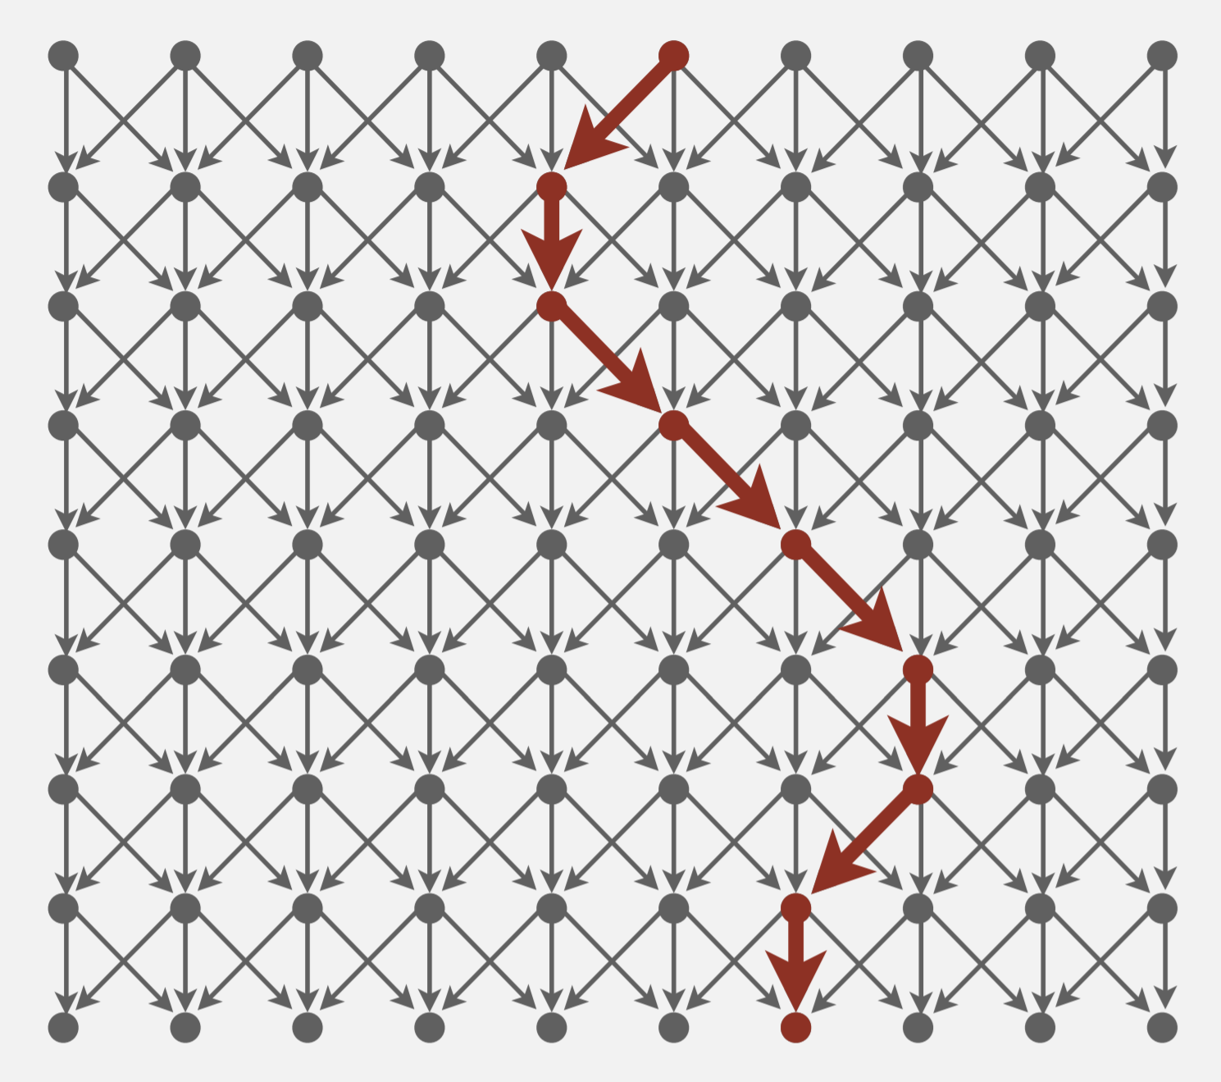
Seam Carving Reduces to Dijkstra’s!
Transform the input so that it can be solved by the standard algorithm
Formulate the image as a graph
Vertices: pixel in the image
Edges: connects a pixel to its 3 downward neighbors
Edge Weights: the “energy” (visual difference) between adjacent pixels
Run the standard algorithm as-is on the transformed input
Run Dijkstra’s to find the shortest path (sum of weights) from top row to bottom row
Transform the output of the algorithm to solve the original problem
Interpret the path as a removable “seam” of unimportant pixels
greater pixel difference = higher weight!
1.5
58.2
1.0
1.6
120.9
Shortest Paths (Robert Sedgewick, Kevin Wayne/Princeton)

Slide 33
An Incomplete Reduction
Complication:
Dijkstra’s starts with a single vertex S and ends with a single vertex T
This problem specifies sets of vertices for the start and end
Question to think about: how would you transform this graph into something Dijkstra’s knows how to operate on?
S
T
Shortest Paths (Robert Sedgewick, Kevin Wayne/Princeton)

Slide 34
In Conclusion
P INPUT
Topo Sort is a widely applicable “sorting” algorithm beyond the classic comparison sorts
Reductions are an essential tool in your CS toolbox -- you’re probably already doing them without putting a name to it
Many more reductions than we can cover!
Shortest Path in DAG with Negative Edges reduces to Topological Sort! (Link)
2-Color Graph Coloring reduces to 2-SAT (Link)
…
Staying on top of week 9 in this course reduces to starting early on P4 and EX4
Q INPUT
PROBLEM P
PROBLEM Q
Q OUTPUT
P OUTPUT

