Slide 1
Dijkstra’s Algorithm
BEFORE WE START
Which of the following statements are true about the “shortest path tree” resulting from BFS?
It only contains the shortest path from s to t
It contains the shortest paths from s to any vertex
It contains the shortest paths from any vertex to t
It contains all shortest paths in the graph
Getting the s to t path out is constant time
Getting the s to t path out is linear time
pollev.com/uwcse373

Slide 2
Announcements
P3 due next Wednesday, 8/05
EX3 published this evening, due next Friday 8/07
Will focus on the graph problems we’ve talked about this week
Note: ramping up slightly in difficulty now that you’ve had practice with algorithmic analysis, recommend taking a look early!

Slide 3
Learning Objectives
After this lecture, you should be able to...
Describe the weighted shortest path problem and explain why BFS doesn’t work to solve it
Trace through Dijkstra’s algorithm on a graph showing intermediate steps at each step and implement Dijkstra’s algorithm in code (P4)
Evaluate inputs to (and modifications to) Dijkstra’s algorithm for correct behavior and efficiency based on the algorithm’s properties
Synthesize code to solve problems on a graph based on DFS, BFS, and Dijkstra’s traversals

Slide 4
Lecture Outline
Review DFS, BFS, Unweighted Shortest Paths
Weighted Shortest Path Problem
Reductions: Weighted → Unweighted
Dijkstra’s Algorithm
Definition & Examples
Implementing Dijkstra’s

Slide 5
DFS
Follow a “choice” all the way to the end, then come back to revisit other choices
BFS
Explore layer-by-layer: examine every node at a certain distance from start, then examine nodes that are one level farther
dfs(Graph graph, Vertex start) {
Stack<Vertex> perimeter = new Stack<>();
Set<Vertex> visited = new Set<>();
...
bfs(Graph graph, Vertex start) {
Queue<Vertex> perimeter = new Queue<>();
Set<Vertex> visited = new Set<>();
perimeter.add(start);
visited.add(start);
while (!perimeter.isEmpty()) {
Vertex from = perimeter.remove();
for (Edge edge : graph.edgesFrom(from)) {
Vertex to = edge.to();
if (!visited.contains(to)) {
perimeter.add(to);
visited.add(to);
}
}
}
}
* Can also be implemented recursively; though be careful of stack overflow!
BFS and DFS are just techniques for iterating! (think: for loop over an array)
Need to add code that actually processes something to solve a problem
A lot of interview problems on graphs can be solved with modifications on top of BFS or DFS! Very worth being comfortable with the pseudocode ☺

Slide 6
Review Using BFS for the Shortest Path Problem
...
Map<Vertex, Edge> edgeTo = ...
Map<Vertex, Double> distTo = ...
edgeTo.put(start, null);
distTo.put(start, 0.0);
while (!perimeter.isEmpty()) {
Vertex from = perimeter.remove();
for (Edge edge : graph.edgesFrom(from)) {
Vertex to = edge.to();
if (!visited.contains(to)) {
edgeTo.put(to, edge);
distTo.put(to, distTo.get(from) + 1);
perimeter.add(to);
visited.add(to);
}
}
}
return edgeTo;
}
(Unweighted) Shortest Path Problem
The start required no edge to arrive at, and is on level 0
Given source vertex s and a target vertex t, how long is the shortest path from s to t? What edges make up that path?
This is a little harder, but still totally doable! We just need a way to keep track of how far each node is from the start.
Sounds like a job for?
BFS!
Remember how we got to this point, and what layer this vertex is part of

Slide 7
Review BFS for Shortest Paths: Example
...
Map<Vertex, Edge> edgeTo = ...
Map<Vertex, Double> distTo = ...
edgeTo.put(start, null);
distTo.put(start, 0.0);
while (!perimeter.isEmpty()) {
Vertex from = perimeter.remove();
for (Edge edge : graph.edgesFrom(from)) {
Vertex to = edge.to();
if (!visited.contains(to)) {
edgeTo.put(to, edge);
distTo.put(to, distTo.get(from) + 1);
perimeter.add(to);
visited.add(to);
}
}
}
return edgeTo;
}
PERIMETER
A
B
C
D
E
DISTTO
2
E
VISITED
0
start
A
1
C
EDGETO
1
B
2
D
The edgeTo map stores backpointers: each vertex remembers what vertex was used to arrive at it!
Note: this code stores visited, edgeTo, and distTo as external maps (only drawn on graph for convenience). Another implementation option: store them as fields of the nodes themselves

Slide 8
Review What about the Target Vertex?
This modification on BFS didn’t mention the target vertex at all!
Instead, it calculated the shortest path and distance from start to every other vertex
This is called the shortest path tree
A general concept: in this implementation, made up of distances and backpointers
Shortest path tree has all the answers!
Length of shortest path from A to D?
Lookup in distTo map: 2
What’s the shortest path from A to D?
Build up backwards from edgeTo map: start at D, follow backpointer to B, follow backpointer to A – our shortest path is A → B → D
All our shortest path algorithms will have this property
If you only care about t, you can sometimes stop early!
Shortest Path Tree:
DISTTO
2
E
0
start
A
1
C
EDGETO
1
B
2
D

Slide 9
Lecture Outline
Review DFS, BFS, Unweighted Shortest Paths
Weighted Shortest Path Problem
Reductions: Weighted → Unweighted
Dijkstra’s Algorithm
Definition & Examples
Implementing Dijkstra’s

Slide 10
Our Graph Problem Collection
NEW
Unweighted Shortest Path Problem
Weighted Shortest Path Problem
s-t Connectivity Problem
Given source vertex s and target vertex t, what path from s to t minimizes the number of edges? How long is that path, and what edges make it up?
Given source vertex s and target vertex t, what path from s to t minimizes the total weight of its edges? How long is that path, and what edges make it up?
Given source vertex s and a target vertex t, does there exist a path from s to t?
SOLUTION
Base Traversal: BFS or DFS
Modification: Check if each vertex == t
SOLUTION
Base Traversal: BFS
Modification: Generate shortest path tree as we go
???

Slide 11
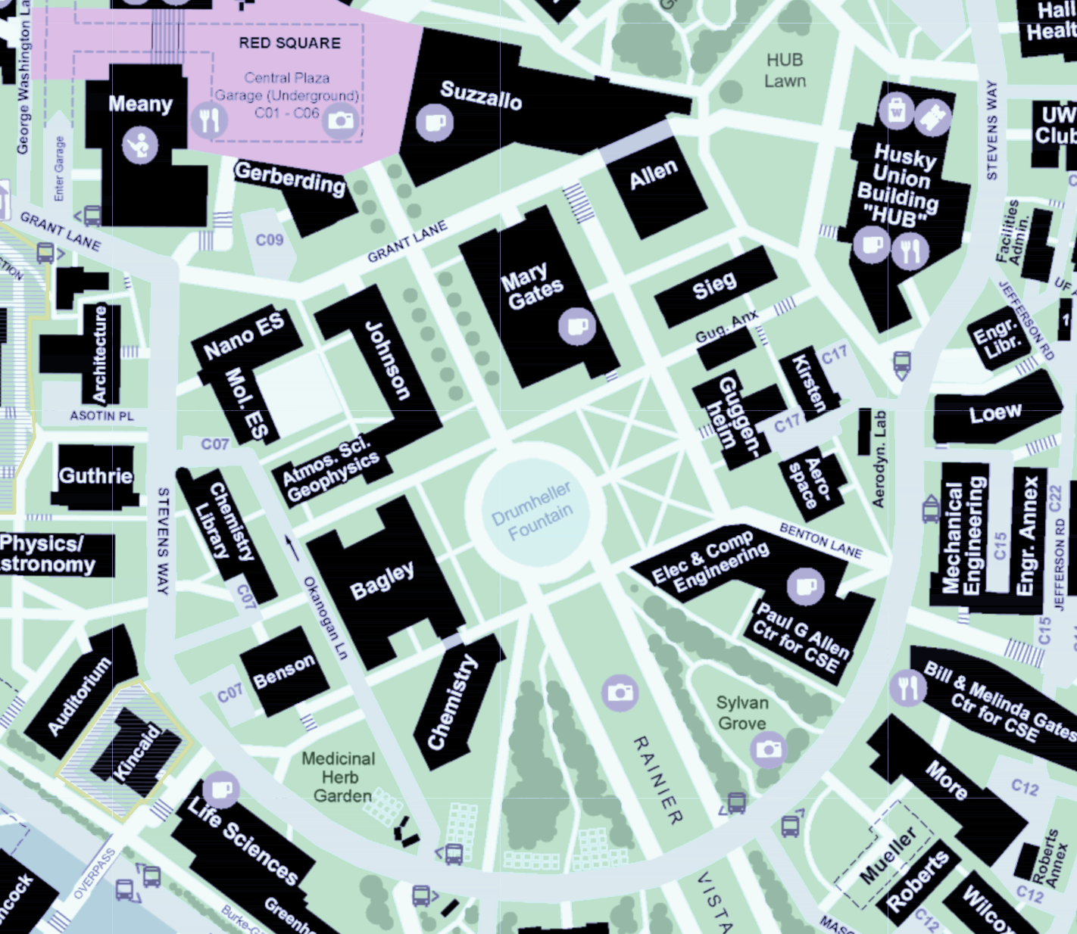
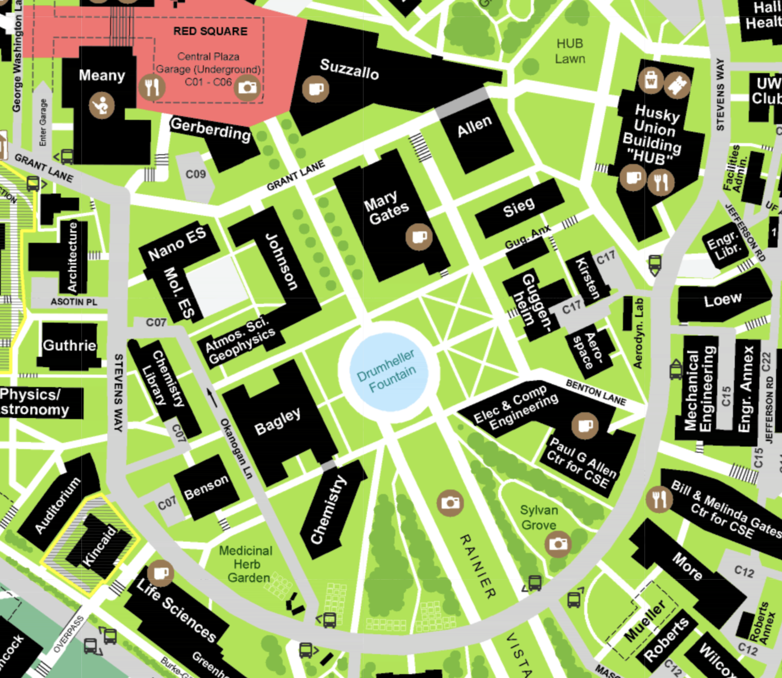
The Weighted Shortest Path Problem
King Lane
0.05 Miles
It’s lunchtime, and that Pagliacci slice isn’t going to eat itself – Suppose we want to find the fastest path from Meany Hall to the HUB
Model as a graph: buildings & road meeting points are vertices, roads are edges
Of course, want to take Asotin – Grant – King, not Stevens Way!
Use edge weights to model distance, since not all edges have the same cost
Would BFS give us the right answer here?
Asotin Place
0.05 Miles
NE Grant Lane
0.2 Miles
HUB
Meany Hall
Stevens Way
0.7 Miles
0.05
0.2
Meany Hall
0.7
0.05
HUB

Slide 12
Why does BFS work for unweighted graphs?
Observation: The “First Try Phenomenon”
BFS only enqueues each vertex once (makes it efficient)
As soon as BFS enqueues a vertex, the final path to that vertex has been chosen! Never re-evaluate its path.
1
0
D
start
A
E
1
Key Intuition: BFS works because:
IF we always process the closest vertices first,
THEN the first path we discover to a new vertex will always be the shortest!
B
2
F
C
target
BFS Tracking:
Example: For shortest path to C, why do we choose edge (B,C) and not (F,C)?
Exactly because we visit B before F!
1
DISTTO
Z
VISITED
EDGETO

Slide 13
Why doesn’t BFS work for weighted graphs?
We want the path that minimizes the sum of edge weights
A-D-E-F-C: total distance 4
A-B-C: total distance 300.
Do the edge weights affect how BFS runs?
Nope! Exactly the same path chosen
1
0
1.0
D
1.0
start
A
E
100.0
1.0
1
Observation: still have “First Try Phenomenon”
Key Intuition: yet BFS breaks because we no longer process the closest vertices first (that is, not closest according to the edge weights!)
So we can’t rely on first path found being best anymore ☹
Idea 1: Could we change the weighted graph into an unweighted graph?
B
2
F
200.0
C
1.0
target
BFS Tracking:
1
DISTTO
Z
VISITED
EDGETO

Slide 14
Lecture Outline
Review DFS, BFS, Unweighted Shortest Paths
Weighted Shortest Path Problem
Reductions: Weighted → Unweighted
Dijkstra’s Algorithm
Definition & Examples
Implementing Dijkstra’s

Slide 15
Idea 1: Change into an unweighted graph
We know BFS works on unweighted graphs
If we can transform a weighted graph to unweighted, we can solve it!
This idea is known as a reduction
“Reduce” a problem you can’t solve to one you can
Here, we’re trying to reduce BFS on weighted graphs to BFS on unweighted graphs
We’ll revisit this concept later in the course!
B
1.0
B
2.0
A
2.0
D
A
D
1.0
C
2.0
C

Slide 16
Weighted Graphs: An Example Reduction
WEIGHTED GRAPHS
UNWEIGHTED GRAPHS
Transform input into a form we can feed into the algorithm
B
2.0
B
1.0
A
D
A
2.0
D
C
1.0
C
Run the algorithm:
Unweighted Shortest Paths
2.0
B
A
D
2
C
Transform output back into the original form, now with a solution
2.0
B
1.0
2.0
A
D
2
1.0
C
2.0

Slide 17
Idea 1: Change into an unweighted graph
1.5
B
1.8
1
B
899999
A
0.01
D
A
500000
D
9.2
C
$$π$$
3000
C
20000
Not possible to convert these to whole numbers of nodes
Even if we can convert, how long will converting take? That’s so many nodes to create.
Unfortunately, looks like we can’t use this reduction here.
Note: we’ll see good examples of reductions later on!
Idea 2: Could we change the order that we visit nodes to take edge weights into account?

Slide 18
Lecture Outline
Review DFS, BFS, Unweighted Shortest Paths
Weighted Shortest Path Problem
Reductions: Weighted → Unweighted
Dijkstra’s Algorithm
Definition & Examples
Implementing Dijkstra’s

Slide 19
Dijkstra’s Algorithm
Named after its inventor, Edsger Dijkstra (1930-2002)
Truly one of the “founders” of computer science
1972 Turing Award
This algorithm is just one of his many contributions!
Example quote: “Computer science is no more about computers than astronomy is about telescopes”
The idea: reminiscent of BFS, but adapted to handle weights
Grow the set of nodes whose shortest distance has been computed
Nodes not in the set will have a “best distance so far”

Slide 20
Dijkstra’s Algorithm: Idea
PERIMETER
2
4??
UNKNOWN
0
2
2
3
∞
start
A
B
F
H
1
4
5
10
2
∞
1
9
1
3
G
4
2
C
KNOWN
D
11
1
E
7
12??
Initialization:
Start vertex has distance 0; all other vertices have distance ∞
At each step:
Pick closest unknown vertex v
Add it to the “cloud” of known vertices
Update “best-so-far” distances for vertices with edges from v

Slide 21
Dijkstra’s Pseudocode (High-Level)
0
KNOWN
start
A
2
2
PERIMETER
B
5
3
Suppose we already visited B, distTo[D] = 7
Now considering edge (C, D):
oldDist = 7
newDist = 3 + 1
That’s better! Update distTo[D], edgeTo[D]
3
7??
Similar to “visited” in BFS, “known” is nodes that are finalized (we know their path)
C
u
1
v
D
dijkstraShortestPath(G graph, V start)
Set known; Map edgeTo, distTo;
initialize distTo with all nodes mapped to ∞, except start to 0
while (there are unknown vertices):
let u be the closest unknown vertex
known.add(u);
for each edge (u,v) from u with weight w:
oldDist = distTo.get(v) // previous best path to v
newDist = distTo.get(u) + w // what if we went through u?
if (newDist < oldDist):
distTo.put(v, newDist)
edgeTo.put(v, u)
Dijkstra’s algorithm is all about updating “best-so-far” in distTo if we find shorter path! Init all paths to infinite.
Order matters: always visit closest first!
Consider all vertices reachable from me: would getting there through me be a shorter path than they currently know about?
CORRECTED
AFTER LECTURE

Slide 22
Dijkstra’s Algorithm: Key Properties
Once a vertex is marked known, its shortest path is known
Can reconstruct path by following back-pointers (in edgeTo map)
While a vertex is not known, another shorter path might be found
We call this update relaxing the distance because it only ever shortens the current best path
Going through closest vertices first lets us confidently say no shorter path will be found once known
Because not possible to find a shorter path that uses a farther vertex we’ll consider later
dijkstraShortestPath(G graph, V start)
Set known; Map edgeTo, distTo;
initialize distTo with all nodes mapped to ∞, except start to 0
while (there are unknown vertices):
let u be the closest unknown vertex
known.add(u)
for each edge (u,v) to unknown v with weight w:
oldDist = distTo.get(v) // previous best path to v
newDist = distTo.get(u) + w // what if we went through u?
if (newDist < oldDist):
distTo.put(v, newDist)
edgeTo.put(v, u)

Slide 23
Dijkstra’s Algorithm: Example #1
0
2
∞
∞
∞
start
B
2
3
A
F
H
1
4
5
10
2
∞
1
9
∞
3
G
∞
2
C
11
∞
D
1
E
Vertex | Known? | distTo | edgeTo
A |  | ∞
B |  | ∞
C |  | ∞
D |  | ∞
E |  | ∞
F |  | ∞
G |  | ∞
H |  | ∞
7
Order Added to Known Set:

Slide 24
Dijkstra’s Algorithm: Example #1
0
2
2??
∞
∞
start
B
2
3
A
F
H
1
4
5
10
2
∞
1
9
1??
3
G
4??
2
C
11
∞
D
1
E
Vertex | Known? | distTo | edgeTo
A | Y | 0 | /
B |  | ≤ 2 | A
C |  | ≤ 1 | A
D |  | ≤ 4 | A
E |  | ∞
F |  | ∞
G |  | ∞
H |  | ∞
7
Order Added to Known Set:
A

Slide 25
Dijkstra’s Algorithm: Example #1
0
2
2??
∞
∞
start
B
2
3
A
F
H
1
4
5
10
2
∞
1
9
1
3
G
4??
2
C
11
12??
D
1
E
Vertex | Known? | distTo | edgeTo
A | Y | 0 | /
B |  | ≤ 2 | A
C | Y | 1 | A
D |  | ≤ 4 | A
E |  | ≤ 12 | C
F |  | ∞
G |  | ∞
H |  | ∞
7
Order Added to Known Set:
A, C
Notes:
Note how E’s distance is 12 (path length) instead of 11 (edge weight)

Slide 26
Dijkstra’s Algorithm: Example #1
0
2
2
4??
∞
start
B
2
3
A
F
H
1
4
5
10
2
∞
1
9
1
3
G
4??
2
C
11
12??
D
1
E
Vertex | Known? | distTo | edgeTo
A | Y | 0 | /
B | Y | 2 | A
C | Y | 1 | A
D |  | ≤ 4 | A
E |  | ≤ 12 | C
F |  | ≤ 4 | B
G |  | ∞
H |  | ∞
7
Order Added to Known Set:
A, C, B
Notes:
Note how
Again, we don’t set F’s pathlen to 2 (the edge weight); we set it to 4 (length of A->B->F)
We don’t update C with distance 7 (A->B->C); its optimal path is already known
We don’t update E with distance 12 (A->B->E); the path length is the same

Slide 27
Dijkstra’s Algorithm: Example #1
0
2
2
4??
∞
start
B
2
3
A
F
H
1
4
5
10
2
∞
1
9
1
3
G
4
2
C
11
12??
D
1
E
Vertex | Known? | distTo | edgeTo
A | Y | 0 | /
B | Y | 2 | A
C | Y | 1 | A
D | Y | 4 | A
E |  | ≤ 12 | C
F |  | ≤ 4 | B
G |  | ∞
H |  | ∞
7
Order Added to Known Set:
A, C, B, D
Notes:
Nothing was updated; we already had an optimal path to C

Slide 28
Dijkstra’s Algorithm: Example #1
0
2
2
4
7??
start
B
2
3
A
F
H
1
4
5
10
2
∞
1
9
1
3
G
4
2
C
11
12??
D
1
E
Vertex | Known? | distTo | edgeTo
A | Y | 0 | /
B | Y | 2 | A
C | Y | 1 | A
D | Y | 4 | A
E |  | ≤ 12 | C
F | Y | 4 | B
G |  | ∞
H |  | ≤ 7 | F
7
Order Added to Known Set:
A, C, B, D, F

Slide 29
Dijkstra’s Algorithm: Example #1
0
2
2
4
7
start
B
2
3
A
F
H
1
4
5
10
2
8??
1
9
1
3
G
4
2
C
11
12??
D
1
E
Vertex | Known? | distTo | edgeTo
A | Y | 0 | /
B | Y | 2 | A
C | Y | 1 | A
D | Y | 4 | A
E |  | ≤ 12 | C
F | Y | 4 | B
G |  | ≤ 8 | H
H | Y | 7 | F
7
Order Added to Known Set:
A, C, B, D, F, H

Slide 30
Dijkstra’s Algorithm: Example #1
0
2
2
4
7
start
B
2
3
A
F
H
1
4
5
10
2
8
1
9
1
3
G
4
2
C
11
11??
D
1
E
Vertex | Known? | distTo | edgeTo
A | Y | 0 | /
B | Y | 2 | A
C | Y | 1 | A
D | Y | 4 | A
E |  | ≤ 11 | G
F | Y | 4 | B
G | Y | 8 | H
H | Y | 7 | F
7
Order Added to Known Set:
A, C, B, D, F, H, G
Notes:
Note how we found a better path to E at last (A->B->F->H->G->E), with cost 11; formerly path A->C->E had cost 12

Slide 31
Dijkstra’s Algorithm: Example #1
0
2
2
4
7
start
B
2
3
A
F
H
1
4
5
10
2
8
1
9
1
3
G
4
2
C
11
11
D
1
E
Vertex | Known? | distTo | edgeTo
A | Y | 0 | /
B | Y | 2 | A
C | Y | 1 | A
D | Y | 4 | A
E | Y | 11 | G
F | Y | 4 | B
G | Y | 8 | H
H | Y | 7 | F
7
Order Added to Known Set:
A, C, B, D, F, H, G, E
Notes:
Done!

Slide 32
Dijkstra’s Algorithm: Interpreting the Results
0
2
2
4
7
Now that we’re done, how do we get the path from A to E?
Follow edgeTo backpointers!
distTo and edgeTo make up the shortest path tree
start
B
2
3
A
F
H
1
4
5
10
2
8
1
9
1
3
G
4
2
C
11
11
D
1
E
Vertex | Known? | distTo | edgeTo
A | Y | 0 | /
B | Y | 2 | A
C | Y | 1 | A
D | Y | 4 | A
E | Y | 11 | G
F | Y | 4 | B
G | Y | 8 | H
H | Y | 7 | F
7
Order Added to Known Set:
A, C, B, D, F, H, G, E
Notes:
Walk through the chain of “previous” (E->G->H->F->B->A)

Slide 33
Review: Key Features
Once a vertex is marked known, its shortest path is known
Can reconstruct path by following backpointers
While a vertex is not known, another shorter path might be found!
The “Order Added to Known Set” is unimportant
A detail about how the algorithm works (client doesn’t care)
Not used by the algorithm (implementation doesn’t care)
It is sorted by path-distance; ties are resolved “somehow”
If we only need path to a specific vertex, can stop early once that vertex is known
Because its shortest path cannot change!
Return a partial shortest path tree

Slide 34
Dijkstra’s Algorithm: Example #2
0
∞
start
2
B
A
1
1
∞
2
5
E
∞
1
∞
1
D
C
5
3
∞
2
6
G
Vertex | Known? | distTo | edgeTo
A |  | ∞
B |  | ∞
C |  | ∞
D |  | ∞
E |  | ∞
F |  | ∞
G |  | ∞
∞
10
F
Order Added to Known Set:
Notes:
Can print this on the worksheet

Slide 35
Dijkstra’s Algorithm: Example #2
0
∞
start
2
B
A
1
1
∞
2
5
E
1??
1
2??
1
D
C
5
3
∞
2
6
G
Vertex | Known? | distTo | edgeTo
A | Y | 0 | /
B |  | ∞
C |  | ≤ 2 | A
D |  | ≤ 1 | A
E |  | ∞
F |  | ∞
G |  | ∞
∞
10
F
Order Added to Known Set:
A

Slide 36
Dijkstra’s Algorithm: Example #2
0
6??
start
2
B
A
1
1
2??
2
5
E
1
1
2??
1
D
C
5
3
6??
2
6
G
Vertex | Known? | distTo | edgeTo
A | Y | 0 | /
B |  | ≤ 6 | D
C |  | ≤ 2 | A
D | Y | 1 | A
E |  | ≤ 2 | D
F |  | ≤ 7 | D
G |  | ≤ 6 | D
7??
10
F
Order Added to Known Set:
A, D

Slide 37
Dijkstra’s Algorithm: Example #2
0
6??
start
2
B
A
1
1
2??
2
5
E
1
1
2
1
D
C
5
3
6??
2
6
G
Vertex | Known? | distTo | edgeTo
A | Y | 0 | /
B |  | ≤ 6 | D
C | Y | 2 | A
D | Y | 1 | A
E |  | ≤ 2 | D
F |  | ≤ 4 | C
G |  | ≤ 6 | D
4??
10
F
Order Added to Known Set:
A, D, C

Slide 38
Dijkstra’s Algorithm: Example #2
0
3??
start
2
B
A
1
1
2
2
5
E
1
1
2
1
D
C
5
3
6??
2
6
G
Vertex | Known? | distTo | edgeTo
A | Y | 0 | /
B |  | ≤ 3 | E
C | Y | 2 | A
D | Y | 1 | A
E | Y | 2 | D
F |  | ≤ 4 | C
G |  | ≤ 6 | D
4??
10
F
Order Added to Known Set:
A, D, C, E

Slide 39
Dijkstra’s Algorithm: Example #2
0
3
start
2
B
A
1
1
2
2
5
E
1
1
2
1
D
C
5
3
6??
2
6
G
Vertex | Known? | distTo | edgeTo
A | Y | 0 | /
B | Y | 3 | E
C | Y | 2 | A
D | Y | 1 | A
E | Y | 2 | D
F |  | ≤ 4 | C
G |  | ≤ 6 | D
4??
10
F
Order Added to Known Set:
A, D, C, E, B

Slide 40
Dijkstra’s Algorithm: Example #2
0
3
start
2
B
A
1
1
2
2
5
E
1
1
2
1
D
C
5
3
6??
2
6
G
Vertex | Known? | distTo | edgeTo
A | Y | 0 | /
B | Y | 3 | E
C | Y | 2 | A
D | Y | 1 | A
E | Y | 2 | D
F | Y | 4 | C
G |  | ≤ 6 | D
4
10
F
Order Added to Known Set:
A, D, C, E, B, F

Slide 41
Dijkstra’s Algorithm: Example #2
0
3
start
2
B
A
1
1
2
2
5
E
1
1
2
1
D
C
5
3
6
2
6
G
Vertex | Known? | distTo | edgeTo
A | Y | 0 | /
B | Y | 3 | E
C | Y | 2 | A
D | Y | 1 | A
E | Y | 2 | D
F | Y | 4 | C
G | Y | 6 | D
4
10
F
Order Added to Known Set:
A, D, C, E, B, F, G

Slide 42
Why Does Dijkstra’s Work?
Dijkstra’s Algorithm Invariant
All vertices in the “known” set have the correct shortest path
INVARIANT
KNOWN
5
1
6??
Similar “First Try Phenomenon” to BFS
How can we be sure we won’t find a shorter path to X later?
Key Intuition: Dijkstra’s works because:
IF we always add the closest vertices to “known” first,
THEN by the time a vertex is added, any possible relaxing has happened and the path we know is always the shortest!
3
A
8??
1
X
Example:
We’re about to add X to the known set
But how can we be sure we won’t later find a path through some node A that is shorter to X?
Because if we could, Dijkstra’s would explore A first

Slide 43
Why Does Dijkstra’s Work?
Dijkstra’s Algorithm Invariant
All vertices in the “known” set have the correct shortest path
INVARIANT
KNOWN
5
1
6
Similar “First Try Phenomenon” to BFS
How can we be sure we won’t find a shorter path to X later?
Key Intuition: Dijkstra’s works because:
IF we always add the closest vertices to “known” first,
THEN by the time a vertex is added, any possible relaxing has happened and the path we know is always the shortest!
3
A
7??
1
X
Example:
We’re about to add X to the known set
But how can we be sure we won’t later find a path through some node A that is shorter to X?
Because if we could, Dijkstra’s would explore A first

Slide 44
When Doesn’t Dijkstra’s Work?
KNOWN
5
6
11??
3
A
8??
-5
X
Example:
Which vertex do we add first?
X, using edge 3, because 8 < 11

Slide 45
When Doesn’t Dijkstra’s Work?
😵
Dijkstra’s Algorithm Invariant
All vertices in the “known” set have the correct shortest path
INVARIANT
KNOWN
5
6
11??
Dijkstra’s Algorithm is not guaranteed to work on graphs with negative edge weights
It can work, but is fooled when a negative edge “hides” behind a large edge weight
Will still run, but give wrong answer
3
A
8
-5
X
Example:
Which vertex do we add first?
X, using edge 3, because 8 < 11
Is 8 the correct shortest path length to X?
No! Going through A, we could have gotten a path of length 6

Slide 46
Lecture Outline
Review DFS, BFS, Unweighted Shortest Paths
Weighted Shortest Path Problem
Reductions: Weighted → Unweighted
Dijkstra’s Algorithm
Definition & Examples
Implementing Dijkstra’s

Slide 47
Implementing Dijkstra’s
How do we implement “let u be the closest unknown vertex”?
Would sure be convenient to store vertices in a structure that…
Gives them each a distance “priority” value
Makes it fast to grab the one with the smallest distance
Lets us update that distance as we discover new, better paths
dijkstraShortestPath(G graph, V start)
Set known; Map edgeTo, distTo;
initialize distTo with all nodes mapped to ∞, except start to 0
while (there are unknown vertices):
let u be the closest unknown vertex
known.add(u)
for each edge (u,v) to unknown v with weight w:
oldDist = distTo.get(v) // previous best path to v
newDist = distTo.get(u) + w // what if we went through u?
if (newDist < oldDist):
distTo.put(v, newDist)
edgeTo.put(v, u)
MIN PRIORITY QUEUE ADT

Slide 48
Implementing Dijkstra’s: Pseudocode
dijkstraShortestPath(G graph, V start)
Map edgeTo, distTo;
initialize distTo with all nodes mapped to ∞, except start to 0
PriorityQueue<V> perimeter; (initialize with start)
while (!perimeter.isEmpty()):
u = perimeter.removeMin()
for each edge (u,v) to v with weight w:
oldDist = distTo.get(v) // previous best path to v
newDist = distTo.get(u) + w // what if we went through u?
if (newDist < oldDist):
distTo.put(v, newDist)
edgeTo.put(v, u)
if (perimeter.contains(v)):
perimeter.changePriority(v, newDist)
else:
perimeter.add(v, newDist)
Use a MinPriorityQueue to keep track of the perimeter
Don’t need to track entire graph
Don’t need separate “known” set – implicit in PQ (we’ll never try to update a “known” vertex)
This pseudocode is much closer to what you’ll implement in P4
However, still some details for you to figure out!
e.g. how to initialize distTo with all nodes mapped to ∞
Spec will describe some optimizations for you to make ☺
CORRECTED
AFTER LECTURE

Slide 49
Dijkstra’s Runtime
dijkstraShortestPath(G graph, V start)
Map edgeTo, distTo;
initialize distTo with all nodes mapped to ∞, except start to 0
PriorityQueue<V> perimeter; (initialize with start)
while (!perimeter.isEmpty()):
u = perimeter.removeMin()
for each edge (u,v) to v with weight w:
oldDist = distTo.get(v) // previous best path to v
newDist = distTo.get(u) + w // what if we went through u?
if (newDist < oldDist):
distTo.put(v, newDist)
edgeTo.put(v, u)
if (perimeter.contains(v)):
perimeter.changePriority(v, newDist)
else:
perimeter.add(v, newDist)
$$Θ(|V|)$$
$$Θ\left(|V|log⁡|V|\right)$$
$Θ(|V|)$ iterations
$$Θ(log⁡|V|)$$
total $Θ\left(\left|E\right|\right)$ iterations
$$Θ\left(1\right)$$
$$Θ\left(|E|log⁡|V|\right)$$
$$Θ\left(log⁡|V|\right)$$
$$Θ\left(log⁡|V|\right)$$

Slide 50
Dijkstra’s Runtime
dijkstraShortestPath(G graph, V start)
Map edgeTo, distTo;
initialize distTo with all nodes mapped to ∞, except start to 0
PriorityQueue<V> perimeter; (initialize with start)
while (!perimeter.isEmpty()):
u = perimeter.removeMin()
for each edge (u,v) to v with weight w:
oldDist = distTo.get(v) // previous best path to v
newDist = distTo.get(u) + w // what if we went through u?
if (newDist < oldDist):
distTo.put(v, newDist)
edgeTo.put(v, u)
if (perimeter.contains(v)):
perimeter.changePriority(v, newDist)
else:
perimeter.add(v, newDist)
$$Θ(|V|)$$
Final result:
$$Θ\left(|V|log⁡|V|\right)$$
$Θ(|V|)$ iterations
$$Θ(log⁡|V|)$$
$$Θ\left(\left|V\right|\log\left|V\right|+ |E|log⁡|V|\right)$$
total $Θ\left(\left|E\right|\right)$ iterations
Why can’t we simplify further?
We don’t know if |V| or |E| is going to be larger, so we don’t know which term will dominate.
Sometimes we assume |E| is larger than |V|, so |E|log|V| dominates. But not always true!
$$Θ\left(1\right)$$
$$Θ\left(|E|log⁡|V|\right)$$
$$Θ\left(log⁡|V|\right)$$
$$Θ\left(log⁡|V|\right)$$

