Slide 1
Memory & Caching, B+ Trees
BEFORE WE START
Which of the following statements is true about an AVL Tree?
It remains perfectly balanced after an insert
The get operation has a better best-case runtime than get for a normal BST
Rotations always happen at the tree’s root
At most one rotation (or double rotation) is needed to rebalance after an insert
pollev.com/uwcse373

Slide 2
Announcements
EX2 (Due TONIGHT 11:59pm)
P2 (Due next Wednesday)
Mid-Quarter Survey out now
  Let us know how the course is going!
Exam I
  Start forming groups if you haven’t already! Consider posting on Discord’s #find-a-partner channel
  Practice exam released on Monday to help give you a picture of what to expect
  Section next week will also be exam review
  We highly recommend reviewing section problems, exercises, and post-lecture review questions!

Slide 3
Learning Objectives
After this lecture, you should be able to...
Contrast the CPU, RAM, the cache, and Disk in terms of their storage space and the time to access them
Explain why arrays tend to lead to better performance than linked lists, in terms of spatial locality
Describe how B+ Trees help minimize disk accesses and trace a get() operation in a B+ Tree (Non-objective: Be able to construct, modify, or explain every detail of a B+ Tree)

Slide 4
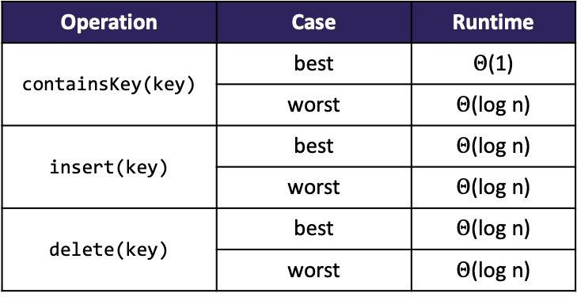
Review AVL Trees
Operation | Case | Runtime
containsKey(key) | best | $Θ$(1)
 | worst | $Θ$(log n)
insert(key) | best | $Θ$(log n)
 | worst | $Θ$(log n)
delete(key) | best | $Θ$(log n)
 | worst | $Θ$(log n)
AVL Invariant
  For every node, the height of its left and right subtrees may only differ by at most 1
INVARIANT
PROS
CONS
All operations on an AVL Tree have a logarithmic worst case
  Because these trees are always balanced!
The act of rebalancing adds no more than a constant factor to insert and delete
Asymptotically, just better than a normal BST!
Relatively difficult to program and debug (so many moving parts during a rotation)
Additional space for the height field
Though asymptotically faster, rebalancing does take some time
  Depends how important every little bit of performance is to you

Slide 5

Review Fixing AVL Invariant
1
h:2
5
h:1
h:0
8
h:0

Slide 6
Review Fixing AVL Invariant: Left Rotation
In general, we can fix the AVL invariant by performing rotations wherever an imbalance was created
Left Rotation
  Find the node that is violating the invariant (here, )
  Let it “fall” left to become a left child
1
1
h:2
5
h:1
5
h:1
8
h:0
1
h:0
8
h:0
Apply a left rotation whenever the newly inserted node is located under the right child of the right child

Slide 7
Review 4 AVL Rotation Cases
”Line” Cases
Solve with 1 rotation
”Kink” Cases
Solve with 2 rotations
Left Rotation
Right Rotation
Right/Left Rotation
Left/Right Rotation
1
6
1
9
5
4
5
2
8
1
3
5

Slide 8
Review AVL insert(): Approach
(1) Originally, whole tree balanced, and this subtree has height 2
Our overall algorithm:
  Insert the new node as in a BST (a new leaf)
  For each node on the path from the root to the new leaf:
    The insertion may (or may not) have changed the node’s height
    Detect height imbalance and perform a rotation to restore balance
Facts that make this easier:
  Imbalances can only occur along the path from the new leaf to the root
  We only have to address the lowest unbalanced node
  Applying a rotation (or double rotation), restores the height of the subtree before the insertion -- when everything was balanced!
  Therefore, we need at most one rebalancing operation
...
6
...
8
7
2
10
9
12
(2) Insertion creates imbalance(s), including the subtree (8 is lowest unbalanced node)
11
(3) Since the rotation on 8 will restore the subtree to height 2, whole tree balanced again!

Slide 9
Lecture Outline
Memory & Caching
  How Memory Looks
  How Memory Is Used
B+ Trees

Slide 10
So... What is a Computer?
At the simplest level, think of a computer as being two components:
  CPU: Central Processing Unit (The “brain”. When any operation is run, it’s running in the CPU. Takes in inputs and evaluates an output.)
  RAM: Random Access Memory (The “notebook”. Where data is kept track of, and stored between operations. Inputs are read from here and outputs are written here.)
CPU
RAM

Slide 11
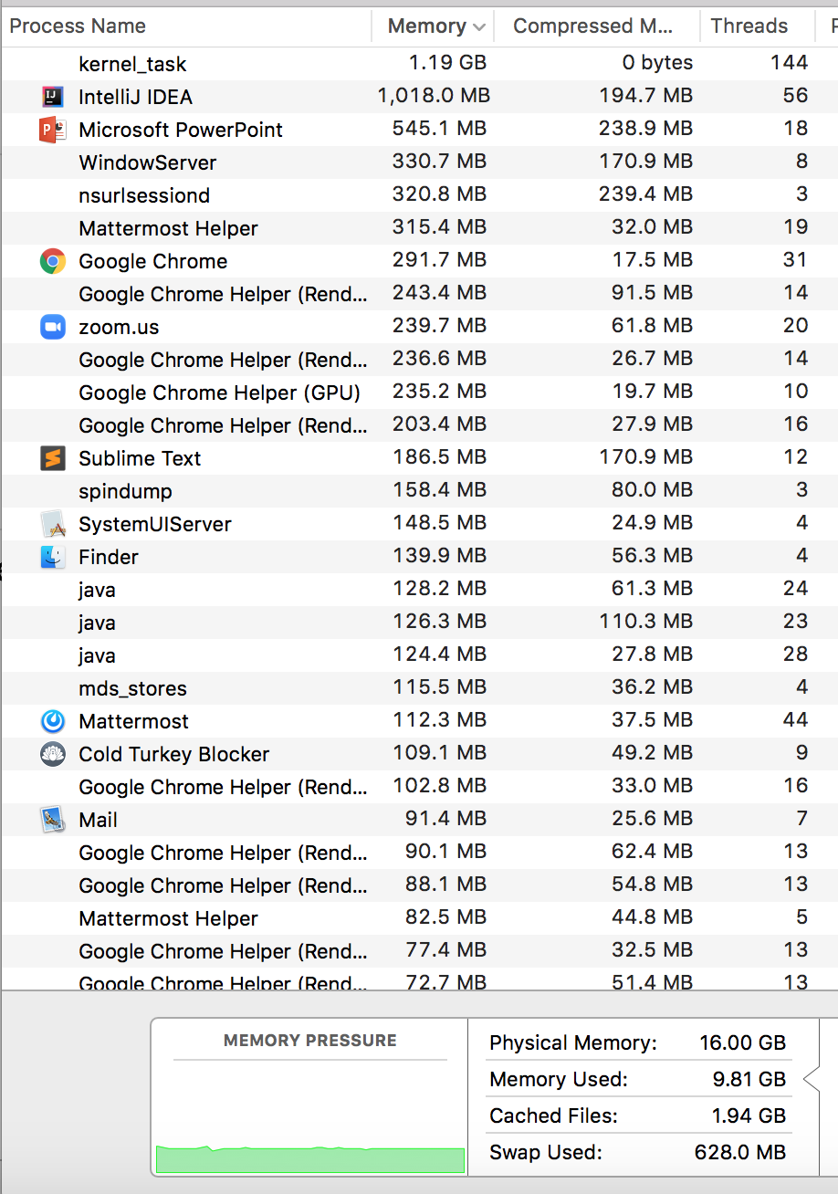
RAM (Random-Access Memory)
RAM is where the programs you run store their data.
  Data structures, variables, method call frames, etc. all stored here!
Often just called “Memory” or “Main Memory”
Notes:
RAM is a term frequently mentioned when purchasing computers and looking at the hardware details. For us programmers, RAM is the physical location where data gets stored for the programs we run. It’s the main location for data structures, variables, method calls, etc. that we create in our programs. When you look at this screenshot saying how much memory is being used, it’s talking about how much RAM. Somewhat frequently when things say ‘memory’ it really means RAM.

Slide 12

Think of RAM as a Giant Array!
Fortunately, as programmers we don’t need to understand the circuitry below!
We think about RAM through the abstraction of a giant array:
  Stores data in specific locations
  Indices to describe those locations (we call them addresses for memory)
  We can jump to any index (“random access”)
372 | 373 | 374 | 375 | 376
RAM is really a physical chip in your computer consisting of complicated circuitry
LOW-LEVEL REALITY
HIGH-LEVEL ABSTRACTION
Notes:
It turns out that for computer scientists / programming, we don’t have to know about the circuits and electricity that makes this green blob computer chip works. Luckily for us RAM can be thought of as a very big array -- this is how we should thing about RAM in our programs for us to be able to take advantage of it / understand how our programs interact with it.
RAM can be thought of as an array for 2 reasons in particular
you think of RAM having spaces for you to store stuff, just like you would in an array … and it also has indices (but for memory its called addresses) that describe where in RAM / the array a particular piece of data is located
Also just because of this Random access thing – you might have heard this before but people sometimes describe arrays as random access because you can access any random index in an array equally to other indices / easily. It’s the same for RAM (the computer chip one) – all addresses are easily accessed as all the others

Slide 13
Simple Data in RAM
a: refers to address 107
letter: refers to address 113
int a = 5;
char letter = ‘z’
100 | 101 | 102 | 103 | 104 | 105 | 106 | 107 | 108 | 109 | 110 | 111 | 112 | 113 | 114 | 115 | 116 | 117 | 118 | 119
 |  |  |  |  |  |  | 5 |  |  |  |  |  | ‘z’
Notes:
A very high-level view (there are some more details to it if you want to Google / take more classes) of how variables and values are stored inside RAM visually. You can imagine that when we create variables like above, it’s just like putting things in array, except for this course we can think of your computer just choosing where things go (there’s a more well defined system for it that you can read up on – search memory layout)

Slide 14
Data Structures in RAM
int[] array = new int[3];
array[0] = 3;
array[1] = 7;
array[2] = 3;
Node front = new Node(3);
front.next = new Node(7);
front.next.next = new Node(3);
100 | 101 | 102 | 103 | 104 | 105 | 106 | 107 | 108 | 109 | 110 | 111 | 112 | 113 | 114 | 115 | 116 | 117 | 118 | 119
3
7
3
7
117
3
108
3
An array is a contiguous block of memory (a bunch of slots next to each other)
A linked list is a series of nodes, with references to each other
  How to reference? Simply store the address!
  Nodes do not need to be contiguous, or even in order
Notes:
How do data structures look like? Variables are simple but what about when we put things inside linked lists and arrays?

Slide 15
Lecture Outline
Memory & Caching
  How Memory Looks
  How Memory Is Used
B+ Trees

Slide 16

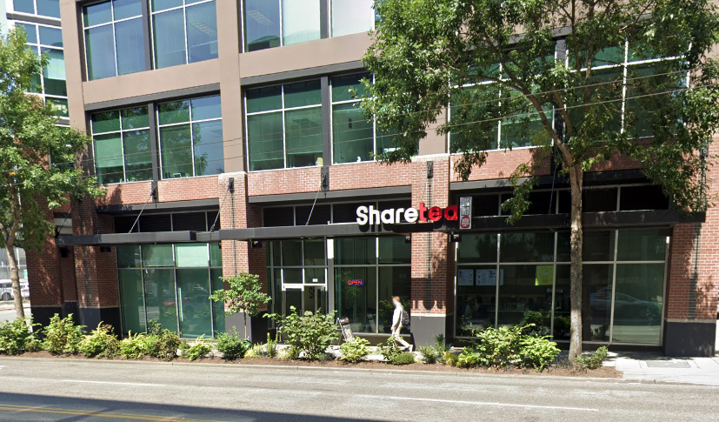


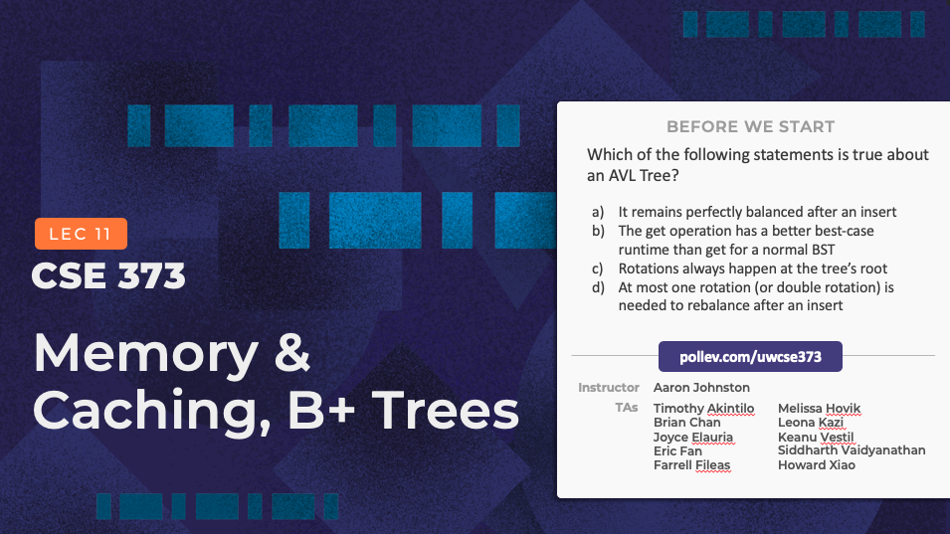
Buying Bubble Tea
Suppose there’s some treat essential grocery you need every few hours
As soon as you realize you’re thirsty, you:
  (1) Walk to the store (2) Buy a bubble tea (3) Walk back home (4) Enjoy
But you repeat this multiple times a day! It takes so long to walk to the store, and that’s a lot of time spent away from 373 lecture...

Slide 17
Buying Bubble Tea: Planning Ahead
Could this be more efficient?
Since you know it’s likely you’ll want another bubble tea in a few hours, what if you do what any reasonable person would: buy a bubble tea minifridge and store a handful closer to home!

Slide 18
Cache
Pronounced “cash”
Intermediate storage between the CPU and RAM
  RAM takes a long time to access, but is gigantic. Cache is much faster (closer to the CPU where data gets processed), but smaller.
Store a copy of some data here
  When we’re about to go grab an address from RAM, we check the cache first – and we love when the data’s there, because it’s much faster!
CPU
Cache
RAM

Slide 19
Bringing More Data Back
If we need to go all the way to RAM, might as well make it count!
Your computer automatically grabs a whole chunk of data around each address from RAM when you access it
  That chunk of data is then copied to the cache
  Your computer knows its’s likely you’ll want a nearby address soon
  Bringing back multiple addresses of data costs nothing: the hardware is designed to grab many at a time
Say you go to access address 114
Addresses 110 - 117 might be brought back with you!
110 | 111 | 112 | 113 | 114 | 115 | 116 | 117
Cache
RAM
100 | 101 | 102 | 103 | 104 | 105 | 106 | 107 | 108 | 109 | 110 | 111 | 112 | 113 | 114 | 115 | 116 | 117 | 118 | 119

Slide 20
Cache Implications: Arrays
This has a major impact on programming with arrays!
  Suppose we’re looping through everything in an array. When we access index 0, we grab a whole chunk of the array and put it in the cache – now the next (block size) accesses are much faster!
  For a short array, we might even grab the whole thing and bring it into the cache
110 | 111 | 112 | 113 | 114 | 115 | 116 | 117
Cache
The chunk of memory that gets brought back is a “block”

Slide 21
Characterizing Cache-Friendly Programs
Spatial locality: tendency for programs to access locations nearby to recent locations
  Plenty of our programs exhibit spatial locality: e.g. looping through an array
Temporal locality: tendency for programs to access data that was recently accessed
  Plenty of our programs exhibit temporal locality: e.g. adding to sum variable over and over
Programs with spatial and temporal locality benefit the most from caching!

Slide 22
Cache Implications: Linked Lists
Linked lists can be spread out all over the RAM array
  Do not exhibit strong spatial locality!
Don’t get the same cache benefits – frequently the next list node is far enough away that it’s not included on the same block
110 | 111 | 112 | 113 | 114 | 115 | 116 | 117
Cache
😭
“block”
100 | 101 | 102 | 103 | 104 | 105 | 106 | 107 | 108 | 109 | 110 | 111 | 112 | 113 | 114 | 115 | 116 | 117 | 118 | 119
7
117
3
108
3
RAM
Notes:
https://repl.it/repls/MistyroseLinedTransformation (15 sec to run)

Slide 23
Memory Architecture
Typically multiple caches (progressively smaller and faster: L1, L2, & L3)
Beyond RAM is the disk, which is way, way, WAY slower – but much bigger, & disk memory persists when the computer is off (RAM gets cleared)
  Similar idea: chunk of data gets pulled into RAM when accessed on disk (called a “page”)

Slide 24
Asymptotic Analysis, Meet The Real World
Asymptotic analysis tells us iterating through an array and a linked list are the same complexity class (linear)
  This is still true: growth rates are the same, and asymptotic analysis is a helpful tool to capture that
  But arrays are frequently a significant constant factor faster due to cache performance! One area asymptotic analysis isn’t a good tool for
https://repl.it/repls/MistyroseLinedTransformation (~15 sec to run)
“Latency Numbers Everyone Should Know” from Jeff Dean, Senior Fellow at Google and UW Alum!
L1 cache reference | 0.5 ns
Branch mispredict | 5 ns
L2 cache reference | 7 ns
Mutex lock/unlock | 100 ns
Main memory reference | 100 ns
Compress 1K bytes with Zippy | 10,000 ns | 0.01 ms
Send 1K bytes over 1 Gbps network | 10,000 ns | 0.01 ms
Read 1 MB sequentially from memory | 250,000 ns | 0.25 ms
Round trip within same datacenter | 500,000 ns | 0.5 ms
Disk seek | 10,000,000 ns | 10 ms
Read 1 MB sequentially from network | 10,000,000 ns | 10 ms
Read 1 MB sequentially from disk | 30,000,000 ns | 30 ms
Send packet CA->Netherlands->CA | 150,000,000 ns | 150 ms
Where
1 ns = 10⁻⁹ seconds
1 ms = 10⁻³ seconds

Slide 25
Lecture Outline
Memory & Caching
  How Memory Looks
  How Memory Is Used
B+ Trees

Slide 26
Minimizing Disk Accesses
A laptop these days might have:
8 GB of RAM
250 GB of Disk space
Let’s consider a truly massive amount of data – too much data to fit in RAM (some has to be stored on disk)
  This is very common! For example, a database
What will happen if we store it in a giant AVL tree? Say height 40, so
2⁴⁰ = 1.1 * 10¹² nodes
  Similar problem as before, just with disk this time: nodes are too spread out to be captured on a single disk read (“page”)
6
3
8
2
4
7
10
1
5
9
11
...
RAM
“page”
8
3
6
Disk

Slide 27
Minimizing Disk Accesses
A laptop these days might have:
8 GB of RAM
250 GB of Disk space
Let’s consider a truly massive amount of data – too much data to fit in RAM (some has to be stored on disk)
  This is very common! For example, a database
What will happen if we store it in a giant AVL tree? Say height 40, so
2⁴⁰ = 1.1 * 10¹² nodes
  Similar problem as before, just with disk this time: nodes are too spread out to be captured on a single disk read (“page”)
Our goal:
A data structure optimized to make as few disk accesses as possible! (suitable for large amounts of data)
?
RAM
“page”
8
3
6
Disk

Slide 28
Minimizing Disk Accesses: Idea 1/3
Idea: Node size of our BSTs/AVL Trees is small, but we move a whole page at a time in from disk
  What if we could stuff more useful information in each node?
First, let’s generalize the number of children: while a Binary Tree has at most 2 children, an “M-ary” Tree has at most M children
3
Binary Search Tree
M-ary Tree
4
This is incomplete: How do we keep these children organized? What happens to the key?

Slide 29
Minimizing Disk Accesses: Idea 2/3
How do we keep these children organized? What happens to the key?
In a Binary Search Tree, the key divides the contents of the child subtrees
  Same principle: in our tree, we have a sorted array of M-1 keys, which divide the contents of child subtrees
 | 4 |  | 7 |  | 9 |  | 12
3
Binary Search Tree
M-ary Tree
<4
≥4,<7
≥7,<9
≥9,<12
≥12
<3
>3
Suppose we want to store values too (implement the Map ADT, useful for a database)? Where should we put those?

Slide 30
Minimizing Disk Accesses: Idea 3/3
We can pack all the key/value pairs into the leaf nodes, to really maximize stuffing in useful information
This is a B+ Tree: a disk-friendly data structure™
  Internal nodes become “fenceposts” that guide us to the leaves, leaves have all the data
  Both types of nodes sized to fit on a single page!
internal nodes
 | K |  | K |  | K |  | K |  | K
K | V
K | V
K | V
K | V
K | V
K | V
K | V
K | V
K | V
K | V
K | V
K | V
K | V
K | V
K | V
K | V
K | V
K | V
K | V
K | V
K | V
K | V
K | V
K | V
leaf nodes

Slide 31
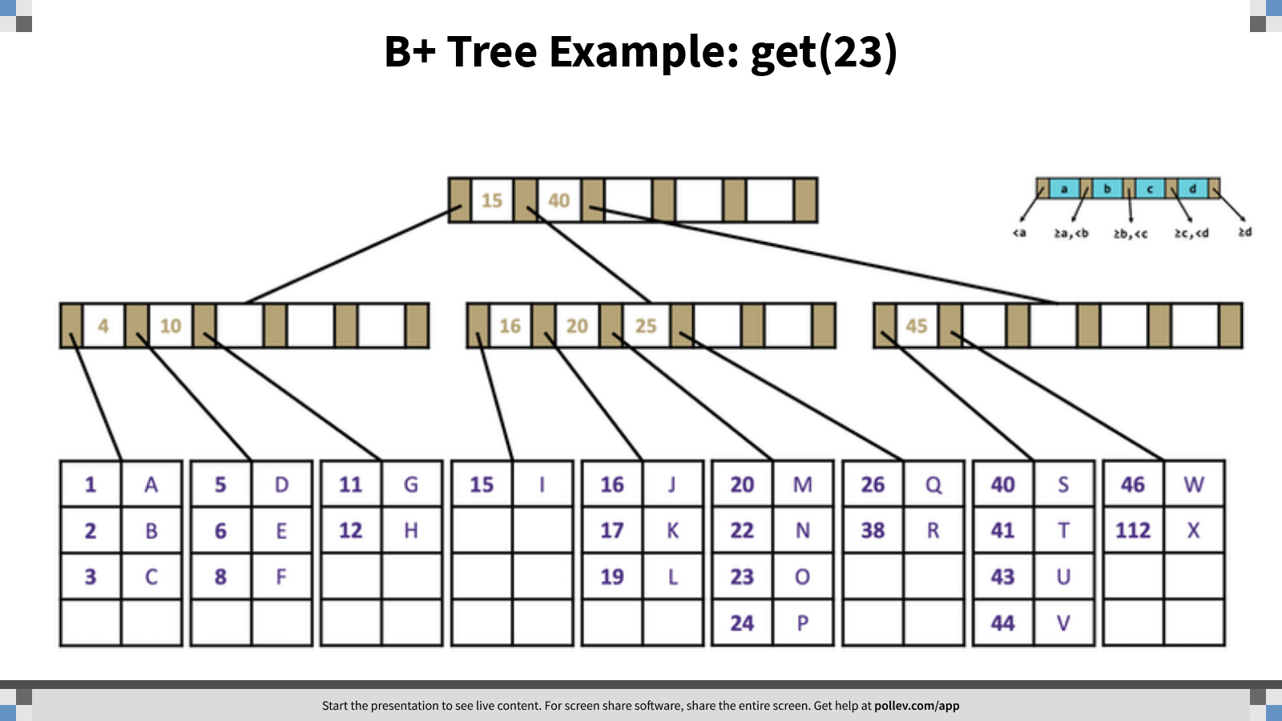
Notes:
B+ Tree Example: get(23)
https://www.polleverywhere.com/clickable_images/GoDV0NXtzSvrRyksM9RSL

Slide 32
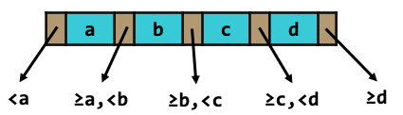
B+ Tree Example: get(23)
 | 15 |  | 40
 | 4 |  | 10
 | 16 |  | 20 |  | 25
 | 45
1 | A
2 | B
3 | C
5 | D
6 | E
8 | F
11 | G
12 | H
15 | I
16 | J
17 | K
19 | L
20 | M
22 | N
23 | O
24 | P
26 | Q
38 | R
40 | S
41 | T
43 | U
44 | V
46 | W
112 | X

Slide 33
Why Are B+ Trees so Disk-Friendly? (Summary)
We minimized the height of the tree by adding more keys/potential children at every node. Because the nodes are more spread out at a shallower place in the tree, it takes fewer nodes (disk-accesses) to traverse to a leaf.
All relevant information about a single node fits in one page (If it’s an internal node: all the keys it needs to determine which branch it should go down next. If it’s a leaf: the relevant K/V pairs).
We use as much of the page as we can: each node contains many keys that are all brought in at once with a single disk access, basically “for free”.
The time needed to do a search within a node is insignificant compared to disk access time, so looking within a node is also “free”.

Slide 34
What About Inserting/Removing?
Beyond the scope of this class
Our goal in 373: to learn enough about B+ Tree usage so you know when to consider using one in your program! You don’t need to be able to implement.
Takeaways:
  Disk lookups are slow, so if you have large amounts of data (enough that it spills over onto the disk), consider using a B+ trees!
    Databases use these all the time! Even the very core file system in your computer makes use of B+ trees
  B+ trees minimize the # of disk accesses by stuff as much data into each node so that the height of tree is short, and every node requires just one disk access

Slide 35
B+ Tree Invariants
Defined by 3 different invariants:
  1. B+ trees must have two different types of nodes: internal nodes and leaf nodes
    An Internal Node contains M pointers to children and M – 1 sorted keys. (M must be greater than 2)
    A Leaf Node contains L key-value pairs, sorted by key.
  2. B+ trees order invariant
    For any given key k, all subtrees to the left may only contain keys that satisfy x < k
    All subtrees to the right may only contain keys x that satisfy k >= x
  3. B+ trees structure invariant
    If n <= L, the root is a leaf
    If n >= L, root node must be an internal node containing 2 to M children
    All nodes must be at least half-full

Slide 36
Diving Deeper into the Computer
In CSE 373, we only need to know enough about the computer’s workings to understand how it could impact performance
But there’s so much more to learn if you’re interested! A really cool topic to explore
Great place to get started: https://www.youtube.com/watch?v=fpnE6UAfbtU
There are plenty of UW ECE courses that go into these details!

