Slide 1
Welcome!
BEFORE WE START
Use the Zoom chat:
Introduce yourself! What are you most excited about in this class? What’s your least favorite vegetable?

Slide 2
Lecture Outline
Introductions
About this Course
Course Components & Tools
Policies
Making the Most of this Class
Abstract Data Types

Slide 3
Course Staff
Instructor: Aaron Johnston
Grad student from UW CSE, previously taught CSE 333 (Systems Programming) and CSE 390B (Academic Skill-Building)
Teaching Assistants:
Available in section, office hours, discussion board, and 1:1 meetings
Invaluable source of information & help in this course
We’re excited to get to know you!
Our goal is to help you succeed

Slide 4
Students
Currently 205 students registered for the course
Over double the size of last year’s summer 373 offering (!)
If you’re waiting to register, unfortunately there are no overloads available, and the course staff does not have add codes
Reach out to ugrad-advisor@cs.washington.edu with any registration questions
Strength in numbers
With 205 students, if you’re confused about something, I guarantee someone else is too!
Students come from all different backgrounds & majors

Slide 5
What is this Class?
CSE 143 – Object Oriented Programming
CSE 373 – Data Structures and Algorithms
Classes and Interfaces
Methods, variables and conditionals
Loops and recursion
Linked lists and binary trees
Sorting and Searching
O(n) analysis
Generics
Design decisions
Design analysis
Implementations of data structures
Debugging and testing
Abstract Data Types
Code Modeling
Complexity Analysis
Software Engineering Practices

Slide 6
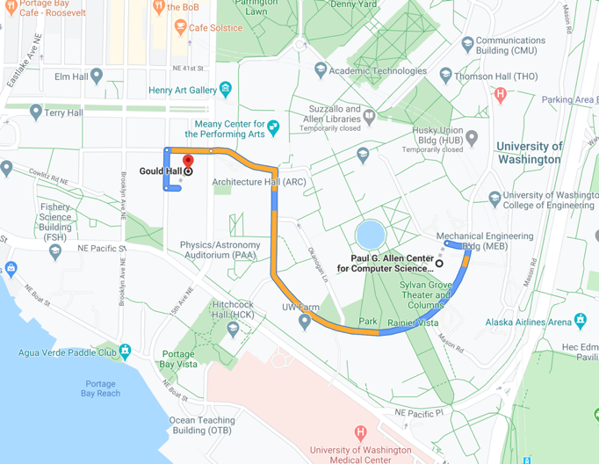
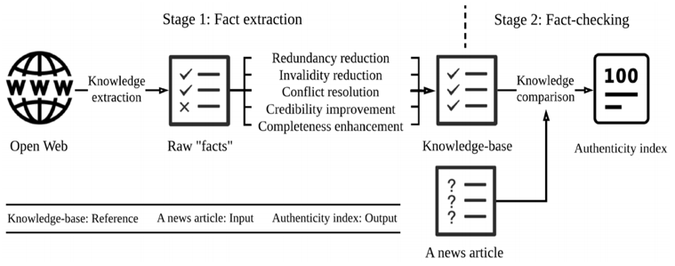
Why 373?
1. Build a strong foundation of data structures and algorithms that will let you tackle the biggest problems in computing
373 Data Structures & Algorithms
Fake News: A Survey of Research, Detection Methods, and Opportunities (Xinyi Zhou, Reza Zafarani/arXiv:1812.00315)

Slide 7
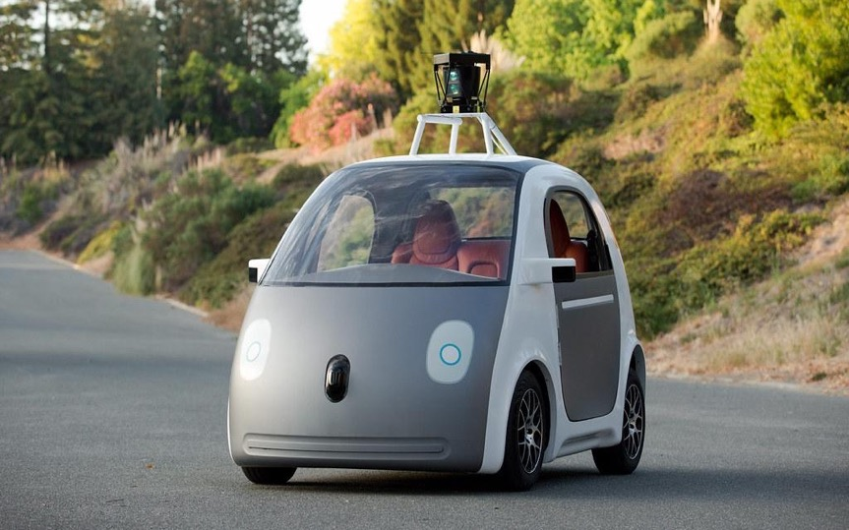
Why 373?
2. Pick up the vocabulary, skills, and practice needed to make design decisions. Learn to evaluate the tools in your CS toolbox
SORTING ALGORITHMS
BINARY TREES
Differences between technical implementations
Evaluation can mean many different things!

Slide 8
Lecture Outline
Introductions
About this Course
Course Components & Tools
Policies
Making the Most of this Class
Abstract Data Types

Slide 9
Course Components
LECTURES
(x26)
SECTIONS
(x9)
Held live via Zoom
Recordings available after
In-lecture activities
Introduction to course concepts
Held live via Zoom
Review videos available after
Practice problems, reviews, TA advice
Preparation for exams
PROJECTS
(x5)
EXERCISES
(x4)
EXAMS
(x2)
Partner recommended
Programming in Java
Applying & implementing course concepts
More practical
Individual
Written problems, focusing on the “why”
More conceptual
Available over a multi-day window, complete whenever works for you
More details as we get closer

Slide 10
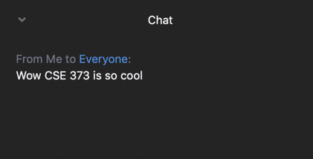
Using Zoom
Two important ways to interact in lecture:
Open Participants Pane
Use the feedback buttons for quick cues
Open Chat Pane
Type your questions in the chat
Other students, TAs, or I can answer!
Please conduct yourself as you would in a classroom – be respectful!
Sign in early to chat with other students, warm up for the day

Slide 11
Using PollEverywhere
Sometimes I’ll ask for more involved feedback or we’ll pause to do an active learning activity
Go to pollev.com/uwcse373 to register and participate
Let’s practice: which puppy is cutest?
A
B
C
D

Slide 12
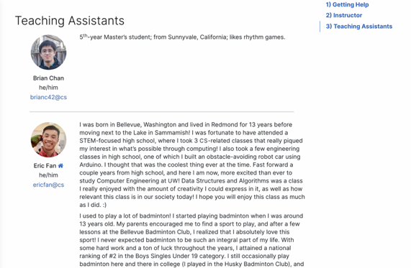
Course Website
cs.uw.edu/373
Get to know the staff
Contains most course info – check frequently!
Announcements, Calendar, Lecture Slides, Assignment Specs, Office Hours schedule, Staff Bios, Important Links

Slide 13
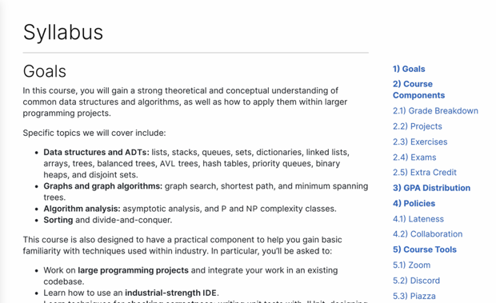
Course Website
cs.uw.edu/373
Contains most course info – check frequently!
Announcements, Calendar, Lecture Slides, Assignment Specs, Office Hours schedule, Staff Bios, Important Links
Please familiarize yourself with the course syllabus this week!

Slide 14
Other Course Tools
Piazza
Discussion Board & Announcements
Please ask AND answer!
Anonymous option
Opt out of Piazza Network
Discord
Community: meet other students, form study groups
Most Office Hours held here
More details to come
Gitlab
Everyone gets a git repo
We’ll distribute starter code, you’ll push your work
More details to come
Gradescope
Submit all your assignments
Get feedback
Canvas
Only used for Zoom recordings and gradebook

Slide 15
Lecture Outline
Introductions
About this Course
Course Components & Tools
Policies
Making the Most of this Class
Abstract Data Types

Slide 16
Grading Breakdown
Your grade will consist of the following weighted categories:
Instead of curving the class as usual, we’ll use a bucket system:
These are minimum GPA guarantees – may adjust upward
Category | Weight
Programming Projects | 45%
Individual Exercises | 25%
Exam I | 15%
Exam II | 15%
Percentage | GPA
95% | 4.0
90% | 3.5
80% | 3.0
60% | 2.0
50% | 0.7

Slide 17
Assignment Policies
Collaboration & Academic Integrity
These concepts are hard: we strongly encourage discussion + collaboration!
Don’t attempt to gain credit for something you didn’t do
In general, share ideas and work together, but don’t copy work. Never show someone else your code or solution write up.
Always cite the help you receive
Full collaboration with your partner on projects!
Read full policy in Syllabus
Lateness
You get 7 “free” late days for the quarter – submit 24 hours late with no penalty
Use on projects or exercises
After that, -5% each day late
No assignment can be submitted >72 hours late
Except with instructor permission

Slide 18
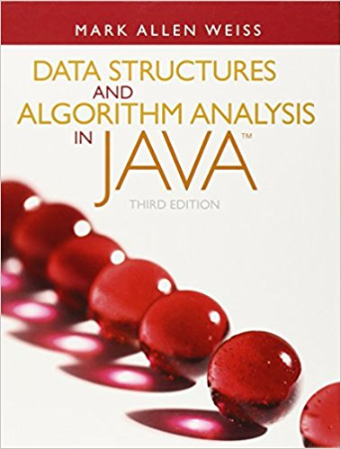
Textbook
Data Structures and Algorithm Analysis in Java by Mark Allen Weiss
Completely optional
Nothing assigned out of the textbook
No readings
Advice: only purchase if you learn best with a textbook, otherwise not recommended

Slide 19
Lecture Outline
Introductions
About this Course
Course Components & Tools
Policies
Making the Most of this Class
Abstract Data Types

Slide 20
Getting Help
Discussion Board
Feel free to make a public or private post on Piazza
We encourage you to answer other peoples’ questions! A great way to learn
Office Hours
TAs can help you face to face in office hours, and look at your code
Discord gives great flexibility – feel free to join your peers in the OH chat and listen in to see who else has a similar problem
Section
Work through related problems, get to know your TA who is here to support you
Your Peers
We encourage you to form study groups! Discord or Piazza are great places to do that
Email the Staff List
You can always email cse373-staff@cs.washington.edu if you don’t know how to get help – we’ll work to get you the support you need

Slide 21
Help Us Improve!
We’re still learning how to do this online ☺
Thank you in advance for your patience and understanding
We really value your feedback!
Let us know what’s working and what isn’t working for you
Something that went well in another course? Tell us about it!
Email the course staff at cse373-staff@cs.uw.edu
Submit feedback via the Anonymous Feedback Tool (linked under “Course Tools” on the website)

Slide 22
Metacognition
Metacognition: asking questions about your solution process.
Examples:
While debugging: explain to yourself why you’re making this change to your program.
Before running your program: make an explicit prediction of what you expect to see.
When coding: be aware when you’re not making progress, so you can take a break or try a different strategy.
When designing:
Explain the tradeoffs with using a different data structure or algorithm.
If one or more requirements change, how would the solution change as a result?
Reflect on how you ruled out alternative ideas along the way to a solution.
When studying: what is the relationship of this topic to other ideas in the course?

Slide 23
The World Around 373
Our goal is to give you a great 373 experience
But CSE 373 does not exist in a vacuum – there’s a lot going on in the world right now that can impact your education
We’ve designed course policies for maximum flexibility: plenty of late days, take-home exams, no participation
But we cannot cover every individual situation
Please reach out if you need accommodations of any kind to deal with these unfamiliar situations

Slide 24
Lecture Outline
Introductions
About this Course
Course Components & Tools
Policies
Making the Most of this Class
Abstract Data Types

Slide 25
Data Structures & Algorithms
Data Structure:
A way of organizing, storing, accessing, and updating data
Examples from CSE 14x: Arrays, Linked Lists, Stacks, Queues, Trees
Algorithm:
A series of precise instructions to produce a specific outcome
Examples from CSE 14x: Binary Search, Merge Sort, Recursive Backtracking

Slide 26
Review Interface vs. Implementation
In Java, an interface is a data type that specifies what to do but not how to do it.
List: an ordered sequence of elements.
A subtype implements all methods required by the interface.
ArrayList: Resizable array implementation of the List interface.
LinkedList: Doubly-linked implementation of the List interface.
List
ArrayList
LinkedList

Slide 27
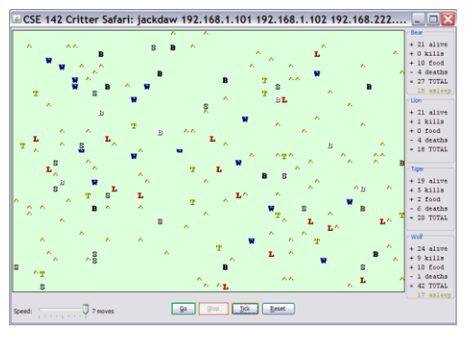
Review Client vs. Object
Client Classes
Object Classes
A class that is executable, in Java: contains a Main method
public static void main(String[] args)
A coded structure that contains data and behavior
Start with the data you want to hold, organize the things you want to enable users to do with that data

Slide 28
ADTs: Abstract Data Types
Java interfaces represent the concept of abstract data types.
An abstract data type is a data type that does not specify any one implementation.
Data structures implement ADTs.
Resizable array can implement List, Stack, Queue, Deque, PQ, etc.
Linked nodes can implement List, Stack, Queue, Deque, PQ, etc.
List ADT
A collection storing an
ordered sequence of elements.
Each element is accessible by a zero-based index.
A list has a size defined as the number of elements in the list.
Elements can be added to the front, back, or any index in the list.
Optionally, elements can be removed.

Slide 29
Where we’re Headed: ADTs we’ll look at
List
Set
Map
Stack
Queue
Priority Queue
Graph
Disjoint Set

Slide 30
Learning to Bake in a CSE Class
Think of what you’ll learn this quarter as a cookbook
ADTs are the chapters/category: Soups, Salads, Cookies, Cakes, etc
High-level descriptions of a category of functionality
You don’t serve a soup when guests expect a cookie!
Data structures are the recipes: chocolate chip cookies, snickerdoodles, etc
Step-by-step, concrete descriptions of an item with specific characteristics
Understand your tradeoffs before replacing carrot cake with a wedding cake
When you go out into the world …
Figure out which category is required
Choose the specific recipe that best fit the situation

