Slide 1
Lecture 6: Modeling Complex Code
CSE 373: Data Structures and Algorithms

Slide 2
Warm Up!
Master Theorem
$$T\left(n\right)=\left\{\begin{aligned}d if n is at most some constant \\ aT\left(\frac{n}{b}\right)+f\left(n\right) otherwise \end{aligned}\right.$$
What’s the theta bound for the runtime function for this piece of code?
public void method1(int n) {
if (n <= 100) {
System.out.println(“:3”);
} else {
System.out.println(“:D”);
for (int i = 0; i<16; i++) {
method1(n / 4);
}
}
}
Where $f\left(n\right)$ is $Θ\left(n^{c}\right)$
If
$$\log_{b}{a}<c$$
then
$$T\left(n\right)∈Θ\left(n^{c}\right)$$
If
$$\log_{b}{a}=c$$
then
$$T\left(n\right)∈Θ\left(n^{c}\log{n}\right)$$
If
$$\log_{b}{a}>c$$
then
$$T\left(n\right)∈Θ\left(n^{\log_{b}{a}}\right)$$
Take 2 Minutes
www.pollev.com/cse373activity for participating in our active learning questions.
https://www.pollev.com/cse373studentqs to ask your own questions

Slide 3
Warm Up!
Master Theorem
$$T\left(n\right)=\left\{\begin{aligned}d if n is at most some constant \\ aT\left(\frac{n}{b}\right)+f\left(n\right) otherwise \end{aligned}\right.$$
What’s the theta bound for the runtime function for this piece of code?
public void method1(int n) {
if (n <= 100) {
System.out.println(“:3”);
} else {
System.out.println(“:D”);
for (int i = 0; i<16; i++) {
method1(n / 4);
}
}
}
Where $f\left(n\right)$ is $Θ\left(n^{c}\right)$
If
$$\log_{b}{a}<c$$
then
$$T\left(n\right)∈Θ\left(n^{c}\right)$$
If
$$\log_{b}{a}=c$$
then
$$T\left(n\right)∈Θ\left(n^{c}\log{n}\right)$$
If
$$\log_{b}{a}>c$$
then
$$T\left(n\right)∈Θ\left(n^{\log_{b}{a}}\right)$$
Take 2 Minutes
$$T\left(n\right)=\left\{\begin{aligned}constant work if n≤100 \\ 16T\left(\frac{n}{4}\right)+constant work otherwise \end{aligned}\right.$$
www.pollev.com/cse373activity for participating in our active learning questions.
https://www.pollev.com/cse373studentqs to ask your own questions

Slide 4
Warm Up!
Master Theorem
$$T\left(n\right)=\left\{\begin{aligned}d if n is at most some constant \\ aT\left(\frac{n}{b}\right)+f\left(n\right) otherwise \end{aligned}\right.$$
What’s the theta bound for the runtime function for this piece of code?
public void method1(int n) {
if (n <= 100) {
System.out.println(“:3”);
} else {
System.out.println(“:D”);
for (int i = 0; i<16; i++) {
method1(n / 4);
}
}
}
Where $f\left(n\right)$ is $Θ\left(n^{c}\right)$
If
$$\log_{b}{a}<c$$
then
$$T\left(n\right)∈Θ\left(n^{c}\right)$$
If
$$\log_{b}{a}=c$$
then
$$T\left(n\right)∈Θ\left(n^{c}\log{n}\right)$$
If
$$\log_{b}{a}>c$$
then
$$T\left(n\right)∈Θ\left(n^{\log_{b}{a}}\right)$$
Take 2 Minutes
$$T\left(n\right)=\left\{\begin{aligned}constant work if n≤100 \\ 16T\left(\frac{n}{4}\right)+constant work otherwise \end{aligned}\right.$$
www.pollev.com/cse373activity for participating in our active learning questions.
https://www.pollev.com/cse373studentqs to ask your own questions
a = 16, b = 4, c = 0

Slide 5
Warm Up!
Master Theorem
$$T\left(n\right)=\left\{\begin{aligned}d if n is at most some constant \\ aT\left(\frac{n}{b}\right)+f\left(n\right) otherwise \end{aligned}\right.$$
What’s the theta bound for the runtime function for this piece of code?
public void method1(int n) {
if (n <= 100) {
System.out.println(“:3”);
} else {
System.out.println(“:D”);
for (int i = 0; i<16; i++) {
method1(n / 4);
}
}
}
Where $f\left(n\right)$ is $Θ\left(n^{c}\right)$
If
$$\log_{b}{a}<c$$
then
$$T\left(n\right)∈Θ\left(n^{c}\right)$$
If
$$\log_{b}{a}=c$$
then
$$T\left(n\right)∈Θ\left(n^{c}\log{n}\right)$$
If
$$\log_{b}{a}>c$$
then
$$T\left(n\right)∈Θ\left(n^{\log_{b}{a}}\right)$$
Take 2 Minutes
$$T\left(n\right)=\left\{\begin{aligned}constant work if n≤100 \\ 16T\left(\frac{n}{4}\right)+constant work otherwise \end{aligned}\right.$$
www.pollev.com/cse373activity for participating in our active learning questions.
https://www.pollev.com/cse373studentqs to ask your own questions
$$\log_{4}{16} ? 0$$
a = 16, b = 4, c = 0

Slide 6
Warm Up!
Master Theorem
$$T\left(n\right)=\left\{\begin{aligned}d if n is at most some constant \\ aT\left(\frac{n}{b}\right)+f\left(n\right) otherwise \end{aligned}\right.$$
What’s the theta bound for the runtime function for this piece of code?
public void method1(int n) {
if (n <= 100) {
System.out.println(“:3”);
} else {
System.out.println(“:D”);
for (int i = 0; i<16; i++) {
method1(n / 4);
}
}
}
Where $f\left(n\right)$ is $Θ\left(n^{c}\right)$
If
$$\log_{b}{a}<c$$
then
$$T\left(n\right)∈Θ\left(n^{c}\right)$$
If
$$\log_{b}{a}=c$$
then
$$T\left(n\right)∈Θ\left(n^{c}\log{n}\right)$$
If
$$\log_{b}{a}>c$$
then
$$T\left(n\right)∈Θ\left(n^{\log_{b}{a}}\right)$$
Take 2 Minutes
$$T\left(n\right)=\left\{\begin{aligned}constant work if n≤100 \\ 16T\left(\frac{n}{4}\right)+constant work otherwise \end{aligned}\right.$$
www.pollev.com/cse373activity for participating in our active learning questions.
https://www.pollev.com/cse373studentqs to ask your own questions
$$\log_{4}{16} ? 0$$
$$\log_{4}{16} > 0$$
$$T\left(n\right)∈Θ\left(n^{\log_{b}{a}}\right)$$
a = 16, b = 4, c = 0

Slide 7
Warm Up!
Master Theorem
$$T\left(n\right)=\left\{\begin{aligned}d if n is at most some constant \\ aT\left(\frac{n}{b}\right)+f\left(n\right) otherwise \end{aligned}\right.$$
What’s the theta bound for the runtime function for this piece of code?
public void method1(int n) {
if (n <= 100) {
System.out.println(“:3”);
} else {
System.out.println(“:D”);
for (int i = 0; i<16; i++) {
method1(n / 4);
}
}
}
Where $f\left(n\right)$ is $Θ\left(n^{c}\right)$
If
$$\log_{b}{a}<c$$
then
$$T\left(n\right)∈Θ\left(n^{c}\right)$$
If
$$\log_{b}{a}=c$$
then
$$T\left(n\right)∈Θ\left(n^{c}\log{n}\right)$$
If
$$\log_{b}{a}>c$$
then
$$T\left(n\right)∈Θ\left(n^{\log_{b}{a}}\right)$$
Take 2 Minutes
$$T\left(n\right)=\left\{\begin{aligned}constant work if n≤100 \\ 16T\left(\frac{n}{4}\right)+constant work otherwise \end{aligned}\right.$$
www.pollev.com/cse373activity for participating in our active learning questions.
https://www.pollev.com/cse373studentqs to ask your own questions
$$\log_{4}{16} ? 0$$
$$\log_{4}{16} > 0$$
$$T\left(n\right)∈Θ\left(n^{\log_{b}{a}}\right)$$
a = 16, b = 4, c = 0
$Θ\left(n^{\log_{4}{16}}\right)$ = $Θ\left(n^{2}\right)$

Slide 8
Administrivia
project1 due Wednesday 11:59pm
exercise1 due Friday 11:59pm
Piazza
  try to use the search bar before you post / use descriptive summary titles when possible - thank you
  Office Hours
  - please come to them! Piazza is super busy and office hours are less busy. We promise we won’t bite ☺
  anonymous feedback
    lectures + projects are so different?
      it’ll be better soon - we didn’t have time to cram in Deques (it’s probably the least relevant ADT) or make a new assignment this quarter. We’re aware, should be better for the future since the next few projects are all implementing new data structures and algorithms (HashMap, Binary Heaps, Graphs, ArrayDisjointSets, Kruskal’s and Dijkstra’s algorithms) we talk about directly in lecture.
      exercises + experiments should help connect lecture topics (while also not being _too_ much time)
    is there time to give an intro to the projects in lecture?
      maybe barely – we can try to see if it fits on a week-to-week

Slide 9
Questions

Slide 10
Code Analysis Process
Best-case upper bound O(n)
model of best-case runtime f(n)
best case
Best-case lower bound Ω(n)
case analysis
code modeling
asymptotic analysis
Best-case tight fit Θ(n)
code
Worst-case upper bound O(n)
model of worst-case runtime f(n)
worst case
Worst-case lower bound Ω(n)
Worst-case tight fit Θ(n)
If code is recursive:
Closed Form
Recurrence
Master Theorem

Slide 11
Recursive Patterns
Pattern #1: Halving the Input
Pattern #2: Constant size input and doing work
Pattern #3: Doubling the Input
Binary Search Θ(logn)
Merge Sort Θ(nlogn)
Calculating Fibonacci

Slide 12
Calculating Fibonacci
public int fib(int n) {
if (n <= 1) {
return 1;
}
return fib(n-1) + fib(n-1);
}
f(4)
f(3)
f(3)
f(2)
f(2)
f(2)
f(2)
Each call creates 2 more calls
Each new call has a copy of the input, almost
Almost doubling the input at each call
f(1)
f(1)
f(1)
f(1)
f(1)
f(1)
f(1)
f(1)
Almost
Pattern #3 – Doubling the Input

Slide 13
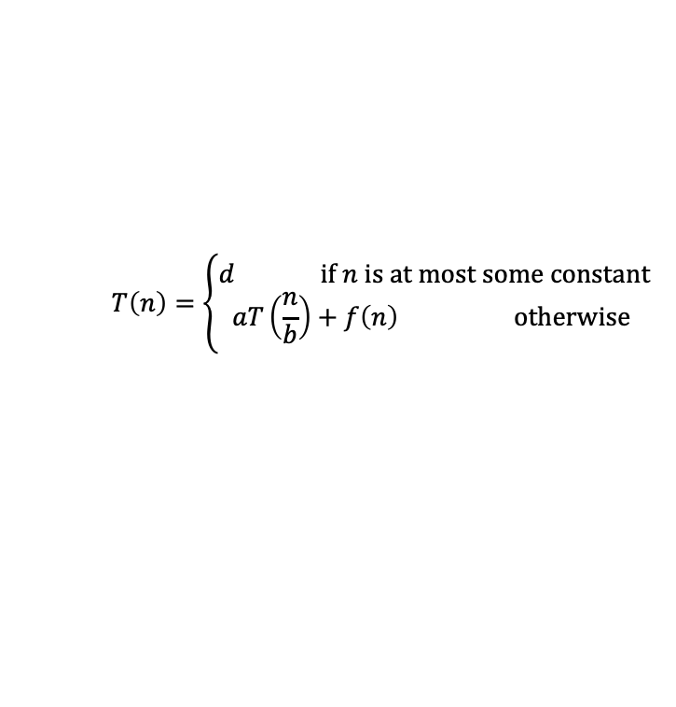
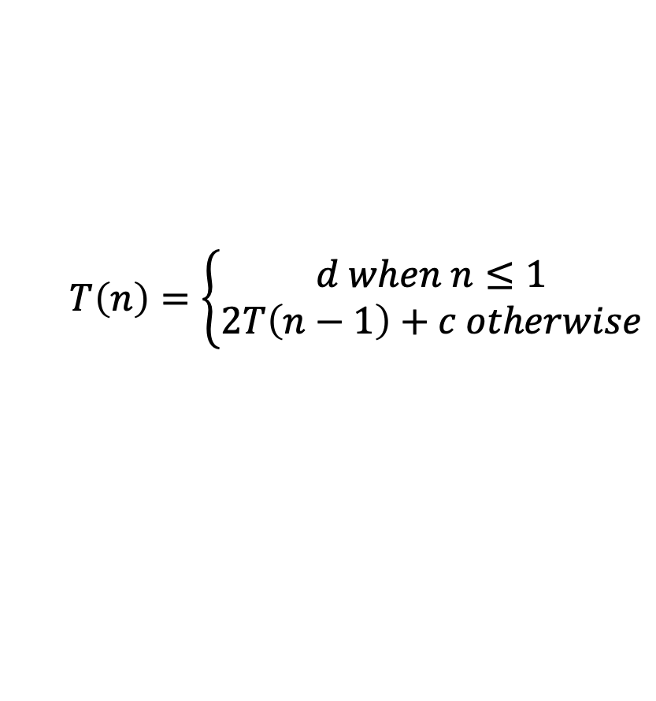
Calculating Fibonacci Recurrence to Big-Θ
public int f(int n) {
if (n <= 1) {
return 1;
}
return f(n-1) + f(n-1);
}
Can we use master theorem?
Master Theorem
d
$$T\left(n\right)=\left\{\begin{aligned}d if n is at most some constant \\ aT\left(\frac{n}{b}\right)+f\left(n\right) otherwise \end{aligned}\right.$$
2T(n-1) + c
Uh oh, our model doesn’t match that format…
Can we intuit a pattern?
T(1) = d
T(2) = 2T(2-1) + c = 2(d) + c
T(3) = 2T(3-1) + c = 2(2(d) + c) + c = 4d + 3c
T(4) = 2T(4-1) + c = 2(4d + 3c) + c = 8d + 7c
T(5) = 2T(5-1) + c = 2(8d + 7c) + c = 16d +25c
Looks like something’s happening but it’s tough
$$T\left(n\right)=\left\{\begin{aligned}d when n≤1 \\ 2T\left(n−1\right)+c otherwise\end{aligned}\right.$$
Take 1 min to respond to activity
www.pollev.conm/cse373activity
Finish the recurrence, what is the model for the recursive case?
Maybe geometry can help!

Slide 14
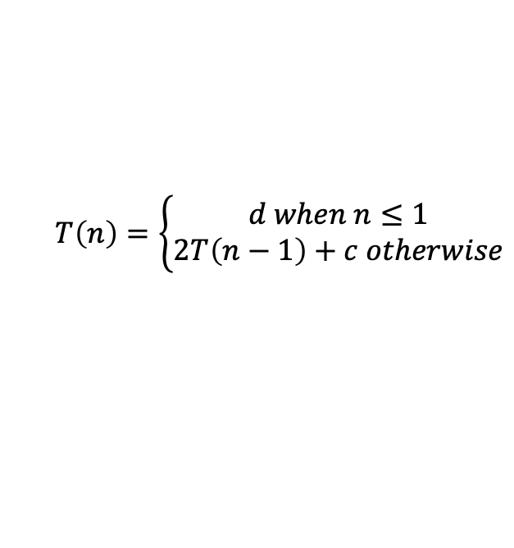
Calculating Fibonacci Recurrence to Big-Θ
How many layers in the function call tree?
How many layers will it take to transform “n” to the base case of “1” by subtracting 1
For our example, 4 -> Height = n
How many function calls per layer?
$$T\left(n\right)=\left\{\begin{aligned}d when n≤1 \\ 2T\left(n−1\right)+c otherwise\end{aligned}\right.$$
f(4)
f(3)
f(3)
Layer | Function calls
0 | 1
1 | 2
2 | 4
3 | 8
How many function calls on layer k?
2^{k-1}
f(2)
f(2)
f(2)
f(2)
How many function calls TOTAL
for a tree of k layers?
1 + 2 + 3 + 4 + … + 2^{k-1}
f(1)
f(1)
f(1)
f(1)
f(1)
f(1)
f(1)
f(1)

Slide 15

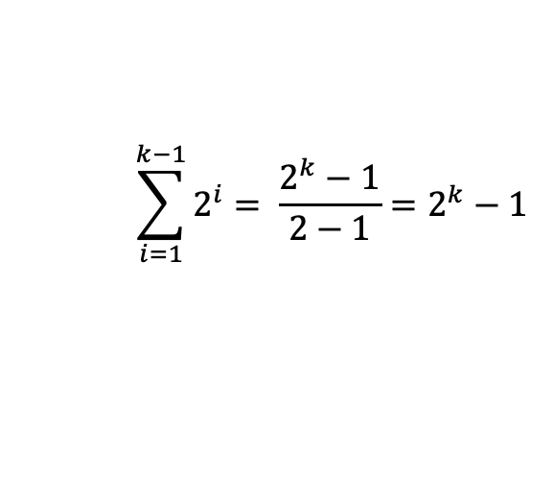
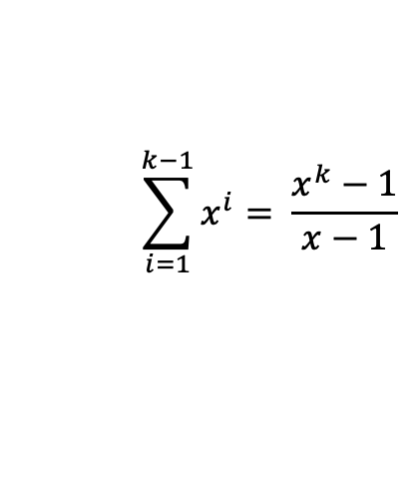
Calculating Fibonacci Recurrence to Big-Θ
Patterns found:
How many layers in the function call tree?
n
How many function calls on layer k?
2^{k-1}
How many function calls TOTAL for a tree of k layers?
1 + 2 + 4 + 8 + … + 2^{k-1}
Total runtime = (total function calls) x (runtime of each function call)
Total runtime = (1 + 2 + 4 + 8 + … + 2^{k-1}) x (constant work)
Summation Identity
Finite Geometric Series
$$\sum_{i=1}^{k−1}{2^{i}= \frac{2^{k}−1}{2−1}=2^{k}−1 }$$
1 + 2 + 4 + 8 + … + 2^{k-1} =
$$\sum_{i=1}^{k−1}{x^{i}= \frac{x^{k}−1}{x−1}}$$
$$T\left(n\right)=2^{n}−1 ∈Θ(2^{n})$$

Slide 16
Recursive Patterns
Pattern #1: Halving the Input
Pattern #2: Constant size input and doing work
Pattern #3: Doubling the Input
Binary Search Θ(logn)
Merge Sort Θ(nlogn)
Calculating Fibonacci Θ(2^{n})

Slide 17
Questions

Slide 18
Tree Method

Slide 19
Code Analysis Process
Best-case upper bound O(n)
model of best-case runtime f(n)
best case
Best-case lower bound Ω(n)
case analysis
code modeling
asymptotic analysis
Best-case tight fit Θ(n)
code
Worst-case upper bound O(n)
model of worst-case runtime f(n)
worst case
Worst-case lower bound Ω(n)
Worst-case tight fit Θ(n)
If code is recursive:
Closed Form
Recurrence
Tree Method
Master Theorem

Slide 20
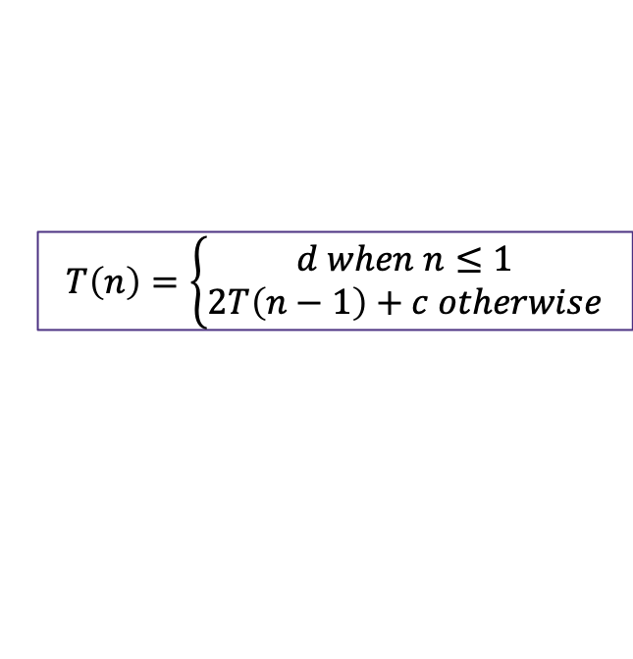
Recurrence to Big Θ Techniques
A recurrence is a mathematical function that includes itself in its definition
This makes it very difficult to find the dominating term that will dictate the asymptotic growth
Solving the recurrence or “finding the closed form” is the process of eliminating the recursive definition. So far, we’ve seen three methods to do so:
Apply Master Theorem
  Pro: Plug and chug convenience
  Con: only works for recurrences of a certain format
Unrolling
  Pro: Least complicated setup
  Con: requires intuitive pattern matching
Tree Method
  Pro: Plug and chug
  Con: Complex setup
$$T\left(n\right)=\left\{\begin{aligned}d when n≤1 \\ 2T\left(n−1\right)+c otherwise\end{aligned}\right.$$
Master Theorem
$$T\left(n\right)=\left\{\begin{aligned}d if n is at most some constant \\ aT\left(\frac{n}{b}\right)+f\left(n\right) otherwise \end{aligned}\right.$$
T(1) = d
T(2) = 2T(2-1) + c = 2(d) + c
T(3) = 2T(3-1) + c = 2(2(d) + c) + c = 4d + 3c
T(4) = 2T(4-1) + c = 2(4d + 3c) + c = 8d + 7c
T(5) = 2T(5-1) + c = 2(8d + 7c) + c = 16d +25c
f(4)
f(3)
f(3)
f(2)
f(2)
f(2)
f(2)
f(1)
f(1)
f(1)
f(1)
f(1)
f(1)
f(1)
f(1)

Slide 21
Tree Method
Draw out call stack, what is the input to each call? How much work is done by each call?
How much work is done at each layer?
64 for this example -> n work at each layer
Work is variable per layer, but across the entire layer work is constant - always n
How many layers are in our function call tree?
Hint: how many levels of recursive calls does it take binary search to get to the base case?
Height = log₂n
It takes log₂n divisions by 2 for n to be reduced to the base case 1
log₂64 = 6 -> 6 levels of this tree
1 if n<= 1
2T(n/2) + n otherwise
Merge Sort
T(n) =
f(n=64)
work = 64
f(n=32)
w=32
f(n=32)
w=32
f(n=16)
w=16
f(n=16)
w=16
f(n=16)
w=16
f(n=16)
w=16
f(n=8)
w=8
f(n=8)
w=8
f(n=8)
w=8
f(n=8)
w=8
f(n=8)
w=8
f(n=8)
w=8
f(n=8)
w=8
f(n=8)
w=8
… and so on…

Slide 22

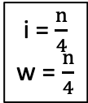
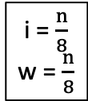

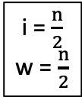





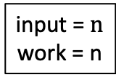
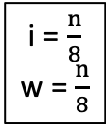
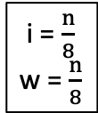


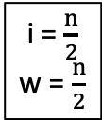







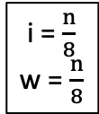



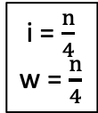



Tree Method
a
$$1 when n≤1$$
$$T\left(n\right)=$$
$$2T\left(\frac{n}{2}\right)+n otherwise$$
How many nodes at each level?
How much work done by each node?
How much work across each level?
Recursive level
input = $n$
work = n
0
1
n
n
i = $\frac{n}{2}$
w = $\frac{n}{2}$
i = $\frac{n}{2}$
w = $\frac{n}{2}$
$\frac{n}{2}$
1
2
n
i = $\frac{n}{4}$
w = $\frac{n}{4}$
i = $\frac{n}{4}$
w = $\frac{n}{4}$
i = $\frac{n}{4}$
w = $\frac{n}{4}$
i = $\frac{n}{4}$
w = $\frac{n}{4}$
2
4
$\frac{n}{4}$
n
i = $\frac{n}{8}$
w = $\frac{n}{8}$
i = $\frac{n}{8}$
w = $\frac{n}{8}$
i = $\frac{n}{8}$
w = $\frac{n}{8}$
i = $\frac{n}{8}$
w = $\frac{n}{8}$
i = $\frac{n}{8}$
w = $\frac{n}{8}$
i = $\frac{n}{8}$
w = $\frac{n}{8}$
i = $\frac{n}{8}$
w = $\frac{n}{8}$
i = $\frac{n}{8}$
w = $\frac{n}{8}$
3
8
$\frac{n}{8}$
n
…
…
…
…
…
…
…
…
…
…
…
…
…
…
…
…
i = $1$
w = $1$
i = $1$
w = $1$
i = $1$
w = $1$
i = $1$
w = $1$
i = $1$
w = $1$
i = $1$
w = $1$
i = $1$
w = $1$
i = $1$
w = $1$
i = $1$
w = $1$
i = $1$
w = $1$
i = $1$
w = $1$
i = $1$
w = $1$
i = $1$
w = $1$
logn
n
$1$
n

Slide 23
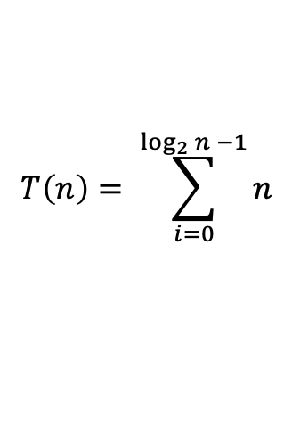

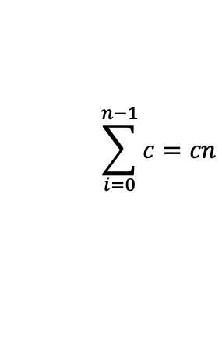
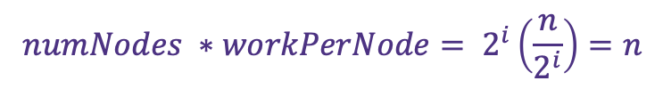


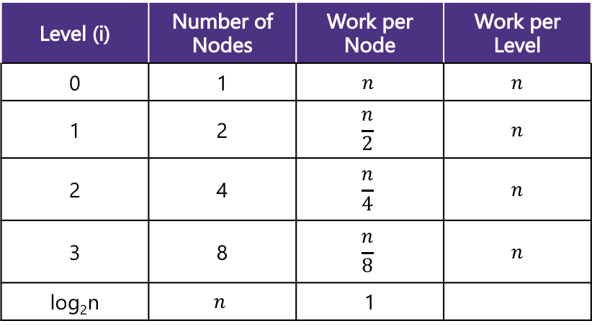








Tree Method Practice
a
$$1 when n≤1$$
$$T\left(n\right)=$$
$$2T\left(\frac{n}{2}\right)+n otherwise$$
Level (i) | Number of Nodes | Work per Node | Work per Level
0 | 1 | $$n$$ | $$n$$
1 | 2 | $$\frac{n}{2}$$ | $$n$$
2 | 4 | $$\frac{n}{4}$$ | $$n$$
3 | 8 | $$\frac{n}{8}$$ | $$n$$
log₂n | $$n$$ | 1
$$\frac{n}{2^{i}}$$
What is the size of the input on level $i$?
What is the work done by each node on the $i^{th}$ recursive level?
What is the number of nodes at level $i?$
What is the total work done at the $i^{th}$recursive level?
What value of $i$ does the last level occur?
What is the total work across the base case level?
$$(\frac{n}{2^{i}})$$
$$2^{i}$$
Combining it all together…
$$numNodes ∗workPerNode= 2^{i}\left(\frac{n}{2^{i}}\right)=n$$
$$T\left(n\right)= \sum_{i=0}^{\log_{2}{n −1}}{n }$$
$$+ n$$
$$=nlog2n+n$$
$$=Θ(nlogn)$$
$\frac{n}{2^{i}}=1$→ $n=2^{i}$→ $i=\log_{2}{n}$
Summation of a constant
power of a log
$$\sum_{i=0}^{n−1}{c=cn}$$
$$numNodes ∗workPerNode= 2^{log2n}\left(1\right)=n$$
$$x^{\log_{b}{y}}=y^{\log_{b}{x}}$$

Slide 24
Questions

Slide 25
Summations

Slide 26
Modeling Complex Loops
Write a mathematical model of the following code
for (int i = 0; i < n; i++) {
for (int j = 0; j < i; j++) {
System.out.println(“Hello!”);
}
}
+1
n
n
f(n) = n²
Keep an eye on loop bounds!

Slide 27
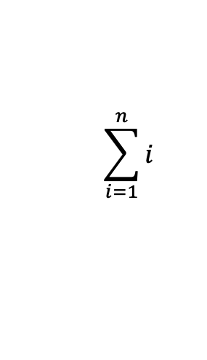
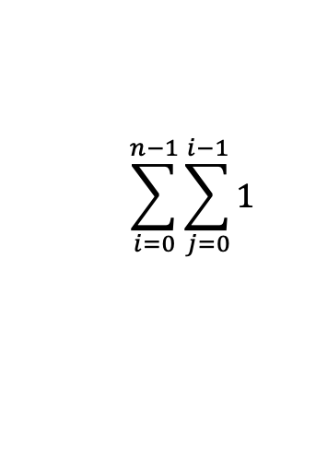
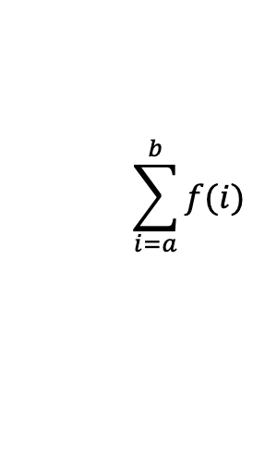
Modeling Complex Loops
for (int i = 0; i < n; i++) {
for (int j = 0; j < i; j++) {
System.out.print(“Hello! ”);
}
  Sysem.out.println();
}
+1
0 + 1 + 2 + 3 +…+ i-1
n
T(n) = (0 + 1 + 2 + 3 +…+ i-1)
Definition: Summation
How do we model this part?
Summations!
1 + 2 + 3 + 4 +… + n =
$$\sum_{i=1}^{n}{i}$$
$$\sum_{i=a}^{b}{f(i)}$$
= f(a) + f(a + 1) + f(a + 2) + … + f(b-2) + f(b-1) + f(b)
$$\sum_{i=0}^{n−1}{\sum_{j=0}^{i−1}{1}}$$
T(n) =
What is the Big O?

Slide 28
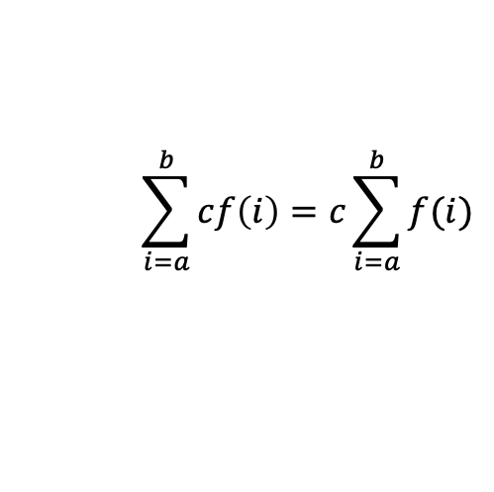

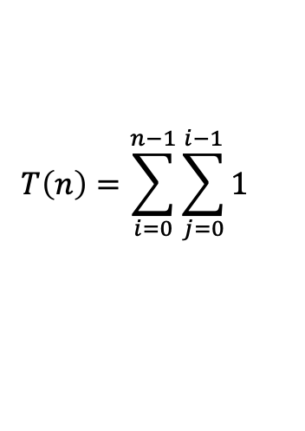
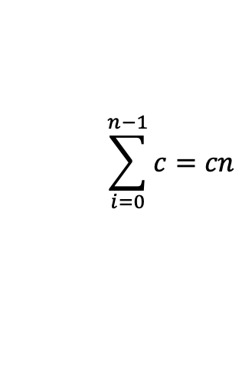
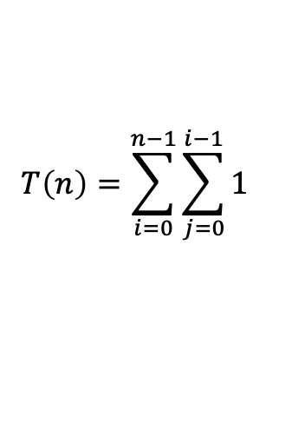
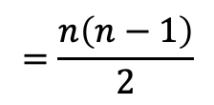
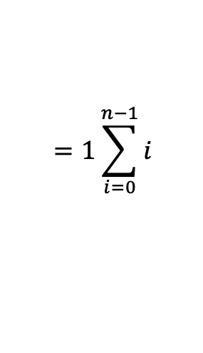
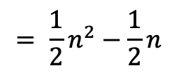
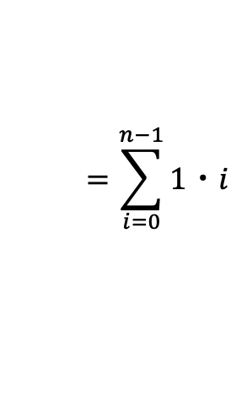
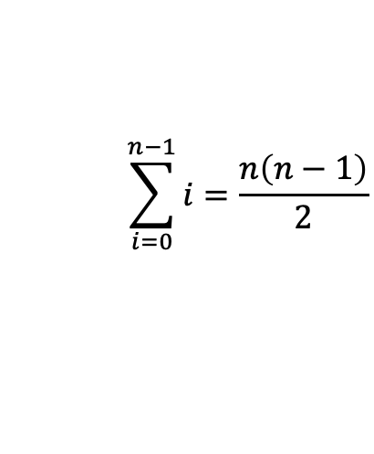
Simplifying Summations
Find closed form using summation identities
(given on exams)
for (int i = 0; i < n; i++) {
for (int j = 0; j < i; j++) {
System.out.println(“Hello!”);
}
}
$$T\left(n\right)=\sum_{i=0}^{n−1}{\sum_{j=0}^{i−1}{1}}$$
simplified tight big O
closed form
$$T\left(n\right)=\sum_{i=0}^{n−1}{\sum_{j=0}^{i−1}{1}}$$
$$=\sum_{i=0}^{n−1}{1・i}$$
$$=1\sum_{i=0}^{n−1}{i}$$
$$=\frac{n\left(n−1\right)}{2}$$
$$= \frac{1}{2}n^{2}−\frac{1}{2}n$$
$$=O(n^{2})$$
Summation of a constant
Factoring out a constant
Gauss’s Identity
$$\sum_{i=0}^{n−1}{c=cn}$$
$$\sum_{i=a}^{b}{cf\left(i\right)=c\sum_{i=a}^{b}{f(i)}}$$
$$\sum_{i=0}^{n−1}{i=\frac{n\left(n−1\right)}{2}}$$

Slide 29
Questions

Slide 30
Appendix

Slide 31
Tree Method Practice
$$4 when n≤1$$
$$T\left(n\right)=$$
$$3T\left(\frac{n}{4}\right)+n^{2} otherwise$$
$$T\left(\frac{n}{4}\right)+T\left(\frac{n}{4}\right)+T\left(\frac{n}{4}\right)+n^{2}$$
$$T\left(n\right)$$
$$n^{2}$$
Answer the following questions:
What is the size of the input on level $i$?
What is the work done by each node on the $i^{th}$ recursive level
What is the number of nodes at level $i?$
What is the total work done at the i^th recursive level?
What value of $i$ does the last level occur?
What is the total work across the base case level?
$${\left(\frac{n}{4}\right)}^{2}$$
$$T\left(\frac{n}{4}\right)$$
$$T\left(\frac{n}{16}\right)+T\left(\frac{n}{16}\right)+T\left(\frac{n}{16}\right)+{\left(\frac{n}{4}\right)}^{2}$$
$$T\left(\frac{n}{16}\right)+T\left(\frac{n}{16}\right)+T\left(\frac{n}{16}\right)+{\left(\frac{n}{4}\right)}^{2}$$
$$T\left(\frac{n}{16}\right)+T\left(\frac{n}{16}\right)+T\left(\frac{n}{16}\right)+{\left(\frac{n}{4}\right)}^{2}$$
$${\left(\frac{n}{4}\right)}^{2}$$
$${\left(\frac{n}{4}\right)}^{2}$$
$$T\left(\frac{n}{4}\right)$$
$$T\left(\frac{n}{4}\right)$$
$$T\left(\frac{n}{16}\right)$$
$$T\left(\frac{n}{16}\right)$$
$$T\left(\frac{n}{16}\right)$$
$$T\left(\frac{n}{16}\right)$$
$$T\left(\frac{n}{16}\right)$$
$$T\left(\frac{n}{16}\right)$$
$${\left(\frac{n}{16}\right)}^{2}$$
$$T\left(\frac{n}{16}\right)$$
$${\left(\frac{n}{16}\right)}^{2}$$
$${\left(\frac{n}{16}\right)}^{2}$$
$${\left(\frac{n}{16}\right)}^{2}$$
$${\left(\frac{n}{16}\right)}^{2}$$
$$T\left(\frac{n}{16}\right)$$
$$T\left(\frac{n}{16}\right)$$
$${\left(\frac{n}{16}\right)}^{2}$$
$${\left(\frac{n}{16}\right)}^{2}$$
$${\left(\frac{n}{16}\right)}^{2}$$
$${\left(\frac{n}{16}\right)}^{2}$$
…
…
…
…
…
…
…
…
…
…
…
…
…
…
…
…
…
…
…
…
…
…
…
…
…
…
…
4
4
4
4
4
4
4
4
4
4
4
4
4
4
4
4
4
4
4
4
4
4
4
4
4
4
4

Slide 32
Tree Method Practice
5 Minutes
$$4 when n≤1$$
$$T\left(n\right)=$$
$$3T\left(\frac{n}{4}\right)+n^{2} otherwise$$
Level (i) | Number of Nodes | Work per Node | Work per Level
0 | 1 | $$n2$$ | $$n2$$
1 | 3 | $${\left(\frac{n}{4}\right)}^{2}$$ | $$\frac{3}{4^{2}}n^{2}$$
2 | 9 | $${\left(\frac{n}{4^{2}}\right)}^{2}$$ | $$\frac{3^{2}}{4^{4}}n^{2}$$
base | $$3^{log4n}$$ | 4 | $$4 ∗ 3^{log4n}$$
$$\frac{n}{4^{i}}$$
What is the size of the input on level $i$?
What is the work done by each node on the $i^{th}$ recursive level?
What is the number of nodes at level $i?$
What is the total work done at the $i^{th}$recursive level?
What value of $i$ does the last level occur?
What is the total work across the base case level?
$${\left(\frac{n}{4^{i}}\right)}^{2}$$
$$3^{i}$$
Combining it all together…
$$3^{i}{\left[\left(\frac{n}{4^{i}}\right)\right]}^{2}{=\left(\frac{3}{16}\right)}^{i}n^{2}$$
$$T\left(n\right)= \sum_{i=0}^{\log_{4}{n −1}}{{\left(\frac{3}{16}\right)}^{i}n^{2}+ } 4n^{log43}$$
$\frac{n}{4^{i}}=1$→ $n=4^{i}$→ $i=\log_{4}{n}$
$$3^{\log_{4}{n}}⋅4$$
power of a log
$${4⋅n}^{\log_{4}{3}}$$
$$x^{\log_{b}{y}}=y^{\log_{b}{x}}$$

Slide 33
Tree Method Practice
factoring out a constant
$$T\left(n\right)= \sum_{i=0}^{\log_{4}{n −1}}{{\left(\frac{3}{16}\right)}^{i}n^{2}+ } 4n^{log43}$$
$$T\left(n\right)=n^{2}\sum_{i=0}^{\log_{4}{n −1}}{{\left(\frac{3}{16}\right)}^{i}+ } 4n^{log43}$$
$$\sum_{i=a}^{b}{cf(i)=}c\sum_{i=a}^{b}{f(i)}$$
Closed form:
Identities are on the webpage.
You don’t need to memorize them.
finite geometric series
$$T\left(n\right)=n^{2}\left(\frac{{\left(\frac{3}{16}\right)}^{\log_{4}{n}}−1}{\frac{3}{16} −1}\right)+4n^{log43}$$
$$\sum_{i=0}^{n−1}{x^{i}=\frac{x^{n}−1}{x−1}}$$
So what’s the big-$Θ$…
$$T\left(n\right)=n^{2}\left(−\frac{16}{13}\right){\left(\frac{3}{16}\right)}^{\log_{4}{n}}+\left(\frac{16}{13}\right)n^{2}+4n^{log43}$$
$$T\left(n\right)=n^{2}\left(−\frac{16}{13}\right){\left(n\right)}^{\log_{4}{\frac{3}{16}}}+\left(\frac{16}{13}\right)n^{2}+4n^{log43}$$
$$T\left(n\right)∈Θ(n^{2})$$

Slide 34
More Tree Method
$$T\left(n\right)= \left\{\begin{aligned}6T\left(\frac{n}{2}\right)+2n if n>8 \\ 3 otherwise\end{aligned}\right.$$

Slide 35
Tree Method Practice
$$T\left(n\right)= \left\{\begin{aligned}6T\left(\frac{n}{2}\right)+2n if n>8 \\ 3 otherwise\end{aligned}\right.$$
Answer the following questions:
What is the size of the input on level $i$?
What is the work done by each node on the $i^{th}$ recursive level
What is the number of nodes at level $i?$
What is the total work done at the i^th recursive level?
What value of $i$ does the last level occur?
What is the total work across the base case level?

Slide 36
Tree Method Practice
$$T\left(n\right)= \left\{\begin{aligned}6T\left(\frac{n}{2}\right)+2n if n>2 \\ 3 otherwise\end{aligned}\right.$$
5 Minutes
Level (i) | Number of Nodes | Work per Node | Work per Level
0 | 1 | $$2n$$ | $$2n$$
1 | 2 | $$\frac{2n}{8}$$ | $\frac{n}{2}$
2 | 4 | $$2\left(\frac{n}{8^{2}}\right)$$ | $$\frac{n}{8}$$
base | $$2^{\log_{8}n−1}$$ | 3 | $$\frac{3}{2}n^{1/3}$$
$$\frac{n}{2^{i}}$$
What is the size of the input on level $i$?
What is the work done by each node on the $i^{th}$ recursive level?
What is the number of nodes at level $i?$
What is the total work done at the $i^{th}$recursive level?
What value of $i$ does the last level occur?
What is the total work across the base case level?
$$2\frac{n}{2^{i}}$$
$$6^{i}$$
Combining it all together…
$$6^{i}\left[2\frac{n}{2^{i}}\right]=2⋅3^{i}⋅n$$
$$T\left(n\right)= \sum_{i=0}^{\log_{2}{(n) −2}}{2⋅3^{i}n+ }\frac{1}{2}n^{\log_{2}{6}}$$
$\frac{n}{2^{i}}=2$→ $n=2^{i+1}$→ $i=\log_{2}{(n)−1}$
power of a log
$$\frac{{3⋅6}^{\log_{2}{n}}}{6}=\frac{1}{2}⋅n^{\log_{2}{6}}=\frac{1}{2}⋅n^{\log_{2}{6}}$$
$$6^{\log_{2}{(n) −1}}⋅3$$
$$x^{\log_{b}{y}}=y^{\log_{b}{x}}$$

Slide 37
$$T\left(n\right)= \sum_{i=0}^{\log_{2}{(n) −2}}{2⋅3^{i}n+ }\frac{1}{2}n^{\log_{2}{6}}$$
$$=2n\sum_{i=0}^{\log_{2}{(n)}−2}{3^{i}+\frac{1}{2}n^{\log_{2}{6}}}$$
$$=2n\frac{3^{\log_{2}\left(n\right)−1}}{3−1}+\frac{1}{2}n^{\log_{2}{6}}$$
$$=n⋅\frac{n^{\log_{2}\left(3\right)}}{3}+\frac{1}{2}n^{\log_{2}{6}}$$
$$=\frac{n^{\log_{2}\left(3\right)+1}}{3}+\frac{1}{2}n^{\log_{2}{6}}$$
$$=\frac{n^{\log_{2}\left(6\right)}}{3}+\frac{1}{2}n^{\log_{2}{6}}=\frac{5}{6}n^{\log_{2}{6}}$$
finite geometric series
$$\sum_{i=0}^{n−1}{x^{i}=\frac{x^{n}−1}{x−1}}$$
power of a log
$$x^{\log_{b}{y}}=y^{\log_{b}{x}}$$
$$1=\log_{2}{2}$$
$$\log_{a}{b}+\log_{a}{c}=\log_{a}{(bc)}$$

Slide 38
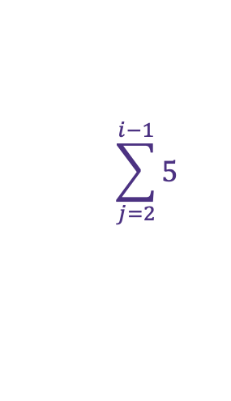
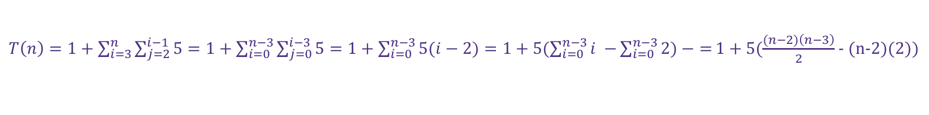
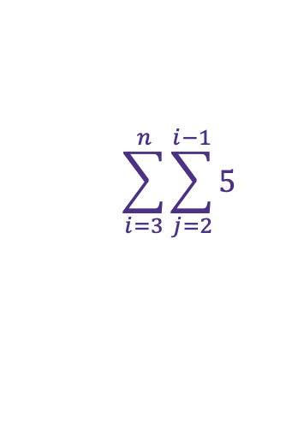
Summation Practice
public static void primesUpToN(int n) {
System.out.print("1 2 ");
for (int i = 3; i <= n; i++) {
for (int j = 2; j < i; j++){
if (j != i && j % i == 0) {
System.out.print(i + " ");
break;
}
}
System.out.println();
}
+1
+4
$$\sum_{j=2}^{i−1}{5}$$
$$\sum_{i=3}^{n}{\sum_{j=2}^{i−1}{5} }$$
+1
+1
$T\left(n\right)=1+\sum_{i=3}^{n}{\sum_{j=2}^{i−1}{5}}=1+\sum_{i=0}^{n−3}{\sum_{j=0}^{i−3}{5}}=1+\sum_{i=0}^{n−3}{5(i−2)=1+5(\sum_{i=0}^{n−3}{i −}\sum_{i=0}^{n−3}{2)−}=}1+5(\frac{(n−2)\left(n−3\right)}{2}$ - (n-2)(2))
Adjusting summation bounds
Summation of a constant
Factoring out a constant
Gauss’s identity

