Slide 1
Lecture 6: Modeling Complex Code
CSE 373: Data Structures and Algorithms

Slide 2
Warm Up!
$f(n)$ $∈$ $O(g\left(n\right))$ if there exist positive constants $c, n_{0}$ such that for all $n≥n_{0}$,
$$f\left(n\right)≤c⋅g\left(n\right)$$
Take 2 Minutes
Big-O
$$f1\left(n\right)=3^{n}$$
$$f2\left(n\right)=2n^{3}+2$$
www.pollev.com/cse373activity for participating in our active learning questions.
https://www.pollev.com/cse373studentqs to ask your own questions
$$f3\left(n\right)=n^{2}−2n+3$$
$$f4\left(n\right)=7n^{2}+5n$$
$f(n)$ $∈ Ω(g\left(n\right))$ if there exist positive constants $c, n_{0}$ such that for all $n≥n_{0}$,
$$f\left(n\right)≥c⋅g\left(n\right)$$
Big-Omega
$$f5\left(n\right)=5n+1$$
A. (answer this question A in the pollev)
which of the above functions are in O($n^{2}$)?
B. which of the above functions are in Theta($n^{2}$)?
$f(n)$ $∈$ $Θ(g\left(n\right))$ if
$f\left(n\right)$ is $O(g\left(n\right))$ and $f\left(n\right)$ is $Ω(g\left(n\right))$.
Big-Theta

Slide 3
Warm Up!
For finding a tight Big-O of a function (process from Monday / in quiz section):
- drop the constant multipliers
- drop the non dominant terms
the remaining term is your tight big O or Theta bound
Remember Big-O is just an upperbound so we can say stuff like
f(n) = n is in O(n^2)
$f(n)$ $∈$ $O(g\left(n\right))$ if there exist positive constants $c, n_{0}$ such that for all $n≥n_{0}$,
$$f\left(n\right)≤c⋅g\left(n\right)$$
Big-O
$$f1\left(n\right)=3^{n}$$
$$f2\left(n\right)=2n^{3}+2$$
$$f3\left(n\right)=n^{2}−2n+3$$
$$f4\left(n\right)=7n^{2}+5n$$
$f(n)$ $∈ Ω(g\left(n\right))$ if there exist positive constants $c, n_{0}$ such that for all $n≥n_{0}$,
$$f\left(n\right)≥c⋅g\left(n\right)$$
Big-Omega
$$f5\left(n\right)=5n+1$$
A. (answer this question A in the pollev)
which of the above functions are in O($n^{2}$)?
B. which of the above functions are in Theta($n^{2}$)?
$f(n)$ $∈$ $Θ(g\left(n\right))$ if
$f\left(n\right)$ is $O(g\left(n\right))$ and $f\left(n\right)$ is $Ω(g\left(n\right))$.
Big-Theta

Slide 4
Warm Up!
For finding a tight Big-O of a function (process from Monday / in quiz section):
- drop the constant multipliers
- drop the non dominant terms
the remaining term is your tight big O or Theta bound
Remember Big-O is just an upperbound so we can say stuff like
f(n) = n is in O(n^2)
$f(n)$ $∈$ $O(g\left(n\right))$ if there exist positive constants $c, n_{0}$ such that for all $n≥n_{0}$,
$$f\left(n\right)≤c⋅g\left(n\right)$$
Big-O
$$f1\left(n\right)=3^{n}$$
$$f2\left(n\right)=2n^{3}+2$$
$$f3\left(n\right)=n^{2}−2n+3$$
$$f4\left(n\right)=7n^{2}+5n$$
For theta it’s exactly the same process here except we don't need to consider the loose upper bound part so it's actually simpler. We can just consider the biggest term directly. The only functions that are Theta(n^2) are those that have some n^2 term as the dominating term.
$f(n)$ $∈ Ω(g\left(n\right))$ if there exist positive constants $c, n_{0}$ such that for all $n≥n_{0}$,
$$f\left(n\right)≥c⋅g\left(n\right)$$
Big-Omega
$$f5\left(n\right)=5n+1$$
A. (answer this question A in the pollev)
which of the above functions are in O($n^{2}$)?
B. which of the above functions are in Theta($n^{2}$)?
$f(n)$ $∈$ $Θ(g\left(n\right))$ if
$f\left(n\right)$ is $O(g\left(n\right))$ and $f\left(n\right)$ is $Ω(g\left(n\right))$.
Big-Theta

Slide 5
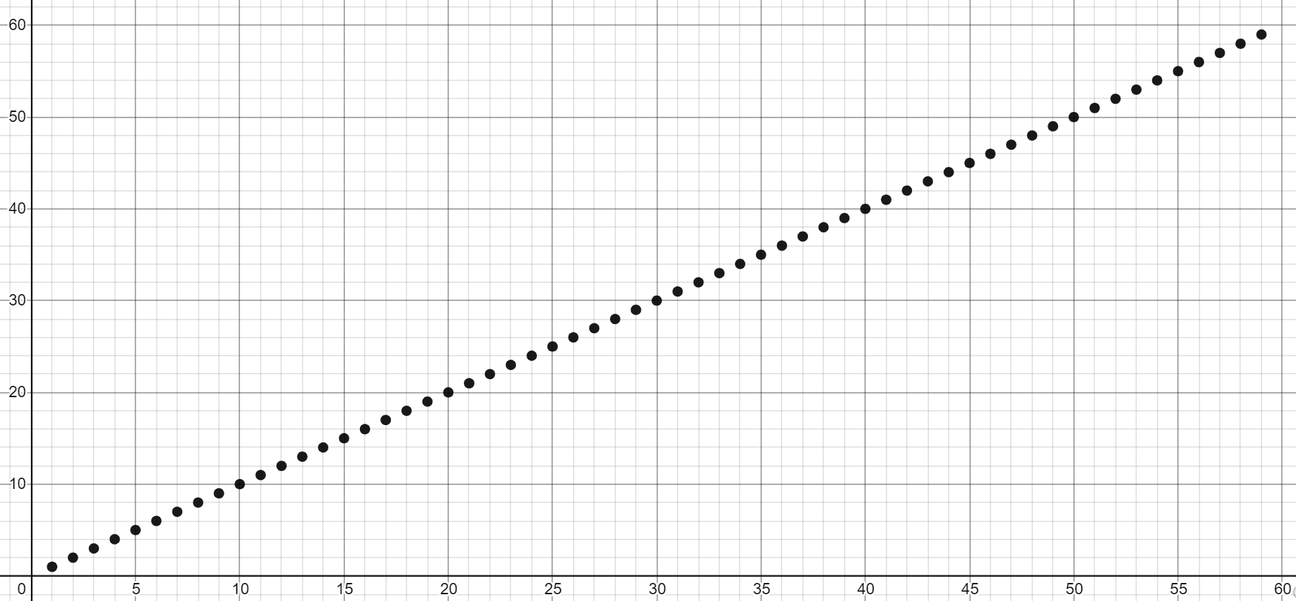
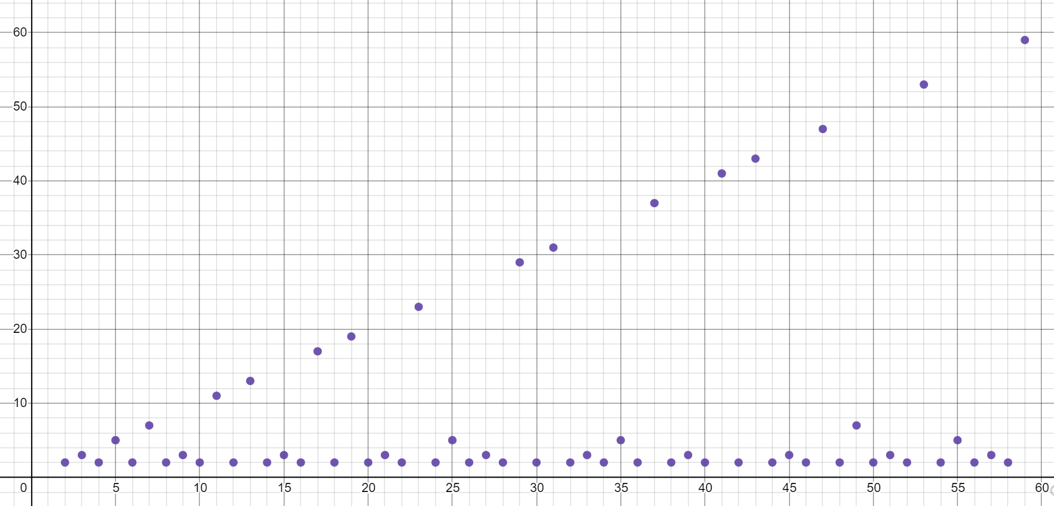
A “recap” about big-O vs big-Theta going forward
Mainly we'll use big-Theta for the bounds from now on since it's the most specific while still being generally direct process to go from f(n) = 2n^3 + 2 --> Theta(n^3) time
When to use Big-Theta (most of the time): | When you have to use Big-O/Big-Omega:
for any function that's just the sum of its terms like f(n) = 2^n + 3n^3 + 4n - 5 we can always just do the approach of dropping constant multipliers / removing the lower order terms to find the big Theta at a glance. | f(n) { n if n is prime, 1 otherwise} since in this case, the big O (n) and the big Omega(1) Omega don't overlap at the same complexity class, there is no reasonable big-Theta and we couldn't use it here.

Slide 6
Administrivia
project1 released
grader-only tests and rate limiting
you get an additional submission every 10 minutes, can store up to 6 submissions (tokens)
we don’t want you spamming the auto-grader (extra computation on the server + guess and check is generally not that effective for your learning if you’re doing it a lot) – instead you can take a breather and investigate the problems / errors. We want to encourage you all to do more testing / reviewing your code to grow to become more independent programmers throughout this course.
Most students don’t bump into the limit / run out of submissions and have to wait to recharge – the point of this isn’t to block y’all. If you feel that it’s too strict then please bring it up for discussion after trying this assignment.
exercise1 - out by midnight tonight, due next Friday 11:59pm
Piazza
try to use the search bar before you post / use descriptive summary titles when possible - thank you

Slide 7
Questions

Slide 8
Code Analysis Process
Best-case upper bound O(n)
model of best-case runtime f(n)
best case
Best-case lower bound Ω(n)
case analysis
code modeling
asymptotic analysis
Best-case tight fit Θ(n)
code
Worst-case upper bound O(n)
model of worst-case runtime f(n)
worst case
Worst-case lower bound Ω(n)
Worst-case tight fit Θ(n)

Slide 9
Modeling Recursive Code

Slide 10
Recursive Patterns
Modeling and analyzing recursive code is all about finding patterns in how the input changes between calls and how much work is done within each call
Let’s explore some of the more common recursive patterns
Pattern #1: Halving the Input
Pattern #2: Constant size input and doing work
Pattern #3: Doubling the Input

Slide 11
Binary Search
public int binarySearch(int[] arr, int toFind, int lo, int hi) {
if( hi < lo ) {
return -1;
} if(hi == lo) {
if(arr[hi] == toFind) {
return hi;
}
return -1;
}
int mid = (lo+hi) / 2;
if(arr[mid] == toFind) {
return mid;
} else if(arr[mid] < toFind) {
return binarySearch(arr, toFind, mid+1, hi);
} else {
return binarySearch(arr, toFind, lo, mid-1);
}
}

Slide 12
Binary Search Runtime
binary search: Locates a target value in a sorted array or list by successively eliminating half of the array from consideration.
Example: Searching the array below for the value 42:
index | 0 | 1 | 2 | 3 | 4 | 5 | 6 | 7 | 8 | 9 | 10 | 11 | 12 | 13 | 14 | 15 | 16
value | -4 | 2 | 7 | 10 | 15 | 20 | 22 | 25 | 30 | 36 | 42 | 50 | 56 | 68 | 85 | 92 | 103
min
mid
max
How many elements will be examined?
What is the best case?
What is the worst case?
element found at index 8, 1 item examined, O(1)
Take 1 min to respond to activity
www.pollev.conm/cse373activity
Take a guess! What is the tight Big-O of worst case binary search?
element not found, ½ elements examined, then ½ of that…
Pattern #1 – Halving the input

Slide 13
Binary search runtime
Logarithm – inverse of exponentials
Examples:
$2^{2}=4⇒2=\log_{2}{4}$
$3^{2}=9⇒2=\log_{3}{9}$
For an array of size N, it eliminates ½ until 1 element remains.
N, N/2, N/4, N/8, ..., 4, 2, 1
How many divisions does it take?
Think of it from the other direction:
How many times do I have to multiply by 2 to reach N?
1, 2, 4, 8, ..., N/4, N/2, N
Call this number of multiplications "x".
2^{x} = N
x = log₂ N
Binary search is in the logarithmic complexity class.
$$y= \log_{b}{x} is equal to b^{y}=x$$

Slide 14
Moving Forward
While this analysis is correct it relied on our ability to think through the pattern intuitively
This works for binary search, but most recursive code is too complex to rely on our intuition.
We need more powerful tools to form a proper code model.
O(1)
Some constant number of operations
Found in the middle
Ω(1)
case analysis
intuit patterns
asymptotic analysis
Θ(1)
Binary search code
O(logn)
Logarithmic
Not found
Ω(logn)
Θ(logn)

Slide 15
Model
Let’s start by just getting a model. Let $F(n)$ be our model for the worst-case running time of binary search.
public int binarySearch(int[] arr, int toFind, int lo, int hi) {
if( hi < lo ) {
return -1;
} if(hi == lo) {
if(arr[hi] == toFind) {
return hi;
}
return -1;
}
int mid = (lo+hi) / 2;
if(arr[mid] == toFind) {
return mid;
} else if(arr[mid] < toFind) {
return binarySearch(arr, toFind, mid+1, hi);
} else {
return binarySearch(arr, toFind, lo, mid-1);
}
}
2
4
6
How do you model recursive calls?
2
+ ??
With a recursive math function!

Slide 16
Meet the Recurrence
A recurrence relation is an equation that defines a sequence based on a rule that gives the next term as a function of the previous term(s)
It’s a lot like recursive code:
At least one base case and at least one recursive case
Each case should include the values for n to which it corresponds
The recursive case should reduce the input size in a way that eventually triggers the base case
The cases of your recurrence usually correspond exactly to the cases of the code
$$T\left(n\right)= \left\{\begin{aligned}5 if n<3 \\ 2T\left(\frac{n}{2}\right)+10 otherwise\end{aligned}\right.$$

Slide 17
Write a Recurrence
public int recursiveFunction(int n){
if(n < 3) {
return 3;
}
for(int int i=0; i < n; i++) {
System.out.println(i);
}
int val1 = recursiveFunction(n/3);
int val2 = recursvieFunction(n/3);
return val1 * val2;
}
Base Case
2
+n
Recursive Case
Non-recursive work
Recursive work
n+2
2*T(n/3)
$$T\left(n\right)= \left\{\begin{aligned}2 if n<3 \\ 2T\left(\frac{n}{3}\right)+n otherwise\end{aligned}\right.$$

Slide 18
Recurrence to Big-Θ
$$T\left(n\right)= \left\{\begin{aligned}2 if n<3 \\ 2T\left(\frac{n}{3}\right)+n otherwise\end{aligned}\right.$$
It’s still really hard to tell what the big-O is just by looking at it.
But fancy mathematicians have a formula for us to use!
Master Theorem
a=2 b=3 and c=1
$\log_{3}{2}=x⇒3^{x}=2⇒x ≅$0.63
$$\log_{3}{2}<1$$
We’re in case 1
$$T\left(n\right)∈Θ(n)$$
$$T\left(n\right)=\left\{\begin{aligned}d if n is at most some constant \\ aT\left(\frac{n}{b}\right)+f\left(n\right) otherwise \end{aligned}\right.$$
$$y= \log_{b}{x} is equal to b^{y}=x$$
Where $f\left(n\right)$ is $Θ\left(n^{c}\right)$
If
$$\log_{b}{a}<c$$
then
$$T\left(n\right)∈Θ\left(n^{c}\right)$$
If
$$\log_{b}{a}=c$$
then
$$T\left(n\right)∈Θ\left(n^{c}\log{n}\right)$$
If
$$\log_{b}{a}>c$$
then
$$T\left(n\right)∈Θ\left(n^{\log_{b}{a}}\right)$$

Slide 19
Understanding Master Theorem
The case
Recursive case does a lot of non recursive work in comparison to how quickly it divides the input size
Most work happens in beginning of call stack
Non recursive work in recursive case dominates growth, n^{c} term
The case
Recursive case evenly splits work between non recursive work and passing along inputs to subsequent recursive calls
Work is distributed across call stack
The case
Recursive case breaks inputs apart quickly and doesn’t do much non recursive work
Most work happens near bottom of call stack
$$\log_{b}{a}<c$$
Master Theorem
$$T\left(n\right)=\left\{\begin{aligned}d if n is at most some constant \\ aT\left(\frac{n}{b}\right)+f\left(n\right) otherwise \end{aligned}\right.$$
Where $f\left(n\right)$ is $Θ\left(n^{c}\right)$
If
$$\log_{b}{a}<c$$
then
$$T\left(n\right)∈Θ\left(n^{c}\right)$$
$$\log_{b}{a}=c$$
If
$$\log_{b}{a}=c$$
then
$$T\left(n\right)∈Θ\left(n^{c}\log{n}\right)$$
If
$$\log_{b}{a}>c$$
then
$$T\left(n\right)∈Θ\left(n^{\log_{b}{a}}\right)$$
A measures how many recursive calls are triggered by each method instance
B measures the rate of change for input
C measures the dominating term of the non recursive work within the recursive method
D measures the work done in the base case
$$\log_{b}{a}>c$$

Slide 20
Questions

Slide 21
Recursive Patterns
Pattern #1: Halving the Input
Pattern #2: Constant size input and doing work
Pattern #3: Doubling the Input
Binary Search Θ(logn)
Merge Sort

Slide 22
Merge Sort
Divide
0 | 1 | 2 | 3 | 4 | 5 | 6 | 7 | 8 | 9
8 | 2 | 91 | 22 | 57 | 1 | 10 | 6 | 7 | 4
0 | 1 | 2 | 3 | 4
8 | 2 | 91 | 22 | 57
5 | 6 | 7 | 8 | 9
1 | 10 | 6 | 7 | 4
0
8
Conquer
0
8
Combine
0 | 1 | 2 | 3 | 4
2 | 8 | 22 | 57 | 91
5 | 6 | 7 | 8 | 9
1 | 4 | 6 | 7 | 10
0 | 1 | 2 | 3 | 4 | 5 | 6 | 7 | 8 | 9
1 | 2 | 4 | 6 | 7 | 8 | 10 | 22 | 57 | 91

Slide 23
Merge Sort
0 | 1 | 2 | 3 | 4
8 | 2 | 57 | 91 | 22
0 | 1
8 | 2
0 | 1 | 2
57 | 91 | 22
mergeSort(input) {
if (input.length == 1)
return
else
smallerHalf = mergeSort(new [0, ..., mid])
largerHalf = mergeSort(new [mid + 1, ...])
return merge(smallerHalf, largerHalf)
}
0
8
0
2
0
57
0 | 1
91 | 22
0
91
0
22
T(n) =
1 if n<= 1
2T(n/2) + n otherwise
0 | 1
22 | 91
Pattern #2 – Constant size input and doing work
0 | 1
2 | 8
0 | 1 | 2
22 | 57 | 91
Take 1 min to respond to activity
0 | 1 | 2 | 3 | 4
2 | 8 | 22 | 57 | 91
www.pollev.conm/cse373activity
Take a guess! What is the Big-O of worst case merge sort?

Slide 24
Merge Sort Recurrence to Big-Θ
T(n) =
1 if n<= 1
2T(n/2) + n otherwise
Master Theorem
a=2 b=2 and c=1
$$\log_{2}{2}=x⇒2^{x}=2⇒x=1$$
$$\log_{2}{2}=1$$
We’re in case 2
$$T\left(n\right)∈Θ(n\log{n})$$
$$T\left(n\right)=\left\{\begin{aligned}d if n is at most some constant \\ aT\left(\frac{n}{b}\right)+f\left(n\right) otherwise \end{aligned}\right.$$
$$y= \log_{b}{x} is equal to b^{y}=x$$
Where $f\left(n\right)$ is $Θ\left(n^{c}\right)$
If
$$\log_{b}{a}<c$$
then
$$T\left(n\right)∈Θ\left(n^{c}\right)$$
If
$$\log_{b}{a}=c$$
then
$$T\left(n\right)∈Θ\left(n^{c}\log{n}\right)$$
If
$$\log_{b}{a}>c$$
then
$$T\left(n\right)∈Θ\left(n^{\log_{b}{a}}\right)$$

Slide 25
Questions

Slide 26
Recursive Patterns
Pattern #1: Halving the Input
Pattern #2: Constant size input and doing work
Pattern #3: Doubling the Input
Binary Search Θ(logn)
Merge Sort Θ(nlogn)
Calculating Fibonacci

Slide 27
Calculating Fibonacci
public int fib(int n) {
if (n <= 1) {
return 1;
}
return fib(n-1) + fib(n-1);
}
f(4)
f(3)
f(3)
f(2)
f(2)
f(2)
f(2)
Each call creates 2 more calls
Each new call has a copy of the input, almost
Almost doubling the input at each call
f(1)
f(1)
f(1)
f(1)
f(1)
f(1)
f(1)
f(1)
Almost
Pattern #3 – Doubling the Input

Slide 28
Calculating Fibonacci Recurrence to Big-Θ
public int f(int n) {
if (n <= 1) {
return 1;
}
return f(n-1) + f(n-1);
}
Can we use master theorem?
Master Theorem
d
$$T\left(n\right)=\left\{\begin{aligned}d if n is at most some constant \\ aT\left(\frac{n}{b}\right)+f\left(n\right) otherwise \end{aligned}\right.$$
2T(n-1) + c
Uh oh, our model doesn’t match that format…
Can we intuit a pattern?
T(1) = d
T(2) = 2T(2-1) + c = 2(d) + c
T(3) = 2T(3-1) + c = 2(2(d) + c) + c = 4d + 3c
T(4) = 2T(4-1) + c = 2(4d + 3c) + c = 8d + 7c
T(5) = 2T(5-1) + c = 2(8d + 7c) + c = 16d +25c
Looks like something’s happening but it’s tough
$$T\left(n\right)=\left\{\begin{aligned}d when n≤1 \\ 2T\left(n−1\right)+c otherwise\end{aligned}\right.$$
Take 1 min to respond to activity
www.pollev.conm/cse373activity
Finish the recurrence, what is the model for the recursive case?
Maybe geometry can help!

Slide 29
Calculating Fibonacci Recurrence to Big-Θ
How many layers in the function call tree?
How many layers will it take to transform “n” to the base case of “1” by subtracting 1
For our example, 4 -> Height = n
How many function calls per layer?
$$T\left(n\right)=\left\{\begin{aligned}d when n≤1 \\ 2T\left(n−1\right)+c otherwise\end{aligned}\right.$$
f(4)
f(3)
f(3)
Layer | Function calls
1 | 1
2 | 2
3 | 4
4 | 8
How many function calls on layer k?
2^{k-1}
f(2)
f(2)
f(2)
f(2)
How many function calls TOTAL
for a tree of k layers?
1 + 2 + 3 + 4 + … + 2^{k-1}
f(1)
f(1)
f(1)
f(1)
f(1)
f(1)
f(1)
f(1)

Slide 30
Calculating Fibonacci Recurrence to Big-Θ
Patterns found:
How many layers in the function call tree?
n
How many function calls on layer k?
2^{k-1}
How many function calls TOTAL for a tree of k layers?
1 + 2 + 4 + 8 + … + 2^{k-1}
Total runtime = (total function calls) x (runtime of each function call)
Total runtime = (1 + 2 + 4 + 8 + … + 2^{k-1}) x (constant work)
Summation Identity
Finite Geometric Series
$$\sum_{i=1}^{k−1}{2^{i}= \frac{2^{k}−1}{2−1}=2^{k}−1 }$$
1 + 2 + 4 + 8 + … + 2^{k-1} =
$$\sum_{i=1}^{k−1}{x^{i}= \frac{x^{k}−1}{x−1}}$$
$$T\left(n\right)=2^{n}−1 ∈Θ(2^{n})$$

Slide 31
Recursive Patterns
Pattern #1: Halving the Input
Pattern #2: Constant size input and doing work
Pattern #3: Doubling the Input
Binary Search Θ(logn)
Merge Sort Θ(nlogn)
Calculating Fibonacci Θ(2^{n})

