Slide 1
Lecture 4: Code Modeling and Asymptotic Analysis
CSE 373: Data Structures and Algorithms

Slide 2
Warm Up
Take 2 Minutes
ArrayQueue<E>
LinkedQueue<E>
Respond to the poll everywhere with what complexity class (constant or linear) would best the runtime of the following situations.
Situation #1 – adding a new element to an ArrayQueue when there is still unused capacity in the underlying array “data[]”
Situation #2 - adding a new element to an ArrayQueue when there is no unused capcity in the underlying array “data[]”
Situation #3 – adding a new element to a LinkedQueue
www.pollev.com/cse373activity for participating in our active learning questions. For this question label your answer with
what situation #
Constant or Linear
why.
https://www.pollev.com/cse373studentqs to ask your own questions
state
state
data[]
Size
front index
back index
Node front
Node back
size
behavior
behavior
add – data[size] = value, if out of room grow data
remove – return data[size - 1], size-1
peek – return data[size - 1]
size – return size
isEmpty – return size == 0
add – add node to back
remove – return and remove node at front
peek – return node at front
size – return size
isEmpty – return size == 0

Slide 3
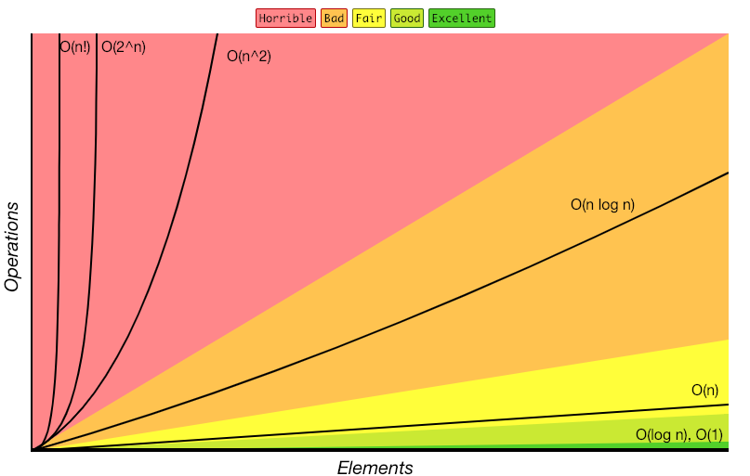
Review: Complexity Classes
complexity class – a category of algorithm efficiency based on the algorithm’s relationship to the input size N
Class | Big O | If you double N… | Example algorithm
constant | O(1) | unchanged | Add to front of linked list
logarithmic | O(log n) | Increases slightly | Binary search
linear | O(n) | doubles | Sequential search
“n log n”* | O(nlog n) | Slightly more than doubles | Merge sort
quadratic | O(n²) | quadruples | Nested loops traversing a 2D array
cubic | O(n³) | Multiplies by 8 | Triple nested loop
polynomial | O(n^{c})
exponential | O(c^{n}) | Increases drastically
*There’s no generally agreed on term. “near[ly]-linear” is sometimes used.
http://bigocheatsheet.com/

Slide 4
Administrivia
Project 0 is due Wednesday at 11:59pm PST
Office hours start this week, check out the calendar
Project 1 will go live by Wednesday 11:59pm (you might want to find a partner)
Check out the slack!
Find a partner
Individual written exercise going out on Friday
Feedback: too many breaks for questions

Slide 5
General process
a piece of code
code modeling
a mathematical function modeling the runtime of a piece of code
asymptotic analysis
big O runtime
An example of the process
method1()
code modeling
f(n) = 5$n^{2}$+3n+2
asymptotic analysis
O($n^{2}$)
Notes:
We’re going to talk about the code modeling part of this flowchart first. But we’ll come back to this slide later.

Slide 6
Disclaimer
This topic has lots of details/subtle relationships between concepts.
We’re going to try to introduce things one at a time (all at once can be overwhelming).
“We’ll see that later” might be the answer to a lot of questions.
“Could you go over ____ again? or “ ____ part of this topic is confusing” are totally valid questions / opinions to voice. If you’re able to say those on pollev / chat we can probably all learn and benefit from it.

Slide 7
Code Modeling
code modeling – the process of mathematically representing how many operations a piece of code will run in relation to the number of inputs $n$. (We’re going to turn code into a function representing it’s runtime)
What counts as an “operation”?
Basic operations
Adding ints or doubles
Variable update
Return statement
Accessing array index or object field
Consecutive statements
Sum time of each statement
Assume all basic operations run in equivalent time
Function calls
Count runtime of function body
Remember that new calls a function!
Conditionals
Time of test + appropriate branch
We’ll talk about which branch to analyze when we get to cases.
Loops
(Number of loop iterations) * (runtime of loop body)
Notes:
We’re going to try this approach and see how it goes – there are a couple of problems with it that we’ll uncover, but it’ll give us some intuition about how to think about the runtime of code.

Slide 8
Code | Runtime function
public void method1(int n) { int sum = 0; int i = 0; while (i < n) { sum = sum + (i * 3); i = i + 1; } return sum; }
public void method2(int n) { int sum = 0; int i = 0; while (i < n) { int j = 0; while (j < n) { if (j % 2 == 0) { // do nothing, just for fun! } sum = sum + (i * 3) + j; j = j + 1; } i = i + 1; } return sum; }
Approach
-> start with basic operations
Each basic operation = +1
Loop = #iterations * (operations in loop body)
+1
+1
+1
+3
+2
- the loop runs n times - 6 steps per iteration
f(n) = 6n + 3
= 6n
+1
+1
+1
+1
+1
f(n) =
n(8n+3) + 3
+1
+1
- outer loop: runs n times - 8n + 3 steps per iteration
- inner loop: runs n times - 8 steps per iteration
= n(8n+3)
= 8n
+4
+2
+2

Slide 9
General process
a piece of code
code modeling
a function modeling the runtime of a piece of code
asymptotic analysis
big O runtime
An example of the process
method1()
code modeling
f(n) = 5$n^{2}$+3n+2
or
visual plot representation
asymptotic analysis
O($n^{2}$)
Notes:
Now we’re going to talk about the asymptotic analysis part for pretty much the rest of lecture – there’s a lot of different parts of asymptotic analysis, but note that it starts with a math function and goes into the big-Oh notation. There’s no code in this step – and in fact if it makes it simpler, you don’t have to think about the code from this point out. Now that we have a mathematical function, it could represent anything – money, a physics equation, anything. We’re totally isolated in this step for the rest of lecture – analyzing math functions in a computer science lens.

Slide 10
Finding a Big-O
We have an expression for $f(n)$.
How do we get the $O()$ that we’ve been talking about?
1. Find the “dominating term” and delete all others.
The “dominating” term is the one that is largest as $n$ gets bigger. In this class, often the largest power of $n$.
2. Remove any constant factors.
3. Write the final big-O – (basically just putting the O symbol around your remaining n-term)
$$f\left(n\right)=\text{n}\text{(8}\text{n}\text{+3) + 3}$$
$$f\left(n\right)=\text{n}\text{(8}\text{n}\text{+3) + 3}=8n^{2}+3n+3$$
$$f\left(n\right)=8n^{2}+3n+3≈8n^{2}$$
$$f\left(n\right)≈8n^{2}≈n^{2}$$
$f\left(n\right)$ is $O(n^{2})$

Slide 11
Wait, what? Asymptotic Analysis - big ideas
Why did we just throw out all of that information? Big-O is like the “significant digits” of computer science.
Asymptotic Analysis is how a function behaves as n→ ∞ so when we do asymptotic analysis (putting functions inside a big-O), we only care about what happens when $n$ gets bigger and approaches infinity.
We don’t care about smaller values because all code is “fast enough” for small $n$ in practice. If you’re only focusing on small inputs /small n, you’re not doing asymptotic analysis.
Since we’re dealing with infinity, constants and lower-order terms don’t meaningfully add to the final result. The highest-order term is what matters and drives growth, and is why we hone in on it and drop everything else.
Caring about infinity and the highest order term are big ideas!

Slide 12
Using the constants isn’t more accurate either
public static void method1(int[] input) { int n = input.length; input[n-1] = input[3] + input[4]; input[0]+= input[1]; }
public static void method2(int[] input) { int five = 5; input[five] = input[five] + 1; input[five]--; }
public static void method1(int[]); Code:
0: aload_0 1: arraylength 2: istore_1 3: aload_0 4: iload_1 5: iconst_1 6: isub 7: aload_0 8: iconst_3 9: iaload
public static void method2(int[]); Code:
10: aload_0 11: iconst_4 12: iaload 13: iadd 14: iastore 15: aload_0 16: iconst_0 17: dup2 18: iaload 19: aload_0
20: iconst_1 21: iaload 22: iadd 23: iastore 24: return
0: iconst_5 1: istore_1 2: aload_0 3: iload_1 4: aload_0 5: iload_1
6: iaload 7: iconst_1 8: iadd 9: iastore
10: aload_0 11: iload_1 12: dup2 13: iaload 14: iconst_1 15: isub 16: iastore 17: return

Slide 13
Code Modeling anticipating asymptotic analysis
We can’t accurately model the constant factors just by staring at the code.
And the lower-order terms matter even less than the constant factors.
So we just ignore them for the big-O.
This does not mean you shouldn’t care about constant factors ever – they are important in real code!
Our theoretical tools aren’t precise enough to analyze them well.

Slide 14
Code modeling: more practice
Write the specific mathematical code model for the following code and indicate the big-O runtime in terms of $k$.
public void method3 (int k) {
int j = 0;
while (j < k) {
for (int i = 0; i < k; i++) {
System.out.println(“Hello world”);
}
j = j + 5;
}
}
+1
+k/5 (body)
$$f\left(k\right)=\frac{k\left(k+2\right)}{5}$$
+k(body)
+1
quadratic -> $O\left(k^{2}\right)$
+2
Approach
-> start with basic operations, work inside out for control structures
Each basic operation = +1
Loop = #iterations * (operations in loop body)

Slide 15
Code modeling takeaways
- We talked about counting +1s to give you an intuition and point out what’s not important (variable assignments, math operators, etc.) and what is important (loops, method calls, etc.)
Once you’ve gotten some practice with a couple of these, you’ll find that you won’t need to count up the individual +1s. Those +1s won’t really matter at a high-level (for the most part we’re going to drop constants when we turn the code model function into a big-O), we instead look at what the more expensive operations are (loops, method calls, recursion) and see how the +n’s or the *n’s add up;

Slide 16
Questions

Slide 17
Formal Definition of Big-O

Slide 18
Formal Definitions: Why?
If you’re analyzing simple functions that are similar to those you’ve analyzed before, you don’t bother with the formal definition. You can just be comfortable using your intuitive definition.
If you’re analyzing more complex code or functions, however, this formal definition is a good fallback.
We’re going to be making more subtle big-O statements in this class.
We need a mathematical definition to be sure we know exactly where we are.
We’re going to teach you how to use the formal definition, so if you get lost (come across a weird edge case) you know how to get your bearings.

Slide 19
Function growth and what we want out of our formal definition
Imagine you have three possible algorithms to choose between.
Each has already been reduced to its mathematical model
$$f\left(n\right)=n$$
$$g\left(n\right)=4n$$
$$h\left(n\right)=n^{2}$$
$$T\left(n\right)$$
$$T\left(n\right)$$
$$T\left(n\right)$$
$$n$$
$$n$$
$$n$$
The growth rate for f(n) and g(n) looks very different for small numbers of input
…but since both are linear eventually look similar at large input sizes
But for very small input values h(n) actually has a slower growth rate than either f(n) or g(n)
whereas h(n) has a distinctly different growth rate
Notes:
The way we’ve been talking about functions going into big O classes (dropping the lower order terms, dropping the constants, dropping multipliers) is pretty loose / not formal at all. So this next section is going into the more formal definition of big O and is another way to understand the concept more deeply.
We want a way to formally be able to group n and 4n together and also make sure we’re distinguishing between n^2. And also make sure that we don’t make the mistake of looking at too small values (we care about infinitely big things and we would get tricked by this third graph if we looked at small values)

Slide 20
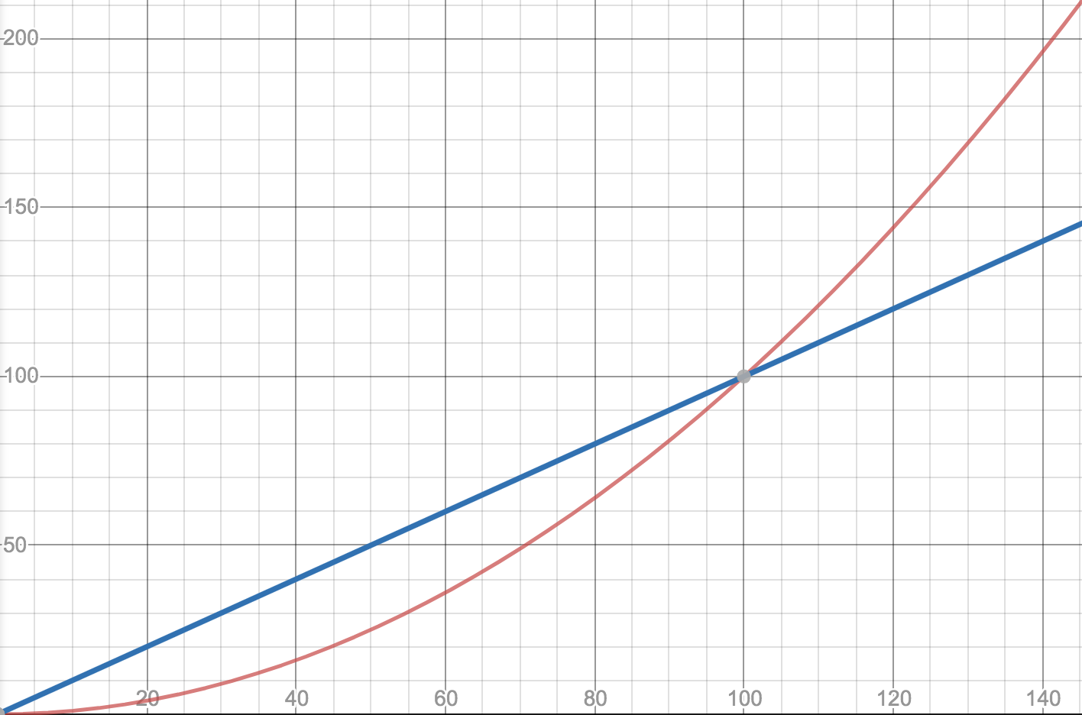
Definition: Big-O
Why $n_{0}$?
f1(n)=0.01n²
We wanted to find an upper bound on our algorithm’s running time, but
We only care about what happens as $n$ gets large.
We don’t want to care about constant factors.
f2(n)=n
$f(n)$ is $O(g\left(n\right))$ if there exist positive constants $c, n_{0}$ such that for all $n≥n_{0}$,
$$f\left(n\right)≤c⋅g\left(n\right)$$
Big-O
Why $c$?
$$T\left(n\right)$$
We also say that $g\left(n\right)$ “dominates” $f(n)$
f1(n)=5n
$$n$$
f2(n)=n

Slide 21
Big O Definition Proofs
$f(n)$ is $O(g\left(n\right))$ if there exist positive constants $c, n_{0}$ such that for all $n≥n_{0}$,
$$f\left(n\right)≤c⋅g\left(n\right)$$
Big-O
Show that
$$f\left(n\right)=10n+15$$
is
$$O\left(n\right)$$
Apply definition term by term
$$10n≤c・n when c=10 for all values of n. So 10n≤10n$$
$15≤c・n when c=15 for n≥1.$ $So 15≤15n$
Add up all your truths
$$10n+15≤10n+15n=25n for n≥1$$
10n + 15 <= 25n for n >= 1.
which is in the form of the definition
f(n) <= c * g(n)
where c = 25 and n0 = 1.

Slide 22
Big O Definition Proofs: more practice
Demonstrate that $5n2 + 3n + 6$ is dominated by $n2$ (i.e. that $5n^{2}+3n+6$ is $O\left(n^{2}\right)$, by finding a $c$ and $n0$ that satisfy the definition of domination
5n² + 3n + 6 ≤ 5n² + 3n² + 6n² when n ≥ 1
5n² + 3n² + 6n² = 14n²
5n² + 3n + 6 ≤ 14n² for n ≥ 1
14n² ≤ c*n² for c = ? n >= ?
$c$ = 14 & $n_{0}$ = 1
$f(n)$ is $O(g\left(n\right))$ if there exist positive constants $c, n_{0}$ such that for all $n≥n_{0}$,
$$f\left(n\right)≤c⋅g\left(n\right)$$
Big-O

Slide 23
Big-O Definition Proofs: outline
Steps to a big-O proof, to show $f\left(n\right)$ is $O\left(g\left(n\right)\right)$.
1. Find a $c, n_{0}$ that fit the definition for each of the terms of $f$.
Each of these is a mini, easier big-O proof.
2. Add up all your $c$, take the max of your $n_{0}.$
3. Add up all your inequalities to get the final inequality you want.
4. Clearly tell us what your $c$ and $n_{0}$ are!
For any big-O proof, there are many $c$ and $n_{0}$ that work.
You might be tempted to find the smallest possible $c$ and $n_{0}$ that work.
You might be tempted to just choose $c=1,000,000,000$ and $n_{0}=73,000,000$ for all the proofs.
Don’t do either of those things.
A proof is designed to convince your reader that something is true. They should be able to easily verify every statement you make. – We don’t care about the best $c$, just an easy-to-understand one.
We have to be able to see your logic at every step.

Slide 24
Note: Big-O definition is just an upper-bound, not always an exact bound
True or False: $10n^{2}+15n$ is $O(n^{3})$
It’s true – it fits the definition
$$10n2≤c・n3 when c=10 for n≥1$$
$$15n≤c・n3 when c=15 for n≥1$$
$$10n2+15n≤10n3+15n3≤25n3 for n≥1$$
$10n^{2}+15n$ is $O(n^{3})$ because $10n^{2}+15n≤25n3 for n≥1$
Big-O is just an upper bound that may be loose and not describe the function fully. For example, all of the following are true:
$10n^{2}+15n$ is $O(n^{3})$
$10n^{2}+15n$ is $O\left(n^{4}\right)$
$10n^{2}+15n$ is $O\left(n^{5}\right)$
$10n^{2}+15n$ is $O(n^{n})$
$10n^{2}+15n$ is $O(n!)$ … and so on
This is a big idea!

Slide 25
Note: Big-O definition is just an upper-bound, not always an exact bound (plots)
What do we want to look for on a plot to determine if one function is in the big-O of the other?
You can sanity check that your g(n) function (the dominating one) overtakes or is equal to your f(n) function after some point and continues that greater-than-or-equal-to trend towards infinity
n⁵
The visual representation of big-O and asymptotic analysis is a big idea!
$10n^{2}+15n$ is $O(n^{3})$
$10n^{2}+15n$ is $O\left(n^{4}\right)$
$10n^{2}+15n$ is $O\left(n^{5}\right)$
… and so on …
n⁴
$$T\left(n\right)$$
n³
10n² + 15n
$$n$$
Notes:
note that for big O the function inside the big O is the dominating one (the greater one)
you have to zoom out enough so that the constants don’t affect anything and then this sanity check will be true :P
@big idea – the graphs and the formal definition say the same thing in different ways – a lot of people prefer the visual method, but if you feel comfortable with one you should be able to transfer your understanding to the other mode and connect the ideas in your mind.

Slide 26
Tight Big-O Definition Plots
If we want the most-informative upper bound, we’ll ask you for a simplified, tight big-O bound.
$O\left(n^{2}\right)$ is the tight bound for the function f(n) = 10n²+15n. See the graph below – the tight big-O bound is the smallest upperbound within the definition of big-O.
Computer scientists It is almost always technically correct to say your code runs in time $O(n!)$. (Warning: don’t try this trick in an interview or exam)
If you zoom out a bunch,
the your tight bound and your function will
be overlapping compared to other
complexity classes.
10n² + 15n
$$T\left(n\right)$$
n²
$$n$$

Slide 27
Questions

Slide 28
Uncharted Waters: a different type of code model
Find a model $f\left(n\right)$ for the running time of this code on input $n →$ What’s the Big-O?
boolean isPrime(int n){
int toTest = 2;
while(toTest < n){
if(n % toTest == 0) {
return true;
} else {
toTest++;
}
}
return false;
}
Operations per iteration: let’s just call it 1 to keep all the future slides simpler.
Number of iterations?
Smallest divisor of $n$
Remember, $f(n)$ = the number of basic operations performed on the input $n$.

Slide 29
Prime Checking Runtime
$$f(n)$$
Is the running time of the code $O\left(1\right)$ or $O\left(n\right)?$
More than half the time we need 3 or fewer iterations. Is it $O(1)$?
But there’s still always another number where the code takes $n$ iterations. So $O\left(n\right)?$
This is why we have definitions!

Slide 30
$f(n)$ is $O(g\left(n\right))$ if there exist positive constants $c, n_{0}$ such that for all $n≥n_{0}$,
$$f\left(n\right)≤c⋅g\left(n\right)$$
$$f(n)$$
Big-O
Is the running time $O(n)$?
Can you find constants $c$ and $n_{0}$?
How about $c=1$ and $n_{0}=5$,
$f\left(n\right)=$smallest divisor of $n≤1⋅n$ for $n≥5$
Is the running time $O(1)$?
Can you find constants $c$ and $n_{0}$?
No! Choose your value of $c$. I can find a prime number $k$bigger than $c.$
And $f\left(k\right)=k>c⋅1$ so the definition isn’t met!
It’s $O(n)$ but not $O\left(1\right)$

Slide 31
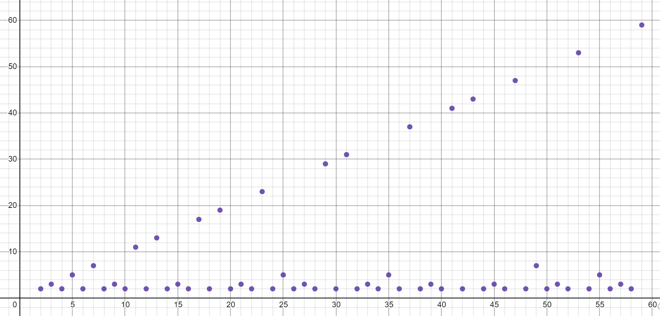
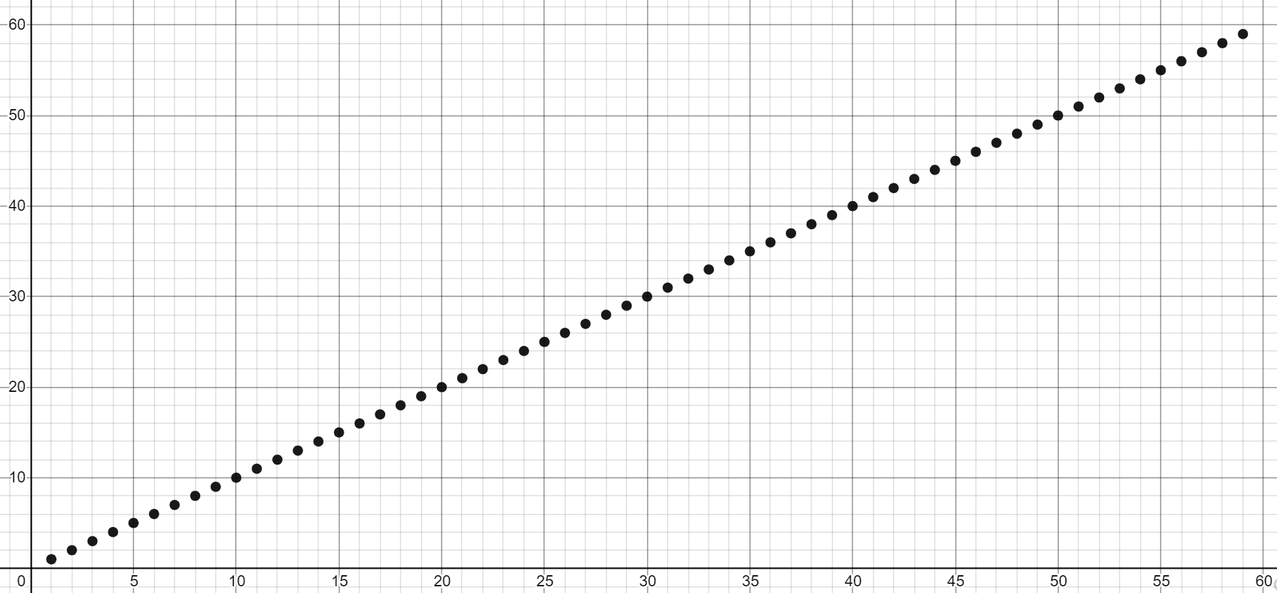
Big-O isn’t everything
Our prime finding code is $O\left(n\right)$as tight bound. But so is printing all the elements of a list.
$$O(n)$$
$$O(n)$$
Your experience running these two pieces of code is going to be very different.
It’s disappointing that the $O()$ are the same – that’s not very precise.
Could we have some way of pointing out the list code always takes AT LEAST $n$ operations?

Slide 32
Big-$Ω$ [Omega]
$f(n)$ is $Ω(g\left(n\right))$ if there exist positive constants $c, n_{0}$ such that for all $n≥n_{0}$,
$$f\left(n\right)≥c⋅g\left(n\right)$$
Big-Omega
$f(n)$ is $O(g\left(n\right))$ if there exist positive constants $c, n_{0}$ such that for all $n≥n_{0}$,
$$f\left(n\right)≤c⋅g\left(n\right)$$
Big-O
The formal definition of Big-Omega is the flipped version of Big-Oh.
When we make Big-Oh statements about a function and say f(n) is O(g(n)) we’re saying that f(n) grows at most as fast as g(n).
But with Big-Omega statements like f(n) is $Ω$(g(n)), we’re saying that f(n) will grows at least as fast as g(n).
Visually: what is the lower limit of this function? What is bounded on the bottom by?
$$O(n)$$
$$Ω(1)$$

Slide 33
Big-Omega definition Plots
$2n^{3} is Ω($1)
${2n}^{3} is Ω(n$)
$2n^{3} is Ω(n^{2})$
${2n}^{3} is Ω(n^{3})$
$2n^{3} is lowerbounded by all the complexity classes listed above (1, n,n^{2},n^{3})$
2n³
$$T\left(n\right)$$
n³
n²
n
1
$$n$$

Slide 34
Examples
$f(n)$ $∈$ $O(g\left(n\right))$ if there exist positive constants $c, n_{0}$ such that for all $n≥n_{0}$,
$$f\left(n\right)≤c⋅g\left(n\right)$$
Big-O
4n² ∈ Ω(1)
true
4n² ∈ Ω(n)
true
4n² ∈ Ω(n²)
true
4n² ∈ Ω(n³)
false
4n² ∈ Ω(n⁴)
false
4n² ∈ O(1)
false
4n² ∈ O(n)
false
4n² ∈ O(n²)
true
4n² ∈ O(n³)
true
4n² ∈ O(n⁴)
true
$f(n)$ $∈ Ω(g\left(n\right))$ if there exist positive constants $c, n_{0}$ such that for all $n≥n_{0}$,
$$f\left(n\right)≥c⋅g\left(n\right)$$
Big-Omega

Slide 35
Tight Big-O and Big-$Ω bounds shown together$
prime runtime function
f(n) = n
$$O(n)$$
$$O(n)$$
$Ω$(1)
$Ω$(n)
Note: this right graph’s tight O bound is O(n) and its tight Omega bound is Omega(n). This is what most of the functions we’ll deal with will look like, but there exists some code that would produce runtime functions like on the left.

Slide 36
O, and Omega, and Theta [oh my?]
$f(n)$ is $O(g\left(n\right))$ if there exist positive constants $c, n_{0}$ such that for all $n≥n_{0}$,
$$f\left(n\right)≤c⋅g\left(n\right)$$
Big-O
Big-O is an upper bound
My code takes at most this long to run
Big-Omega is a lower bound
My code takes at least this long to run
Big Theta is “equal to”
My code takes “exactly”* this long to run
*Except for constant factors and lower order terms
$f(n)$ is $Ω(g\left(n\right))$ if there exist positive constants $c, n_{0}$ such that for all $n≥n_{0}$,
$$f\left(n\right)≥c⋅g\left(n\right)$$
Big-Omega
Big-Theta
$f(n)$ is $Θ(g\left(n\right))$ if
$f\left(n\right)$ is $O(g\left(n\right))$ and $f\left(n\right)$ is $Ω(g\left(n\right))$.
(in other words: there exist positive constants $c1, c2, n_{0}$ such that for all $n≥n_{0}$)
$c1⋅g\left(n\right)≤f\left(n\right)$ $≤c2⋅g\left(n\right)$

Slide 37
O, and Omega, and Theta [oh my?]
Big-Theta
Big Theta is “equal to”
My code takes “exactly”* this long to run
*Except for constant factors and lower order terms
$f(n)$ is $Θ(g\left(n\right))$ if
$f\left(n\right)$ is $O(g\left(n\right))$ and $f\left(n\right)$ is $Ω(g\left(n\right))$.
(in other words: there exist positive constants $c1, c2, n_{0}$ such that for all $n≥n_{0}$)
$c1⋅g\left(n\right)≤f\left(n\right)$ $≤c2⋅g\left(n\right)$
f(n) = n
To define a big-Theta, you expect the tight big-Oh and tight big-Omega bounds to be touching on the graph (meaning they’re the same complexity class)
$$O(n)$$
$Ω$(n)
$$Θ(n)$$

Slide 38
Initial general process
a piece of code
code modeling
a function modeling the runtime of a piece of code
asymptotic analysis
big O runtime
An example of the process
method1()
code modeling
f(n) = 5$n^{2}$+3n+2
or
visual plot representation
asymptotic analysis
O($n^{2}$)
Notes:
Now we’re going to talk about the asymptotic analysis part for pretty much the rest of lecture – there’s a lot of different parts of asymptotic analysis, but note that it starts with a math function and goes into the big-Oh notation. There’s no code in this step – and in fact if it makes it simpler, you don’t have to think about the code from this point out. Now that we have a mathematical function, it could represent anything – money, a physics equation, anything. We’re totally isolated in this step for the rest of lecture – analyzing math functions in a computer science lens.

Slide 39
General process after knowing about Omega and Theta
a piece of code
code modeling
a function modeling the runtime of a piece of code
big O runtime
big Omega runtime
big Theta runtime
asymptotic analysis
An example of the process
method1()
code modeling
f(n) =
5n +3
tight upper bound: O(n$)$
tight lower bound: $Ω$(n)
$Θ$(n)
Most code is more straightforward and the tight O and tight Omega are the same, so we can just
refer to the Theta runtime.
Notes:
For a lot of code, your function is more normal / simple and so then there isn’t that much use for O / Omega Theta

Slide 40
General process
a piece of code
code modeling
a function modeling the runtime of a piece of code
big O runtime
big Omega runtime
big Theta runtime
asymptotic analysis
An example of the process
isPrime(n)
code modeling
f(n) =
5n +3 when n is prime
or 4 otherwise
tight upper bound: O(n$)$
tight lower bound: $Ω$(1)
$$no reasonable$$
$$Theta bound$$
isPrime example (unusual odd case)

Slide 41
Questions

Slide 42
Takeaways
- rough idea of how to turn a piece of code into a function that we can categorize with big-O, Omega, and Theta
definition of big O, Omega Theta and how functions fit into them:
visually with plots
through formal math definitions
tight/loose bounds

