Slide 1
Lecture 2: Lists
CSE 373: Data Structures and Algorithms

Slide 2
Warm Up
Reminder: Please open www.pollev.com/cse373studentqs to ask questions :)
From our last lecture:
Abstract Data Type (ADT)
A definition for expected operations and behavior
A mathematical description of a collection with a set of supported operations and how they should behave when called upon
Describes what a collection does, not how it does it
Can be expressed as an interface
Data Structure
A way of organizing and storing related data points
An object that implements the functionality of a specified ADT
Describes exactly how the collection will perform the required operations
Please go to www.pollev.com/cse373activity to respond
Which of the following is NOT an “ADT”:
List
ArrayList
Set
Map
TreeMap
Stack
Queue

Slide 3
Administration
Project 0 released later today
Due next Wednesday April 8th before 11:59pm PST
Check “Projects” tab on website, live later today
Learning Goals
Refresh CSE 143 concepts and set the expectations for homework in CSE 373.
Set up IntelliJ and other systems we’ll use in this class (Java, GitLab, Git, Checkstyle).
Learn how to use JUnit and run unit tests in IntelliJ.
Let’s connect!
Check out the piazza
Office hours start next week
Limited offering this week to help with set up
Section
Starts tomorrow

Slide 4
Question Break

Slide 5
Review: “Big Oh”
Note: You don’t have to understand all of this right now – we’ll dive into it soon.
efficiency: measure of computing resources used by code.
can be relative to speed (time), memory (space), etc.
most commonly refers to run time
Assume the following:
Any single Java statement takes same amount of time to run.
A method call's runtime is measured by the total of the statements inside the method's body.
A loop's runtime, if the loop repeats N times, is N times the runtime of the statements in its body.
We measure runtime in proportion to the input data size, N.
growth rate: Change in runtime as N gets bigger. How does this algorithm perform with larger and larger sets of data?
b = c + 10;
for (int i = 0; i < N; i++) {
for (int j = 0; j < N; j++) {
dataTwo[j][i] = dataOne[i][j];
dataOne[i][j] = 0;
}
}
for (int i = 0; i < N; i++) {
dataThree[i] = b;
}
This algorithm runs 2N² + N + 1 statements.
We ignore constants like 2 because they are tiny next to N.
The highest-order term (N²) “dominates” the overall runtime.
We say that this algorithm runs "on the order of" N².
or O(N²) for short ("Big-Oh of N squared")

Slide 6
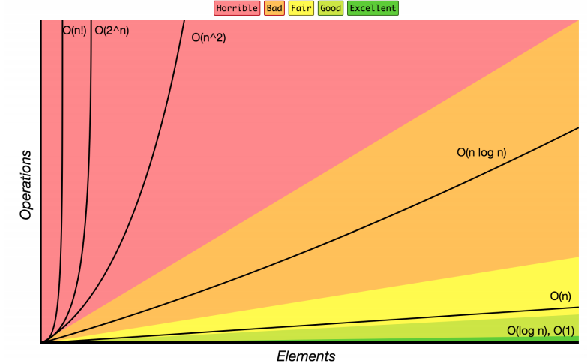
Review: Complexity Class
Note: You don’t have to understand all of this right now – we’ll dive into it soon.
complexity class: A category of algorithm efficiency based on the algorithm's relationship to the input size N.
Complexity Class | Big-O | Runtime if you double N | Example Algorithm
constant | O(1) | unchanged | Accessing an index of an array
logarithmic | O(log₂ N) | increases slightly | Binary search
linear | O(N) | doubles | Looping over an array
log-linear | O(N log₂ N) | slightly more than doubles | Merge sort algorithm
quadratic | O(N²) | quadruples | Nested loops!
... | ... | ... | ...
exponential | O(2^{N}) | multiplies drastically | Fibonacci with recursion

Slide 7
Case Study: The List ADT
list: a collection storing an ordered sequence of elements.
Each item is accessible by an index.
A list has a variable size defined as the number of elements in the list
Elements can be added to or removed from any position in the list
Relation to code and our mental image of a list:
List<String> names = new ArrayList<>(); // []
names.size(); // evaluates to 0
names.add(”Amanda"); // [“Amanda”]
names.add(”Anish"); // [“Amanda, Anish”]
names.insert("Brian”, 0); // [“Brian”, “Amanda”, “Anish”]
names.size(); // evaluates to 3
Notes:
The main idea is that a list can store pieces of data and you can control the order when you add / remove / it.
Also a note on these slides before we talk about code: we know our code isn’t going to be perfect java programs since we want it to be readable / simple when possible, but if there’s something that’s bothering or confusing you about the code (like syntax or what something means) please ask. There will definitely be weird typos since Powerpoint is not the best way to write code.
Transition to next slide: Now that we have perspective of what the ADT representation is (when we think about this visual model and understanding the indices), let’s talk about this line of code that specifies ArrayList and what an ArrayList is.

Slide 8
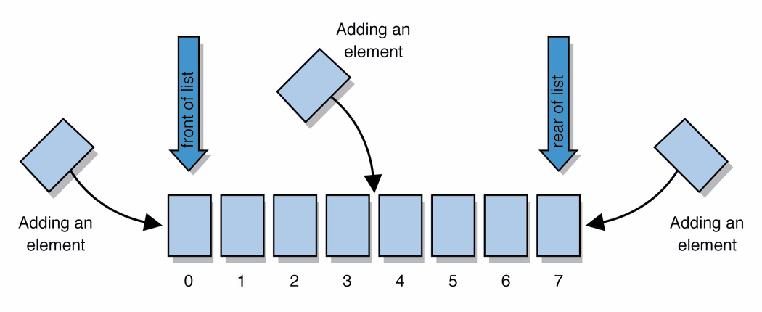
Case Study: List Implementations
ArrayList
uses an Array as underlying storage
LinkedList
uses nodes as underlying storage
List ADT
ArrayList<E>
LinkedList<E>
state
Set of ordered items
Count of items
state
state
data[]
size
Node front
size
behavior
get(index) return item at index
set(item, index) replace item at index
add(item) add item to end of list
insert(item, index) add item at index
delete(index) delete item at index
size() count of items
behavior
behavior
get return data[index]
set data[index] = value
add data[size] = value, if out of space grow data
insert shift values to make hole at index, data[index] = value, if out of space grow data
delete shift following values forward
size return size
get loop until index, return node’s value
set loop until index, update node’s value
add create new node, update next of last node
insert create new node, loop until index, update next fields
delete loop until index, skip node
size return size
0 | 1 | 2 | 3 | 4
88.6 | 26.1 | 94.4 | 0 | 0
88.6
26.1
94.4
list
free space
Notes:
Mention on the relevant slide: There are plenty of more methods that the ADT defines and listed here as reference and for curiosity, but they’re not necessary for the rest of today’s lecture.

Slide 9
Case Study: The List ADT: ArrayList
How do Java / other programming languages implement ArrayList to achieve all the List behavior?
On the inside:
stores the elements inside an array (which has a fixed capacity) that typically has more space than currently used (For example when there is only 1 element in the actual list, the array might have 10 spaces for data),
stores all of these elements at the front of the array and keeps track of how many there are (the size) so that the implementation doesn’t get confused enough to look at the empty space. This means that sometimes we will have to do a lot of work to shift the elements around.
List view ArrayList view
[”Brian”, “Amanda”, “Anish”] [“Brian”, “Amanda”, “Anish”, null, null, null, null]
(this is the internal array with extra space)

Slide 10
Implementing ArrayList
ArrayList<E>
insert(element, index) with shifting
state
data[]
size
0 | 1 | 2 | 3
insert(“d”, 0)
a
b
c
d
behavior
a
b
c
get return data[index]
set data[index] = value
add data[size] = value, if out of space make data into a bigger array and copy everything over
insert shift values to make hole at index, data[index] = value, if out of space grow data
delete shift following values forward
size return numberOfItems
size =
4
3
delete(index) with shifting
0 | 1 | 2 | 3
a
b
c
delete(0)
d
a
b
c
Take 1 Minute
size =
4
3
Yes or No: should we overwrite index 3 (the old c) with null? Please go to www.pollev.com/cse373activity to submit a ‘Yes’ or ‘No’ answer with a brief explanation why you think so.
Notes:
2 minutes – how does insert work? Delete?
2 minutes – should we overwrite garbage values with null or leave them garbage?
Which should we do? The answer is: I don’t know! It depends on what we’re trying to achieve with this particular data structure – this is a major theme of this course (here are the pros, here are the cons, but there are multiple correct answers). Something probably new compared to CSE 142 / 143, but we’re going to do a lot of it in this class. Throughout this course we’re going to come up with reasons for one option to be good, and other reasons for another option to be good and debate them.

Slide 11
Implementing ArrayList
append(element) with growth
ArrayList<E>
0 | 1 | 2 | 3
state
append(2)
10
3
4
5
data[]
size
behavior
get return data[index]
set data[index] = value
add data[size] = value, if out of space grow data
insert shift values to make hole at index, data[index] = value, if out of space grow data
delete shift following values forward
size return size
numberOfItems =
4
5
0 | 1 | 2 | 3 | 4 | 5 | 6 | 7
2

Slide 12
Case Study: List Implementations
ArrayList
uses an Array as underlying storage
LinkedList
uses nodes as underlying storage
List ADT
ArrayList<E>
LinkedList<E>
state
Set of ordered items
Count of items
state
state
data[]
size
Node front
size
behavior
get(index) return item at index
set(item, index) replace item at index
add(item) add item to end of list
insert(item, index) add item at index
delete(index) delete item at index
size() count of items
behavior
behavior
get return data[index]
set data[index] = value
add data[size] = value, if out of space grow data
insert shift values to make hole at index, data[index] = value, if out of space grow data
delete shift following values forward
size return size
get loop until index, return node’s value
set loop until index, update node’s value
add create new node, update next of last node
insert create new node, loop until index, update next fields
delete loop until index, skip node
size return size
Take 1 Minute
What method/situations will be much faster for LinkedList than for ArrayList?
Please go to www.pollev.com/cse373activity to submit a method/situation with a brief explanation why you think so.
0 | 1 | 2 | 3 | 4
88.6 | 26.1 | 94.4 | 0 | 0
88.6
26.1
94.4
list
free space
Notes:
Now let’s zoom out again.
Just talked about ArrayList, one possible data structure implementation for the List ADT. Let’s compare it to LinkedList, the other implementation!
With ArrayList you can specify the index and just notation like data[index], but for LL the only way to get to data further in the list is to follow the .next fields (the arrows in this picture here). So for get for example, for ArrayList we just said looks like data[index], one line of code and pretty simple. But for LL, we have to start at the front, then go to the next, and the next and the next, till we get to the specified index.
So it seems like that’s one case where ArrayList is preferred over LinkedList, but since we’re so focused on design stuff:
What about the other side? In what situations (what methods / parameters) is LinkedList preferred?

Slide 13
Design Decisions
For every ADT there are lots of different ways to implement them
Based on your situation you should consider:
Memory vs Speed
Generic/Reusability vs Specific/Specialized
One Function vs Another
Robustness vs Performance
This class is all about implementing ADTs based on making the right design tradeoffs!
> A common topic in interview questions

Slide 14
Design Decisions
Take 3 Minutes
Dub Street Burgers is implementing a new system for ticket (i.e. food order) management.
When a new ticket comes in, it is placed at the end of the set of tickets.
Food is prepared in approximately the same order it was requested, but sometimes tickets are fulfilled out of order.
Let’s represent tickets as a list. Which of our ADT implementations should we use?
Why?

Slide 15
We’re going to try some more online activities here: please have some mercy
We’re going to group you all into groups of ~5 students with the Zoom breakouts feature, click here for some instructions with screenshots about how to use it if you’re stuck / not sure. You should be able to just click join, but if you’re trouble check out the slides.
With your group, discuss and submit an answer (or multiple if you have different opinions!) and vote at
www.pollev.com/cse373activity

Slide 16
Design Decisions
Let’s represent tickets as a list. Which of our ADT implementations should we use?
Why?
ArrayList
Creating a new ticket is very fast (as long as we don’t resize), and I want the cooks to be able to see all the orders right away.
LinkedList
We’ll mostly be removing from the front of the list, which is much faster for the linkedlist (no shifting), and I want finished orders to be removed fast so they aren’t distracting.

Slide 17
Design Decisions
Both ArrayList and LinkedList implementations have pros and cons.
Neither is strictly better than the other.
Some major objectives of this course:
Evaluating pros and cons
Deciding on a design
Defending that design decision
Especially when there’s more than one possible answer.

Slide 18
Question Break

Slide 19
This is where we stopped in lecture

Slide 20
Design Decisions
Take 3 Minutes
Discuss in your Breakout: How would you implement the List ADT for each of the following situations? For each consider the most important functions to optimize.
Situation #1: Write a data structure that implements the List ADT that will be used to store a list of songs in a playlist.
LinkedList – optimize for growth of list and movement of songs
Situation #2: Write a data structure that implements the List ADT that will be used to store the history of a bank customer’s transactions.
ArrayList – optimize for addition to back and accessing of elements
Situation #3: Write a data structure that implements the List ADT that will be used to store the order of students waiting to speak to a TA at a tutoring center
LinkedList - optimize for removal from front
ArrayList – optimize for addition to back

Slide 21
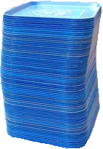
Review: What is a Stack?
stack: A collection based on the principle of adding elements and retrieving them in the opposite order.
Last-In, First-Out ("LIFO")
Elements are stored in order of insertion.
We do not think of them as having indexes.
Client can only add/remove/examine the last element added (the "top").
push
pop, peek
top | 3
 | 2
bottom | 1
Stack ADT
state
supported operations:
push(item): Add an element to the top of stack
pop(): Remove the top element and returns it
peek(): Examine the top element without removing it
size(): how many items are in the stack?
isEmpty(): true if there are 1 or more items in stack, false otherwise
Set of ordered items
Number of items
behavior
push(item) add item to top
pop() return and remove item at top
peek() look at item at top
size() count of items
isEmpty() count of items is 0?

Slide 22
Implementing a Stack with an Array
Stack ADT
ArrayStack<E>
Big O Analysis
pop()
peek()
size()
isEmpty()
push()
state
state
O(1) Constant
Set of ordered items
Number of items
data[]
size
O(1) Constant
behavior
behavior
push(item) add item to top
pop() return and remove item at top
peek() look at item at top
size() count of items
isEmpty() count of items is 0?
push data[size] = value, if out of room grow data
pop return data[size - 1], size-1
peek return data[size - 1]
size return size
isEmpty return size == 0
O(1) Constant
O(1) Constant
O(1) Constant or
worst case O(N) linear
push(3)
push(4)
pop()
push(5)
0 | 1 | 2 | 3
Take 1 min to respond to activity
3
4
5
www.pollev.com/cse373activity
What do you think the worst case runtime of the “push()” operation will be?
2
0
numberOfItems =
1

Slide 23
Implementing a Stack with Nodes
Stack ADT
LinkedStack<E>
Big O Analysis
pop()
peek()
size()
isEmpty()
push()
state
state
O(1) Constant
Set of ordered items
Number of items
Node top
size
O(1) Constant
behavior
behavior
push(item) add item to top
pop() return and remove item at top
peek() look at item at top
size() count of items
isEmpty() count of items is 0?
push add new node at top
pop return and remove node at top
peek return node at top
size return size
isEmpty return size == 0
O(1) Constant
O(1) Constant
O(1) Constant
4
Take 1 min to respond to activity
push(3)
push(4)
pop()
front
3
www.pollev.com/cse373activity
What do you think the worst case runtime of the “push()” operation will be?
numberOfItems =
1
0
2

Slide 24
Question Break

Slide 25
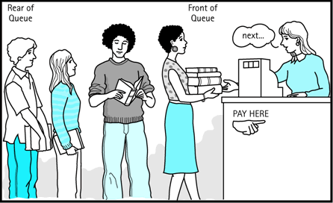
Review: What is a Queue?
queue: Retrieves elements in the order they were added.
First-In, First-Out ("FIFO")
Elements are stored in order of insertion but don't have indexes.
Client can only add to the end of the queue, and can only examine/remove the front of the queue.
Queue ADT
front |  | back
1 | 2 | 3
remove, peek
add
state
Set of ordered items
Number of items
behavior
supported operations:
add(item): aka “enqueue” add an element to the back.
remove(): aka “dequeue” Remove the front element and return.
peek(): Examine the front element without removing it.
size(): how many items are stored in the queue?
isEmpty(): if 1 or more items in the queue returns true, false otherwise
add(item) add item to back
remove() remove and return item at front
peek() return item at front
size() count of items
isEmpty() count of items is 0?

Slide 26
Implementing a Queue with an Array
Queue ADT
ArrayQueue<E>
Big O Analysis
remove()
peek()
size()
isEmpty()
add()
state
state
O(1) Constant
Set of ordered items
Number of items
data[]
Size
front index
back index
O(1) Constant
behavior
add(item) add item to back
remove() remove and return item at front
peek() return item at front
size() count of items
isEmpty() count of items is 0?
O(1) Constant
behavior
add – data[size] = value, if out of room grow data
remove – return data[size - 1], size-1
peek – return data[size - 1]
size – return size
isEmpty – return size == 0
O(1) Constant
O(1) Constant or
worst case O(N) linear
0 | 1 | 2 | 3 | 4
Take 1 min to respond to activity
add(5)
add(8)
add(9)
remove()
5
8
9
www.pollev.com/cse373activity
What do you think the worst case runtime of the “add()” operation will be?
1
2
numberOfItems =
3
0
1
front = 0
back = 0
2
1
Notes:
Spend rest of class implementing queue – do we need to address circular queues?

Slide 27
Implementing a Queue with an Array
> Wrapping Around
add(7)
add(4)
add(1)
front
back
0 | 1 | 2 | 3 | 4
4
5
9
2
7
front
5
3
back
numberOfItems =
4
0 | 1 | 2 | 3 | 4 | 5 | 6 | 7 | 8 | 9
5 | 9 | 2 | 7 | 4
1

Slide 28
Implementing a Queue with Nodes
Queue ADT
LinkedQueue<E>
Big O Analysis
remove()
peek()
size()
isEmpty()
add()
state
state
O(1) Constant
Set of ordered items
Number of items
Node front
Node back
size
O(1) Constant
behavior
add(item) add item to back
remove() remove and return item at front
peek() return item at front
size() count of items
isEmpty() count of items is 0?
O(1) Constant
behavior
add – add node to back
remove – return and remove node at front
peek – return node at front
size – return size
isEmpty – return size == 0
O(1) Constant
O(1) Constant
numberOfItems =
Take 1 min to respond to activity
0
2
1
add(5)
add(8)
remove()
www.pollev.com/cse373activity
What do you think the worst case runtime of the “add()” operation will be?
front
5
8
back
Notes:
Spend rest of class implementing queue – do we need to address circular queues?

Slide 29
Design Decisions
Take 5 Minutes
Discuss in your Breakouts: For each scenario select the appropriate ADT and implementation to best optimize for the given scenario.
Situation #1: You are writing a program to manage a todo list with a very specific approach to tasks. This program will order tasks for someone to tackle so that the most recent task is addressed first. How would you store the transactions in appropriate order?
Stack – First in Last out
Nodes – make addition and removal of tasks very easy
Situation #2: You are writing a program to schedule jobs sent to a laser printer. The laser printer should process these jobs in the order in which the requests were received. How would you store the jobs in appropriate order?
Queue – First in First out
Array – want easy access to all items in queue in case you need to cancel a job

