Slide 1
Recurrences, Master Theorem
BEFORE WE START
pollev.com/uwcse373

Slide 2
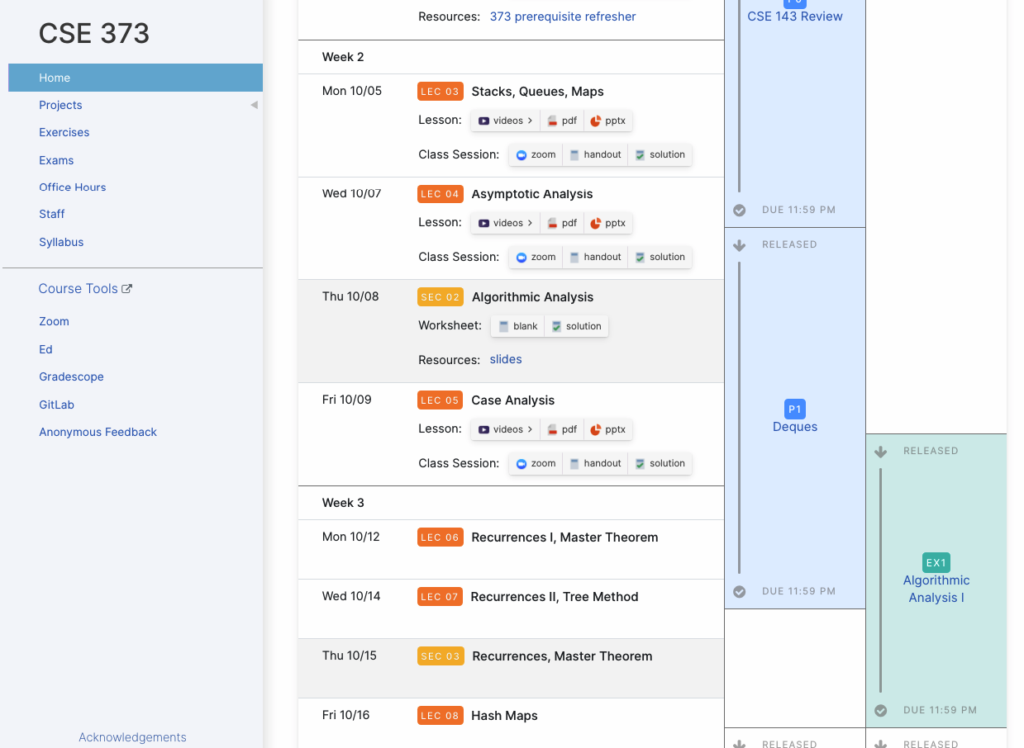
Announcements
Remember you can submit Anonymous Feedback! Especially in this online world, we are extremely grateful for your insight!
Project 1 (Deques) due Wednesday 10/14 11:59pm PDT
Exercise 1 (written, individual) due Friday 10/16 11:59pm PDT

Slide 3
Which of the following statements are true?
Select all options that apply.
A Big-Theta bound will exist for every function.
One possible Best Case for adding to ArrayDeque is when it is empty.
We only use Big-Omega for Worst Case analysis
If a function is $O\left(n^{2}\right)$ it can’t also be $Ω\left(n^{2}\right)$.
All false!

Slide 4
Learning Objectives
After this lecture, you should be able to...
Review Distinguish between Asymptotic Analysis & Case Analysis, and apply both to code snippets
Describe the 3 most common recursive patterns and identify whether code belongs to one of them
Model recursive code using a recurrence relation (Step )
Use the Master Theorem to characterize a recurrence relation with Big-Oh/Big-Theta/Big-Omega bounds (Step )
1
2

Slide 5
Lecture Outline
Review Asymptotic Analysis & Case Analysis
Analyzing Recursive Code

Slide 6
Review Algorithmic Analysis Roadmap
TIGHT
BIG-OH
2
O(1)
1
BEST CASE
FUNCTION
BIG-THETA
Asymptotic
Analysis
f(n) = 2
Θ(1)
CODE
WORST CASE
FUNCTION
TIGHT
BIG-OMEGA
Case Analysis
$Ω$(1)
f(n) = 3n+1
for (i = 0; i < n; i++) {
if (arr[i] == toFind) {
return i;
}
}
return -1;
OTHER CASE
FUNCTION

Slide 7
Review Oh, and Omega, and Theta, oh my
$f(n)$ is $O(g\left(n\right))$ if there exist positive constants $c, n_{0}$ such that for all $n≥n_{0}$,
$$f\left(n\right)≤c⋅g\left(n\right)$$
Big-Oh
Big-Oh is an upper bound
My code takes at most this long to run
Big-Omega is a lower bound
My code takes at least this long to run
Big Theta is “equal to”
My code takes “exactly”* this long to run
*Except for constant factors and lower order terms
Only exists when Big-Oh == Big-Omega!
$f(n)$ is $Ω(g\left(n\right))$ if there exist positive constants $c, n_{0}$ such that for all $n≥n_{0}$,
$$f\left(n\right)≥c⋅g\left(n\right)$$
Big-Omega
Big-Theta
$f(n)$ is $Θ(g\left(n\right))$ if
$f\left(n\right)$ is $O(g\left(n\right))$ and $f\left(n\right)$ is $Ω(g\left(n\right))$.
(in other words: there exist positive constants $c1, c2, n_{0}$ such that for all $n≥n_{0}$)
$c1⋅g\left(n\right)≤f\left(n\right)$ $≤c2⋅g\left(n\right)$

Slide 8
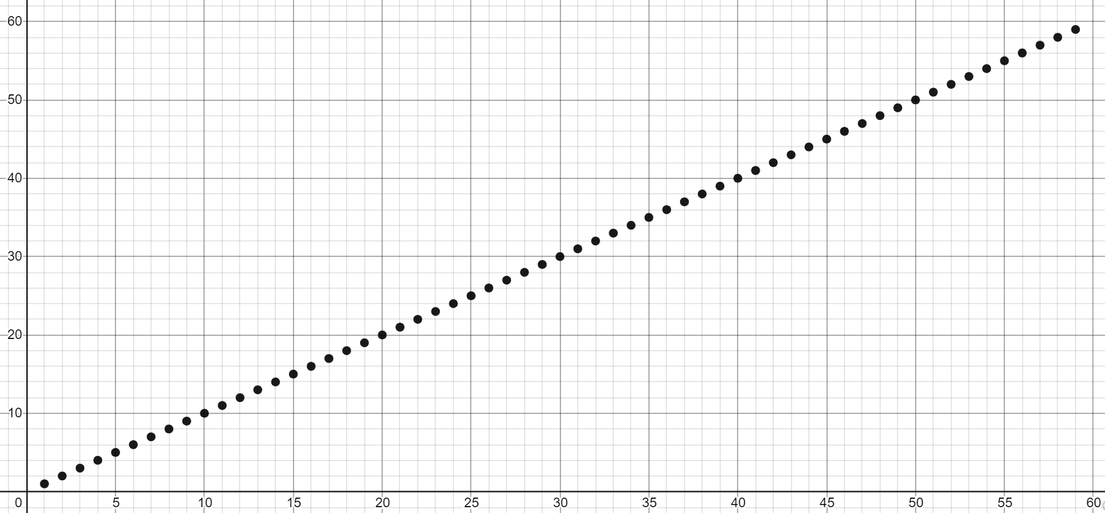
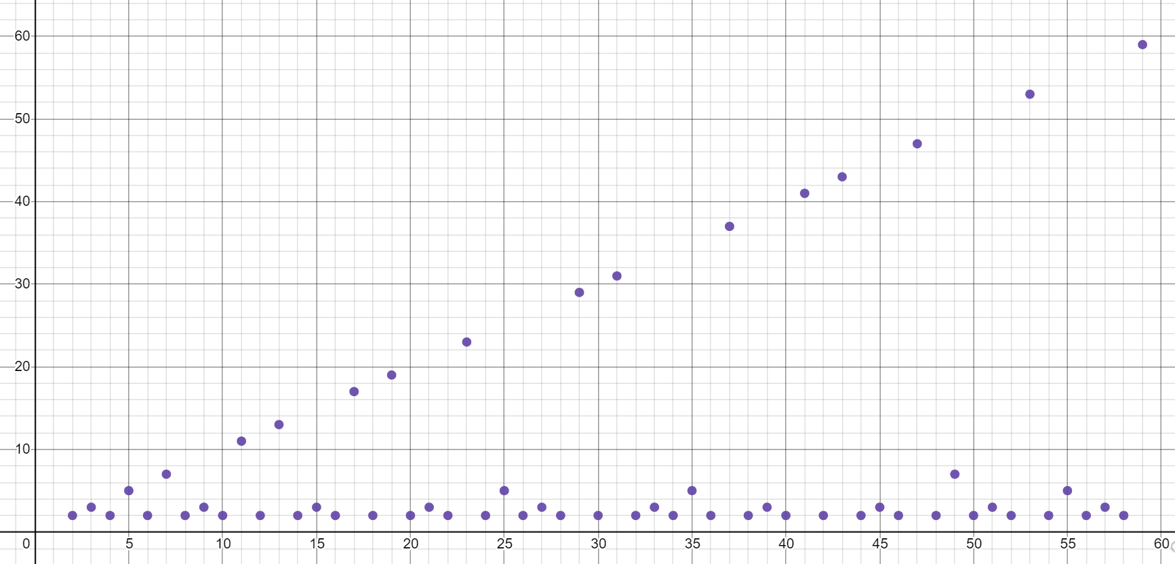
A Note on Asymptotic Analysis Tools
We’ll generally use Big-Theta from here on out: most specific
In industry, people often use Big-Oh to mean “Tight Big-Oh” and use it even when a Big-Theta exists
When to use Big-Theta (most of the time): | When you have to use Big-Oh/Big-Omega:
for any function that's just the sum of its terms like f(n) = 2^n + 3n^3 + 4n - 5 we can always just do the approach of dropping constant multipliers / removing the lower order terms to find the big-Theta at a glance. | f(n) { n if n is prime, 1 otherwise} since in this case, the big-Oh (n) and the big-Omega (1) don't overlap at the same complexity class, there is no big-Theta and we couldn't use it here.

Slide 9
Review When to do Case Analysis?
Imagine a 3-dimensional plot
Which case we’re considering is one dimension
Choosing a case lets us take a “slice” of the other dimensions: n and f(n)
We do asymptotic analysis on each slice in step 2
f(n)
n
At front
(Best Case)
Not present
(Worst Case)
toFind position

Slide 10
Review How to do Case Analysis
Are there significantly different cases?
Do other variables/parameters/fields affect the runtime, other than input size? For many algorithms, the answer is no.
Figure out how things could change depending on the input (excluding n, the input size)
Can you exit loops early?
Can you return early?
Are some branches much slower than others?
Determine what inputs could cause you to hit the best/worst parts of the code.

Slide 11
Other Useful Cases You Might See
Overall Case:
Model code as a “cloud” that covers all possibilities across all cases. What’s the O/Ω/Θ of that cloud?
“Assume X Won’t Happen Case”:
E.g. Assume array won’t need to resize
“Average Case”:
Assume random input
Lots of complications – what distribution of random?
“In-Practice Case”:
Not a real term, but a useful idea
Make reasonable assumptions about how the world will work, then do worst-case analysis under those assumptions.
Worst
Overall
Other Cases
Best

Slide 12
How Can You Tell if Best/Worst Cases Exist?
Are there other possible models for this code?
If n is given, are there still other factors that determine the runtime?
Note: sometimes there aren’t significantly different cases! Sometimes we just want to model the code with a single function and go straight to asymptotic analysis!

Slide 13
In your own words, describe why we can or cannot use n=0 as the best case in our analysis.

Slide 14
Can We Choose n=0 as the Best Case?
Remember that each case needs to be a “slice”: a function over n
The input to asymptotic analysis is a function over all of n, because we’re concerned with growth rate
Fixing n doesn’t work with our tools because it wouldn’t let us examine the bound asymptotically
Think of it as “Best Case as n grows infinitely large”, not “Best Case of all inputs, including n”

Slide 15
Lecture Outline
Review Asymptotic Analysis & Case Analysis
Analyzing Recursive Code
Recursive code usually falls into one of 3 common patterns:
1
2
3
Halving the Input
Constant size Input
Doubling the Input
Binary Search

Slide 16
Case Study: Binary Search
public int binarySearch(int[] arr, int toFind, int lo, int hi) {
if (hi < lo) {
return -1;
} else if (hi == lo) {
if (arr[hi] == toFind) {
return hi;
}
return -1;
}
int mid = (lo + hi) / 2;
if (arr[mid] == toFind) {
return mid;
} else if (arr[mid] < toFind) {
return binarySearch(arr, toFind, mid+1, hi);
} else {
return binarySearch(arr, toFind, lo, mid-1);
}
}
Base Cases
Recursive Cases
Note: the parameters passed to recursive call reduce the size of the problem!

Slide 17
Binary Search Runtime
Binary search: An algorithm to find a target value in a sorted array or list by successively eliminating half of the array from consideration.
Example: Searching the array below for the value 42:
index | 0 | 1 | 2 | 3 | 4 | 5 | 6 | 7 | 8 | 9 | 10 | 11 | 12 | 13 | 14 | 15 | 16
value | -4 | 2 | 7 | 10 | 15 | 20 | 22 | 25 | 30 | 36 | 42 | 50 | 56 | 68 | 85 | 92 | 103
lo
mid
hi
Let’s consider the runtime of Binary Search
What’s the first step?

Slide 18
Binary Search Runtime
Binary search: An algorithm to find a target value in a sorted array or list by successively eliminating half of the array from consideration.
Example: Searching the array below for the value 42:
index | 0 | 1 | 2 | 3 | 4 | 5 | 6 | 7 | 8 | 9 | 10 | 11 | 12 | 13 | 14 | 15 | 16
value | -4 | 2 | 7 | 10 | 15 | 20 | 22 | 25 | 30 | 36 | 42 | 50 | 56 | 68 | 85 | 92 | 103
lo
mid
hi
What’s the Best Case?
Element found at first index examined (index 8)
f(n) = 1
=> Θ(1)
What’s the Worst Case?
1
Element not found, cut input in half, then in half again...
???
Halving the Input

Slide 19
Binary Search Runtime
Logarithm – inverse of exponentials
Examples:
$2^{2}=4⇒2=\log_{2}{4}$
$3^{2}=9⇒2=\log_{3}{9}$
For an array of size n, eliminate ½ until 1 element remains.
n, n/2, n/4, n/8, ..., 4, 2, 1
How many divisions does that take?
Think of it from the other direction:
How many times do I have to multiply by 2 to reach n?
1, 2, 4, 8, ..., n/4, n/2, n
Call this number of multiplications "x".
2^{x} = n
x = log₂ n
Binary search is in the logarithmic complexity class.
$$y= \log_{b}{x} is equal to b^{y}=x$$

Slide 20
We Just Saw: A Leap of Intuition
TIGHT
BIG-OH
O(1)
BIG-THETA
Θ(1)
Best Case: First element matches
TIGHT
BIG-OMEGA
$Ω$(1)
CODE
TIGHT
BIG-OH
binarySearch
O(log n)
Worst Case: Split log(n) times
BIG-THETA
Θ(log n)
TIGHT
BIG-OMEGA
$Ω$(log n)
We identified the best and worst cases – a good start!
But we didn’t do:
Step 1: model the code as a function
Step 2: analyze that function to find its bounds

Slide 21
Our Goal: A Complete Toolchain
TIGHT
BIG-OH
2
O(1)
BEST CASE
FUNCTION
Asymptotic
Analysis
BIG-THETA
Θ(1)
1
???
TIGHT
BIG-OMEGA
$Ω$(1)
CODE
Case
Analysis
TIGHT
BIG-OH
binarySearch
2
O(log n)
WORST CASE
FUNCTION
Asymptotic
Analysis
BIG-THETA
Θ(log n)
???
TIGHT
BIG-OMEGA
$Ω$(log n)
We want to be able to use our algorithmic analysis tools
To do that, we need an essential intermediate: to model the code with runtime functions

Slide 22
Modeling Binary Search
public int binarySearch(int[] arr, int toFind, int lo, int hi) {
if (hi < lo) {
return -1;
} else if (hi == lo) {
if (arr[hi] == toFind) {
return hi;
}
return -1;
}
int mid = (lo + hi) / 2;
if (arr[mid] == toFind) {
return mid;
} else if (arr[mid] < toFind) {
return binarySearch(arr, toFind, mid+1, hi);
} else {
return binarySearch(arr, toFind, lo, mid-1);
}
}
+2
Base Case
+4
Base Case
+6
Recursive Case
How do we model a recursive call?
???
Fortunately, we have a tool for this!

Slide 23
Meet the Recurrence
A recurrence relation is an equation that defines a sequence based on a rule that gives the next term as a function of the previous term(s)
It’s a lot like recursive code:
At least one base case and at least one recursive case
Each case should include the values for n to which it corresponds
The recursive case should reduce the input size in a way that eventually triggers the base case
The cases of your recurrence usually correspond exactly to the cases of the code
$$T\left(n\right)= \left\{\begin{aligned}5 if n<3 \\ 2T\left(\frac{n}{2}\right)+10 otherwise\end{aligned}\right.$$
A generic example of a recurrence:

Slide 24
Writing Recurrences: Example 1
public int recurse(int n) {
if (n < 3) {
return 80;
}
int a = n * 2;
int val1 = recurse(n / 3);
int val2 = recurse(n / 3);
return val1 + val2;
}
+2
Base Case
+2
Recursive Case
Non-recursive Work:
+4
Recursive Work:
+ 2*T(n/3)
+2
$$T\left(n\right)= \left\{\begin{aligned}2 if n<3 \\ 2T\left(\frac{n}{3}\right)+4 otherwise\end{aligned}\right.$$

Slide 25
Writing Recurrences: Example 2
public int recurse(int n) {
if (n < 3) {
return 80;
}
for (int i = 0; i < n; i++) {
System.out.println(i);
}
int val1 = recurse(n / 3);
int val2 = recurse(n / 3);
return val1 + val2;
}
+2
Base Case
+n
Recursive Case
Non-recursive Work:
+ n + 2
Recursive Work:
+ 2*T(n/3)
+2
$$T\left(n\right)= \left\{\begin{aligned}2 if n<3 \\ 2T\left(\frac{n}{3}\right)+n+2 otherwise\end{aligned}\right.$$

Slide 26
Writing Recurrences: Example 3
public int recurse(int n) {
if (n < 3) {
return 80;
}
for (int i = 0; i < n; i++) {
System.out.println(i);
}
int val1 = recurse(n / 4);
int val2 = recurse(n / 4);
int val3 = recurse(n / 4);
return val1 + val2 * val3;
}
+2
Base Case
+n
Recursive Case
Non-recursive Work:
+ n + 3
Recursive Work:
+
+ 3*T(n/4)
+3
$$T\left(n\right)= \left\{\begin{aligned}2 if n<3 \\ 3T\left(\frac{n}{4}\right)+n+3 otherwise\end{aligned}\right.$$

Slide 27
Our Goal: A Complete Toolchain
TIGHT
BIG-OH
2
BEST CASE
FUNCTION
Asymptotic
Analysis
BIG-THETA
1
TIGHT
BIG-OMEGA
CODE
Case
Analysis
TIGHT
BIG-OH
Write a Recurrence
2
WORST CASE
FUNCTION
Asymptotic
Analysis
BIG-THETA
TIGHT
BIG-OMEGA

Slide 28
Recurrence to Big-Θ
$$T\left(n\right)= \left\{\begin{aligned}2 if n<3 \\ 2T\left(\frac{n}{3}\right)+n otherwise\end{aligned}\right.$$
It’s still really hard to tell what the Big-Θ is just by looking at it.
But fancy mathematicians have a formula for us to use!
MASTER THEOREM
a=2 b=3 and c=1
$$\log_{3}{2}≅0.63$$
$$\log_{3}{2}<1$$
We’re in case 1
$$T\left(n\right)∈Θ(n)$$
$$T\left(n\right)=\left\{\begin{aligned}d if n is at most some constant \\ aT\left(\frac{n}{b}\right)+f\left(n\right) otherwise \end{aligned}\right.$$
$$y= \log_{b}{x} is equal to b^{y}=x$$
Where $f\left(n\right)$ is $Θ\left(n^{c}\right)$
If
$$\log_{b}{a}<c$$
then
$$T\left(n\right)∈Θ\left(n^{c}\right)$$
If
$$\log_{b}{a}=c$$
then
$$T\left(n\right)∈Θ\left(n^{c}\log{n}\right)$$
If
$$\log_{b}{a}>c$$
then
$$T\left(n\right)∈Θ\left(n^{\log_{b}{a}}\right)$$

Slide 29
Aside Understanding the Master Theorem
MASTER THEOREM
$$\log_{b}{a}<c$$
The case
Recursive case does a lot of non recursive work in comparison to how quickly it divides the input size
Most work happens in beginning of call stack
Non recursive work in recursive case dominates growth, n^{c} term
The case
Recursive case evenly splits work between non recursive work and passing along inputs to subsequent recursive calls
Work is distributed across call stack
The case
Recursive case breaks inputs apart quickly and doesn’t do much non recursive work
Most work happens near bottom of call stack
$$T\left(n\right)=\left\{\begin{aligned}d if n is at most some constant \\ aT\left(\frac{n}{b}\right)+f\left(n\right) otherwise \end{aligned}\right.$$
Where $f\left(n\right)$ is $Θ\left(n^{c}\right)$
If
$$\log_{b}{a}<c$$
then
$$T\left(n\right)∈Θ\left(n^{c}\right)$$
$$\log_{b}{a}=c$$
If
$$\log_{b}{a}=c$$
then
$$T\left(n\right)∈Θ\left(n^{c}\log{n}\right)$$
If
$$\log_{b}{a}>c$$
then
$$T\left(n\right)∈Θ\left(n^{\log_{b}{a}}\right)$$
A measures how many recursive calls are triggered by each method instance
B measures the rate of change for input
C measures the dominating term of the non recursive work within the recursive method
D measures the work done in the base case
$$\log_{b}{a}>c$$

Slide 30
Lecture Outline
Review Asymptotic Analysis & Case Analysis
Analyzing Recursive Code
Recursive code usually falls into one of 3 common patterns:
1
2
3
Halving the Input
Constant size Input
Doubling the Input
Binary Search
Merge Sort
Θ (log n)

Slide 31
Merge Sort
Divide
0 | 1 | 2 | 3 | 4 | 5 | 6 | 7 | 8 | 9
8 | 2 | 91 | 22 | 57 | 1 | 10 | 6 | 7 | 4
0 | 1 | 2 | 3 | 4
8 | 2 | 91 | 22 | 57
5 | 6 | 7 | 8 | 9
1 | 10 | 6 | 7 | 4
0
8
Conquer
0
8
Combine
0 | 1 | 2 | 3 | 4
2 | 8 | 22 | 57 | 91
5 | 6 | 7 | 8 | 9
1 | 4 | 6 | 7 | 10
0 | 1 | 2 | 3 | 4 | 5 | 6 | 7 | 8 | 9
1 | 2 | 4 | 6 | 7 | 8 | 10 | 22 | 57 | 91

Slide 32
Merge Sort
0 | 1 | 2 | 3 | 4
8 | 2 | 57 | 91 | 22
0 | 1
8 | 2
0 | 1 | 2
57 | 91 | 22
mergeSort(input) {
if (input.length == 1)
return
else
smallerHalf = mergeSort(new [0, ..., mid])
largerHalf = mergeSort(new [mid + 1, ...])
return merge(smallerHalf, largerHalf)
}
0
8
0
2
0
57
0 | 1
91 | 22
0
91
0
22
$$T\left(n\right)= \left\{\begin{aligned}1 if n≤3 \\ 2T\left(\frac{n}{2}\right)+n otherwise\end{aligned}\right.$$
0 | 1
22 | 91
0 | 1
2 | 8
0 | 1 | 2
22 | 57 | 91
2
Constant size Input
0 | 1 | 2 | 3 | 4
2 | 8 | 22 | 57 | 91

Slide 33
What is the Big-Theta of worst-case Merge Sort?
0 | 1
8 | 2
0 | 1 | 2
57 | 91 | 22
$$T\left(n\right)= \left\{\begin{aligned}1 if n≤3 \\ 2T\left(\frac{n}{2}\right)+n otherwise\end{aligned}\right.$$
0
8
0
2
0
57
0 | 1
91 | 22
MASTER THEOREM
0
91
0
22
$$T\left(n\right)=\left\{\begin{aligned}d if n is at most some constant \\ aT\left(\frac{n}{b}\right)+f\left(n\right) otherwise \end{aligned}\right.$$
0 | 1
22 | 91
Where $f\left(n\right)$ is $Θ\left(n^{c}\right)$
0 | 1
2 | 8
0 | 1 | 2
22 | 57 | 91
If
$$\log_{b}{a}<c$$
then
$$T\left(n\right)∈Θ\left(n^{c}\right)$$
If
$$\log_{b}{a}=c$$
then
$$T\left(n\right)∈Θ\left(n^{c}\log{n}\right)$$
If
$$\log_{b}{a}>c$$
then
$$T\left(n\right)∈Θ\left(n^{\log_{b}{a}}\right)$$
0 | 1 | 2 | 3 | 4
2 | 8 | 22 | 57 | 91
Notes:
Take a guess: What is the Big-Theta of worst-case Merge Sort? Why?
https://www.polleverywhere.com/discourses/ng9DCZMiQz5PUbfvhJ8vR

Slide 34
Merge Sort Recurrence to Big-Θ
$$T\left(n\right)= \left\{\begin{aligned}1 if n≤3 \\ 2T\left(\frac{n}{2}\right)+n otherwise\end{aligned}\right.$$
MASTER THEOREM
b=2
and c=1
$$\log_{2}{2}=1$$
We’re in case 2
$$T\left(n\right)∈Θ(n\log{n})$$
a=2
$$T\left(n\right)=\left\{\begin{aligned}d if n is at most some constant \\ aT\left(\frac{n}{b}\right)+f\left(n\right) otherwise \end{aligned}\right.$$
Where $f\left(n\right)$ is $Θ\left(n^{c}\right)$
If
$$\log_{b}{a}<c$$
then
$$T\left(n\right)∈Θ\left(n^{c}\right)$$
If
$$\log_{b}{a}=c$$
then
$$T\left(n\right)∈Θ\left(n^{c}\log{n}\right)$$
If
$$\log_{b}{a}>c$$
then
$$T\left(n\right)∈Θ\left(n^{\log_{b}{a}}\right)$$

Slide 35
Recursive Toolchain
TIGHT
BIG-OH
2
BEST CASE
FUNCTION
Asymptotic
Analysis
BIG-THETA
1
Master Theorem
TIGHT
BIG-OMEGA
CODE
Case
Analysis
TIGHT
BIG-OH
Write a Recurrence
2
WORST CASE
FUNCTION
Asymptotic
Analysis
BIG-THETA
Master Theorem
TIGHT
BIG-OMEGA
For recursive code, we now have tools that fall under Case Analysis (Writing Recurrences) and Asymptotic Analysis (The Master Theorem).

Slide 36
Lecture Outline
Review Asymptotic Analysis & Case Analysis
Analyzing Recursive Code
Recursive code usually falls into one of 3 common patterns:
1
2
3
Halving the Input
Constant size Input
Doubling the Input
Binary Search
Merge Sort
Fibonacci
Θ (log n)
Θ (n log n)

Slide 37
Lecture Outline
Review Asymptotic Analysis & Case Analysis
Analyzing Recursive Code
Recursive code usually falls into one of 3 common patterns:
1
2
3
NEXT LECTURE
Halving the Input
Constant size Input
Doubling the Input
Binary Search
Merge Sort
Fibonacci
Θ (log n)
Θ (n log n)

Slide 38
Calculating Fibonacci
public int fib(int n) {
if (n <= 1) {
return 1;
}
return fib(n-1) + fib(n-1);
}
f(4)
f(3)
f(3)
f(2)
f(2)
f(2)
f(2)
Each call creates 2 more calls
Each new call has a copy of the input, almost
Almost doubling the input at each call
f(1)
f(1)
f(1)
f(1)
f(1)
f(1)
f(1)
f(1)
Almost
3
Doubling the Input

Slide 39
Fibonacci Recurrence to Big-Θ
public int fib(int n) {
if (n <= 1) {
return 1;
}
return fib(n-1) + fib(n-1);
}
Can we use the Master Theorem?
MASTER THEOREM
d
2T(n-1) + c
$$T\left(n\right)=\left\{\begin{aligned}d if n is at most some constant \\ aT\left(\frac{n}{b}\right)+f\left(n\right) otherwise \end{aligned}\right.$$
Uh oh, our model doesn’t match that format…
$$T\left(n\right)= \left\{\begin{aligned}d if n≤1 \\ 2T\left(n−1\right)+c otherwise\end{aligned}\right.$$
Can we intuit a pattern?
T(1) = d
T(2) = 2T(2-1) + c = 2(d) + c
T(3) = 2T(3-1) + c = 2(2(d) + c) + c = 4d + 3c
T(4) = 2T(4-1) + c = 2(4d + 3c) + c = 8d + 7c
T(5) = 2T(5-1) + c = 2(8d + 7c) + c = 16d +25c
Looks like something’s happening but it’s tough
Maybe geometry can help!

Slide 40
Fibonacci Recurrence to Big-Θ
How many layers in the function call tree?
How many layers will it take to transform “n” to the base case of “1” by subtracting 1
For our example, 4 -> Height = n
How many function calls per layer?
$$T\left(n\right)=\left\{\begin{aligned}d when n≤1 \\ 2T\left(n−1\right)+c otherwise\end{aligned}\right.$$
f(4)
f(3)
f(3)
LAYER | FUNCTION CALLS
1 | 1
2 | 2
3 | 4
4 | 8
How many function calls on layer k?
2^{k-1}
f(2)
f(2)
f(2)
f(2)
How many function calls TOTAL
for a tree of k layers?
f(1)
f(1)
f(1)
f(1)
f(1)
f(1)
f(1)
f(1)
1 + 2 + 3 + 4 + … + 2^{k-1}

Slide 41
Fibonacci Recurrence to Big-Θ
Patterns found:
How many layers in the function call tree?
n
How many function calls on layer k?
2^{k-1}
How many function calls TOTAL for a tree of k layers?
1 + 2 + 4 + 8 + … + 2^{k-1}
Total runtime = (total function calls) x (runtime of each function call)
Total runtime = (1 + 2 + 4 + 8 + … + 2^{k-1}) x (constant work)
Summation Identity
Finite Geometric Series
$$\sum_{i=1}^{k−1}{2^{i}= \frac{2^{k}−1}{2−1}=2^{k}−1 }$$
1 + 2 + 4 + 8 + … + 2^{k-1} =
$$\sum_{i=1}^{k−1}{x^{i}= \frac{x^{k}−1}{x−1}}$$
$$T\left(n\right)=2^{n}−1 ∈Θ(2^{n})$$

Slide 42
Fibonacci Recurrence to Big-Θ
How many layers in the function call tree?
n
How many function calls on layer k?
2^{k-1}
How many function calls TOTAL for a tree of k layers?
1 + 2 + 4 + 8 + … + 2^{k-1}
Total runtime = (total function calls) * (runtime of each function call)
(1 + 2 + 4 + 8 + … + 2^{k-1}) x (constant work)
Summation Identity
Finite Geometric Series
$$\sum_{i=1}^{k−1}{2^{i}= \frac{2^{k}−1}{2−1}=2^{k}−1 }$$
1 + 2 + 4 + 8 + … + 2^{k-1} =
$$\sum_{i=1}^{k−1}{x^{i}= \frac{x^{k}−1}{x−1}}$$
$$T\left(n\right)=2^{n}−1 ∈Θ(2^{n})$$

Slide 43
3 Patterns for Recursive Code
1
2
3
Halving the Input
Constant size Input
Doubling the Input
Binary Search
Merge Sort
Fibonacci
Θ (log n)
Θ (n log n)
Θ (2^{n})

