Slide 1
O/Ω/𝝝, Case Analysis
BEFORE WE START

Slide 2
Announcements
Project 1 (Deques) came out Wednesday, due next Wednesday 10/14 11:59pm PDT
Remember to read the partner set-up instructions!
P0 Extra credit opportunity
Exercise 1 (written, individual) released Friday, due next Friday 10/16 11:59pm PDT
Reminder to sign up for a class session group if you’re coming to class!

Slide 3
P1: Deques
DEQUEUE ADT
Deque ADT: a double-ended queue
Add/remove from both ends, get in middle
This project builds on ADTs vs. Data Structure Implementations, Queues, and a little bit of Asymptotic Analysis
Practice the techniques and analysis covered in LEC 02 & LEC 03!
3 components:
Debug ArrayDeque implementation
Implement LinkedDeque
Run experiments
State
Collection of ordered items
Count of items
Behavior
addFirst(item) add to front
addLast(item) add to end
removeFirst() remove from front
removeLast() remove from end
size() count of items
isEmpty() count is 0?
get(index) get 0-indexed element
LinkedDeque
ArrayDeque

Slide 4
P1: Sentinel Nodes
Find yourself writing case after case in your linked node code?
Tired of running into these?
Introducing
Client View:
[3, 9]
Sentinel Nodes
Implementation:
Reduce code complexity & bugs
Tradeoff: a tiny amount of extra storage space for more reliable, easier-to-develop code

Slide 5
P1: Gradescope & Testing
From this project onward, we’ll have some Gradescope-only tests
Run & give feedback when you submit, but only give a general name!
The practice of reasoning about your code and writing your own tests is crucial
Use Gradescope tests as a double-check that your tests are thorough
To debug Gradescope failures, your first step should be writing your own test case
You can submit as many times as you want on Gradescope (we’ll only grade the last active submission)
If you’re submitting a lot (more than ~6 times/hr) it will ask you to wait a bit
Intention is not to get in your way: to give server a break, and guess/check is not usually an effective way to learn the concepts in these assignments
1. Write Implementation
2. Think about edge cases, Write your own tests
3. Run your own tests
4. Run Gradescope tests as a double-check

Slide 6
P1: Working with a Partner
P1 Instructions talk about collaborating with your partner
Adding each other to your GitLab repos
Recommendations for partner work:
Pair programming! Talk through and write the code together
Two heads are better than one, especially when spotting edge cases ☺
Meet in real-time! Consider screen-sharing via Zoom
Be kind! Collaborating in our online quarter can be especially difficult, so please be patient and understanding – partner projects are usually an awesome experience if we’re all respectful
We expect you to understand the full projects, not just half
Please don’t just split the projects in half and only do part
Please don’t come to OH and say “my partner wrote this code, I don’t understand it, can you help me debug it?”

Slide 7
Learning Objectives
After this lecture, you should be able to...
Differentiate between Big-Oh, Big-Omega, and Big-Theta
Come up with Big-Oh, Big-Omega, and Big-Theta bounds for a given function
Perform Case Analysis to identify the Best Case and Worst Case for a given piece of code
Describe the difference between Case Analysis and Asymptotic Analysis

Slide 8
Lecture Outline
Big-O, Big-Omega, Big-Theta
Case Study: Linear Search
A New Tool: Case Analysis

Slide 9
Review Algorithmic Analysis Roadmap
1
2
CODE
RUNTIME
FUNCTION
COMPLEXITY
CLASS
Code Modeling
Asymptotic Analysis
for (i = 0; i < n; i++) {
a[i] = 1;
b[i] = 2;
}
f(n) = 2n
O(n)
Algorithmic Analysis: The overall process of characterizing code with a complexity class, consisting of:
Code Modeling: Code → Function describing code’s runtime
Asymptotic Analysis: Function → Complexity class describing asymptotic behavior

Slide 10
Which of the following functions are $𝓞(n^{2})$?
$f_{1}\left(n\right)=30n^{3}+10$
$f_{2}\left(n\right)=10,000,000$
$f_{3}\left(n\right)=2n^{2}+5n+20$
$f_{4}\left(n\right)=15log⁡(n)$

Slide 11
Review Asymptotic Analysis
Given a function that models some piece of code, characterize that function’s growth rate asymptotically (as n approaches infinity)
We usually think of n as the “size of the input”, so we typically only care about non-negative integers
Big-Oh is an upper bound on that function’s growth rate
Constants and smaller terms ignored
We prefer a tight bound (e.g. n²), but doesn’t have to be. This function is also in O(n³)
n⁵
n⁴
$$T\left(n\right)$$
n³
f(n) = 10n² + 8
10n² + 8
$$n$$

Slide 12
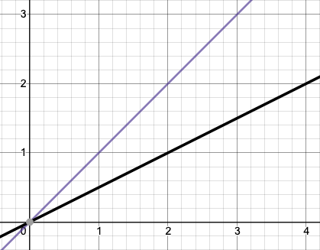
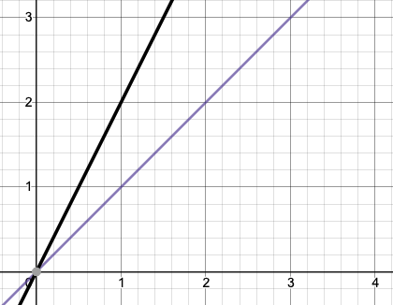
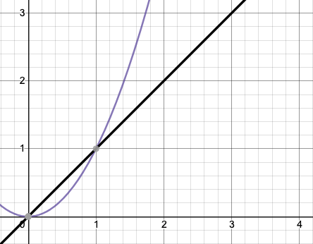
Review Big-Oh Definition
$f(n)$ is $O(g\left(n\right))$ if there exist positive constants $c, n_{0}$ such that for all $n≥n_{0}$,
$$f\left(n\right)≤c⋅g\left(n\right)$$
Big-Oh
Intuitively, f(n) is O(g(n)) if it’s smaller than a constant factor of g(n), asymptotically
To prove that, all we need is:
(c): What is the constant factor?
(n₀): From what point onward is f(n) smaller?
f(n) = 0.5n
is O(
g(n) = n
)
f(n) = 2n
is O(
g(n) = n
)
f(n) = n
is O(
g(n) = n²
)
n
n
n
Proof: c=5 n₀=0
Proof: c=2 n₀=0
Proof: c=4 n₀=6
0.5n always ≤ n!
Straightforward O(n).
Just need to use constant factor c=2 so 2n ≤ c $⋅$ n
n ≤ n², but only after n=1. Choose that as n₀.

Slide 13
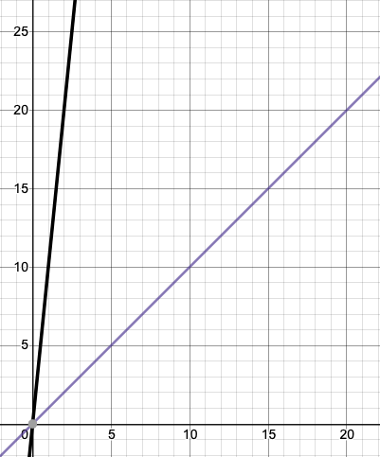
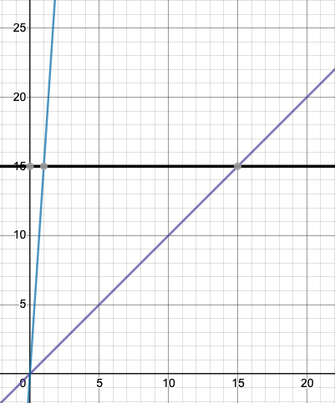
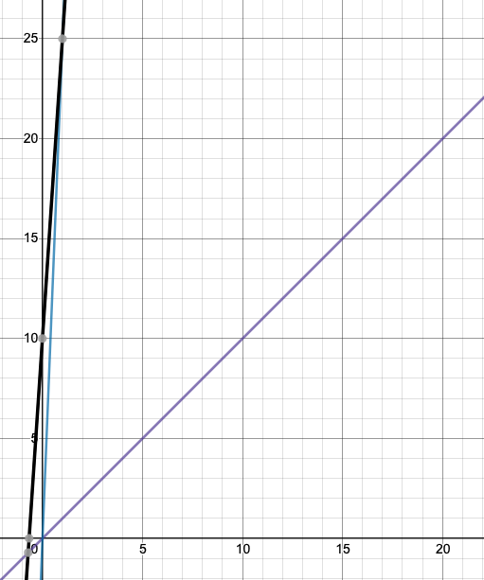
Review What about Multiple Terms?
f(n) = 10n
is O(
g(n) = n
)
f(n) = 15
is O(
g(n) = n
)
f(n) = 15n+10
is O(
g(n) = n
)
+
=
n
n
n
Proof: c=10 n₀=0
Proof: c=15 n₀=1
Proof: c=25 n₀=1
Just need to use constant factor c=10 so 10n ≤ c $⋅$ n
One way: use c=15, then 15 ≤ 15n becomes true starting at n=1
Just add up the proofs we came up with for individual terms!

Slide 14
Uncharted Waters: Prime Checking
Find a model $f\left(n\right)$ for the running time of this code on input $n →$ What’s the Big-O?
We know how to count the operations
But how many times does this loop run?
Sometimes it can stop early
Sometimes it needs to run n times
boolean isPrime(int n) {
int toTest = 2;
while(toTest < n) {
if (n % toTest == 0) {
return false;
} else {
toTest += 1;
}
}
return true;
}
+1
+1
+2
+1
~+5
*?
+2
+1

Slide 15
Prime Checking Runtime
$$f(n)$$
Is the runtime O(1) or O(n)?
More than half the time we need 3 or fewer iterations. Is it O(1)?
But we can always come up with another value of n to make it take n iterations. So O(n)?
This is why we have definitions!

Slide 16
$f(n)$ is $O(g\left(n\right))$ if there exist positive constants $c, n_{0}$ such that for all $n≥n_{0}$,
$$f\left(n\right)≤c⋅g\left(n\right)$$
Big-O
$$f(n)$$
Using our definitions, we see it’s O(n) and not O(1)
Is the runtime O(1)?
Can you find constants $c$ and $n_{0}$?
No! Choose your value of $c$. I can find a prime number $k$bigger than $c.$
And $f\left(k\right)=k>c⋅1$ so the definition isn’t met!
Is the runtime O(n)?
Can you find constants $c$ and $n_{0}$?
How about $c=1$ and $n_{0}=5$,
$f\left(n\right)=$smallest divisor of $n≤1⋅n$ for $n≥5$

Slide 17
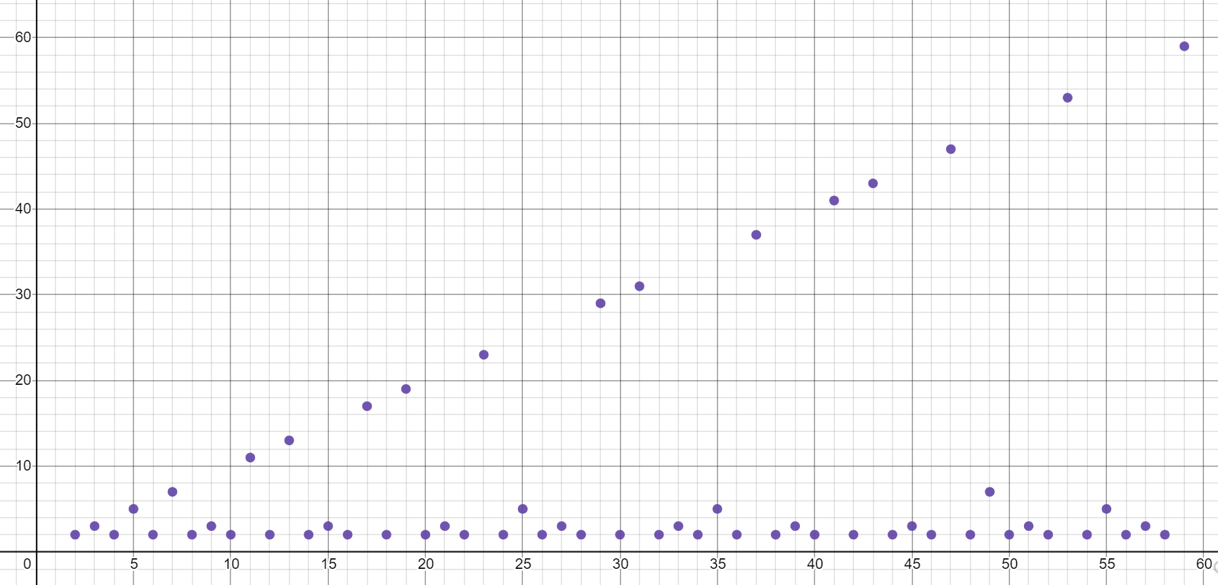
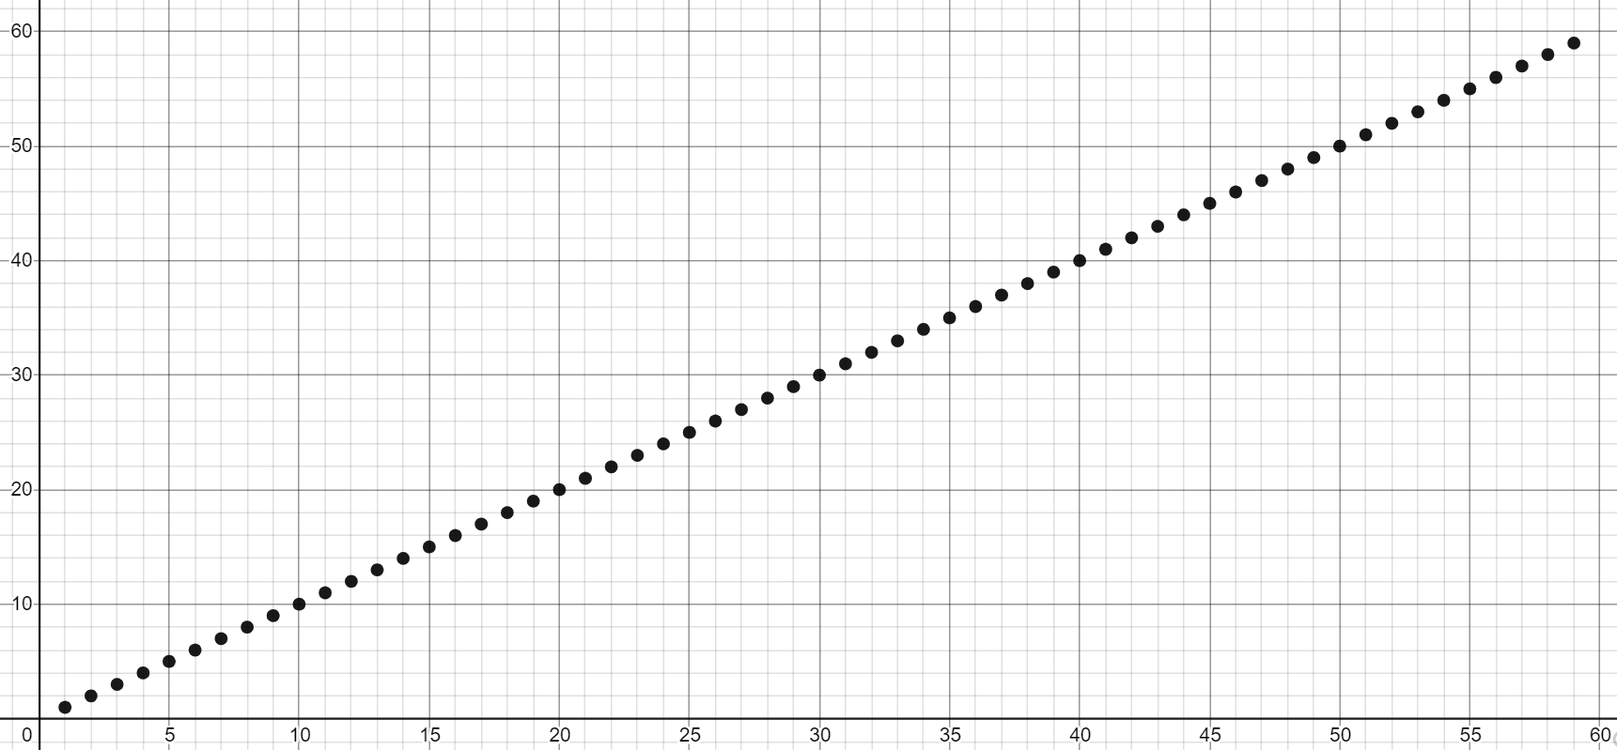
Big-Oh isn’t everything
Our prime finding code is O(n) as a tight bound. But so is printing all the elements of a list (a basic for loop).
$$O(n)$$
$$O(n)$$
Your experience running these two pieces of code is going to be very different.
It’s disappointing that the Big-Ohs are the same – that’s not very precise!
Could we have some way of pointing out the list code always takes AT LEAST $n$ operations?

Slide 18
Big-$Ω$ [Omega]
$f(n)$ is $Ω(g\left(n\right))$ if there exist positive constants $c, n_{0}$ such that for all $n≥n_{0}$,
$$f\left(n\right)≥c⋅g\left(n\right)$$
Big-Omega
$f(n)$ is $O(g\left(n\right))$ if there exist positive constants $c, n_{0}$ such that for all $n≥n_{0}$,
$$f\left(n\right)≤c⋅g\left(n\right)$$
Big-O
The formal definition of Big-Omega is the flipped version of Big-Oh!
“f(n) is O(g(n))” : f(n) grows at most as fast as g(n)
“f(n) is $Ω$(g(n))” : f(n) grows at least as fast as g(n)
$$O(n)$$
$$Ω(1)$$

Slide 19
Big-Omega Also Doesn’t Have to be Tight
2n³
$2n^{3} is Ω($1)
${2n}^{3} is Ω(n$)
$2n^{3} is Ω(n^{2})$
${2n}^{3} is Ω(n^{3})$
$2n^{3} is lowerbounded by all the complexity classes listed above (1, n,n^{2},n^{3})$
$$T\left(n\right)$$
n³
n²
n
1
$$n$$

Slide 20
Examples
$f(n)$ $∈$ $O(g\left(n\right))$ if there exist positive constants $c, n_{0}$ such that for all $n≥n_{0}$,
$$f\left(n\right)≤c⋅g\left(n\right)$$
Big-O
4n² ∈ O(1)
false
4n² ∈ O(n)
false
4n² ∈ O(n²)
true
4n² ∈ O(n³)
true
4n² ∈ O(n⁴)
true
4n² ∈ Ω(1)
true
4n² ∈ Ω(n)
true
4n² ∈ Ω(n²)
true
4n² ∈ Ω(n³)
false
4n² ∈ Ω(n⁴)
false
$f(n)$ $∈ Ω(g\left(n\right))$ if there exist positive constants $c, n_{0}$ such that for all $n≥n_{0}$,
$$f\left(n\right)≥c⋅g\left(n\right)$$
Big-Omega

Slide 21
Tight Big-O and Big-$Ω$ Bounds Together
Prime runtime function
f(n) = n
$$O(n)$$
$$O(n)$$
$Ω$(1)
$Ω$(n)
Note: most functions look like the one on the right, with the same tight Big-Oh and Big-Omega bound. But we’ll see important examples of the one on the left.

Slide 22
Oh, and Omega, and Theta, oh my
$f(n)$ is $O(g\left(n\right))$ if there exist positive constants $c, n_{0}$ such that for all $n≥n_{0}$,
$$f\left(n\right)≤c⋅g\left(n\right)$$
Big-Oh
Big-Oh is an upper bound
My code takes at most this long to run
Big-Omega is a lower bound
My code takes at least this long to run
Big Theta is “equal to”
My code takes “exactly”* this long to run
*Except for constant factors and lower order terms
Only exists when Big-Oh == Big-Omega!
$f(n)$ is $Ω(g\left(n\right))$ if there exist positive constants $c, n_{0}$ such that for all $n≥n_{0}$,
$$f\left(n\right)≥c⋅g\left(n\right)$$
Big-Omega
Big-Theta
$f(n)$ is $Θ(g\left(n\right))$ if
$f\left(n\right)$ is $O(g\left(n\right))$ and $f\left(n\right)$ is $Ω(g\left(n\right))$.
(in other words: there exist positive constants $c1, c2, n_{0}$ such that for all $n≥n_{0}$)
$c1⋅g\left(n\right)≤f\left(n\right)$ $≤c2⋅g\left(n\right)$

Slide 23
Oh, and Omega, and Theta, oh my
Big-Theta
Big Theta is “equal to”
My code takes “exactly”* this long to run
*Except for constant factors and lower order terms
$f(n)$ is $Θ(g\left(n\right))$ if
$f\left(n\right)$ is $O(g\left(n\right))$ and $f\left(n\right)$ is $Ω(g\left(n\right))$.
(in other words: there exist positive constants $c1, c2, n_{0}$ such that for all $n≥n_{0}$)
$c1⋅g\left(n\right)≤f\left(n\right)$ $≤c2⋅g\left(n\right)$
f(n) = n
To define a big-Theta, you expect the tight big-Oh and tight big-Omega bounds to be touching on the graph (the same complexity class)
$$O(n)$$
$Ω$(n)
$$Θ(n)$$

Slide 24
Our Upgraded Tool: Asymptotic Analysis
TIGHT
BIG-OH
2
O(n²)
RUNTIME
FUNCTION
BIG-THETA
Asymptotic
Analysis
Θ(n²)
f(n) = 10n² + 13n + 2
TIGHT
BIG-OMEGA
$Ω$(n²)
We’ve upgraded our Asymptotic Analysis tool to convey more useful information! Having 3 different types of bounds means we can still characterize the function in simple terms, but describe it more thoroughly than just Big-Oh.

Slide 25
Our Upgraded Tool: Asymptotic Analysis
TIGHT
BIG-OH
2
O(n)
RUNTIME
FUNCTION
BIG-THETA
Asymptotic
Analysis
Does not exist for this function
$$f(n)$$
TIGHT
BIG-OMEGA
$Ω$(1)
Big-Theta doesn’t always exist for every function! But the information that Big-Theta doesn’t exist can itself be a useful characterization of the function.
isPrime()

Slide 26
Algorithmic Analysis Roadmap
TIGHT
BIG-OH
2
1
O(n)
CODE
RUNTIME
FUNCTION
BIG-THETA
Asymptotic
Analysis
Code Modeling
Θ(n)
for (i = 0; i < n; i++) {
a[i] = 1;
b[i] = 2;
}
f(n) = 2n
TIGHT
BIG-OMEGA
$Ω$(n)
Now, let’s look at this tool in more depth. How exactly are we coming up with that function?
We just finished building this tool to characterize a function in terms of some useful bounds!

Slide 27
Lecture Outline
Big-O, Big-Omega, Big-Theta
Case Study: Linear Search
A New Tool: Case Analysis

Slide 28
Case Study: Linear Search
Let’s analyze this realistic piece of code!
toFind
2
int linearSearch(int[] arr, int toFind) {
for (int i = 0; i < arr.length; i++) {
if (arr[i] == toFind) {
return i;
}
}
return -1;
}
arr
2 | 3 | 9 | 4 | 5
i
toFind
8
arr
2 | 3 | 9 | 4 | 5
What’s the first step?
We have code, so we need to convert to a function describing its runtime
Then we know we can use asymptotic analysis to get bounds
i

Slide 29
Let’s Model This Code!
*Remember, these constants don’t really matter (we’ll start phasing them out soon)
int linearSearch(int[] arr, int toFind) {
for (int i = 0; i < arr.length; i++) {
if (arr[i] == toFind) {
return i;
}
}
return -1;
}
Same problem as before: How many times does loop run?
+2
+1
+1
+3
*?
+1
When would that happen?
Suppose the loop runs n times?
f(n) = 3n + 1
Suppose the loop only runs once?
f(n) = 2
toFind not present
These are key!
toFind at beginning

Slide 30
Best Case
Worst Case
On Lucky Earth
On Unlucky Earth (where it’s 2020 every year)
toFind
2
toFind
8
arr
2 | 3 | 9 | 4 | 5
arr
2 | 3 | 9 | 4 | 5
i
i
f(n) = 2
f(n) = 3n + 1
After asymptotic analysis:
After asymptotic analysis:
O(1)
Θ(1)
$Ω$(1)
O(n)
Θ(n)
$Ω$(n)
Notes:
Each case results in its OWN runtime function, which can then be fed into asymptotic analysis

Slide 31
Lecture Outline
Big-O, Big-Omega, Big-Theta
Case Study: Linear Search
A New Tool: Case Analysis

Slide 32
Case Analysis
Case: a description of inputs/state for an algorithm that is specific enough to build a code model (runtime function) whose only parameter is the input size
Case Analysis is our tool for reasoning about all variation other than n!
Occurs during the code → function step instead of function → O/Ω/Θ step!
(Best Case: fastest/Worst Case: slowest) that our code could finish on input of size n.
Importantly, any position of toFind in arr could be its own case!
For this simple example, probably don’t care (they all still have bound O(n))
But intermediate cases will be important later
Worst
Other Cases
Best

Slide 33
Should we consider the prime/not-prime input separate cases in our isPrime analysis?
Yes
No

Slide 34
When to do Case Analysis?
Why are the different functions in isPrime not Case Analysis, but the different functions in linearSearch are?
In isPrime, they’re different bounds on a single function over n.
in linearSearch, they’re entirely different functions over n, each with its own set of bounds!
The difference? linearSearch uses another input as well, the contents of the array – that variation creates different functions over n!
boolean isPrime(int n) {
int linearSearch(int[] arr, int toFind) {

Slide 35
When to do Case Analysis?
Case Analysis, then Asymptotic Analysis
Straight to Asymptotic Analysis
linearSearch:
multiple different functions over n, because runtime can be affected by something other than n!
for each function, we’ll do asymptotic analysis
isPrime:
- only has one function to consider, because only input is n!
$$O(n)$$
$$O(n)$$
f(n) (isPrime)
$$Θ(n)$$
$$Ω(n)$$
Best Case of linearSearch
f(n) = 2
$$Ω(1)$$
$$O(1)$$
Worst Case
f(n) = 3n + 1
$$Θ(1)$$
$$Ω(1)$$
Do Case Analysis when varying other input properties besides n can change runtime!

Slide 36
When to do Case Analysis?
Imagine a 3-dimensional plot
Which case we’re considering is one dimension
Choosing a case lets us take a “slice” of the other dimensions: n and f(n)
We do asymptotic analysis on each slice in step 2
f(n)
n
At front
(Best Case)
Not present
(Worst Case)
toFind position

Slide 37
Other Useful Cases You Might See
Overall Case:
Model code as a “cloud” that covers all possibilities across all cases. What’s the O/Ω/Θ of that cloud?
“Assume X Won’t Happen Case”:
E.g. Assume array won’t need to resize
“Average Case”:
Assume random input
Lots of complications – what distribution of random?
“In-Practice Case”:
Not a real term, but a useful idea
Make reasonable assumptions about how the world will work, then do worst-case analysis under those assumptions.
Worst
Overall
Other Cases
Best

Slide 38
Algorithmic Analysis Roadmap
TIGHT
BIG-OH
2
O(1)
BEST CASE
FUNCTION
BIG-THETA
1
Asymptotic
Analysis
f(n) = 2
Θ(1)
CODE
WORST CASE
FUNCTION
TIGHT
BIG-OMEGA
Case Analysis
$Ω$(1)
f(n) = 3n+1
OTHER CASE
FUNCTION
for (i = 0; i < n; i++) {
if (arr[i] == toFind) {
return i;
}
}
return -1;

Slide 39
How Can You Tell if Best/Worst Cases Exist?

Slide 40
How Can You Tell if Best/Worst Cases Exist?
Are there other possible models for this code?
If n is given, are there still other factors that determine the runtime?
Note: sometimes there aren’t significantly different cases! Sometimes we just want to model the code with a single function and go straight to asymptotic analysis!

Slide 41
Can We Choose n=0 as the Best Case?

Slide 42
Can We Choose n=0 as the Best Case?
Remember that each case needs to be a “slice”: a function over n
The input to asymptotic analysis is a function over all of n, because we’re concerned with growth rate
Fixing n doesn’t work with our tools because it wouldn’t let us examine the bound asymptotically
Think of it as “Best Case as n grows infinitely large”, not “Best Case of all inputs, including n”

Slide 43
How to do Case Analysis
Are there significantly different cases?
Do other variables/parameters/fields affect the runtime, other than input size? For many algorithms, the answer is no.
Figure out how things could change depending on the input (excluding n, the input size)
Can you exit loops early?
Can you return early?
Are some branches much slower than others?
Determine what inputs could cause you to hit the best/worst parts of the code.

Slide 44
Cases vs. Asymptotic
 | Big-O | Big-Omega | Big-Theta
Worst Case | No matter what, as $n$ gets bigger, the code takes at most this much time | Under certain circumstances, as $n$ gets bigger, the code takes at least this much time | On the worst input, as $n$ gets bigger, the code takes precisely this much time (up to constants).
Best Case | Under certain circumstances, even as $n$ gets bigger, the code takes at most this much time. | No matter what, even as $n$ gets bigger, the code takes at least this much time. | On the best input, even as $n$ gets bigger, the code takes precisely this much time (up to constants)
“worst input”: input that causes the code to run slowest.

Slide 45
Cases vs. Asymptotic
 | Big-O | Big-Omega | Big-Theta
Worst Case | No matter what, as $n$ gets bigger, the code takes at most this much time | Under certain circumstances, as $n$ gets bigger, the code takes at least this much time | On the worst input, as $n$ gets bigger, the code takes precisely this much time (up to constants).
Best Case | Under certain circumstances, even as $n$ gets bigger, the code takes at most this much time. | No matter what, even as $n$ gets bigger, the code takes at least this much time. | On the best input, even as $n$ gets bigger, the code takes precisely this much time (up to constants)
“worst input”: input that causes the code to run slowest.

Slide 46
Cases vs. Asymptotic
 | Big-O | Big-Omega | Big-Theta
Worst Case | No matter what, as $n$ gets bigger, the code takes at most this much time | Under certain circumstances, as $n$ gets bigger, the code takes at least this much time | On the worst input, as $n$ gets bigger, the code takes precisely this much time (up to constants).
Best Case | Under certain circumstances, even as $n$ gets bigger, the code takes at most this much time. | No matter what, even as $n$ gets bigger, the code takes at least this much time. | On the best input, even as $n$ gets bigger, the code takes precisely this much time (up to constants)
“worst input”: input that causes the code to run slowest.

