Slide 1
P vs. NP
BEFORE WE START

Slide 2
Learning Objectives
After this lecture, you should be able to...
This lecture is optional! It will cover some cool and modern applications of the things we have learned so far but is not part of the ”core” material for CSE 373. Therefore, we won’t highlight learning objectives since this is focused more on showing off a cool topic!

Slide 3
Lecture Outline
2-SAT and 2-Coloring
Efficiency, P vs. NP
More Complex: NP-Complete, NP-Hard

Slide 4
2-SAT
Given a Boolean formula over Boolean variables
(A || !B) && (!A || B) && (!A || !B) && (A || !C)
Is there a setting of these variables to make this formula true?
Called a satisfiability problem.
2-SAT is a specific satisfiability problem where each part of the formula uses at most 2 terms.
Fact: There is an efficient algorithm to solve 2-SAT.

Slide 5
2-Coloring
Given a graph, determine if it is possible to color the vertices such that no two vertices that share an edge have the same color.
C
B
C
B
E
E
A
A
D
D

Slide 6
2-Coloring
Why would we care about coloring a graph?
Need to divide vertices into two sets, and edges represent conflicts
Could come up with a new algorithm to solve this problem (a modified BFS, a good exercise to try). Instead, let’s solve this with a reduction.
Big Idea
Reduce 2-Coloring to 2-SAT

Slide 7
Review Reductions
P INPUT
A reduction is a problem-solving strategy that involves using an algorithm for problem Q to solve a different problem P
Rather than modifying the algorithm for Q, we modify the inputs/outputs to make them compatible with Q!
“P reduces to Q”
1. Convert input for P into input for Q
2. Solve using algorithm for Q
3. Convert output from Q into output from P
Q INPUT
PROBLEM P
PROBLEM Q
Q OUTPUT
P OUTPUT

Slide 8
Reduction: 2-Coloring to 2-SAT
Need to describe 2 steps:
Turn a graph for a 2-color problem into an input to 2-SAT
How to turn the ANSWER for that 2-SAT input into the answer for the original 2-coloring problem.
Idea: Encode a variable for each vertex like v1IsRed. Then to make sure two neighboring vertices have different colors, use a formula
(v1IsRed || v2IsRed) && (!v1IsRed || !v2IsRed)

Slide 9
How To Perform Topo Sort?
Transform Input
B
C
(AisRed||BisRed)&&(!AisRed||!BisRed)
(AisRed||DisRed)&&(!AisRed||!DisRed)
(BisRed||CisRed)&&(!BisRed||!CisRed)
(BisRed||EisRed)&&(!BisRed||!EisRed)
(DisRed||EisRed)&&(!DisRed||!EisRed)
A
E
D
2-SAT Algorithm
AisRed = True
BisRed = False
CisRed = True
DisRed = False
EisRed = True
Transform Output
B
C
A
E
D

Slide 10
Context
Saw that reductions can be a powerful tool in solving seemingly unrelated problems.
We will also use reductions as a powerful theoretical tool in proving relationships between problems.
Preview for rest of class:
If we change 2-SAT to 3-SAT and 2-Coloring to 3-Coloring, the reduction remains essentially the same. So far, there are no known efficient algorithms to solve 3-SAT.
If you came up with an efficient 3-SAT algorithm, you will be able to solve a HUGE set of currently intractable problems including, but not limited to:
Traveling Salesperson Problem
Folding proteins (inventing new medications)
Scheduling UW classes in classrooms to optimize for student demand

Slide 11
Lecture Outline
2-SAT and 2-Coloring
Efficiency, P vs. NP
More Complex: NP-Complete, NP-Hard

Slide 12
Efficiency
So far, we have talked about the efficiency of a particular algorithm. Two noticeable differences in our discussion today:
We will talk about a problem being efficiently solvable if an efficient algorithm exists to solve it.
We will use a loose definition of efficient: Any polynomial runtime!
Claim: A polynomial time algorithm runs in time $O(n^{k})$ where $k$ is some constant. We consider polynomial time algorithms to be efficient.
Are they always efficient? Well…. no. Your $O(n^{1000})$ algorithm isn’t really efficient.
These extreme cases are rare, but we could say that polynomial is an absolute minimum qualification to be efficient. A good “low bar”

Slide 13
Running Times
We care about this distinction between polynomial time or not since it’s a VERY strong heuristic for if you can reasonably find a solution to a problem.
A (somewhat old) table from Rosen. Very long means 10²⁵ years.

Slide 14
Aside Decision Problems
To be a bit pedantic, everything we are going to talk about today only applies to decision problems. These are problems where the answer is yes/no.
Why?
Mostly definitional reasons and it’s hard to change lots of research using one definition.
Almost any problem can be rephrased as a similar decision problem.
Instead of ”How do we 2-color this graph?” ask “Can we 2-color this graph?”
Instead of “Find the shortest path from s to t” ask “Is there are shortest path from s to t of length at most k?”
We will be a bit hand-wavy in this lecture and not focus too much on the decision aspects of these problems, but we thought it was important to mention.

Slide 15
P
The set of all decision problems that have an algorithm that runs in time $O(n^{k})$ for some constant $k$
The decision version of most problems we’ve seen in this class are in P.
If we saw a poly time algorithm to solve it, its decision counterpart will be in P.
P is an example of a complexity class. A class problems that share some characteristic in terms of how difficult it is to solve them.
P is generally referred to as “problems that can be solved efficiently”.
P (stands for “Polynomial”)

Slide 16
I’ll Know it When I See It
Another class of problems that we can efficiently verify a solution to. “I’ll Know it When I See it” Problems.
These are decision problems such that
If the answer is YES, you can verify a potential solution to the problem does result in a YES result.
This verification takes polynomial time.
Examples:
If you are a claimed 2-coloring of a graph, you can verify in polynomial that the claimed coloring is a valid 2-colorin
If someone claims they have a path in a graph of length at most k, you can verify that claim by checking the path itself in poly time.

Slide 17
NP
The set of all decision problems such that if the answer is YES, there is a proof of that which can be verified in polynomial time.
It is a very common misconception that NP stands for “not polynomial”.
Please don’t say that. Please!
Every time this is said, a theoretical computer scientist somewhere sheds a tear.
NP is another complexity class.
Intuition: P is the set of decision problems we can solve in poly time. NP is the set of decision problems we can verify in poly time if an answer makes the decision YES.
NP (stands for “Nondeterministic Polynomial”)

Slide 18
Aside Nondeterministic Polynomail
Where the heck does that name come from and why did no one have the foresight to know people would think NP stands for “not polynomial”?
The concept of a nondeterministic computer is an important concept in CS theory. It’s the concept of having a computer that “knows” the right step to take at each time (or equivalently, exploring all paths at once).
It’s not something we can use in practice, but in theory shows up frequently in statements about computability and efficiency.

Slide 19
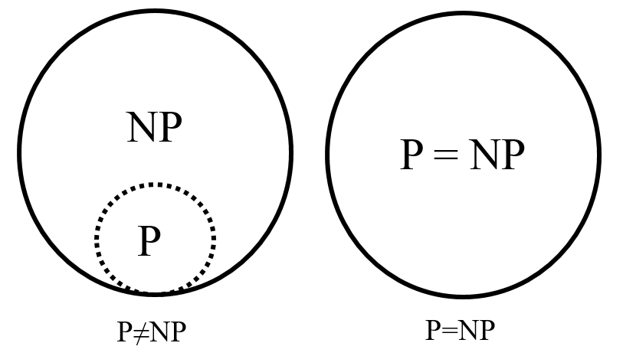
P vs. NP
The fundamental question for computer scientists is answering how P and NP relate to each other.
It’s pretty easy to show that $P⊆NP$. If you efficiently solve a problem, then you can use that solver if you want to verify an answer. In other words, efficiently solving implies there is an efficient verification.
The big question is: Is P = NP?
Most computer scientists think no.
Verifying a solutions to problems seems fundamentally easier than solving the problem itself.
No one has proven this though!

Slide 20
Why should you care about P vs NP?
Even though most of us are convinced $P≠NP$, why do people care?
It’s your chance to:
$1,000,000. The Clay Mathematics Institute will give a million dollars to whoever solves P vs. NP (or any of their other 5 problems).
To get a Turing Award the Turing Award renamed after you.

Slide 21
Why should you Care if P = NP?
Suppose P = NP. Specifically, that you found an efficient algorithm for one of these “NP-complete” problems (next video). What would you do?
Get $1,000,000 from the Clay Math Institute. But what’s next?
Put mathematicians out of work
Decrypt (essentially) all current internet communication.
No more secure online shopping, banking or messaging, or really online anything.
Maybe find the cure for cancer?
A world where P = NP is a very very different place from the world we live now.

Slide 22
Why Should you Care if $P≠NP$?
We already expect this is the case, why prove it?
Tells us something fundamental about the universe and computation.
For some questions, there is not a clever way to find the right answer.
Even though you’ll know the answer once you see it.
To prove $P≠NP$, we need to better understand differences between problems.
Why do some problems allow easy solutions and other don’t?
What is the structure of these problems?
We don’t care about P vs. NP just because it has a huge effect on what the world looks like (even though that’s one reason). We will learn a LOT about computation along the way.

Slide 23
Lecture Outline
2-SAT and 2-Coloring
Efficiency, P vs. NP
More Complex: NP-Complete, NP-Hard

Slide 24
P vs. NP
Most computer scientists thing $P≠NP$. No one has proven this yet, but there is an important subset of NP that will be useful when it comes to understand the hardness of problems.
To prove $P≠NP$, “all you have to do” is show there is a problem in NP that requires exponential time to solve.
We know lots of problems that we only currently have exponential algorithms for, but that doesn’t mean there is some unknown efficient algorithm we haven’t found yet!
Before we introduce these other sets of problems, we have to make one clarification to the idea of reductions.

Slide 25
Reductions (again)
To talk about hardness of problems in NP, we need to bring back the idea of reductions to solve problems. One addition to the idea of a reduction is the idea of an efficient reduction.
All this means is the reduction itself is totally polynomial.
If the runtime of the algorithm for B is also polynomial time, then this whole procedure is polynomial.
If A reduces to B, then A should be “easier” than B.
If we can solve B, we can definitely solve A.
Usually denoted $A≤_{P}B$
Polynomial Time Reducible
We say A reduces to B in polynomial time, if there is an algorithm for A that:
Calls a black box for B at most a polynomial number of times
Runs at most a polynomial number of other operations

Slide 26
NP-complete
If we want to prove there is a problem in NP that isn’t in P, we should probably pick the hardest one we can think of!
What is the hardest problem in NP?
Any problem you can prove is NP-complete is one of the hardest problems in NP (since all problems in NP reduce to it)
Problem B is NP-complete if:
B is in NP and
For all problems A in NP, A reduces to B in polynomial time
NP-complete

Slide 27
Why NP-complete?
Seems like the right place to start to prove $P≠NP$. If it’s the hardest problem in NP, it’s probably the one that requires that highest runtime.
Turns out, it’s also the right place to start for proving $P=NP$!
If you can find a polynomial time algorithm for one NP-complete problem, it gives you a polynomial time algorithm for every problem in NP.

Slide 28
Examples
There are literally thousands of NP-complete problems. Some look weirdly similar to problems we care about or ones that we have efficient algorithms for.
In P NP-complete
Short Path
Given a directed graph, report if there is a path from s to t of length at most k.
Long Path
Given a directed graph, report if there is a path from s to t of length at least k.

Slide 29
Examples
There are literally thousands of NP-complete problems. Some look weirdly similar to problems we care about or ones that we have efficient algorithms for.
In P NP-complete
Light Spanning Tree
Given a weighted graph, report of there is a spanning tree of weight at most k.
Traveling Salesperson
Given a weighted graph, find a tour (cycle that visits every vertex once before returning to start) of weight at most k.

Slide 30
Examples
There are literally thousands of NP-complete problems. Some look weirdly similar to problems we care about or ones that we have efficient algorithms for.
In P NP-complete
2-SAT
Given a Boolean formula of the form “at least one of two must be true”, determine if a setting of variables can make the whole formula true.
3-SAT
Given a Boolean formula of the form “at least one of three must be true”, determine if a setting of variables can make the whole formula true.

Slide 31
NP-complete
If you find an efficient algorithm for an NP-complete problem, you have an efficient algorithm for every problem in NP.
Started with Cook-Levin Theorem (1971) that proved that SAT (general version of 3-SAT) is NP-complete. A year later…

Slide 32
NP-complete
But wait! There’s more!
By 1979, at least 300 problems had been proven NP-complete.
Garey and Johnson wrote a textbook with 100 pages listing known NP-complete problems.
No one has made a super comprehensive list since, but there are literally thousands and there are new ones found each year.

Slide 33
NP-Hard
Problem B is NP-complete if:
For all problems A in NP, A reduces to B in polynomial time
NP-hard
NP-hard are the problems that are “at least as hard as the hardest problems in NP”.
NP-complete = NP and NP-hard.
Many problems that are in NP-hard that aren’t in NP (i.e. no efficient verification). The edges of NP-hard is the “there be dragons” of our problem space.
Determining if you can win a game of n x n chess (really hard).
Determining if your P2 code is stuck in an infinite loop or just taking a long time to run (undecidable).

Slide 34
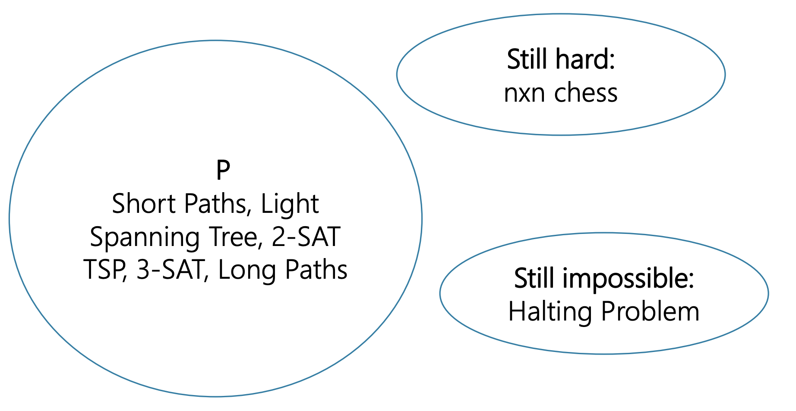
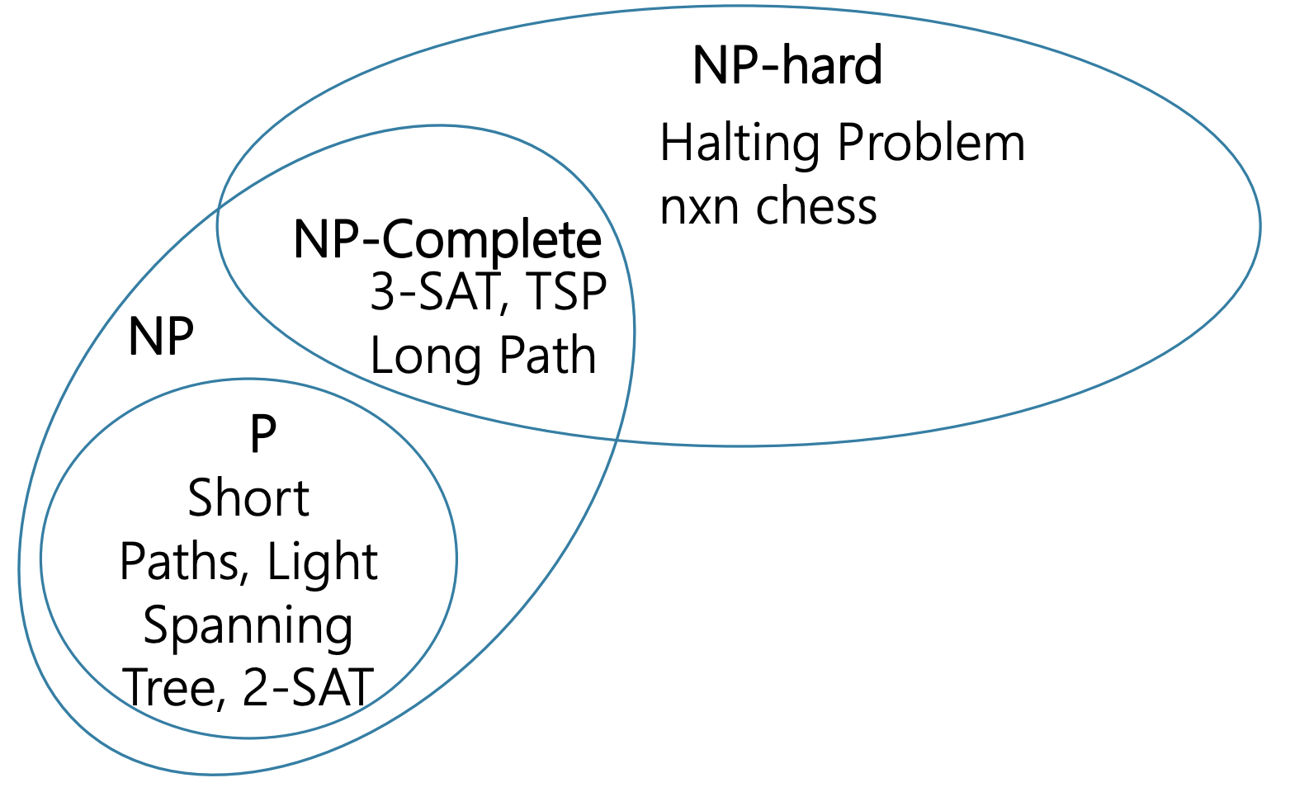
WorldView
If $P≠NP$ (what we think) If $P=NP$

Slide 35
NP-complete in Practice
Since it’s unlikely that P = NP, if you know your problem is NP-complete you likely can’t solve it efficiently. Three common options:
Maybe it’s a special case we understand better.
While SAT is NP-complete, 2-SAT is not!
Even if a problem is NP-complete, ”nice” instances might exist that can be solved quickly.
Common: Reduce your problem to a SAT instance and us a SAT-solver to help you solve it quickly (worst case, still might be exponential)
Approximation Algorithms: Just like with TSP, make an efficient algorithm that can approximately compute an answer if only an approximate guess is good enough.

