Slide 1
Lecture 14: Midterm Review
Data Structures and Algorithms

Slide 2
Administrivia
Snow delays
  you get 3 more late days for the quarter
  you may now turn in any assignment up to 72 hours after deadline instead of 48 hours
HW 4 is due Friday
  turn in via grade scope, you have been added
  We are moving to Piazza!
  https://piazza.com/class/js313vs4yym1tg
  You have all been added
Midterm Prep
  Attend section tomorrow, solutions have already been posted
  Erik filmed a review session, check it out
  I am posting another set of “Monday” slides
  HW 4 is midterm review
HW 5 goes out Friday
  Partner form due Thursday 11:59pm

Slide 3
A message about grades…

Slide 4
Midterm Logistics
50 minutes
8.5 x 11 in note page, front and back
Math identities sheet provided (see posted on website)
We will be scanning your exams to grade…
  Do not write on the back of pages
  Try not to cram answers into margins or corners

Slide 5
Midterm Topics
ADTs and Data Structures
  Lists, Stacks, Queues, Maps/Dictionaries
  Array vs Node implementations of each
Asymptotic Analysis
  Proving Big-O by finding a c and N_0
  Modeling code runtime with math functions, including recurrences and summations
  Finding closed form of recurrences using unrolling, tree method and master theorem
  Looking at code models and giving Big O runtimes
  Definitions of Big O, Big Omega, Big Theta
BST and AVL Trees
  Binary Search Property, Balance Property
  Insertions, Retrievals
  AVL rotations
Hashing
  Understanding hash functions
  Insertions and retrievals from a table
  Collision resolution strategies: chaining, linear probing, quadratic probing, double hashing
Heaps
  Heap properties
  Insertions, retrievals while maintaining structure with bubbling up
Homework
  ArrayDictionary
  DoubleLinkedList
  ChainedHashDictionary
  ChainedHashSet
NOT on the exam
  Memory and Locality
  B-Trees
  JUnit specifics and JUnit syntax

Slide 6
Asymptotic Analysis

Slide 7
Asymptotic Analysis
asymptotic analysis – the process of mathematically representing runtime of a algorithm in relation to the number of inputs and how that relationship changes as the number of inputs grow
Two step process
Model – the process of mathematically representing how many operations a piece of code will run in relation to the number of inputs n
Analyze – compare runtime/input relationship across multiple algorithms
  Graph the model of your code where x = number of inputs and y = runtime
  For which inputs will one perform better than the other?

Slide 8


Code Modeling
code modeling – the process of mathematically representing how many operations a piece of code will run in relation to the number of inputs n
Examples:
  Sequential search
  Binary search
$$f\left(n\right)=n$$
$$f\left(n\right)=log2n$$
What counts as an “operation”?
Basic operations
  Adding ints or doubles
  Variable assignment
  Variable update
  Return statement
  Accessing array index or object field
Consecutive statements
  Sum time of each statement
Assume all operations run in equivalent time
Function calls
  Count runtime of function body
Conditionals
  Time of test + worst case scenario branch
Loops
  Number of iterations of loop body x runtime of loop body

Slide 9
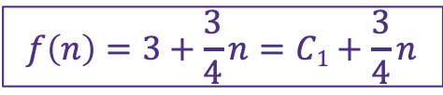
Code Modeling
public int mystery(int n) {
int result = 0;
for (int i = 0; i < n/2; i++) {
result++;
}
for (int i = 0; i < n/2; i+=2) {
result++;
}
result * 10;
return result;
}
+1
n/2
+1
n/4
+1
+1
$$f\left(n\right)=3+\frac{3}{4}n=C1+\frac{3}{4}n$$
+1

Slide 10

Code Modeling Example
public String mystery (int n) {
ChainedHashDictionary<Integer, Character> alphabet =
new ChainedHashDictionary<Integer, Character>();
for (int i = 0; i < 26; i++) {
char c = ‘a’ + (char)i;
alphabet.put(i, c);
}
DoubleLinkedList<Character> result = new DoubleLinkedList<Character>();
for (int i = 0; i < n; i += 2) {
char c = alphabet.get(i);
result.add(c);
}
String final = “”;
for (int i = 0; i < result.size(); i++) {
final += result.remove();
}
return final;
}
+1
+26c
+1
+26c
n/2
+1
+1
+1
n/2
+1
$$f\left(n\right)=4+26+27\left(\frac{n}{2}\right)+\frac{n}{2}=C_{1}+C_{2}n$$

Slide 11









Function growth
Imagine you have three possible algorithms to choose between.
Each has already been reduced to its mathematical model
$$f\left(n\right)=n$$
$$g\left(n\right)=4n$$
$$h\left(n\right)=n^{2}$$
$$T\left(n\right)$$
$$T\left(n\right)$$
$$T\left(n\right)$$
$$n$$
$$n$$
$$n$$
The growth rate for f(n) and g(n) looks very different for small numbers of input
…but since both are linear eventually look similar at large input sizes
But for very small input values h(n) actually has a slower growth rate than either f(n) or g(n)
whereas h(n) has a distinctly different growth rate

Slide 12
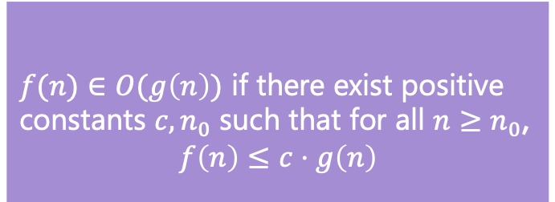
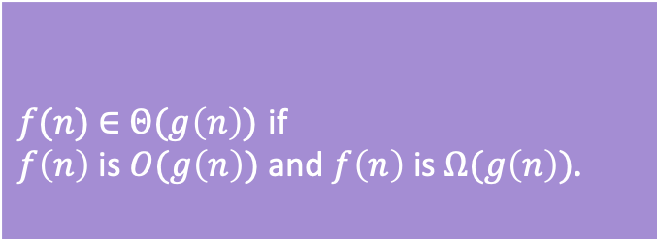
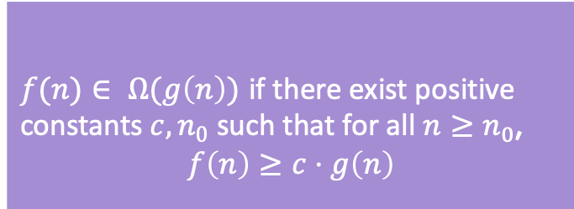
O, Ω, Θ Definitions
O(f(n)) is the “family” or “set” of all functions that are dominated by f(n)
  f(n) ∈ O(g(n)) when f(n) <= g(n)
  The upper bound of an algorithm’s function
Ω(f(n)) is the family of all functions that dominate f(n)
  f(n) ∈ Ω(g(n)) when f(n) >= g(n)
  The lower bound of an algorithm’s function
Θ(f(n)) is the family of functions that are equivalent to f(n)
  We say f(n) ∈ Θ(g(n)) when both
  f(n) ∈ O(g(n)) and f(n) ∈ Ω (g(n)) are true
  A direct fit of an algorithm’s function
$f(n)$ $∈$ $O(g\left(n\right))$ if there exist positive constants $c, n_{0}$ such that for all $n≥n_{0}$,
$$f\left(n\right)≤c⋅g\left(n\right)$$
Big-O
$f(n)$ $∈ Ω(g\left(n\right))$ if there exist positive constants $c, n_{0}$ such that for all $n≥n_{0}$,
$$f\left(n\right)≥c⋅g\left(n\right)$$
Big-Omega
$f(n)$ $∈$ $Θ(g\left(n\right))$ if
$f\left(n\right)$ is $O(g\left(n\right))$ and $f\left(n\right)$ is $Ω(g\left(n\right))$.
Big-Theta

Slide 13
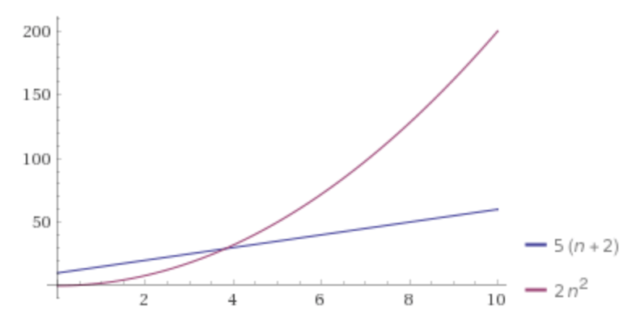





Proving Domination
$f(n)$ $∈$ $O(g\left(n\right))$ if there exist positive constants $c, n_{0}$ such that for all $n≥n_{0}$,
$$f\left(n\right)≤c⋅g\left(n\right)$$
Big-O
f(n) = 5(n + 2)
g(n) = 2n²
Find a c and n₀ that show that f(n) ∈ O(g(n)).
$$f\left(n\right)=5\left(n+2\right)=5n+10$$
$5n≤c∙2n^{2} for c=3 when n≥1$
$10≤c∙2n^{2} for c=5 when n≥1$
$5n+10≤3\left(2n^{2}\right)+5(2n^{2}) when n≥1$
$5n+10≤8\left(2n^{2}\right) when n≥1$
$$f\left(n\right)≤c∙g\left(n\right) when c=8 and n0=1$$

Slide 14

O, Ω, Θ Examples
For the following functions give the simplest tight O bound
a(n) = 10logn + 5
b(n) = 3^{n} – 4n
c(n) = $\frac{n}{2}$
For the above functions indicate whether the following are true or false
a(n) ∈ O(b(n))
a(n) ∈ O(c(n))
a(n) ∈ Ω(b(n))
a(n) ∈ Ω(c(n))
a(n) ∈ Θ(b(n))
a(n) ∈ Θ(c(n))
a(n) ∈ Θ(a(n))
O(logn)
O(3^{n})
O(n)
TRUE
TRUE
FALSE
FALSE
FALSE
FALSE
TRUE
b(n) ∈ O(a(n))
b(n) ∈ O(c(n))
b(n) ∈ Ω(a(n))
b(n) ∈ Ω(c(n))
b(n) ∈ Θ(a(n))
b(n) ∈ Θ(c(n))
b(n) ∈ Θ(b(n))
FALSE
FALSE
TRUE
TRUE
FALSE
FALSE
TRUE
c(n) ∈ O(b(n))
c(n) ∈ O(a(n))
c(n) ∈ Ω(b(n))
c(n) ∈ Ω(a(n))
c(n) ∈ Θ(b(n))
c(n) ∈ Θ(a(n))
c(n) ∈ Θ(c(n))
TRUE
FALSE
FALSE
TRUE
FALSE
FALSE
TRUE

Slide 15
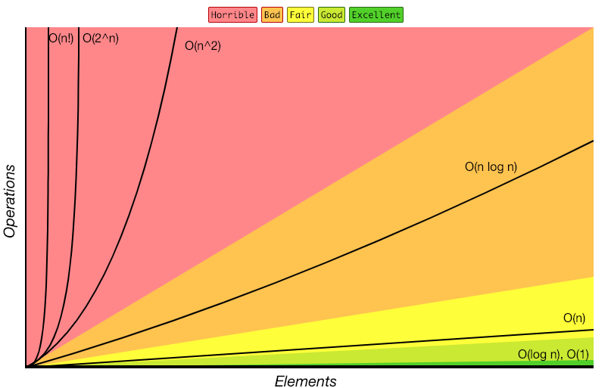
Review: Complexity Classes
complexity class – a category of algorithm efficiency based on the algorithm’s relationship to the input size N
Class | Big O | If you double N… | Example algorithm
constant | O(1) | unchanged | Add to front of linked list
logarithmic | O(log₂n) | Increases slightly | Binary search
linear | O(n) | doubles | Sequential search
log-linear | O(nlog₂n) | Slightly more than doubles | Merge sort
quadratic | O(n²) | quadruples | Nested loops traversing a 2D array
cubic | O(n³) | Multiplies by 8 | Triple nested loop
polynomial | O(n^{c})
exponential | O(c^{n}) | Multiplies drastically
http://bigocheatsheet.com/

Slide 16

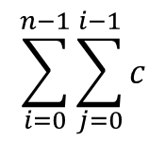

Modeling Complex Loops
for (int i = 0; i < n; i++) {
for (int j = 0; j < i; j++) {
System.out.println(“Hello!”);
}
}
+c
+1
0 + 1 + 2 + 3 +…+ n-1
n
$$\sum_{i=1}^{n}{i}$$
Summation
1 + 2 + 3 + 4 +… + n =
Definition: Summation
= f(a) + f(a + 1) + f(a + 2) + … + f(b-2) + f(b-1) + f(b)
$$\sum_{i=a}^{b}{f(i)}$$
$$\sum_{i=0}^{n−1}{\sum_{j=0}^{i−1}{c}}$$
T(n) =

Slide 17
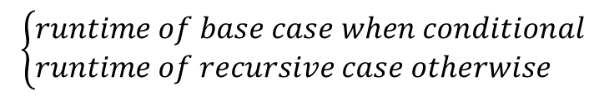
Function Modeling: Recursion
public int factorial(int n) {
if (n == 0 || n == 1) {
return 1;
} else {
return n * factorial(n – 1);
}
+c₁
+T(n-1)
+c₂
C₁
C₂ + T(n-1)
when n = 0 or 1
otherwise
T(n) =
Definition: Recurrence
Mathematical equivalent of an if/else statement
f(n) =
$$\left\{\begin{aligned}&runtime of base case when conditional \\ &runtime of recursive case otherwise\end{aligned}\right.$$

Slide 18


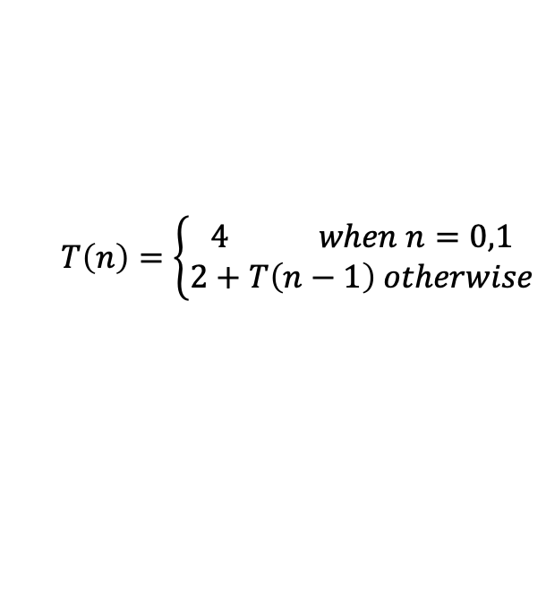



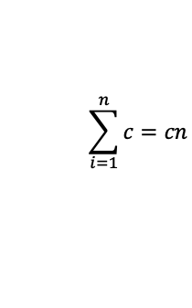
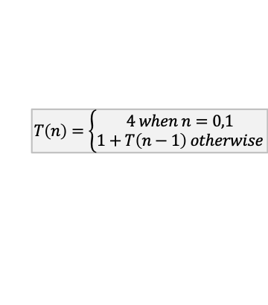

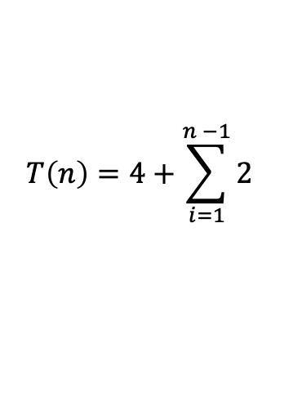




Unrolling Method
Walk through function definition until you see a pattern
$$T\left(n\right)=\left\{\begin{aligned}4 when n=0,1 \\ 2+T\left(n−1\right) otherwise\end{aligned}\right.$$
$$2+T(n−1)$$
$$T\left(n\right)=$$
$$T\left(n\right)=\left\{\begin{aligned}4 when n=0,1 \\ 2+T\left(n−1\right) otherwise\end{aligned}\right.$$
$$T\left(n\right)=2+2+T(n−1 −1)$$
i = 1
$$T\left(n\right)=2+2+T(n−2)$$
$$T\left(n\right)=\left\{\begin{aligned}4 when n=0,1 \\ 1+T\left(n−1\right) otherwise\end{aligned}\right.$$
$$T\left(n\right)=2+2+2+T(n−2−1)$$
i = 2
$$T\left(n\right)=2+2+2+T(n−3)$$
$$T\left(n\right)=\left\{\begin{aligned}4 when n=0,1 \\ 1+T\left(n−1\right) otherwise\end{aligned}\right.$$
$$T\left(n\right)=2+2+2+2+ T(n−3−1)$$
i = 3
i = ?
$$T\left(n\right)=2+2+2+2+…+ T\left(1\right)=2+2+2+2+ … +4$$
T(n-i) = T(1) when i= n-1
n-1 recursive cases
1 base case
$$T\left(n\right)=4+\sum_{i=1}^{n −1}{2}$$
Summation of a constant
$$\sum_{i=1}^{n}{c=cn}$$
$$T\left(n\right)=4+2(n−1)$$
$T\left(4\right)=2+T\left(4−1\right)=2+2+T\left(3−1\right)=2+2+2+T\left(2−1\right)=2+2+2+4=3∗2+4$

Slide 19
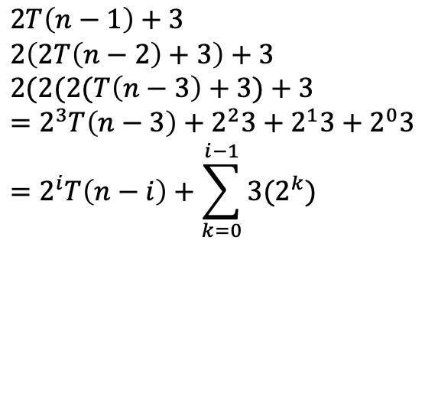
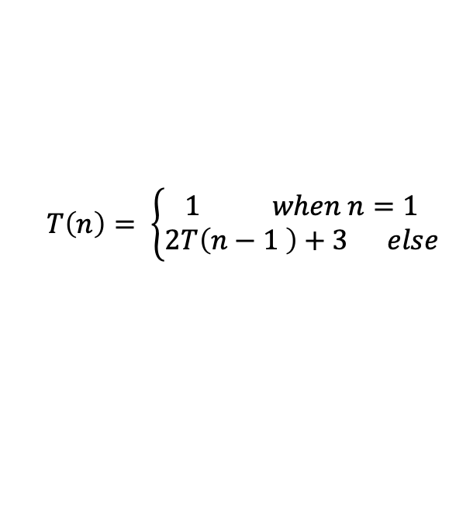

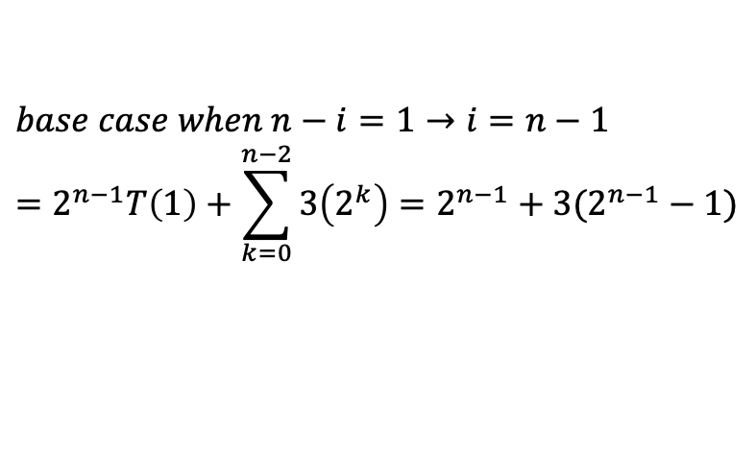
Unrolling Example
$$T\left(n\right)= \left\{\begin{aligned}1 when n=1 \\ 2T\left(n−1 \right)+3 else\end{aligned}\right.$$
$$2T\left(n−1\right)+3 \\ 2\left(2T\left(n−2\right)+3\right)+3 \\ 2(2(2(T\left(n−3\right)+3)+3 \\ =2^{3}T\left(n−3\right)+2^{2}3+2^{1}3+2^{0}3 \\ =2^{i}T\left(n−i\right)+\sum_{k=0}^{i−1}{3(2^{k})}$$
$$base case when n−i=1→i=n−1 \\ =2^{n−1}T\left(1\right)+\sum_{k=0}^{n−2}{3\left(2^{k}\right)=2^{n−1}+3(2^{n−1}−1)}$$
$$T(n)=2^{n+1}−3$$

Slide 20

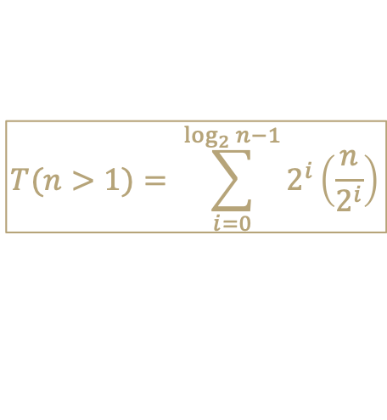
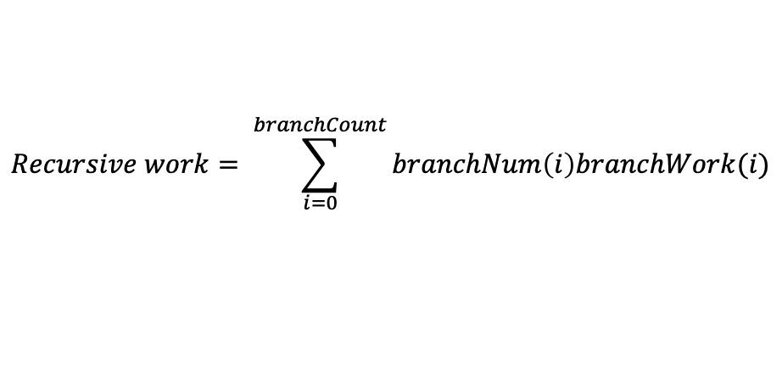
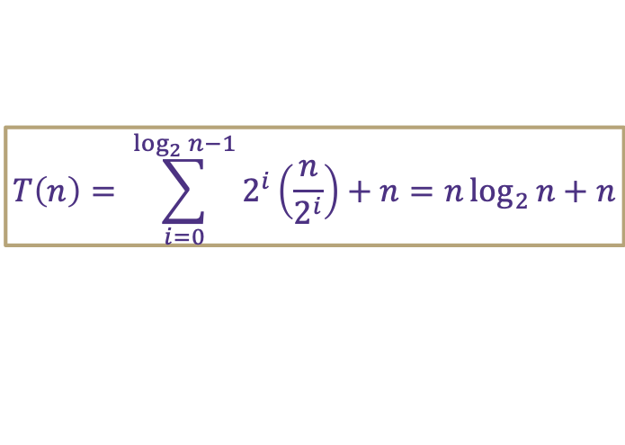
Tree Method Formulas
$$1 when n≤1$$
$$T\left(n\right)=$$
$$2T\left(\frac{n}{2}\right)+n otherwise$$
How much work is done by recursive levels (branch nodes)?
  1. How many recursive calls are on the i-th level of the tree?
    i = 0 is overall root level
  2. At each level i, how many inputs does a single node process?
  3. How many recursive levels are there?
    Based on the pattern of how we get down to base case
How much work is done by the base case level (leaf nodes)?
  1. How much work is done by a single leaf node?
  2. How many leaf nodes are there?
numberNodesPerLevel(i) = 2^{i}
inputsPerRecursiveCall(i) = (n/ 2^{i})
branchCount = log₂n - 1
$$Recursive work= \sum_{i=0}^{branchCount}{branchNum\left(i\right)branchWork(i)}$$
$$T(n>1)= \sum_{i=0}^{\log_{2}{n}−1}{2^{i}\left(\frac{n}{2^{i}}\right)}$$
leafWork = 1
leafCount = 2^{log}₂^{n} = n
$$NonRecursive work=leafWork×leafCount=leafWork×branchNum^{numLevels}$$
$$T\left(n≤1\right)=1\left(2^{log2n}\right)= n$$
$$T\left(n\right)= \sum_{i=0}^{\log_{2}{n}−1}{2^{i}\left(\frac{n}{2^{i}}\right)}+n=n\log_{2}{n}+n$$
$$total work=recursive work+nonrecursive work=$$

Slide 21


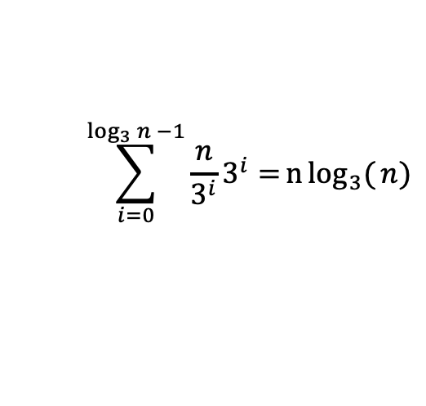





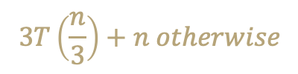

Tree Method Example
$$3 when n=1$$
$$T\left(n\right)=$$
$$3T\left(\frac{n}{3}\right)+n otherwise$$
Size of input at level i?
$$\frac{n}{3^{i}}$$
How many nodes are on the bottom level?
$$3^{\log_{3}({n})}=n$$
Number of nodes at level i?
$$3^{i}$$
How much work done in base case?
$$3n$$
How many levels of the tree?
$$\log_{3}({n)}$$
$$\sum_{i=0}^{\log_{3}{n −1}}{\frac{n}{3^{i}}3^{i}=}n\log_{3}({n})$$
$$T\left(n\right)=n\log_{3}(n){+}3n$$
Total recursive work

Slide 22
Reflecting on Master Theorem
The case
  Recursive case conquers work more quickly than it divides work
  Most work happens near “top” of tree
  Non recursive work in recursive case dominates growth, n^{c} term
  The case
  Work is equally distributed across call stack (throughout the “tree”)
  Overall work is approximately work at top level x height
The case
  Recursive case divides work faster than it conquers work
  Most work happens near “bottom” of tree
  Leaf work dominates branch work
Given a recurrence of the form:
$$\log_{b}{a}<c$$
$$d when n=1$$
$$T\left(n\right)=$$
$$aT\left(\frac{n}{b}\right)+n^{c} otherwise$$
If
$$\log_{b}{a}<c$$
then
$$T\left(n\right)∈Θ\left(n^{c}\right)$$
If
$$\log_{b}{a}=c$$
then
$$T\left(n\right)∈Θ\left(n^{c}\log_{2}{n}\right)$$
$$\log_{b}{a}=c$$
If
$$\log_{b}{a}>c$$
then
$$T\left(n\right)∈Θ\left(n^{\log_{b}{a}}\right)$$
$$height ≈\log_{b}{a}$$
$$\log_{b}{a}>c$$
$$branchWork ≈n^{c}\log_{b}{a}$$
$$leafWork ≈d\left(n^{\log_{b}{a}}\right)$$

Slide 23

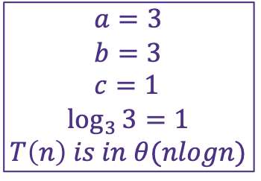
Master Theorem Example
$$3 when n=1$$
Given a recurrence of the form:
$$T\left(n\right)=$$
$$3T\left(\frac{n}{3}\right)+n otherwise$$
$$d when n=1$$
$$T\left(n\right)=$$
$$aT\left(\frac{n}{b}\right)+n^{c} otherwise$$
If
$$\log_{b}{a}<c$$
then
$$T\left(n\right)∈Θ\left(n^{c}\right)$$
If
$$\log_{b}{a}=c$$
then
$$T\left(n\right)∈Θ\left(n^{c}\log_{}{n}\right)$$
$$a=3 \\ b=3 \\ c=1$$
$\log_{3}{3}=1$
$$T\left(n\right) is in θ(nlogn)$$
If
$$\log_{b}{a}>c$$
then
$$T\left(n\right)∈Θ\left(n^{\log_{b}{a}}\right)$$

Slide 24
BST & AVL Trees

Slide 25
Binary Search Trees
A binary search tree is a binary tree that contains comparable items such that for every node, all children to the left contain smaller data and all children to the right contain larger data.
10
9
15
7
12
18
8
17

Slide 26
Meet AVL Trees
AVL Trees must satisfy the following properties:
  binary trees: all nodes must have between 0 and 2 children
  binary search tree: for all nodes, all keys in the left subtree must be smaller and all keys in the right subtree must be larger than the root node
  balanced: for all nodes, there can be no more than a difference of 1 in the height of the left subtree from the right. Math.abs(height(left subtree) – height(right subtree)) ≤ 1
  AVL stands for Adelson-Velsky and Landis (the inventors of the data structure)

Slide 27
Two AVL Cases
Line Case
Solve with 1 rotation
Kink Case
Solve with 2 rotations
3
1
1
3
2
2
3
1
1
3
2
2
Rotate Right
Parent’s left becomes child’s right
Child’s right becomes its parent
Rotate Left
Parent’s right becomes child’s left
Child’s left becomes its parent
Right Kink Resolution
Rotate subtree left
Rotate root tree right
Left Kink Resolution
Rotate subtree right
Rotate root tree left

Slide 28
Hashing

Slide 29
Implement First Hash Function
public V get(int key) {
int newKey = getKey(key);
this.ensureIndexNotNull(key);
return this.data[key].value;
}
public void put(int key, int value) {
this.array[getKey(key)] = value;
}
public void remove(int key) {
int newKey = getKey(key);
this.entureIndexNotNull(key);
this.data[key] = null;
}
public int getKey(int value) {
return value % this.data.length;
}
SimpleHashMap<Integer>
state
Data[]
size
behavior
put mod key by table size, put item at result
get mod key by table size, get item at result
containsKey mod key by table size, return data[result] == null remove mod key by table size, nullify element at result
size return count of items in dictionary

Slide 30
First Hash Function: % table size
indices | 0 | 1 | 2 | 3 | 4 | 5 | 6 | 7 | 8 | 9
elements
“foo”
“biz”
“bar”
“bop”
“poo”
put(0, “foo”);
put(5, “bar”);
put(11, “biz”)
put(18, “bop”);
put(20, “poo”);
0 % 10 = 0
5 % 10 = 5
11 % 10 = 1
18 % 10 = 8
20 % 10 = 0
Collision!

Slide 31
Handling Collisions
Solution 1: Chaining
Each space holds a “bucket” that can store multiple values. Bucket is often implemented with a LinkedList
Operation |  | Array w/ indices as keys
put(key,value) | best | O(1)
 | average | O(1 + λ)
 | worst | O(n)
get(key) | best | O(1)
 | average | O(1 + λ)
 | worst | O(n)
remove(key) | best | O(1)
 | average | O(1 + λ)
 | worst | O(n)
Average Case:
Depends on average number of elements per chain
Load Factor λ
If n is the total number of key-value pairs
Let c be the capacity of array
Load Factor λ = $\frac{n}{c}$

Slide 32
Handling Collisions
Solution 2: Open Addressing
Resolves collisions by choosing a different location to tore a value if natural choice is already full.
Type 1: Linear Probing
If there is a collision, keep checking the next element until we find an open spot.
public int hashFunction(String s)
int naturalHash = this.getHash(s);
if(natural hash in use) {
int i = 1;
while (index in use) {
try (naturalHash + i);
i++;
Type 2: Quadratic Probing
If we collide instead try the next i² space
public int hashFunction(String s)
int naturalHash = this.getHash(s);
if(natural hash in use) {
int i = 1;
while (index in use) {
try (naturalHash + i * i);
i++;

Slide 33
Linear Probing
Insert the following values into the Hash Table using a hashFunction of % table size and linear probing to resolve collisions
1, 5, 11, 7, 12, 17, 6, 25
0 | 1 | 2 | 3 | 4 | 5 | 6 | 7 | 8 | 9
6
17
1
12
25
7
11
5

Slide 34
Quadratic Probing
Insert the following values into the Hash Table using a hashFunction of % table size and quadratic probing to resolve collisions
89, 18, 49, 58, 79
0 | 1 | 2 | 3 | 4 | 5 | 6 | 7 | 8 | 9
58
79
18
49
89
(49 % 10 + 0 * 0) % 10 = 9
(49 % 10 + 1 * 1) % 10 = 0
(58 % 10 + 0 * 0) % 10 = 8
(58 % 10 + 1 * 1) % 10 = 9
(58 % 10 + 2 * 2) % 10 = 2
Problems:
If λ≥ ½ we might never find an empty spot
  Infinite loop!
Can still get clusters
(79 % 10 + 0 * 0) % 10 = 9
(79 % 10 + 1 * 1) % 10 = 0
(79 % 10 + 2 * 2) % 10 = 3

Slide 35
Handling Collisions
Solution 3: Double Hashing
If the natural hash location is taken, apply a second and separate hash function to find a new location. h’(k, i) = (h(k) + i * g(k)) % T
public int hashFunction(String s)
int naturalHash = this.getHash(s);
if(natural hash in use) {
int i = 1;
while (index in use) {
try (naturalHash + i * jump_Hash(key));
i++;

Slide 36
Heaps

Slide 37
Binary Heap
A type of tree with new set of invariants
1. Binary Tree: every node has at most 2 children
2. Heap: every node is smaller than its child
3. Structure: Each level is “complete” meaning it has no “gaps”
- Heaps are filled up left to right
1
8
1
2
3
9
10
2
3
22
4
5
4
5
6
7
36
9
10
47
8

Slide 38
Implementing Heaps
How do we find the minimum node?
How do we find the last node?
How do we find the next open space?
How do we find a node’s left child?
How do we find a node’s right child?
How do we find a node’s parent?
$$peekMin()=arr[0]$$
A
$$lastNode()=arr[size −1]$$
B
C
$$openSpace()=arr[size]$$
D
E
F
G
$$leftChild\left(i\right)=2i+1$$
H
I
J
K
L
$$rightChild\left(i\right)=2i+2$$
Fill array in level-order from left to right
$$parent\left(i\right)=\frac{\left(i−1\right)}{2}$$
0 | 1 | 2 | 3 | 4 | 5 | 6 | 7 | 8 | 9 | 10 | 11 | 12 | 13
A | B | C | D | E | F | G | H | I | J | K | L
Notes:
Gives us fast insertions and removals
Completeness forces height to be log(n)
Gives us contiguious memory

Slide 39
Homework

Slide 40
Homework 2
ArrayDictionary<K, V>
DoubleLinkedList<T>
Function | Best case | Worst case
get(K key) | O(1) Key is first item looked at | O(n) Key is not found
put(K key, V value) | O(1) Key is first item looked at | 2n -> O(n) N search, N resizing
remove(K key) | O(1) Key is first item looked at | O(n) N search, C swapping
containsKey(K key) | O(1) Key is first item looked at | O(n) Key is not found
size() | O(1) Return field | O(1) Return field
Function | Best case | Worst case
get(int index) | O(1) Index is 0 or size | n/2 -> O(n) Index is size/2
add(T item) | O(1) Item added to back | O(1) Item added to back
remove() | O(1) Item removed from back | O(1) Item removed from back
delete(int index) | O(1) Index is 0 or size | n/2 -> O(n) Index is size/2
set(int index, T item) | O(1) Index is 0 or size | n/2 -> O(n) Index is size/2
insert(int index, T item) | O(1) Index is 0 or size | n/2 -> O(n) Index is size/2

Slide 41
Homework 3
ChainedHashDictionary<K, V>
ChainedHashSet<T>
Function | Best case | Worst case
get(K key) | O(1) Chain size of 1 | O(n) Chain size of n
put(K key, V value) | O(1) Add into empty bucket | 3N -> O(n) N search in chain, N resizing of chain, N resizing of Hash
remove(K key) | O(1) Chain of size 1 | O(n) Chain of size n
containsKey(K key) | O(1) Key is first item in chain / empty chain | O(n) Chain of size n, key not found
size() | O(1) Return field | O(1) Return field
Function | Best case | Worst case
add(T item) | O(1) Add into empty bucket | 3N -> O(n) N search in chain, N resizing of chain, N resizing of Hash
remove(T item) | O(1) Chain of size 1 | O(n) Chain of size n
contains(T item) | O(1) Item is at front of chain | O(n) Chain of size n, item not found
size() | O(1) Return field | O(1) Return field

