Slide 1
Lecture 16: Midterm recap + Heaps ii
CSE 373 Data Structures and Algorithms
CSE 373 19 SP - Kasey Champion

Slide 2
Practice: Building a minHeap
3 Minutes
Construct a Min Binary Heap by inserting the following values in this order:
5, 10, 15, 20, 7, 2
Min Priority Queue ADT
Min Binary Heap Invariants
Binary Tree – each node has at most 2 children
Min Heap – each node’s children are larger than itself
Level Complete - new nodes are added from left to right completely filling each level before creating a new one
state
Set of comparable values
- Ordered based on “priority”
5
2
behavior
removeMin() – returns the element with the smallest priority, removes it from the collection
10
15
7
5
2
peekMin() – find, but do not remove the element with the smallest priority
percolateUp!
insert(value) – add a new element to the collection
20
7
2
10
15
percolateUp!
percolateUp!

Slide 3
Administrivia
HW 4 due Wednesday night
HW 5 out Wednesday (partner project)
Partner form due tonight
How to get get a tech job with Kim Nguyen
Today 4-5pm PAA

Slide 4
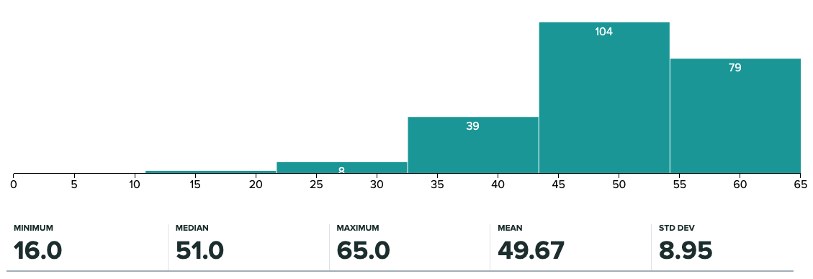
Midterm Grades
Course Grade Breakdown
Midterm: 20%
Final Exam: 25%
Individual Assignments: 15%
Partner Projects: 40%
Hashing
Trees
Tree Method
Big O
Code
Modeling
Design
Decisions
CSE 373 19 SP - Kasey Champion

Slide 5
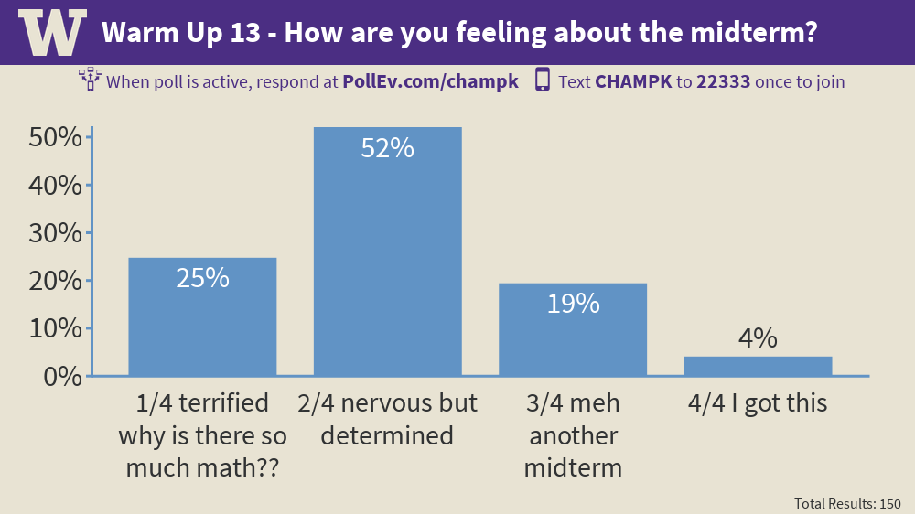
Midterm Performance

Slide 6
Implementing Heaps
How do we find the minimum node?
How do we find the last node?
How do we find the next open space?
How do we find a node’s left child?
How do we find a node’s right child?
How do we find a node’s parent?
$$peekMin()=arr[0]$$
A
$$lastNode()=arr[size −1]$$
B
C
$$openSpace()=arr[size]$$
D
E
F
G
$$leftChild\left(i\right)=2i+1$$
H
I
J
K
L
$$rightChild\left(i\right)=2i+2$$
Fill array in level-order from left to right
$$parent\left(i\right)=\frac{\left(i−1\right)}{2}$$
0 | 1 | 2 | 3 | 4 | 5 | 6 | 7 | 8 | 9 | 10 | 11 | 12 | 13
A | B | C | D | E | F | G | H | I | J | K | L
Notes:
Gives us fast insertions and removals
Completeness forces height to be log(n)
Gives us contiguious memory

Slide 7
Heap Implementation Runtimes
char peekMin()
timeToFindMin
Tree
Array
char removeMin()
findLastNodeTime + removeRootTime + numSwaps * swapTime
Tree
Array
void insert(char)
findNextSpace + addValue + numSwaps * swapTime
Tree
Array
A
Θ(1)
Θ(1)
B
C
n + 1 + log(n) * 1
Θ(n)
D
E
F
1 + 1 + log(n) * 1
Θ(log(n))
0 | 1 | 2 | 3 | 4 | 5 | 6 | 7
A | B | C | D | E | F
n + 1 + log(n) * 1
Θ(n)
1 + 1 + log(n) * 1
Θ(log(n))

Slide 8
Building a Heap
Insert has a runtime of Θ(log(n))
If we want to insert a n items…
Building a tree takes O(nlog(n))
Add a node, fix the heap, add a node, fix the heap
Can we do better?
Add all nodes, fix heap all at once!

Slide 9
Cleaver building a heap – Floyd’s Method
Facts of binary trees
Increasing the height by one level doubles the number of possible nodes
A complete binary tree has half of its nodes in the leaves
A new piece of data is much more likely to have to percolate down to the bottom than be the smallest element in heap
1. Dump all the new values into the bottom of the tree
Back of the array
2. Traverse the tree from bottom to top
Reverse order in the array
3. Percolate Down each level moving towards overall root
see lecture 16 slides for example / animations

