Slide 1
Final Review
Data Structures and Algorithms

Slide 2
Announcements
Final Review Due Tonight – Don’t stress too much about it!
Final on Friday – 1 page of notes is allowed
Course evaluations due tomorrow night. (see e-mail)
Please fill out the survey on Kendra Yourtee’s talk, and sign her thank-you card!

Slide 3
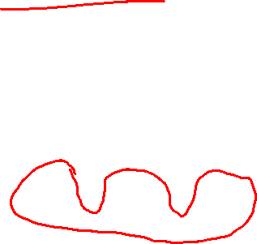
Dynamic Programming
Subsequence palindrome:
Given a string S, find the longest subsequence that is a palindrome.
RACECAR
RADCECXAR
Unlike your homework, the letters don’t need to be consecutive!

Slide 4
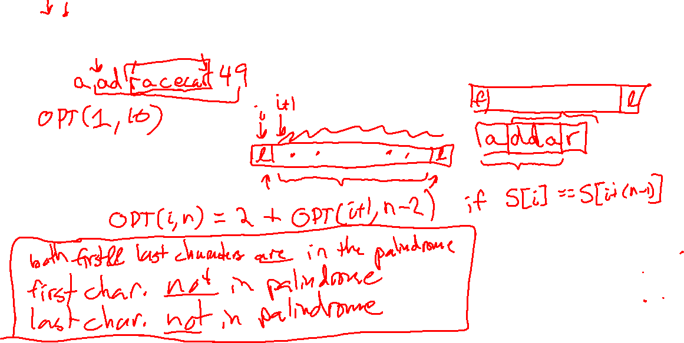
Dynamic Programming
Let OPT(i, n) denote the length of the longest palindrome subsequence in the substring of length n starting at index i. Write an expression for the recursive case of OPT(i, n).

Slide 5
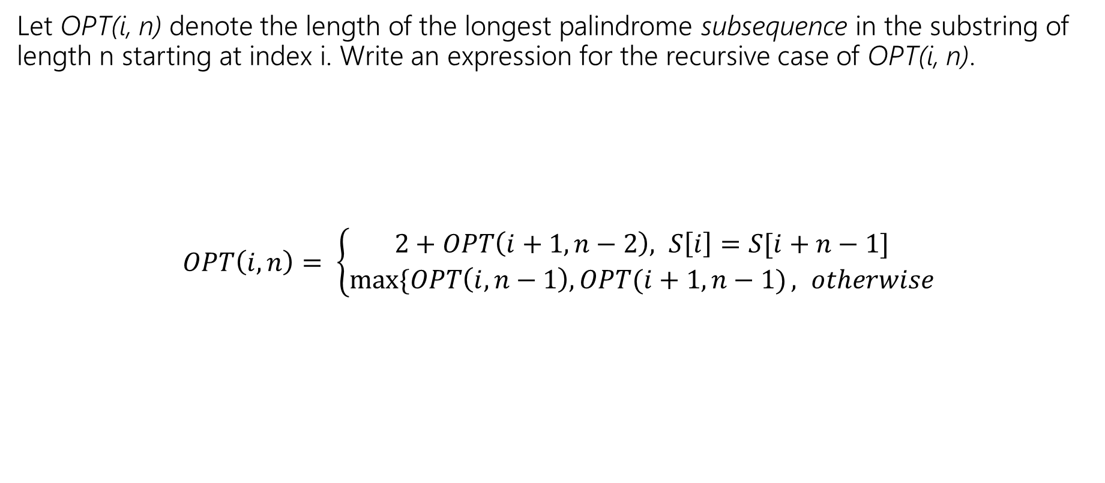
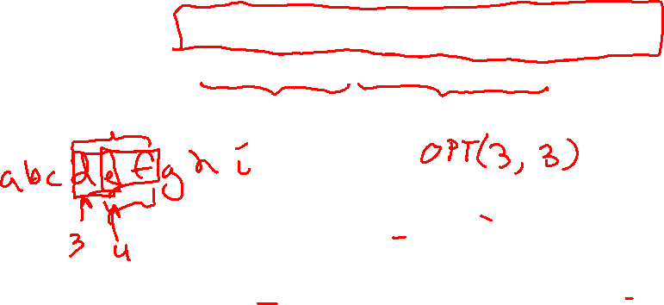
Dynamic Programming
Let OPT(i, n) denote the length of the longest palindrome subsequence in the substring of length n starting at index i. Write an expression for the recursive case of OPT(i, n).
$OPT\left(i,n\right)= \left\{\begin{aligned}2+OPT\left(i+1, n−2\right), S\left[i\right]=S[i+n−1] \\ &\max{\{OPT\left(i,n−1\right), OPT(i+1, n−1)}, otherwise\end{aligned}\right.$

Slide 6
Dynamic Programming
Next we need a base case for our OPT recurrence. Write an expression for the base case(s) of this recurrence.

Slide 7

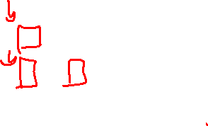
Dynamic Programming
Next we need a base case for our OPT recurrence. Write an expression for the base case(s) of this recurrence.
$OPT\left(i,0\right)=0$
$OPT\left(i,1\right)=1$

Slide 8

Dynamic Programming
Now that we have a complete recurrence, we need to figure out which order to solve the subproblems in. Which subproblems does the recursive case OPT(i, n) require to be calculated before it can be solved?
$OPT\left(i+1,n−2\right), OPT\left(i, n−1\right), OPT(i+1, n−1)$

Slide 9
Dynamic Programming
Given these dependencies, what order should we loop over the subproblem in?

Slide 10
Dynamic Programming
Given these dependencies, what order should we loop over the subproblem in?
Since we depend on OPT(i+1, n-2), OPT(i, n-1), and OPT(i+1,n-1) it is sufficient to have solved all subproblems with smaller n first (i.e. the subproblem for strings of shorter length). Therefore we can loop over the subproblems in order of increasing length (the order of i does not matter).

Slide 11
Dynamic Programming
We have all of the pieces required to put together a dynamic program now. Write psuedocode for the dynamic program that computes the length of the longest palindromic subsequence of S.

Slide 12
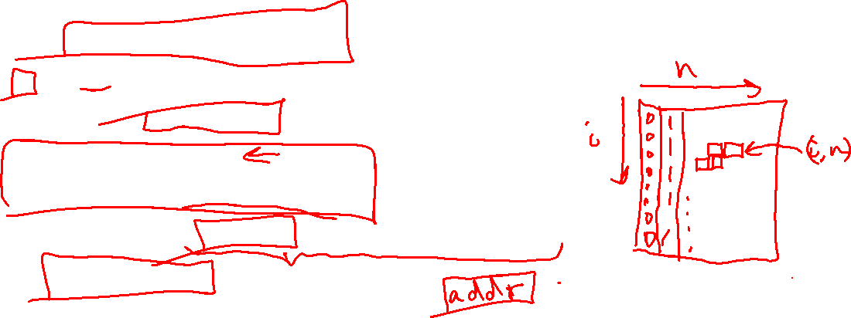
Dynamic Programming
We have all of the pieces required to put together a dynamic program now. Write psuedocode for the dynamic program that computes the length of the longest palindromic subsequence of S.
Initialize OPT[S.length][S.length+1] with 0s for all OPT[i][0] and 1s for all OPT[i][1]
for n from 2 to S.length:
for i from 0 to S.length – n:
if (S[i] == S[i + n – 1]):
OPT[i][n] = 2 + OPT[i+1][n-2]
OPT[i][n] = max( OPT[i][n], OPT[i+1][n-1], OPT[i, n-1] )
return OPT[0][S.length]

Slide 13
Differences from Your HW Review
In the HW, there is an extra constraint that the palindrome is consecutive.
You’ll need an extra condition to account for this.

Slide 14
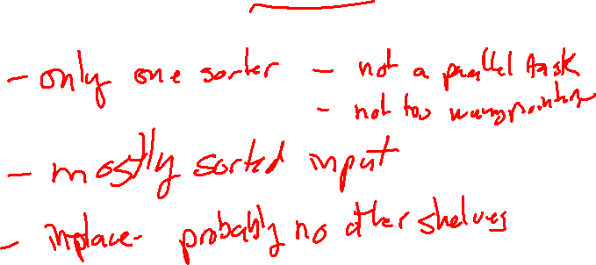
Sorting
A store stocks its cereal boxes in alphabetical order along the shelf from left to right. One day, a customer picks up a few boxes, and puts them back in the wrong positions. Which sorting algorithm would be best for the store to use to put the cereal isle back in order?

Slide 15
Sorting
A store stocks its cereal boxes in alphabetical order along the shelf from left to right. One day, a customer picks up a few boxes, and puts them back in the wrong positions. Which sorting algorithm would be best for the store to use to put the cereal isle back in order?
Assumptions:
a) The store doesn’t have an empty shelf elsewhere to sort into.
  We want an in-place sort
b) Only a few boxes were misplaced. The shelf is mostly sorted – only a few out-of-place.
  We want a sort that has a fast best-case time when the list is mostly sorted.
  Insertion sort has both of these properties!

Slide 16
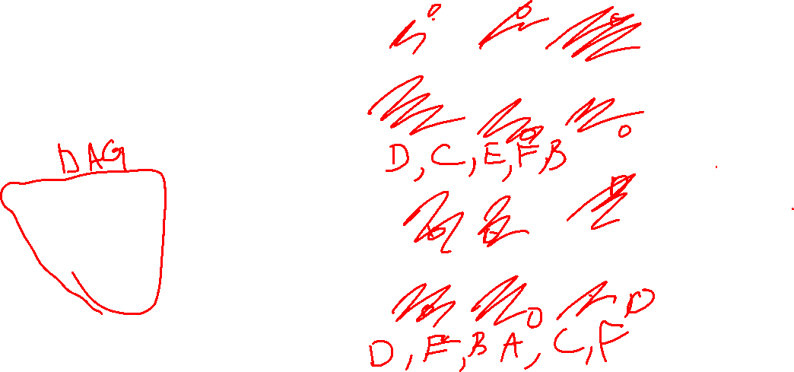
Topological Sort
For each graph, give the topological sorting, or if there is none, why?
A
B
C
A
B
C
D
E
F
D
E
F
A
B
C
A
B
C
D
E
F
D
E
F

Slide 17
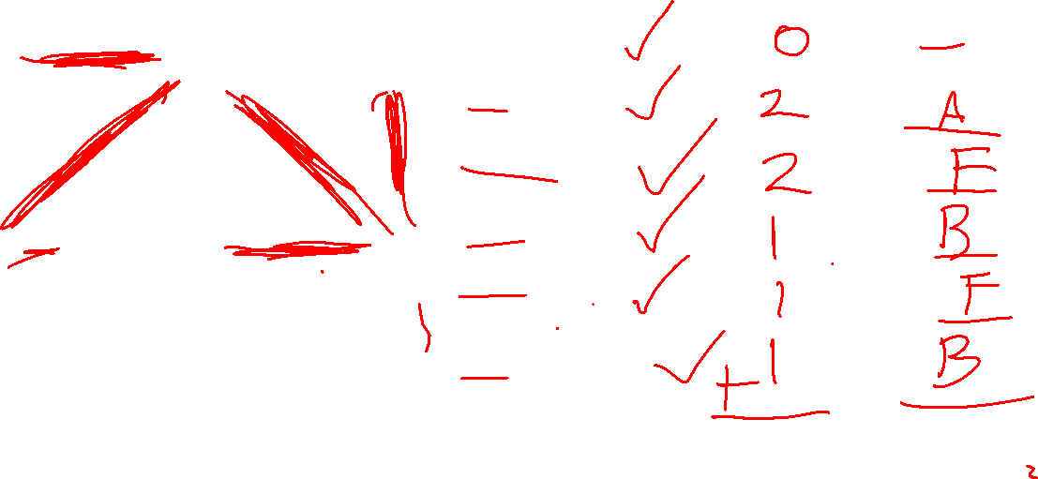
MST Prim’s Algorithm
Vertex | Known? | Cost (d) | Parent
A
B
C
D
E
F
A
2
B
4
C
4
1
3
1
2
D
E
F
2
1

Slide 18
Graph Traversals (DFS)
Perform a DFS from vertex G. Visit neighbors in alphabetical order. Show your work.
A
B
C
D
E
F
G
H
I

Slide 19
Graph Traversals (BFS)
Perform a BFS from vertex G. Visit neighbors in alphabetical order. Show your work.
A
B
C
D
E
F
G
H
I

