Slide 1
Floyd-Warshall and Review
Data Structures and Algorithms

Slide 2
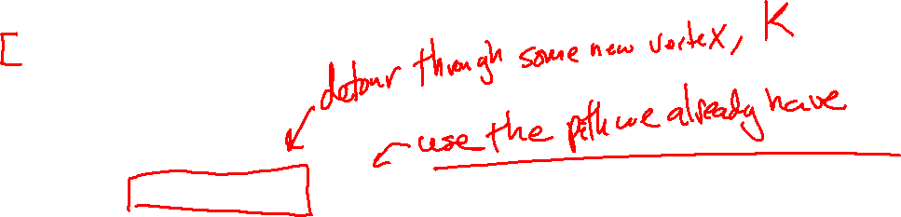
Floyd-Warshall Algorithm
shortestPaths(G):
let d[][] be a |V|x|V| matrix
d[i][j] = w(i,j) or infinity if no edge (w(i,i) = 0 for all i)
for k=0 ... |V| - 1 :
for i = 0 … |V| - 1:
for j = 0 … |V| - 1:
if (d[i][k] + d[k][j] < d[i][j] ):
d[i][j] = d[i][k] + d[k][j]
return d

Slide 3
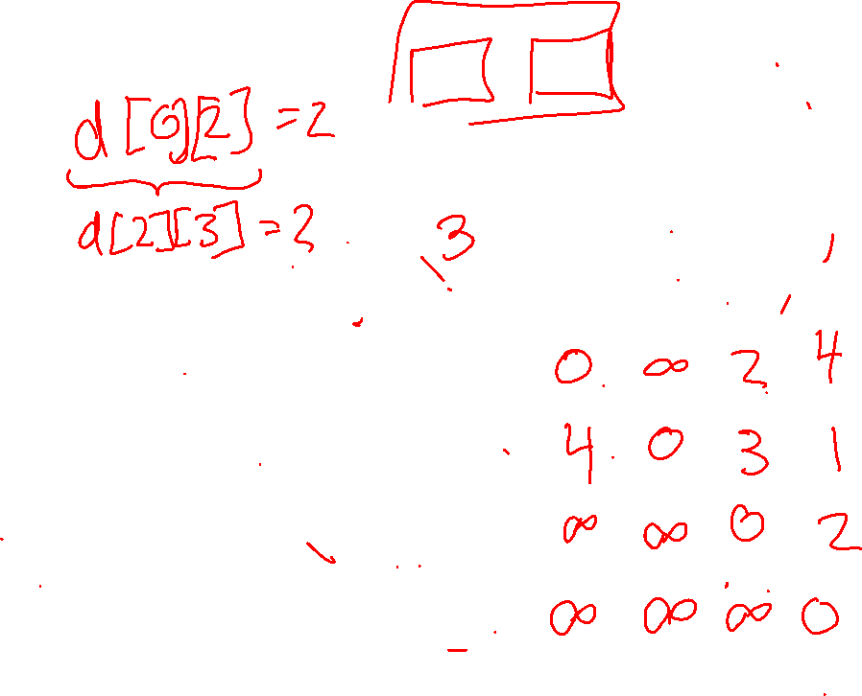
Example
if (d[i][k] + d[k][j] < d[i][j] ):
d[i][j] = d[i][k] + d[k][j]
k =
j
0
0
1
2
3
2
4
i
0
1
3
2
1
1
2
2
3
3

Slide 4
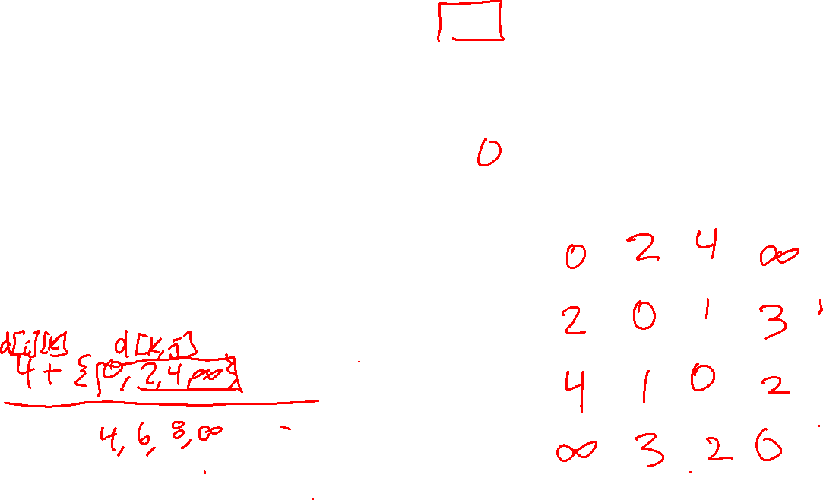
Example
if (d[i][k] + d[k][j] < d[i][j] ):
d[i][j] = d[i][k] + d[k][j]
k =
j
0
2
1
0
1
2
3
4
1
3
i
0
2
3
1
2
2
3

Slide 5
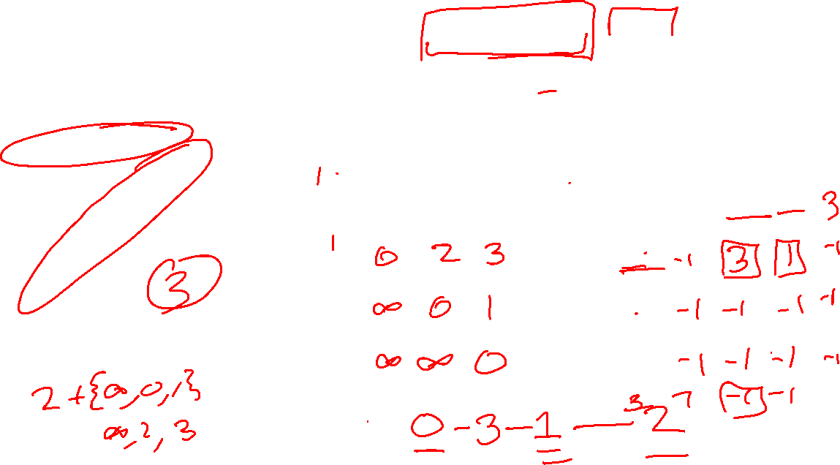
Path Reconstruction
if (d[i][k] + d[k][j] < d[i][j] ):
d[i][j] = d[i][k] + d[k][j]
0
2
1
k =
j
k =
j
0
1
2
0
1
2
4
1
i
0
i
0
2
1
1
2
2

Slide 6
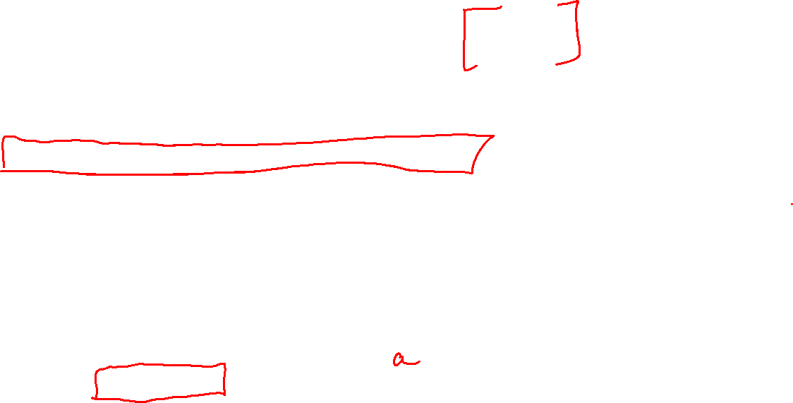
Path Reconstruction
shortestPaths(G):
let d[][] be a |V|x|V| matrix
let path[][] be a |V|x|V| matrix initialized to -1s
d[i][j] = w(i,j) or infinity if no edge (w(i,i) = 0 for all i)
for k=0 ... |V| - 1 :
for i = 0 … |V| - 1:
for j = 0 … |V| - 1:
if (d[i][k] + d[k][j] < d[i][j] ):
d[i][j] = d[i][k] + d[k][j]
path[i][j] = k
return d
// ALT: next[i][j] = next[i][k]

Slide 7
Announcements
Poll for Kendra Yourtee - https://tinyurl.com/yay8m24s
Final on Friday – One sheet of notes
  Will be shorter than the midterm!
Review – Wednesday in class and Thursday in Section
Final Review HW due on Wednesday
  No late days – we will be posting solutions as soon as the dropbox closes.
Course Feedback Survey: https://uw.iasystem.org/survey/195884
  Super useful for me – this was my first time teaching, and I would really appreciate constructive feedback: what I did well, what I did poorly, and how the class could have been improved.

Slide 8
Review

Slide 9
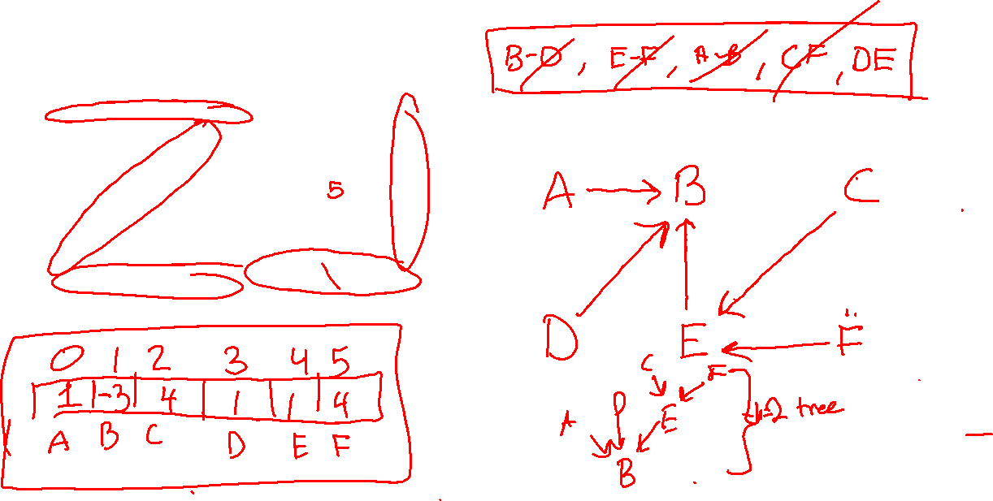
MST (Kruskal, Union By Height + Path C.)
A
2
B
4
C
4
1
3
2
D
E
F
2
1

