Slide 1
Dynamic Programming
Data Structures and Algorithms

Slide 2
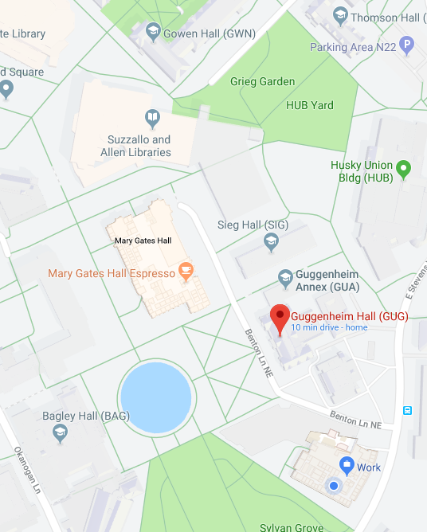
Announcements
Friday is a guest lecture in GUG 220
Kendra Yourtee will give insider information on tech interviews
Will not be covered on the final – will be very useful for jobs though!
Don’t go to Gowen Hall on Friday – we won’t be there!
Final Homework will be posted tonight!
Short (2 question) FINAL REVIEW
Due Wed. before final

Slide 3
Goals for Today
3 examples of dynamic programming – the details of the first two are not important – it is the strategy that I want you to focus on
Learning goal 1: Be able to state the steps of designing a dynamic program
Learning goal 2: Be able to implement the Floyd-Warshall all-shortest-paths algorithm.
Learning goal 3: Given a description of a problem and how it is broken into subproblems, be able to write a dynamic program to solve the problem.

Slide 4
Coin Changing Problem (1)
THIS IS A VERY COMMON INTERVIEW QUESTION!
Problem: I have an unlimited set of coins of denomitations w[0], w[1], w[2], … I need to make change for W cents. How can I do this using the minimum number of coins?
Example: I have pennies w[0] = 1, nickels w[1] = 5, dimes w[2] = 10, and quarters w[3] = 25, and I need to make change for 37 cents.
I could use 37 pennies (37 coins), 3 dimes + 1 nickels + 2 pennies (6 coins), but the optimal solution is 1 quarter + 1 dime + 2 pennies (5 coins).
We want an algorithm to efficiently compute the best solution for any problem instance.

Slide 5
Step 1: Find the subproblems
What are our subproblems? How do we use them to compute a larger solution?
One way to make the problem “smaller” is to reduce the number of cents we are making change for.
Let OPT(W) denote the optimal number of coins to use to make change for W cents.

Slide 6
Step 2: “Characterize the Optimum”
What recurrence relation describes our optimum solution? What are the base cases?
Break the problem into cases. Any non-zero amount will use at least one coin, so we can cover all of our cases by:
1) use at least one penny
2) use at least one nickel
Etc.
i) use at least one of w[i]
So in the i’th case, if OPT(W) uses w[i], then OPT(W) = OPT(W – w[i]) + 1
or overall: OPT(W) = min{ OPT(W – w[1]) + 1, OPT(W – w[2]) + 1, … OPT(W – w[m]) + 1}
For our base cases, we know that it takes 0 coins to make change for 0 cents:
OPT(0) = 0
We also know that it is impossible to make negative change
OPT(n) = infinity for n < 0

Slide 7
Step 3: Order the Subproblems
We have characterized our optimum solution:
$OPT\left(W\right)= \left\{\begin{aligned}∞ if W<0 \\ 0 if W=0 \\ \min_{i}{OPT\left(W −w\left[i\right]\right)+1 otherwise}\end{aligned}\right.$
What order do we solve these in?
Notice that the recursive case depends only on smaller values of W.
Therefore we can solve from smallest to largest: from 1 to W

Slide 8
Step 4: Write the algorithm
change(W, w[]): // w[] has length n
OPT = new array[W + 1]
OPT[0] = 0
for i = 1 to W:
best = infinity
for j = 0 to n:
if (i – w[j]) >= 0 && OPT[i – w[j]] + 1 < best:
best = OPT[i – w[j]] + 1
OPT[i] = best
return OPT[W]
// Base case
Base case – since index < 0, used a conditional instead
Notes:
Runtime?
O(nW)

Slide 9
Which coins did we use?
This algorithm only tells us how many coins we need to use, not which coins they were.
Each time we found OPT(k), we made a choice about which coin we were adding (see why)?
The coin we “removed” to find the best subproblem in the top-down view is a coin “added” when viewed bottom-up.
Idea: Use a second array to keep track of which coins we are adding!

Slide 10
Step 5: Tracking Coins
change(W, w[]): // w[] has length n
OPT = new array[W + 1]
coins = new array[W+1]
coins[0] = -1
OPT[0] = 0
for i = 1 to W:
best = infinity
bestCoin = -1
for j = 0 to n:
if (i – w[j]) >= 0 && OPT[i – w[j]] + 1 < best:
best = OPT[i – w[j]] + 1
bestCoin = j
OPT[i] = best
coins[i] = bestCoin
return coins

Slide 11
Coin changing problem (2)
Same setup: How many different ways are there of making change? (Counting problem)
This time we’ll need both size variables – the amount of change to make, and the coins available:
OPT(W, k) := The number of ways to make change for W, using only the first k coin types
e.g. if w[0] = pennies, w[1] = nickels, w[2] = dimes, and w[3] = quarters,
OPT(12, 2) = 3; the number of ways to make 12 cents using only pennies and nickels

Slide 12
Characterizing the Optimum
For our base cases, we know that there is only one way to make 0 cents (no coins):
OPT(0, k) = 1 for all k
There are 0 ways to make change with 0 coins (for non-zero amounts of change):
OPT(W,0) = 0 for all W != 0
Recursive Case: If we are making change with the first k coin types, we can use the k’th type of coin 0 times, 1 time, 2 times, …, up to W / w[k-1] times (remember the k’th coin is w[k-1]).
The remainder of the money needs to be made up of the other coin types, so we have
$$OPT(W,k)=\sum_{i=0}^{⌊\frac{W}{w\left[k−1\right]}⌋}{OPT(W−i⋅w\left[k−1\right], k−1)}$$
Notes:
We didn’t have a negative base case. Why?
The way we wrote our optimum, we will never try to use a negative subproblem.

Slide 13
Ordering the Subproblems
We now have 2 variables, W and k, so our array will be 2D:
W = 0 1 2 …
k = 0
1
2
…
1
0
0
0
0
0
0
0
1
1
1
OPT(W,k)
1
1
$$OPT(W,k)=\sum_{i=0}^{⌊\frac{W}{w\left[k−1\right]}⌋}{OPT(W−i⋅w\left[k−1\right], k−1)}$$
Subproblems depended on only have smaller W and k values

Slide 14
Algorithm
changeCounting(W, w[]): // w[] has length m
OPT[][] = new int[][]
OPT[0][k] = 0 for all k
for k = 1…m:
for n = 1…W:
numWays = 0
for i = 0… W / w[k-1]:
numWays += OPT[n – i*w[k-1], k-1]
OPT[n, k] = numWays
return OPT(W, m)
Notes:
Runtime? O(m W^2)

Slide 15
All Shortest Paths
Given a graph G, find the length of the shortest path between every pair of vertices.
Looks like OPT(i,j) := length of shortest path from $v_{i}$ to $v_{j}$
How to break this into smaller problems?
Borrow a trick from the last example: introduce a restriction:
OPT(k,i,j) := length of shortest path from $v_{i}$ to $v_{j}$ using only the first k vertices as intermediate nodes ($v_{0}, v_{1}, v_{2}, …, v_{k−1}$)

Slide 16
Characterizing OPT
OPT(k,i,j) := shortest path from i to j using only first k vertices in between
What is OPT(3, 0, 4) for this graph? What path does it correspond to?
OPT(3, 0, 4) = 9 since we can’t use 3 as an intermediate node.

Slide 17
Characterizing OPT
OPT(k,i,j) := shortest path from i to j using only first k vertices in between
Observation: OPT(k,i,j) either uses the k’th vertex, or it doesn’t:
OPT(k,i,j) = min { OPT(k-1, i, j) , OPT(k-1, i, k) + OPT(k-1, k, j) }

Slide 18
Characterizing OPT
OPT(k,i,j) = min {OPT(k-1, i, j) , OPT(k-1, i, k) + OPT(k-1, k, j) }
Base cases?
The path from a vertex to itself has length 0:
OPT(k, i, i ) = 0
A path with no intermediate vertices is only possible if the edge i->j exists:
OPT(0, i, j) = $w_{ij}$ if i->j exists, otherwise $∞$

Slide 19
Ordering the Subproblems
$OPT\left(k,i,j\right)= \left\{\begin{aligned}0 if i=j \\ w_{ij} if k=0 (assume w_{ij} is ∞ if no edge) \\ min⁡\{ OPT\left(k−1, i, j\right), OPT\left(k−1, i, k\right)+OPT\left(k−1, k, j\right) otherwise\end{aligned}\right.$
What order should we use?
Q: Which subproblems do we depend on in the recursive case?
A: Lower values of k, and the same values of i and j
So if we order our subproblems in increasing order of k, we will always have the subproblems we need solved!
OPTIMIZATION: Since we only use one lower k value, we can re-use the same array for each iteration of k.

Slide 20
Floyd-Warshall Algorithm
shortestPaths(G):
let d[][] be a |V|x|V| matrix
d[i][j] = w(i,j) or infinity if no edge (w(i,i) = 0 for all i)
for k=0 ... |V| - 1 :
for i = 0 … |V| - 1:
for j = 0 … |V| - 1:
if (d[i][j] + d[k][j] < d[i][j] ):
d[i][j] = d[i][k] + d[k][j]
return d

Slide 21
Example

Slide 22
Path Reconstruction
shortestPaths(G):
let d[][] be a |V|x|V| matrix
let path[][] be a |V|x|V| matrix initialized to -1s
d[i][j] = w(i,j) or infinity if no edge (w(i,i) = 0 for all i)
for k=0 ... |V| - 1 :
for i = 0 … |V| - 1:
for j = 0 … |V| - 1:
if (d[i][j] + d[k][j] < d[i][j] ):
d[i][j] = d[i][k] + d[k][j]
path[i][j] = k
return d

