Slide 1
Sorting
Data Structures and Algorithms

Slide 2
Warmup
Discuss with your neighbors:
What considerations do we think about when choosing a sorting algorithm?
So far we have seen: selection sort, insertion sort, and heap sort. What is the “main idea” behind each one? What are their properties? In which contexts are they better or worse?

Slide 3
Warmup
Algorithm | Main Idea | Best Case | Worst Case | Average Case | In Place? | Stable?
Selection Sort | Repeatedly find the next smallest element and put in front. | O(n^2) | O(n^2) | O(n^2) | Yes | Yes
Insertion Sort | Pull the next unsorted element and insert into the proper position. | O(n) | O(n^2) | O(n^2) | Yes | Yes
Heap Sort | Repeatedly pull the min element from a heap. | O(n log n) | O(n log n) | O(n log n) | Can Be | Yes
Merge Sort | Recursively sort then merge the left and right halves. | O(n log n)* | O(n log n) | O(n log n) | No | ???
* there are O(n) best case variants of merge-sort used in practice

Slide 4
Announcements
Individual Homework Due Tonight
Project 2 is assigned – it’s a one week project (so due on Friday)
Also by Friday: sign up for partner for project 3! https://goo.gl/forms/KYVCv4QddVN5Rbyi1
- Remember to sign up for a partner – you won’t automatically be re-partnered with the same person
- (for random partnering, we’ll assume your availability is the same as last time)
Course format change: Smaller homeworks, more frequently
- Should keep HW content closer to lecture content

Slide 5
Review: Selection Sort and Insertion Sort
https://visualgo.net/en/sorting

Slide 6
Merge Sort
https://www.youtube.com/watch?v=XaqR3G_NVoo
Divide
0 | 1 | 2 | 3 | 4 | 5 | 6 | 7 | 8 | 9
8 | 2 | 91 | 22 | 57 | 1 | 10 | 6 | 7 | 4
0 | 1 | 2 | 3 | 4
8 | 2 | 91 | 22 | 57
5 | 6 | 7 | 8 | 9
1 | 10 | 6 | 7 | 4
0
8
Conquer
0
8
Combine
0 | 1 | 2 | 3 | 4
2 | 8 | 22 | 57 | 91
5 | 6 | 7 | 8 | 9
1 | 4 | 6 | 7 | 10
0 | 1 | 2 | 3 | 4 | 5 | 6 | 7 | 8 | 9
1 | 2 | 4 | 6 | 7 | 8 | 10 | 22 | 57 | 91

Slide 7
Merge Sort
0 | 1 | 2 | 3 | 4
8 | 2 | 57 | 91 | 22
0 | 1
8 | 2
0 | 1 | 2
57 | 91 | 22
mergeSort(input) {
if (input.length == 1)
return
else
smallerHalf = mergeSort(new [0, ..., mid])
largerHalf = mergeSort(new [mid + 1, ...])
return merge(smallerHalf, largerHalf)
}
0
8
0
2
0
57
0 | 1
91 | 22
0
91
0
22
0 | 1
22 | 91
Worst case runtime?
Best case runtime?
Average runtime?
Stable?
In-place?
T(n) =
1 if n<= 1
2T(n/2) + n otherwise
0 | 1
2 | 8
0 | 1 | 2
22 | 57 | 91
Yes
0 | 1 | 2 | 3 | 4
2 | 8 | 22 | 57 | 91
No

Slide 8
Merge Sort Optimization
Use just two arrays – swap between them
Another Optimization: Switch to Insertion Sort for small arrays (e.g. n < 10)

Slide 9
Merge Sort Benefits
Useful for massive data sets that cannot fit on one machine
Works well for linked-lists and other sequentially accessible data sets
A O(n log n) stable sort!
Easy to implement!
mergeSort(input) {
if (input.length == 1)
return
else
smallerHalf = mergeSort(new [0, ..., mid])
largerHalf = mergeSort(new [mid + 1, ...])
return merge(smallerHalf, largerHalf)
}
Homework!

Slide 10
Quick Sort
Main Idea: Divide and Conquer – “smaller” “half” and “bigger” “half”
“smaller” and “bigger” relative to some pivot element
“half” doesn’t always mean half, but the closer it is to half, the better

Slide 11
Quick Sort
https://www.youtube.com/watch?v=ywWBy6J5gz8
Divide
Conquer
Combine
0 | 1 | 2 | 3 | 4 | 5 | 6 | 7 | 8 | 9
8 | 2 | 91 | 22 | 57 | 1 | 10 | 6 | 7 | 4
0 | 1 | 2 | 3 | 4
2 | 1 | 6 | 7 | 4
0
8
0 | 1 | 2 | 3
91 | 22 | 57 | 10
0
6
0
6
0 | 2 | 3 | 4
2 | 22 | 57 | 91
0
8
5 | 6 | 7 | 8 | 9
1 | 4 | 6 | 7 | 10
0 | 1 | 2 | 3 | 4 | 5 | 6 | 7 | 8 | 9
1 | 2 | 4 | 6 | 7 | 8 | 10 | 22 | 57 | 91

Slide 12
Quick Sort
0 | 1 | 2 | 3 | 4 | 5 | 6
20 | 50 | 70 | 10 | 60 | 40 | 30
0
10
0 | 1 | 2 | 3 | 4
50 | 70 | 60 | 40 | 30
quickSort(input) {
if (input.length == 1)
return
else
pivot = getPivot(input)
smallerHalf = quickSort(getSmaller(pivot, input))
largerHalf = quickSort(getBigger(pivot, input))
return smallerHalf + pivot + largerHalf
}
0 | 1
40 | 30
0 | 1
70 | 60
0
30
0
60
0 | 1
30 | 40
0 | 1
60 | 70
Worst case runtime?
Best case runtime?
Average runtime?
Stable?
In-place?
T(n) =
1 if n<= 1
n + T(n - 1) otherwise
0 | 1 | 2 | 3 | 4
30 | 40 | 50 | 60 | 70
T(n) =
1 if n<= 1
n + 2T(n/2) otherwise
0 | 1 | 2 | 3 | 4 | 5 | 6
10 | 20 | 30 | 40 | 50 | 60 | 70
No
No

Slide 13
Can we do better?
Pick a better pivot
Pick a random number
Pick the median of the first, middle and last element
Sort elements by swapping around pivot in place

Slide 14
Better Quick Sort
0 | 1 | 2 | 3 | 4 | 5 | 6 | 7 | 8 | 9
8 | 1 | 4 | 9 | 0 | 3 | 5 | 2 | 7 | 6
0 | 1 | 2 | 3 | 4 | 5 | 6 | 7 | 8 | 9
6 | 1 | 4 | 9 | 0 | 3 | 5 | 2 | 7 | 8
Low
X < 6
High
X >= 6
0 | 1 | 2 | 3 | 4 | 5 | 6 | 7 | 8 | 9
6 | 1 | 4 | 2 | 0 | 3 | 5 | 9 | 7 | 8
Low
X < 6
High
X >= 6

Slide 15
Project 2: Invariants, Pre-conditions, and post-conditions

Slide 16
Introduction to Graphs

Slide 17
Inter-data Relationships
Arrays
Categorically associated
Sometimes ordered
Typically independent
Elements only store pure data, no connection info
Trees
Directional Relationships
Ordered for easy access
Limited connections
Elements store data and connection info
Graphs
Multiple relationship connections
Relationships dictate structure
Connection freedom!
Both elements and connections can store data
0 | 1 | 2
A | B | C
A
B
B
C
C
A

Slide 18
Graph: Formal Definition
G
A graph is defined by a pair of sets G = (V, E) where…
V is a set of vertices
A vertex or “node” is a data entity
E is a set of edges
An edge is a connection between two vertices
H
V = { A, B, C, D, E, F, G, H }
F
A
E = { (A, B), (A, C), (A, D), (A, H),
(C, B), (B, D), (D, E), (D, F),
(F, G), (G, H)}
D
C
B
E

Slide 19
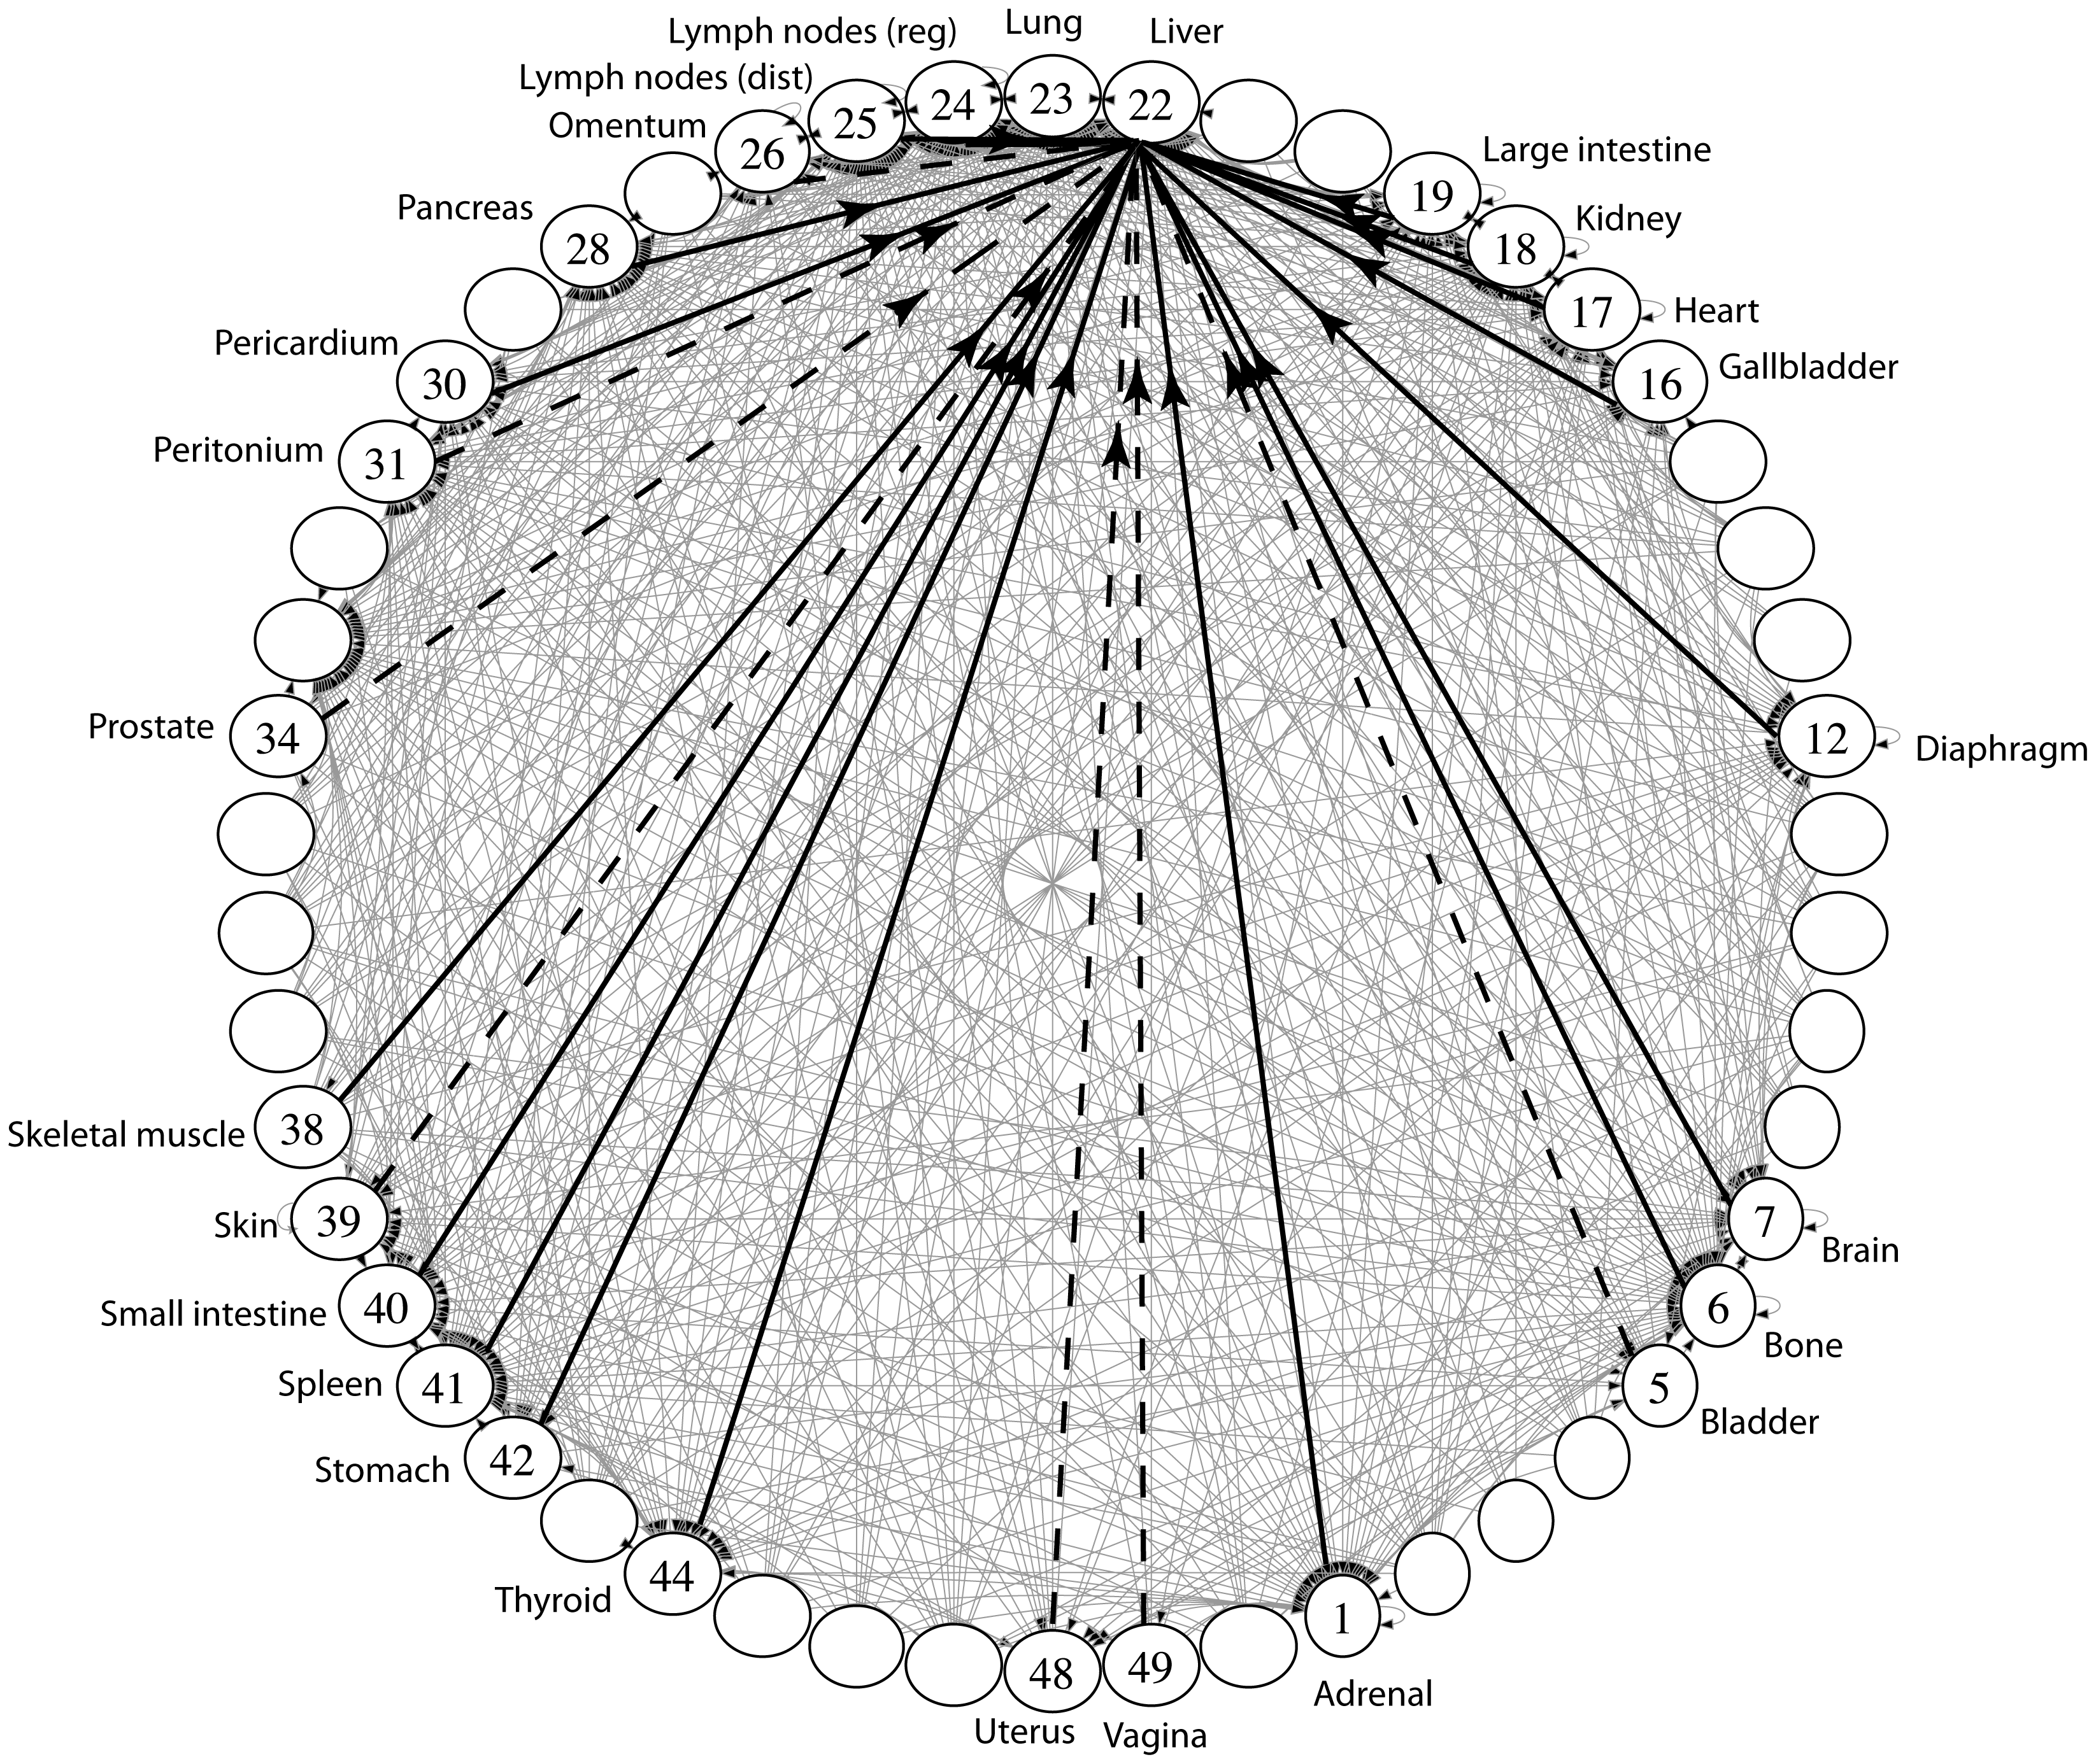
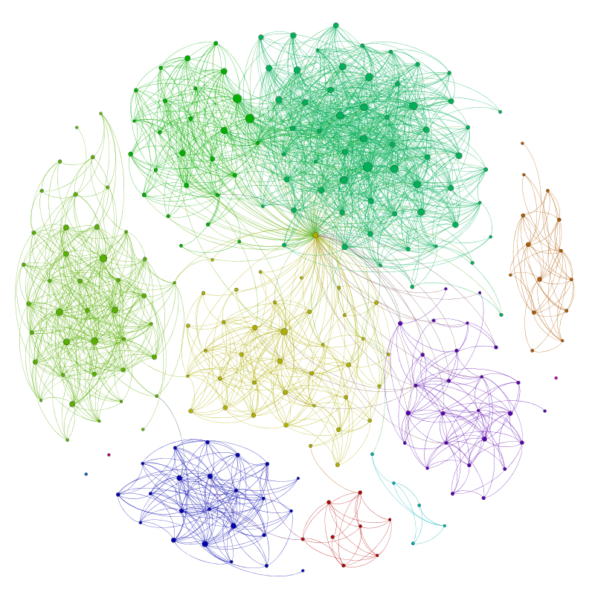
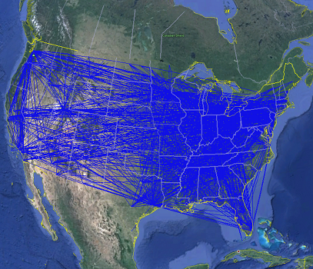
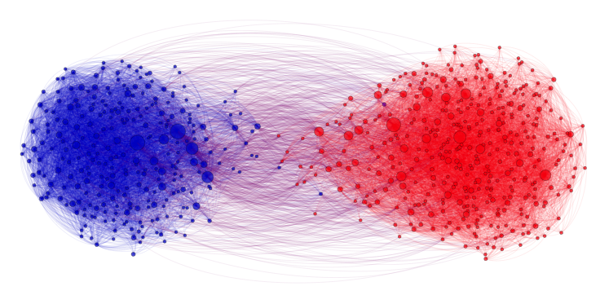
Applications
Physical Maps
Airline maps
Vertices are airports, edges are flight paths
Traffic
Vertices are addresses, edges are streets
Relationships
Social media graphs
Vertices are accounts, edges are follower relationships
Code bases
Vertices are classes, edges are usage
Influence
Biology
Vertices are cancer cell destinations, edges are migration paths
Related topics
Web Page Ranking
Vertices are web pages, edges are hyperlinks
Wikipedia
Vertices are articles, edges are links
SO MANY MORREEEE
www.allthingsgraphed.com

Slide 20
Graph Vocabulary
Undirected Graph:
Graph Direction
Undirected graph – edges have no direction and are two-way
Directed graphs – edges have direction and are thus one-way
Degree of a Vertex
Degree – the number of edges containing that vertex
A : 1, B : 1, C : 1
In-degree – the number of directed edges that point to a vertex
A : 0, B : 2, C : 1
Out-degree – the number of directed edges that start at a vertex
A : 1, B : 1, C : 1
A
B
V = { A, B, C }
E = { (A, B), (B, C) } inferred (B, A) and (C,B)
Undirected Graph:
C
V = { A, B, C }
B
E = { (A, B), (B, C), (C, B) }
A
C

Slide 21
Food for thought
Is a graph valid if there exists a vertex with a degree of 0?
Yes
B
B
B
A
A
A
C
C
C
A has an “in degree” of 0
B has an “out degree” of 0
C has both an “in degree” and an “out degree” of 0
Are these valid?
Is this a valid graph?
Yup
A
B
A
B
C
A
Yes!
Sure
D
C

Slide 22
Graph Vocabulary
Self loop – an edge that starts and ends at the same vertex
Parallel edges – two edges with the same start and end vertices
Simple graph – a graph with no self-loops and no parallel edges
A
A
B

