Slide 1
Sorting
Data Structures and Algorithms

Slide 2
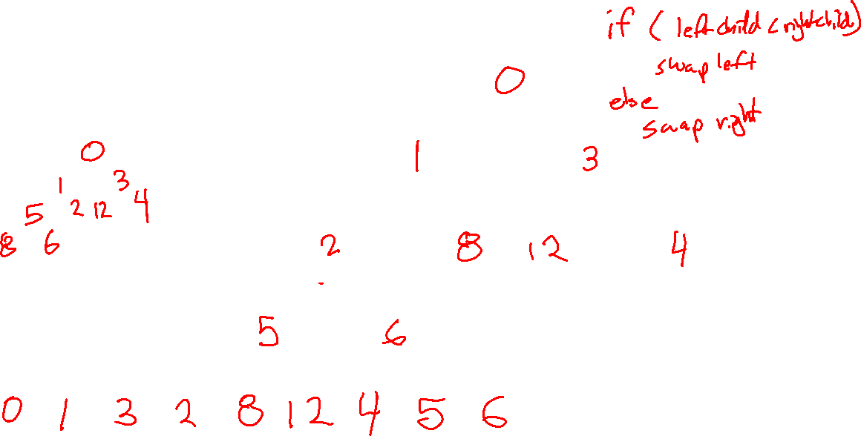
Warmup
buildHeap([8, 2, 4, 0, 1, 12, 3, 5 6])

Slide 3
Sorting
Comparison Sorts
Compare two elements at a time
General sort, works for most types of elements
Element must form a “consistent, total ordering”
For every element a, b and c in the list the following must be true:
  If a <= b and b <= a then a = b
  If a <= b and b <= c then a <= c
  Either a <= b is true or <= a
What does this mean? compareTo() works for your elements
Comparison sorts run at fastest O(nlog(n)) time
Take this:
3, 7, 0, 6, 9, 8, 1, 2, 5, 8
And make this:
0, 1, 2, 3, 5, 6, 7, 8, 8, 9
Or this:
9, 8, 8, 7, 6, 5, 3, 2, 1, 0
Niche Sorts aka “linear sorts”
Leverages specific properties about the items in the list to achieve faster runtimes
niche sorts typically run O(n) time
In this class we’ll focus on comparison sorts

Slide 4
Why Not Just Heap Sort? It’s O(n log n)…
In Place sort
A sorting algorithm is in-place if it requires only O(1) extra space to sort the array
Typically modifies the input collection
Useful to minimize memory usage
Other Considerations
Worst Case, Average Case
External Sorts (can’t fit in memory)
Good for small data sets
Ease of implementation
LinkedList vs Array
Stable sort
A sorting algorithm is stable if any equal items remain in the same relative order before and after the sort
Why do we care?
  Sometimes we want to sort based on some, but not all attributes of an item
  Items that “compareTo()” the same might not be exact duplicates
  Enables us to sort on one attribute first then another etc…
[(8, “fox”), (9, “dog”), (4, “wolf”), (8, “cow”)]
[(4, “wolf”), (8, “fox”), (8, “cow”), (9, “dog”)]
Stable
[(4, “wolf”), (8, “cow”), (8, “fox”), (9, “dog”)]
Unstable

Slide 5
Selection Sort
https://www.youtube.com/watch?v=Ns4TPTC8whw
Basic Idea:
Repeatedly scan through the list, moving the next smallest element to the front.
This sounds a lot like heap sort, but worse…

Slide 6
Selection Sort
https://www.youtube.com/watch?v=Ns4TPTC8whw
0 | 1 | 2 | 3 | 4 | 5 | 6 | 7 | 8 | 9
2 | 3 | 6 | 7 | 18 | 10 | 14 | 9 | 11 | 15
Sorted Items
Current Item
Unsorted Items
0 | 1 | 2 | 3 | 4 | 5 | 6 | 7 | 8 | 9
2 | 3 | 6 | 7 | 9 | 10 | 14 | 18 | 11 | 15
Sorted Items
Current Item
Unsorted Items
0 | 1 | 2 | 3 | 4 | 5 | 6 | 7 | 8 | 9
2 | 3 | 6 | 7 | 9 | 10 | 18 | 14 | 11 | 15
Sorted Items
Unsorted Items
Current Item

Slide 7
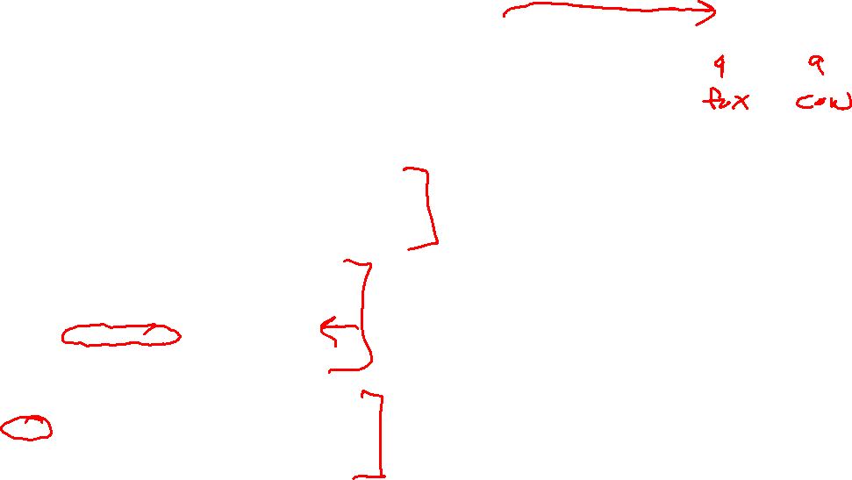
Selection Sort
0 | 1 | 2 | 3 | 4 | 5 | 6 | 7 | 8 | 9
2 | 3 | 6 | 7 | 18 | 10 | 14 | 9 | 11 | 15
Sorted Items
Current Item
Unsorted Items
public void selectionSort(collection) {
for (entire list)
int newIndex = findNextMin(currentItem);
swap(newIndex, currentItem);
}
public int findNextMin(currentItem) {
min = currentItem
for (unsorted list)
if (item < min)
min = currentItem
return min
}
public int swap(newIndex, currentItem) {
temp = currentItem
currentItem = newIndex
newIndex = currentItem
}
Worst case runtime?
Best case runtime?
Average runtime?
Stable?
In-place?
O(n²)
O(n²)
O(n²)
Yes
Yes

Slide 8
Insertion Sort
https://www.youtube.com/watch?v=ROalU379l3U
Basic Idea:
Like you would sort a hand of cards – pull out the next card, then insert it into it where it belongs

Slide 9
Insertion Sort
https://www.youtube.com/watch?v=ROalU379l3U
0 | 1 | 2 | 3 | 4 | 5 | 6 | 7 | 8 | 9
2 | 3 | 6 | 7 | 5 | 8 | 4 | 10 | 2 | 8
Sorted Items
Current Item
Unsorted Items
0 | 1 | 2 | 3 | 4 | 5 | 6 | 7 | 8 | 9
2 | 3 | 5 | 6 | 7 | 8 | 4 | 10 | 2 | 8
Sorted Items
Unsorted Items
Current Item
0 | 1 | 2 | 3 | 4 | 5 | 6 | 7 | 8 | 9
2 | 3 | 5 | 6 | 7 | 8 | 4 | 10 | 2 | 8
Sorted Items
Unsorted Items
Current Item

Slide 10
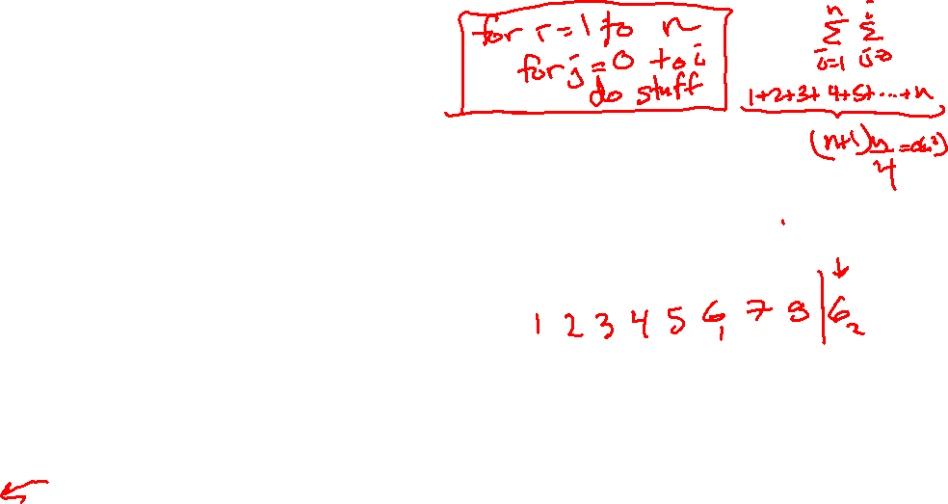
Insertion Sort
0 | 1 | 2 | 3 | 4 | 5 | 6 | 7 | 8 | 9
2 | 3 | 5 | 6 | 7 | 8 | 4 | 10 | 2 | 8
Sorted Items
Unsorted Items
Current Item
public void insertionSort(collection) {
for (entire list)
if(currentItem is bigger than nextItem)
int newIndex = findSpot(currentItem);
shift(newIndex, currentItem);
}
public int findSpot(currentItem) {
for (sorted list)
if (spot found) return
}
public void shift(newIndex, currentItem) {
for (i = currentItem > newIndex)
item[i+1] = item[i]
item[newIndex] = currentItem
}
Worst case runtime?
Best case runtime?
Average runtime?
Stable?
In-place?
O(n²)
O(n)
O(n²)
Yes
Yes

Slide 11

Heap Sort
https://www.youtube.com/watch?v=Xw2D9aJRBY4
1. run Floyd’s buildHeap on your data
2. call removeMin n times
public void heapSort(collection) {
E[] heap = buildHeap(collection)
E[] output = new E[n]
for (n)
output[i] = removeMin(heap)
}
Worst case runtime?
Best case runtime?
Average runtime?
Stable?
In-place?
O(nlogn)
O(nlogn)
O(nlogn)
No
No

Slide 12
In Place Heap Sort
0 | 1 | 2 | 3 | 4 | 5 | 6 | 7 | 8 | 9
1 | 4 | 2 | 14 | 15 | 18 | 16 | 17 | 20 | 22
Heap
Sorted Items
Current Item
0 | 1 | 2 | 3 | 4 | 5 | 6 | 7 | 8 | 9
22 | 4 | 2 | 14 | 15 | 18 | 16 | 17 | 20 | 1
percolateDown(22)
Heap
Sorted Items
Current Item
0 | 1 | 2 | 3 | 4 | 5 | 6 | 7 | 8 | 9
2 | 4 | 16 | 14 | 15 | 18 | 22 | 17 | 20 | 1
Heap
Sorted Items
Current Item

Slide 13

In Place Heap Sort
0 | 1 | 2 | 3 | 4 | 5 | 6 | 7 | 8 | 9
15 | 17 | 16 | 18 | 20 | 22 | 14 | 4 | 2 | 1
Heap
Sorted Items
Current Item
public void inPlaceHeapSort(collection) {
E[] heap = buildHeap(collection)
for (n)
output[n – i - 1] = removeMin(heap)
}
Worst case runtime?
Best case runtime?
Average runtime?
Stable?
In-place?
O(nlogn)
O(nlogn)
O(nlogn)
Complication: final array is reversed!
Run reverse afterwards (O(n))
Use a max heap
Reverse compare function to emulate max heap
No
Yes

Slide 14
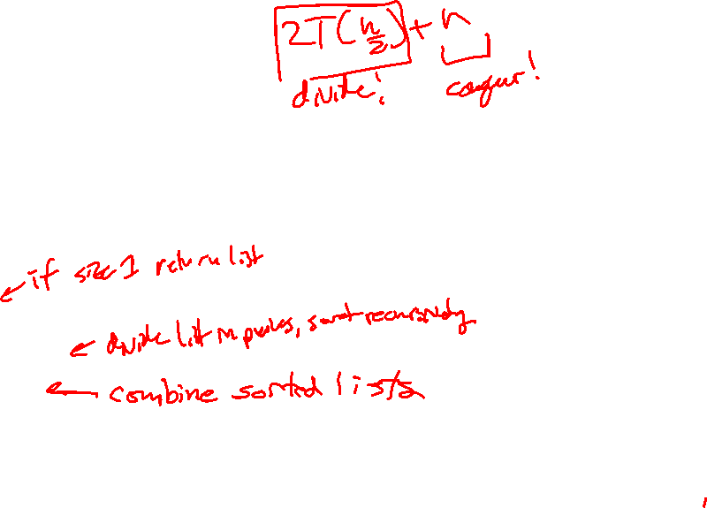
Divide and Conquer Technique
1. Divide your work into smaller pieces recursively
  Pieces should be smaller versions of the larger problem
2. Conquer the individual pieces
  Base case!
3. Combine the results back up recursively
divideAndConquer(input) {
if (small enough to solve)
conquer, solve, return results
else
divide input into a smaller pieces
recurse on smaller piece
combine results and return
}

Slide 15
Merge Sort
https://www.youtube.com/watch?v=XaqR3G_NVoo
Divide
0 | 1 | 2 | 3 | 4 | 5 | 6 | 7 | 8 | 9
8 | 2 | 91 | 22 | 57 | 1 | 10 | 6 | 7 | 4
0 | 1 | 2 | 3 | 4
8 | 2 | 91 | 22 | 57
5 | 6 | 7 | 8 | 9
1 | 10 | 6 | 7 | 4
0
8
Conquer
0
8
Combine
0 | 1 | 2 | 3 | 4
2 | 8 | 22 | 57 | 91
5 | 6 | 7 | 8 | 9
1 | 4 | 6 | 7 | 10
0 | 1 | 2 | 3 | 4 | 5 | 6 | 7 | 8 | 9
1 | 2 | 4 | 6 | 7 | 8 | 10 | 22 | 57 | 91

Slide 16
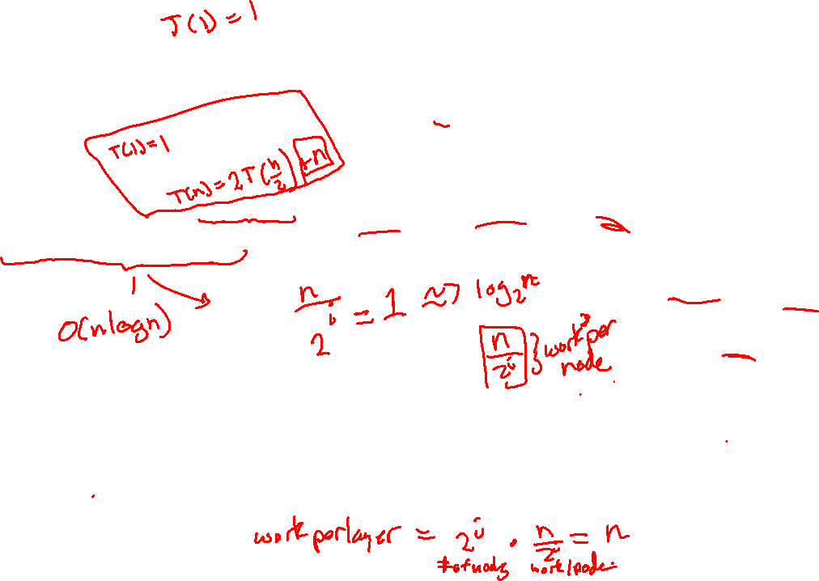
Merge Sort
0 | 1 | 2 | 3 | 4
8 | 2 | 57 | 91 | 22
0 | 1
8 | 2
0 | 1 | 2
57 | 91 | 22
mergeSort(input) {
if (input.length == 1)
return
else
smallerHalf = mergeSort(new [0, ..., mid])
largerHalf = mergeSort(new [mid + 1, ...])
return merge(smallerHalf, largerHalf)
}
0
8
0
2
0
57
0 | 1
91 | 22
0
91
0
22
0 | 1
22 | 91
Worst case runtime?
Best case runtime?
Average runtime?
Stable?
In-place?
T(n) =
1 if n<= 1
2T(n/2) + n otherwise
0 | 1
2 | 8
0 | 1 | 2
22 | 57 | 91
Yes
0 | 1 | 2 | 3 | 4
2 | 8 | 22 | 57 | 91
No

Slide 17
Merge Sort Optimization
Use just two arrays – swap between them

Slide 18
Quick Sort
https://www.youtube.com/watch?v=ywWBy6J5gz8
Divide
Conquer
Combine
0 | 1 | 2 | 3 | 4 | 5 | 6 | 7 | 8 | 9
8 | 2 | 91 | 22 | 57 | 1 | 10 | 6 | 7 | 4
0 | 1 | 2 | 3 | 4
2 | 1 | 6 | 7 | 4
0
8
0 | 1 | 2 | 3
91 | 22 | 57 | 10
0
6
0
6
0 | 2 | 3 | 4
2 | 22 | 57 | 91
0
8
5 | 6 | 7 | 8 | 9
1 | 4 | 6 | 7 | 10
0 | 1 | 2 | 3 | 4 | 5 | 6 | 7 | 8 | 9
1 | 2 | 4 | 6 | 7 | 8 | 10 | 22 | 57 | 91

Slide 19
Quick Sort
0 | 1 | 2 | 3 | 4 | 5 | 6
20 | 50 | 70 | 10 | 60 | 40 | 30
0
10
0 | 1 | 2 | 3 | 4
50 | 70 | 60 | 40 | 30
quickSort(input) {
if (input.length == 1)
return
else
pivot = getPivot(input)
smallerHalf = quickSort(getSmaller(pivot, input))
largerHalf = quickSort(getBigger(pivot, input))
return smallerHalf + pivot + largerHalf
}
0 | 1
40 | 30
0 | 1
70 | 60
0
30
0
60
0 | 1
30 | 40
0 | 1
60 | 70
Worst case runtime?
Best case runtime?
Average runtime?
Stable?
In-place?
T(n) =
1 if n<= 1
n + T(n - 1) otherwise
0 | 1 | 2 | 3 | 4
30 | 40 | 50 | 60 | 70
T(n) =
1 if n<= 1
n + 2T(n/2) otherwise
0 | 1 | 2 | 3 | 4 | 5 | 6
10 | 20 | 30 | 40 | 50 | 60 | 70
No
No

Slide 20
Can we do better?
Pick a better pivot
  Pick a random number
  Pick the median of the first, middle and last element
Sort elements by swapping around pivot in place

Slide 21
Better Quick Sort
0 | 1 | 2 | 3 | 4 | 5 | 6 | 7 | 8 | 9
8 | 1 | 4 | 9 | 0 | 3 | 5 | 2 | 7 | 6
0 | 1 | 2 | 3 | 4 | 5 | 6 | 7 | 8 | 9
6 | 1 | 4 | 9 | 0 | 3 | 5 | 2 | 7 | 8
Low
X < 6
High
X >= 6
0 | 1 | 2 | 3 | 4 | 5 | 6 | 7 | 8 | 9
6 | 1 | 4 | 2 | 0 | 3 | 5 | 9 | 7 | 8
Low
X < 6
High
X >= 6

Slide 22
Announcements
Project 1 (Calculator) is Due Tonight! Use “SUBMIT” as tag.
HW3 (Individual Assignment) will be assigned this weekend
- Due Sunday 7/22
- Make sure you know how to do it before the midterm! It’s the best midterm review
Come to Class Next Week:
- Monday: Midterm Review – Going from Diagrams to Code
- Wednesday: Software Engineering – Deep Dive into Git, Pair Programming, and Testing
- Friday: Midterm Exam! – Review materials and practice midterms on website (this evening).

Slide 23
More Announcements
If you are applying to the CSE major, send me an e-mail reminding me of our interactions
Office hours immediately after class – follow me!

