Slide 1
Priority Queues and Heaps
Data Structures and Algorithms

Slide 2
Warm Up
We have seen several data structures that can implement the Dictionary ADT so far: Arrays, Binary (AVL) Trees, and Hash Tables.
Discuss with your neighbors the relative merits of each approach?
Is there any reason to choose an AVL Tree Dictionary over a Hash Table?

Slide 3
BST vs Hash Table
BST advantages
Hash Table advantages
Extra Operations: Get keys in sorted order, ordering statistics (min-key, max-key, etc.), “closest” elements, range queries
O(log n) worst case runtime guaranteed, better than O(n) for hash tables
Easier to implement
O(1) Average Case Operations
Array Lookups can be an order of magnitude faster than following references

Slide 4
How can we track the “biggest” thing?
Last class, a question was raised: couldn’t we guarantee O(1) operations if we kept track of the largest cluster in a hash table?

Slide 5
ADT: Priority Queue
A Priority Queue models a collection that is not First-In-First-Out (FIFO), but instead most-important-in-first-out.
Example: Hospital emergency room. The patient who is most in danger is treated first.
Items in a priority queue are comparable, and the comparison determines priority. Often this is done by inserting items as a pair: (item, priority).
Operations:
insert(item, [priority]) – adds an item to the queue with a given priority
deleteMin() – removes and returns the most-important item in the priority queue
peekMin() – returns the most-important item in the priority queue without removal
(This is a min priority queue. You can also have a max priority queue by swapping min/max.)
Notes:
(We will consider the “smallest” priority to be the most important, choosing min vs max is not important to the implementation as long as the choice is consistent. A min priority queue can be used in place of max, and vis-versa, by negating all of the priorities, or by reversing the comparison operator)

Slide 6
Implementing Priority Queue
Idea | Description | removeMin() runtime | peekMin() runtime | insert() runtime
Unsorted ArrayList | Linear collection of values, stored in an Array, in order of insertion | O(n) | O(n) | O(1)
Unsorted LinkedList | Linear collection of values, stored in Nodes, in order of insertion | O(n) | O(n) | O(1)
Sorted ArrayList | Linear collection of values, stored in an Array, priority order maintained as items are added | O(1) | O(1) | O(n)
Sorted Linked List | Linear collection of values, stored in Nodes, priority order maintained as items are added | O(1) | O(1) | O(n)
Binary Search Tree | Hierarchical collection of values, stored in Nodes, priority order maintained as items are added | O(n) | O(n) | O(n)
AVL tree | Balanced hierarchical collection of values, stored in Nodes, priority order maintained as items are added | O(logn) | O(logn) | O(logn)

Slide 7

Heaps
Priority Queue Data Structure
Notes:
The idea of a heap is that since we only care about the smallest element, we really just need to keep track of that. Just like this heap of rocks has big rocks near the bottom and small ones near the top, we want the smallest element to “float to the top”.

Slide 8
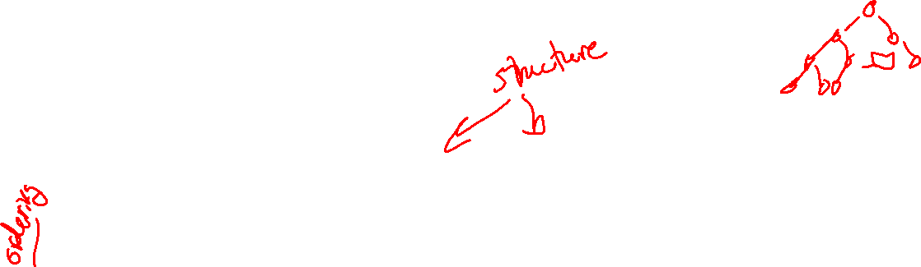
Binary Heap
A type of tree with new set of invariants
1. Binary Tree: every node has at most 2 children
2. Heap: every node is smaller than its child
3. Structure: Each level is “complete” meaning it has no “gaps”
- Heaps are filled up left to right
1
8
1
2
3
9
10
2
3
22
4
5
4
5
6
7
36
9
10
47
8
Notes:
For AVLs we had 3 invariants as well – Balance, binary tree, and search tree. The first two were “Structure” properties, while the last is an “ordering” property. Binary heaps also have 2 structure properties and one ordering property.

Slide 9
Self Check - Are these valid heaps?
Binary Heap Invariants:
Binary Tree
Heap
Complete
INVALID
INVALID
VALID
4
1
4
2
5
3
5
6
3
7
8
7
9
8
7
9
11
10
6

Slide 10
Implementing peekMin()
2
4
7
5
8
10
9
11
13

Slide 11
Implementing removeMin()
Removing overallRoot creates a gap
Replacing with one of its children causes lots of gaps
What node can we replace with overallRoot that wont cause any gaps?
2
13
4
7
4
7
5
8
10
9
5
8
10
9
11
13
11
Structure maintained, heap broken
Notes:
When adding or removing from an AVL tree, we maintained the ordering property (by moving the most extreme leaf on one side or putting something in the correct spot in the tree) and then fixed the structure property by re-balancing.
For heaps, we again maintain one invariant first, then fix the others, but this time we maintain structure by adding or removing so as to maintain completeness, and then we fix the ordering property.

Slide 12
Fixing Heap – percolate down
Recursively swap parent with smallest child
13
4
4
7
5
13
5
10
9
13
11
8
11
13
percolateDown(node) {
while (node.data is bigger than its children) {
swap data with smaller child
}
}

Slide 13
Self Check – removeMin() on this tree
5
18
9
9
18
10
11
17
14
11
13
18
20
19
16
15
24
22
18

Slide 14
Implementing insert()
Insert a node to ensure no gaps
Fix heap invariant
percolate UP
2
4
7
3
5
8
10
9
4
3
11
13
3
7

Slide 15
How long does percolating take?
Up and Down both go through all levels
- O(h)
How tall is the tree?
- Complete trees are always balanced (all leaves in level h or h+1)
- h = log n
So, percolation is O(log n)

Slide 16
Problems
Finding the last child in a complete tree is O(n)
Finding parents is difficult without back-links (O(n)), so percolate-up is hard
A
B
C
D
E
F
G
H
I
J

Slide 17
0
0
1
1
2
2
3
3
4
4
5
5
6
6
7
7
8
8
9
9
10
10
11
11
A
B
C
D
E
F
G
H
I
J
Indices:
min =
0
last =
n - 1
insert location =
n
left child of i =
2i + 1
right child of i =
2i + 2
parent of i =
(i - 1) / 2

Slide 18
Runtimes
Calculating Indices is ϴ(1)
peekMin = find min index = ϴ(1)
removeMin = find min index + find last index + swap + percolate down
= ϴ(1) + ϴ(1) + ϴ(1) + ϴ(log n)
= ϴ(log n)
insert = find insert location + add to array + percolate up
= ϴ(1) + ϴ(1) + ϴ(log n)
= ϴ(log n)

Slide 19

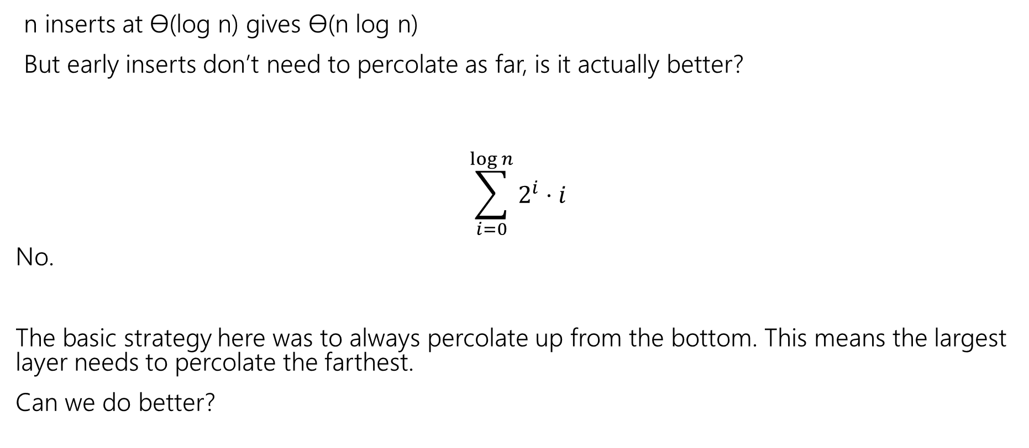
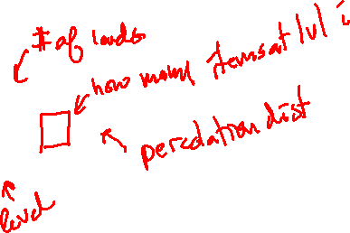
How Long to build a heap from scratch?
n inserts at ϴ(log n) gives ϴ(n log n)
But early inserts don’t need to percolate as far, is it actually better?
$$\sum_{i=0}^{\log{n}}{2^{i}}⋅ⅈ$$
No.
The basic strategy here was to always percolate up from the bottom. This means the largest layer needs to percolate the farthest.
Can we do better?
$$=θ\left(n\log{n}\right)$$

Slide 20
Floyd’s Build Heap
Main Idea: Start from the bottom (end of array) and percolate down.
This ensures that the largest layer has the least distance to percolate.
We start with the structural invariants (complete binary tree) fulfilled, and then fix the ordering invariant (the heap property – parents smaller than children)
After each percolation, the subtree rooted at the percolated node is a valid min-heap!
buildHeap(array) – Modifies an array in-place to be a heap

Slide 21
Floyd’s buildHeap algorithm
Build a tree with the values:
12, 5, 11, 3, 10, 2, 9, 4, 8, 1, 7, 6
12
Add all values to back of array
percolateDown(parent) starting at last index
5
11
3
10
2
9
4
8
1
7
6
0 | 1 | 2 | 3 | 4 | 5 | 6 | 7 | 8 | 9 | 10 | 11 | 12 | 13
12
5
11
3
10
2
9
4
8
1
7
6

Slide 22
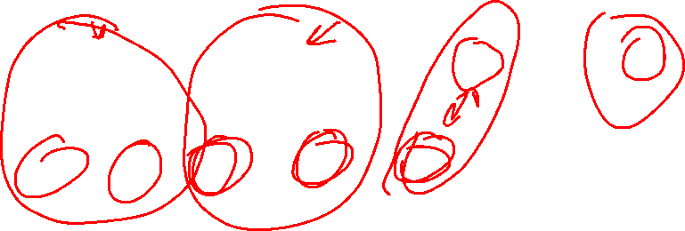
Floyd’s buildHeap algorithm
Build a tree with the values:
12, 5, 11, 3, 10, 2, 9, 4, 8, 1, 7, 6
12
2
Add all values to back of array
percolateDown(parent) starting at last index
  percolateDown level 3
  percolateDown level 2
  percolateDown level 1
  percolateDown level 0
3
2
5
11
11
5
7
11
9
3
10
2
4
8
1
7
6
10
0 | 1 | 2 | 3 | 4 | 5 | 6 | 7 | 8 | 9 | 10 | 11 | 12 | 13
12
5
11
3
10
2
9
4
8
1
7
6

Slide 23

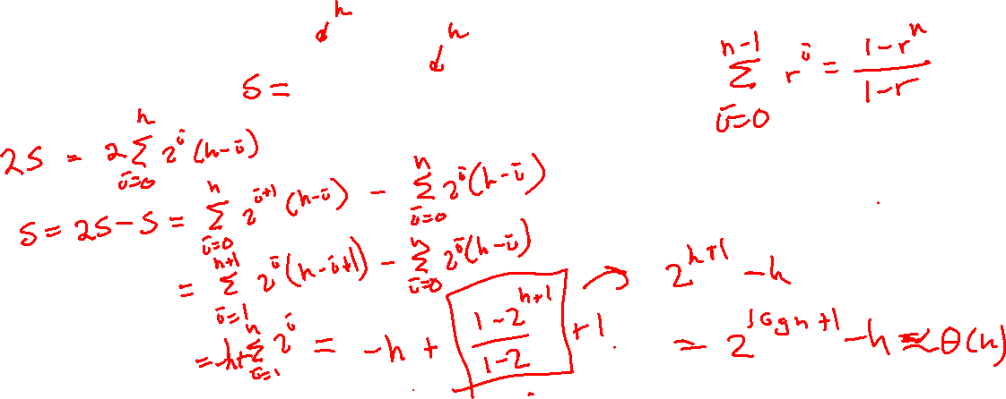
Floy’d buildHeap Runtime
For repeated inserts we had $\sum_{i=0}^{\log{n}}{2^{i}}⋅ⅈ$
Work per node at the i-th level is now (log n – i) since we percolate down
$$\sum_{i=0}^{\log{n}}{2^{i}}⋅(\log{n −i)= θ\left(n\right)}$$

Slide 24
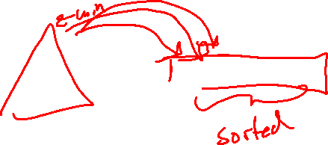
Heap Sort
Can we use a heap to sort data?
Yes! Heap Sort: repeatedly removeMin, and add this to an output array.
This takes an extra array of space. Can we do better?
Yes! Re-use the space vacated at the end of the array after each remove.
This reverses the sorting order – either reverse the list (O(n)), or use a max-heap!

Slide 25
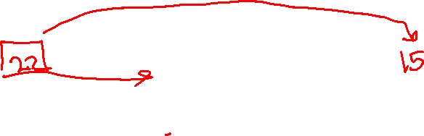
In Place Heap Sort
0 | 1 | 2 | 3 | 4 | 5 | 6 | 7 | 8 | 9
15 | 17 | 16 | 18 | 20 | 22 | 14 | 4 | 2 | 1
Heap
Sorted Items
Current Item
public void inPlaceHeapSort(collection) {
E[] heap = buildHeap(collection)
for (n)
output[n – i - 1] = removeMin(heap)
}
Worst case runtime?
Best case runtime?
Average runtime?
O(nlogn)
O(nlogn)
O(nlogn)
Complication: final array is reversed!
Run reverse afterwards (O(n))
Use a max heap
Reverse compare function to emulate max heap

Slide 26
Announcements
Midterm is next Friday in class
- All material up to and including next Monday’s lecture is fair game
HW3 (an individual written assignment) will be posted soon
- Excellent midterm review (similar questions)
- Due after midterm, but HIGHLY SUGGESTED you at least solve, if not write up, all of the questions before midterm as studying.
Project 1 is due Friday by midnight

