Slide 1
Hash Open Indexing
Data Structures and Algorithms

Slide 2
Warm Up
Discuss with your neighbors:
- What is a collision in a hash table, and how can we handle it?
- What is the load factor?
- What is the probability of a collision in a hash table?
- What’s the worst case time complexity for adding an element to a hash table? Why?
- What’s the expected case time complexity for adding an element to a hash table? Why?

Slide 3

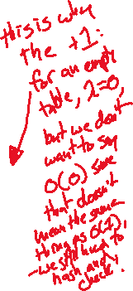
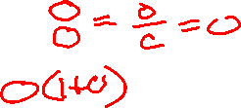
Review: Handling Collisions
Solution 1: Chaining
Each space holds a “bucket” that can store multiple values. Bucket is often implemented with a LinkedList
Operation |  | Array w/ indices as keys
put(key,value) | best | O(1)
 | average | O(1 + λ)
 | worst | O(n)
get(key) | best | O(1)
 | average | O(1 + λ)
 | worst | O(n)
remove(key) | best | O(1)
 | average | O(1 + λ)
 | worst | O(n)
Average Case:
Depends on average number of elements per chain
Load Factor λ
If n is the total number of key-value pairs
Let c be the capacity of array
Load Factor λ = $\frac{n}{c}$

Slide 4

Handling Collisions
Solution 2: Open Addressing
Resolves collisions by choosing a different location to tore a value if natural choice is already full.
Type 1: Linear Probing
If there is a collision, keep checking the next element until we find an open spot.
public int hashFunction(String s)
int naturalHash = this.getHash(s);
if(natural hash in use) {
int i = 1;
while (index in use) {
try (naturalHash + i);
i++;

Slide 5
Linear Probing
Insert the following values into the Hash Table using a hashFunction of % table size and linear probing to resolve collisions
1, 5, 11, 7, 12, 7, 6, 25
0 | 1 | 2 | 3 | 4 | 5 | 6 | 7 | 8 | 9
6
17
1
12
25
7
11
5

Slide 6
Linear Probing
Insert the following values into the Hash Table using a hashFunction of % table size and linear probing to resolve collisions
38, 19, 8, 109, 10
0 | 1 | 2 | 3 | 4 | 5 | 6 | 7 | 8 | 9
8
10
38
8
19
109
Problem:
  Linear probing causes clustering
  Clustering causes more looping when probing
Primary Clustering
When probing causes long chains of occupied slots within a hash table

Slide 7
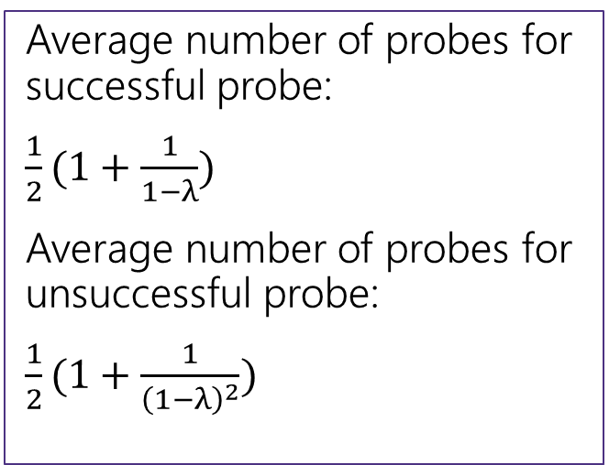
Runtime
When is runtime good?
Empty table
When is runtime bad?
Table nearly full
When we hit a “cluster”
Maximum Load Factor?
λ at most 1.0
When do we resize the array?
λ ≈ ½
Average number of probes for successful probe:
$\frac{1}{2}(1+\frac{1}{1−λ})$
Average number of probes for unsuccessful probe:
$\frac{1}{2}(1+\frac{1}{{\left(1−λ\right)}^{2}})$

Slide 8
Can we do better?
Clusters are caused by picking new space near natural index
Solution 2: Open Addressing
Type 2: Quadratic Probing
If we collide instead try the next i² space
public int hashFunction(String s)
int naturalHash = this.getHash(s);
if(natural hash in use) {
int i = 1;
while (index in use) {
try (naturalHash + i);
i++;
i * i);

Slide 9
Quadratic Probing
Insert the following values into the Hash Table using a hashFunction of % table size and quadratic probing to resolve collisions
89, 18, 49, 58, 79
0 | 1 | 2 | 3 | 4 | 5 | 6 | 7 | 8 | 9
58
79
18
49
89
(49 % 10 + 0 * 0) % 10 = 9
(49 % 10 + 1 * 1) % 10 = 0
(58 % 10 + 0 * 0) % 10 = 8
(58 % 10 + 1 * 1) % 10 = 9
(58 % 10 + 2 * 2) % 10 = 2
Problems:
If λ≥ ½ we might never find an empty spot
  Infinite loop!
Can still get clusters
(79 % 10 + 0 * 0) % 10 = 9
(79 % 10 + 1 * 1) % 10 = 0
(79 % 10 + 2 * 2) % 10 = 3

Slide 10
Secondary Clustering
Insert the following values into the Hash Table using a hashFunction of % table size and quadratic probing to resolve collisions
19, 39, 29, 9
0 | 1 | 2 | 3 | 4 | 5 | 6 | 7 | 8 | 9
39
29
9
19
Secondary Clustering
When using quadratic probing sometimes need to probe the same sequence of table cells, not necessarily next to one another

Slide 11
Probing
  h(k) = the natural hash
  h’(k, i) = resulting hash after probing
  i = iteration of the probe
  T = table size
Linear Probing:
h’(k, i) = (h(k) + i) % T
Quadratic Probing
h’(k, i) = (h(k) + i²) % T
For both types there are only O(T) probes available
  Can we do better?

Slide 12

Double Hashing
Probing causes us to check the same indices over and over- can we check different ones instead?
Use a second hash function!
h’(k, i) = (h(k) + i * g(k)) % T
public int hashFunction(String s)
int naturalHash = this.getHash(s);
if(natural hash in use) {
int i = 1;
while (index in use) {
try (naturalHash + i * jump_Hash(key));
i++;
<- Most effective if g(k) returns value prime to table size

Slide 13






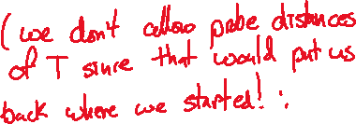


Second Hash Function
Effective if g(k) returns a value that is relatively prime to table size
  If T is a power of 2, make g(k) return an odd integer
  If T is a prime, make g(k) return any smaller, non-zero integer
    g(k) = 1 + (k % T(-1))
  How many different probes are there?
  T different starting positions
  T – 1 jump intervals
  O(T²) different probe sequences
    Linear and quadratic only offer O(T) sequences

Slide 14
Summary
1. Pick a hash function to:
  Avoid collisions
  Uniformly distribute data
  Reduce hash computational costs
2. Pick a collision strategy
  Chaining
    LinkedList
    AVL Tree
  Probing
    Linear
    Quadratic
  Double Hashing
No clustering
Potentially more “compact” (λ can be higher)
Managing clustering can be tricky
Less compact (keep λ < ½)
Array lookups tend to be a constant factor faster than traversing pointers

