Slide 1
Binary Search Trees
Data Structures and Algorithms

Slide 2
Warm Up
What is the runtime for get, put, and remove of an ArrayDictionary?
Can you think of a way of making it better?

Slide 3
Finding your partner
Your repository will be titled
project1-NETID1-NETID2
To find your partner, take the NETID that isn’t yours, add @uw.edu, and e-mail them!
If that still doesn’t work, e-mail the course staff and we’ll send an introductory e-mail to the two of you.

Slide 4
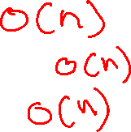
Storing Items in an Array
get(key):
put(key, value):
remove():
Key
3
4
7
9
10
12
15
Value
“dog”
“cat”
“bird”
“horse”
“oxen”
“ferret”
“moose”

Slide 5
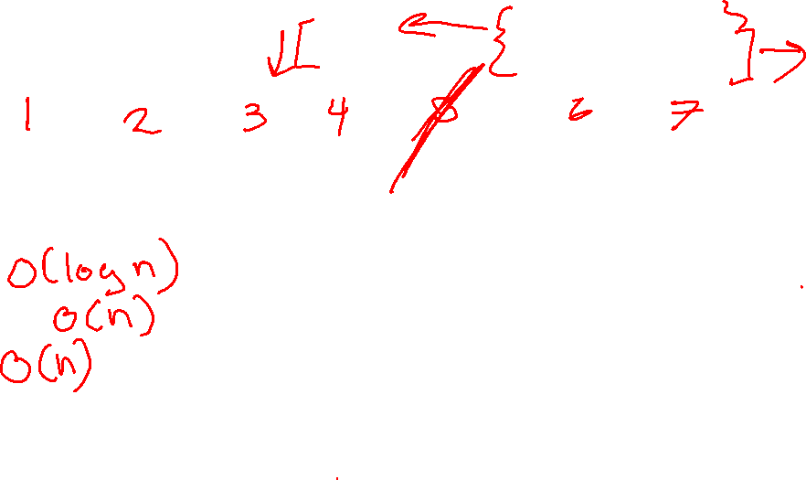
Storing Sorted Items in an Array
get(key):
put(key, value):
remove():
Key
7
4
3
12
10
9
15
Value
“bird”
“cat”
“dog”
“ferret”
“oxen”
“horse”
“moose”

Slide 6
Storing Sorted Items in an Array
get() – O(logn)
put() – O(n)
remove() – O(n)
Can we do better with insertions and removals?

Slide 7
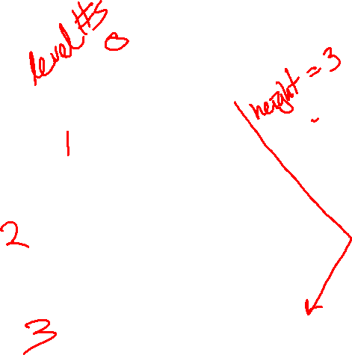
Trees!
A tree is a collection of nodes
  Each node has at most 1 parent and 0 or more children
Root node: the single node with no parent, “top” of the tree
Branch node: a node with one or more children
Leaf node: a node with no children
Edge: a pointer from one node to another
Subtree: a node and all it descendants
Height: the number of edges contained in the longest path from root node to some leaf node
1
2
5
3
6
7
4
8

Slide 8
Tree Height
What is the height of the following trees?
overallRoot
overallRoot
overallRoot
1
7
null
2
5
7
Height = 2
Height = 0
Height = -1 or NA

Slide 9

Traversals
traversal: An examination of the elements of a tree.
  A pattern used in many tree algorithms and methods
Common orderings for traversals:
  pre-order: process root node, then its left/right subtrees
    17 41 29 6 9 81 40
  in-order: process left subtree, then root node, then right
    29 41 6 17 81 9 40
  post-order: process left/right subtrees, then root node
    29 6 41 81 40 9 17
Traversal Trick: Sailboat method
  Trace a path around the tree.
  As you pass a node on the
  proper side, process it.
    pre-order: left side
    in-order: bottom
    post-order: right side
overallRoot
17
41
9
29
6
81
40

Slide 10
Binary Search Trees
A binary search tree is a binary tree that contains comparable items such that for every node, all children to the left contain smaller data and all children to the right contain larger data.
10
9
15
7
12
18
8
17

Slide 11
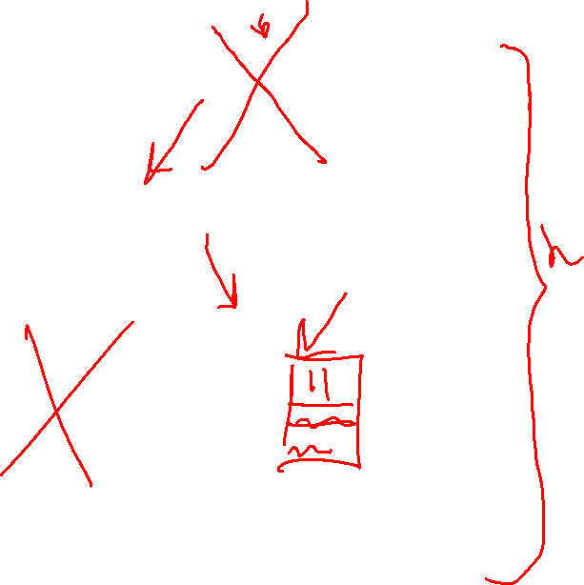
Implement Dictionary
10
“foo”
Binary Search Trees allow us to:
  quickly find what we’re looking for
  add and remove values easily
  Dictionary Operations:
  Runtime in terms of height, “h”
  get() – O(h)
  put() – O(h)
  remove() – O(h)
    What do you replace the node with?
    Largest in left sub tree or smallest in right sub tree
7
12
“bar”
“baz”
5
9
15
“fo”
“sho”
“sup”
1
8
13
“burp”
“poo”
“boo”

Slide 12
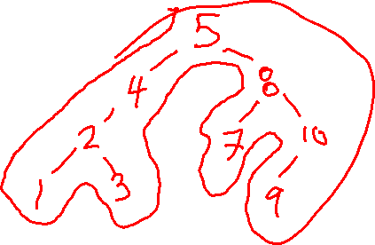
Practice
  What will the binary search tree look like if you insert nodes in the following order:
  5, 8, 7, 10, 9, 4, 2, 3, 1
  What is the pre-order traversal order for the resulting tree?

Slide 13

Height in terms of Nodes
For “balanced” trees h ≈ log_{c}(n) where c is the maximum number of children
Balanced binary trees h ≈ log₂(n)
Balanced trinary tree h ≈ log₃(n)
Thus for balanced trees operations take Θ(log_{c}(n))

Slide 14
Unbalanced Trees
10
Is this a valid Binary Search Tree?
Yes, but…
We call this a degenerate tree
For trees, depending on how balanced they are,
Operations at worst can be O(n) and at best
can be O(logn)
How are degenerate trees formed?
  insert(10)
  insert(9)
  insert(7)
  insert(5)
9
7
5

Slide 15
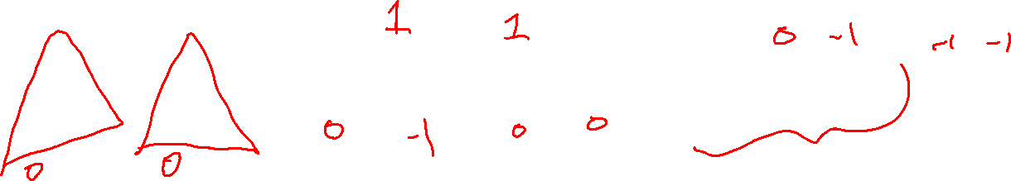
Measuring Balance
Measuring balance:
For each node, compare the heights of its two sub trees
Balanced when the difference in height between sub trees is no greater than 1
8
10
8
7
7
9
8
15
7
7
12
18

Slide 16
Meet AVL Trees
AVL Trees must satisfy the following properties:
  binary trees: all nodes must have between 0 and 2 children
  binary search tree: for all nodes, all keys in the left subtree must be smaller and all keys in the right subtree must be larger than the root node
  balanced: for all nodes, there can be no more than a difference of 1 in the height of the left subtree from the right. Math.abs(height(left subtree) – height(right subtree)) ≤ 1
  AVL stands for Adelson-Velsky and Landis (the inventors of the data structure)

Slide 17
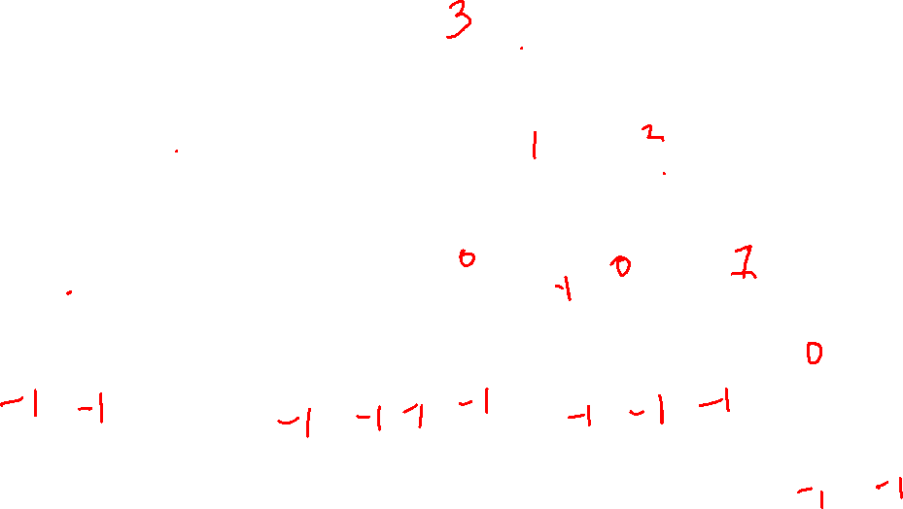
Is this a valid AVL tree?
7
Is it…
Binary
BST
Balanced?
yes
yes
4
10
yes
3
5
9
12
2
6
8
11
13
14

Slide 18
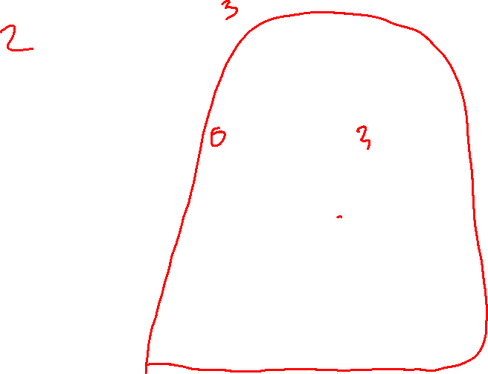
Is this a valid AVL tree?
6
Is it…
Binary
BST
Balanced?
yes
yes
2
8
no
Height = 0
Height = 2
1
4
7
12
3
5
10
13
9
11

Slide 19
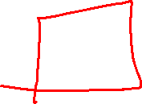
Is this a valid AVL tree?
8
Is it…
Binary
BST
Balanced?
yes
no
6
11
yes
2
7
15
-1
5
9
9 > 8

Slide 20
Implementing an AVL tree dictionary
Dictionary Operations:
get() – same as BST
containsKey() – same as BST
put() - ???
remove() - ???
Add the node to keep BST, fix AVL property if necessary
Replace the node to keep BST, fix AVL property if necessary
Unbalanced!
1
2
2
1
3
3

Slide 21
Rotations!
Unbalanced!
Balanced!
a
b
a
Insert ‘c’
b
b
a
X
Z
X
Y
Z
c
Y
Z
X
Y
c

Slide 22
Rotations!
Balanced!
Unbalanced!
a
b
a
Insert ‘c’
b
b
a
X
Z
X
Y
Z
c
Y
Z
X
Y
c

Slide 23
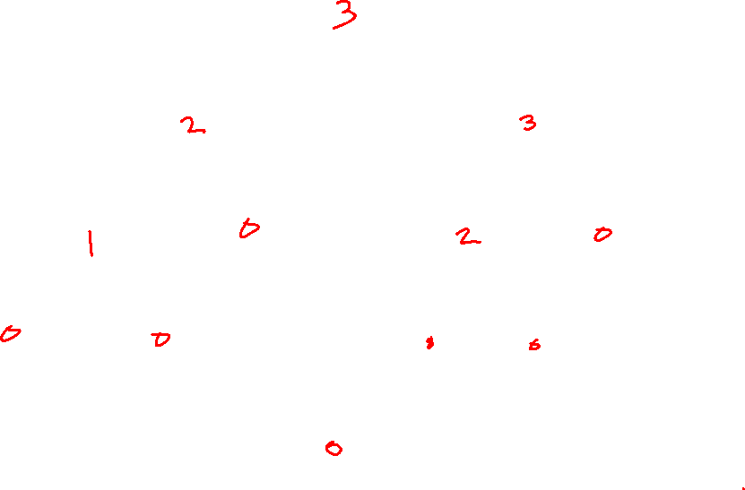
Practice
15
put(16);
8
22
4
10
19
24
3
6
17
20
16

Slide 24
Practice
15
put(16);
8
19
4
10
17
22
3
6
16
20
24

Slide 25
So much can go wrong
Unbalanced!
Unbalanced!
Unbalanced!
1
3
1
3
1
3
Rotate Left
Rotate Right
2
2
2

Slide 26

Two AVL Cases
Line Case
Solve with 1 rotation
Kink Case
Solve with 2 rotations
3
1
1
3
2
2
3
1
1
3
2
2
Rotate Right
Parent’s left becomes child’s right
Child’s right becomes its parent
Rotate Left
Parent’s right becomes child’s left
Child’s left becomes its parent
Rotate subtree left
Rotate root tree right
Rotate subtree right
Rotate root tree left

Slide 27
Double Rotations 1
Unbalanced!
a
a
a
Insert ‘c’
e
d
X
e
d
W
W
e
Z
d
Y
Z
Y
X
c
X
Z
Y
X
c

