Slide 1
Lecture 5: Master Theorem, Maps, and Iterators
Data Structures and Algorithms

Slide 2
Warmup
Draw a tree for this recurrence, and write equations for the recursive and non-recursive work:
$$T\left(n\right)=\left\{\begin{aligned}d when n≤1 \\ aT\left(\frac{n}{b}\right)+n^{c} otherwise\end{aligned}\right.$$

Slide 3
Warmup
$$T\left(n\right)=\left\{\begin{aligned}d when n≤1 \\ aT\left(\frac{n}{b}\right)+n^{c} otherwise\end{aligned}\right.$$

Slide 4
Master Theorem
Given a recurrence of the following form:
$$T\left(n\right)=\left\{\begin{aligned}d when n≤some constant \\ aT\left(\frac{n}{b}\right)+n^{c} otherwise\end{aligned}\right.$$
Where a, b, c, and d are all constants.
The big-theta solution always follows this pattern:
If
$$\log_{b}{a}<c$$
then
$$T\left(n\right) is Θ\left(n^{c}\right)$$
If
$$\log_{b}{a}=c$$
then
$$T\left(n\right) is Θ\left(n^{c}\log{n}\right)$$
If
$$\log_{b}{a}>c$$
then
$$T\left(n\right) is Θ\left(n^{\log_{b}{a}}\right)$$

Slide 5
Apply Master Theorem
Given a recurrence of the form:
$$d when n≤some constant$$
$$T\left(n\right)=$$
a = 2
b = 2
c = 1
d = 1
$$aT\left(\frac{n}{b}\right)+n^{c} otherwise$$
$$1 when n≤1$$
$$T\left(n\right)=$$
$$2T\left(\frac{n}{2}\right)+n otherwise$$
If
$$\log_{b}{a}<c$$
then
$$T\left(n\right) is Θ\left(n^{c}\right)$$
If
$$\log_{b}{a}=c$$
then
$$T\left(n\right) is Θ\left(n^{c}\log{n}\right)$$
If
$$\log_{b}{a}>c$$
then
$$T\left(n\right) is Θ\left(n^{\log_{b}{a}}\right)$$
$\log_{b}{a}=c$ ${⇒ log}_{2}{2}=1$
$$T\left(n\right) is Θ\left(n^{c}\log_{2}{n}\right)⇒Θ\left(n^{1}\log_{2}{n}\right)$$

Slide 6
Reflecting on Master Theorem
The case
Recursive case conquers work more quickly than it divides work
Most work happens near “top” of tree
Non recursive work in recursive case dominates growth, n^{c} term
The case
Work is equally distributed across levels of the tree
Overall work is approximately work at any level x height
The case
Recursive case divides work faster than it conquers work
Most work happens near “bottom” of tree
Work at base case dominates.
$$\log_{b}{a}<c$$
Given a recurrence of the form:
$$d when n≤some constant$$
$$T\left(n\right)=$$
$$aT\left(\frac{n}{b}\right)+n^{c} otherwise$$
If
$$\log_{b}{a}<c$$
then
$$T\left(n\right) is Θ\left(n^{c}\right)$$
$$\log_{b}{a}=c$$
If
$$\log_{b}{a}=c$$
then
$$T\left(n\right) is Θ\left(n^{c}\log{n}\right)$$
If
$$\log_{b}{a}>c$$
then
$$T\left(n\right) is Θ\left(n^{\log_{b}{a}}\right)$$
$$height ≈\log_{b}{a}$$
$$\log_{b}{a}>c$$
$$branchWork ≈n^{c}\log_{b}{a}$$
$$leafWork ≈d\left(n^{\log_{b}{a}}\right)$$

Slide 7
Announcements
Pre-Course Survey Due Tonight!
HW1 Due Tonight!
Use cse373-staff@cs.washington.edu if you want to e-mail the staff – faster responses than just e-mailing Ben!
No class Wed. July 4.
Guest lecturer Robbie Webber on Friday, July 6 (I will be out of town Wed. – Sun. with limited internet, so use the staff list for questions)

Slide 8
Git – How it Works
Your Machine
Gitlab
Current Code
pull
“head”
commit
.git folder
“head”
push
Code History
Code History

Slide 9
Git – Playing Nicely With Other
Git is designed to work on teams
Workflow:
You: Commit -> Push ->
Partner: Pull
(Swap roles and repeat)
You should be pair programming, so you should not need to deal with merges
If you do run into an issue with merges, talk to a TA and we will teach you more about Git!

Slide 10
Project Turn-In
HW 1 Due Tonight!
Tag with SUBMIT (in all caps)
If there is no SUBMIT tag, we’ll use whatever was in the master branch on Gitlab as your submission
How to use late days: tag it later. We will use the server’s timestamp of the SUBMIT tag to determine late days.

Slide 11
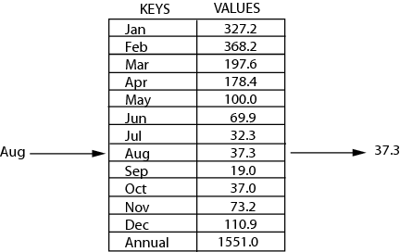
Review: Maps (Dictionaries)
map: Holds a set of unique keys and a collection of values, where each key is associated with one value.
a.k.a. "dictionary", "associative array", "hash"
operations:
put(key, value ): Adds a mapping from a key to a value.
get(key ): Retrieves the value mapped to the key.
remove(key ): Removes the given key and its mapped value.
key | value
“at" | 43
key | value
“in" | 37
key | value
“you" | 22
key | value
“the" | 56
map.get("the")
56

Slide 12
ArrayDictionary

Slide 13
Doubly-Linked List (Deque)

Slide 14
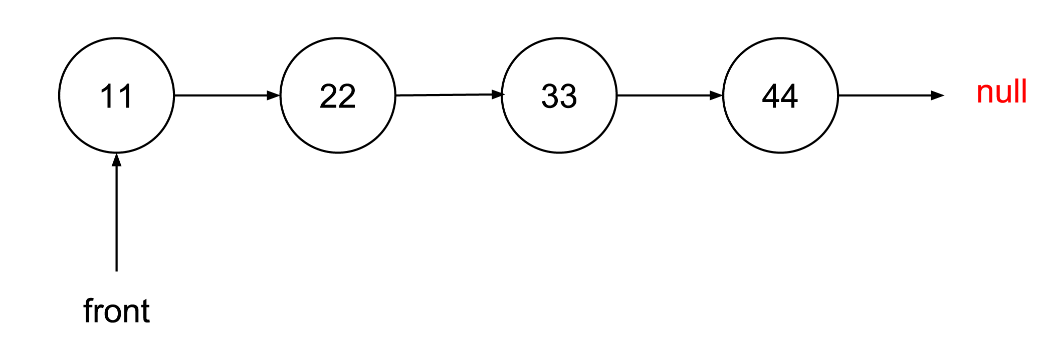
Doubly-Linked List (Deque)

Slide 15
Traversing Data
Array
for (int i = 0; i < arr.length; i++) {
System.out.println(arr[i]);
}
List
for (int i = 0; i < myList.size(); i++) {
System.out.println(myList.get(i));
}
for (T item : list) {
System.out.println(item);
}
Iterator!

Slide 16
Iterators
iterator: a Java interface that dictates how a collection of data should be traversed.
Behaviors:
hasNext() – returns true if the iteration has more elements
next() – returns the next element in the iteration
while (iterator.hasNext()) {
T item = iterator.next();
}

Slide 17
Iterable
Iterable: a Java interface that lets a class be traversed using iterators (for each, etc).
Behaviors:
iterator() – returns an iterator to the class instance

Slide 18
Implementing Iterable
Demo Implementation for CircularQueue

Slide 19
Bonus Slides
Amortized Analysis

Slide 20
Amortization
What’s the worst case for inserting into an ArrayList?
O(n). If the array is full.
Is O(n) a good description of the worst case behavior?
If you’re worried about a single insertion, maybe.
If you’re worried about doing, say, $n$ insertions in a row. NO!
Amortized bounds let us study the behavior of a bunch of consecutive calls.

Slide 21
Amortization
The most common application of amortized bounds is for insertions/deletions and data structure resizing.
Let’s see why we always do that doubling strategy.
How long in total does it take to do $n$ insertions?
We might need to double a bunch, but the total resizing work is at most O(n)
And the regular insertions are at most $n⋅O\left(1\right)=O(n)$
So $n$ insertions take $O(n)$ work total
Or amortized $O(1)$ time.

Slide 22
Amortization
Why do we double? Why not increase the size by 10,000 each time we fill up?
How much work is done on resizing to get the size up to $n$?
Will need to do work on order of current size every 10,000 inserts
$\sum_{i=0}^{\frac{n}{10000}}{10000i}≈10,000⋅\frac{n^{2}}{{10,000}^{2}}=O(n^{2})$
The other inserts do $O\left(n\right)$ work total.
The amortized cost to insert is $O\left(\frac{n^{2}}{n}\right)=O(n)$.
Much worse than the $O(1)$ from doubling!

