Slide 1
Modeling Complex Algorithms
Data Structures and Algorithms

Slide 2
Warm Up
Construct a mathematical function modeling the worst-case runtime of the following method. Your function should be written in terms of n, the provided input.
Assume each println takes some constant time c to run.
public void mystery(int n) {
for (int i = 0; i < n; i++) {
for (int j = 0; j < n * n; j++) {
System.out.println(“Hello”);
}
for (int j = 0; j < 10; j++) {
System.out.println(“world”);
}
}
}
Remember: work outside in
Solution: T(n) = n(n² + 10) = n³ + 10n
+1
n²
n
+1
10
Socrative:
www.socrative.com
Room Name: CSE373
Please enter your name as: Last, First

Slide 3
Project 1 Out
Project 1 out – Part 1 due Friday April 13th
Pair Programming
Navigating the Project
How it will be graded
Need a partner? Come see me after class or email me ASAP
HW 1 due tonight!
please make sure your legal name is associated with your practice-it account
Class Survey due tonight

Slide 4
Modeling Complex Loops
for (int i = 0; i < n; i++) {
for (int j = 0; j < i; j++) {
System.out.println(“Hello!”);
}
}
+1
n
n
f(n) = n²
Keep an eye on loop bounds!

Slide 5
Modeling Complex Loops
for (int i = 0; i < n; i++) {
for (int j = 0; j < i; j++) {
System.out.println(“Hello!”);
}
}
+c
+1
0 + 1 + 2 + 3 +…+ n-1
n
$$\sum_{i=1}^{n}{i}$$
Summation
1 + 2 + 3 + 4 +… + n =
Definition: Summation
= f(a) + f(a + 1) + f(a + 2) + … + f(b-2) + f(b-1) + f(b)
$$\sum_{i=a}^{b}{f(i)}$$
$$\sum_{i=0}^{n−1}{\sum_{j=0}^{i−1}{c}}$$
T(n) =

Slide 6
Simplifying Summations
for (int i = 0; i < n; i++) {
for (int j = 0; j < i; j++) {
System.out.println(“Hello!”);
}
}
(0c + 1c + 2c + 3c + … + i-1c)
+ (0c + 1c + 2c + 3c + … + i-1c)
+ (0c + 1c + 2c + 3c + … + i-1c)
+ repeat n times
+c
0 + 1 + 2 + 3 +…+ n-1
n
$$\sum_{i=0}^{n−1}{\sum_{j=0}^{i−1}{c}}$$
$$\sum_{i=0}^{n−1}{ci}$$
T(n) =
=
Summation of a constant
$$c\sum_{i=0}^{n−1}{i}$$
=
Factoring out a constant
$$c\frac{n\left(n−1\right)}{2}$$
=
Gauss’s Identity
=
$$\frac{c}{2}n^{2}−\frac{c}{2}n$$
O(n²)

Slide 7
Function Modeling: Recursion
public int factorial(int n) {
if (n == 0 || n == 1) {
return 1;
} else {
return n * factorial(n – 1);
}
+3
+c
+1
+????

Slide 8
Function Modeling: Recursion
public int factorial(int n) {
if (n == 0 || n == 1) {
return 1;
} else {
return n * factorial(n – 1);
}
+c₁
+T(n-1)
+c₂
C₁
C₂ + T(n-1)
when n = 0 or 1
otherwise
T(n) =
Definition: Recurrence
Mathematical equivalent of an if/else statement
f(n) =

Slide 9
Unfolding Method
C₁
C₂ + T(n-1)
when n = 0 or 1
otherwise
T(n) =
= 2C₂ + C₁
T(3) =
T(n) = C₁ +
Summation of a constant
T(n) = C₁ + (n-1)C₂
C₂ + T(3 – 1)
= C₂ + (C₂ + T(2 – 1))
= C₂ + (C₂ + (C₁))
$$\sum_{i=0}^{n−1}{C2}$$

Slide 10
Asymptotic Analysis

Slide 11
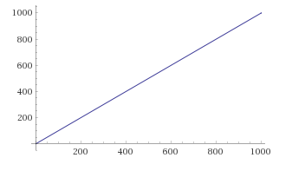
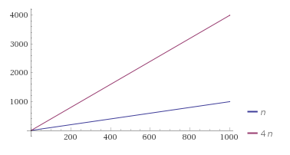
Asymptotic Analysis
clock cycles
clock cycles
f(n) = n
<- 4n clearly dominates n
number of inputs
number of inputs
Definition: Domination
A function f(n) is dominated by g(n) when…
There exists two constants c > 0 and n₀ > 0
Such that for all values of n ≥ n₀
f(n) ≤ c * g(n)
Can we say that n “dominates” 4n?
Yes!
c = 4 or more
n₀ = 1 (because definition requires n₀>0)

Slide 12
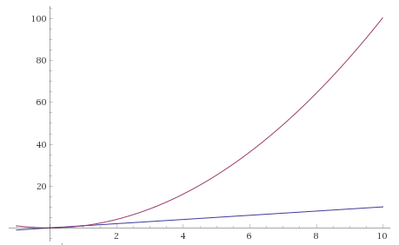
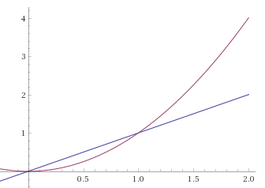
Asymptotic Analysis
clock cycles
g(n) = n²
clock cycles
g(n) = n²
problematic
Zoom in ->
f(n) = n
f(n) = n
number of inputs
number of inputs
Clearly n² dominates n, right?
We can find a c & n₀ that satisfy the definition of domination
c = 1
n₀ = 1
Definition: Big O
O(f(n)) is the “family” or “set” of all functions that are dominated by f(n)

Slide 13
∈ Element Of
f(n) is less than or equal to g(n)
“f(n) is dominated by g(n)”
“f(n) is contained inside O(g(n))”
f(n) ∈ O(g(n))

Slide 14
Practice
Definition: ∈
“element of” mathematical symbol
5n + 3 ∈ O(n)
n ∈ O(5n + 3)
5n + 3 = O(n)
O(5n + 3) = O(n)
O(n²) = O(n)
n² ∈ O(1)
n² ∈ O(n)
n² ∈ O(n²)
n² ∈ O(n³)
n² ∈ O(n¹⁰⁰)
True
True
Definition: Big O
True
O(f(n)) is the “family” or “set” of all functions that are dominated by f(n)
True
False
False
False
True
True
True

Slide 15
Definitions: Big Ω
Definition: Big O
O(f(n)) is the “family” or “set” of all functions that are dominated by f(n)
O(f(n)) is less than or equal to f(n)
$O(f\left(n\right))≤f\left(n\right)$
O(f(n)) is the lower bound of f(n)’s asymptotic analysis
Do we have a name for a set of functions that are the dominators?
Definition: Big Ω
Ω(f(n)) is the family of all functions that dominate f(n)
Ω(f(n)) is greater than or equal to f(n)
$$Ω(f(n))≥f(n)$$
Ω(f(n)) is the upper bound of f(n)’s asymptotic analysis

Slide 16
Examples
Definition: Big O
O(f(n)) is the “family” or “set” of all functions that are dominated by f(n)
4n² ∈ Ω(1)
true
4n² ∈ Ω(n)
true
4n² ∈ Ω(n²)
true
4n² ∈ Ω(n³)
false
4n² ∈ Ω(n⁴)
false
4n² ∈ O(1)
false
4n² ∈ O(n)
false
4n² ∈ O(n²)
true
4n² ∈ O(n³)
true
4n² ∈ O(n⁴)
true
Definition: Big Ω
Ω(f(n)) is the family of all functions that dominates f(n)

Slide 17
Definitions: Big Θ
We say f(n) ∈ Θ(g(n)) when both
f(n) ∈ O(g(n)) and f(n) ∈ Ω (g(n)) are true
Which is only when f(n) = g(n)
Θ(f(n)) is the family of functions that are equivalent to f(n)
Industry uses “Big Θ” and “Big O” interchangeably
Definition: Big Θ

Slide 18
Summary
O(f(n)) $≤$ f(n) == Θ(f(n)) $≤$ Ω(f(n))
f(n)
O(1)
O(log n)
O(n)
O(n²)
O(n³)
Dominated by
f(n) ∈ O(g(n))
Dominates
f(n) ∈ Ω(g(n))

