Slide 1
Lecture 1: Welcome to CSE 373
Data Structures and Algorithms

Slide 2
Agenda
Introductions
Syllabus
Dust off data structure cob webs
Meet the ADT

Slide 3
Waitlist/ Overloads
I have no control over these things :/
Email cse373@cs.washington.edu for all registration requests/questions
Many students move around, likely a spot will open
Keep coming to lecture!

Slide 4
Hello!
I am Kasey Champion
Software Engineer @ Microsoft
High School Teacher @ Franklin High
champk@cs.washington.edu
Office Hours: Fridays 2:30pm-5:30pm
@techie4good

Slide 5
Class Style
Kasey has to go to “real work” after this
The internets
Your TAs
Each other
Please come to lecture
Collaboration
Demos
Ask questions! Point out mistakes!
Sections
TAs = heroes
Practice problems
Sections start this week

Slide 6
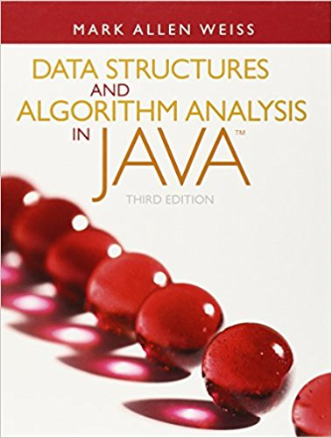
Course Administration
Course Page
All course content/announcements posted here
Pay attention for updates!
Canvas
Grades will be posted here
Office Hours
Will be posted on Course Page
Will start next week
Piazza
Great place to discuss questions with other students
Will be monitored by course staff
No posting of project code!
Textbook
Optional!
Data Structures and Algorithm Analysis in Java by Mark Allen Weiss

Slide 7
Grade Break Down
Homework (65%)
4 Projects (50%)
Partners encouraged
3 Written Assignments (15%)
Must be individual
Exams (35%)
Midterm Exam – Friday April 27th in class (15%)
Final Exam – Tuesday June 5th 8:30-10:30 here! (20%)

Slide 8
Syllabus

Slide 9
Questions?
Clarification on syllabus, General complaining/moaning

Slide 10
What is this class about?
CSE 143 – Object Oriented Programming
CSE 373 – Data Structures and Algorithms
Classes and Interfaces
Methods, variables and conditionals
Loops and recursion
Linked lists and binary trees
Sorting and Searching
O(n) analysis
Generics
Design decisions
Design analysis
Implementations of data structures
Debugging and testing
Abstract Data Types
Code-base development

Slide 11
Data Structures and Algorithms
What are they anyway?

Slide 12
Basic Definitions
Data Structure
A way of organizing and storing related data points
Examples from CSE 14X: arrays, linked lists, stacks, queues, trees
Algorithm
A series of precise instructions used to perform a task
Examples from CSE 14X: binary search, merge sort, recursive backtracking

Slide 13
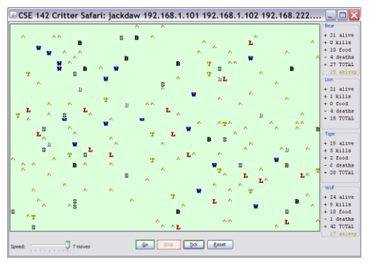
Review: Clients vs Objects
Client classes
Object Classes
A class that is executable, in Java this means it contains a Main method
public static void main(String[] args)
A coded structure that contains data and behavior
Start with the data you want to hold, organize the things you want to enable users to do with that data

Slide 14
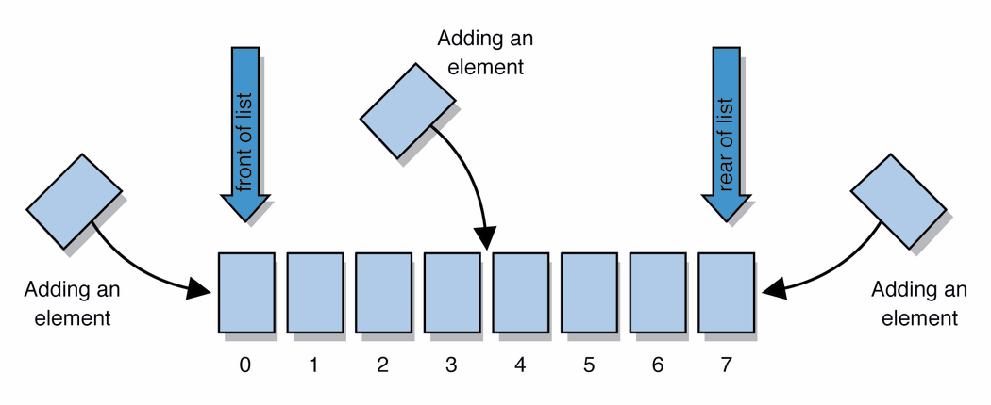
Abstract Data Types (ADT)
Abstract Data types
A definition for expected operations and behavior
Start with the operations you want to do then define how those operations will play out on whatever data is being stored
Review: List - a collection storing an ordered sequence of elements
each element is accessible by a 0-based index
a list has a size (number of elements that have been added)
elements can be added to the front, back, or elsewhere
in Java, a list can be represented as an ArrayList object
Notes:
A way to communicate with other programmers, a standard that we all can agree on so we can discuss conceptual ways of organizing data

Slide 15
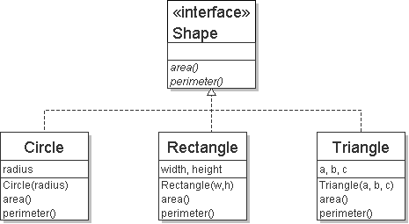
Review: Interfaces
Example
// Describes features common to all // shapes.
public interface Shape {
public double area();
public double perimeter();
}
interface: A list of methods that a class promises to implement.
Interfaces give you an is-a relationship without code sharing.
A Rectangle object can be treated as a Shape but inherits no code.
Analogous to non-programming idea of roles or certifications:
"I'm certified as a CPA accountant. This assures you I know how to do taxes, audits, and consulting."
"I'm 'certified' as a Shape, because I implement the Shape interface. This assures you I know how to compute my area and perimeter."
public interface name {
public type name(type name, ..., type name);
public type name(type name, ..., type name);
...
public type name(type name, ..., type name);
}

Slide 16
Review: Java Collections
Java provides some implementations of ADTs for you!
You used:
Lists List<Integer> a = new ArrayList<Integer>();
Stacks Stack<Character> c = new Stack<Character>();
Queues Queue<String> b = new LinkedList<String>();
Maps Map<String, String> d = new TreeMap<String, String>();
But some data structures you made from scratch… why?
Linked Lists - LinkedIntList was a collection of ListNode
Binary Search Trees – SearchTree was a collection of SearchTreeNodes

Slide 17
Full Definitions
Abstract Data Type (ADT)
A definition for expected operations and behavior
A mathematical description of a collection with a set of supported operations and how they should behave when called upon
Describes what a collection does, not how it does it
Can be expressed as an interface
Examples: List, Map, Set
Data Structure
A way of organizing and storing related data points
An object that implements the functionality of a specified ADT
Describes exactly how the collection will perform the required operations
Examples: LinkedIntList, ArrayIntList

Slide 18
List of ADTs
List
Set
Map
Stack
Queue
Priority Queue
Graph

Slide 19
Case Study: The List ADT
list: stores an ordered sequence of information.
Each item is accessible by an index.
Lists have a variable size as items can be added and removed
Supported Operations:
get(index): returns the item at the given index
set(value, index): sets the item at the given index to the given value
append(value): adds the given item to the end of the list
insert(value, index): insert the given item at the given index maintaining order
delete(index): removes the item at the given index maintaining order
size(): returns the number of elements in the list

Slide 20
Case Study: List Implementations
Notes:
Code up an implementation of List

Slide 21
TODO list
Skim through full Syllabus on class web page
Sign up for Piazza
Review 142/143 materials. Materials provided on class webpage

