Slide 1
Instructor: Lilian de Greef Quarter: Summer 2017
CSE 373: Data Structures and Algorithms
Lecture 6: Finishing Amortized Analysis; Dictionaries ADT; Introduction to Hash Tables

Slide 2
Today:
Finish up Amortized Analysis
Dictionary ADT
Introduce Hash Tables

Slide 3
Reminder: No class on Monday!
Unofficial holiday – have a good 4-day weekend! ☺
Will ask you to do a ~30 minute activity to make up for last class time
Remember that homework 2 is also due the day after we’re back

Slide 4
Amortized Analysis
How we calculate the average time!

Slide 5
Amortized Cost
The amortized cost of n operations is the worst-case total cost of the operations divided by n.
Shorthand:
If T(n) = worst-case (upper bound) of total cost
for n = number of operations
⇒ Amortized Cost = T(n) / n

Slide 6
Example: Array Stack
What’s the amortized cost of calling push() n times if we double the array size when it’s full?
n operations:
n pushes at O(1) each -> total cost = n
cost of resizing = n + n/2 + n/4 + n/8 + … ≤ 2n -> total cost ≤ 2n
-> T(n) = n + 2n = 3n
-> Amortized cost = T(n)/n = 3n/n = 3
-> Amortized Running time = O(1)
The amortized cost of n operations is the worst-case total cost of the operations divided by n.

Slide 7
Example #2: Queue made of Stacks
A sneaky way to implement Queue using two Stacks
Example walk-through:
enqueue A
enqueue B
enqueue C
dequeue
enqueue D
enqueue E
dequeue
dequeue
dequeue
in
out

Slide 8
Example #2: Queue made of Stacks
A sneaky way to implement Queue using two Stacks
class Queue<E> {
Stack<E> in = new Stack<E>();
Stack<E> out = new Stack<E>();
void enqueue(E x){ in.push(x); }
E dequeue(){
if(out.isEmpty()) {
while(!in.isEmpty()) {
out.push(in.pop());
}
}
return out.pop();
}
}
in
out
Wouldn’t it be nice to have a queue of t-shirts to wear instead of a stack (like in your dresser)?
So have two stacks
in: stack of t-shirts go after you wash them
out: stack of t-shirts to wear
if out is empty, reverse in into out

Slide 9
Example #2: Queue made of Stacks (Analysis)
class Queue<E> {
Stack<E> in = new Stack<E>();
Stack<E> out = new Stack<E>();
void enqueue(E x){ in.push(x); }
E dequeue(){
if(out.isEmpty()) {
while(!in.isEmpty()) {
out.push(in.pop());
}
}
return out.pop();
}
}
Assume stack operations are (amortized) O(1).
What’s the worst-case for dequeue()?
What operations did we need to do to reach that condition (starting with an empty Queue)?
Hence, what is the amortized cost?
So the average time for dequeue() is:
in
out

Slide 10
Example #2: Using “Currency” Analogy
“Spend” $2 for every enqueue – $1 to the “computer”, $1 to the “bank”.
Example walk-through:
enqueue A
enqueue B
enqueue C
enqueue D
enqueue E
dequeue
in
out
Potential Function

Slide 11
Example #3: (Parody / Joke Example)
Lectures are 1 hour long, 3 times per week, so I’m supposed to lecture for 27 hours this quarter.
If I end the first 26 lectures 5 minutes early, then I’d have “saved up” 130 minutes worth of extra lecture time.
Then I could spend it all on the last lecture and can keep you here for 3 hours (bwahahahaha)!
(After all, each lecture would still be 1 hour amortized time)

Slide 12
Wrapping up Amortized Analysis
In what cases do we care more about the average / amortized run time?
In what cases do we care more about the worst-case run time?

Slide 13
What have we covered so far?
Abstract Data Types (ADTs)
Two data structures
Stacks (both using arrays and linked-lists)
Queues (including circular queues)
Asymptotic Analysis
Intuition for Big-O
Formally proving Big-O using Inductive Proofs
Calculating Big-O for recursive methods using Recurrence Relations
Big-O’s cousins: Big-Ω, Big-θ, little-o, little-ω
Average running time using Asymptotic Analysis

Slide 14
Whew!
That was a *lot* of algorithm analysis.
Now shifting gears completely…
on to some new data structures!

Slide 15
Dictionary ADT

Slide 16
Dictionary ADT

Slide 17
Uses of Dictionary ADT
Used to store information with some key and retrieve it efficiently – lots of programs do that!
Examples:
Contacts in a phone (name: number, email)
Orca/Husky cards (account number: balance)
Genome maps (DNA sequence: location on genome)
Lilian’s database of your grades (student ID: assignments, grades)
Networks (router tables), Operating Systems (page tables), Compilers (symbol tables), Databases
… and so much more!
Possibly the most widely used ADT!

Slide 18
Motivating Hash Tables
Creative thinking time: how could you implement a dictionary using what you know so far (namely, linked-lists and arrays)? e.g. map names (key) to phone numbers (value)

Slide 19
(extra space for notes)

Slide 20
Motivating Hash Tables
Running times for Dictionary operations with n (key, value) pairs:
insert find delete
“Magic Array”

Slide 21
“Magic Array”
Use key to compute array index for an item in O(1) time
Example: phone contacts (name, number)
name → index = computeIndex(name) → array[index] = (name, number)

Slide 22
“Magic Array”
Use key to compute array index for an item in O(1) time
Example: phone contacts (name, number)
name → index = computeIndex(name) → array[index] = (name, number)
What would be important about the indices from computeIndex?

Slide 23
Introducing… Hash Tables!
Closest thing to our “magic array”

Slide 24
Hash Tables: closest thing to our “Magic Array”
Average case O(1) find, insert, and delete
(when under some often-reasonable assumptions)
Our computeIndex function is called a
The index from the hash function is called a
Hash Table
0
 | …
hash function:
index = h(key)
all possible keys
tableSize –1

Slide 25
Hash Tables: Example Illustration

Slide 26
Hash Functions
Hash functions need to…
For a person’s name, would it be a good hash function to…
Use the ASCII values of first and second letter?
Use the number of letters in the name?

Slide 27
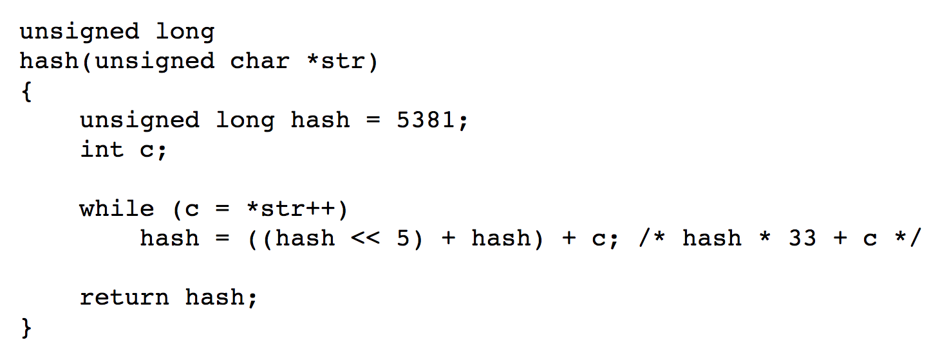
Example Hash Function
Hash function “djb2”:

Slide 28
Hash Functions
Many datatypes and Objects are hashable
When writing a class, can make it hashable! Do so by implementing hashCode method
We’ll focus on ints and Strings in this class.

Slide 29
Collisions
Happens when two elements get the same index (unavoidable in practice)
Homework: come up with a strategy, write it down on paper, and bring it to class on Weds

Slide 30
Hash Table roles
When hash tables are a reusable library, the division of responsibility generally breaks down into two roles:
We will learn both roles, but most programmers “in the real world” spend more time as clients while understanding the library
client
hash table library
collision?
collision
resolution
E
int
table-index

Slide 31
Hash Tables
There are m possible keys (m typically large, even infinite)
We expect our table to have only n items
n is much less than m (often written n << m)
Many dictionaries have this property
Compiler: All possible identifiers allowed by the language vs. those used in some file of one program
Database: All possible student names vs. students enrolled
AI: All possible chess-board configurations vs. those considered by the current player
…

Slide 32
Hash Table Size
How can we keep hash values (i.e. the indices) within the table size?
_
Table size usually prime
Real-life data tends to have a pattern
"Multiples of 61" probably less likely than "multiples of 60"
Helpful for a collision-handling strategy we'll see next week

Slide 33
Review: Hash Tables thus far…
The hash table is one of the most important data structures – Supports only find, insert, and delete efficiently
Have to search entire table for other operations
Important to use a good hash function
Important to keep hash table at a good size
Side-comment: hash functions have uses beyond hash tables – Examples: Cryptography, check-sums
Big remaining topic: Handling collision

Slide 34
Homework
Come up with a collision-resolution strategy, write it down on paper, and bring it to class on Wednesday
Goal: prime our brains for learning the most common collision-resolution strategies.

