Slide 1
Instructor: Lilian de Greef Quarter: Summer 2017
CSE 373: Data Structures and Algorithms
Lecture 4: Asymptotic Analysis part 3 Code Style, Recurrence Relations, Formal Big-O & Cousins

Slide 2
Code Style
Why does code style matter?

Slide 3
Code Style
Do
Don’t

Slide 4
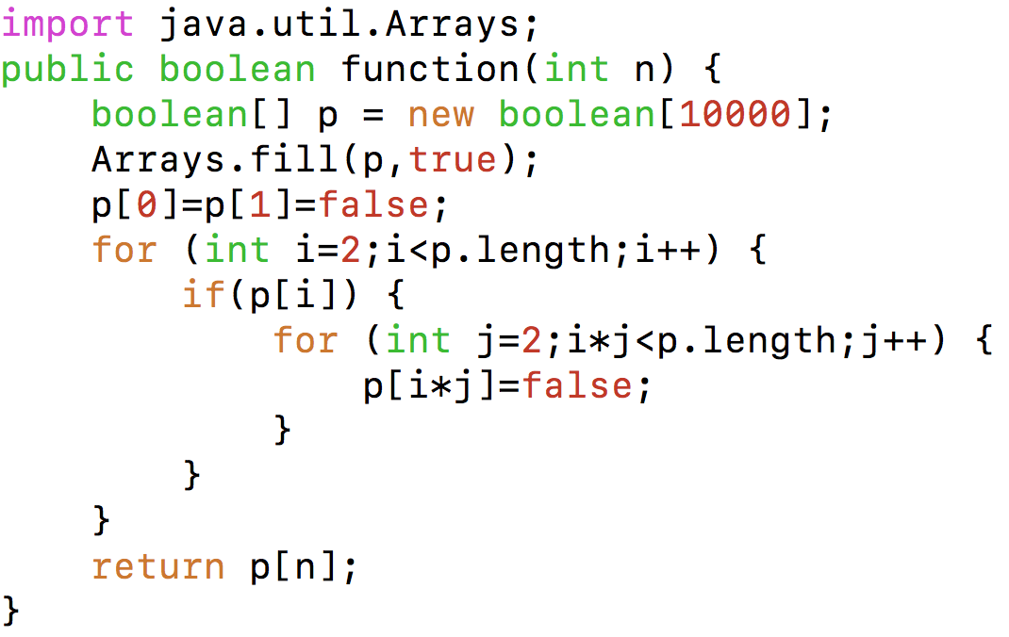
Code Style Critique
Notes:
Source code from https://www.mkyong.com/java/how-to-determine-a-prime-number-in-java/

Slide 5
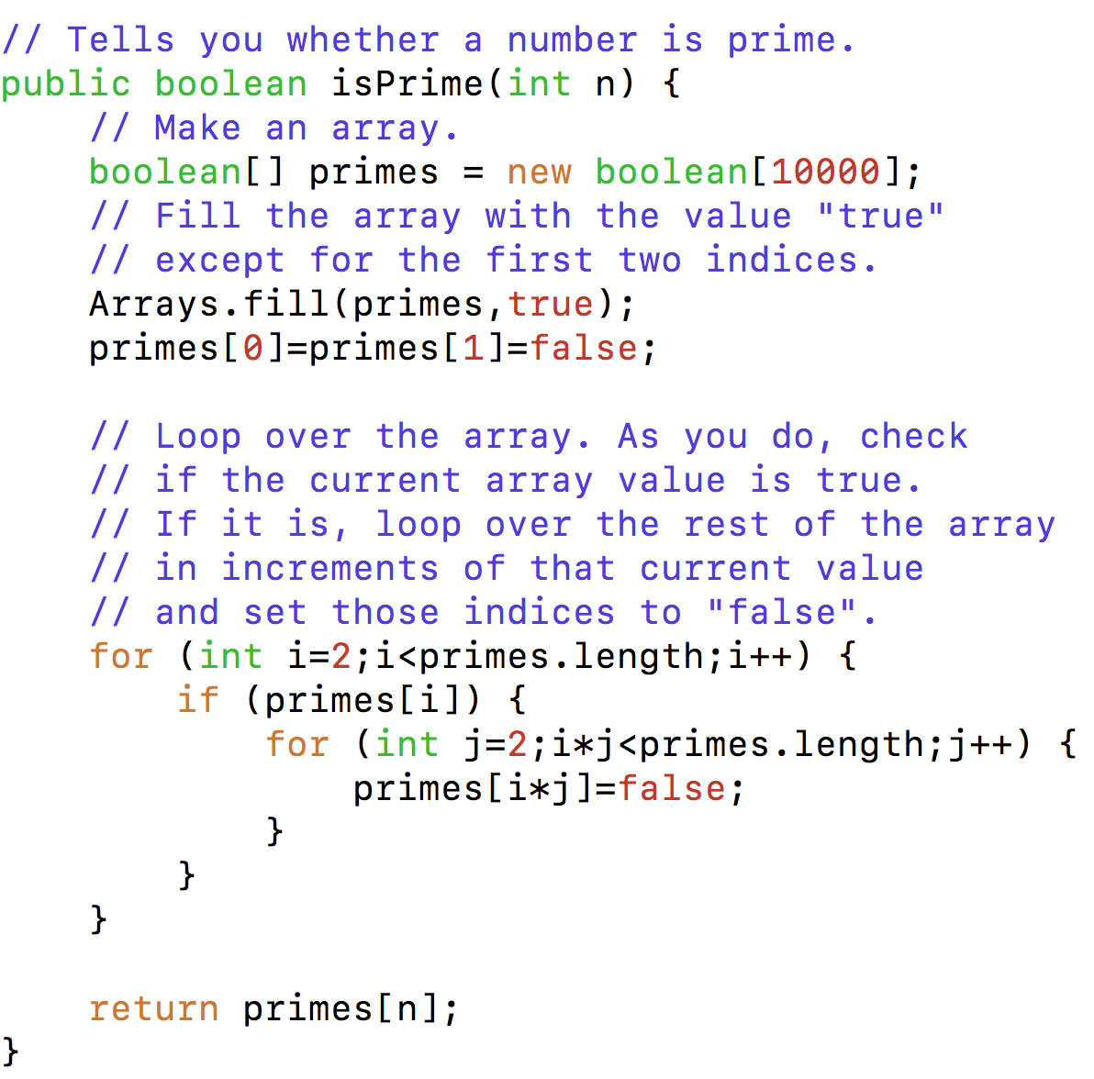
Code Style Critique #2
Notes:
Source code from https://www.mkyong.com/java/how-to-determine-a-prime-number-in-java/

Slide 6
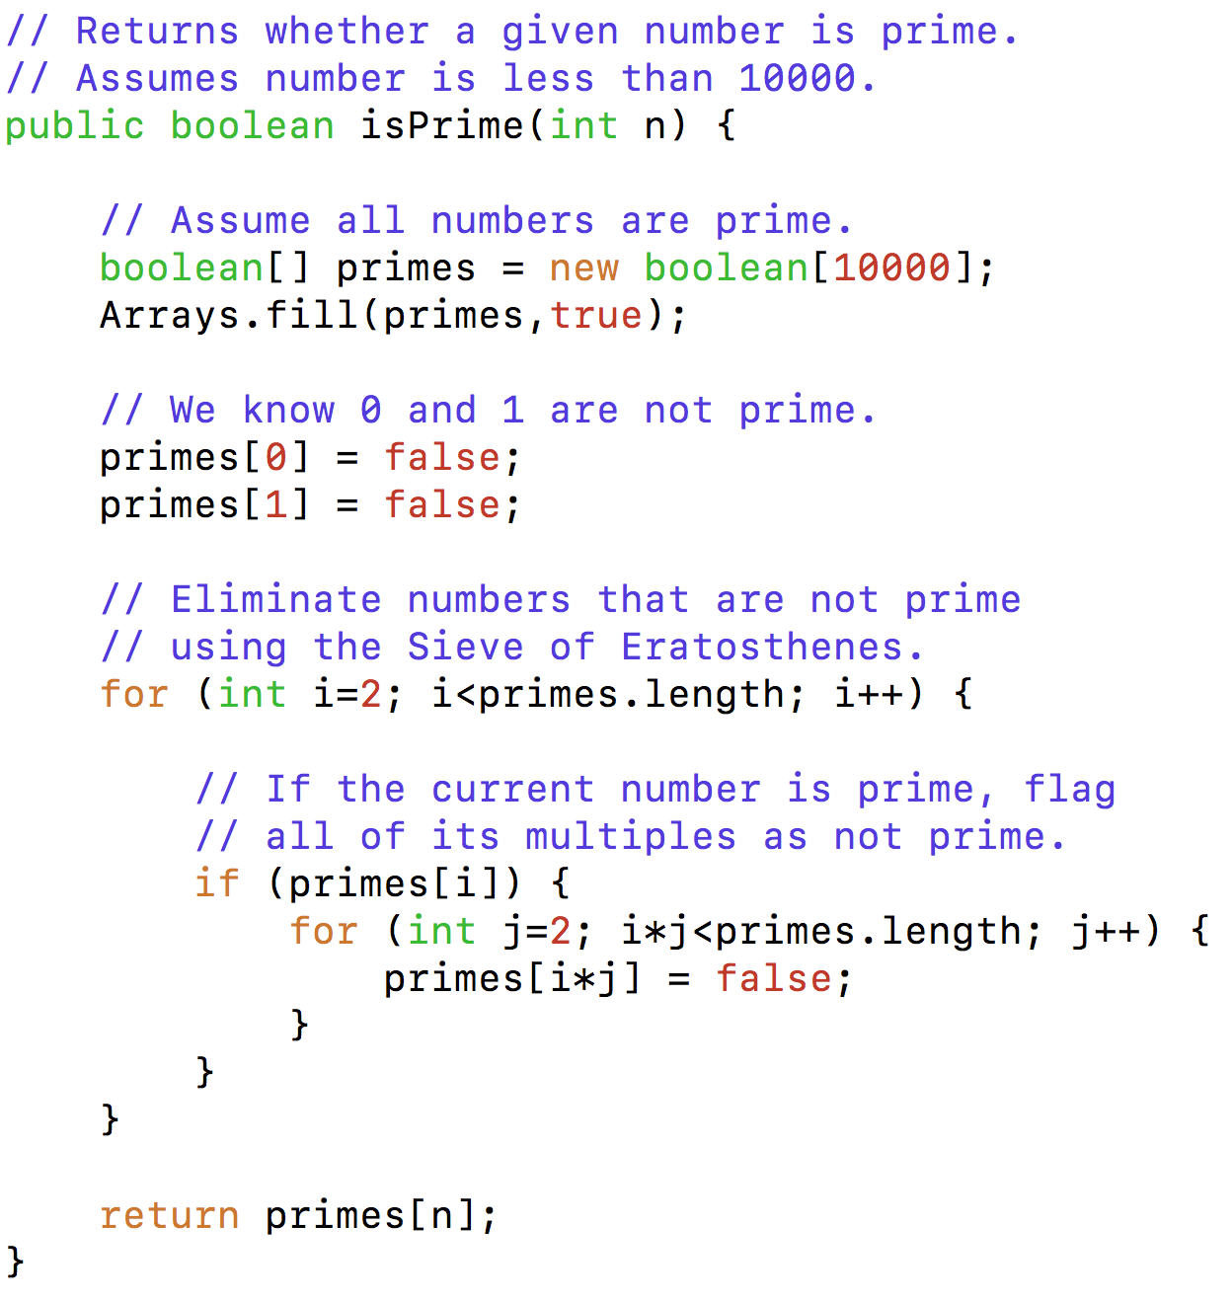
Code Style Critique #3
Notes:
Source code from https://www.mkyong.com/java/how-to-determine-a-prime-number-in-java/

Slide 7
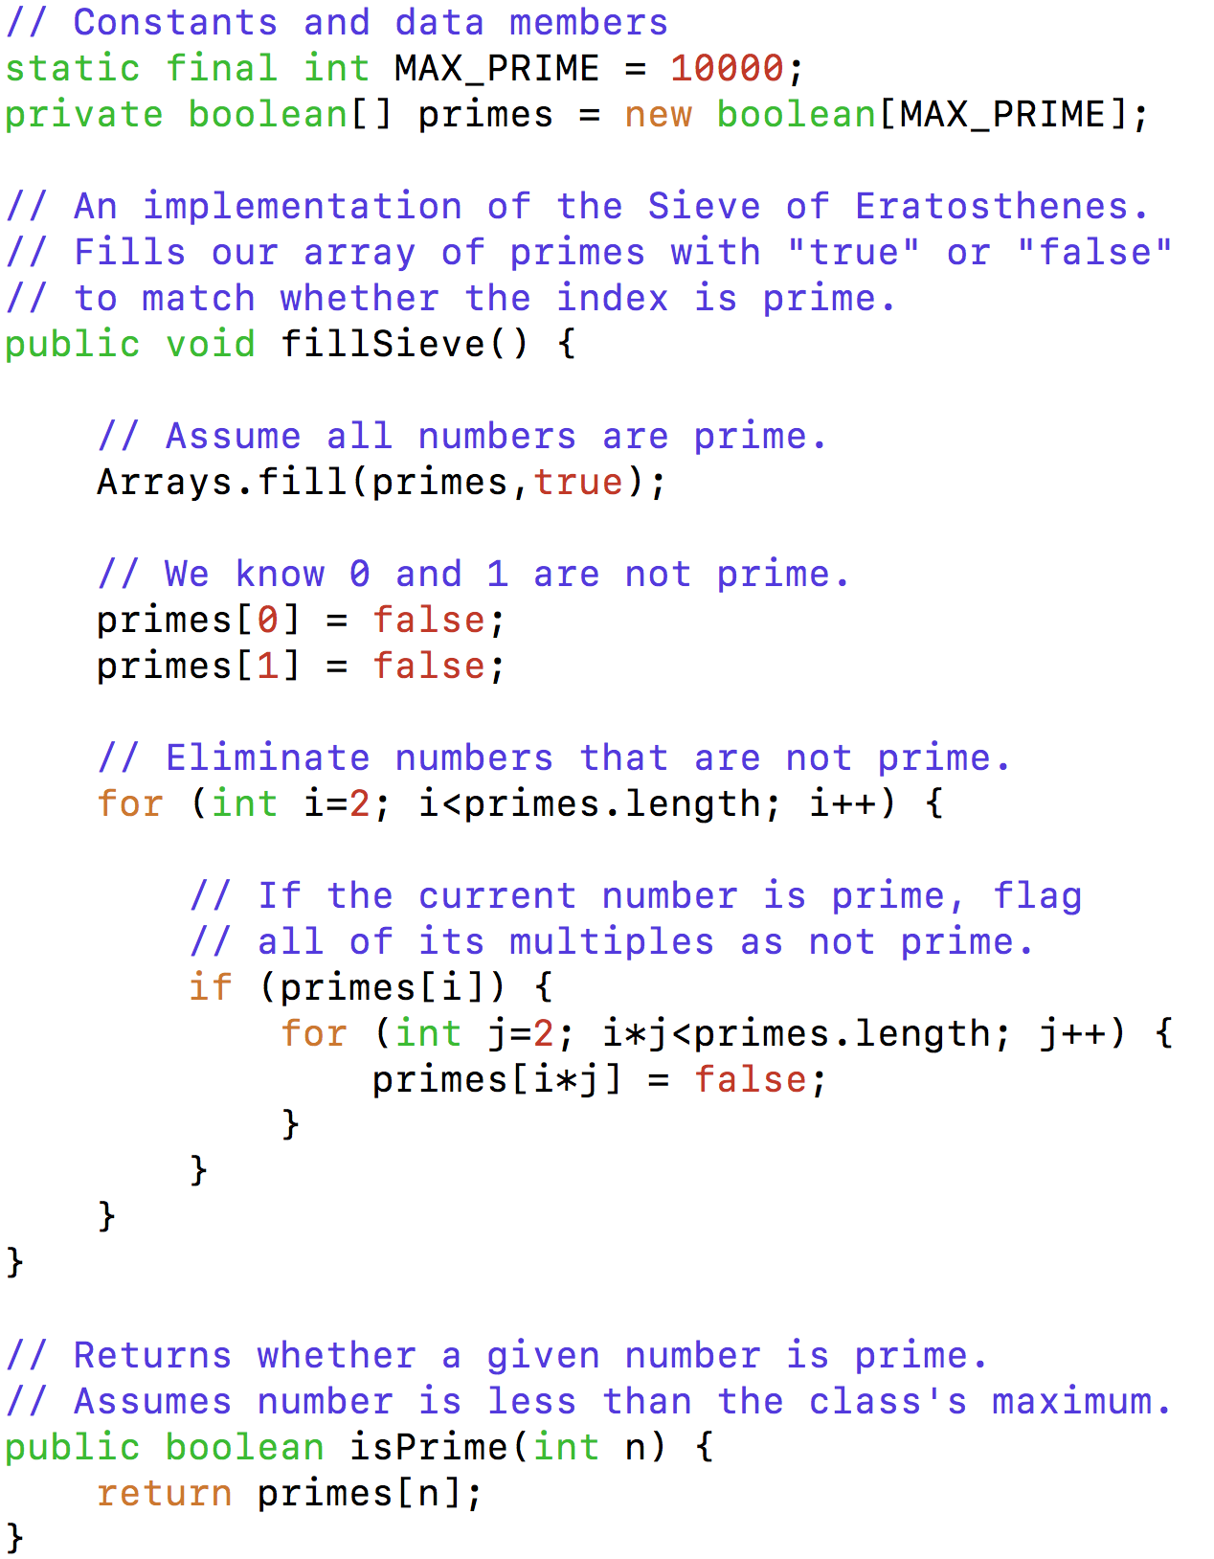
Code Style Critique #4
Notes:
Source code from https://www.mkyong.com/java/how-to-determine-a-prime-number-in-java/

Slide 8
Recurrence Relations
How to calculate Big-O for recursive functions!
(Continued from last lecture)

Slide 9
Example #1: Towers of Hanoi
// Prints instructions for moving disks from one
// pole to another, where the three poles are
// labeled with integers "from", "to", and "other".
// Code from rosettacode.org
public void move(int n, int from, int to, int other) {
if (n == 1) {
System.out.println("Move disk from pole " + from +
" to pole " + to);}
else {
move(n - 1, from, other, to);
move(1, from, to, other);
move(n - 1, other, to, from);
}
}

Slide 10
Example #1: Towers of Hanoi
if (n == 1) {
System.out.println("Move disk from pole " + from +
" to pole " + to);}
else {
move(n - 1, from, other, to);
move(1, from, to, other);
move(n - 1, other, to, from);
}

Slide 11
(Example #1 continued)
Base Case:
Recurrence Relation:

Slide 12
(Example #1 continued)

Slide 13
Example #2: Binary Search
2
3
5
16
37
50
73
75
126
Find an integer in a sorted array
(Can also be done non-recursively)
// Requires the array to be sorted.
// Returns whether k is in array.
public boolean find(int[]arr, int k){
return help(arr,k,0,arr.length);
}
private boolean help(int[]arr, int k, int lo, int hi) {
int mid = (hi+lo)/2; // i.e., lo+(hi-lo)/2
if(lo==hi) return false;
if(arr[mid]==k) return true;
if(arr[mid]< k) return help(arr,k,mid+1,hi);
else return help(arr,k,lo,mid);

Slide 14
What is the recurrence relation?
// Requires the array to be sorted.
// Returns whether k is in array.
public boolean find(int[]arr, int k){
return help(arr,k,0,arr.length);
}
private boolean help(int[]arr, int k, int lo, int hi) {
int mid = (hi+lo)/2; // i.e., lo+(hi-lo)/2
if(lo==hi) return false;
if(arr[mid]==k) return true;
if(arr[mid]< k) return help(arr,k,mid+1,hi);
else return help(arr,k,lo,mid);
2T(n-1) + 3
T(n-1)*T(n-1) + 3
T(n/2) + 3
T(n/2) * T(n/2) + 3

Slide 15
(Example #2 continued)
Base Case:
Recurrence Relation:

Slide 16
(Example #2 continued)

Slide 17
Recap: Solving Recurrence Relations
Determine the recurrence relation. What is the base case?
T(n) = 3 + T(n/2) T(1) = 3
“Expand” the original relation to find an equivalent general expression in terms of the number of expansions.
T(n) = 3 + 3 + T(n/4)
= 3 + 3 + 3 + T(n/8)
= …
= 3k + T(n/(2^{k}))
Find a closed-form expression by setting the number of expansions to a value which reduces the problem to a base case
n/(2^{k}) = 1 means n = 2^{k} means k = log₂ n
So T(n) = 10 log₂ n + 8 (get to base case and do it)
So T(n) is O(log n)

Slide 18
Common Recurrence Relations
Should know how to solve recurrences but helps to recognize some
common ones:
T(n) = O(1) + T(n-1) linear
T(n) = O(1) + 2T(n/2) linear
T(n) = O(1) + T(n/2) logarithmic O(log n)
T(n) = O(1) + 2T(n-1) exponential
T(n) = O(n) + T(n-1) quadratic
T(n) = O(n) + T(n/2) linear (why?)
T(n) = O(n) + 2T(n/2) O(n log n)

Slide 19
Big-O Big Picture
with its formal definition

Slide 20
In terms of Big-O, which function has the faster asymptotic running time?
f(n)
worst-case running time
g(n)
n
0 1 2 3 4 5 6 7 8

Slide 21
In terms of Big-O, which function has the faster asymptotic running time?
g(n)
f(n)
worst-case running time
n
0 100 200 300 400 500 600 700 800

Slide 22
In terms of Big-O, which function has the faster asymptotic running time?
f(n)
g(n)
worst-case running time
n
0 500 1000 1500 2000 2500 3000 3500 4000
Take-away:

Slide 23
Formal Definition of Big-O
“General Idea” explanation from last week:
Mathematical upper bound describing the behavior of how long a function takes to run in terms of N. (The “shape” as N → ∞)
Formal definition of Big-O:
Notes:
f(n) is in O( g(n) ) if there exist constants c and n₀ such that f(n) ≤ c g(n) for all n ≥ n₀

Slide 24
Formal Definition of Big-O

Slide 25
Using the Formal Definition of Big-O
Definition: f(n) is in O( g(n) ) if there exist constants
c and n₀ such that f(n) ≤ c g(n) for all n ≥ n₀
To show f(n) is in O( g(n) ), pick a c large enough to “cover the constant factors” and n₀ large enough to “cover the lower-order terms”
Example:
Let f(n) = 3n²+18 and g(n) = n²
Example:
Let f(n) = 3n²+18 and g(n) = n⁵

Slide 26
Practice with the Definition of Big-O
Let f(n) = 1000n and g(n) = n²
What are some values of c and n₀
we can use to show f(n)∈O(g(n))?
Definition: f(n) is in O( g(n) ) if there exist constants
c and n₀ such that f(n) ≤ c g(n) for all n ≥ n₀

Slide 27
More Practice with the Definition of Big-O
Let a(n) = 10n+3n² and b(n) = n²
What are some values of c and n₀
we can use to show a(n)∈O(b(n))?
Definition: f(n) is in O( g(n) ) if there exist constants
c and n₀ such that f(n) ≤ c g(n) for all n ≥ n₀

Slide 28
Constants and Lower Order Terms
The constant multiplier c is what allows functions that differ only in their largest coefficient to have the same asymptotic complexity
Example:
Eliminate lower-order terms because
Eliminate coefficients because
3n² vs 5n² is meaningless without the cost of constant-time operations
Can always re-scale anyways
Do not ignore constants that are not multipliers! n³ is not O(n²), 3^{n} is not O(2^{n})

Slide 29
Cousins of Big-O
Big-O, Big-Omega, Big-Theta, little-o, little-omega

Slide 30
Big-O & Big-Omega
Big-O:
f(n) is in O( g(n) ) if there exist constants c and n₀ such that f(n) c g(n) for all n ≥ n₀
Big-Ω:
f(n) is in Ω ( g(n) ) if there exist constants c and n₀ such that f(n) c g(n) for all n ≥ n₀

Slide 31
Big-Theta
Big- θ:
f(n) is in θ( g(n) ) if f(n) is in both O(g(n)) and Ω (g(n))

Slide 32
little-o & little-omega
little-o:
f(n) is in o( g(n) ) if
constants c >0 there exists an n₀ s.t. f(n) c g(n) for all n ≥ n₀
little-ω:
f(n) is in ω( g(n) ) if
constants c >0 there exists an n₀ s.t. f(n) c g(n) for all n ≥ n₀

Slide 33
Big-O, Big-Omega, Big-Theta
Which one is more useful to describe asymptotic behavior?
A common error is to say O( f(n) ) when you mean θ( f(n) )
A linear algorithm is in both O(n) and O(n5)
Better to say it is θ(n)
That means that it is not, for example O(log n)

Slide 34
Notes on Worst-Case Analysis

Slide 35
Analyzing “Worst-Case” Cheat Sheet
Basic operations take “some amount of” constant time
Arithmetic (fixed-width)
Assignment
Access one Java field or array index
etc.
(This is an approximation of reality: a very useful “lie”)
Control Flow | Time Required
Consecutive statements | Sum of time of statement
Conditionals | Time of test plus slower branch
Loops | Sum of iterations * time of body
Method calls | Time of call’s body
Recursion | Solve recurrence relation

Slide 36
Comments on Asymptotic Analysis
Is choosing the lowest Big-O or Big-Theta the best way to choose the fastest algorithm?
Big-O can use other variables (e.g. can sum all of the elements of an n-by-m matrix in O(nm))

