Slide 1


CSE373: Data Structures and Algorithms
Lecture 1: Introduction; ADTs; Stacks/Queues
Linda Shapiro
Spring 2016

Slide 2
Registration
We have 180 students registered and others who want to get in.
If you’re thinking of dropping the course please decide soon!
Waiting students
Please sign up on the paper waiting list after class, so I know who you are.
If you need the class to graduate this June, put that down, too.
The CSE advisors and I will decide by end of Friday who gets in.

Slide 3

Welcome!
We have 10 weeks to learn fundamental data structures and algorithms for organizing and processing information
  “Classic” data structures / algorithms
  How to rigorously analyze their efficiency
  How to decide when to use them
  Queues, dictionaries, graphs, sorting, etc.
Today in class:
Introductions and course mechanics
What this course is about
Start abstract data types (ADTs), stacks, and queues
  Largely review

Slide 4
To-do list
In next 24-48 hours:
Read the web page
Read all course policies
Read Chapters 3.1 (lists), 3.6 (stacks) and 3.7 (queues) of the Weiss book
  Relevant to Homework 1, due next week
Set up your Java environment for Homework 1
http://courses.cs.washington.edu/courses/cse373/16sp/

Slide 5


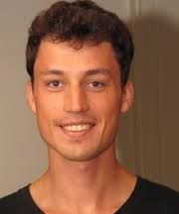





Course staff
Linda Shapiro
CSE Professor with research in computer vision.
Have taught CS&E for 40 years.
First course I ever taught was Data Structures.
Ezgi Mercan
Mert Saglam Ben Jones Shenqi Tang Bran Hagger Chloe Lathe Lysia Li
Office hours, email, etc. on course web-page

Slide 6
Communication
Course email list: cse373a_sp16@u.washington.edu
  Students and staff already subscribed
  You must get announcements sent there
  Fairly low traffic; You don’t post there
Course staff: cse373-staff@cs.washington.edu plus individual emails
Discussion board
  For appropriate discussions; TAs will monitor
  Encouraged, but won’t use for important announcements
Anonymous feedback link
  For good and bad, but please be gentle.

Slide 7
Course meetings
Lecture
  Materials posted, but take notes
  Ask questions, focus on key ideas (rarely coding details)
Optional help sessions
  Help on programming/tool background
  Helpful math review and example problems
  Again, optional but helpful
  Fill out our online poll for best times
Office hours
  Use them: please visit me for talking about course concepts or just CSE in general.
  See the TAs for Java programming questions.

Slide 8
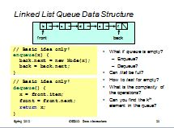
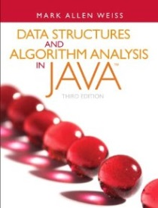
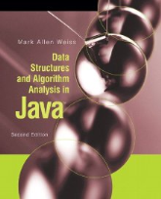

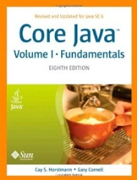
Course materials
All lecture will be posted
  But they are visual aids, not always a complete description!
  If you have to miss, find out what you missed
Textbook: Weiss 3rd Edition in Java
A good Java reference of your choosing
  Don’t struggle Googling for features you don’t understand
Constantly skipping class is not good for your grade.

Slide 9
Computer Lab
College of Arts & Sciences Instructional Computing Lab
  http://depts.washington.edu/aslab/
  Or your own machine
Will use Java for the programming assignments
Eclipse is recommended programming environment

Slide 10
Course Work
5-6 homeworks (50%)
  Most involve programming, but also written questions
  Higher-level concepts than “just code it up”
  First programming assignment due next week
Midterm Week of May 2, in class (20%)
Final exam: Tuesday June 7, 2:30-4:20PM (30%)

Slide 11
Collaboration and Academic Integrity
Read the course policy very carefully
  Explains quite clearly how you can and cannot get/provide help on homework and projects
Always explain any unconventional action on your part
  When it happens, when you submit, not when asked
The CSE Department and I take academic integrity extremely seriously.
IF YOU’RE NOT SURE, THEN ASK!

Slide 12
Some details
You are expected to do your own work
  Exceptions (group work), if any, will be clearly announced
Sharing solutions, doing work for, or accepting work from others is cheating
Referring to solutions from this or other courses from previous quarters is cheating
But you can learn from each other: see the policy

Slide 13
What this course will cover
Introduction to Algorithm Analysis
Lists, Stacks, Queues
Trees, Hashing, Dictionaries
Heaps, Priority Queues
Sorting
Disjoint Sets
Graph Algorithms
Advanced Data Structures and Applications

Slide 14
Goals
Be able to make good design choices as a developer, project manager, etc.
  Reason in terms of the general abstractions that come up in all non-trivial software (and many non-software) systems
Be able to justify and communicate your design decisions
You will learn the key abstractions used almost every day in just about anything related to computing and software.
This is not a course about Java! We use Java as a tool, but the data structures you learn about can be implemented in any language.

Slide 15

Let’s start!

Slide 16
Data structures
A data structure is a (often non-obvious) way to organize information to enable efficient computation over that information
A data structure supports certain operations, each with a:
  Meaning: what does the operation do/return
  Performance: how efficient is the operation
Examples:
  List with operations insert and delete
  Stack with operations push and pop

Slide 17
Trade-offs
A data structure strives to provide many useful, efficient operations
But there are unavoidable trade-offs:
  Time vs. space
  One operation more efficient if another less efficient
  Generality vs. simplicity vs. performance
We ask ourselves questions like:
  Does this support the operations I need efficiently?
  Will it be easy to use (and reuse), implement, and debug?
  What assumptions am I making about how my software will be used? (E.g., more lookups or more inserts?)

Slide 18
Terminology
Abstract Data Type (ADT)
  Mathematical description of a “thing” with set of operations
  Not concerned with implementation details
Algorithm
  A high level, language-independent description of a step-by-step process
Data structure
  A specific organization of data and family of algorithms for implementing an ADT
Implementation of a data structure
  A specific implementation in a specific language

Slide 19
Example: Stacks
The Stack ADT supports operations:
  isEmpty: have there been same number of pops as pushes
  push: adds an item to the top of the stack
  pop: raises an error if empty, else removes and returns most-recently pushed item not yet returned by a pop
  What else?
A Stack data structure could use a linked-list or an array and associated algorithms for the operations
One implementation is in the library java.util.Stack
top (java peek)

Slide 20
Why useful
The Stack ADT is a useful abstraction because:
It arises all the time in programming (e.g., see Weiss 3.6.3)
  Recursive function calls
  Balancing symbols in programming (parentheses)
  Evaluating postfix notation: 3 4 + 5 *
  Clever: Infix ((3+4) * 5) to postfix conversion (see text)
We can code up a reusable library
We can communicate in high-level terms
  “Use a stack and push numbers, popping for operators…”
  Rather than, “create an array and keep indices to the…”

Slide 21
Stack Implementations
stack as a linked list
TOP NULL
TOP
TOP
stack as an array
‘a’
‘b’
‘a’
TOP=-1
TOP=0
‘a’
TOP=1
‘a’ ‘b’

Slide 22
The Queue ADT
Operations
create
destroy
enqueue
dequeue
is_empty
What else?
front
Just like a stack except:
  Stack: LIFO (last-in-first-out)
  Queue: FIFO (first-in-first-out)
F E D C B
G
enqueue
(IN)
dequeue
(OUT)
A
Back
Front

Slide 23
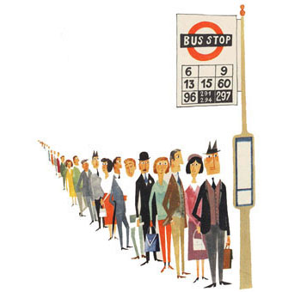

Stacks vs. Queues
Stack Queue

Slide 24
Circular Array Queue Data Structure
Q:
0
size - 1
b
c
d
e
f
x
front
back
next
// Basic idea only!
enqueue(x) {
next = (back + 1) % size
Q[next] = x;
back = next
}
What if queue is empty?
  Enqueue?
  yes
  Dequeue?
  no
What if array is full?
  Enqueue?
  no
  Dequeue
  yes
// Basic idea only!
dequeue() {
  x = Q[front];
  front = (front + 1) % size;
  return x;
  }

Slide 25
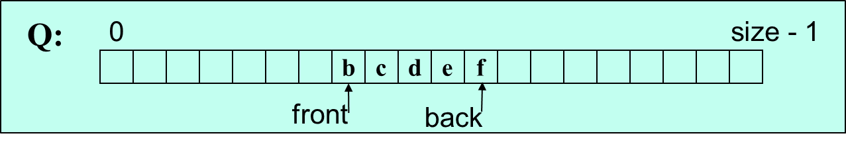
Circular Array Example (text p 94 has another one)
OUT
IN
g
front
enqueue(‘g’)
o1 = dequeue( )
b
o2 = dequeue( )
c
o3 = dequeue( )
d
o4 = dequeue( )
e
o5 = dequeue( )
f
o6 = dequeue( )
g
Now where
are back
and front?
Now
front =
back+1!

Slide 26
Empty Queue
Will front = back + 1 always be true for an empty queue?
back front
-1 0
0 0
4 0
back front
4 4
4 0
‘a’ ‘b’ ‘c’ ‘d’ ‘e’
‘a’
‘a’ ‘b’ ‘c’ ‘d’ ‘e’
‘a’ ‘b’ ‘c’ ‘d’ ‘e’
front = (back + 1) % arraysize
0 = 5 % 5

Slide 27
Circular Queue
When we add an ‘f’ to the queue that has only the ‘e’,
back will go around to position zero. back=(4+1)%5
back front
-1 0
0 0
4 0
back front
4 4
0 4
‘a’ ‘b’ ‘c’ ‘d’ ‘e’
‘a’
‘f’ ‘b’ ‘c’ ‘d’ ‘e’
‘a’ ‘b’ ‘c’ ‘d’ ‘e’

Slide 28
Complexity of Circular Queue Operations
// Basic idea only!
enqueue(x) {
next = (back + 1) % size
Q[next] = x;
back = next
}
O(1)
constant
// Basic idea only!
dequeue() {
  x = Q[front];
  front = (front + 1) % size;
  return x;
  }
O(1)
constant

Slide 29
Linked List Queue Data Structure
b
c
d
e
f
front
back
// Basic idea only!
enqueue(x) {
back.next = new Node(x);
back = back.next;
}
What if queue is empty?
  Enqueue?
  Dequeue?
Can list be full?
How to test for empty?
front=back=null
What is the complexity of the operations?
O(1)
yes
no
no
// Basic idea only!
dequeue() {
  x = front.item;
  front = front.next;
  return x;
  }

Slide 30

Circular Array vs. Linked List for Queues
Array:
May waste unneeded space or run out of space
Space per element excellent
Operations very simple / fast
Constant-time access to k^{th} element
For operation insertAtPosition, must shift all later elements
  Not in Queue ADT
List:
Always just enough space
But more space per element
Operations very simple / fast
No constant-time access to k^{th} element
For operation insertAtPosition must traverse all earlier elements
  Not in Queue ADT
This is stuff you should know after being awakened
in the dark

Slide 31
Conclusion
Abstract data structures allow us to define a new data type and its operations.
Each abstraction will have one or more implementations.
Which implementation to use depends on the application, the expected operations, the memory and time requirements.
Both stacks and queues have array and linked implementations.
We’ll look at other ordered-queue implementations later.

