Slide 1
BSTs, AVL Trees and Heaps
Ezgi
Shenqi
Bran

Slide 2
What to know about Trees?
Height of a tree
Length of the longest path from root to a leaf
Height of an empty tree is -1.
Depth of a node
Length of the path from root to the node
Depth of node A is 0
Depth of node B is 1
Depth of node C is 2
Recursion
Each of the children is the root of a sub-tree. (including null children)
A
Height = 0
A
Height = 1
A
Height = 2
B
B
C
D

Slide 3
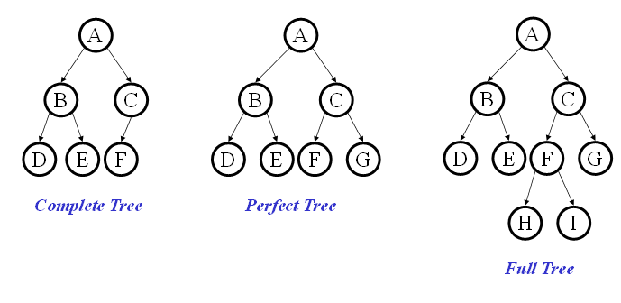
Binary Trees
Each node at most 2 children

Slide 4
Traversals and Recursion
void preOrderTr(Node t){
if(t != null) {
process(t.element);
preOrderTr(t.left);
preOrderTr(t.right);
}
}
void inOrderTr(Node t){
if(t != null) {
inOrderTr(t.left);
process(t.element);
inOrderTr(t.right);
}
}
void postOrderTr(Node t){
if(t != null) {
postOrderTr(t.left);
postOrderTr(t.right);
process(t.element);
}
}

Slide 5
Binary Search Trees
Each node has a key and a value
For any node (recursion!)
All keys in left subtree are smaller than the node’s key
All keys in right subtree are larger than the node’s key
Operations:
find
insert
delete
buildTree

Slide 6
find(root, key)
Recursive?
Base cases?
Recursive calls?
find (tree, key): data
if tree is empty : return null
if key is equal to root’s key: return root’s data
if key is smaller than root’s key: find in the left subtree
if key is larger than root’s key: find in the right subtree

Slide 7
find(root, key)
Data find(Node root, Key key){
if(root == null)
return null;
if (key == root.key)
return root.data;
if (key < root.key)
return find(root.left, key);
if (key > root.key)
return find(root.right, key);
}
return root.data;

Slide 8
insert
Let’s insert 15, 21, 16, 20, 17, 18, 19
14
Worst case: O(n)
Best case: O(1)
Average case: O(logn)
15
21
16
If only there was a structure that is always bounded by the smallest possible height…
20
17
18
19

Slide 9
delete
find the node
remove the node
fix the tree
removed node has no children
removed node has one child
removed node has two children
nothing to fix
replace the removed node with the child
replace the removed node with something
something > everything in the left subtree and
something < everything in the right subtree

Slide 10
Deletion – The Two Child Case
12
delete(5)
5
20
2
9
30
Complexity based on find:
Worst case: O(n)
Best case: O(1)
Average case: O(logn)
4
7
10
A value guaranteed to be
between the two subtrees!
succ from right subtree
- pred from left subtree
largest value
on its left
smallest value
on its right
something > everything in the left subtree and
What can we replace 5 with?
something < everything in the right subtree
Notes:
Ah, now the hard case. How do we delete a two child node?
We remove it and replace it with what?
It has all these left and right children that need to be greater and less than the new value (respectively).
Is there any value that is guaranteed to be between the two subtrees?
Two of them: the successor and predecessor!
So, let’s just replace the node’s value with it’s successor and then delete the succ.

Slide 11
AVL Tree
1. BST
2. How to recognize an AVL Tree?
3. How to keep the balance of AVL Tree?
Another example: [ Spring 2010 Midterm ]
Insert 2, 8, 3, 9, 5, 4, 10 to an initially empty AVL Tree.

Slide 12
Heap Example: Insert
4
Is this a valid heap?
Is it a valid binary search tree?
5
4
24
6
8
7
2
To insert:
 | 4 | 5 | 4 | 24 | 6 | 8 | 7

Slide 13
Heap Example: Insert
4
5
4
24
6
8
7
2
 | 4 | 5 | 4 | 24 | 6 | 8 | 7 | 2

Slide 14
Heap Example: Insert
4
5
4
2
6
8
7
24
 | 4 | 5 | 4 | 2 | 6 | 8 | 7 | 24

Slide 15
Heap Example: Insert
4
2
4
5
6
8
7
24
 | 4 | 2 | 4 | 5 | 6 | 8 | 7 | 24

Slide 16
Heap Example: Insert
2
4
4
5
6
8
7
24
 | 2 | 4 | 4 | 5 | 6 | 8 | 7 | 24

Slide 17
Heap Example: Delete
2
What is deleted?
4
4
5
6
8
7
24
 | 2 | 4 | 4 | 5 | 6 | 8 | 7 | 24

Slide 18
Heap Example: Delete
2
?
24
What is deleted?
4
4
2
5
6
8
7
 | ? | 4 | 4 | 5 | 6 | 8 | 7

Slide 19
Heap Example: Delete
24
4
?
What is deleted?
4
4
2
5
6
8
7
 | 4 | ? | 4 | 5 | 6 | 8 | 7

Slide 20
Heap Example: Delete
4
What is deleted?
24
5
4
2
?
5
6
8
7
 | 4 | 5 | 4 | ? | 6 | 8 | 7

Slide 21
Heap Example: Delete
4
What is deleted?
5
4
2
24
6
8
7
 | 4 | 5 | 4 | 24 | 6 | 8 | 7

Slide 22
Heap Example: Delete
4
What is deleted?
5
4
2
24
6
8
7
 | 4 | 5 | 4 | 24 | 6 | 8 | 7

