Slide 1
Binary Search Tree
AVL Tree
Ben Jones
Lysia Li

Slide 2
Binary Search Tree
Collection of nodes that hold data
Each node in the tree is connected to another
A node can have no more than 2 “children”
The left subtree of any given node will only contain data values less than the value of that node
The right subtree of any given node will only contain data values greater than the value of that node

Slide 3
AVL Tree
A binary tree that is self-balancing.
AVL Tree Node
Field for holding data
Field for accessing right subtree
Field for accessing left subtree
Field for keeping track of height

Slide 4
Runtime Analysis for BST and AVL Tree
BST | Average Case | Worst Case
Insert | O(logn) | O(n)
Delete | O(logn) | O(n)
Search | O(logn) | O(n)
AVL | Average Case | Worst Case
Insert | O(logn) | O(logn)
Delete | O(logn) | O(logn)
Search | O(logn) | O(logn)

Slide 5
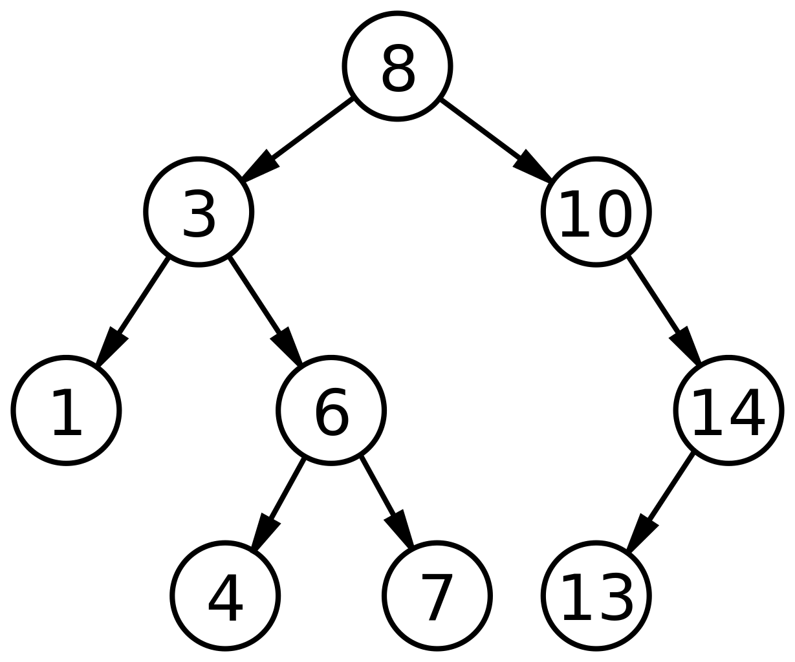
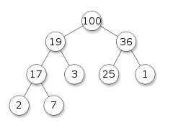
Is it a Binary Search Tree?

Slide 6
isBST
Write a method that takes in a binary tree root node, and check if it is a valid Binary Search Tree.
public class TreeNode {
int val;
TreeNode left;
TreeNode right;
TreeNode(int x) { val = x; }
}

Slide 7
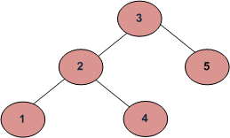
Wrong Answer
Just compare the node itself and its left node and its right node?
Wrong!

Slide 8
Correct Answer Part I
boolean helper(Node node, int min, int max) {
if (node == null) {
return true; }
if (node.data < min || node.data > max) {
return false; }
return (helper(node.left, min, node.data-1) &&
helper(node.right, node.data+1, max));
}

Slide 9
Correct Answer Part II
boolean isBST() {
return helper(root, Integer.MIN_VALUE, Integer.MAX_VALUE);
}

Slide 10
Build AVL tree
Insert 9, 27, 50, 15, 2, 21, 36 in order into an empty AVL tree.

Slide 11
Great AVL Tree Visualization
https://www.cs.usfca.edu/~galles/visualization/AVLtree.html

